Slide 1
Statistical Tests
Comparison of Continuous Variables Across Multiple Groups

Slide 2
Housekeeping
For Course Issues Contact:
Dr. Enrique Alemán, Jr.
Professor & Chair, Educational Leadership & Policy Studies
College of Education and Human Development
Department of Educational Leadership & Policy Studies
210-458-5411
enrique.aleman@utsa.edu
Discussion on Introductions and Research Questions

Slide 3
Comparisons of Continuous Variables for Two-Groups
Review

Slide 4
Comparisons of Continuous Variables for Two-Groups
Compare two (and only two) groups
Male v. Female
White v. Non-White
Poverty in 2010 v. Poverty in 2000
Longitudinal v. Cross-sectional
Data collected at two points in time
Single survey with respondents split into two groups
Paired v. Non-Paired
Paired – Same subjects (student grades over time)
Non-Paired – Different samples (subjects)

Slide 5
T-Test
To test for the difference in the mean of two samples, we use a t-test, which assumes:
The two samples have been drawn from normal distribution
The observations within each sample are independent of one another
The sample sizes of the two samples, n₁ and n₂ are large (>30 each)
The population standard deviation, σ₁ and σ₂ are equal

Slide 6
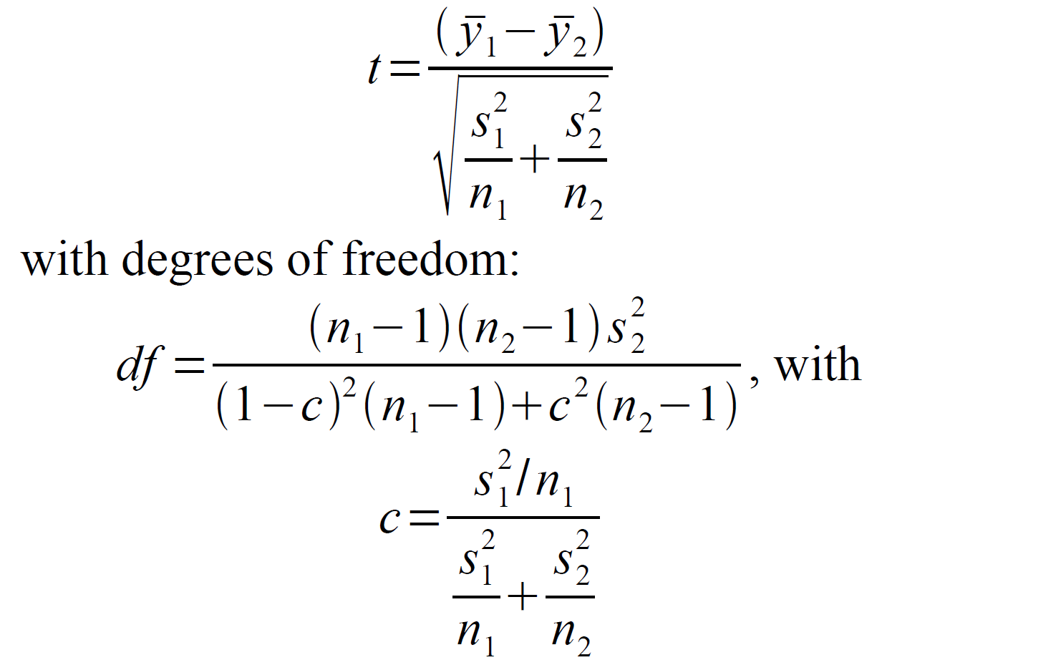
T-Test
If Standard Deviations of samples are not equal you use a Welch-Satterwaite’s Approximation Correction

Slide 7
T-Test
The t-test is only appropriate if your data are normally distributed, or approximately normally distributed
This test is fairly robust to deviations due to small outliers
If your data are highly skewed, this test it not appropriate

Slide 8

Non-Parametric Tests: Wilcoxon Rank Sum Test
H_{o} = Δ $=0$
H₁ = Δ ≠ $0$
Assume:
We have 2 sample of size n₁ and n₂ and that the observations are independent of one another
We assume the distributions of these samples are the same, except for a shifting factor: Δ (delta)
Often data that are skewed have large extreme values, outliers, that make them skewed
One method of dealing with this is to replace the actual value of the observation with its rank

Slide 9
Non-Parametric Tests: Wilcoxon Rank Sum Test
Pool all of the data, keeping group designations intact
Sort the data from lowest value to highest value
Assign ranks from 1 to N (N being the size of the pooled sample) to each observation
If there are ties present, take the average of the rank each would receive
Denote T1 to be the sum of the ranks in sample 1 and T2 be the sum of the ranks in sample 2
If the null hypothesis is true, then the sums of the ranks, T's, only depends on the sample sizes (n1 and n2), not on the shape of the distributions
If our observed T is larger than the theoretical expectation, we have evidence that the distributions are shifted by some difference, Δ
The Wilcoxon test is very similar to the Mann- Whitney U test, and if you see them cited, you know they are doing the same thing: a nonparametric test of equality of two samples

Slide 10
Comparisons of Two Groups R-Code
R Code for T-Test (Paired)
t.test(dat1$var1, dat2$var1, paired=T)
R Code for T-Test (Non-Paired)
t.test(dat1$var1, dat2$var1)
t.test(dat1$var1 ~dat1$group)
R Code for Wilcoxon Rank Sum Test
wilcox.test(dat1$var1, dat2$var1)
wilcox.test(dat1$var1 ~dat1$group

Slide 11
Comparisons of Continuous Variables for Multiple Groups

Slide 12
Comparisons of Continuous Variables for Multiple Groups
Tests for mean differences between more than two groups/categories
To do this we use a statistical tool called the analysis of variance (ANOVA)
This method, although it has “variance” in the name really is used to compare central tendency between groups

Slide 13
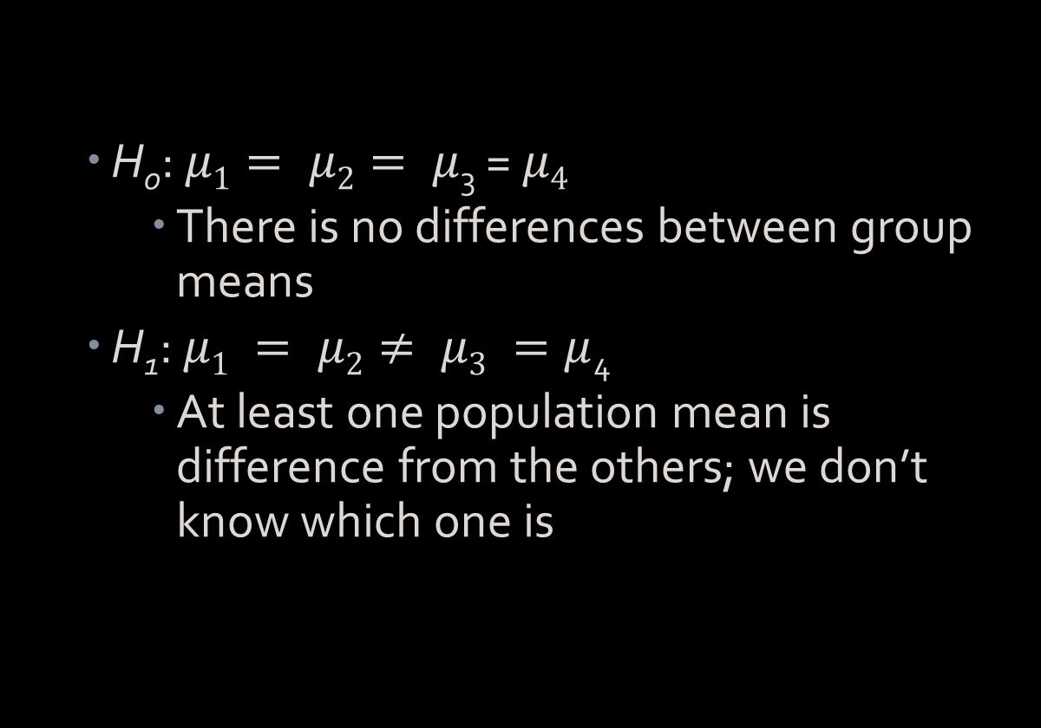
Hypothesis Testing
H₀: $μ1= μ2= μ$₃ = $μ4$
There is no differences between group means
H₁: $μ1 = μ2≠ μ3 =μ$₄
At least one population mean is difference from the others; we don’t know which one is

Slide 14
Logic of ANOVA: Variation Within vs. Variation Between
We have seen so far that we can calculate the amount of variation within a sample
This was done using the sample variance for each sample
This is, for each group in our data, the within group Variance
The ANOVA works by comparing the amount of within group variation to the amount of between group variation
If the amount of between group variance is low compared to the amount of within sample variation, then the means of the groups are probably similar to one another

Slide 15
ANOVA: Assumptions
1) each of the k samples are drawn from a normal distribution
2)The variances of the k samples are equal (homogeneity of variance)
3)The observations within each of the k samples are independent of one another
4) The scores/observations within each sample must be independent
Subjects in the first group cannot also be in the second group
No subject in either group can influence subjects in the other group
No group can influence the other group

Slide 16
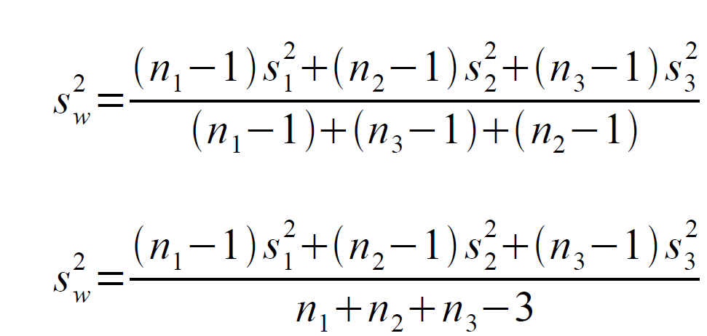
ANOVA: Calculations
Let's consider the case of k=3 groups. We can write the pooled within sample variance of these three groups as:
which is just an extension of the pooling method from the 2 sample case. This gives an estimate of the variation within the 3 groups

Slide 17


ANOVA: Calculations
We now need an estimate of the between group variation. To do this we use the sample means. The sample variance of the means is:
$$variance= \frac{\sum{{(\overline{y_{j}} −\overline{y})}^{2}}}{k−1}$$
Where $\overline{y}$ is the average of the k sample means. We call this quantity, the between group variance, or $s_{B}^{2}$. We can then form an F-test using our estimates of the within and between variances:
F= $\frac{s_{B}^{2}}{s_{W}^{2}}$
because when the null hypothesis is true, both quantities estimate the population variance

Slide 18
ANOVA: Calculations
In this setting, if F=1 then both estimates of the variance are the same. We conclude that our groups are not different
If F≠1, then we have evidence to the contrary and there are differences between our group means
We compare our observed value of F to a critical value from an F distribution with df1=k-1 and df2=n-k degrees of freedom
If our observed value of F is greater than or equal to this critical value, then we conclude that there at least two of our groups' means are different

Slide 19
Logic of ANOVA: Example
Elementary | Middle | High School
0 | 4 | 1
1 | 3 | 2
3 | 6 | 2
1 | 3 | 0
0 | 4 | 0
Mean = 1 | Mean = 4 | Mean = 1
EX: Suppose we are interested in examining difference in the level of support from parents in a school district.
Group 1 = Elementary (Control Group), Group 2 = MS, and Group 3 = HS
Determine total variability for the entire set of scores
Combine all the scores from all the separate samples
Once total variability obtained, break it apart into separate components
Analysis of variance – Divides total variability into components

Slide 20
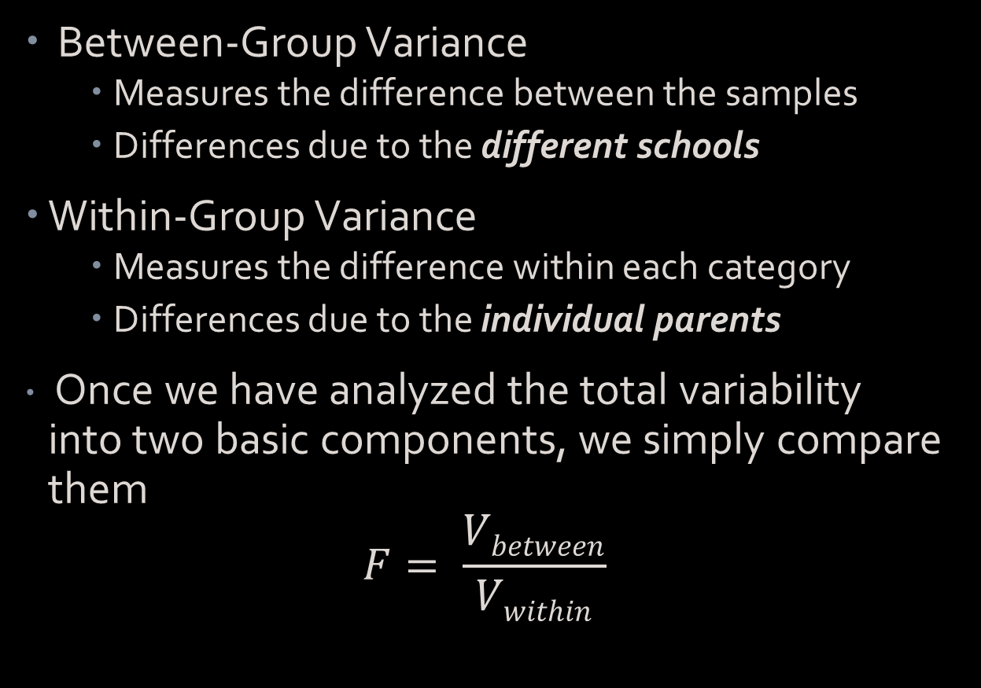
Logic of ANOVA
Between-Group Variance
Measures the difference between the samples
Differences due to the different schools
Within-Group Variance
Measures the difference within each category
Differences due to the individual parents
Once we have analyzed the total variability into two basic components, we simply compare them
$$F= \frac{Vbetween}{Vwithin}$$

Slide 21
One-way ANOVA
Each group should have a least 6 cases/observations
Balanced groups are ideal
F test indicates whether there are differences in the means between any of the groups
But it does not indicate which mean is different
Post hoc test
Post-hoc Tests - additional hypothesis tests that are done after am analysis of variance to determine exactly which mean differences are significant and which are not
Tukey’s HSD
Scheffé

Slide 22
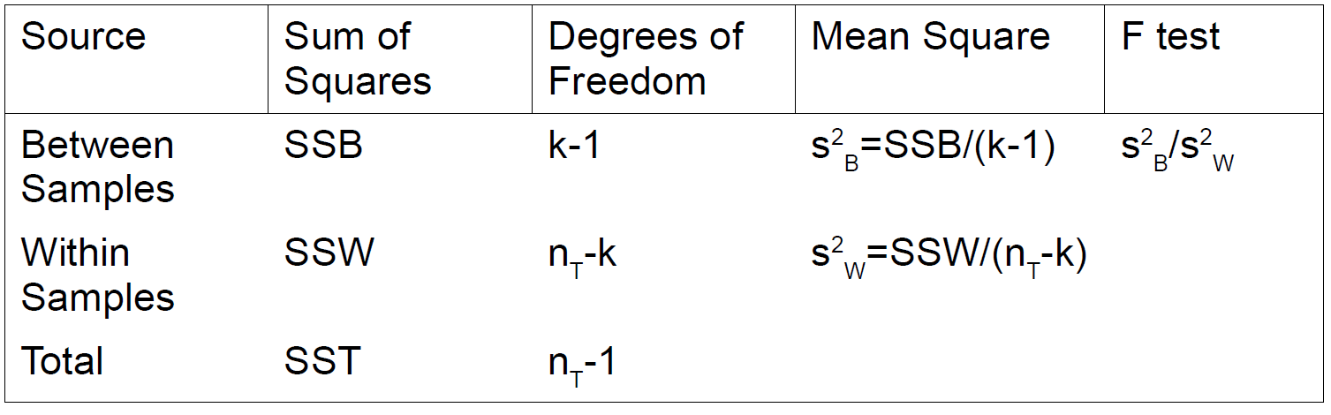
ANOVA Table

