Slide 1

Exploring Home Court Advantage in NCAA Basketball
Do fans have an impact on game outcomes?
This Photo by Unknown Author is licensed under CC BY-SA

Slide 2

Overview
Home court advantage – on average, the home team wins more than the away team
Factors into home court advantage:
Home court familiarity
Away team tired from travel
Fan support
This Photo by Unknown Author is licensed under CC BY

Slide 3

Overview
For all of the 2020-2021 season, fans were not allowed into stadiums
Without fans, does home court advantage still exist?
This Photo by Unknown Author is licensed under CC BY-NC-ND

Slide 4

Data Analyzed
Data from free version of sportsdata.io API
Looked at conference game results from:
2019-2020 season (fans allowed)
2020-2021 season (no fans allowed)
Analyzed a total of 5628 games
2990 games from fans allowed season
2638 games from no fans allowed season
Data of interest:
Score of the away team
Score of the home team
Difference in the above scores

Slide 5
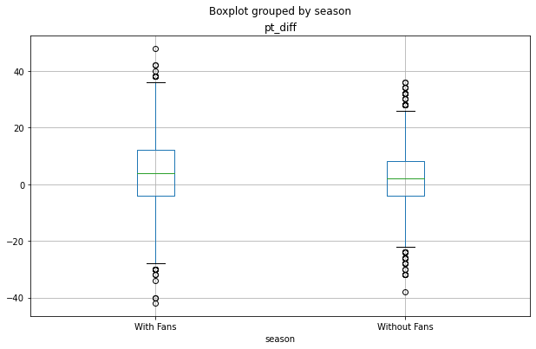
Statistically Significant Difference Between Fans vs. No Fans
With 95% confidence, on average, home court advantage is between 0.88 and 2.02 points higher with fans than without fans
On average, home teams:
With fans won by 3.19 points
Without fans won by 1.73 points

Slide 6

Fans are important!
Impact for fans: continue to show up and be rowdy!
Impact for coaches:
Avoid home games near holidays where stadiums may be empty
Target away games near holidays where stadiums may be empty
This Photo by Unknown Author is licensed under CC BY-NC

Slide 7
Questions?

Slide 8
Thank you!

