Slide 1


Slide 2

Most Food Waste Happens At Home
We throw away good food (and money) mostly because no one taught us how to keep it.
60%
1B+
THE SCALE
of the world’s food waste happens in homes
meals’ worth of food wasted every single day
$762
wasted per person per year (US)
Nobody taught us
Out of Sight
WHY IT HAPPENS
Confusing date labels alone trash 3.5M+ tons a year (US)
Food hides in the back, so we forget and buy again
Source: ReFed (2026), UNEP (2024)
Notes:
Talk about why existing trackers don’t work

Slide 3
Tracking Is Solved. Habits Aren’t
Fridge tracking apps and smart fridges log your food. None we checked makes you get better at keeping it.
 | NoWaste app | Ok2eat app | Fango app | KitchenPal app | Smart Fridge samsung | Freshly us
Receipt or Photo Scan | √ | √ | √ |  | √ | √
Expiry Dates Set for You |  | √ | √ |  |  | √
Shows What You Waste | √ | √ | √ |  |  | √
Streaks & Community |  |  |  |  |  | √
Teaches Storage Habits |  |  |  |  |  | √
Price | Free; Pro: $6.99 | Free | Subscription | $14.99/year | ~$5,000 | Free
Dates guessed or typed by hand
Tracks wastes, never motivates
Shows waste, never teaches
Auto-set from USDA Data
Streaks, Friends, save money
Per-food mastery and tips
Source: Company Websites

Slide 4
DEMO

Slide 5
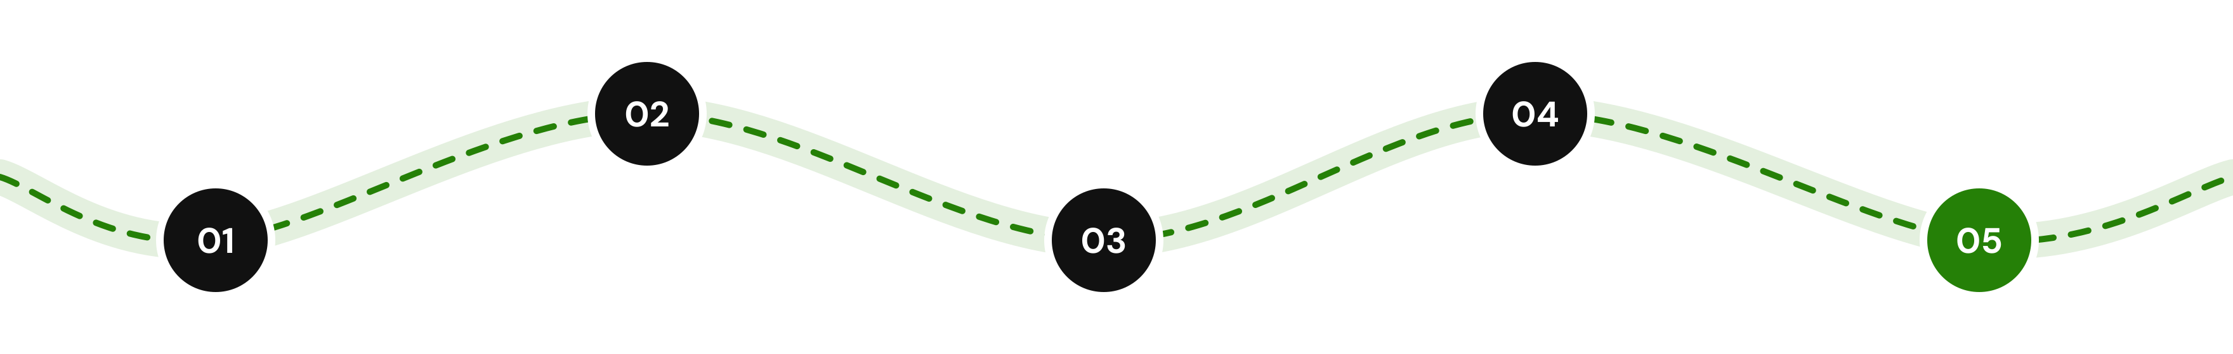
Where Freshly Goes From Here
Location-Aware Nudges
Ask Leeky
Reminders that show up where they matter. At a restaurant, see what’s about to expire at home. At a store, get suggestions that pair with what’s already in your fridge.
A food storage assistant you can type to or talk to. Ask “can I freeze cream cheese?” and get answers from FDA and USDA data, hands-free.
Local Shops & Markets
Freshly Waste Wrapped
Visual Freshness Model
Guided local shopping recommendations from nearby grocers and farmers markets, sized to match actual eating pace while shops get anonymous insights to stock smarter.
A shareable monthly recap that turns sustainability into conversations: comparing money saved, top mastered foods, and your worst waste offender with your friends.
Snap any fruit or vegetable to predict its remaining shelf life in real time, using visual cues like color and ripeness to adjust expiration date automatically.

