Slide 1
2020 Final Project
Is social media a better predictor for election outcomes?

Slide 2
The Problem
Polling
Context
Problem statement
The current polling industry continues to recently miss ongoing voting outcomes and fail to capture voter sentiment and deliver accurate representations of election outcomes.
Large Polling institutions such as 538, CNBC, Reuters and other high level polling institutions missed key election outcomes such as Brexit 2016, Trump 2016, Brazil’s Bolsanaro and British 2019 Parliament. Will They Miss 2020?
Can we disrupt the Status Quo Polling by using social media to measure and predict voter enthusiasm coupled with election outcome for the 2020 Presidential Election?

Slide 3
Challenges deep-dive
Challenge 1
Challenge 2
Challenge 3
Can Twitter be used to predict the U.S. Presidential Election Outcomes?
We want to focus on one source of social media data, Twitter, to help gauge voter enthusiasm and eventual election outcome but where can we find the data.
Which Twitter info can and should be used but where do we find it?
Even though there is large amounts of data, which data should we use and how can we clean up the data for effective and efficient use?
How to Effectively Transform the data for use?
Even after locating the data and locating key information, which prediction model will effectively load the data and present a cohesive structured answer?

Slide 4
Big Questions We’re Looking For:
Does Voter Enthusiasm Predict Voting Turnout and outcomes?
How can we measure Voter Enthusiasm?
Even if Voters are enthusiastic, does negative or positive comments help support elections predictions?
Does each sides negative/positive comments, when combined, help better predict election outcome?
Furthermore, do comment lengths, like counts and retweet counts, either subjective or polarizing, help support a prediction model?

Slide 5
Which is a better election predictor?
Can we tokenize and transform the data into actual reliable sources?
What is our expected outcome using NLP and sentiment extraction?
Twitter or Polls?
Twint & Extract
Transform
Load
Outcomes
Where can we find the data?
MongoDB database with python and import the datasets from MongoDB straight into Jupyter notebook

Slide 6
Solution
In order to perform effective data analysis and prediction models, we will need to Find(Extract the Data from a program called TWINT which pulls Twitter data), Transform(Structure the Twint Data and tokenize Key Trump and Biden names) and Load the data into a Subjective and NLP Sentiment machine and gauge twitter sentiment for outcomes based on the number of likes, retweets of the two candidates and tweet lenght
ETL, Tokenize & Random Forest

Slide 7
Implementation

Slide 8
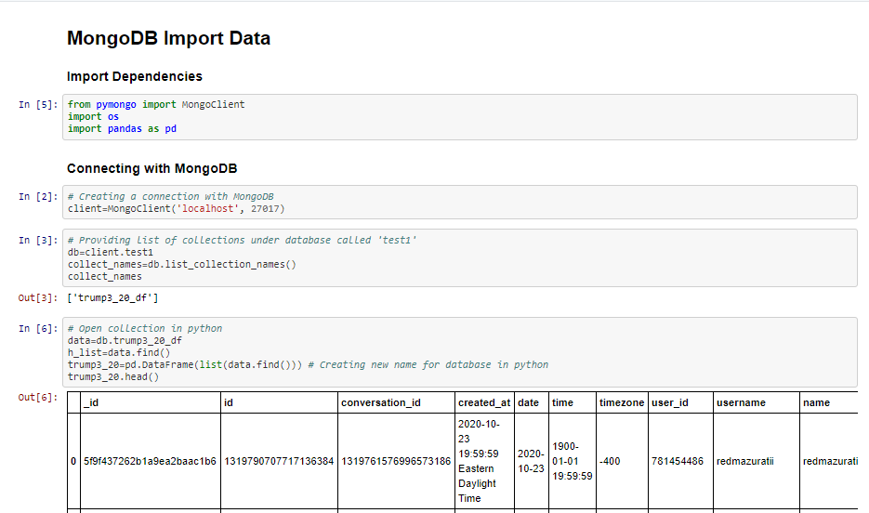
Database Mongo DB Code Import

Slide 9
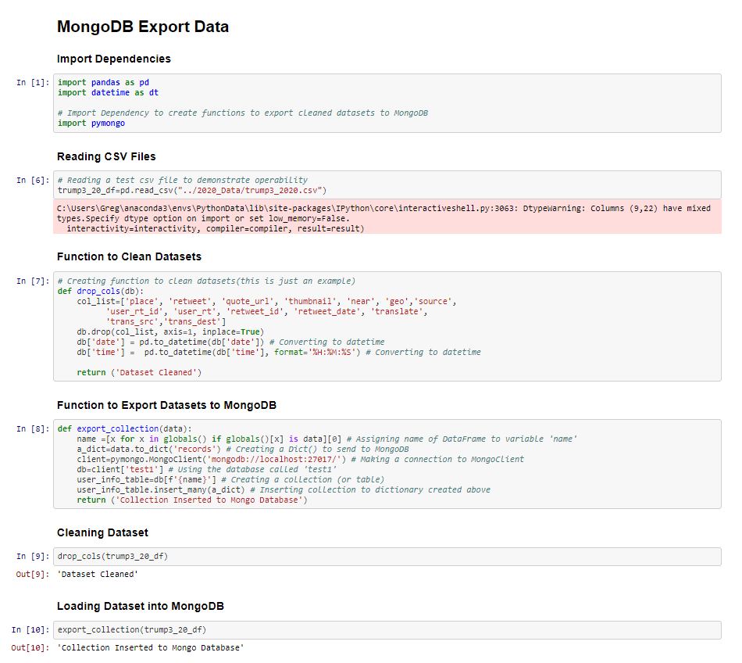
Export Mongo DB

Slide 10
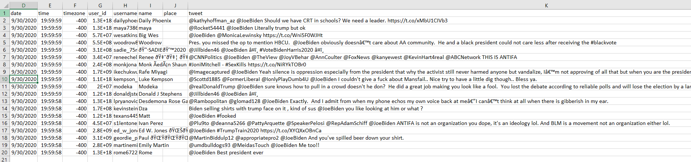
Raw Data from Twint/Pre-Cleaned

Slide 11
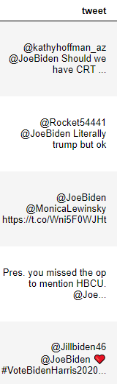
The Data Issue in column “tweet”

Slide 12
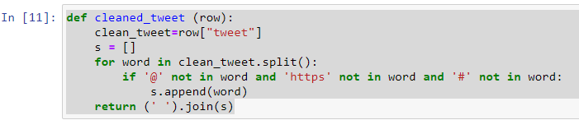
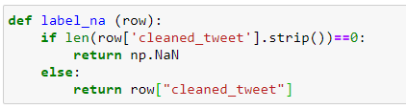
Cleaning Process:
Code Used to Clean Tweet Column Data from Special Characters (https: links and #’s) Step 1 To Clean up Raw “tweet” Column and insert new column called “cleaned_tweet”

Slide 13
Code Used to Clean Tweet Column Data from Special Characters (https: links and #’s) Step 2
Clean up special characters ([^\w\s#@/:%.,_-])
Add “NA” to cleaned up new “cleaned_tweet” column
Keeping only Non “NA” data in “cleaned_tweets”

Slide 14
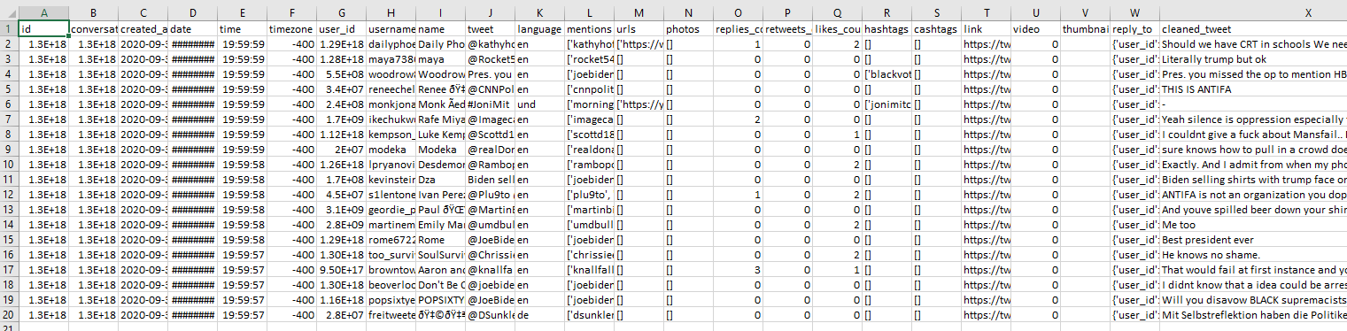
Cleaned Data Set 3
*Key Data point is cleaning up special characters in Tweets to arrive to Clean Data in the Final Column

Slide 15
Tableau
For the following DashBoard, we will use Tableau to represent the clean data findings concerning tweet lengths, likes and retweets.

Slide 16
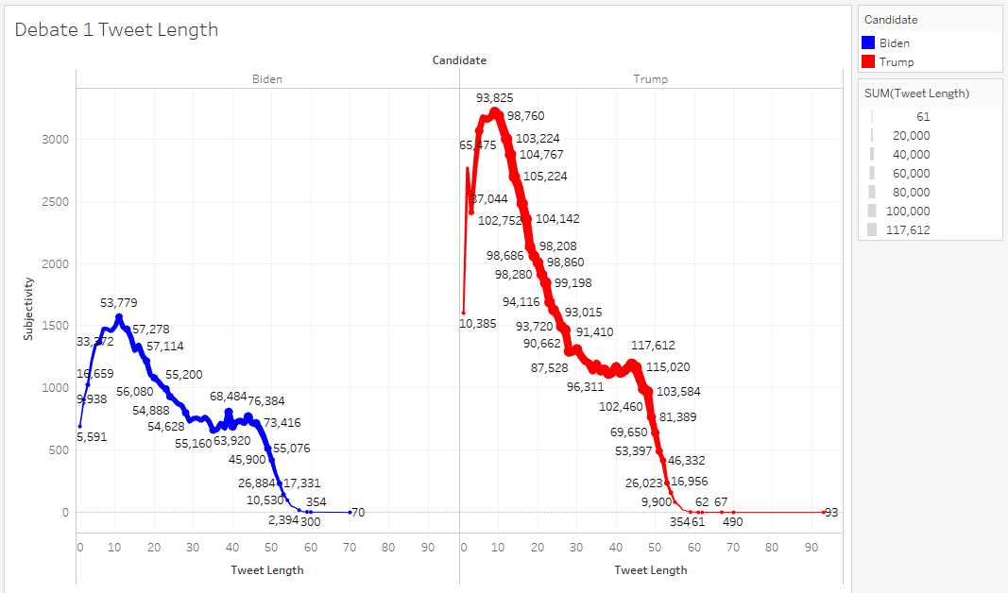

Slide 17
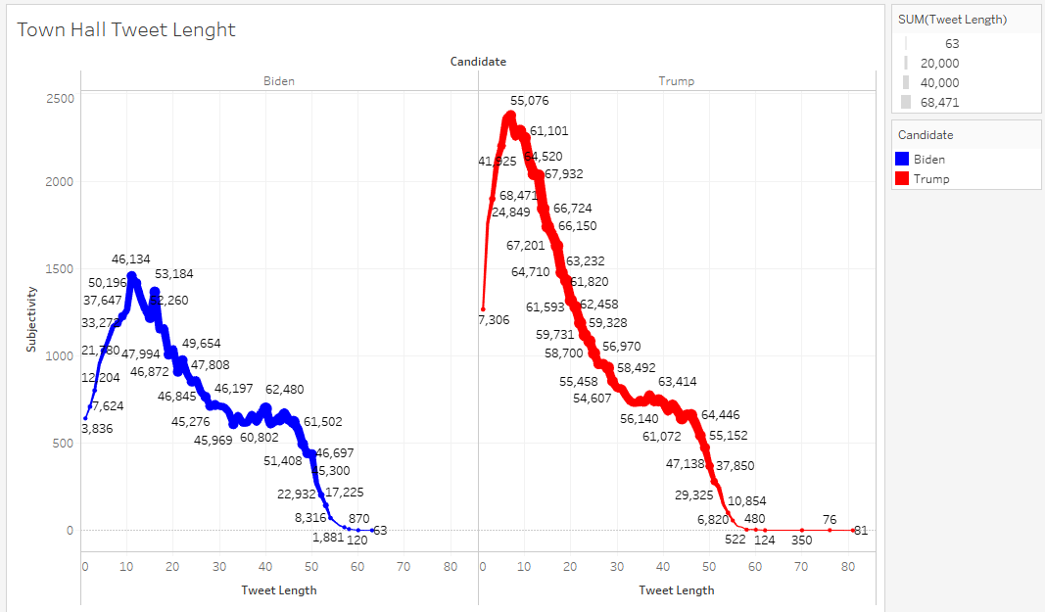

Slide 18
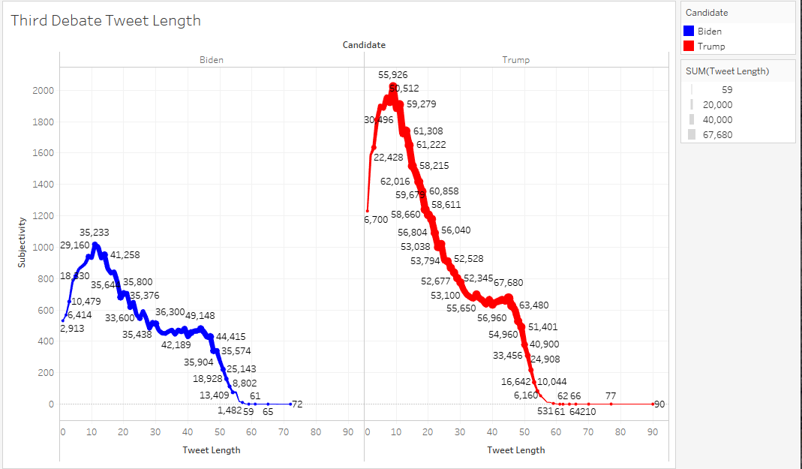

Slide 19
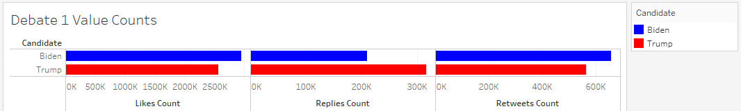
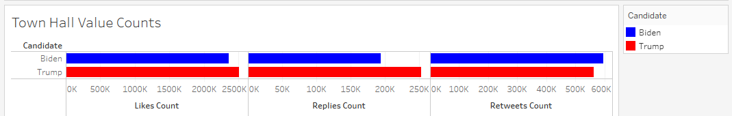
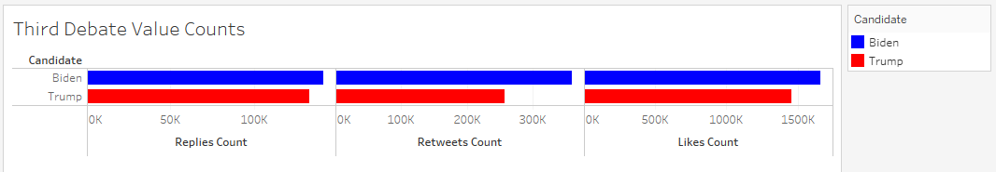
First Debate
TownHall
Third Debate

Slide 20
Machine Learning Observations and Answers
Our model, sentiment, is unsupervised machine learning.
We do not use previous/past results as we don’t go back and measure sentiment of twitter ID’s previous tweets.
No actual training and testing is required due to the unsupervised machine learning choice.
Limitations
This analysis only provides unique, daily representations of twitter user sentiment.
We could further delve into how sentiment changed from the first debate for each twitter user over the 4 weeks of data that we pull from Twint.
Furthermore, we don’t have much understanding of why a Twitter ID is the way they are, or speak out that way. But the one benefit is we capture unique, user data to provide observations about how people actually react and respond to today’s pressing issues and elections.

Slide 21
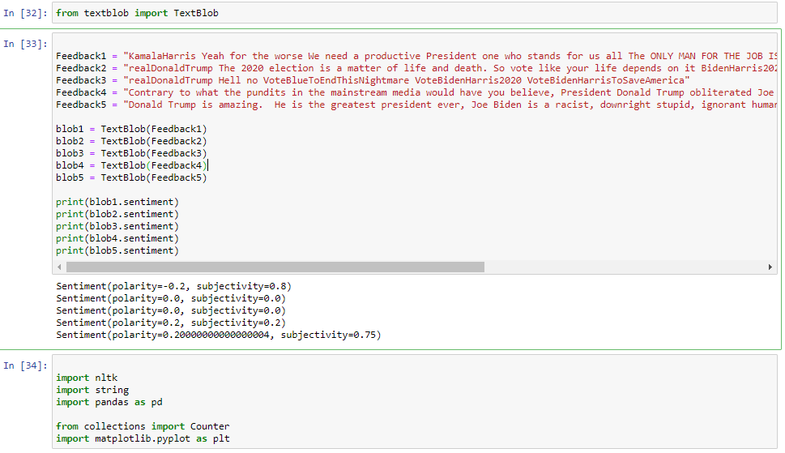
NLP Code: Establish Sentiment Feedback

Slide 22
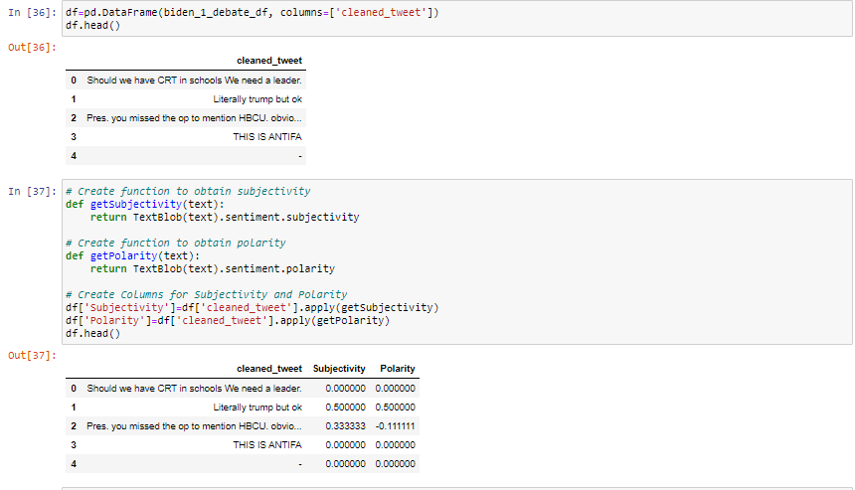
NLP Code: Isolate Tweets and Find Subjectivity and Polarity

Slide 23
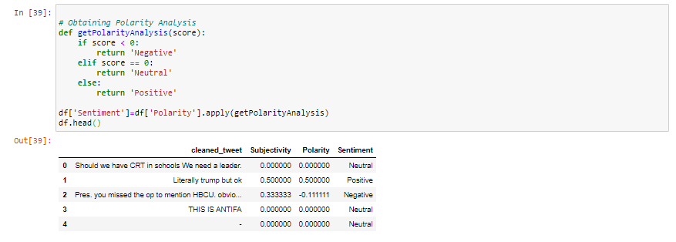
NLP Code: Isolate Tweets and designate Positive, Negative or Neutral Tweets

Slide 24
Machine Learning and NLP Update
The following slides detail the following events” First Debate(September 29th, 2020), Townhall (October 15th, 2020) and the Third Debate (October 22nd, 2020). Each following slide will provide Tableau detailed charts concerning with NLP/Unsupervised Machine Learning via sentiment and subjectivity readings.

Slide 25
Tableau
For the DashBoard, we will use Tableau to represent sentiment analysis

Slide 26
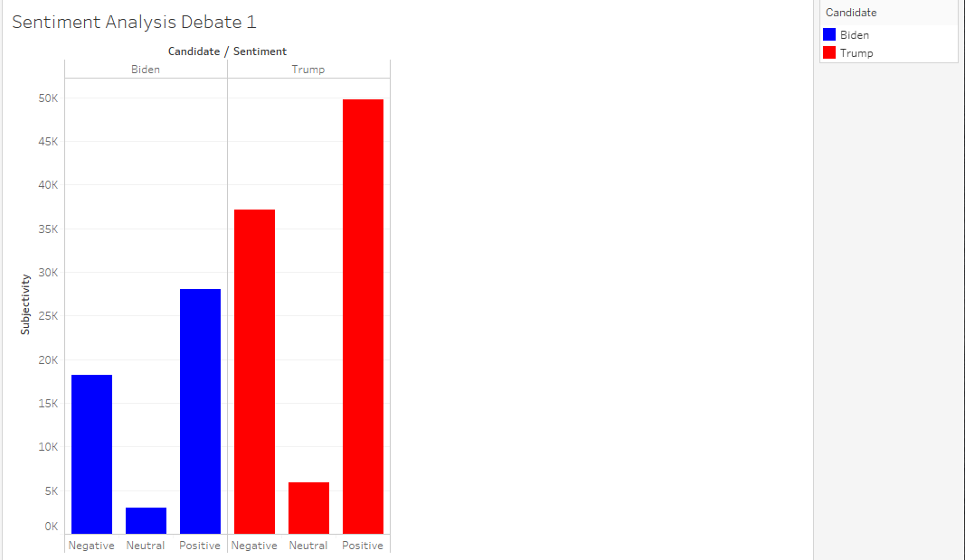

Slide 27
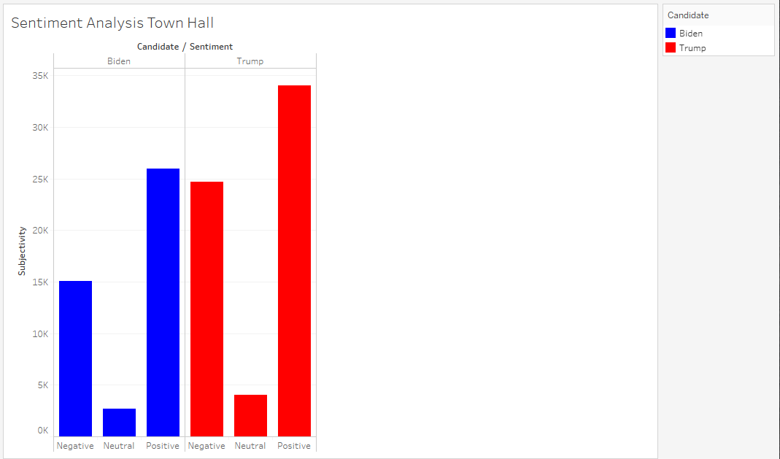

Slide 28
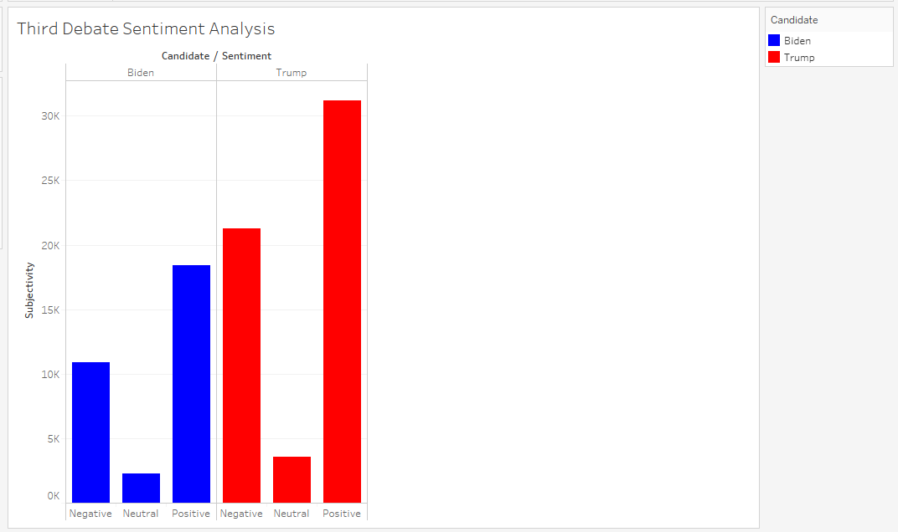

Slide 29
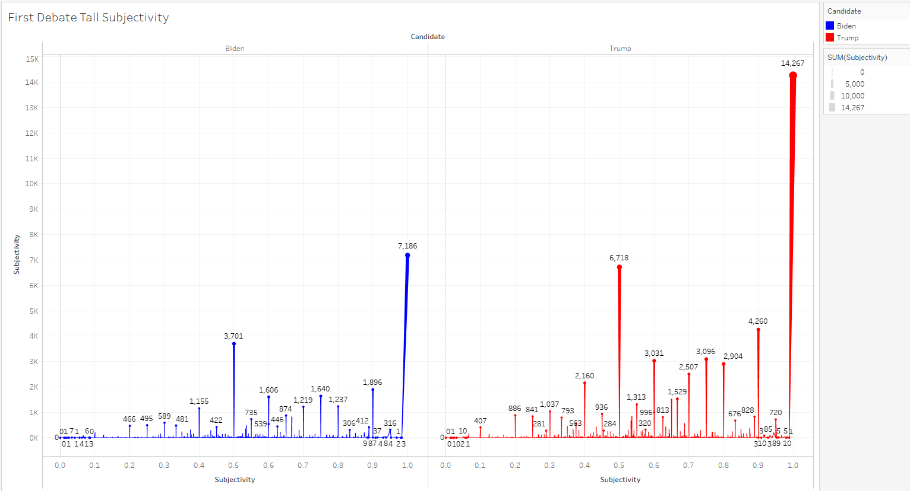

Slide 30
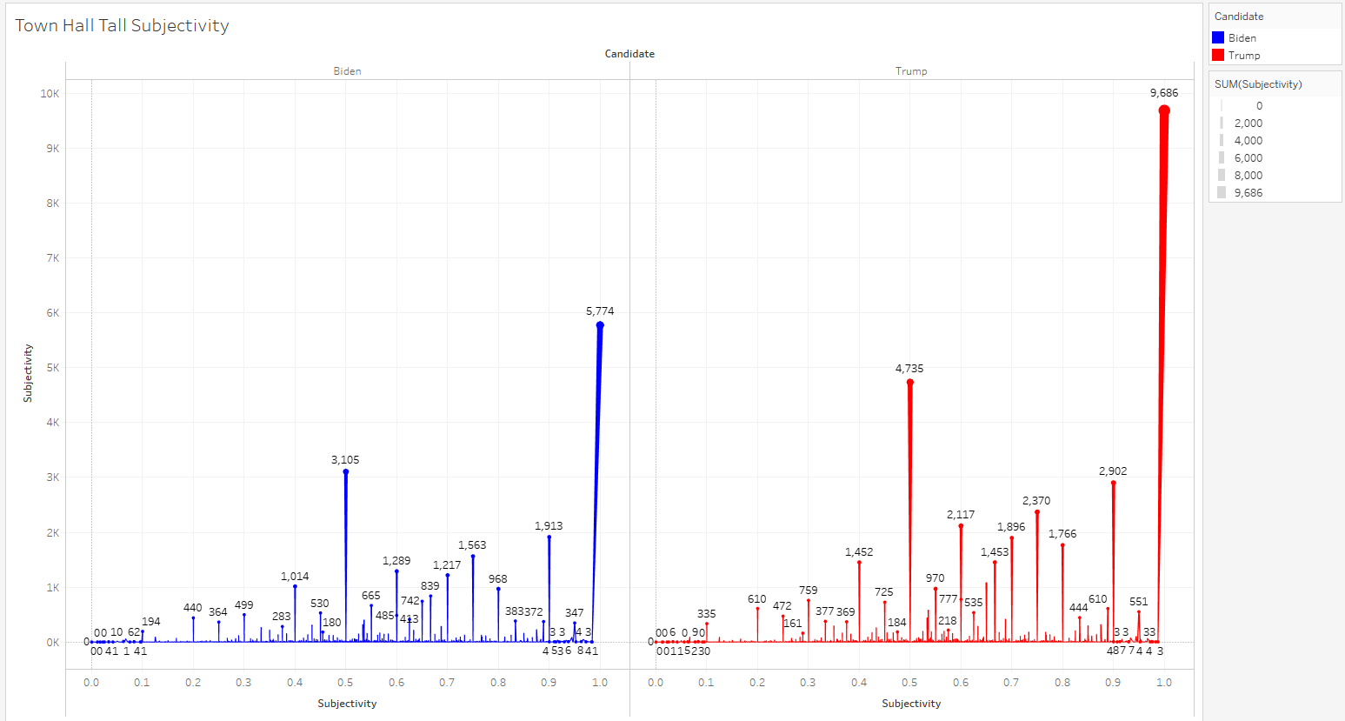

Slide 31
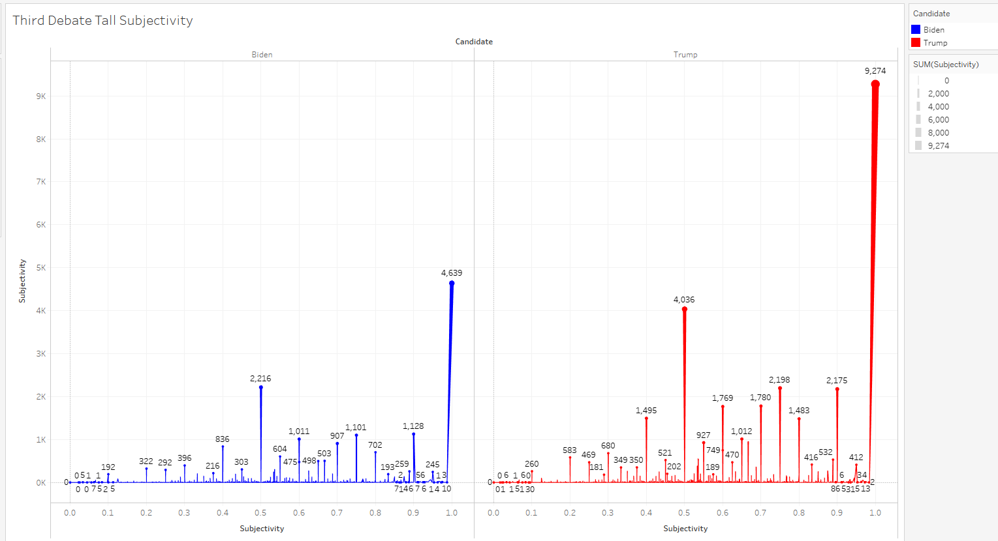

Slide 32
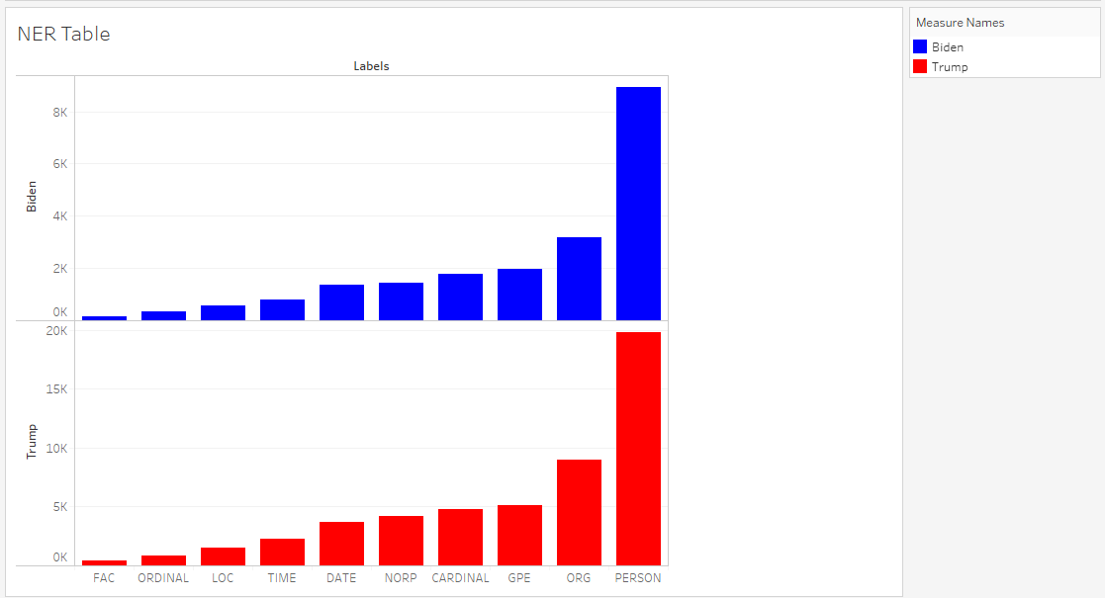

Slide 33
Flaws in model
Social Media is a conglomerate of data inputs from billions of people and we are only using one key piece of the entire Social Media universe. Therein lies the issue with accuracy and can be fine tuned by incorporating more sources of Social Media Data (Google analytics, Facebook, Instagram etc)
Do certain tweets/words carry for effective influence over readers? Hard to quantify if a certain tweet persuades more voters to actually vote or suppress the opposition/readers
How can we be certain social media is even a reliable source for election prediction on its own but may in fact just be a part of a social web of influence where one’s ability to predict election outcomes

