Slide 1
I Need a Drink!
Team On the Rocks

Slide 2
FacePOS
“Give me my Usual!”

Slide 3
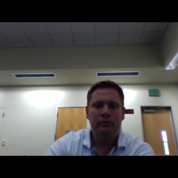
Recognized?
Hello
My Tab
Name:
2 x Vodka Tonic
3 x Heineken
Window title
Speek
Too Young
Create Tab
Name:
Window title
You Must be 21 or Over
Speek

