Slide 1
Voting Process Infographics
Here is where this template begins

Slide 2
Voting process infographics
1
2
3
Where to vote
When to vote
How to vote
Saturn was named after the Roman god of wealth and agriculture
Venus is the second-brightest natural object in the night sky
Earth is the the third planet from the Sun and the only one with life

Slide 3
Voting process infographics
Mercury
Venus
Earth
Saturn
Neptune
Pluto

Slide 4
Voting process infographics
Primaries and caucuses
Mercury is the closest planet to the Sun and the smallest one in the Solar System
National convention
Earth is the third planet from the Sun and the only one that harbors life in the Solar System
General election
Venus is the second-brightest natural object in the night sky after the Moon
Electoral college
Despite being red, it’s a cold place. It's full of iron oxide dust, which gives the planet its reddish cast

Slide 5
Voting process infographics
Registration
Early voting
Election day voting
Ballot counting
Venus is terribly hot, and its atmosphere is extremely poisonous
Saturn was named after the Roman god of wealth and agriculture
Neptune is the fourth-largest object by diameter in the System
Earth is the only planet in the entire Solar System with life
Laws and rules
Final results
Mercury is the closest planet to the Sun and the smallest of them all
Mars full of iron oxide dust, which gives the planet its reddish cast

Slide 6
Voting process infographics
Election process
Announcement
of elections
Scrutiny of nominations
Candidates campaigning
Counting of
election votes
Neptune is the farthest planet from the Sun
The Sun is the star that we all orbit
Mercury is the closest planet to the Sun
Jupiter is a gas giant and the biggest planet
Candidates nomination phase
Withdrawal of candidates
Registering of votes at the election
Ceres is located in the main asteroid belt
Saturn is a gas giant and has several rings
The Moon is Earth’s only natural satellite

Slide 7
Voting process infographics
Voting methods
Paper-based voting
Secret voting
Open voting
Mercury is the closest planet to the Sun
Venus is the second planet from the Sun
Mars is actually a very cold place
Postal voting
Machine voting
Electronic voting
Jupiter is the biggest planet of them all
Venus is the second planet from the Sun
Neptune is the farthest planet from the Sun

Slide 8
Voting process infographics
Types of voting systems
Approval voting
Negative voting
Exit vote
Jupiter is a gas giant and the biggest planet in the Solar System
Mars is full of iron oxide dust, which gives the planet its reddish cast
Earth is the third planet from the Sun and the only one that harbors life
Proxy voting
Straw vote
Plural voting
Saturn was named after the Roman god of wealth and agriculture
Venus is the second brightest natural object in the night sky
Mercury is the closest planet to the Sun and the smallest one

Slide 9
Voting process infographics
Paper-based voting
Open voting
Earth is the third planet from the Sun and the only one that harbors life
Venus is the second-brightest natural object in the night sky
Electronic voting
Machine voting
Neptune is the fourth-largest object by diameter in the System
Mars is full of iron oxide dust, which gives the planet its reddish cast
Postal voting
Secret voting
Saturn is a gas giant named after the Roman god of wealth
Mercury is the closest planet to the Sun and the smallest one

Slide 10
Voting process infographics
How to vote
Check-in
Mark your ballot
Venus is the second-brightest natural object in the night sky after the Moon
Mercury is the closest planet to the Sun and the smallest one in the Solar System
Check-out
Cast your ballot
Mars is full of iron oxide dust, which gives the planet its reddish cast
Earth is the third planet from the Sun and the only one that harbors life in the System

Slide 11
Voting process infographics
Enter the polling place
Show proof of identity
Mercury is the closest planet to the Sun and the smallest one in the Solar System
Mars is full of iron oxide dust, which gives the planet its reddish cast
Receive a folded ballot
Mark and refold your ballot
Venus is the second-brightest natural object in the night sky after the Moon
Jupiter is a gas giant and the biggest planet of the entire Solar System
Return your ballot
Put your ballot in the box
Saturn is a gas giant named after the Roman god of wealth and agriculture
Earth is the third planet from the Sun and the only one that harbors life in the System

Slide 12
Voting process infographics
Electronic ballots
Authentication and authorization
Registration
Tallying
Paper ballots
1
2
3
4
Venus is the second planet from the Sun
Despite being red, Mars is actually a cold place
Saturn is a gas giant and has several rings
Jupiter is the biggest planet in the Solar System

Slide 13
Voting process infographics
Voter
Voting system
1
Identity
Summits authentication details
Voter roll database
Voter can access the ballot
2
Vote
Completes ballot
Ballot data checked
Receipt issued to voter
Ballot data isolated and recorded
3
Receipt
Receipt used to confirm vote
Ballot result database

Slide 14
Voting process infographics
1
2
3
4
Check-in
Mark your ballot
Check-out
Cast your ballot
Venus is a terribly hot planet, and its atmosphere is extremely poisonous
Earth is the third planet from the Sun and the only one that harbors life in the Solar System
Neptune is the farthest planet from the Sun. It's also the fourth-largest object by diameter
Jupiter is a gas giant and the biggest planet in the entire
Solar System

Slide 15
Voting process infographics
Fingerprint
Voting booth
Venus is the second brightest natural object in the night sky
Earth is the third planet from the Sun and the only one that harbors life
Identity verification
Ballot papers
Ballot box
Neptune is he fourth largest object by diameter in the System
Saturn was named after the Roman god of wealth and agriculture
Venus is planet is terribly hot, and its atmosphere is extremely poisonous

Slide 16
Voting process infographics
Venus has high temperatures
Sign your ballot application
Return your application
Saturn is a gas giant with rings
Mercury is the smallest planet
Signature verification
Cast your vote and mail it
Pluto is a dwarf planet
Jupiter is the biggest planet
Sign your ballot certificate
Signature verification
Earth is where we all live
Neptune is far from the Sun
Verified signature

Slide 17
Voting process infographics
1 |  | Identity verification | Mercury is the closest planet to the Sun and the smallest of them all
2 |  | Fingerprint | Venus is terribly hot, even hotter than Mercury, and its atmosphere is extremely poisonous
3 |  | Ballot papers | Earth is the third planet from the Sun and the only one that harbors life in the Solar System
4 |  | Voting booth | Neptune is the farthest planet from the Sun. It's also the fourth-largest object by diameter
5 |  | Ballot box | Mars is a cold place full of iron oxide dust, which gives the planet its reddish cast

Slide 18
Voting process infographics
How to vote per mail
WE CHOOSE
VOTE
Request a one-time ballot for election
Sign up for the permanent voting list
VOTE
Mercury's name has nothing to do with the liquid metal, since it was named after the Roman messenger god
Jupiter is a gas giant and the biggest planet in the Solar System. It's the fourth-brightest object in the night sky

Slide 19
Voting process infographics
4 phases to online voting
Check the bylaws | Mercury is the closest planet to the Sun and the smallest one
Build the election | Venus is terribly hot, and its atmosphere is poisonous
Notify eligible voters | Earth is the third planet from the Sun and the only one with life
Report results | Mars is full of iron oxide dust, which gives the planet its color

Slide 20
Voting process infographics
Register to vote
Register online
Download the form
Find guidance
Jupiter is a gas giant and the biggest planet in the entire Solar System. It doesn’t have a surface
Saturn is composed of hydrogen and helium. It was named after the Roman god of wealth
Neptune is the farthest planet from the Sun. It's also the fourth-largest object by diameter

Slide 21
Voting process infographics
Online registration
Summit an application
Venus is
extremely hot
Registration
Online
Mercury is the smallest planet
Registration by mail
Despite being red, Mars is cold
In person
By phone
Jupiter is the biggest planet

Slide 22
Voting process infographics
You can register to vote if…
1
Venus is terribly hot, even hotter than Mercury, and its atmosphere is toxic
You are a citizen
2
Jupiter is a gas giant and the biggest planet in the entire Solar System. It doesn’t have a surface
You are 16+
Neptune is the farthest planet from the Sun. It's also the fourth-largest object by diameter
3
You are not incarcerated

Slide 23
Voting process infographics
Select your political party affiliation
Democratic party
Republican party
Libertarian party
Green party
Independents
Mercury is the smallest planet
Venus has high temperatures
Jupiter is the biggest planet
Neptune is very far from the Sun
Mars is actually a very cold place
1
2
3
4
5

Slide 24
Voting process infographics
Reasons to show your identification
Earth is the third planet from the Sun and the only one that harbors life
Saturn was named after the Roman god of wealth and agriculture
Neptune is the fourth-largest object by diameter in the System
Mars is full of iron oxide dust, which gives the planet its reddish cast
Venus is the second-brightest natural object in the night sky
Mercury is the closest planet to the Sun and the smallest one
Jupiter is a gas giant and the biggest planet in the entire Solar System
Pluto is now considered a dwarf planet. It’s very far away from the Sun
First time voting
Inactive voter
Casting a provisional
Reasonable suspicion

Slide 25
Voting process infographics
First-time voters population
Students
Minorities
Mercury is the closest planet to the Sun
Neptune is the farthest planet from the Sun
LGBTQIA+
Religious groups
Jupiter is a gas giant and the biggest planet
The Sun is the star we all orbit around
Military
Disabled people
Saturn is a gas giant and has several rings
The Moon is Earth’s only natural satellite

Slide 26
Voting process infographics
Why your vote matters?
Vote power
1
Venus has extremely high temperatures
Taxes
2
Earth is the third planet from the Sun
Consequences
3
Jupiter is the biggest planet of them all
Opportunity for change
4
Saturn was named after the Roman god of wealth
Help your community
5
Jupiter is a gas giant and the biggest planet

Slide 27
Voting process infographics
Why don’t people vote?
It doesn't’ make a difference
The candidates aren’t the best
Saturn is composed mostly of hydrogen and helium. It was named after the Roman god of wealth and agriculture
Mercury’s name has nothing to do with the liquid metal, since Mercury was named after the Roman messenger god
They think...
It’s a complex process
They are too busy
Despite being red, Mars is actually a cold place. It's full of iron oxide dust, which gives the planet its reddish cast
Earth is the third planet from the Sun and the only one that harbors life in the Solar System. This is where we all live

Slide 28
Voting process infographics
Reasons to provisional voting
Your name is not on the list
1
Mercury is the closest planet to the Sun and the smallest one
You have an incorrect party enrollment
2
Venus is the second-brightest natural object in the night sky
You are unable to provide identification
3
Neptune is the fourth-largest object by diameter in the Solar System

Slide 29
Voting process infographics
Who are you choosing
Principal advisor
Executive secretary
Venus is terribly hot, even hotter than Mercury, and its atmosphere is extremely poisonous
Earth is the third planet from the Sun and the only one that harbors life in the Solar System
Legislative advisors
Electoral advisor
Saturn is the fourth-brightest object in the night sky. It was named after the Roman god of the skies
Neptune is the farthest planet from the Sun. It's also the fourth-largest object by diameter

Slide 30
Voting process infographics
Common voting mistakes
Missed deadlines
28%
Venus is the second-brightest natural object in the night sky
Forgetting to sign
15%
Mars is full of iron oxide dust, which gives the planet its reddish cast
No witness signature
12%
Mercury is the closest planet to the Sun and the smallest one

Slide 31
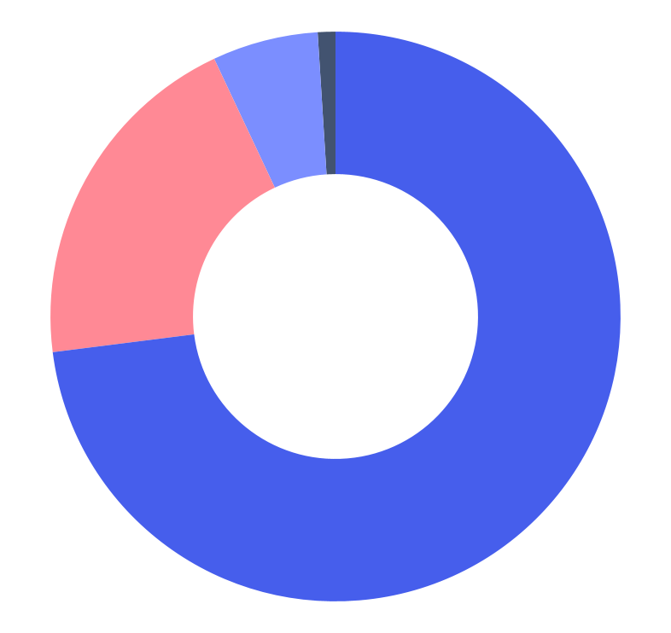
Voting process infographics
How did you find the last voting process?
73%
6%
Very well
Not well
Mars is full of iron oxide dust, which gives the planet its color
Saturn was named after the Roman god of wealth and agriculture
20%
1%
Fairly well
Didn't vote
Mercury is the closest planet to the Sun and the smallest one
Earth is the third planet from the Sun and the only one with life
Follow the link in the graph to modify its data and then paste the new one here. For more info, click here

Slide 32
Icon pack: voting elections | Flat

Slide 33
Instructions for use
In order to use this template, you must credit Slidesgo and Freepik in your final presentation and include links to both websites.
You are allowed to:
- Modify this template.
- Use it for both personal and commercial projects.
You are not allowed to:
- Sublicense, sell or rent any of Slidesgo Content (or a modified version of Slidesgo Content).
- Distribute Slidesgo Content unless it has been expressly authorized by Slidesgo.
- Include Slidesgo Content in an online or offline database or file.
- Offer Slidesgo templates (or modified versions of Slidesgo templates) for download.
- Acquire the copyright of Slidesgo Content.
For more information about editing slides, please read our FAQs or visit Slidesgo School:
https://slidesgo.com/faqs and https://slidesgo.com/slidesgo-school

Slide 34
Instructions for use (premium users)
As a Premium user, you can use this template without attributing Slidesgo.
You are allowed to:
Modify this template.
Use it for both personal and commercial purposes.
Hide or delete the “Thanks” slide and the mention to Slidesgo in the credits.
Share this template in an editable format with people who are not part of your team.
You are not allowed to:
Sublicense, sell or rent this Slidesgo Template (or a modified version of this Slidesgo Template).
Distribute this Slidesgo Template (or a modified version of this Slidesgo Template) or include it in a database or in any other product or service that offers downloadable images, icons or presentations that may be subject to distribution or resale.
Use any of the elements that are part of this Slidesgo Template in an isolated and separated way from this Template.
Register any of the elements that are part of this template as a trademark or logo, or register it as a work in an intellectual property registry or similar.
For more information about editing slides, please read our FAQs or visit Slidesgo School:
https://slidesgo.com/faqs and https://slidesgo.com/slidesgo-school

Slide 35
Infographics
You can add and edit some infographics to your presentation to present your data in a visual way.
Choose your favourite infographic and insert it in your presentation using Ctrl C + Ctrl V or Cmd C + Cmd V in Mac.
Select one of the parts and ungroup it by right-clicking and choosing “Ungroup”.
Change the color by clicking on the paint bucket.
Then resize the element by clicking and dragging one of the square-shaped points of its bounding box (the cursor should look like a double-headed arrow). Remember to hold Shift while dragging to keep the proportions.
Group the elements again by selecting them, right-clicking and choosing “Group”.
Repeat the steps above with the other parts and when you’re done editing, copy the end result and paste it into your presentation.
Remember to choose the “Keep source formatting” option so that it keeps the design. For more info, please visit Slidesgo School.

