Slide 1

Introduction to the lime package
There once was a package called lime,
Whose models were simply sublime,
It gave explanations for their variations,
one observation at a time.
lime-rick by Mara Averick
Matt Dube

Slide 2

Agenda
Introduction
Local vs Global Interpretation
lime Overview
How lime works
Examples
Live Demo
Resources
Alternative tools

Slide 3
Local Interpretation vs Global
Global Interpretation
Global interpretations help us understand the inputs and their entire modeled relationship with the prediction target.
Variable importance quantifies the global contribution of each input variable to the predictions of a machine learning model.
Variable importance measures rarely give insight into the average direction that a variable affects a response function. They simply state the magnitude of a variable’s relationship with the response as compared to other variables used in the model.
Local Interpretation
Local interpretations help us understand model predictions for a single row of data or a group of similar rows.

Slide 4
Model Interpretability Overview
Why do we need to understand black-box models?
Regulatory/Compliance reasons
So Business decision makers can have confidence in predictions
So Data Scientists/Analysts/Engineers can have confidence in models they deploy
Have confidence in models you or your team inherit
Additional metric to utilize when comparing models – beyond accuracy, R-squared, AUC, F1, etc.
Models can have misleading metrics: they can be right for the wrong reasons

Slide 5
What is lime?
lime – Local Interpret-able Model-Agnostic Explanations
Based on the framework developed by Marco Tulio Ribeiro, Sameer Singh, and Carlos Guestrin at the University of Washington, and outlined in their paper “Why Should I Trust You?”: Explaining the Predictions of Any Classifier (https://arxiv.org/abs/1602.04938)
Authors developed a Python implementation of lime. The R version of lime was developed by Thomas Pederson and Michael Benesty.
Behind the workings of lime lies the assumption that every complex model is linear on a local scale
lime asserts that it is possible to fit a simple model around a single observation that will mimic how the global model behaves at that locality.
The simple model can then be used to explain the predictions of the more complex model locally.

Slide 6
Models and Data Types lime Supports
lime supports models from the following packages:
caret (caretEnsemble is NOT supported)
mlr
xgboost
h2o
keras
Other models can manually be made lime compliant:
predict_model()
model_type()
lime can analyze models and predictions based on:
tabular data
text data
images

Slide 7
How lime explains
For each prediction to explain, permute the observation n times.
Let the complex model predict the outcome of all permuted observations.
Calculate the distance from all permutations to the original observation.
Convert the distance to a similarity score.
Select m features best describing the complex model outcome from the permuted data.
Fit a simple model to the permuted data, explaining the complex model outcome with the m features from the permuted data weighted by its similarity to the original observation.
Extract the feature weights from the simple model and use these as explanations for the complex models local behavior.
source: https://cran.r-project.org/web/packages/lime/vignettes/Understanding_lime.html

Slide 8
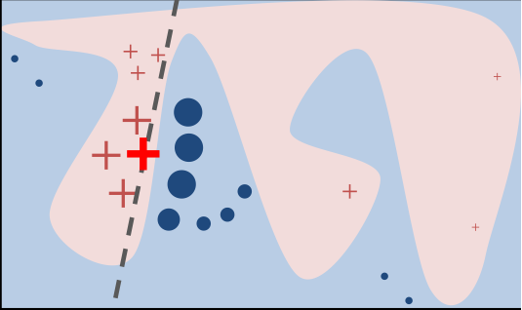
lime process (continued)
The original model's decision function is represented by the blue/pink background, and is clearly nonlinear.
The bright red cross is the instance being explained (let's call it X).
We sample perturbed instances around X, and weight them according to their proximity to X (weight here is represented by size).
We get original model's prediction on these perturbed instances, and then learn a linear model (dashed line) that approximates the
model well in the vicinity of X.
Note that the explanation in this case is not faithful globally, but it is faithful locally around X.
source: https://homes.cs.washington.edu/~marcotcr/blog/lime/

Slide 9
lime functions: lime()
lime::lime() : creates an ‘explainer’ object, which is a list that contains the machine learning model and the feature distributions for the training data (distribution statistics for categorical levels; continuous variables are split into n bins (tunable)).
training data with target removed trained model number of bins to split continuous variable into

Slide 10
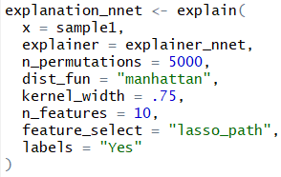
lime functions: explain()
lime::explain(): takes new observation along with the explainer and returns a data.frame with prediction explanations, one observation per row. The returned explanations can then be visualized in a number of ways, e.g. with plot_features().
fsd
explain parameters:
x: 1 or more predictions to explain
explainer: the explainer object created with the lime() function.
n_permuations: number of permutations to create for each observeration in x.
dist_fun: The distance function to use for calculating the distance from the observation to the permutations. Default is Gower. Can use any distance function allowed by dist().
kernel_width: To convert the distance measure to a similarity value, an exponential kernel of a user defined width (defaults to 0.75 times the square root of the number of features) is used. Smaller values restrict the size of the local region.
n_features: the number of features to use for each explanation (10 or less seems to be best).
feature_select: The algorithm to use for selecting features.
auto, none, forward_selection, highest_weights, lasso_path, tree
labels: The specific labels (classes) to explain in case the model is a classifier. For classifiers either this or n_labels must be given.

Slide 11
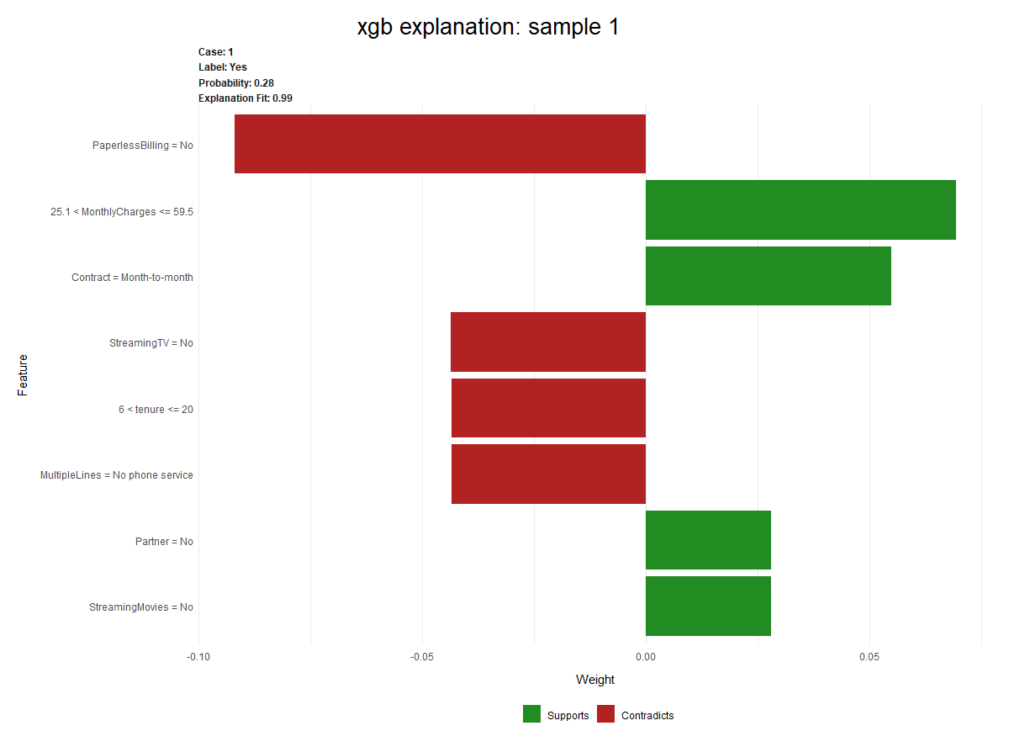
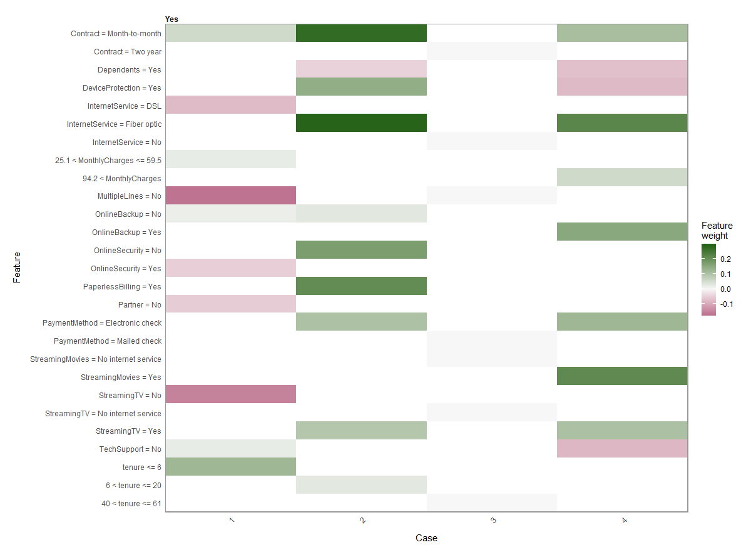
View lime explanations
The explain() function returns a data.frame with prediction explanations.
The explanations can be visualized with:
plot_features(explanation_object) plot_explanations(explanation_object)

Slide 12
Live Demo: Binary Classification
Dataset:
Telco Customer Churn from IBM Watson Analytics site.
After removing unneeded and redundant features: 7043 observations/17 features
Label is ‘Churn’
Fit 5 models:
Gradient Boosting Machine (gbm)
Multivariate Adaptive Regression Splines (mars)
Glmnet
Neural Network (nnet)
eXtreme Gradient Boosting (xgb)

Slide 13
Live Demo: Text Classification
Dataset:
Sentence Corpus data set – comes with lime package
This corpus contains sentences from the abstract and introduction of 30 scientific articles that have been annotated (i.e. labeled or tagged) according to a modified version of the Argumentative Zones annotation scheme.
3117 observations / 2 features
Label is ‘OWNX’, which is ‘neutral description of own work’.

Slide 14
Alternatives to lime
iml: Interpretable Machine Learning
https://cran.r-project.org/web/packages/iml/index.html
https://github.com/christophM/iml
DALEX: Descriptive mAchine Learning EXplanation
https://cran.r-project.org/web/packages/DALEX/index.html
https://github.com/pbiecek/DALEX
breakDown: Model agnostic tool for decomposition of predictions from black boxes
https://cran.r-project.org/web/packages/breakDown/index.html
https://pbiecek.github.io/breakDown/

Slide 15
Resources
Visualizing ML Models with LIME - https://uc-r.github.io/lime
Announcing lime - Explaining the predictions of black-box models - https://www.data-imaginist.com/2017/announcing-lime/
Explaining Predictions of Machine Learning Models with LIME - Münster Data Science Meetup - https://shirinsplayground.netlify.com/2017/12/lime_sketchnotes/
Local Interpretable Model-Agnostic Explanations (LIME): An Introduction - https://www.oreilly.com/learning/introduction-to-local-interpretable-model-agnostic-explanations-lime
lime: Local Interpretable Model-Agnostic Explanations - https://cran.r-project.org/web/packages/lime/
The creator of the IML (Interpretable Machine Learning) package has a free book: Interpretable Machine Learning by Christoph Molnar. https://christophm.github.io/interpretable-ml-book/

