Slide 1
NOISY-OR
Bayesian Risk Model
A Mathematical & Statistical Framework
for Evidence-Based Risk Quantification
Topics: Beta Distributions · Noisy-OR Combination · Marginal Contribution · Certainty Scoring · Bayesian Updating
16 slides

Slide 2
Why Probabilistic Risk Models?
2 / 16
Point estimates hide the most important information: how confident are we? A probabilistic model makes uncertainty a first-class citizen.
Risk is inherently uncertain
Evidence comes from many sources
No signal is perfectly reliable. A match score, a model output, or an analyst judgment all carry noise. Encoding that noise explicitly leads to better decisions.
Different data streams provide independent pathways to a risk outcome. A model that fuses them cleanly is more powerful than any single signal alone.
Beliefs should update fluidly
Confidence is as important as the estimate
As new evidence arrives — feedback arrives, an expert revises a score — the combined risk estimate should shift automatically with a clear mathematical audit trail.
An 80% risk with 95% certainty is a very different situation from an 80% risk with 40% certainty. Both numbers matter for decision-making.
NOISY-OR BAYESIAN RISK MODEL
2 / 16

Slide 3
The Limitations with Labeled Risk Categories
3 / 16
The label-based system assigns a fixed category (High / Moderate / Low) to each source. The combined risk is simply the worst label present — leaving certainty, differentiation, and source contribution unaddressed.
1
The combined score is just the worst label — no aggregation
How the label system works
If Source A = High and Source B = Low, the result is High. Source B contributes nothing. Two sources that both say "Moderate" also produce "Moderate" — as if only one source exists. Independent evidence is discarded.
Step 1 — Each source has a fixed label
Source A
HIGH
2
Identical labels hide completely different sources
Source B
HIGH
Source A (almost always fires, very reliable) and Source B (rarely fires, analyst guessing) both labelled "High." The system treats them identically. There is no way to know which source to investigate first or trust more.
Source C
MODERATE
3
No certainty — the label carries no confidence information
Source D
LOW
A label of "High" could reflect a strong, data-driven signal or a vague, uncertain hunch. The system provides no way to distinguish them. Two analysts looking at the same source could assign "High" for completely different reasons.
Step 2 — Result = worst label present
4
Adding more sources does not improve the score — only the worst label carries through
COMBINED RISK = HIGH
If the current result is already "High," activating additional sources changes nothing — the result stays "High" regardless. The model cannot capture the intuition that more confirming evidence should increase confidence.
Sources B, C, D contribute nothing.
Removing them leaves the same result.
The label system functions as a lookup table — it lacks the combination logic, certainty scoring, and source weighting that a full risk model requires.
NOISY-OR BAYESIAN RISK MODEL
3 / 16

Slide 4
How the Noisy-OR Model Addresses Each Limitation
4 / 16
Every limitation of label-based systems is directly addressed by the Bayesian Noisy-OR model.
Label System Issue
→
Noisy-OR Solution
Example
Result = worst label only
Sources B, C, D all ignored. Independent evidence from multiple sources is silently discarded.
→
Every source contributes via Noisy-OR
P(risk) = 1−(1−p_A)(1−p_B)(1−p_C)(1−p_D). Each source adds coverage. None are ignored.
A=HIGH, B=HIGH
C=MOD, D=LOW
⟹ result: HIGH
(B, C, D ignored)
vs
p_A=0.75, p_B=0.60
p_C=0.45, p_D=0.20
⟹ 97.6% combined
(all sources count)
Same label, unknowable difference
"High" on a reliable source looks identical to "High" on a vague, uncertain source. No way to tell them apart.
→
κ separates signal strength from certainty
A confident High (κ=80) has Var(p)=0.003. A shaky High (κ=5) has Var(p)=0.047. Both visible, both actionable.
Source A = HIGH
Source B = HIGH
(indistinguishable
in label system)
vs
A: μ=0.75, κ=80
→ certainty 93%
B: μ=0.75, κ=5
→ certainty 49%
No certainty attached to any label
"High" carries no confidence information. The model gives no signal about whether to act immediately or investigate further.
→
Certainty = 1 − (P₉₅ − P₅) is always available
Narrow credible interval = act. Wide interval = gather more evidence first. Built into every estimate.
Result: HIGH
(should we act now?
Gather more data?
No way to know.)
vs
Risk: 82%, Cert: 91%
→ act now
Risk: 78%, Cert: 44%
→ investigate first
More sources cannot help — only hurt
Once the result is "High," additional sources are irrelevant. Confirming evidence adds nothing to the score.
→
Each new source narrows uncertainty and raises combined risk
Activating a new source always updates the posterior — even if it confirms what we already know.
A=HIGH → HIGH
+B=HIGH → HIGH
+C=HIGH → HIGH
(no change ever)
vs
p=0.75 → 75%
+p=0.60 → 90.0%
+p=0.45 → 94.5%
(each source adds)
The Noisy-OR model does not improve on the label system — it replaces a broken foundation with a principled one.
NOISY-OR BAYESIAN RISK MODEL
4 / 16

Slide 5
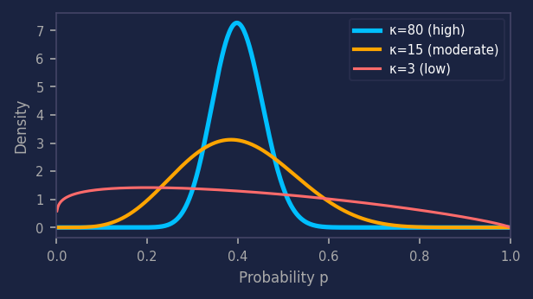
The Beta Distribution — Modeling Uncertainty in a Probability
5 / 16
A distribution over a probability
How κ shapes the distribution
1
Each risk source has an unknown true probability p. Rather than fix a single value, we model the full range of plausible values as a distribution.
κ = 80 (very confident)
μ = 0.40 → tight peak near 40%
Almost all probability mass concentrated near μ. Analyst is very sure.
2
Defined on (0,1) — exactly the right domain for a probability. Parameterized by shape values α and β.
κ = 15 (moderate certainty)
3
Re-parameterized as α = μκ and β = (1−μ)κ, where μ is our best estimate and κ controls confidence.
μ = 0.40 → spread 20%–65%
Reasonable confidence but meaningful spread. Could range widely.
4
Two numbers — μ and κ — capture both our belief and our confidence in that belief.
κ = 3 (low certainty)
μ = 0.40 → nearly flat
Minimal information. Distribution is nearly uniform across (0,1).
Var(p) = μ(1 − μ) / (κ + 1) — higher κ means lower variance, higher certainty
NOISY-OR BAYESIAN RISK MODEL
5 / 16

Slide 6
Multiple Independent Sources of Evidence
7 / 16
Each source represents a distinct, independent signal — a separate reason the risk event could occur.
Source 1
Source 2
Source 3
Source 4
μ = 0.40
μ = 0.60
μ = 0.40
μ = 0.70
κ = 15
κ = 15
κ = 80
κ = 80
Moderate signal
Moderate certainty
Higher signal
Moderate certainty
Moderate signal
High certainty
High signal
High certainty
Independent sources → each covers a separate portion of the risk space
Statistical independence means knowing Source 1 fired tells us nothing about whether Source 2 will fire. This is what makes the Noisy-OR multiplication valid: we can simply multiply the probability that each individual source fails to fire. Without independence, we would need to model correlations — vastly more complex.
NOISY-OR BAYESIAN RISK MODEL
7 / 16

Slide 7
The Noisy-OR Combination Formula
8 / 16
P(risk) = 1 − ∏ᵢ (1 − pᵢ)
Probability that at least one independent source fires
Step-by-step derivation:
1
2
3
4
Sample each source
Compute non-firing prob
Multiply across sources
Invert to get risk
Draw N samples from Beta(α,β) for each source. Each sample pᵢ is one plausible value of that source's true risk probability.
For each sample, compute (1−pᵢ). This is the probability that source i does NOT fire on a single draw.
By independence: P(none fire) = ∏ᵢ(1−pᵢ). Multiplying survival probabilities gives the joint silence probability.
P(at least one fires) = 1 − ∏ᵢ(1−pᵢ). This is the combined risk score — the probability the event occurs via any pathway.
NOISY-OR BAYESIAN RISK MODEL
8 / 16

Slide 8
Why Noisy-OR? The Logic of Independent Risk Pathways
9 / 16
Numeric intuition
Real-world analogy
Two sources: p₁ = 0.70, p₂ = 0.20
Scenario: Vendor payment review
Source A (unusual payment pattern): p = 0.70
Source B (vendor watchlist match): p = 0.20
P(none fire) = 0.30 × 0.80 = 0.24
Overall risk = 1 − 0.24 = 76%
Marginal contributions:
Source A: 76% − P(risk without A)
= 76% − 20% = +56 pts
Source B: 76% − P(risk without B)
= 76% − 70% = +6 pts
Source A dominates; Source B adds the 6% of cases A misses (0.30 × 0.20 = 0.06 ✓)
P(none fire) = (1−0.70)(1−0.20)
= 0.30 × 0.80 = 0.24
P(at least one fires)
= 1 − 0.24 = 0.76
Combined risk (76%) > max source (70%)
The extra 6% = Source 2 covering the
30% of cases Source 1 misses:
0.30 × 0.20 = 0.06 ✓
NOISY-OR BAYESIAN RISK MODEL
9 / 16

Slide 9
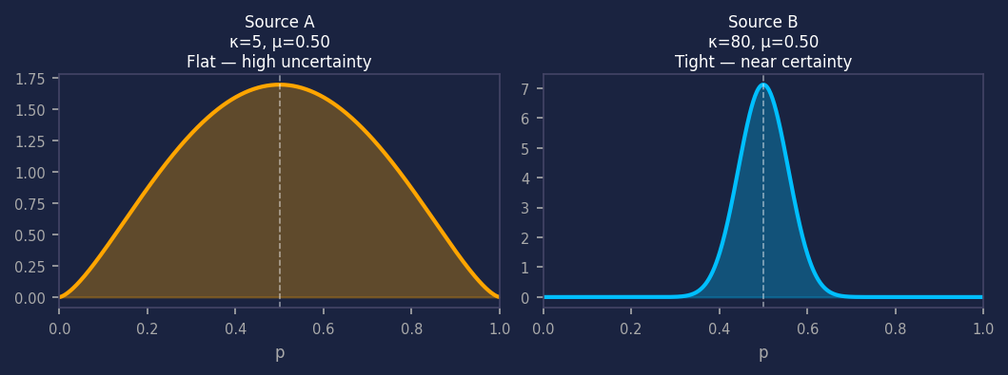
Sources with Different Individual Certainty
10 / 16
Two sources can have the same μ but very different κ — and their contribution to model certainty differs dramatically.
Property
Source A (κ = 5)
Source B (κ = 80)
μ (mean risk)
0.50
0.50
κ (concentration)
5
80
α parameter
2.5
40
β parameter
2.5
40
Variance Var(p)
0.042
0.003
90% credible interval
~8% – 92%
~44% – 56%
Interpretation
Flat prior — almost uniform
Tight prior — near certainty
Effect on certainty
Widens P5–P95 band significantly
Keeps P5–P95 band narrow
Key insight: Both sources have identical mean risk (50%) — but Source B contributes far more to model certainty because it has 16× lower variance.
NOISY-OR BAYESIAN RISK MODEL
10 / 16

Slide 10
Marginal Contribution — What Is Actually Driving the Risk?
11 / 16
Marginal contribution answers: how much would overall risk fall if we removed this source from the model?
Δᵢ = P(risk | all sources) − P(risk | all sources except i)
The marginal reduction in combined risk from removing source i
Worked example — 3 active sources: p₁=0.40, p₂=0.60, p₃=0.70
92.8%
+16.8%
+10.8%
+4.8%
32.4%
Combined Risk
Source 3 Δ
Source 2 Δ
Source 1 Δ
Sum of Δs
Source 3 (p=0.70)
+16.8%
Source 2 (p=0.60)
+10.8%
Source 1 (p=0.40)
+4.8%
NOISY-OR BAYESIAN RISK MODEL
11 / 16

Slide 11
Certainty — How Confident Are We in the Risk Score?
12 / 16
A risk score without a certainty measure is incomplete. Certainty tells us how much to trust the estimate.
Certainty = 1 − ( P₉₅ − P₅ )
1 minus the width of the 90% credible interval of the combined posterior risk distribution
High Certainty
Moderate Certainty
Low Certainty
92%
74%
40%
P5: 47% P95: 55% (κ=80)
P5: 38% P95: 64% (κ=15)
P5: 11% P95: 71% (κ=3)
Tight Beta distributions. P5–P95 span only 8 percentage points. Analyst is very confident in the risk score.
Broader priors. Meaningful uncertainty — risk could range from 38% to 64%. Score is directionally reliable.
Very flat priors. Risk could be almost anywhere 11%–71%. More high-quality evidence is needed before acting.
NOISY-OR BAYESIAN RISK MODEL
12 / 16

Slide 12
Updating Beliefs — Bayesian Reasoning in Practice
13 / 16
The Noisy-OR model is designed to update. Every parameter change has a clear, traceable mathematical effect.
Activate a new source
+ SRC
Raise confidence in a source
↑ κ
Before: 2 sources active P(risk) = 52%
Before: Source A: κ=8 Certainty: 61%
After: 3rd source added P(risk) = 71%
After: Source A: κ=60 Certainty: 87%
A new independent detection pathway is confirmed. Combined risk rises because the new source covers cases the others miss.
We now believe our μ estimate more strongly. Mean risk barely changes, but the credible interval narrows — certainty jumps.
Revise belief upward
↑ μ
Deactivate a ruled-out source
− SRC
Before: Source B: μ=0.30 P(risk) = 44%
Before: 3 sources active P(risk) = 71%
After: Source B: μ=0.55 P(risk) = 66%
After: Source removed P(risk) = 52%
New intelligence suggests this source fires more often. Mean risk shifts accordingly. The posterior updates immediately.
Investigation confirms this source is not active. Risk falls back to baseline — the model is fully reversible and consistent.
NOISY-OR BAYESIAN RISK MODEL
13 / 16

Slide 13
Configuring the Model per Agency
14 / 16
The same underlying sources serve every agency. Only the parameters change — giving each agency a model calibrated to their specific risk thresholds and operating context.
SHARED SOURCES
AGENCY 1
AGENCY 2
S1
Source 1
S1
μ=0.70 κ=80
S1
μ=0.50 κ=12
Primary signal — high μ, very certain (κ=80)
Primary signal — lower μ, low certainty (κ=12)
S2
Source 2
S2
μ=0.20 κ=10
S2
μ=0.30 κ=15
Rarely relevant for this agency
Moderate relevance for this agency
S3
Source 3
S3
μ=0.50 κ=50
S3
μ=0.40 κ=8
Strong secondary signal, confident
Secondary signal, low certainty (κ=8)
per-agency
configuration
S4
Source 4
S4
μ=0.15 κ=8
S4
μ=0.25 κ=10
Near-irrelevant for this agency
Minor signal for this agency
S5
Source 5
S5
μ=0.20 κ=12
S5
μ=0.20 κ=8
Background signal, very low weight
Background signal, minimal weight
Same 5 sources. Same mathematical engine. Different risk thresholds per agency — each calibrated by adjusting μ and κ per source.
NOISY-OR BAYESIAN RISK MODEL
14 / 16

Slide 14
Same Transaction, Two Agency Profiles — Very Different Outcomes
15 / 16
A potentially improper transaction is evaluated against both agency configurations. Both agencies match S1 and S3 only — but Agency 1 places far greater weight and certainty on those sources, producing a 15-point gap in combined risk.
Scenario: potentially improper transaction — S1 and S3 match for both agencies. S2, S4, and S5 do not match.
Agency 1
Agency 2
MATCH
Source 1
μ=0.7 κ=80
MATCH
Source 1
μ=0.5 κ=12
no match
Source 2
μ=0.2 κ=10
no match
Source 2
μ=0.3 κ=15
MATCH
Source 3
μ=0.5 κ=50
MATCH
Source 3
μ=0.4 κ=8
no match
Source 4
μ=0.15 κ=8
no match
Source 4
μ=0.25 κ=10
no match
Source 5
μ=0.2 κ=12
no match
Source 5
μ=0.2 κ=8
85%
Combined Risk
70%
Combined Risk
1 − (1−0.70)(1−0.50)
= 1 − (0.30 × 0.50) = 85.0%
1 − (1−0.50)(1−0.40)
= 1 − (0.50 × 0.60) = 70.0%
Agency 1: S1 carries high weight (μ=0.70) and high certainty (κ=80) → same two matches score 85%.
Agency 2: S1 carries lower weight (μ=0.50) and lower certainty (κ=12) → same two matches score only 70%. 15-point gap from calibration alone.
NOISY-OR BAYESIAN RISK MODEL
15 / 16

Slide 15
WHY THIS
MODEL WORKS
Beta Distribution
Noisy-OR Formula
Models per-source uncertainty using μ (mean belief) and κ (confidence). Var(p)=μ(1−μ)/(κ+1). Higher κ → tighter, more certain prior.
P(risk)=1−∏(1−pᵢ). Combines independent sources via the 'at least one fires' logic. Mathematically exact under independence.
Grounded in probability theory — not heuristics
Transparent: every parameter has a clear meaning
Handles any number of independent sources
Marginal Contribution
Certainty Score
Uncertainty-aware: certainty is built into the output
Δᵢ = overall risk minus risk without source i. Reveals which signal dominates and quantifies each source's unique contribution.
Certainty = 1−(P₉₅−P₅). Measures how tightly the posterior distribution is concentrated. Rises with κ, falls with uncertainty.
Bayesian: beliefs update cleanly with new evidence
Auditable: Monte Carlo traces every inference step
Interpretable: marginal contributions reveal drivers
Bounded: output is always a valid probability in (0,1)
A principled, transparent, and updatable framework for risk under uncertainty

Slide 16
APPENDIX
Beta Distribution Plots
Visual reference for distribution shapes, certainty intervals,
per-agency source priors, and combined risk posteriors.
NOISY-OR BAYESIAN RISK MODEL
Appendix

Slide 17
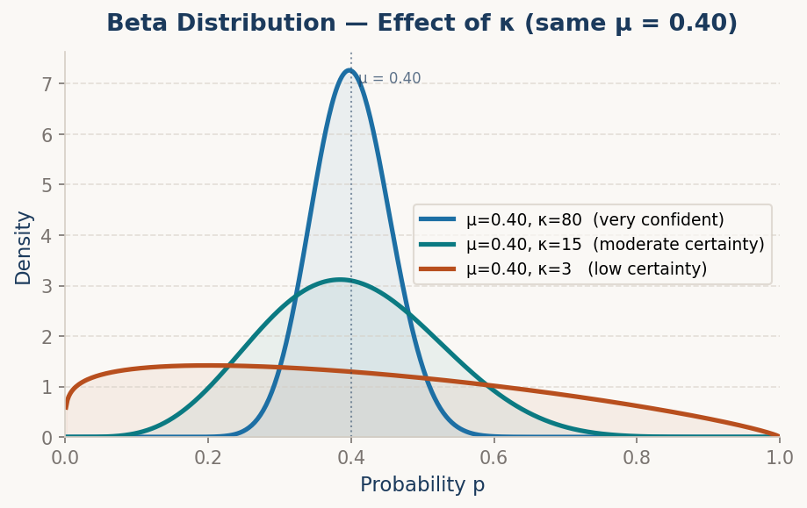
APPENDIX · Beta Distribution — Effect of κ
A-1
All three curves share the same mean belief μ = 0.40. Only κ differs — controlling how tightly the distribution is concentrated around that belief. This plot directly reinforces slide 5.
NOISY-OR BAYESIAN RISK MODEL · APPENDIX

Slide 18
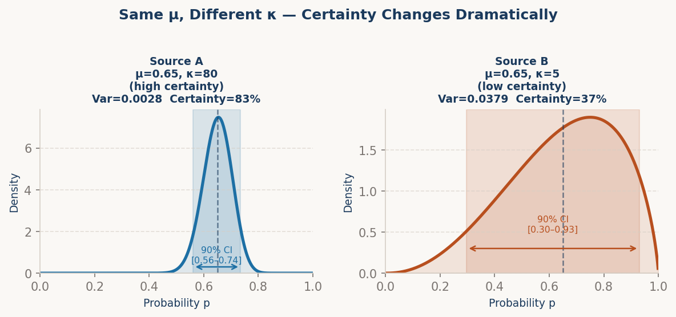
APPENDIX · Same μ, Different κ — Certainty Comparison
A-2
Two sources with identical μ = 0.65 produce dramatically different credible intervals. The 90% CI for the high-κ source is less than a quarter the width of the low-κ source — this is what certainty scoring captures.
NOISY-OR BAYESIAN RISK MODEL · APPENDIX

Slide 19
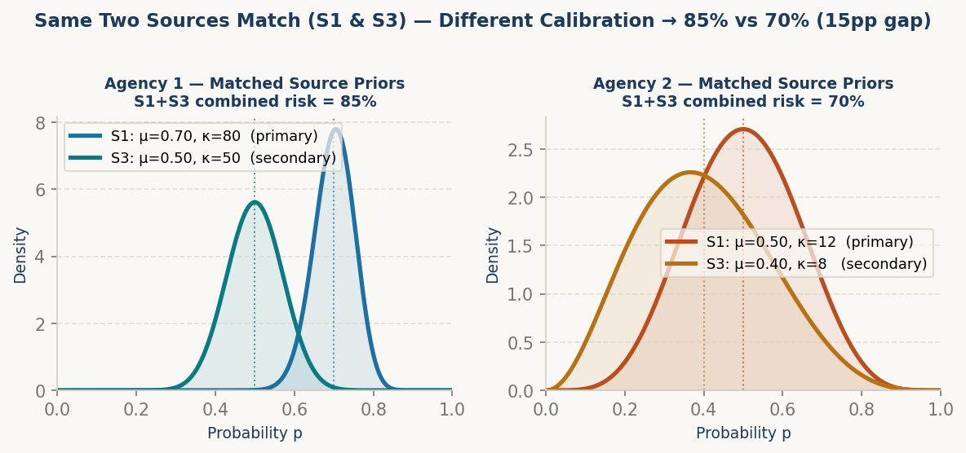
APPENDIX · Per-Agency Source Priors — Same Transaction
A-3
Both agencies match the same two sources (S1 and S3) — but their μ and κ parameters differ dramatically. Agency 1 treats S1 as a strong, certain signal (μ=0.70, κ=80) and S3 as a solid secondary (μ=0.50, κ=50). Agency 2 has lower priors on both (S1: μ=0.50, κ=12; S3: μ=0.40, κ=8). Agency 2's wide, flat curves reflect genuine uncertainty — same evidence, very different confidence.
NOISY-OR BAYESIAN RISK MODEL · APPENDIX

Slide 20
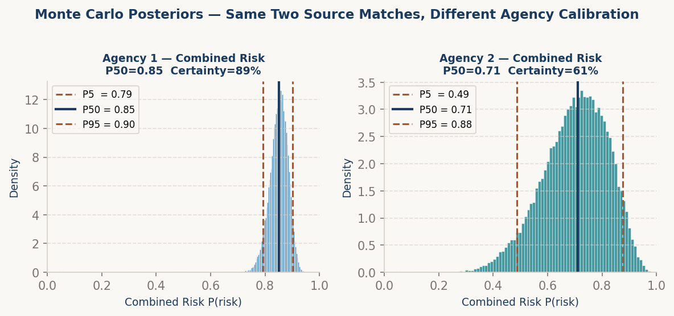
APPENDIX · Monte Carlo Combined Risk Posteriors
A-4
50,000 Monte Carlo samples per agency. Both agencies match exactly two sources (S1 and S3) — the only difference is μ and κ per source. The posteriors sit ~15 percentage points apart, showing how calibration alone drives materially different risk conclusions from identical evidence.
NOISY-OR BAYESIAN RISK MODEL · APPENDIX

Slide 21
APPENDIX · JSON Configuration — Storing and Sharing Parameters
A-5
The μ and κ parameters for every source can be stored as a simple JSON file — making them easy to version, audit, and update. Different agencies maintain separate configs for the same sources.
agency_1_config.json
{
"agency": "Agency_1",
"sources": {
"S1": {"mu": 0.70, "kappa": 80},
"S2": {"mu": 0.20, "kappa": 10},
"S3": {"mu": 0.50, "kappa": 50},
"S4": {"mu": 0.15, "kappa": 8},
"S5": {"mu": 0.20, "kappa": 12}
}
}
# S1 high weight, very certain
# S3 strong secondary signal
agency_2_config.json
{
"agency": "Agency_2",
"sources": {
"S1": {"mu": 0.50, "kappa": 12},
"S2": {"mu": 0.30, "kappa": 15},
"S3": {"mu": 0.40, "kappa": 8},
"S4": {"mu": 0.25, "kappa": 10},
"S5": {"mu": 0.20, "kappa": 8}
}
}
# S1 lower weight, less certain
# S3 weaker secondary signal
Same 5 sources. Same engine. Each agency updates only their JSON — no code changes needed. Parameters version-control cleanly in git.
NOISY-OR BAYESIAN RISK MODEL · APPENDIX

Slide 22
NOTES
NOISY-OR BAYESIAN RISK MODEL

Slide 23
NOTES
NOISY-OR BAYESIAN RISK MODEL

Slide 24
NOTES
NOISY-OR BAYESIAN RISK MODEL

