Slide 1

PS5210
Applied Neuroscience Methods
Workshop: analysis of behaviour

Slide 2
Analysis of behaviour
Participants perform a task, and we record their responses (multiple repetition since behaviour is variable)
We calculate summary measures of individual performance
We do statistical test to estimate effects and make inferences on population

Slide 3
Analysis of behaviour
Participants perform a task, and we record their responses (multiple repetition since behaviour is variable)
We calculate summary measures of individual performance
We do statistical test to estimate effects and make inferences on population
Sometimes summary measures can be just averages (e.g., mean response time), but that is not always appropriate
In many cases is useful to examine behaviour through the lens of a mathematical model

Slide 4
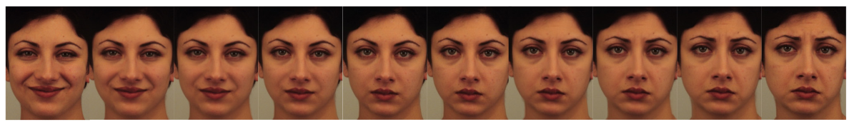
Example: emotion recognition task
Participants are shown an image out of morphed continuum and indicate whether it is happy/sad
https://github.com/mattelisi/NeuroMethods/tree/master/experimental_tasks/emotion-recognition

Slide 5
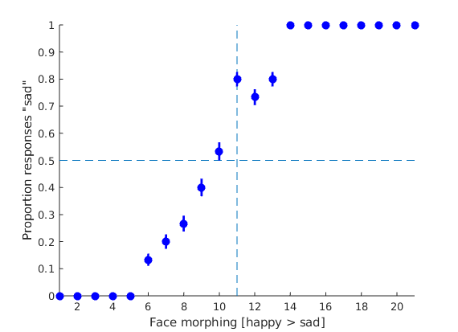
Example: emotion recognition task
Example of data

Slide 6
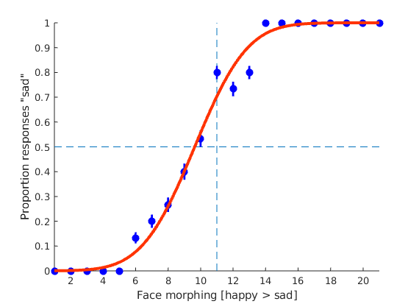
Example: emotion recognition task
Example of data
Psychometric function
(cumulative of a Gaussian
probability density function)

Slide 7
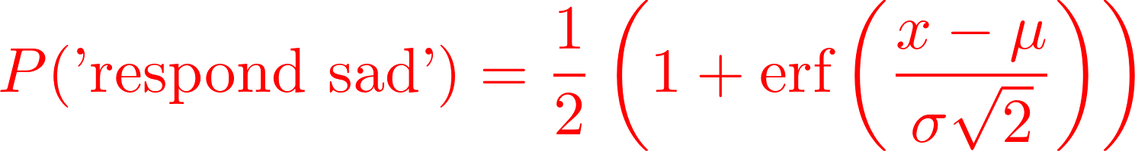
Example: emotion recognition task
Example of data
Psychometric function
(cumulative of a Gaussian
probability density function)

Slide 8
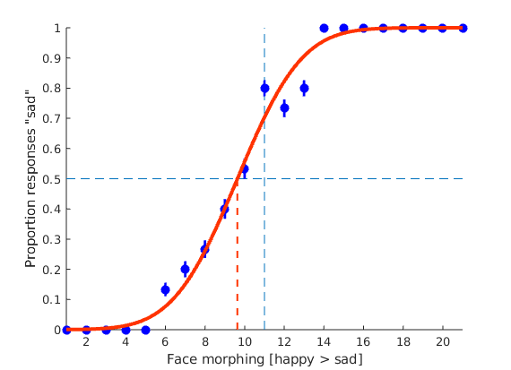
Example: emotion recognition task
Example of data
Psychometric function
point of subjective equality (PSE)

Slide 9
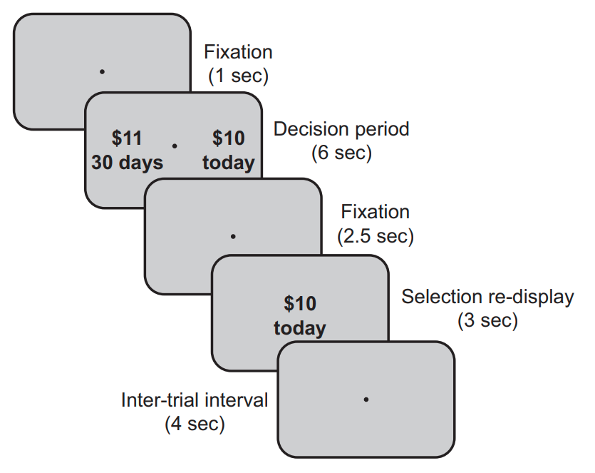
Example: temporal discounting task
Reppert et al, J Neurosci, 2015

Slide 10
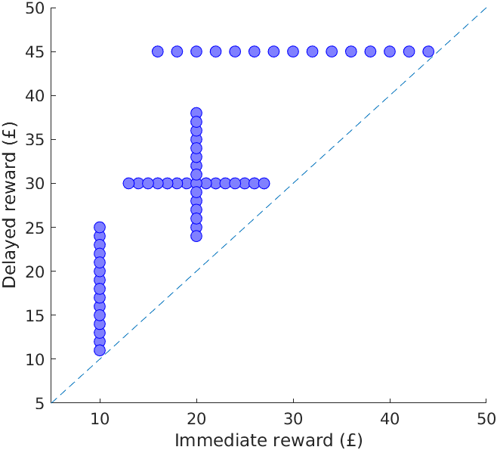
Example: temporal discounting task
60 choice pairs
(each dots represents a pair of immediate & delayed rewards)
120 trials in total
(each pairs repeated twice)

Slide 11
Example: temporal discounting task
60 choice pairs
(each dots represents a pair of immediate & delayed rewards)
120 trials in total
(each pairs repeated twice)
£ 16
today
£ 45
30 days

Slide 12
Example: temporal discounting task
60 choice pairs
(each dots represents a pair of immediate & delayed rewards)
120 trials in total
(each pairs repeated twice)
£ 10
today
£ 11
30 days

Slide 13
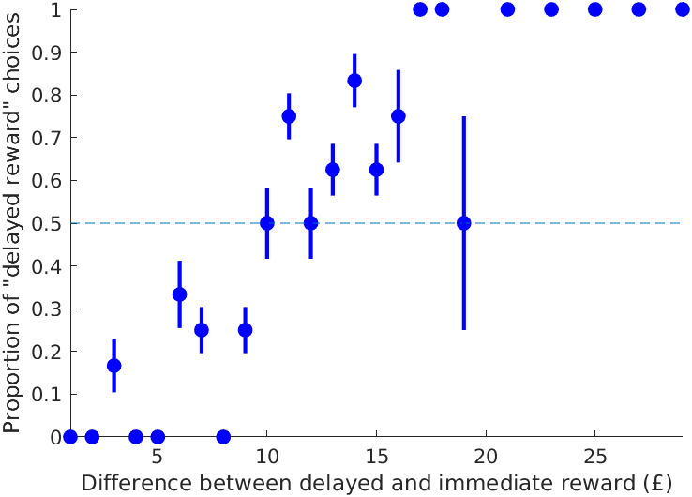
Example: temporal discounting task
Example of data

Slide 14
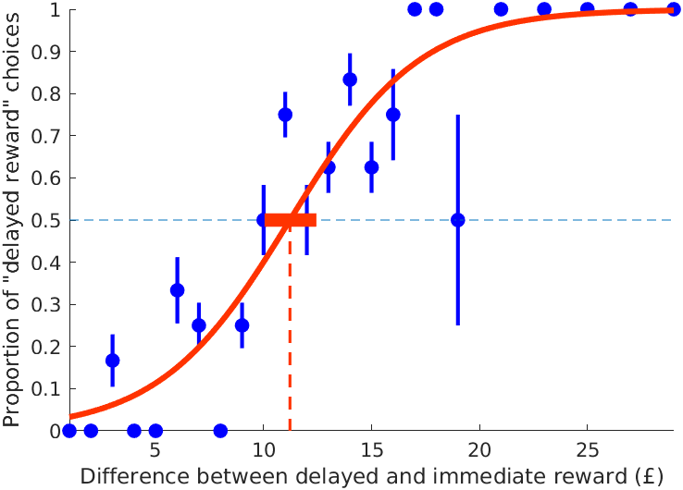
Example: temporal discounting task
Example of data
x reward difference
(delayed minus immediate)
α point of subjective equality of
immediate and delayed reward
β slope of the function
(control steepness)

Slide 15
Maximum likelihood estimation (MLE)
Find the parameter values that maximize the probability (likelihood) of the data (given the model)
The probability of the data is given by
In practice, we code the binary choice immediate/delayed with a numerical variable (call it y) taking only 1 and 0 as values (e.g. representing choices of delayed and immediate rewards, respectively).

Slide 16
Maximum likelihood estimation (MLE)
The probability of the data as a whole is obtained by multiplying the probability of individual responses
In practice, we usually take the logarithm of the likelihood, because it transform the product into a sum; we call this the log-likelihood function

Slide 17
Maximum likelihood estimation (MLE)
In words: we find the values of the parameters maximize the log-likelihood function, which is the sum of the log-probabilities of individual trials/responses/datapoints.
For simple models, there may be formulas that give us the exact values that maximize the likelihood.
In general, we often use numerical optimization algorithms that iteratively test different values of the parameters and find the maximum using a trial-and -error procedure (sort of); for example see function fminsearch() in Matlab, or function optim() in R
The approach is general and can be used to fit *any* model
(as long as you can write and compute the likelihood function)

Slide 18
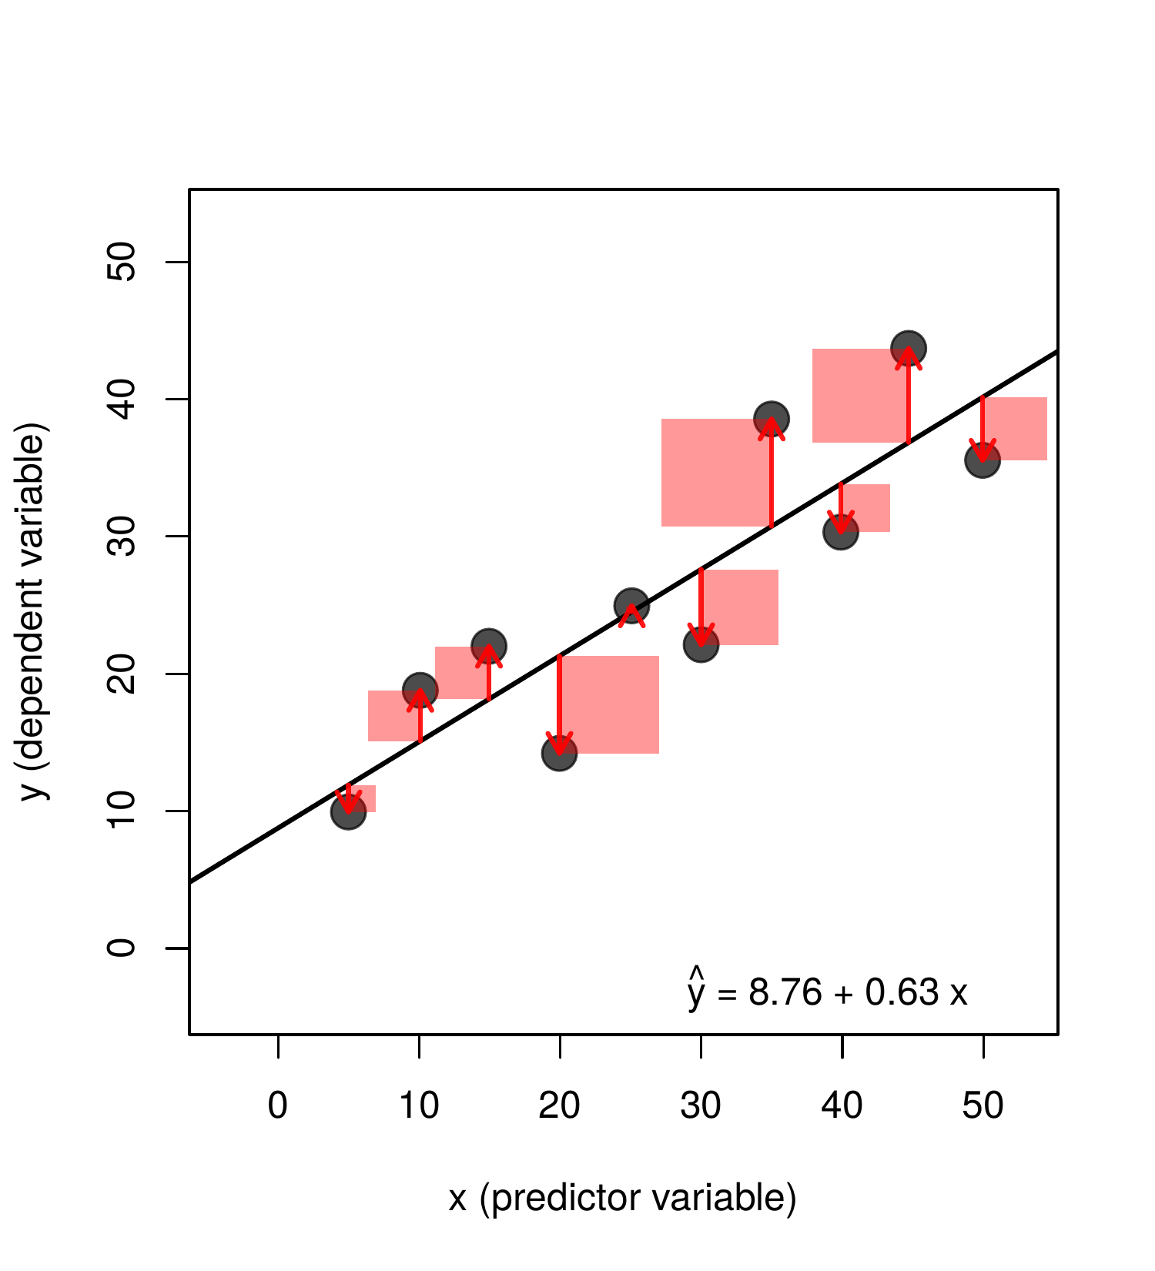
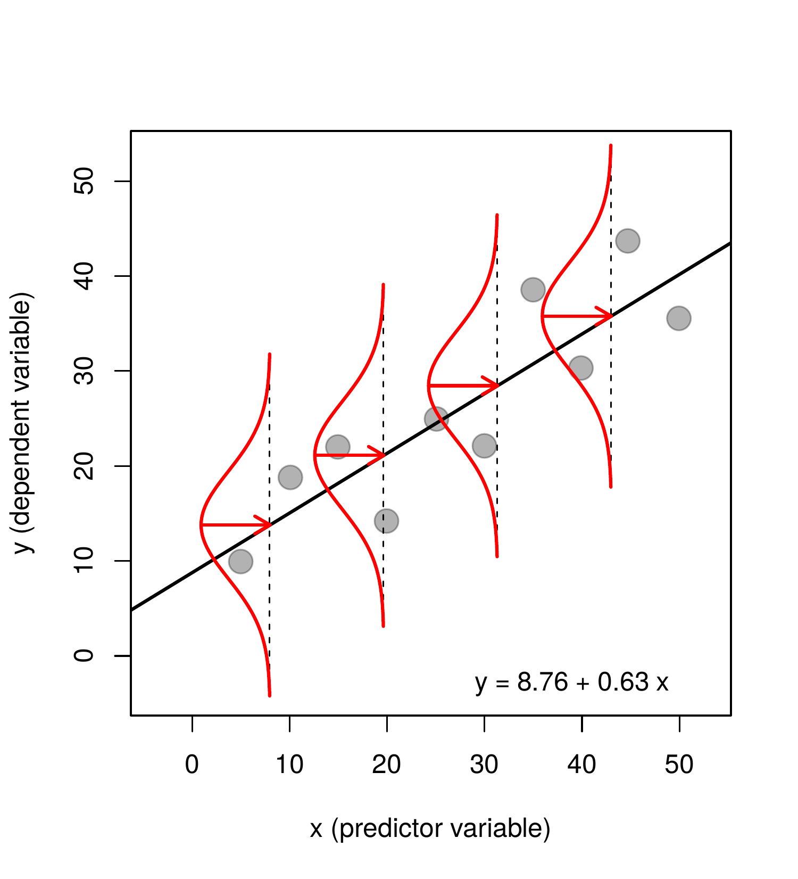
Maximum likelihood estimation (MLE)
Least square estimation, used in linear regression, is a special case of MLE in which the probability of the data is given by a Gaussian distribution

Slide 19
Benefits of MLE estimation
MLE is popular because is a principled method to estimate parameters with some useful theoretical properties:
Consistency: as amount of data increases, MLE estimates become increasingly accurate, eventually converging to the true value.
Efficiency: MLE often makes the best use of available data, producing estimates with the lowest possible uncertainty.
Provides a natural way to compare models using tools like likelihood ratio tests or AIC.tes

Slide 20
MLE summary
To fit *any* model on data:
  Write a function that computes the probability of the data, given some values of the model parameters.
  The parameters values that maximize such probability are the maximum likelihood estimates of the parameter.
  Assess the uncertainty around such values (multiple ways of doing this – today we will use an approach known as parametric bootstrapping).

Slide 21
Possible data analysis report for portfolio
The dataset discounting_all.csv contains the data of 20 participants who completed this task:
10 healthy controls
10 Parkinson patients on dopaminergic medication (which is known to affect reward processing)
Research question to address:
Do medicated Parkinson patients differs from controls in their temporal discounting of economic value?

