Slide 1
PowerEnJoy
Matteo Bresich (mat. 774366)

Slide 2
Overview
Actual system
Product Scope
Proposed system
Actors
Some Details
Car Reservation
Car Availability
Scenario

Slide 3
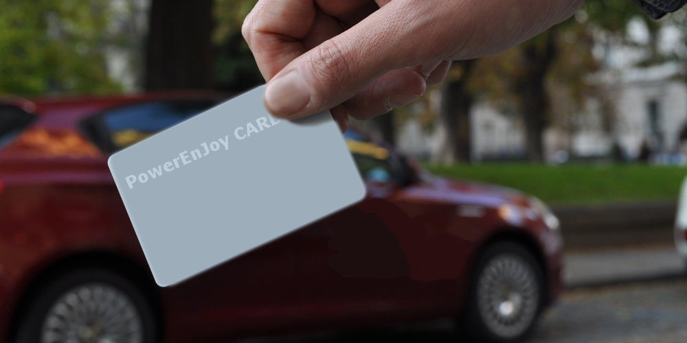
Actual System
Registration: car sharing company office with a module
Reserve a car: Call-center
Car Access: Electronic card
Notes:
Until now the car sharing company has a system where a registered client can reserve an electric car by calling a call-center. The service registration cannot be done on-line. It can only be done in the company office with a specific module. The company has a software called ”CSGestion”, and it's used for managing all company cars. The software stores all the informations into a database.

Slide 4
Product Scope
Simplify user’s ways to access to the service
Reduce unnecessary calls to the call-center
Simplify the work of handyman operators
Notes:
Upgrade the existing system in a Omnichannel system

Slide 5
Proposed System
The solution consists in a software composed by a website and a mobile application
The proposed solution will be implemented in a client-server architecture
The new system will not replace the old one, it will be integrate with it

Slide 6
Actors
Registered Users
Drivers
Passengers
Handyman Operators
Notes:
Registered Users: are the final users of the car sharing service. Only they can book a car by calling the call-center or by using the web or mobile app, and use it.
Passengers: are registered user that can reserve a number of seats of a shared ride using the new application.
Handyman Operators: are company employees that recharge low battery cars and move cars from a safe area to another to ensure that in each area there is the minimum number of cars available.

Slide 7
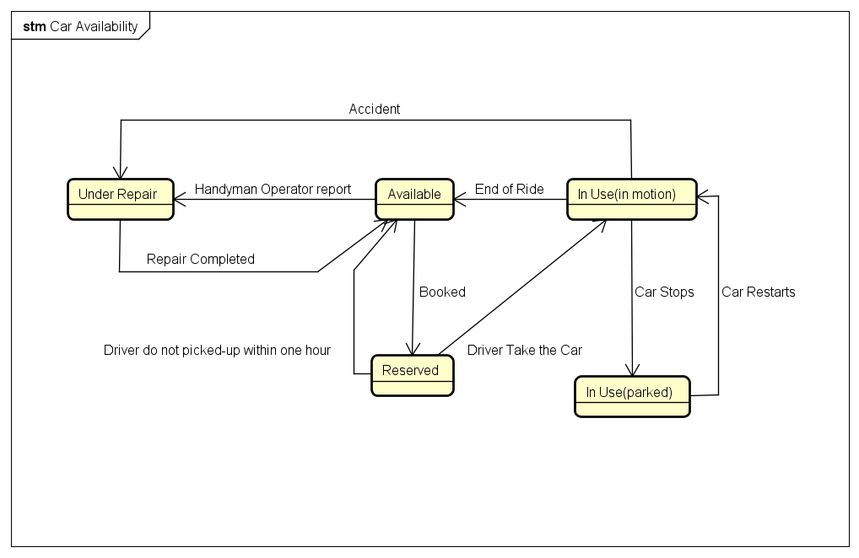
Car Availability

Slide 8
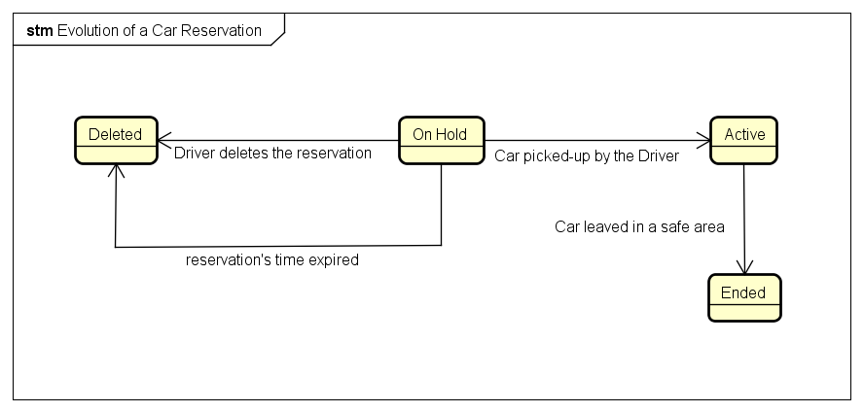
Car Reservation

Slide 9
Scenario
Chiara is an university student and a registered user to the service. Every day she uses public transportation to reach the school in the center of Milan. During the year because of the public transportation's strikes she is forced to find an alternative way to arrive at her destination.Just the other week when she had to go to college for an exam, when she arrives to Cadorna station because of the metro service strike, decided to use the app PowerEnJoy installed on her smartphone.After checking that there is a car available in the equipped parking nearest her, she book it and went to the equipped parking to get to her destination. The car chosen is fully charged.After using it for the most of the day Chiara brings back the car to the Cadorna's equipped parking. Once she parked, the system detects the end of the race and automatically computes the fare and applies a discount on this ride of 20% because the battery car charge is more than 50%. The transaction is performed automatically by the user's method of payment already chosen

