Slide 1
PowerEnJoy
Matteo Bresich (mat. 774366)

Slide 2
Overview
Architectural Design
Component view
Deployment view
Runtime view
Algorithm Design
Payment
Good car distribution
User Interface Design

Slide 3
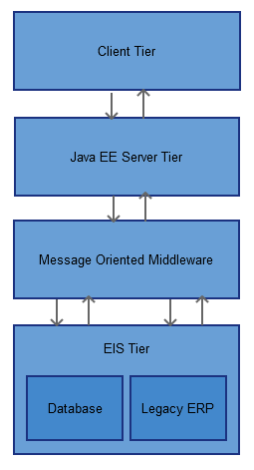
Architectural Design
Java Platform Enterprise Edition
Multi-tier architecture

Slide 4
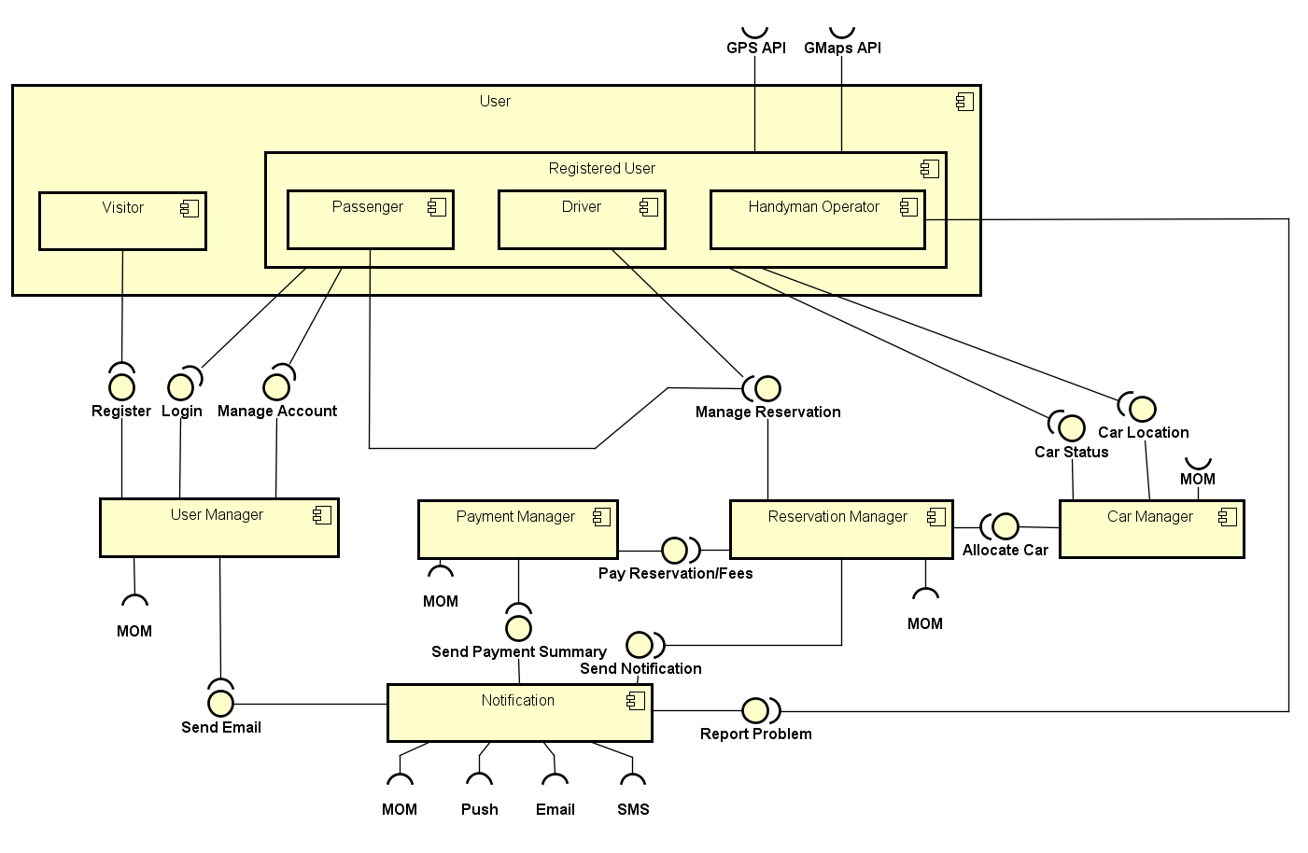
General Component View

Slide 5
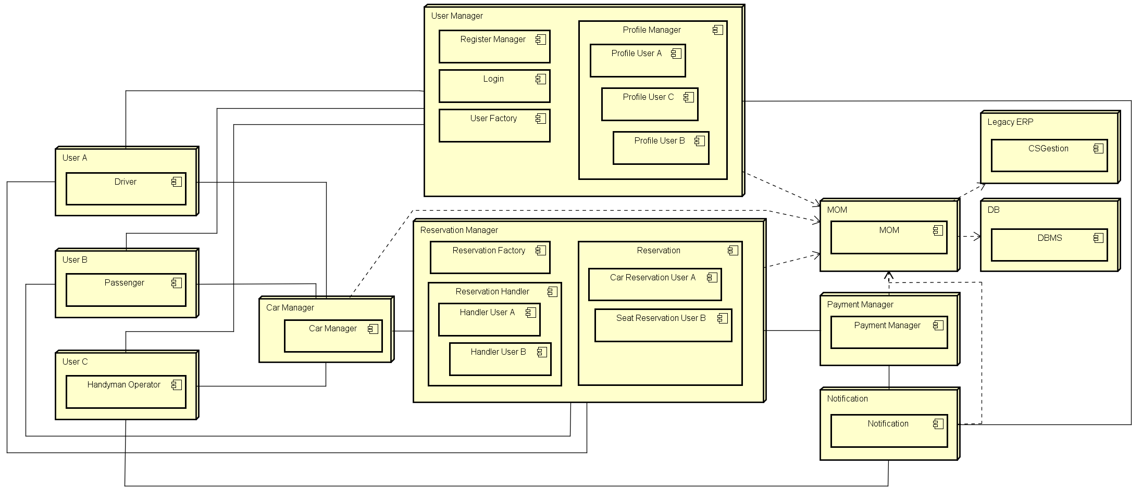
Runtime View

Slide 6
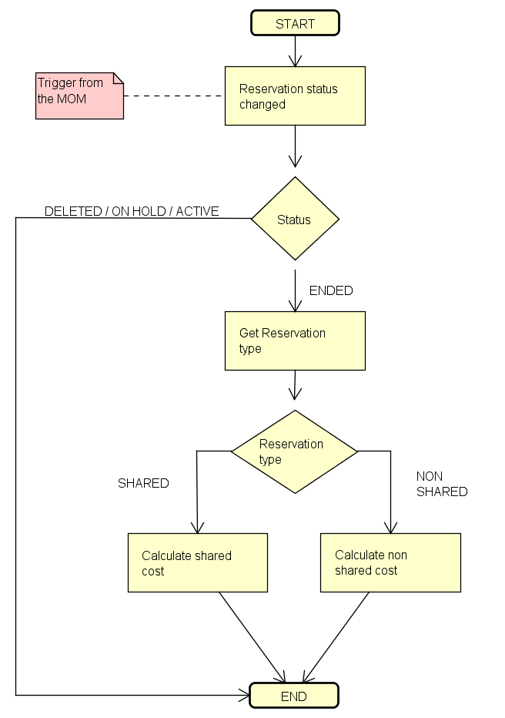
Algorithm Design - Payment

Slide 7
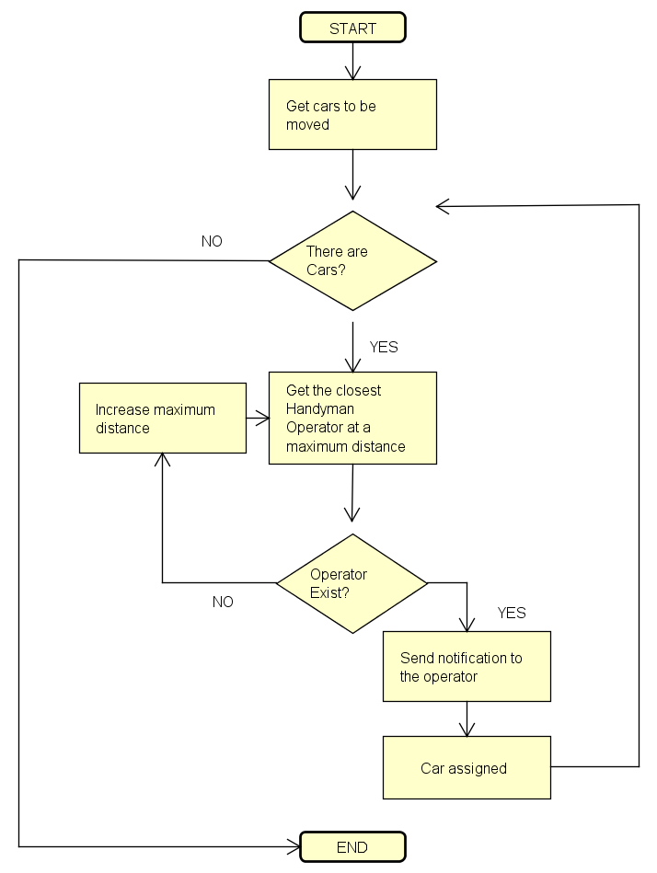
Algorithm Design - Good car distribution

Slide 8
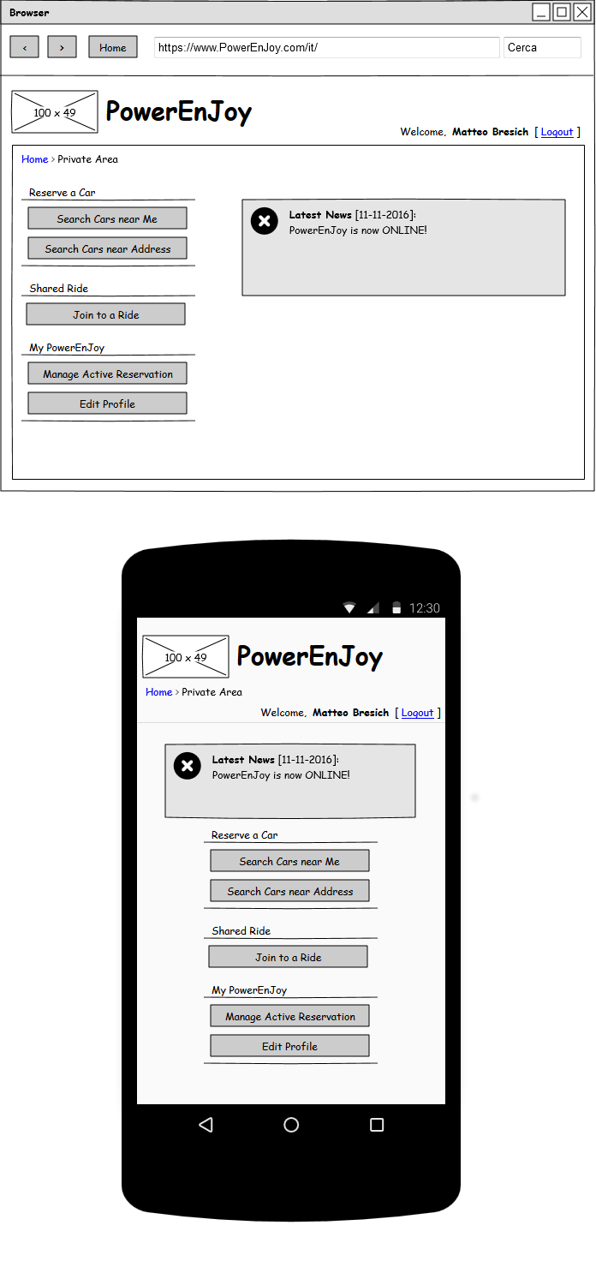
User Interface Design

