Slide 1

March 4, 2015
Project Presentation
Valerio De Maria , Matteo Daverio
Politecnico di Milano

Slide 2
Overview
Feasibility study
RASD
DD
Coding
Testing
Evaluation

Slide 3
Feasibility study
Initial problem description
Scenarios describing possible solutions
Possible alternatives

Slide 4
Requirement analysis and specification
Analyze the domain in which the application takes place
Identify requirements
Derive specifications for the software
Thinking like an user
Understanding of the properties of the domain
➔ RASD

Slide 5
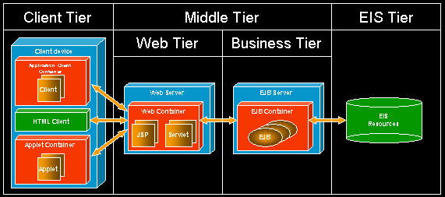
Design
We followed the usual 4 tier JEE architecture

Slide 6
Design Overview
Client Tier (Login Pages, Home Pages,…)
Web Tier (User Bean, Event Bean, Schedule Bean,…)
Business Logic Tier (User Manager, Event Manager, Notification Manager,…)
Persistence Tier (Entity Beans)

Slide 7
Subsystems
Our system can be easily divided into smaller subsystem with high cohesion:
Event Managing
User Managing
Notification Managing
Forecast Managing
The system access each other through a little number of public methods.

Slide 8
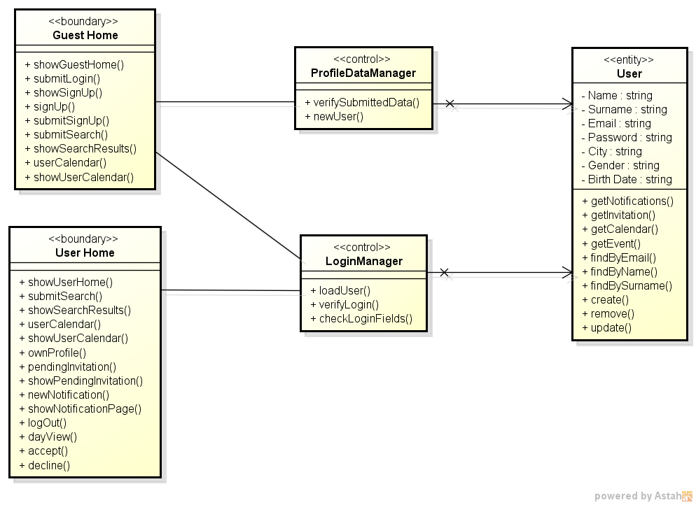
BCE
The system can be divided into 3 main areas according to the MVC pattern

Slide 9
Design Principles
Design for Re-Usability:
JSON objects download accordingly
Increase Cohesion:
Event, User and Notification method are all enclosed in single classes
Keep the level of abstraction as high as possible:
Example in code

Slide 10
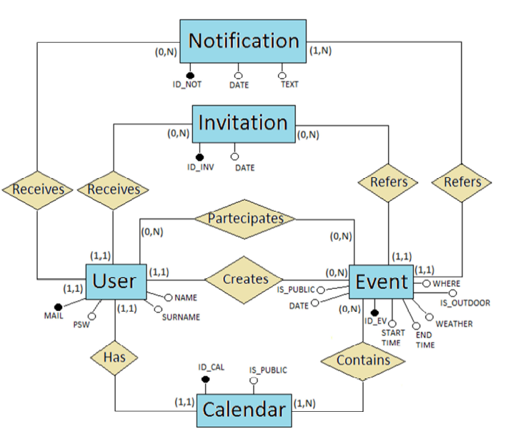
DB scheme

Slide 11
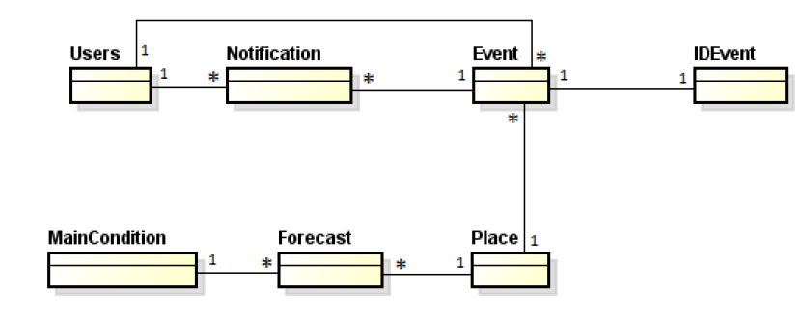

Slide 12
Coding
Implemented using Java as programming language and NetBeans as IDE
Let’s try it and see some code example

Slide 13
Testing
CODE TESTING
JUnit testing for entity classes
Mockito and Arquillan testing for the main manager (User, Event, Notification)
MANUAL TESTING
Mail format condition
Empty forms
Already existing user
Date correctness in event managing
Privacy constraint
No self-invitation

Slide 14
Overall Project Time
Rasd: 20h + 20h
DD: 20h + 20h
Development: 140h + 140h
Total time: 360h

Slide 15
Function Points
UFP = 100 FPs
LOC = AVG x UFP = 46x100 = 4600
Actual Size = 4107
Difference of about 10%

Slide 16
COCOMO II
Exponent = 1,091
Effort Multiplier = 0,655
Effort Estimation:
PM = 8,99 Person-Months

Slide 17
Acceptance
Acceptance testing of:
https://code.google.com/p/in-tempo
Comments:
Table generation strategies: “create” instead of “drop and create”
Friendship unclear

Slide 18
THANKS

