Slide 1

An experimentation with
SCHED_EXT
Linux scheduling class
Matteo Di Noia
Matricola 979620
Relatore: Enrico Bini
University of Turin
Correlatore: Michele Castrovilli
University of Turin

Slide 2
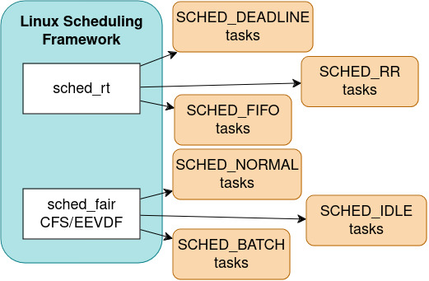
Scheduler
A scheduler is an essential kernel component of any OS which does:
Task selection: chooses the task to be run next;
Time Slice: chooses how long the next task is allowed to run;
Core selection: chooses which CPU core should be used.
In the Linux kernel, there are various scheduling classes that are on different levels of priority.

Slide 3
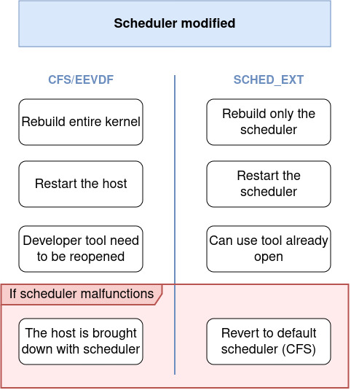
SCHED_EXT: motivations
Advantages of an external scheduler:
Rapid experimentation, avoiding the need to recompile the kernel and reboot the host;
simple API and safety features;
Bespoke (/specific) schedulers can be created;
  Meta could improve Facebook’s web service RPS (Requests Per Second) by 1.25-3% and P99 (99th percentile) latency by 3-6%.
Quick rollouts of policies (i.e. temporary fixes);
Allows moving some decisions to userspace, using maps for userspace-kernelspace communication.

Slide 4

SCHED_EXT: counterarguments
Even though using SCHED_EXT has numerous advantages, these are not enough to dispel all of the concerns.
Inhibition of contributions to the mainline scheduler;
  Creation of out-of-tree non-GPL schedulers.
Program-specific schedulers can be created and required by some programs (causing incompatibilities);
Wheter the kernel should be tainted (the kernel mark itself as such when something occurs that might be relevant later when investigating problems).

Slide 5
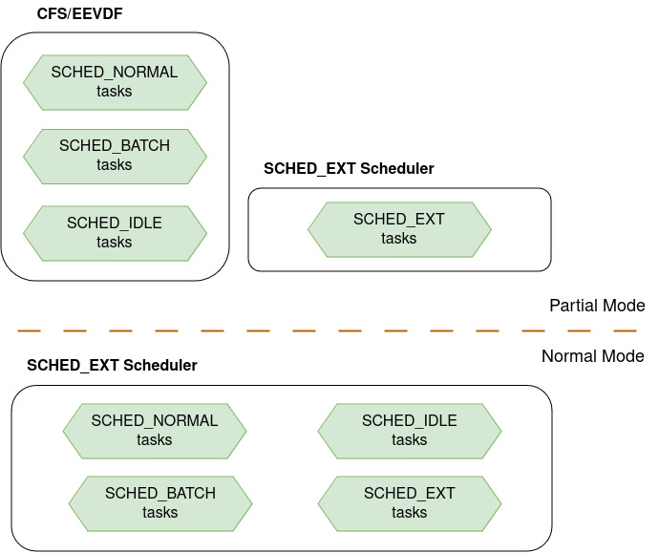
SCHED_EXT: integration in Linux
In the kernel SCHED_EXT is implemented as a new scheduling class with priority lower than SCHED_NORMAL;
SCHED_EXT has two different modes of operation:
Partial mode: tasks with SCHED_EXT priority are scheduled by the external scheduler while SCHED_NORMAL,… ones are scheduled by CFS/EEVDF;
Normal mode: in which all tasks with SCHED_NORMAL priority are set to be scheduled by the external scheduler.

Slide 6
SCHED_EXT: state of development
Linux Torvald announced:
“And using the ‘in order to accept this, some other thing has to be fixed first’ argument doesn’t really work well either […]”
“I’m also not a believer in the argument that has been used (multiple times) that the BPF scheduler would keep people from participating in scheduler development. I personally think the main thing that keeps people from participating is too high barriers to participation.”
Currently, it requires building the kernel with the proposed patch and with certain build flags.
While its upstreaming in the kernel has been discussed for a long time, they have now decided to merge it for the 6.11 kernel release, scheduled for September of this year.

Slide 7
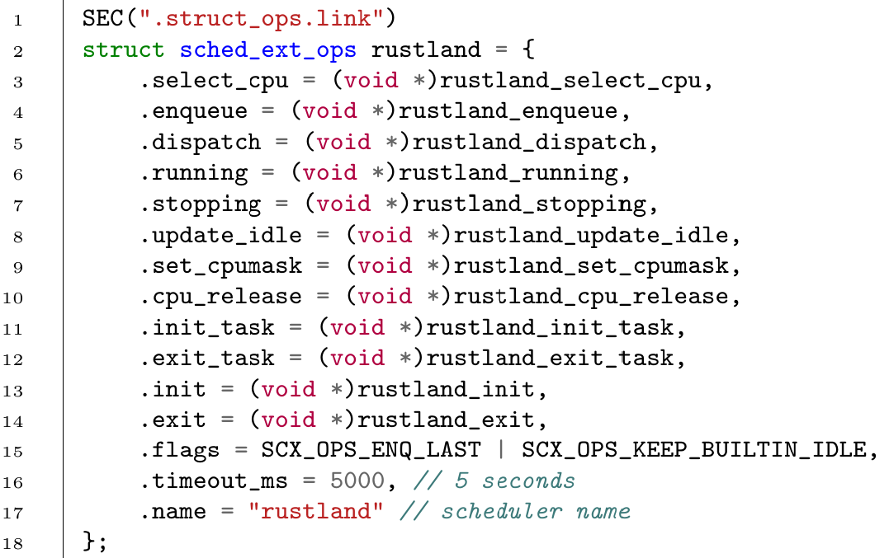
Writing custom scheduler: sched_ext_ops
The first step to writing custom schedulers is the definition of a particular struct called sched_ext_ops. This contains:
all callback implemented in the custom scheduler provided as a pointer to a function;
Flags for changing default behaviour;
Timeout: the maximum amount of time a task can wait consecutively to run before the scheduler is unloaded;
Name.
Example from Rustland scheduler

Slide 8
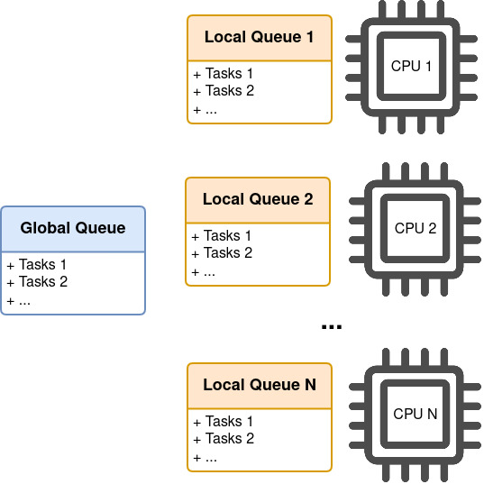
Writing custom scheduler: dispatch queue
Dispatch queues in SCHED_EXT are queues of tasks (either FIFO or priority queues). The dispatch queues are of three types:
local queue: one for each CPU, from which it executes tasks;
global queue;
any number of custom queues.
Each scheduling operation can be achieved by dispatching, moving tasks between queues.
Moving to a local queue represents running the task on that CPU.
Non-local queues can be consumed: its first task is moved to a local queue.

Slide 9
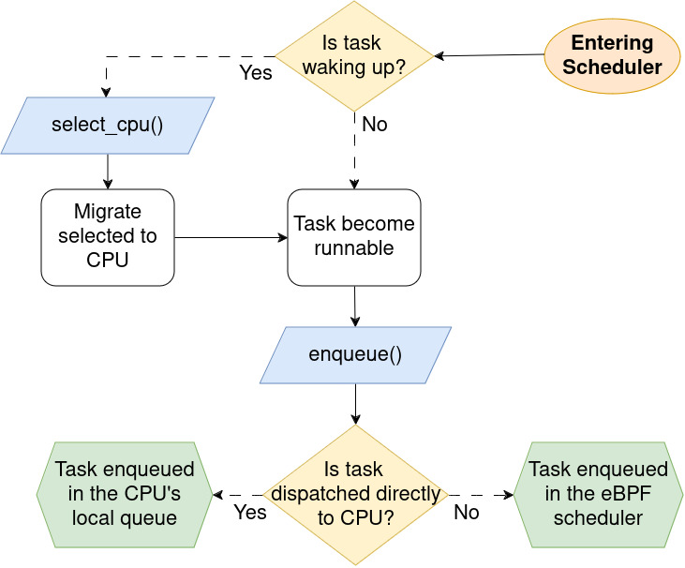
Writing custom scheduler: callbacks to implement
prep_enable(): used for initialization before enable();
enable(): enables the scheduling of new tasks;
select_cpu(): selects the CPU that will run the task, as an optimization;
enqueue(): enqueues a task into the scheduler so that it will be run.

Slide 10
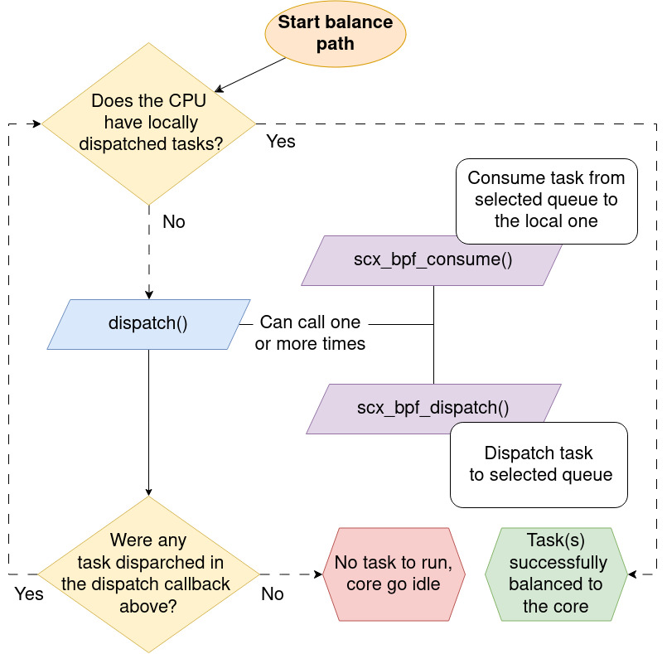
Writing custom scheduler: callbacks to implement
dispatch(): called when a CPU queue is empty to assign a new task to keep the CPU busy;
runnable(), running(), stopping(), quiescent(): notifies of the new status of a task;
update_idle(): notifies of the new state of idleness of a CPU core;
cpu_acquire(), cpu_release(): notifies of a change in core availability.

Slide 11
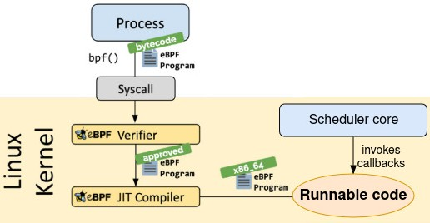
Loading a scheduler at run-time: eBPF
To load the scheduler two elements are required:
a system call to do so;
a language that supports this.
That language is eBPF, a safe JIT (Just In Time) that can be run in the kernel. Its features are:
Performance: its ISA is aligned with x86 ISA allowing JIT compilation;
Safety: eBPF code is statically analyzed before it is loaded into the kernel.

Slide 12
Conclusion
In conclusion, my research on the SCHED_EXT expanded my understanding and skills regarding scheduling mechanisms. The key insights and experiences gained are:
Kernel Scheduling Knowledge: I have gained a comprehensive understanding of Linux kernel task scheduling;
eBPF Proficiency: Developed skills in writing and deploying eBPF programs;
SCHED_EXT Experience: Hands-on experience in loading and managing external schedulers;
Scheduler Code Analysis: Analyzed internal code of standard Linux schedulers;
Real-World Applications: Recognized practical applications of dynamic scheduler loading.
This research not only has enhanced my technical expertise but it also has provided me with a further appreciation for the complexities of modern operating system schedulers and the capabilities of its maintainers.

Slide 13
Extra Slides

Slide 14
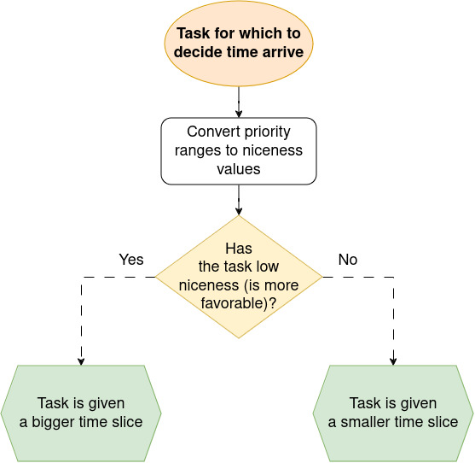
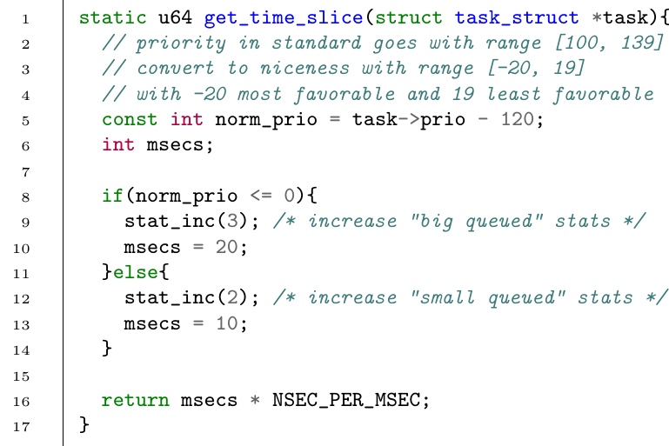
Simple scheduler example: scheduling idea

Slide 15
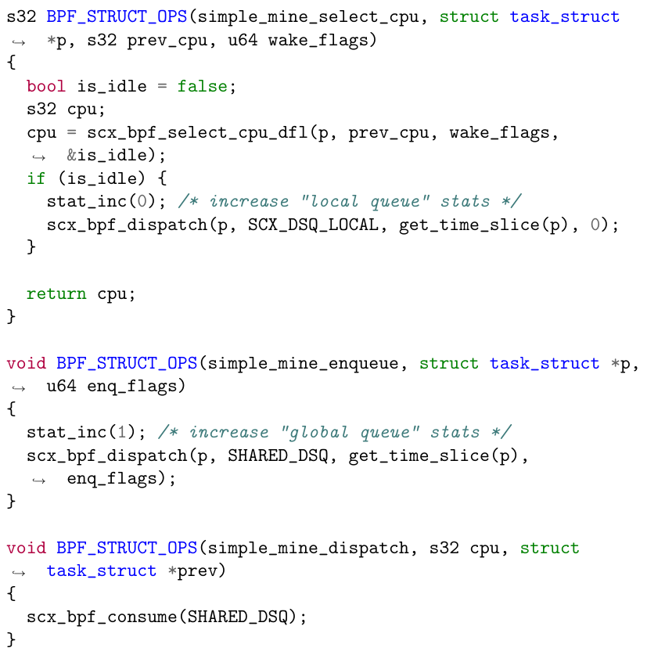
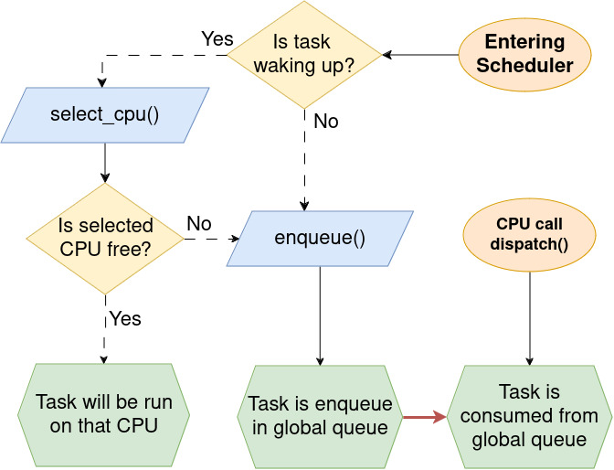
Simple scheduler example: scheduling functions

Slide 16
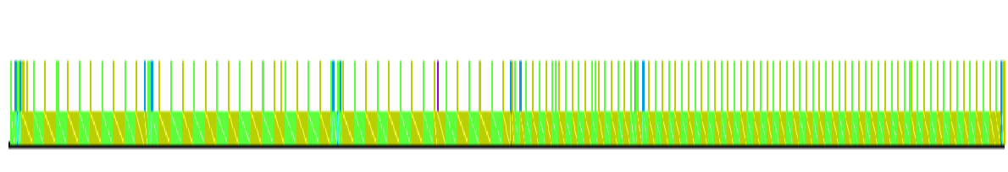
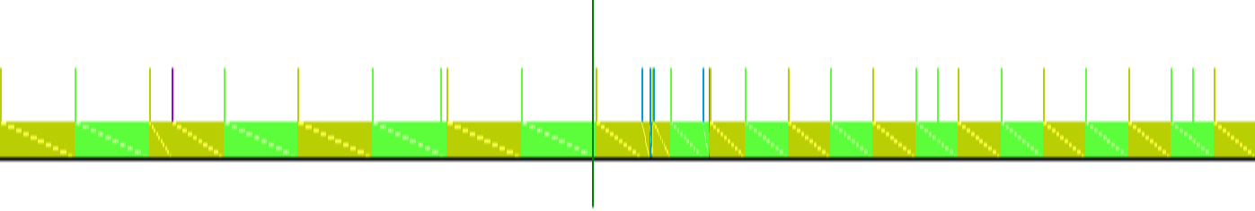
Simple scheduler example: workload and Kernelshark
Then, a workload is created that runs two processes which simply waste clock cycles on the CPU, having them share a single core (using a CPU affinity mask).
This workload also changes the priorities of the two processes during execution to demonstrate the time slice change because of the custom scheduler.
To show this change, two tools are used:
trace-cmd to get a trace of the execution of these two processes;
KernelShark to get a visual representation of the data by trace-cmd.
Graph given by KernelShark
Graph zoomed over the priority change

