Slide 1
Presence Detection with Ultra-Wide Band Radar
Tiya Jreige
Matteo Figini
Hardware Architectures for Embedded and Edge AI
2024/25
Valeria de Gennaro

Slide 2
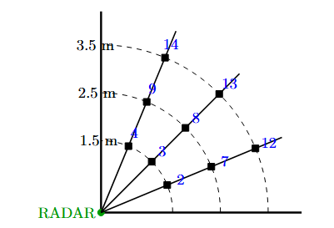
DATA COLLECTION
EXPERIMENT: Nine positions were considered from the radar location, respectively at a distance of 1.5, 2.5 and 3.5 metres, and considering angles of -22.5°, 0° and 22.5°.
RADARS USED: TrueSense SR250 and an InfineonPWMC radar.
DATA: 90 samples collected. Up to 4 people standing in a specific location for 1 minute, plus couple of samples containing one person moving around different positions every 30 seconds.

Slide 3

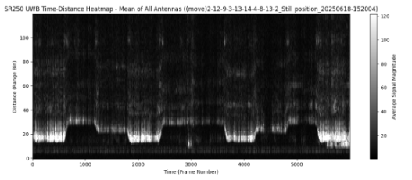
PREPROCESSING
DECLUTTERING: removes static reflections (clutter) from the environment
  -Simple Moving Average
- Exponentially-Weighted Moving Average
Notes:
Both used, first SMA on a 20 frames window, then EWMA

Slide 4

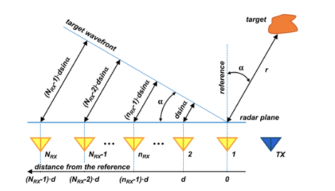
PREPROCESSING
DIGITAL BEAMFORMING: applying calculated complex weights to the individual signals
from multiple receiver antennas before summing them
Transforms the raw time-domain radar measurements into a spatial representation, making it possible to pinpoint the angular location of targets relative to the radar system.

Slide 5
PREPROCESSING
DIGITAL BEAMFORMING: for each of the radar used, different values of the following parameters are used
  NUMBER OF ANTENNAS
  DISTANCE BETWEEN RX ANTENNA ELEMENTS
  CENTER FREQUENCY OF RADAR PULSE
While the angle range [-45°,45°] remains the same due to the data collection setup

Slide 6
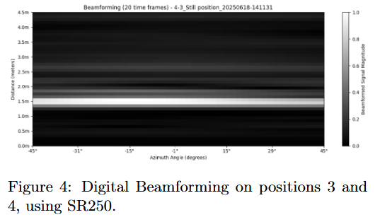
OBJECT DETECTION
IMAGE GENERATION: sliding time window approach is applied to the beamformed data. For each window the complex data within that window is aggregated.
Across timeframes, coherent averaging is performed: summing complex values before taking the absolute magnitude

Slide 7
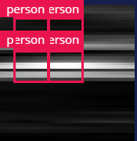
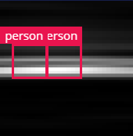
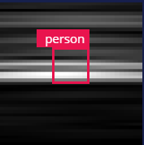
OBJECT DETECTION
BOUNDING BOX LABELING: a GROUND TRUTH TABLE is used to create a .json file of the lables
coordinates for each image.
Notes:
Real values from the data collection setup are used to determinate the position labeling, another approach was trying to have the label where we have the brightest point in the image but the images sucks so it does not work well

Slide 8
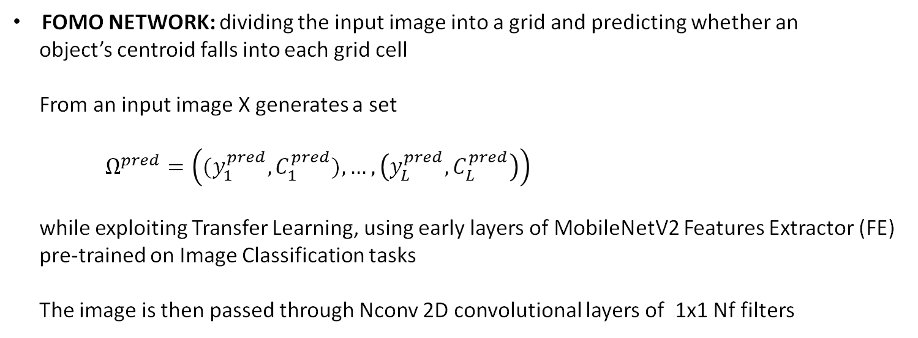
OBJECT DETECTION
FOMO NETWORK: dividing the input image into a grid and predicting whether an
object’s centroid falls into each grid cell
From an input image X generates a set
$Ω^{pred}=\left({(y}_{1}^{pred},C_{1}^{pred}),…,\left(y_{L}^{pred},C_{L}^{pred}\right)\right)$
while exploiting Transfer Learning, using early layers of MobileNetV2 Features Extractor (FE)
pre-trained on Image Classification tasks
The image is then passed through Nconv 2D convolutional layers of 1x1 Nf filters
Notes:
The use

Slide 9
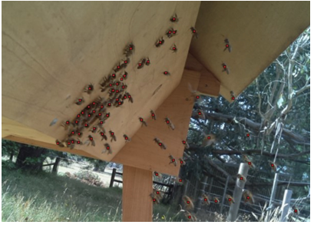
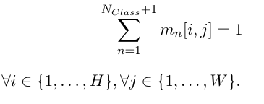
OBJECT DETECTION
With Nclass+1 detected objects plus background, the final 2D convolutional layer produces NClass+ 1 per-region probability maps of size (H,W)
The cells with a probability higher than a confidence threshold are the areas in which belonging to the nth class can be found

Slide 10
OBJECT DETECTION
WHY FOMO?
  The MobileNetV2 Features Extractor (FE) extract diffused lower-resolution image of the input, preserving its locality
  Lightweight deep learning object detection
  Well suited for embedded and real-time object detection applications
Notes:
The main disadvantage of object detectors is that they are computationally very expensive and require a huge amount of annotated train ing data. FOMO is good fro constrained devices, good advances of TinyML that can execute object detection in these devices.

Slide 11
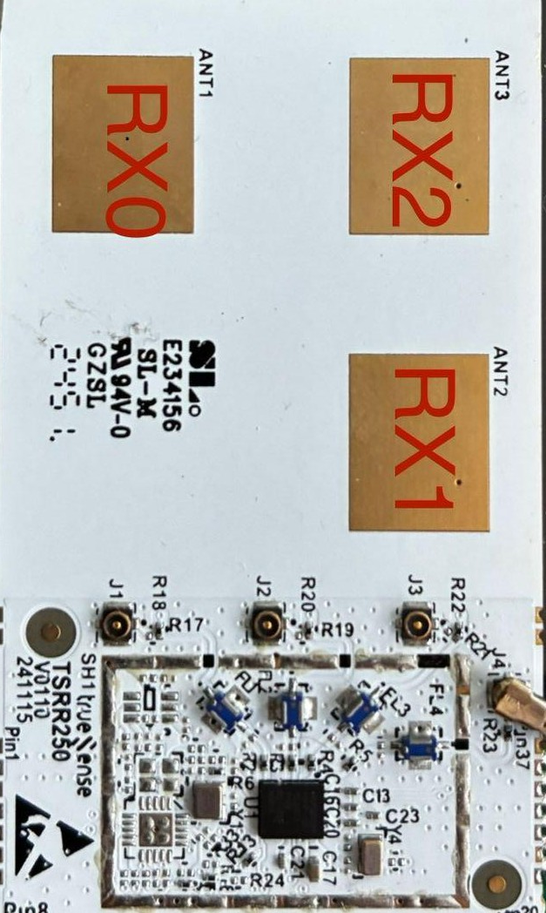
TrueSense SR250 Radar
Operational Characteristics:
1 transmitter antenna
3 receiving antennas
  For azimuth angle computation: RX0 and RX2
Beamforming parameters:
  Distance between RX antenna elements (d): 1.75 cm
  Center frequency of the radar pulse (f): 7.98 GHz

Slide 12
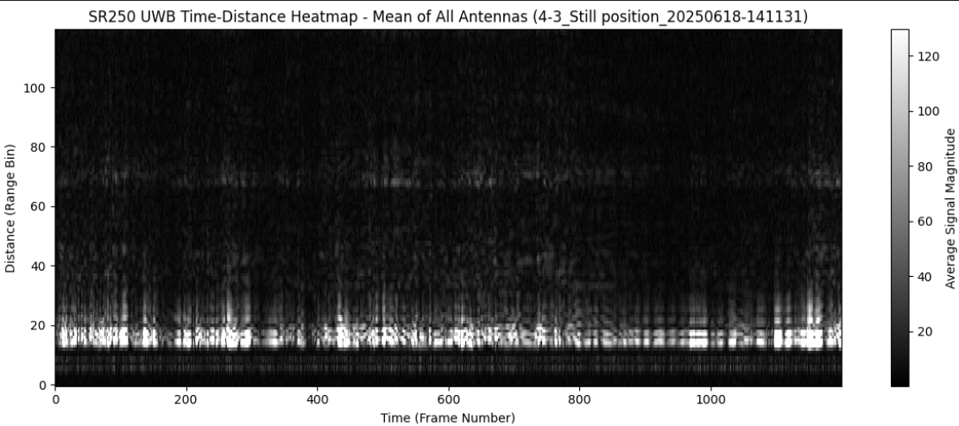
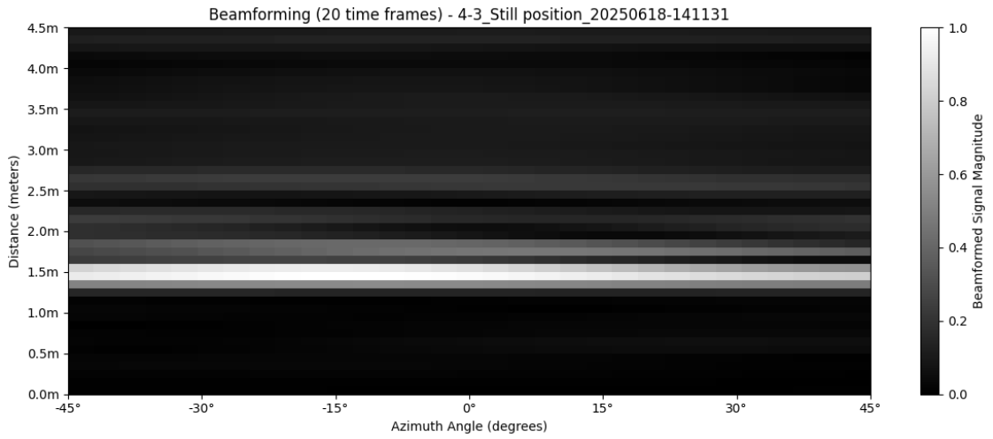
TrueSense SR250 Radar
Beamforming pipeline:
For each sample, load data from RX0 and RX2
Apply SMA, then EWMA decluttering
Compute beamforming weights in the [-45°, +45°] range
Perform azimuth (horizontal angle) beamforming:
  In SR250, the two antennas are slightly mismatched in the range bins
  For RX0: range bins [0:45]
  For RX2: range bins [2:47]
  Conversion factor: 10 range bins ≈ 1 m
Normalization in [0, 1] range

Slide 13
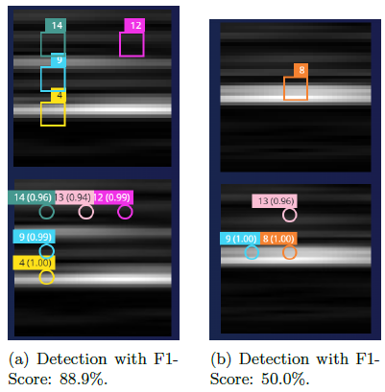
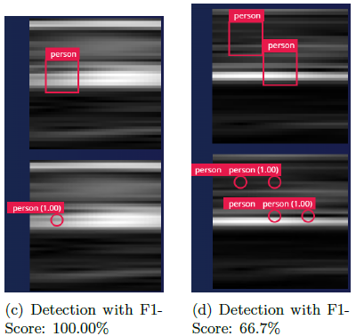
TrueSense SR250 Radar

Slide 14
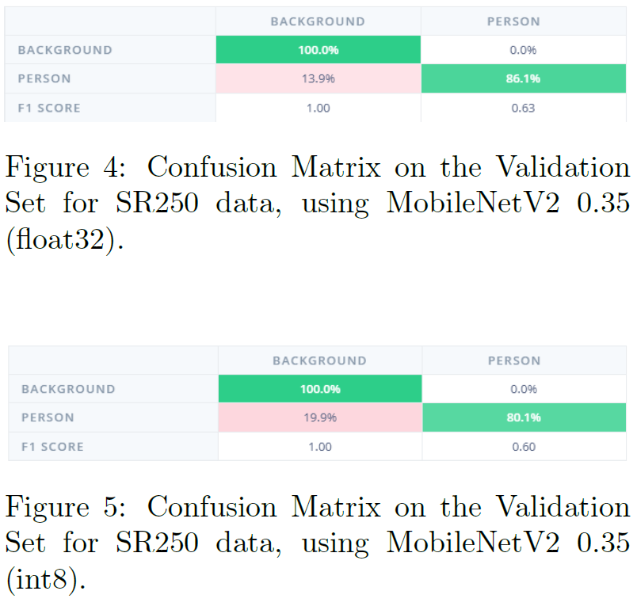
TrueSense SR250 Radar
Object Detection experiments:
Window size: 40 time frames
Step size: 20 time frames
Number of images in the dataset: 5790
Size of each image: 155×154
Training/test split: 80% / 20%
Training/validation split: 85% / 15%
Considering one single class instead of 9 classes leads to higher precision and recall

Slide 15
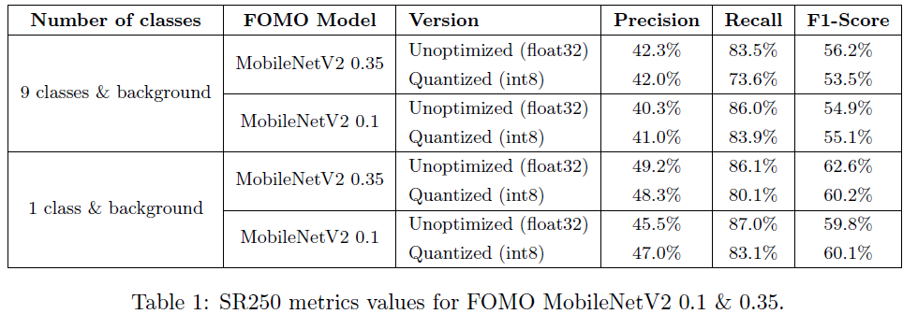
TrueSense SR250 Radar

Slide 16
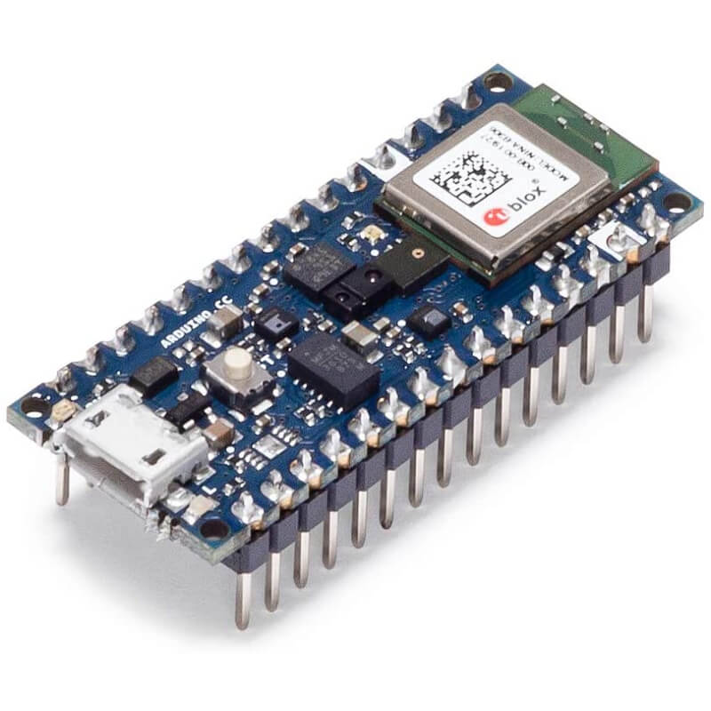
TrueSense SR250 Radar
Quantized FOMO requirements:
FOMO MobileNetV2 0.35:
  EON Compiler: Latency: 811 ms / RAM: 239.4 KB / Flash: 70.7 KB
  TensorFlow Lite: Latency: 811 ms / RAM: 283.1 KB / Flash: 110.3 KB
FOMO MobileNetV2 0.1:
  EON Compiler: Latency: 751 ms / RAM: 235.5 KB / Flash: 58.4 KB
  TensorFlow Lite: Latency: 751 ms / RAM: 280.7 KB / Flash: 94.3 KB

Slide 17
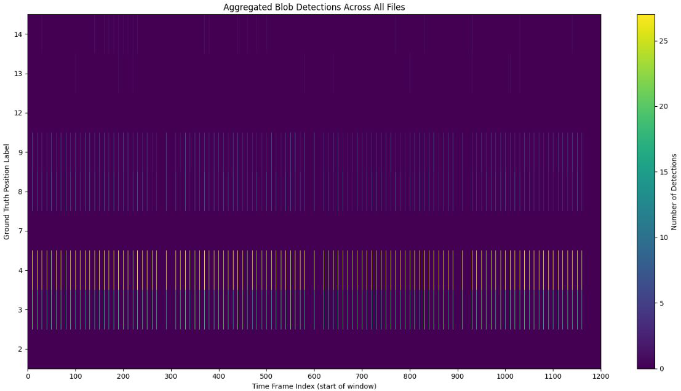
TrueSense SR250 Radar
Discussion of Results:
No substantial differences between EWMA and SMA in the object detection results
Sometimes, blobs are not clearly distinguishable
  Possible physical limitations?
  Further/better preprocessing required?
Issues when detecting a person beyond another one
  Expected brighter spots are barely visible in the beamforming plot, for furthest targets in the scene

Slide 18
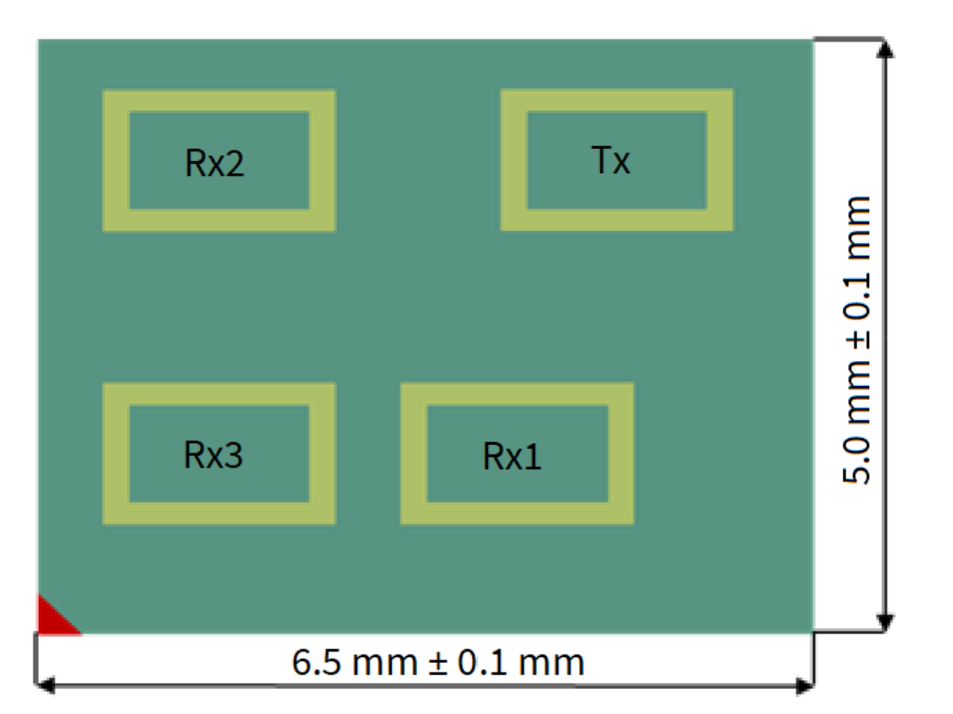
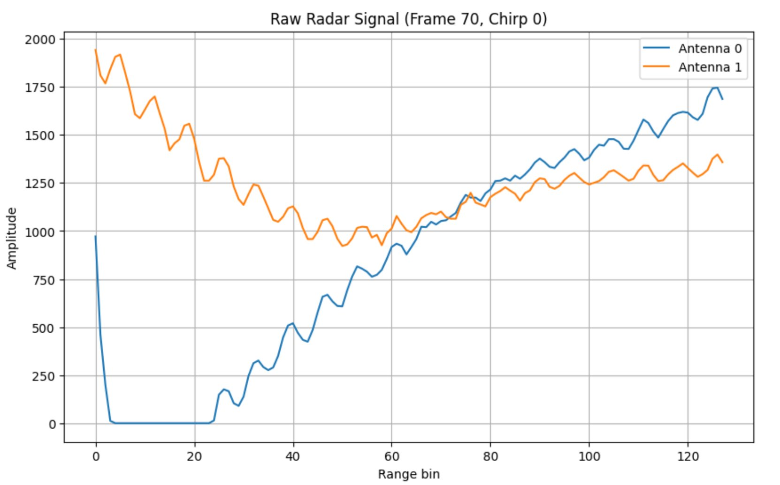
Infineon Radar
This is the raw signal that we need to process

Slide 19
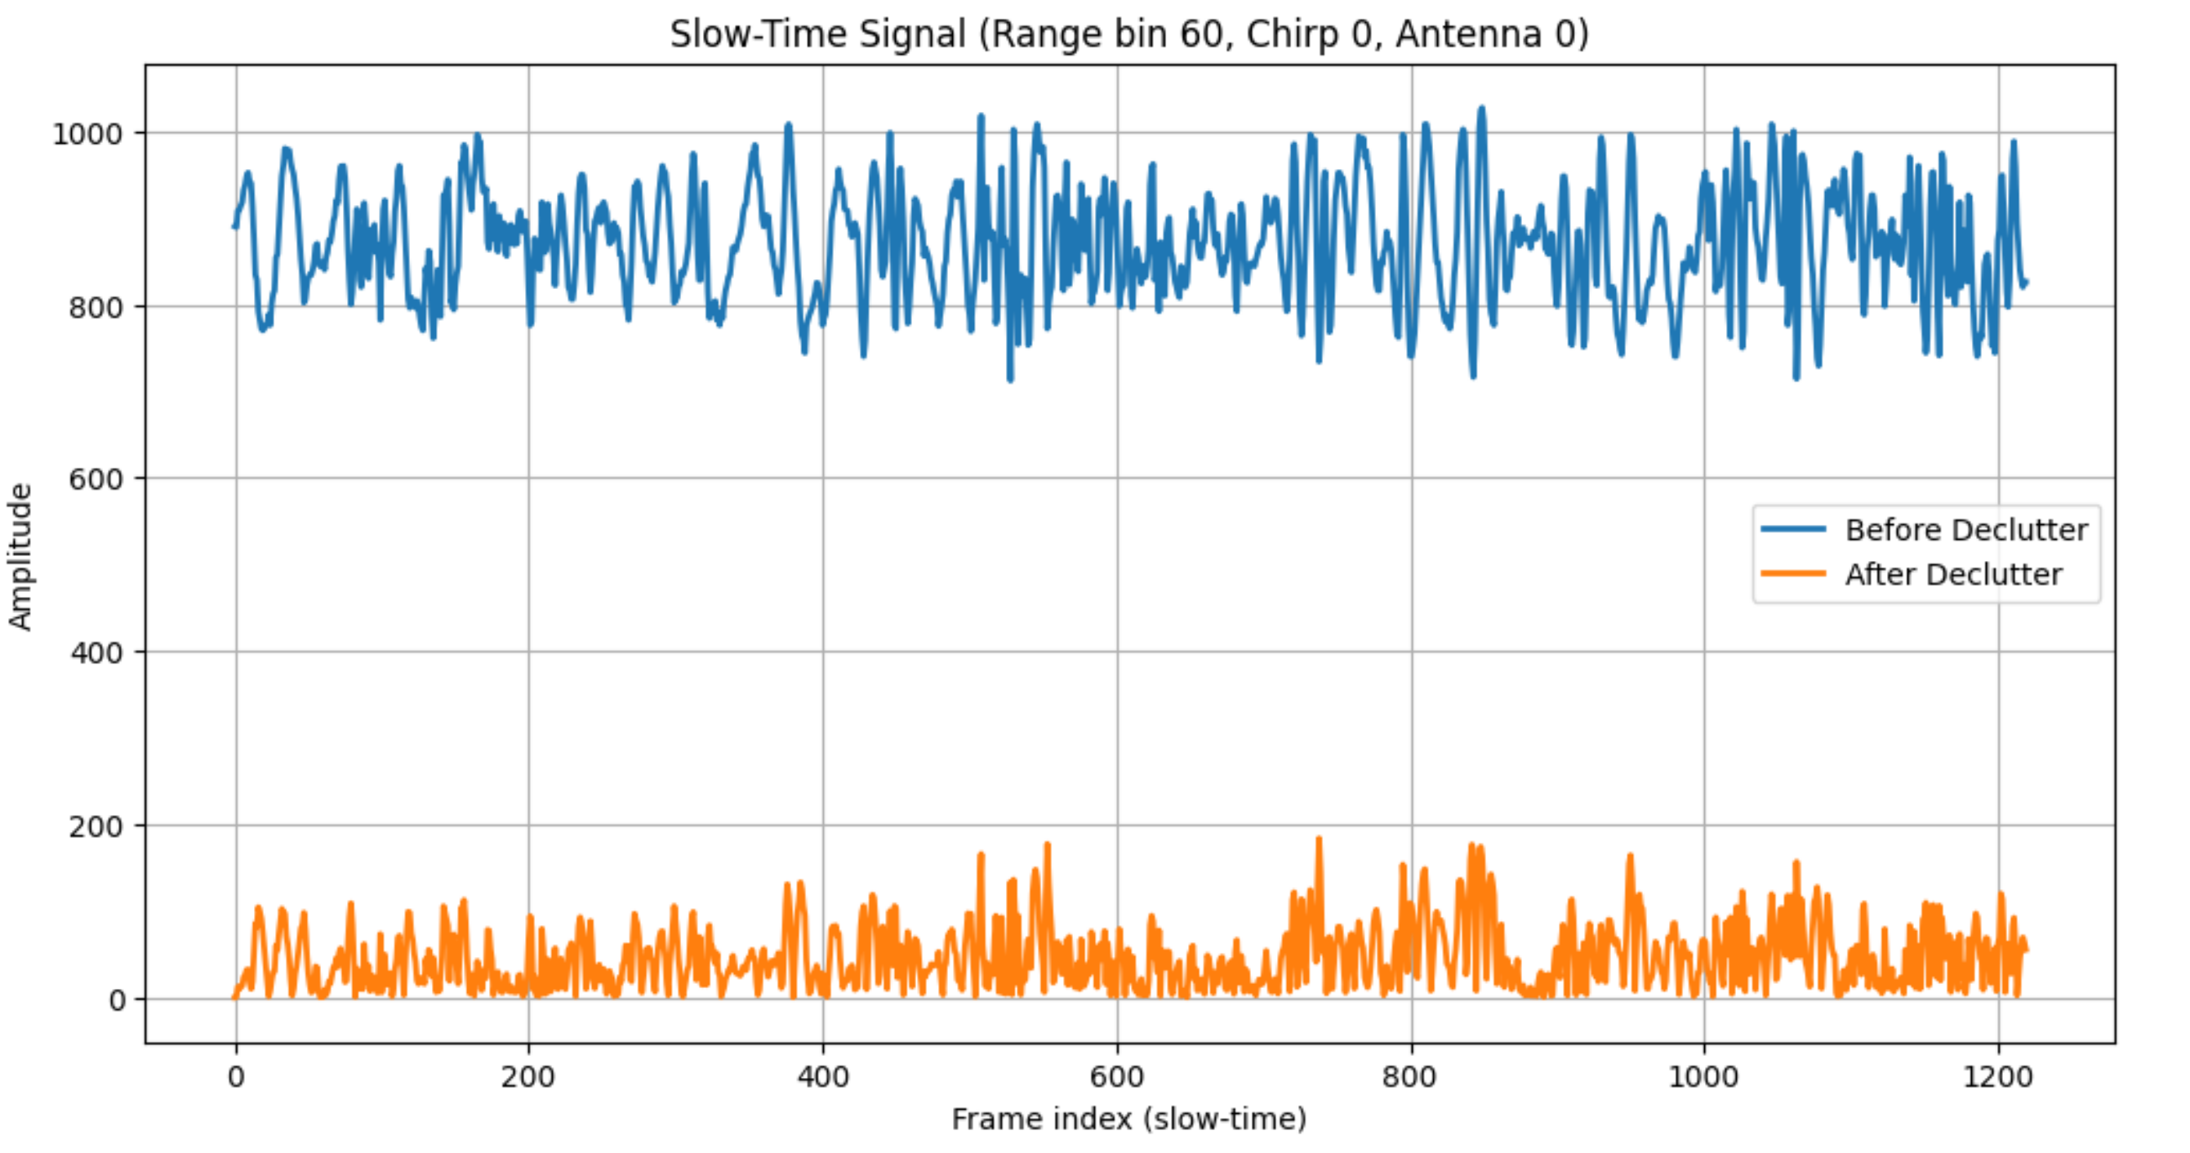
Infineon Radar Processing Pipeline
Decluttering
Background subtraction across frames (static clutter)
Notes:
Moving-average over slow-time (frames) to remove static clutter.
Each frame is corrected by subtracting the mean of previous frames.
Suppresses reflections from stationary objects, highlighting moving targets.

Slide 20
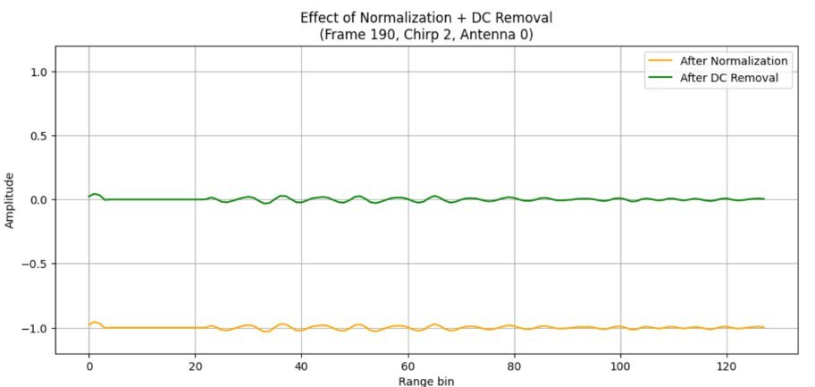
Infineon Radar Processing Pipeline
2. Normalization
3. DC Removal
Bias correction inside each frame (per chirp/antenna)

Slide 21
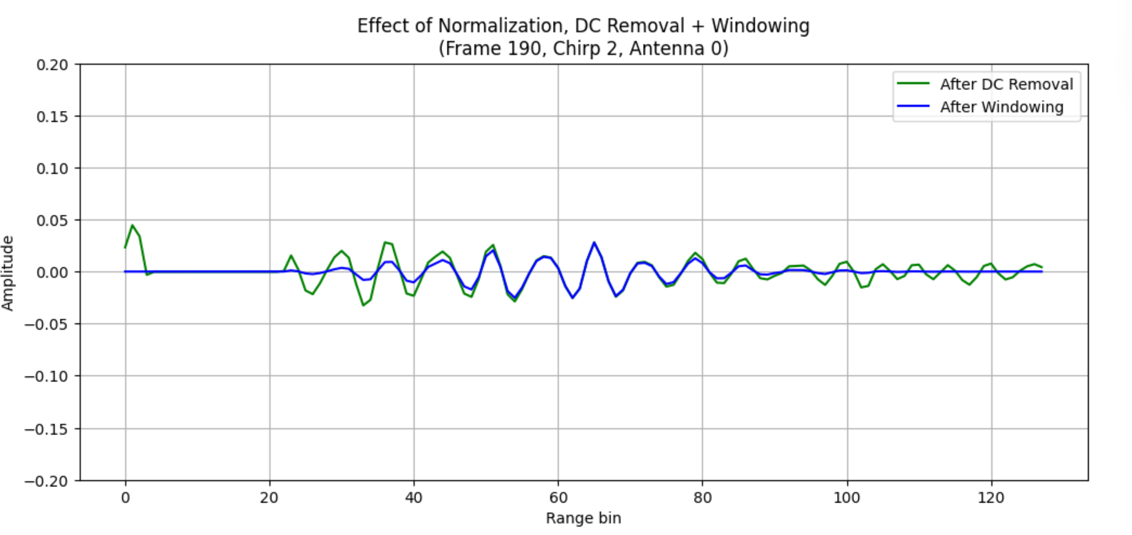
Infineon Radar Processing Pipeline
4. Windowing

Slide 22
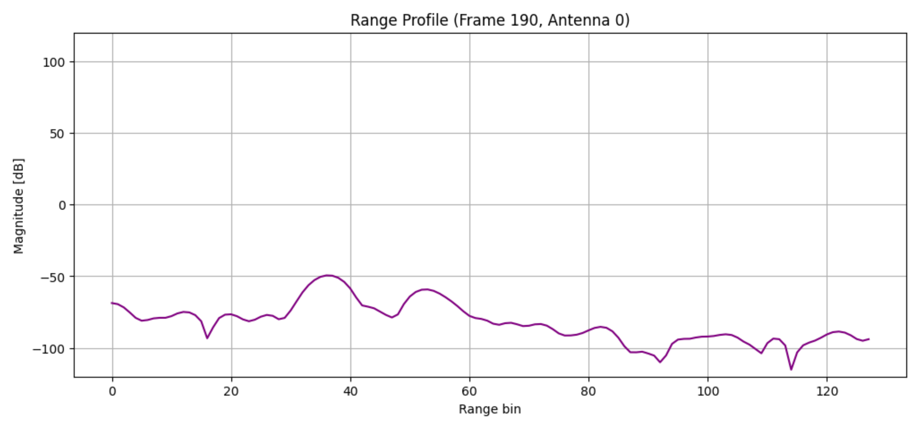
Infineon Radar Processing Pipeline
5. Zero-Padding
6. Range FFT
7. Chirp Averaging

Slide 23
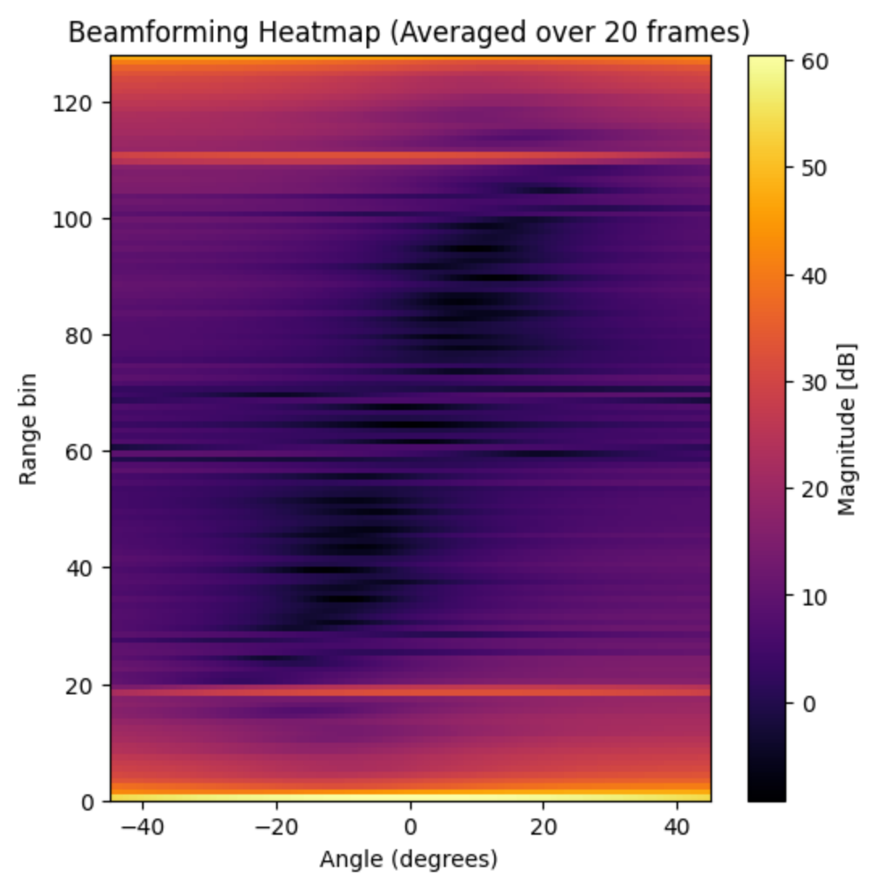
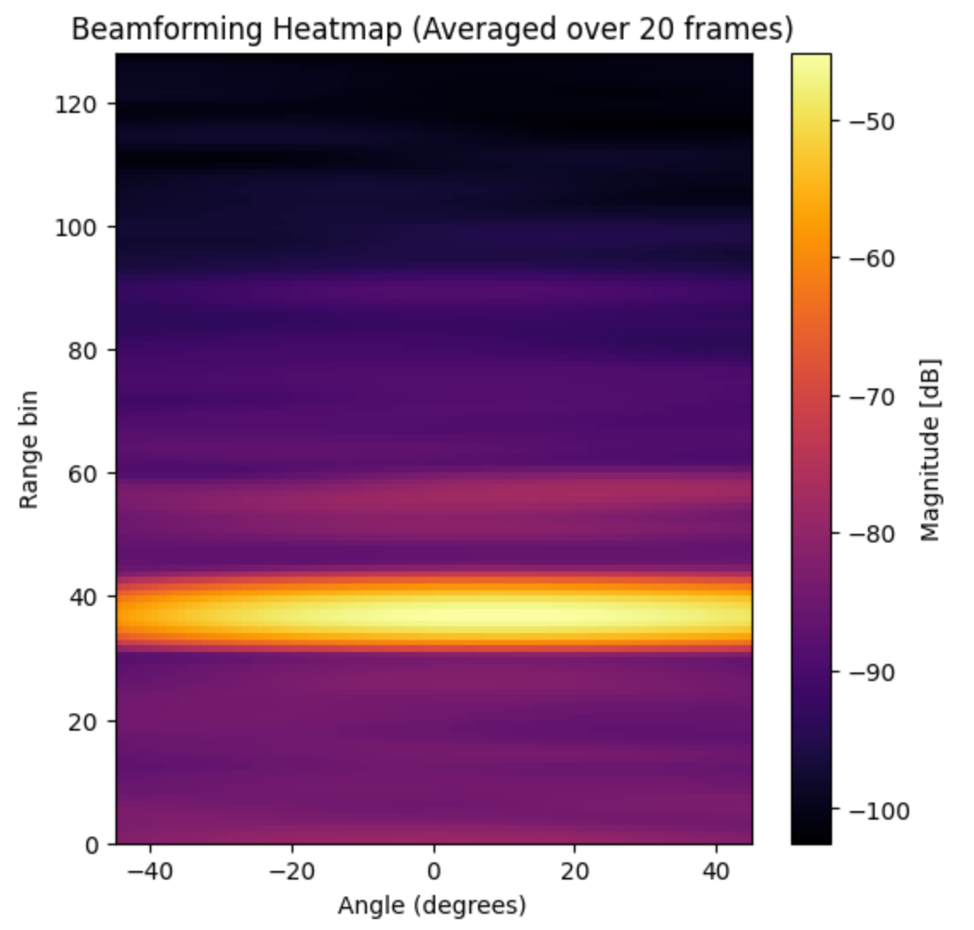
Beamforming

Slide 24
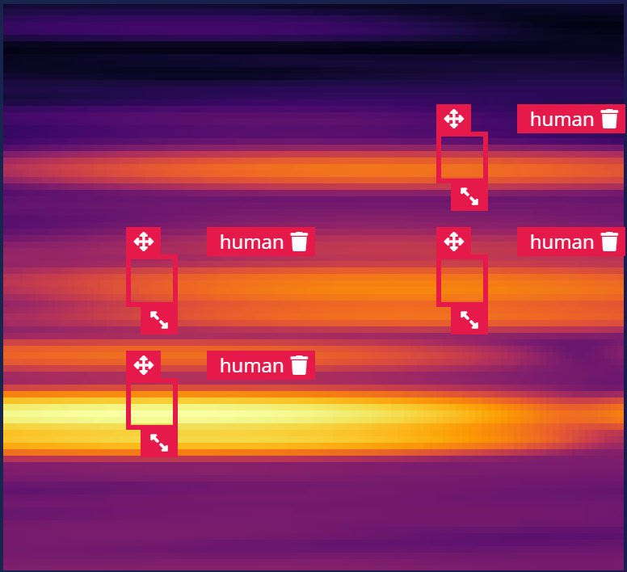
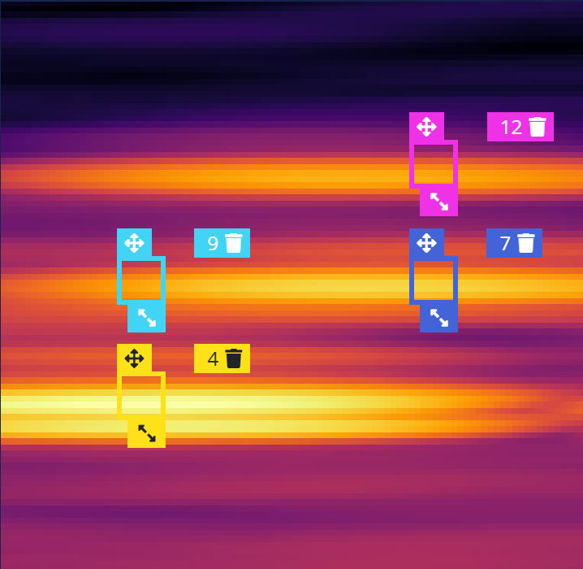
Input Dataset Creation

Slide 25
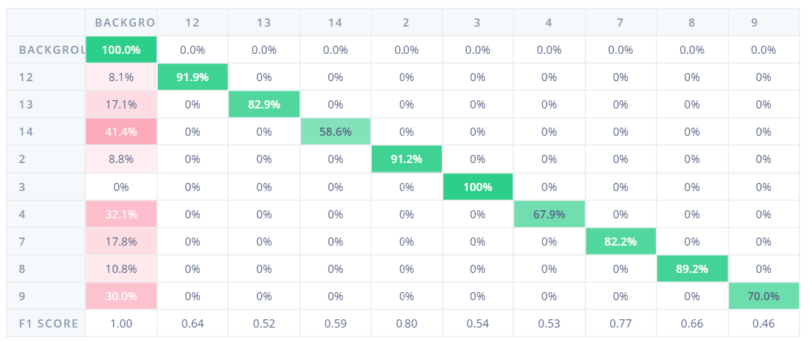
Training With 9 Labels
Precision | Recall | F1 Score
48% | 82% | 61%

Slide 26
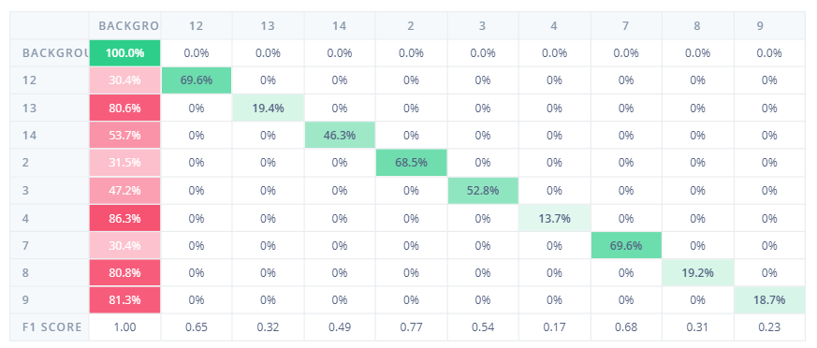
Training With 9 Labels
Precision | Recall | F1 Score
57% | 42% | 48%

Slide 27
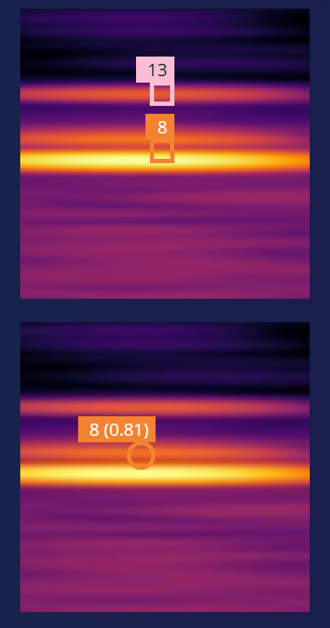
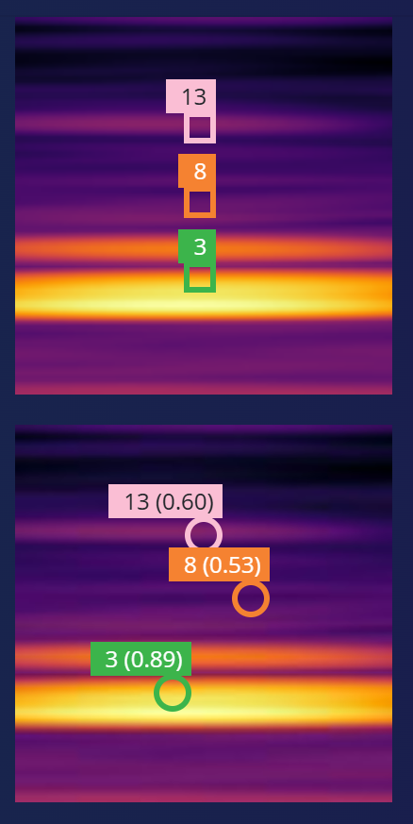
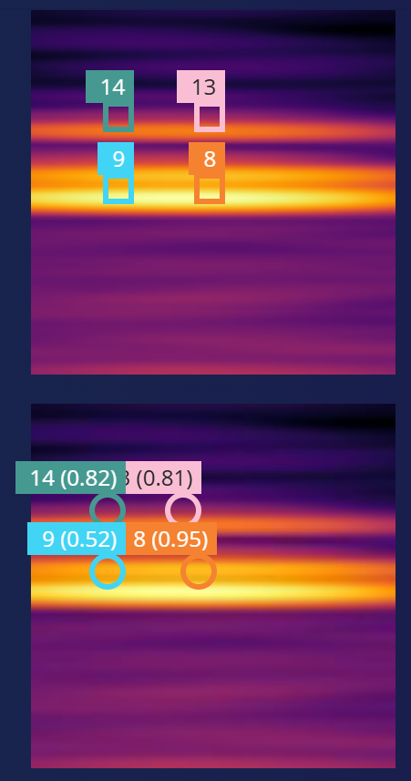
Results
Ground Truth
Prediction

Slide 28
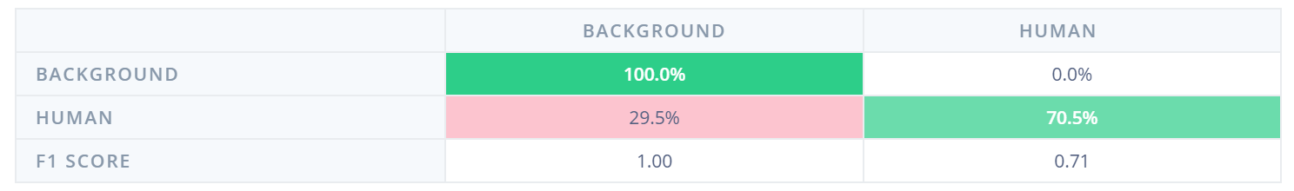
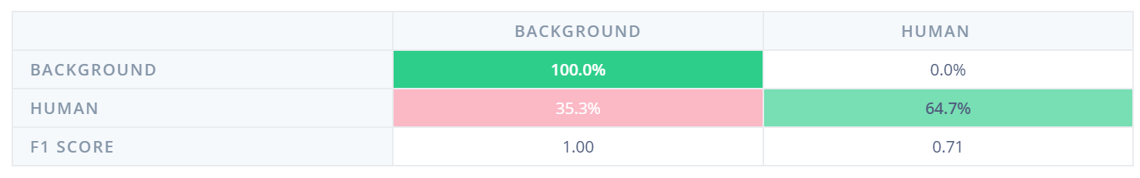
Training With One Label
Result of training 96 × 96 RGB images with MobileNetV2 0.1
Precision | Recall | F1 Score
71% | 70% | 71%
Result of training 64 × 64 RGB images with MobileNetV2 0.1
Precision | Recall | F1 Score
79% | 64% | 71%

Slide 29
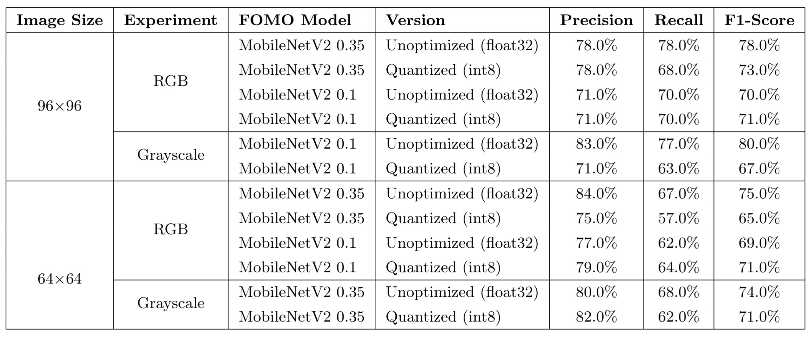
Comparison of Results

Slide 30
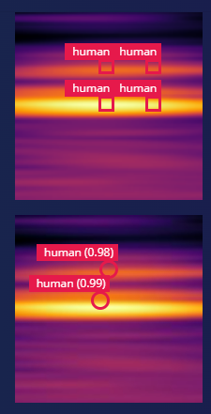
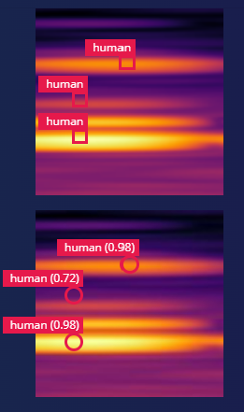
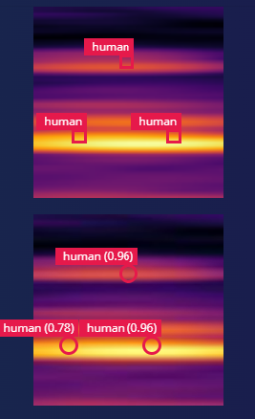
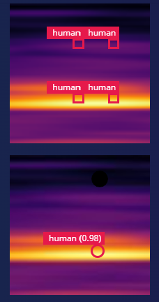
Results
Ground Truth
Prediction
96 × 96 image
64 × 64 image

Slide 31
Deployment Requirements
 | MobileNetV2 (0.35) | MobileNetV2 (0.1)
Grayscale | 64×64 → Latency: 359 ms | RAM: 117.9 KB | Flash: 70.8 KB | 96×96 → Latency: 740 ms | RAM: 235.5 KB | Flash: 58.5 KB
RGB | 64×64 → Latency: 367 ms | RAM: 118.0 KB | Flash: 71.0 KB | 64×64 → Latency: 344 ms | RAM: 114.1 KB | Flash: 58.6 KB
 | 96×96 → Latency: 786 ms | RAM: 239.5 KB | Flash: 71.0 KB

Slide 32
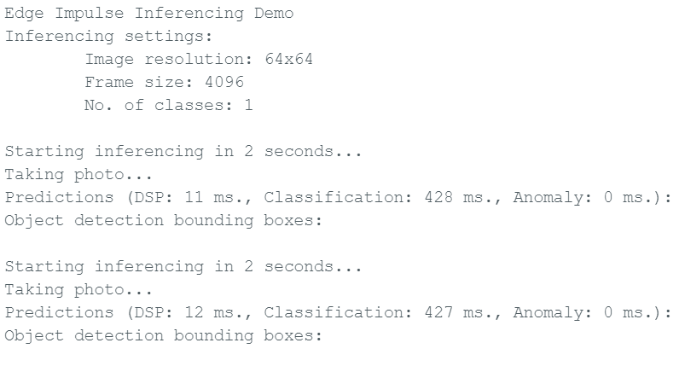
Deployment Results

Slide 33
C0NCLUSIONS
THANK YOU!

