Slide 1
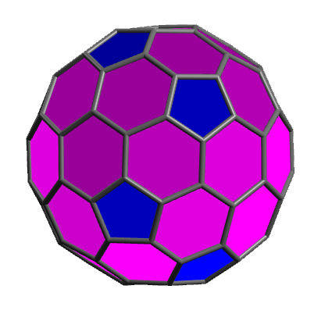
polar
a code for computing molecular polarizabilities in electronic and vibrational spectroscopy
simulated electronic circular dichroism spectrum of the chiral fullerene C84
wavelength (nm)

