Slide 1

Smart Digital Twins for Industry 4.0
Matteo Martinelli, Ph.D. candidate at Industrial Innovation Engineering
DIPI – Distributed and Pervasive Intelligence group at DISMI
Tutor: Prof: Lippi M., Picone M.

Slide 2
Dissertation context
Context: Industrial digitalization.
Industrial expectations [1, 16]:
Horizontal and Vertical integration of industrial systems and sub-systems;
Flexibility, Real-time data analysis, Strategic and operational decision-making, augmented automation.
End-to-end engineering, full integration of PLM
Operations improving, lower down-times and higher productivity
Supply Chain integration
Enabled tools for sustainability
Expectations are considered reachable with the transposition of the industry in the digital domain, to manage its embedded complexity:
Project target: simplify introduction of AI into the industrial system;
Limitations: industrial complexity.
Artificial Intelligence
Big Data
I 4.0
Internet of Things
[1] Ghobakhloo M., Industry 4.0, digitization, and opportunities for sustainability (2020), [16] Tao F. et al., Digital twin-driven product design, manufacturing and service with big data (2018)
Notes:
(1 min)
But … Why I4.0?
Horizontal and Vertical manufacturing process integration for higher industrial performance thanks to IoT and new IT technologies (cite)
Flexibility
Real-time data-analysis
Strategic and operational decision-making
End-to-end engineering (cite)
Integration of engineering in the whole value chain of a product, from development to after-sales;
Full integration of PLM (cite)
Operations:
Enhanced reconfiguration of workplaces due to communication between machines and products;
Decision making support for several events, as breakdowns;
Higher productivity because of efficiency and near-to-optimal resource utilization
Supply Chain integration
Collaborative networks of enterprises
Producers closer to customers
Co-design with customers
New business-models
Sustainability
Data collection, analysis, optimization
Synchronization between the physical and the digital domain, to bring intelligence in the system without dealing with the associated complexity.

Slide 3
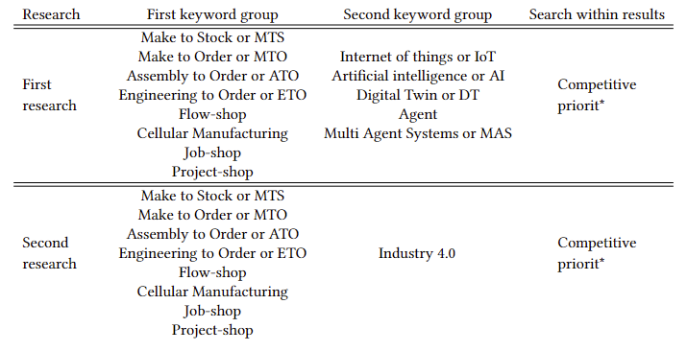
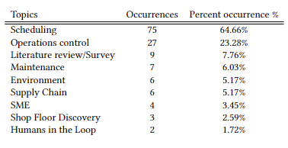
Industrial Technologies State of the Art
Additional filters:
From 2015 to 2022
Results:
989 articles collected
Keyword groups:
Group 1: industrial physical architectures components
Layout
OPP - Order Penetration Point or CODP - Customer Order Decoupling Point
Group 2: technologies for industrial digitalization
Takeaways:
Two most researched topics are scheduling, and operations control supported by technologies involved, i.e., AI and Agents;
Interest around IoT and DTs is growing;
Most of the scientific studies on intelligent applications are scenario-specific.
Notes:
(1 min, 35s)
9 topics identified;
Most researched topic: scheduling
Second most researched topic: operations control
Most used technologies:
Agent systems, present for many years
AI, which attracted a great interest in the last years
Scheduling:
Because of its intrinsic complexity
Because of the variety of scenarios where it can be applied
Operations control
Because of its natural conjunction with IT tools.
IoT and DTs candidate technologies for industrial digitization.
Most of the studies are scenario specific, without a real abstraction and neglecting industrial architectures, its foundational elements or its physical domain
---
Subject areas: Engineering, Decision Sciences, Computer Sciences, Business, Management and Accounting.
989 articles collected
Job-shop: 420 articles
MTS: 237 articles
Flow-shop: 121 articles
Manually filtered
In the first research, the most considered CODP in I4.0 is MTS; least considered is ATO
In the first research, the most considered shop floor layouts I4.0 is Job-shop; least considered is Project-shop
Most considered technologies are agent systems, present for many years, and AI, which attracted a great interest in the last years.
IoT and DT, have similar results
Finally, 116 articles selected.

Slide 4
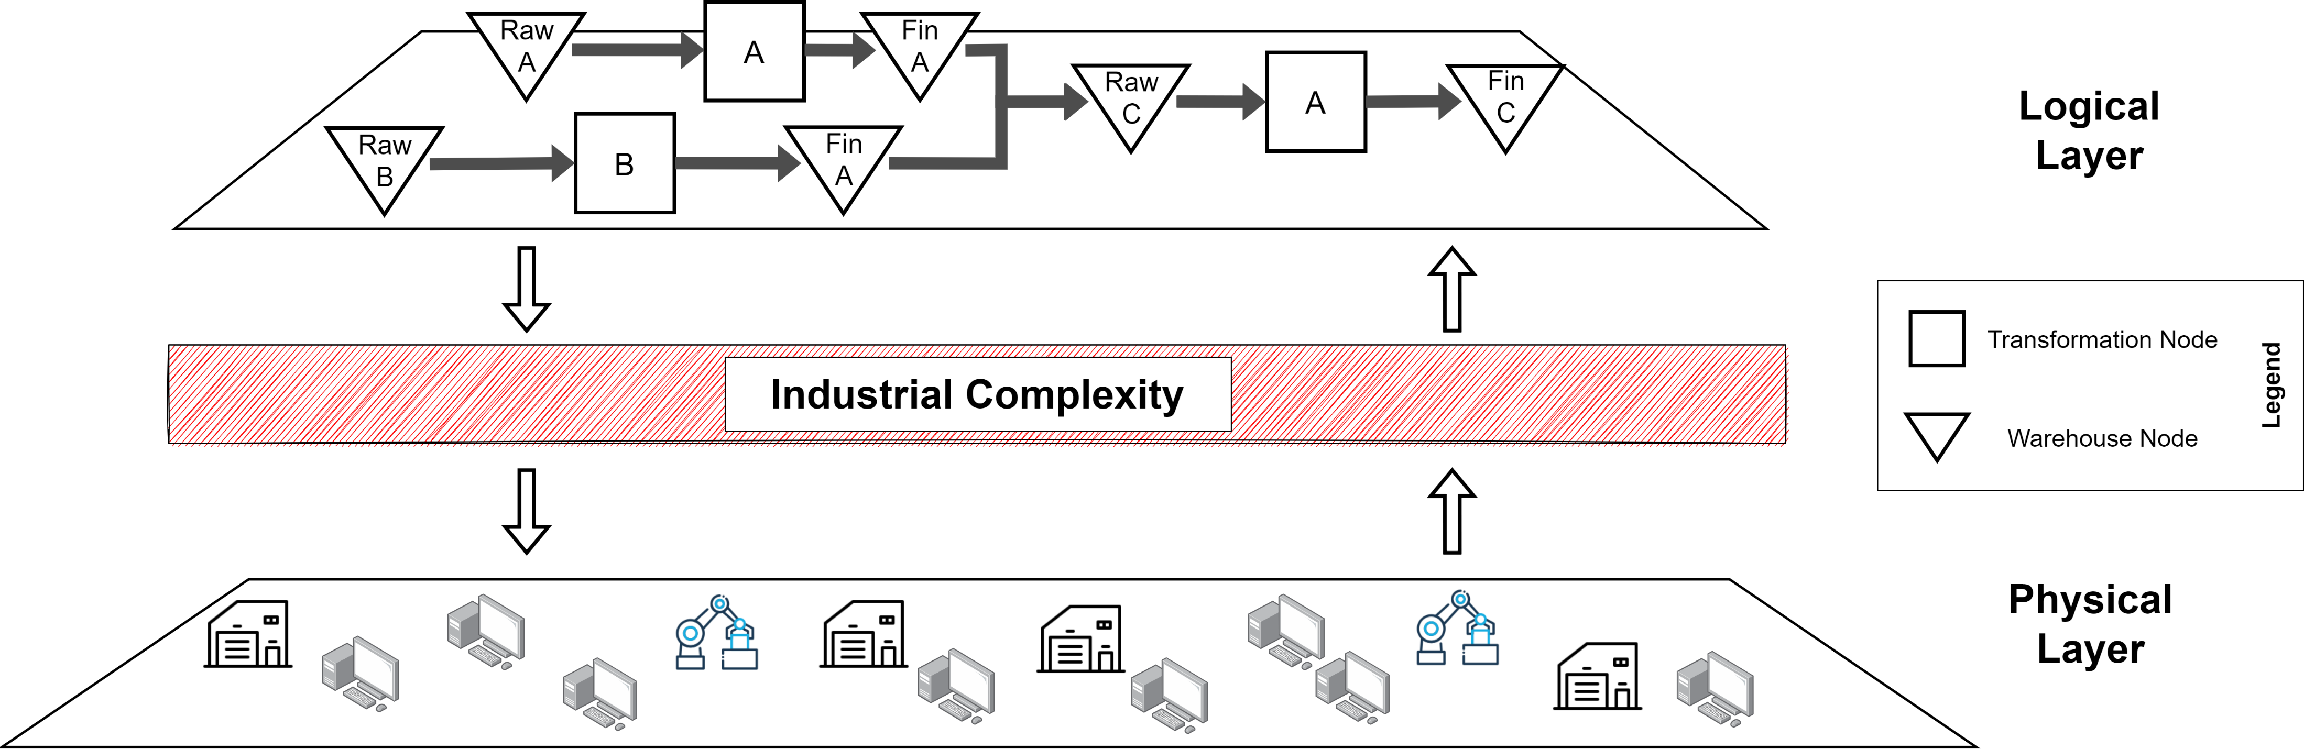
Industrial Complexity Issues
Industry 4.0 technologies are expected to simplify shop-floor management and mitigate the overall industrial complexity [1].
Growing demand for mass customization pushes for more intricate industrial systems.
Mass customization is a paradox for contemporary companies [2], which need new strategies for the next evolutive step.
The complexity level of a production system increases the effort to respond to customers’ requests.
Modelling industrial complexity is strategic to clarify the challenges of future industrial systems and correctly address them.
[1] Ghobakhloo M., Industry 4.0, digitization, and opportunities for sustainability (2020), [2] Rebecca Duray, Mass customization origins: Mass or custom manufacturing? (2002).
Notes:
(1 min)
Indeed, industrial systems are naturally very complex.
Mass customization is not the only complexity source.
Since I4.0 expects to simplify the industrial management from its physical components, modelling and considering industrial complexity is strategic …
Contesto
IIoT hanno abilitato la connessione del mondo fisico consentendoci di Vedere/azionare gli oggetti
Parallelamente tecniche di IA per parlare col mondo fisico per capirlo, ottimizzarlo, controllarlo

Slide 5
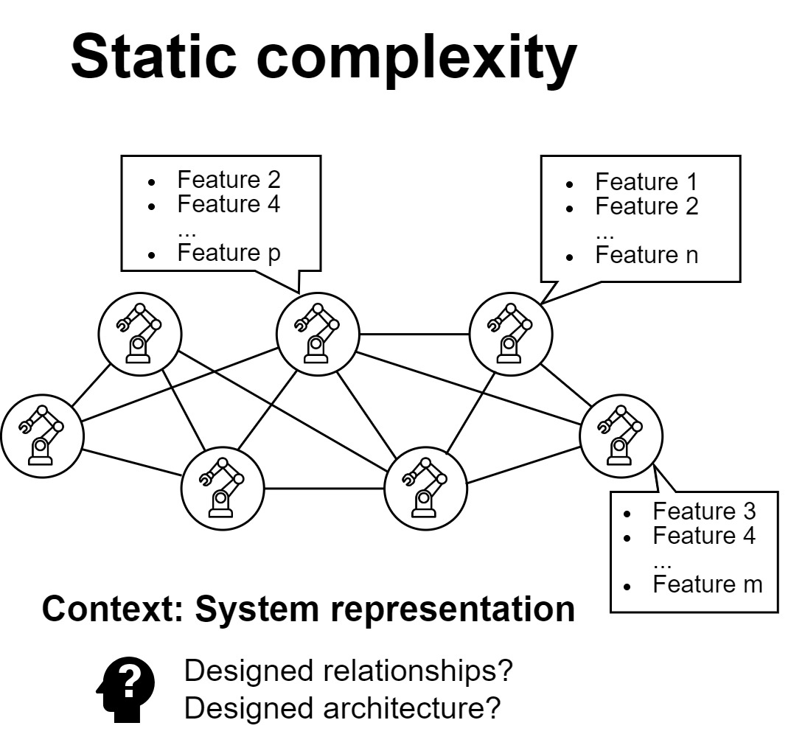
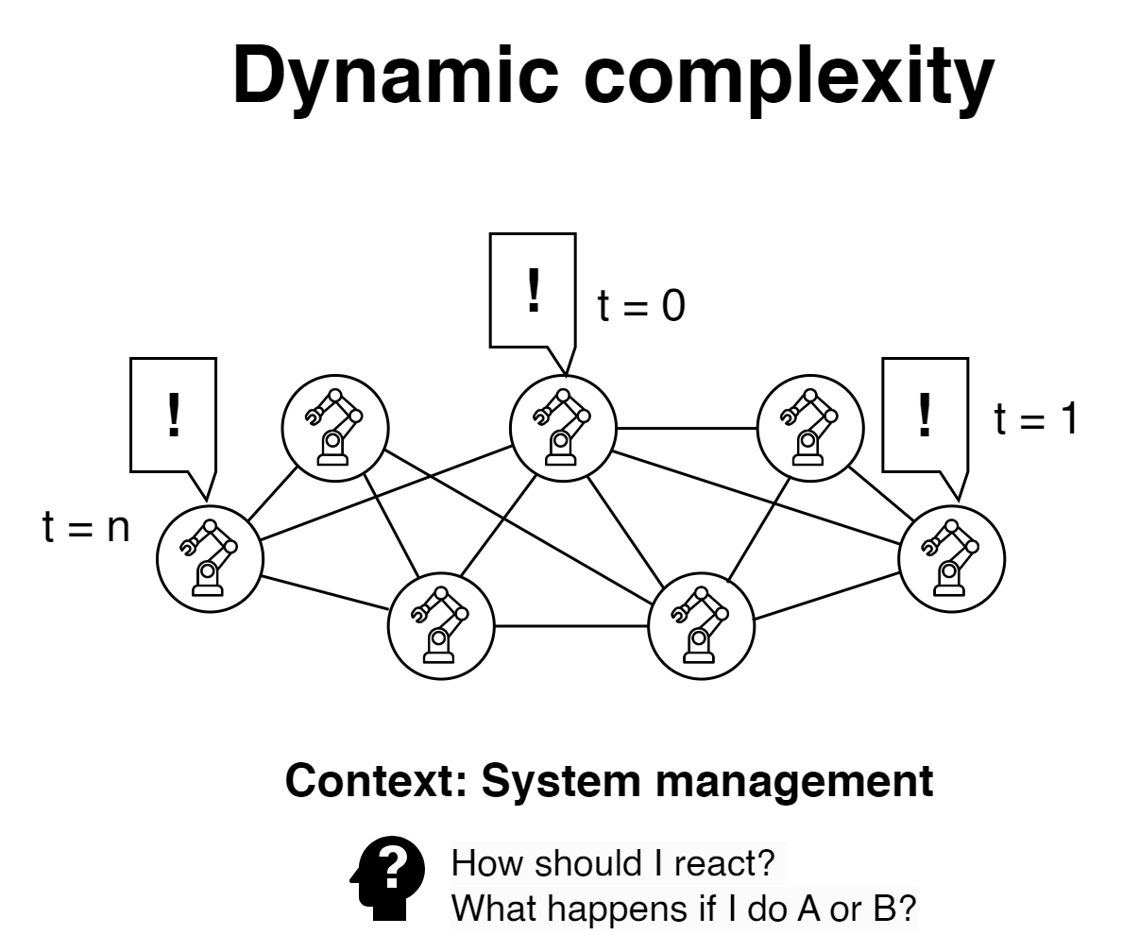
Industrial Complexity
Industrial complexity has been studied in research [3, 4, 5].
Complexity definitions:
“something entwined” (or an intertwined system)
“something made of several closely connected parts” [3].
Industrial Complexity considers the resulting intricateness of all the systems needed to fulfil the industrial production targets.
In the industrial domain, 2 types of complexity are usually distinguished:
static complexity;
dynamic complexity.
[3] Monostori L. et al., Complexity in engineering design and manufacturing, [4] Modrak V. et al., Exploring the Complexity Levels of Discrete Manufacturing Processes, [5] Herrera V., Complexity in Manufacturing Systems, a literature review
Notes:
(1 min)

Slide 6
Static Complexity in the Industrial Domain
Referred to the product and production system structure in a time-independent manner [6].
Considers the amount of information necessary to describe the state of a system concerning the manufacturing tasks it needs to carry on.
Possible sources of static complexity are:
Product complexity [7, 8]
Product portfolio mix [6, 8]
Layout [6, 7, 8]
Equipment [6, 7, 8]
…
Takeaway: static complexity considers the ease of describing the industrial system when it is turned off.
[3] Monostori L. et al., Complexity in engineering design and manufacturing, [4] Herrera V., Complexity in Manufacturing Systems, a literature review, [6] Gabriel AJ., The effect of internal static manufacturing complexity on manufacturing performance
Notes:
(1 min)
Fino ad oggi l’unico modo che le industrie avevano per gestire la complessità era «semplificare» e «standardizzare».
Per anni la standardizzazione industriale è stata efficace.
May be reduced by simplifying the product design and/or the associated production process.
I nuovi paradigmi richiedono però un cambiamento nei prossimi anni.

Slide 7
Dynamic Complexity in the Industrial Domain
Is defined as time-dependent and is also related to real-time operations activities [3, 4, 6].
Considers deviations from the normal/steady-state, comprising uncertainties, unpredictable events, and adaptive responses.
Drivers for this kind of complexity may be:
Internal:
breakdown occurrences [3, 6], maintenance policies [3, 6], scheduling activities [3, 6], quality problems [3, 6]
External:
defects in received raw material or delays due to supplier unpredictable occurrences [3, 4].
Takeaway: dynamic complexity considers all inconveniences and unforeseen happenings of the industrial system statically defined when it is turned on.
[3] Monostori L. et al., Complexity in engineering design and manufacturing, [4] Herrera V., Complexity in Manufacturing Systems, a literature review, [6] Gabriel AJ., The effect of internal static manufacturing complexity on manufacturing performance
Notes:
(1 min)

Slide 8
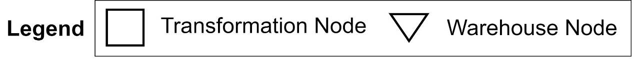
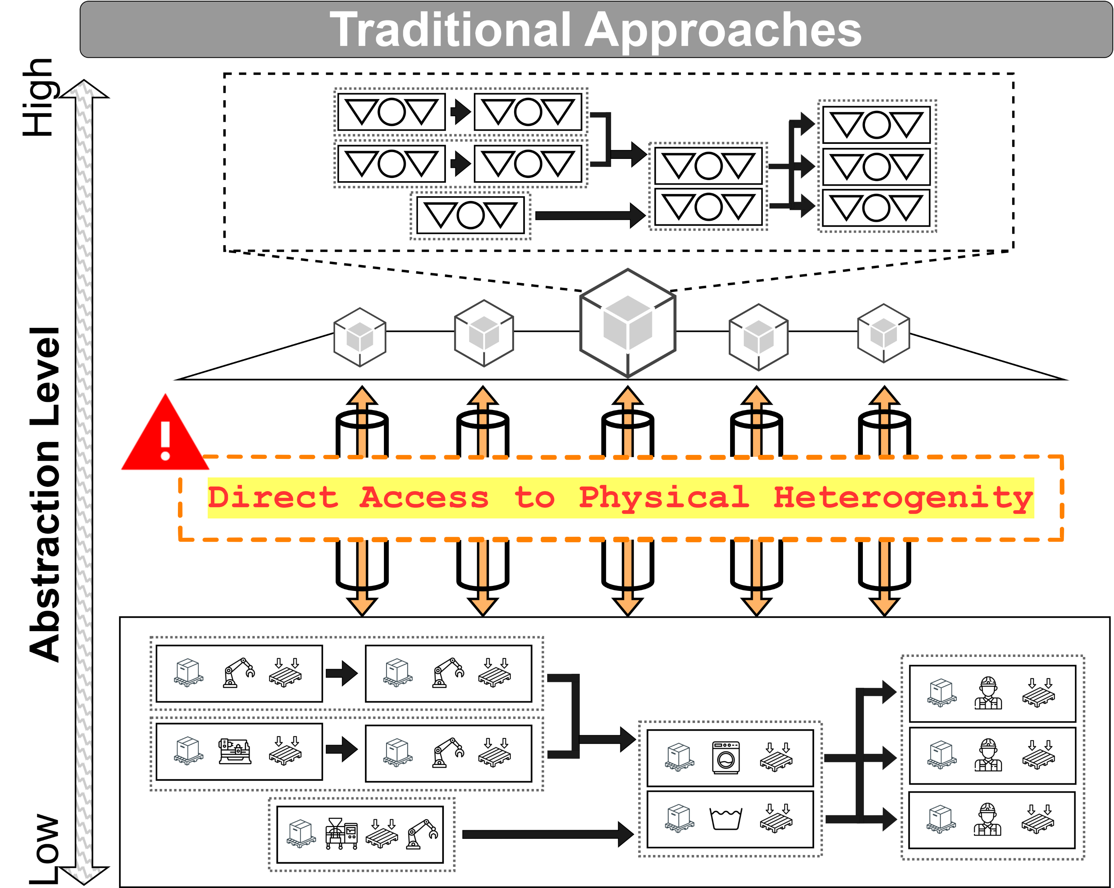
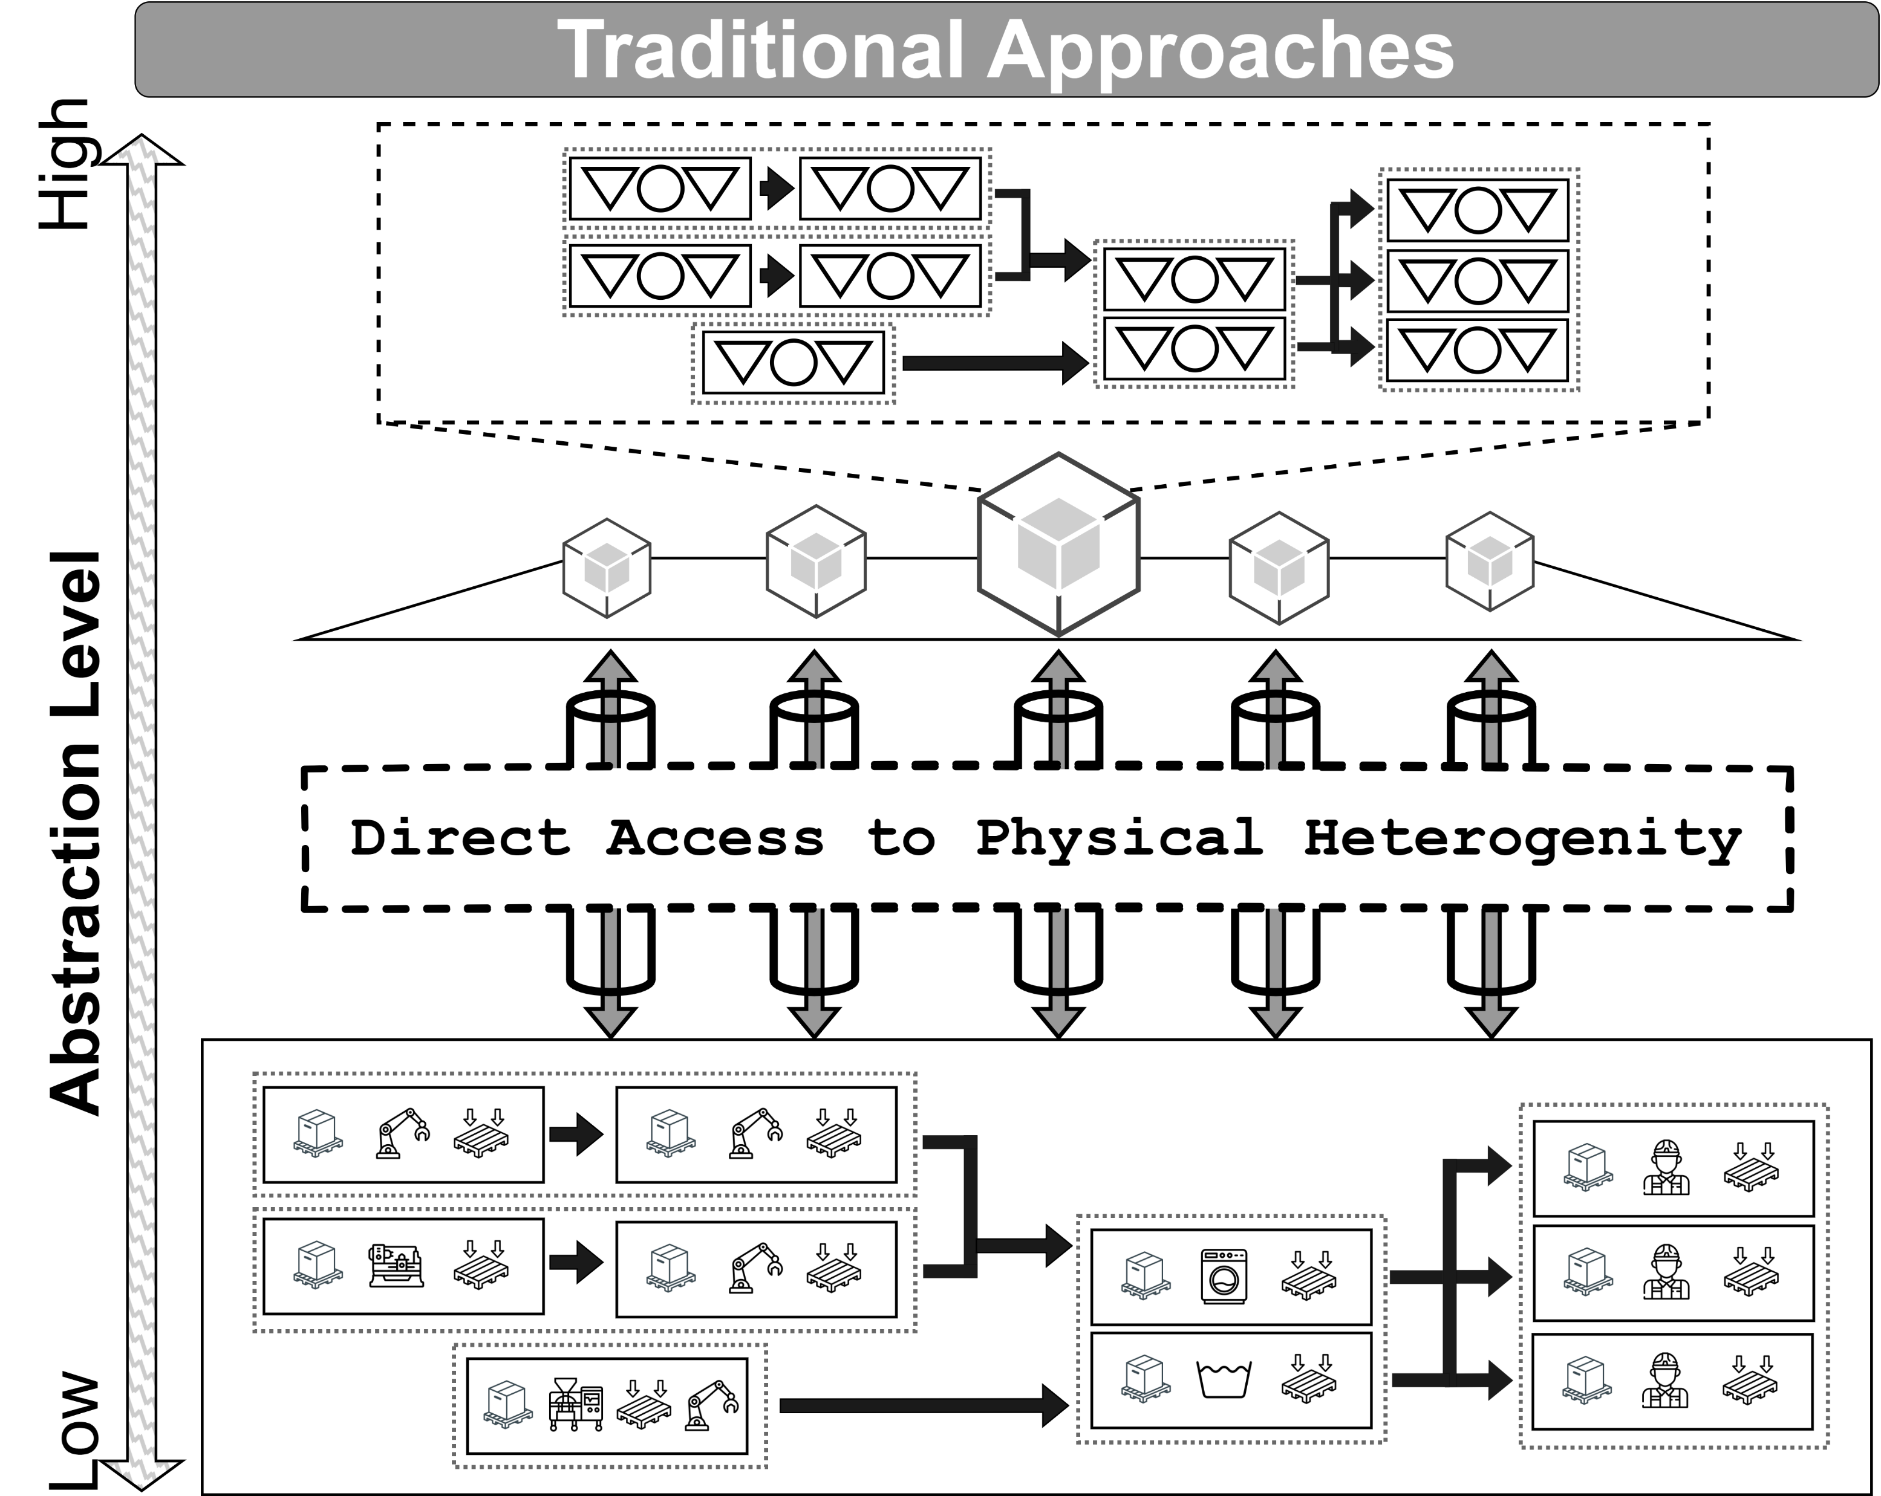
Are Static and Dynamic Complexity enough?
Challenges in digitalizing the physical shop-floor:
Specialized hardware and software [15];
Siloed solutions and lack of uniformity [15];
Lack of adaptivity, collaboration and scalability [15];
Difficulties in integrating new products into the mix;
Difficulties in integrating new production equipment into existing ecosystems;
Difficulties in kaizen activities (i.e., continuous improvement) of operations;
Actual state: Low abstraction and representiveness:
Direct access of applications to physical complexity in terms of its static and dynamic nature
Results:
High costs for integration and maintenance
Low degree of scalability and personalization of the system
Lost opportunities in terms of production management, and representation, optimization.
[15] Hazra A. et al., A Comprehensive Survey on Interoperability for IIoT: Taxonomy, Standards, and Future Directions (2021)
Notes:
(1 min)
Il sw dovrebbe «facilitare» la gestione della complessità esistente, e non aggiungere la propria.
Each IoT element is free to implement one or another communication protocol;
Each IoT device has its own data structures and associated representation;
Nel mondo industriale: come rappresentare in maniera «standardizzata» il reparto produttivo e le sue componenti? (secondario)
Accoppiamento, Silos
Why? Because the digitization of the physical complexity is «blocked» by the digital complexity of an ecosystem of entities not «abstracted» and «open» to standardly talk to each other and with application in the digital domain.

Slide 9
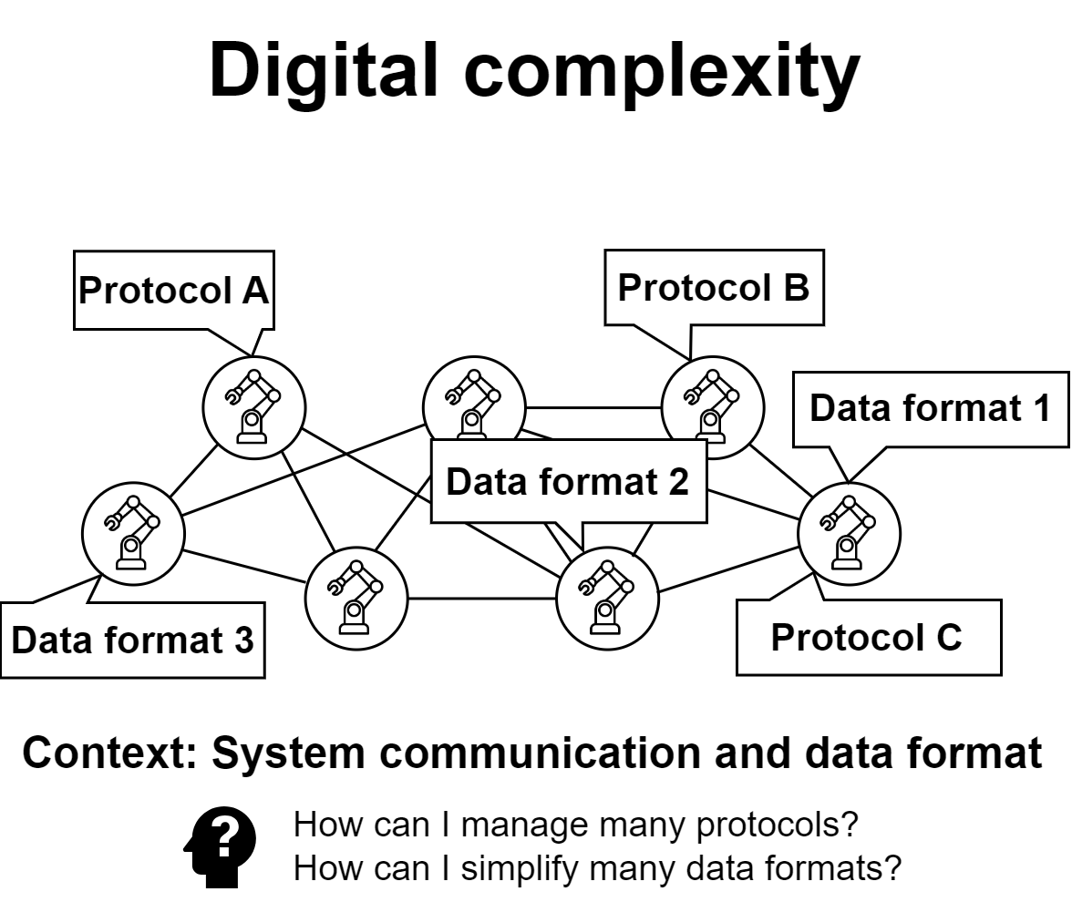
Digital Complexity in the Industrial Domain
Digital instruments are expected to bring benefits in managing static and dynamic complexity but at the cost of a new type of complexity: Digital Complexity.
Digital Complexity deals with challenges in transposing the physical domain into the digital one:
Abstracting and decoupling heterogeneous physical entities;
Promoting their integration with respect the needs of each scenario;
Promoting IoT scalability, collaboration and adaptivity across heterogeneous equipment;
Reflecting the physical world complexity, i.e., the complex aspects of the physical domain that need digital representation;
Simplifying interactions with applications;
Introducing intelligence functionalities.
Notes:
(1 min)
- Indeed, we are not leveraging the full potential of a connected physical world because it has not been properly abstracted.

Slide 10
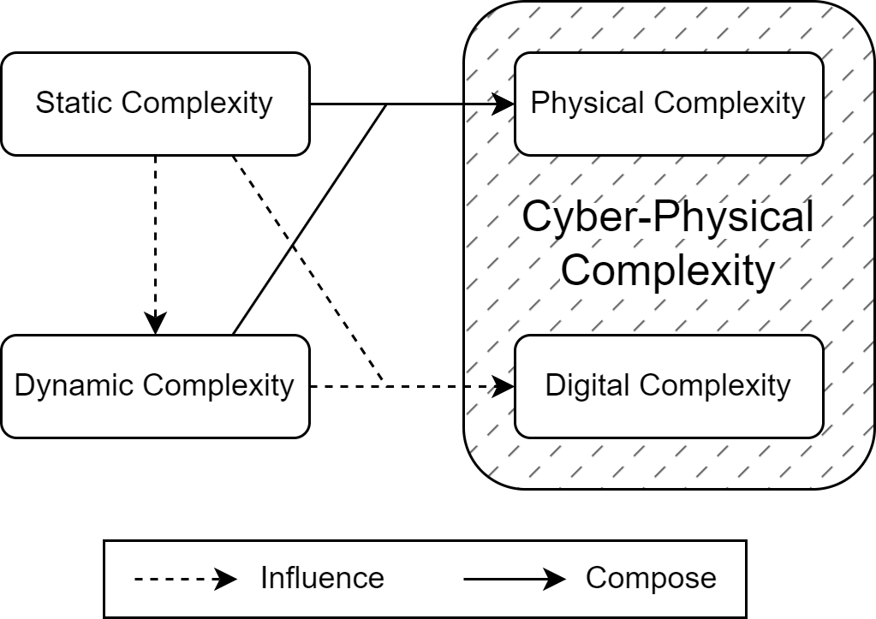
Industrial Cyber-Physical Complexity
Static complexity influences dynamic complexity:
The higher the static complexity, the more the system is prone to uncertainties and critical events.
Static complexity influences digital complexity:
The higher the static complexity, the higher the probability of heterogeneous equipment, products and associated processes.
Dynamic complexity influences digital complexity:
The higher the static complexity, the higher the events to catch, model, manage, and predict, and the higher the effort for managing the heterogeneity and uniformity.
Static and dynamic complexity compose the industrial physical complexity. The physical and digital complexity compose the industrial Cyber-Physical Complexity.
Notes:
(1 min)
the static complexity influences the dynamic, as the more statically complex is the system, the more it is prone to unforeseen states, uncertainties, and more in general critical events to manage;
the static complexity influences the digital complexity as, the more the system is statically complex, the more is likely to have a heterogeneity of equipment characterized by its technological peculiarities involved in the industrial scenario, with a wider mix of products in the portfolio and a higher variety of processes and associated descriptions;
the higher the static complexity the higher the dynamic one, which in turn affects the digital complexity because of the higher volume of events to model, catch, eventually manage and predict, comprised the unforeseen and critical ones.

Slide 11
Handling Industrial Complexity
There are 3 ways to deal with complexity: avoid it, minimize it, and manage it [3]. Industry 4.0 acts toward the second and the third option.
How to manage and eventually abstract the complexity of the physical world captured by the IoT? Using Digital Twins.
There is still a gap between applications needs and the complexity brought by IoT.
Digital Twins have been widely recognized as the steppingstone for industrial environments towards Industry 4.0 [7, 8], and the consequent application of Artificial Intelligence on the shop-floor [8].
[3] Monostori L. et al., Complexity in engineering design and manufacturing
[7] Cheng j. et al., DT-II:Digital twin enhanced Industrial Internet reference framework towards smart manufacturing (2020),
[8] Jan Z. et al., Artificial intelligence for industry 4.0: Systematic review of applications, challenges, and opportunities (2023),
Notes:
(30 sec)

Slide 12
Digital Twins for Cyber-Physical Complexity
The definition and purpose of DTs are different across research areas [10, 11, 12, 13]
“A Digital Twin (DT) is a comprehensive software representation of an individual physical object. It includes properties, conditions, and behavior(s) of the real-life object through models and data. A Digital Twin is a set of realistic models that can simulate an object’s behavior in the deployed environment. The Digital Twin represents and reflects its physical twin and remains its virtual counterpart across the object’s entire lifecycle [9].
[9] S. Haag, and R. Anderl. "Digital Twin–Proof of concept." Manufacturing Letters 15 (2018)
[10] Minerva R. et al., Digital Twin in the IoT Context: A Survey on Technical Features, Scenarios, and Architectural Models (2020)
[11] Kaklis D. et al., Enabling digital twins in the maritime sector through the lens of AI and industry 4.0 (2023)
[12] Wang W. et al., A proactive material handling method for CPS enabled shop-floor (2020)
[13] Friedrich J. et al., A framework for data-driven digital twins for smart manufacturing (2022)
Notes:
(1 min)
Cosa è un DT?
Tante definizioni …. Molte con applicazioni verticali e che non astraggono (Minerva? Dal 2020 si è lavorato sulla terminologia comune con Minerva) – Togli le def e lascia minerva e modifica secondo le slide di MarcoP.
Rispetto alla definizione si possono fare delle estensioni: le relazioni. -> Il DT può essere responsabile anche di modellare le relazioni esistenti nel mondo reale.
In realtà la manufacturing letter parla di simulate. Si può generalizzare parlando di digitize, dove la simulazione è un sottoinsieme della digitalizzazione.
Pilastri:
- … (da slide – cit web of DT)

Slide 13
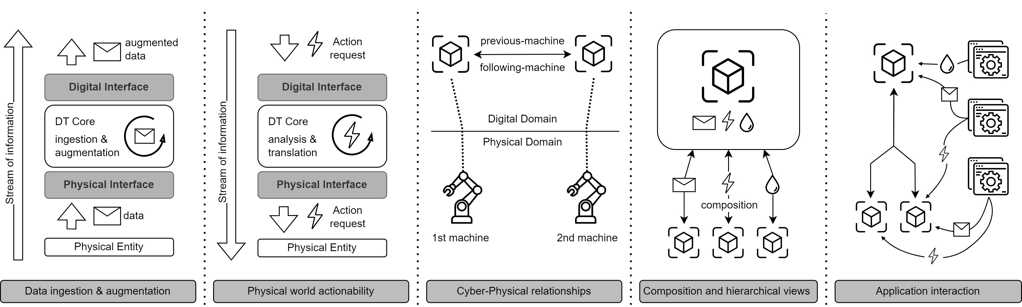
Digital Twins in the Industrial Domain
Integrate different physical protocols and expose the most suitable with respect to the modelled scenario;
Select useful information to reflect in the digital domain with respect to the given use case and logically order it;
Offer a common entry point for actions towards the physical domain;
Model existing relationships among physical assets and higher-level concepts they are part of;
Compose heterogeneous physical assets to obtain a cohesive logical entity;
Ensure a consistent point of interaction with industrial applications.
Notes:
(1 min)
Caratteristiche:
Facilitare la digitalizzazione delle singole componenti industriali
Astrarre e uniformare i protocolli di comunicazione
Ribaltare nel digitale gli oggetti fisici digitalizzati tramite IoT (sensori ed attuatori)
Rappresentare le relazioni industriali che permettono alle operazioni di avvenire correttamente
Comporre gli oggetti fisici da concetti a basso livello fino a concetti ad alto livello (sensori, linee, reparti, BU, plant)
Facilitare l’interazione con le applicazioni grazie alla risultante astrazione.

Slide 14
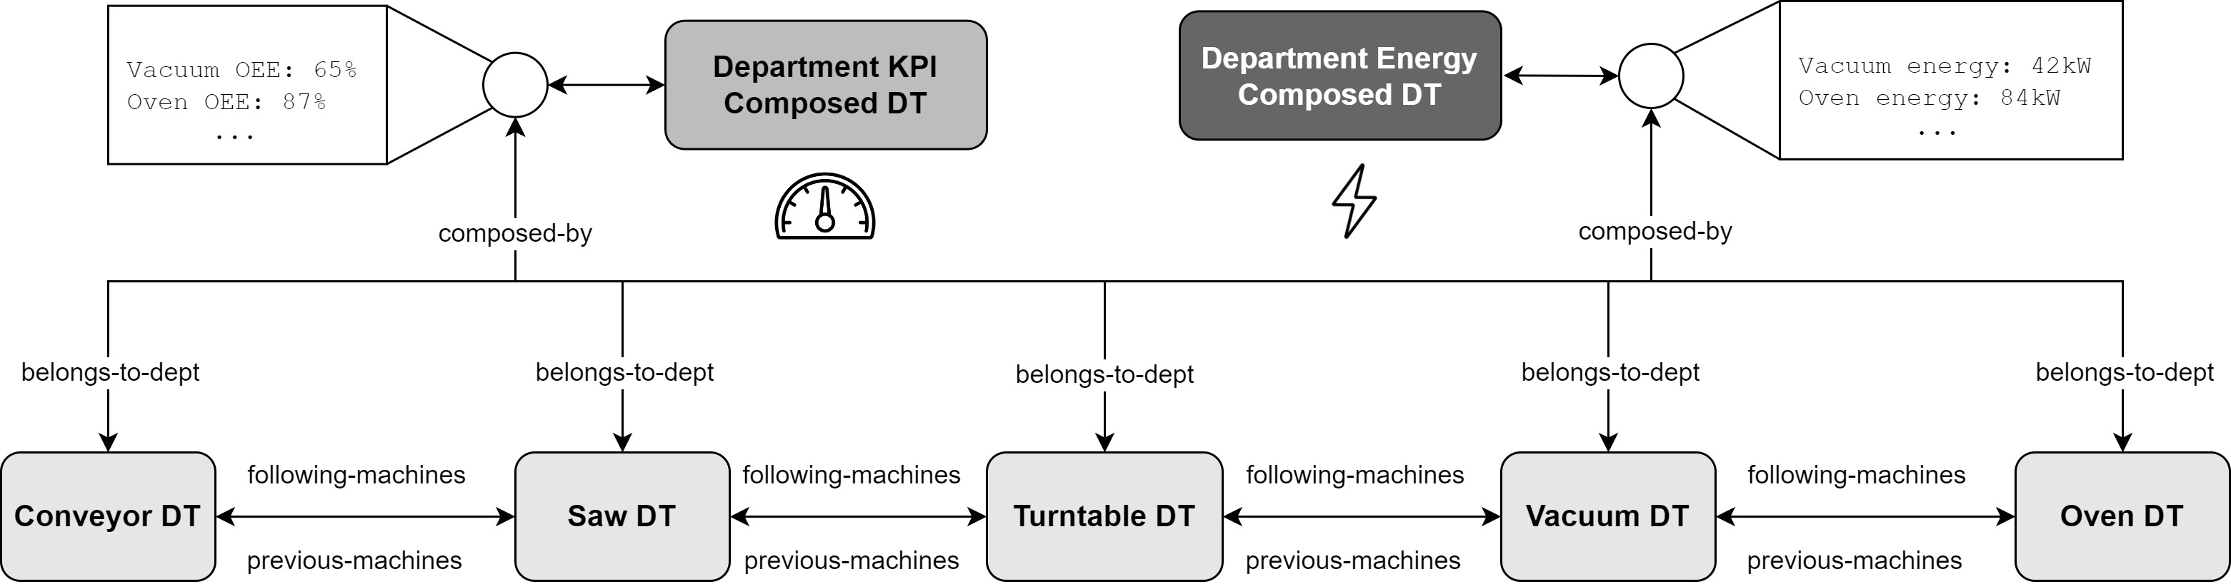
Digital Twins in the Industrial Domain
Relationships and Composability are very useful features to abstract and model industrial domains.
They enable the opportunity to represent upper-level Physical Concepts starting from underlying physical assets.
Notes:
(15 sec)
Physical Concepts are the logical entities that gives us the possibility to abstract the whole physical organizational structure of an industrial system, consequently representing its architecture.

Slide 15
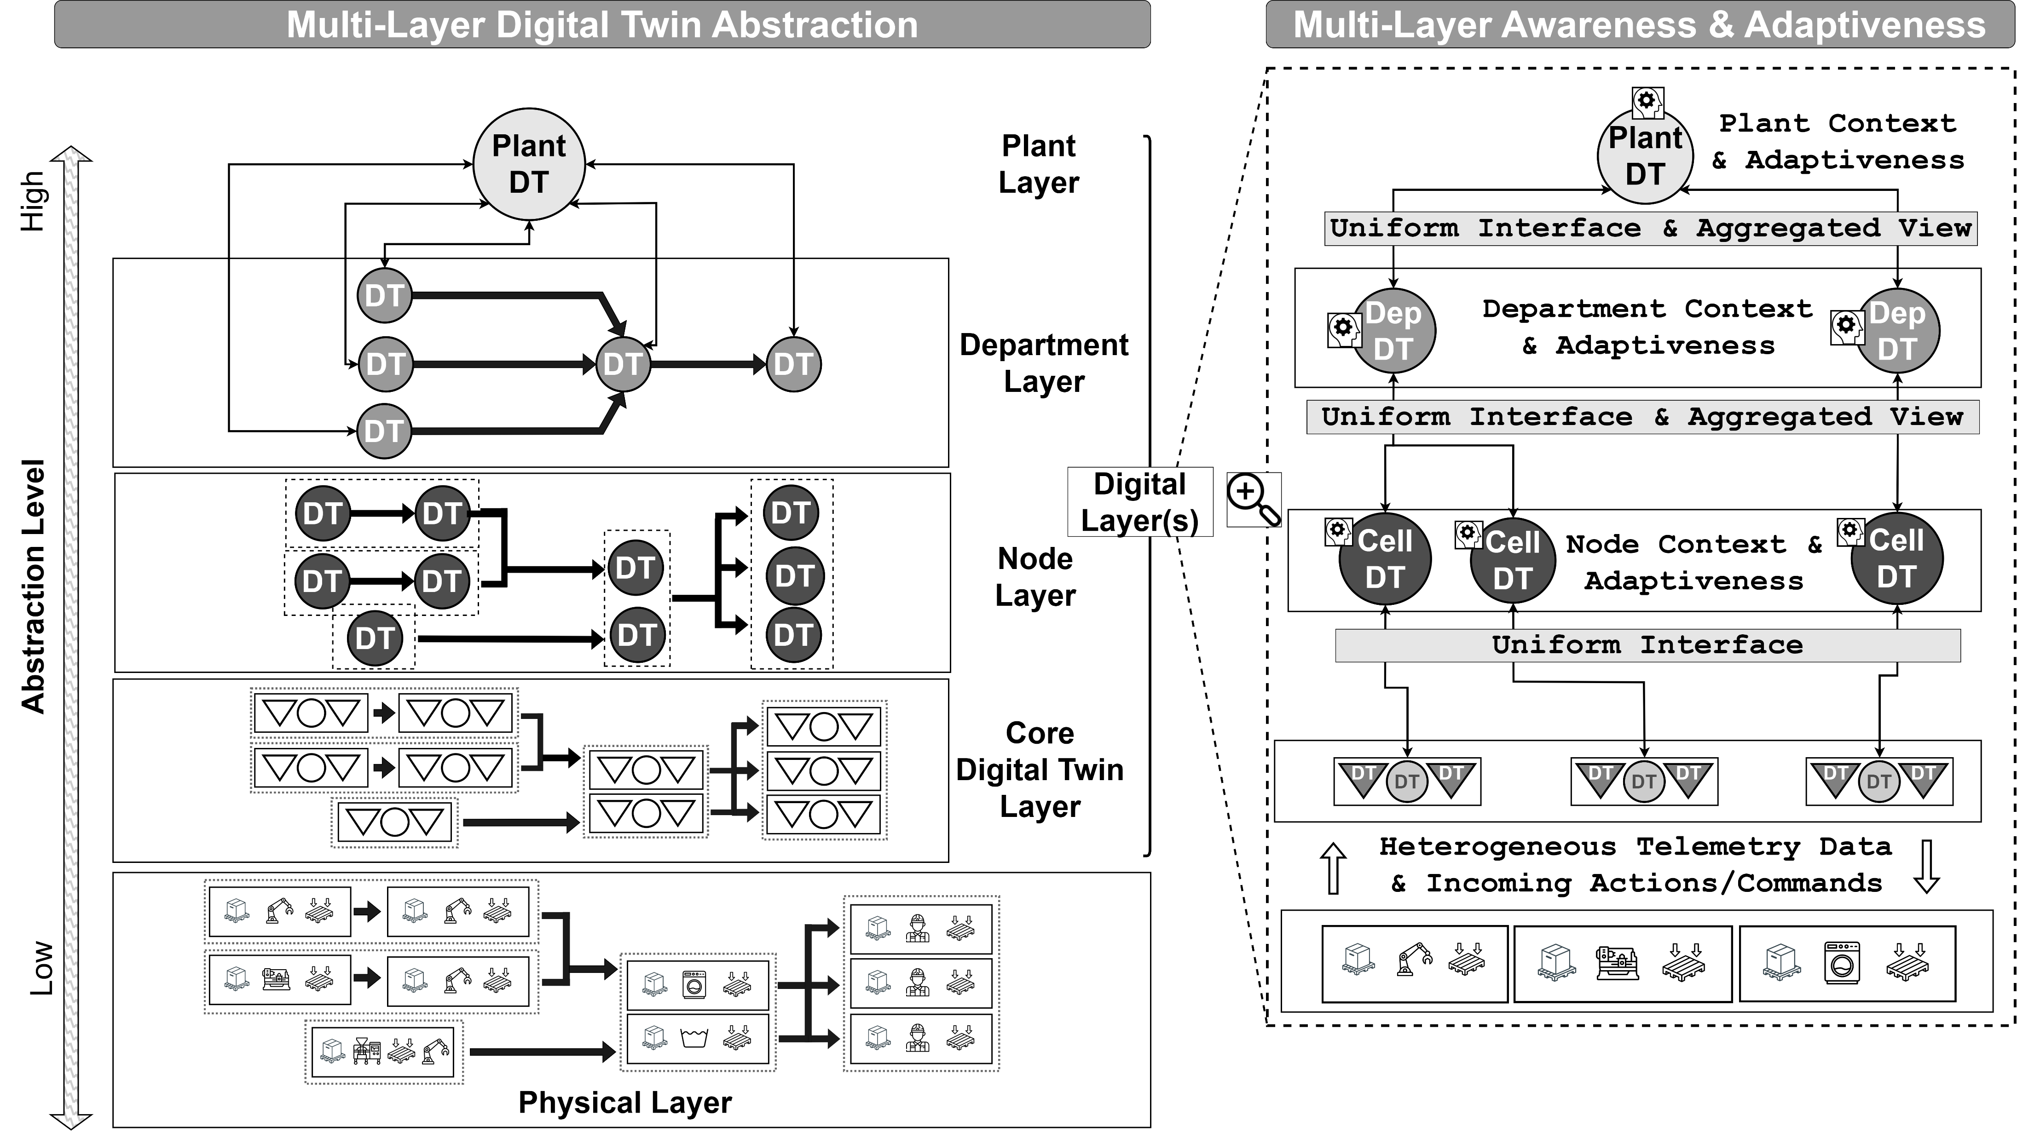
DTs in Industry: Envisioned Result
The digitalized industry of the future will have the whole Physical Concepts pyramid transposed in the digital domain and offered to upper-level applications:
Physical equipment composes a Production Node;
Production Nodes compose a Department;
Departments compose a Plant.
Horizontal and vertical relationships among adopted equipment will be described by DTs, enabling navigability of the physical system.
The result is the representation of the adopted industrial architecture.
Notes:
(1 min)

Slide 16
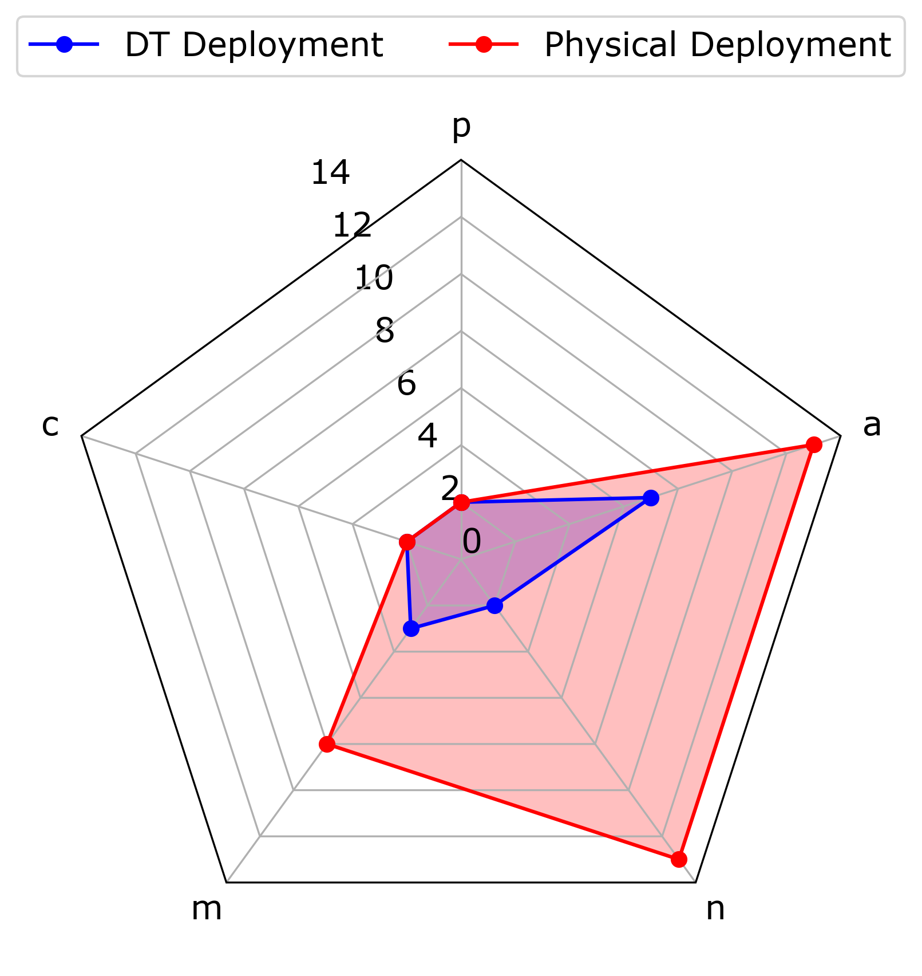
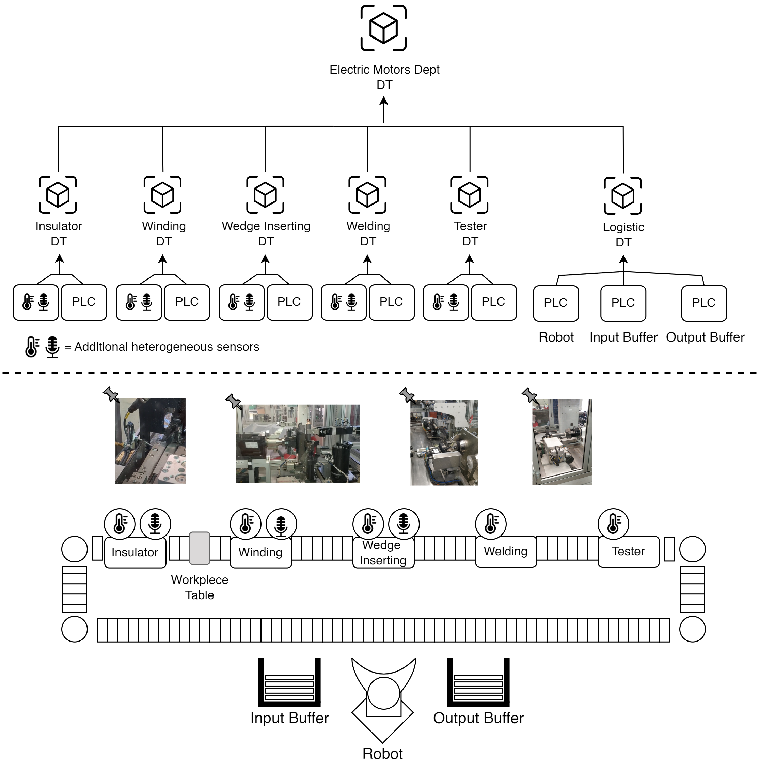
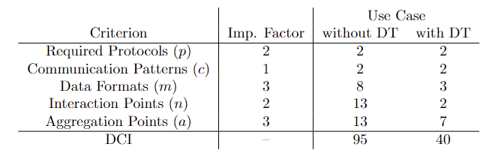
Digital Complexity Index: a Real Case Scenario
$$DCI= \sum_{i=1}^{5}{{criterion}_{i}× {IF}_{i}}$$
Notes:
(1 min)
Criteri proposti, non scritti nella pietra. Proposta metrica per misurare…
Criteri inziali, possono cambiare.
Chi subisce la complessità? Le applicazioni.
Required protocols:
Communication patterns:
Data formats:
Interaction points:
Aggregation points:

Slide 17
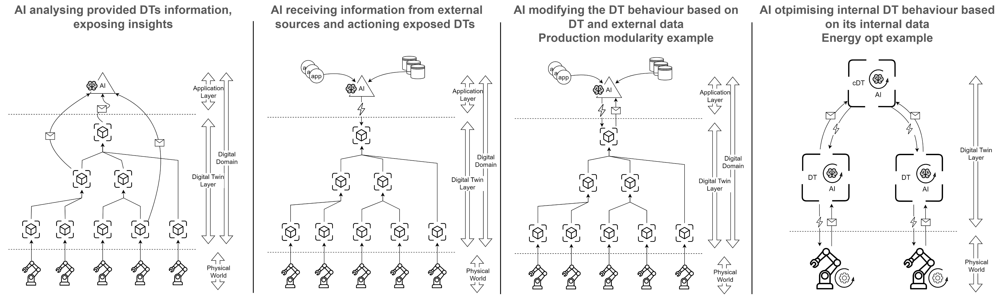
DT & AI Industry: where to put AI?
Observer AI
Advisor AI
Controller AI
Embedded AI
Notes:
(1 min)
SALTO TRA COMPLEXITY E INTELLIGENZA

Slide 18
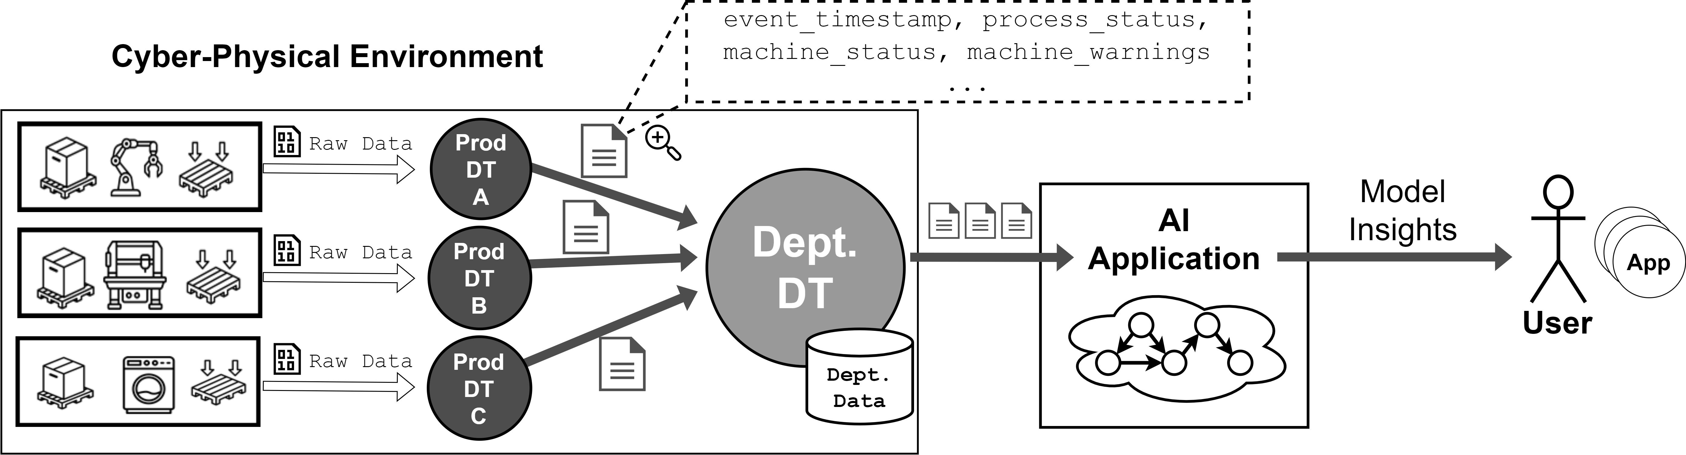
AI & DT interaction – Observer AI
AI external to an industrial DT ecosystem;
Receives data from DTs of its interest;
Monitors single DTs or their compositions;
Does not know anything about the internal structure of each DT;
For advanced monitoring of single DTs states, their compositions, or specific groups of DTs for stakeholders or applications.
[14] Crespi N. et al., Digital Twins: Properties, Software Frameworks, and Application Scenarios (2021)
Notes:
(1 min)

Slide 19
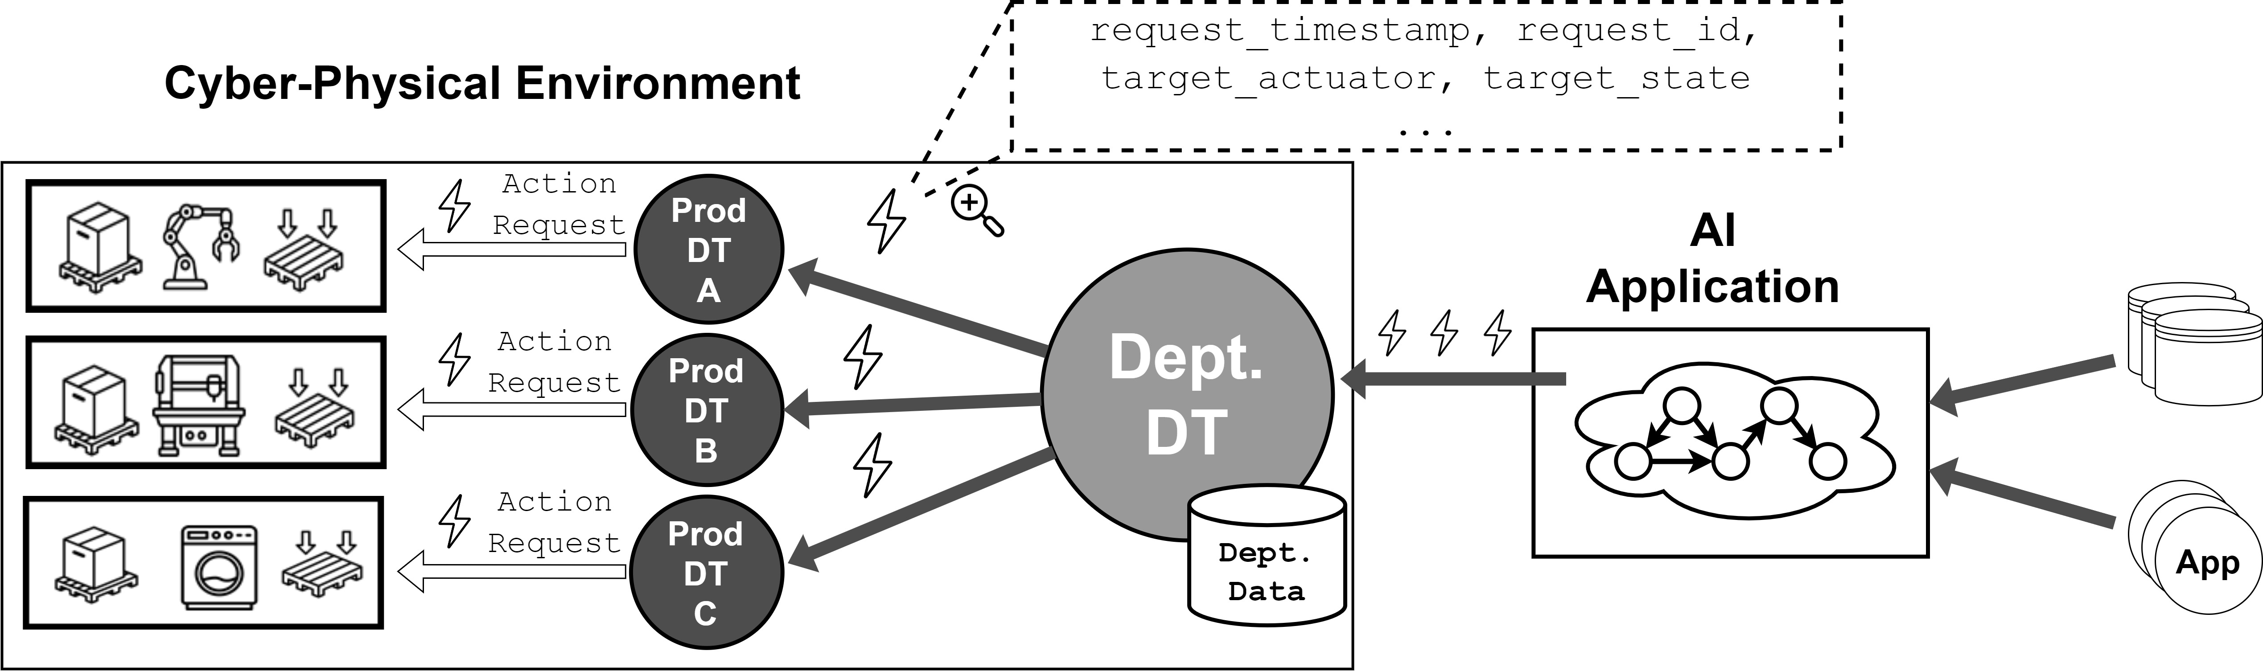
AI & DT interaction – Advisor AI
AI external to an industrial DT ecosystem,
Collects data from external sources;
Does not know anything about DTs internal structure;
Eventually requests actions to the DT ecosystem to reach a target state-of-affairs.
For external data sources monitoring through AI and sending actions requests to adapt to the external predicted future.
[14] Crespi N. et al., Digital Twins: Properties, Software Frameworks, and Application Scenarios (2021)
Notes:
(1 min)
No descriptive e predictive perché non abbiamo i dati dal DT ecosystem
Ma prescriptive e autonomous perché comunque ricevono dei suggerimenti che possono abilitare la risposta autonoma del sistema.

Slide 20
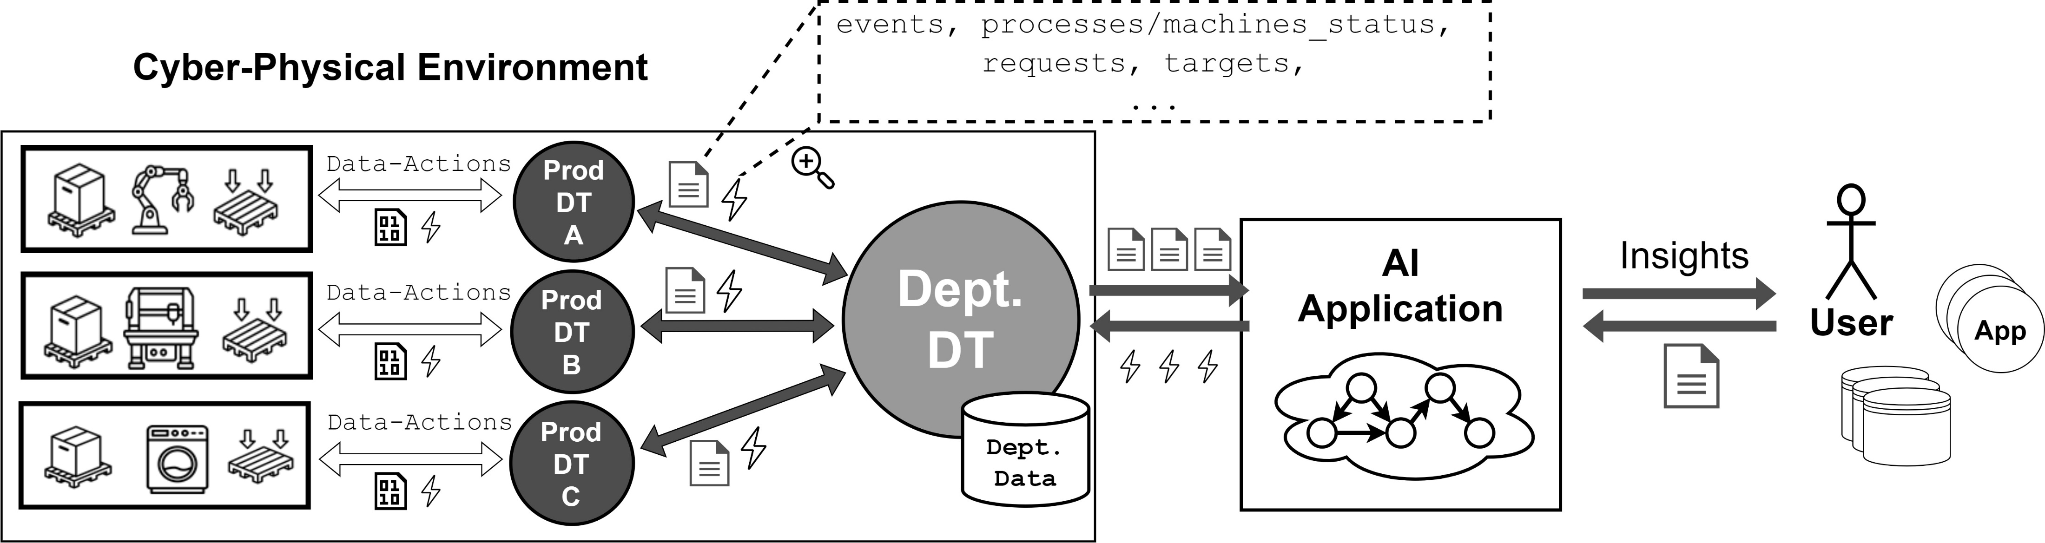
AI & DT interaction – Controller AI
Is a mix between Observer and Advisor AI;
AI system external to the DT ecosystem;
Does not know anything about DTs internal structure;
Collects data both from the DT ecosystem itself and from external sources;
Requests actions to DTs.
For guiding the behavior of the DT ecosystem through external AI considering its state and external data sources, such as stakeholders, applications or databases.
[14] Crespi N. et al., Digital Twins: Properties, Software Frameworks, and Application Scenarios (2021)
Notes:
(1 min)

Slide 21
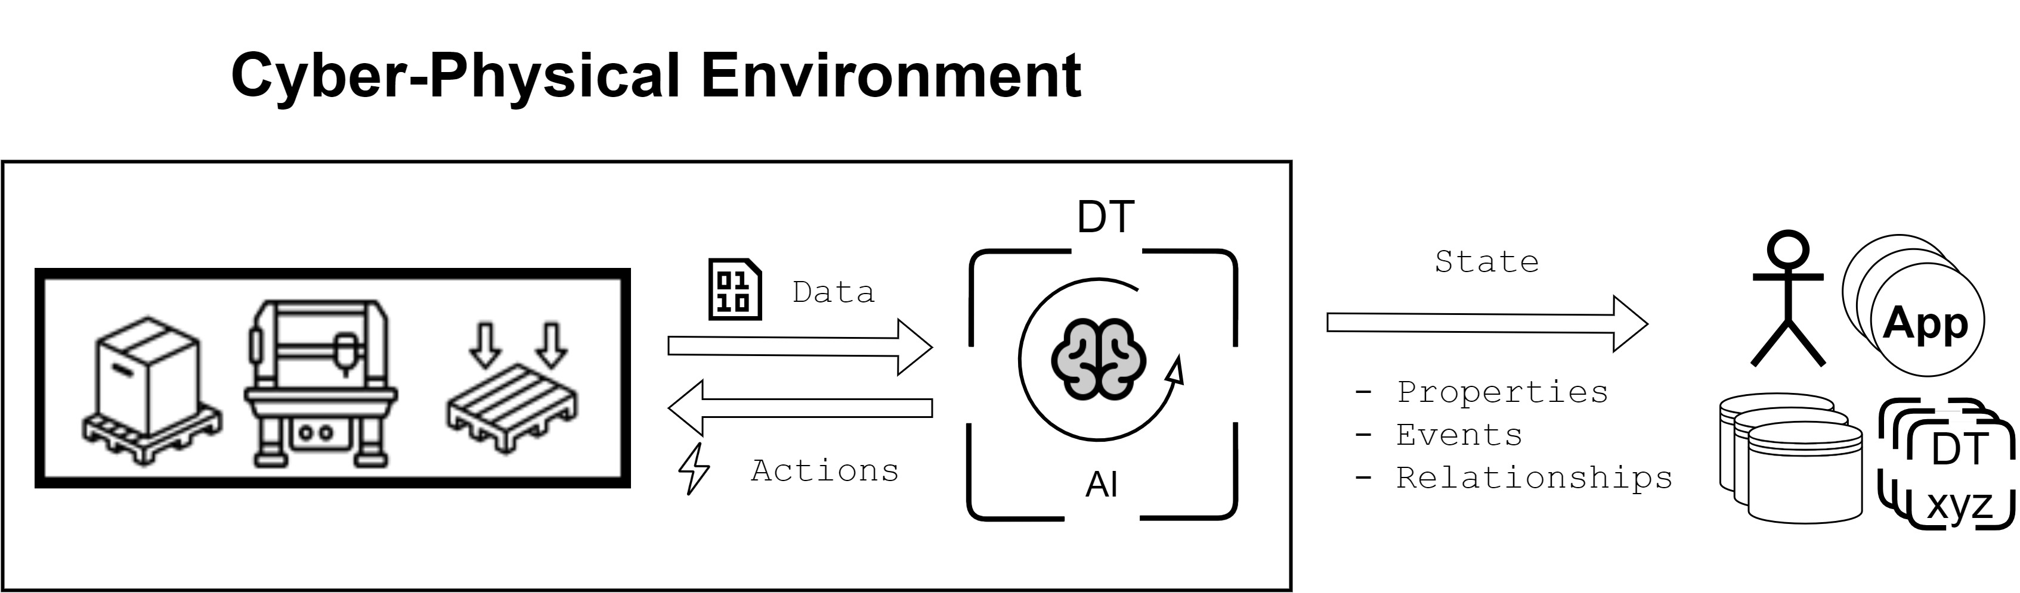
AI & DT interaction – Embedded AI
AI internal to single DTs;
Knows the internal structure of its DT;
Receives data from associated resources, augments it and eventually triggers actions back.
For internal DT inbound data augmentation through AI, and eventual actions triggering towards to obtain a desired outcome.
[14] Crespi N. et al., Digital Twins: Properties, Software Frameworks, and Application Scenarios (2021)
Notes:
(1 min)
Perché prima 3 pattern con 3 tipi di interazioni diverse e qua invece hai augmentation e azioni tutte in un unico pacchetto?

Slide 22
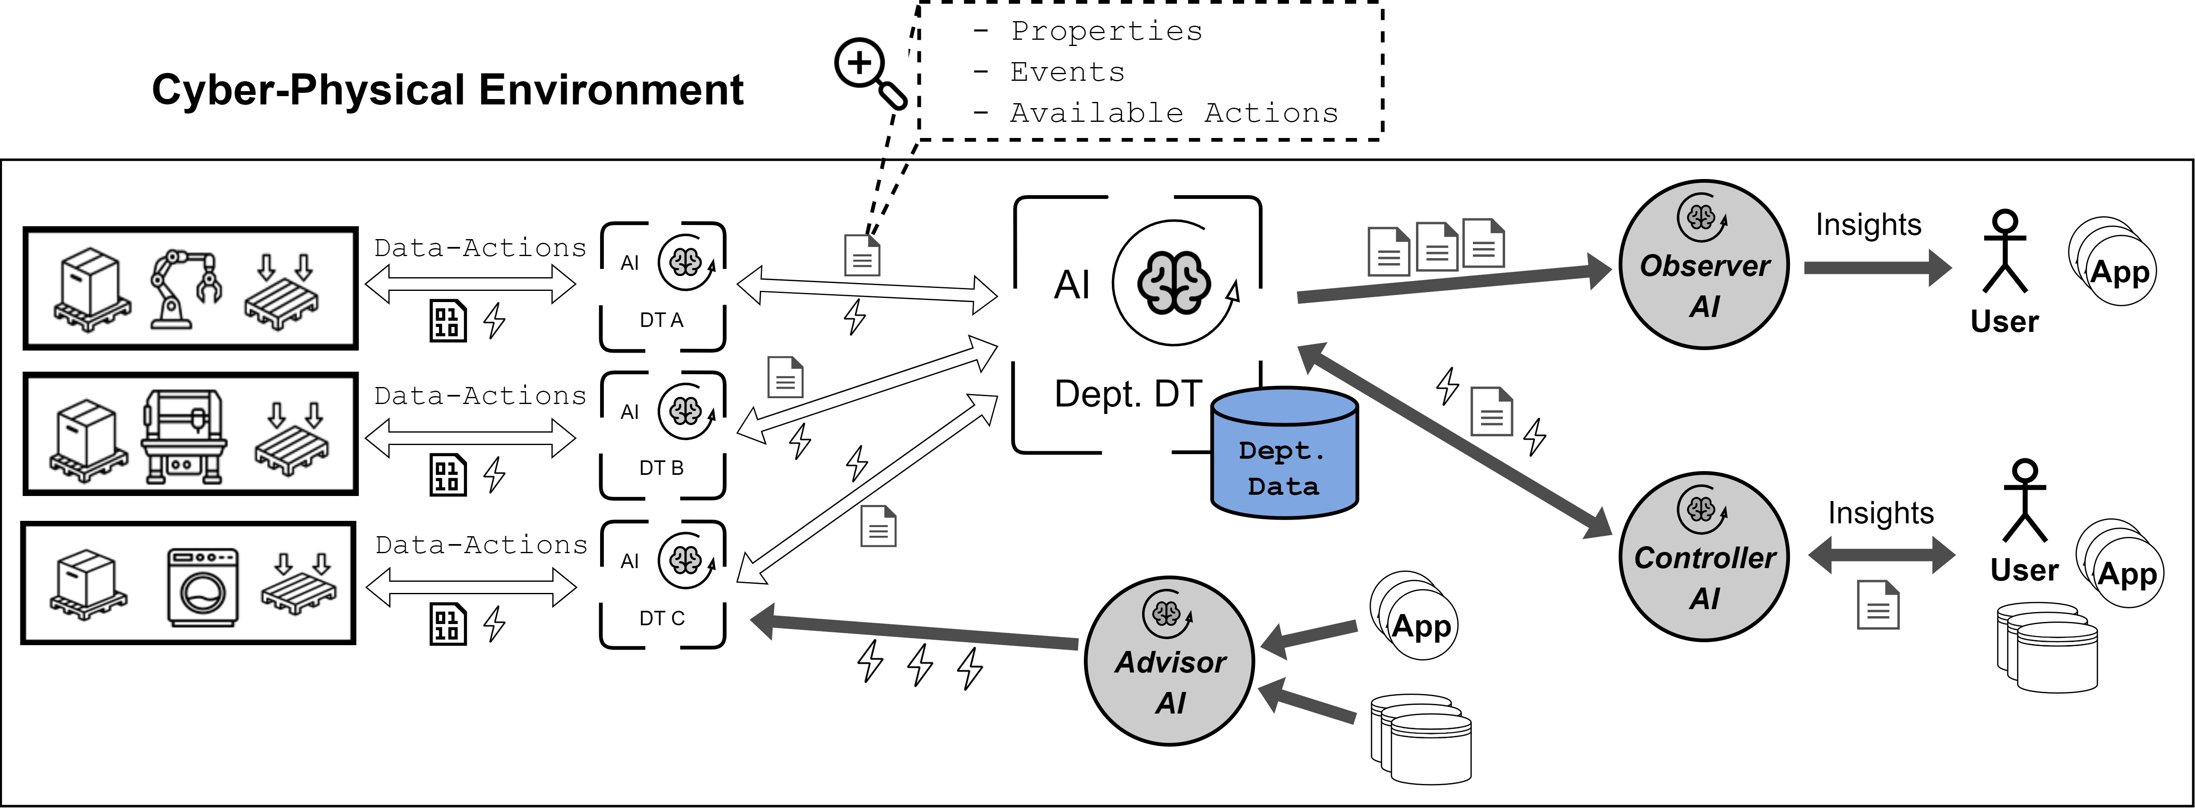
Intelligent DT Ecosystem in Industry
Notes:
(15 sec)

Slide 23
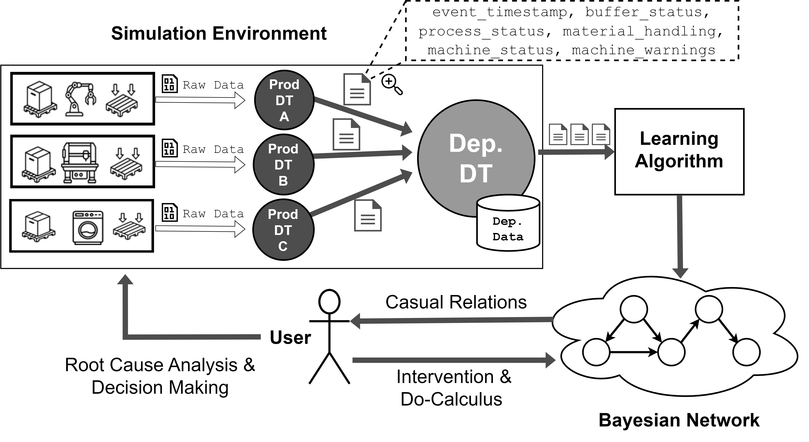
AI & DT interaction – Experimenting Observer AI
Target:
To practically explore the Observer AI pattern;
Leverage Observer AI to integrate causality learning in the system.
Notes:
(1 min)

Slide 24

AI & DT interaction – Experimenting Observer AI
Production Node
Design:
SimPy¹ simulation of production, including machine breakdowns (stochastically modelled);
36 working days simulated on a single work shift;
Downstream node produces if and only if both input pieces from upstream nodes are available;
Monitoring if an output buffer of a production node has recently received a least one piece.
Output Buffer
Operational Node
Input Buffer
¹ SimPy docs available at: https://simpy.readthedocs.io/en/latest/
I-TH MACHINE TABLE
Timestamp | Input buffer level | Output buffer level | Pieces produced | Breakdown state (F_{i}) | Output recently filled (Q_{i})
Notes:
(1 min)

Slide 25
AI & DT interaction – Experimenting Observer AI
Breakdown state (F_{i})
Learning result
Output recently filled (Q_{i})
Notes:
(1 min)
DT simulati

Slide 26

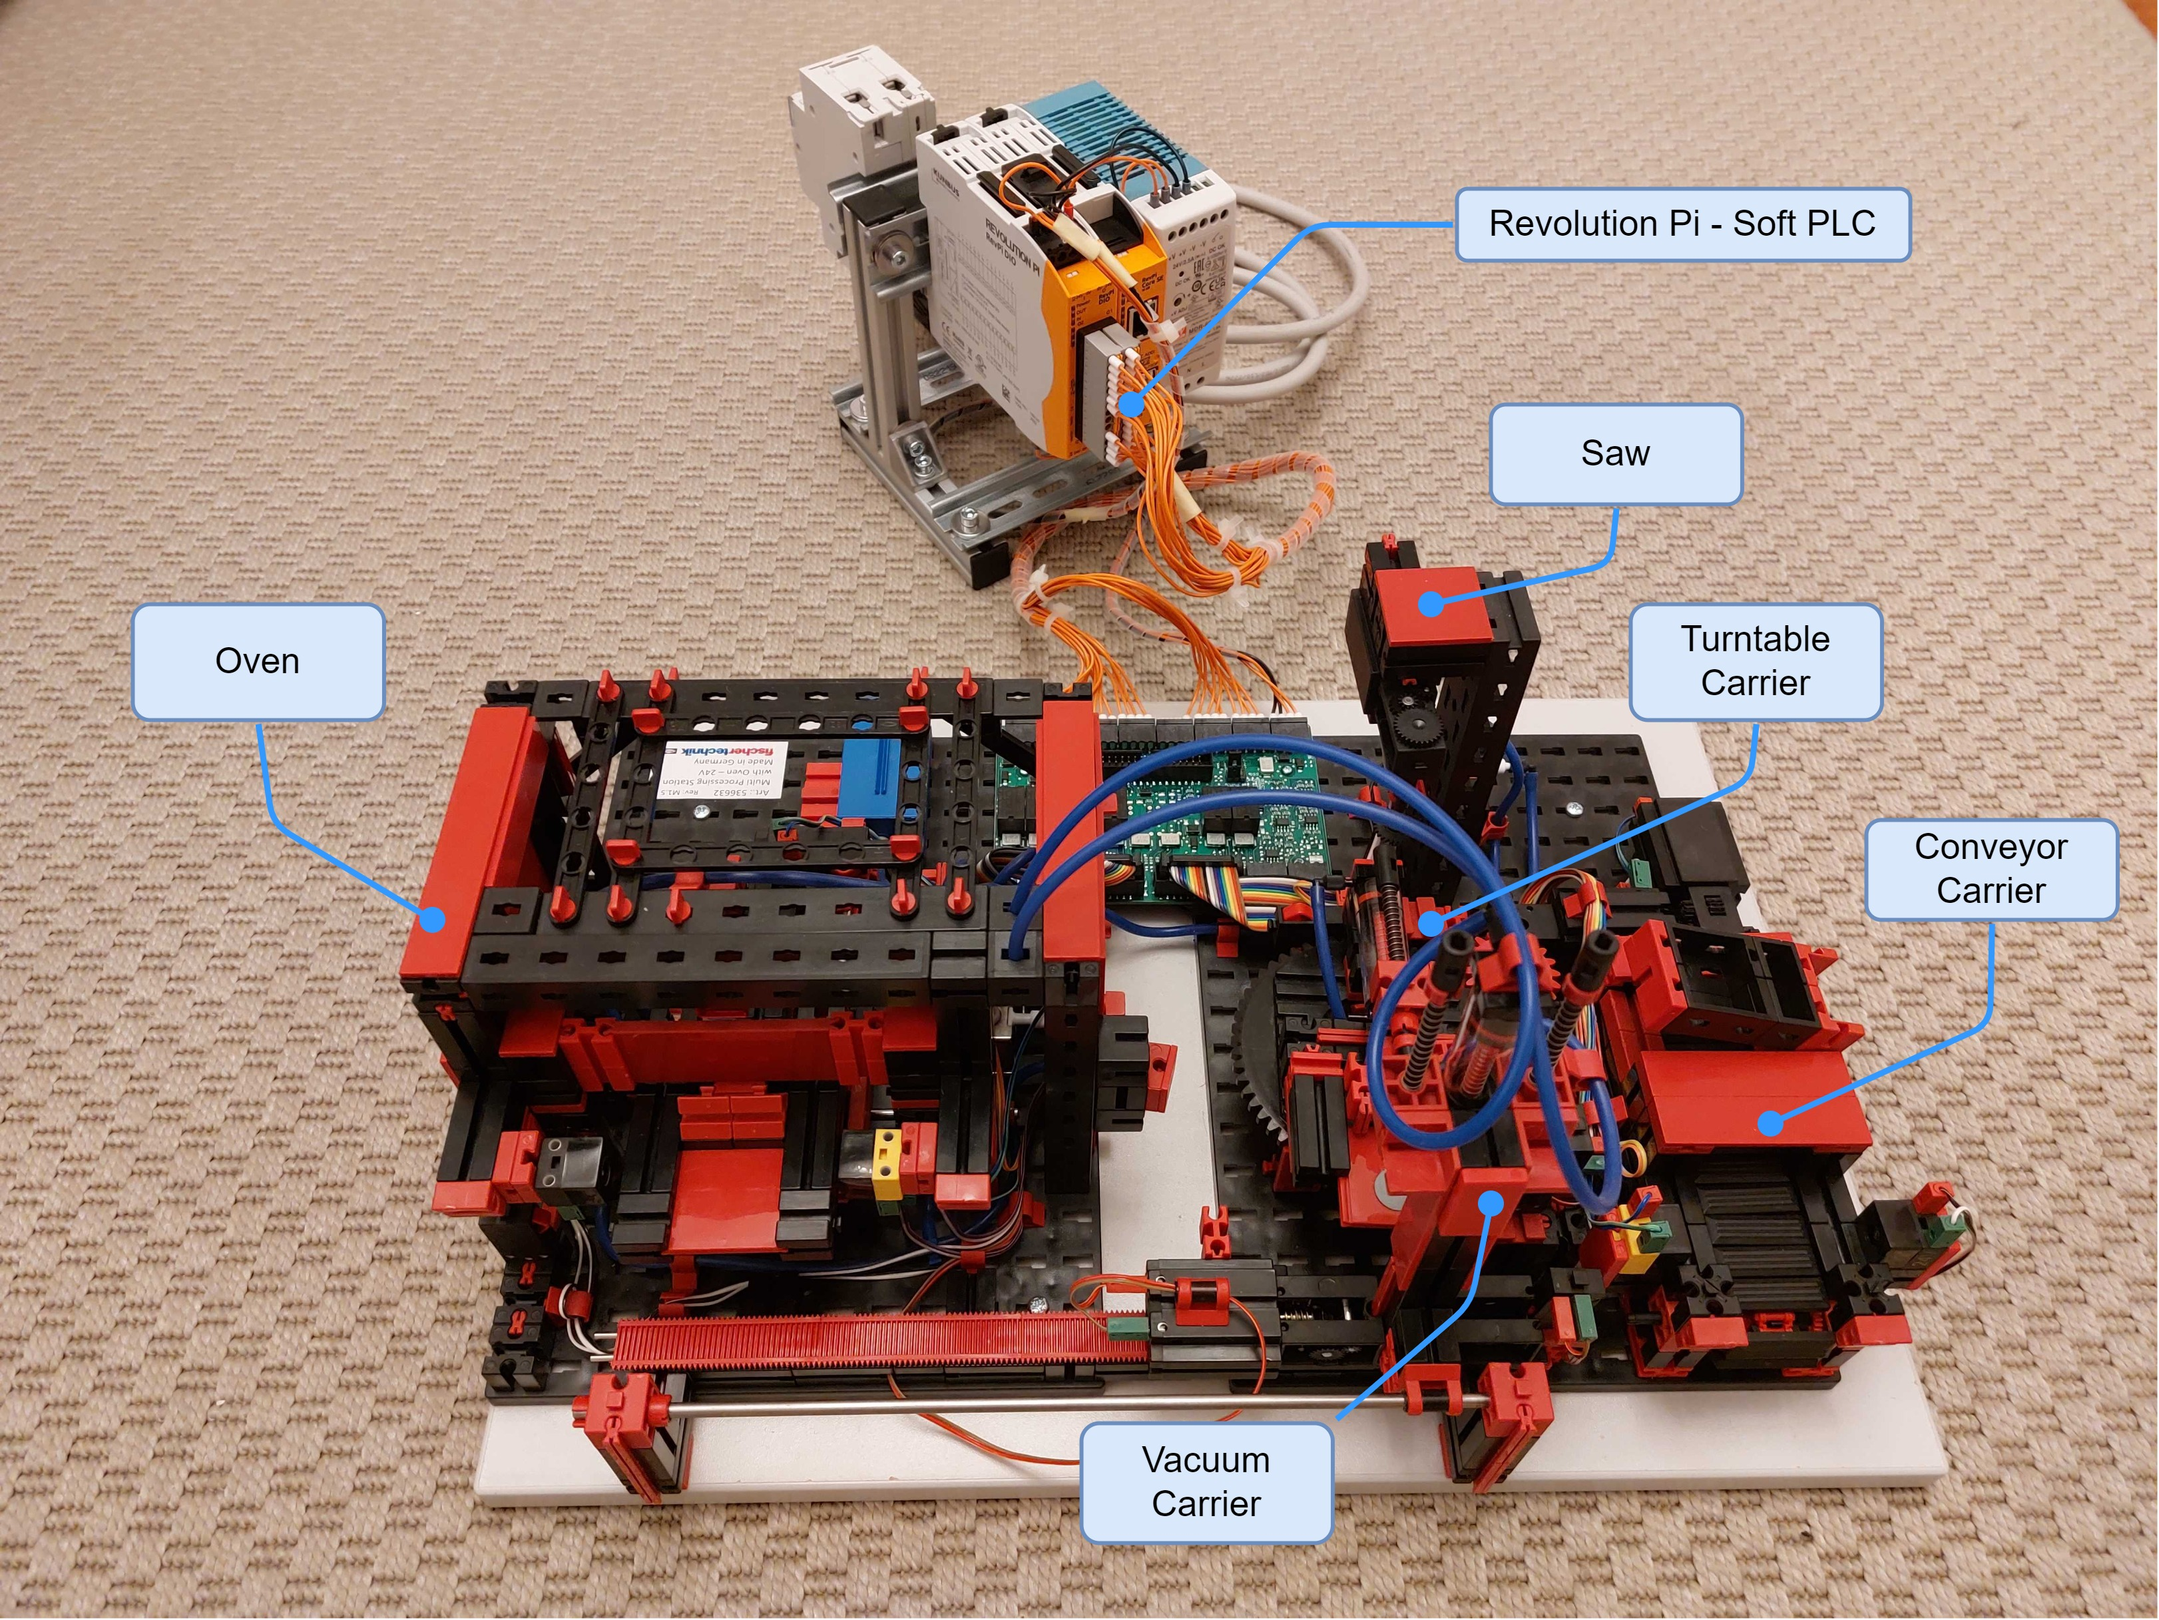
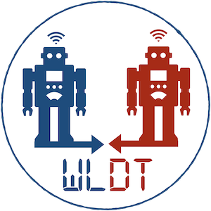


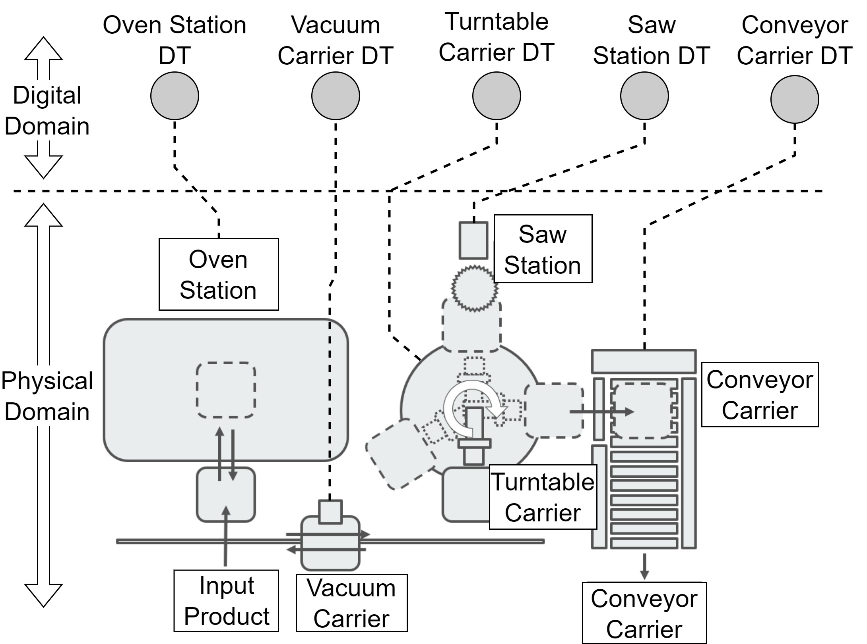
AI & DT interaction – Experimenting Advisor AI
Target:
To practically explore the Advisor AI pattern;
To build a DT ecosystem on top of a realistic physical industrial environment (Fischertechnik);
Implemented in Java using WLDT;
Leverage system navigability through DT hierarchies and relationships to extract valuable information from physical assets;
Compute DT ecosystem resources consumption.
Notes:
(1 min)
- 5 machines on the Fischer abstracted through DT.
- DT system overhead

Slide 27
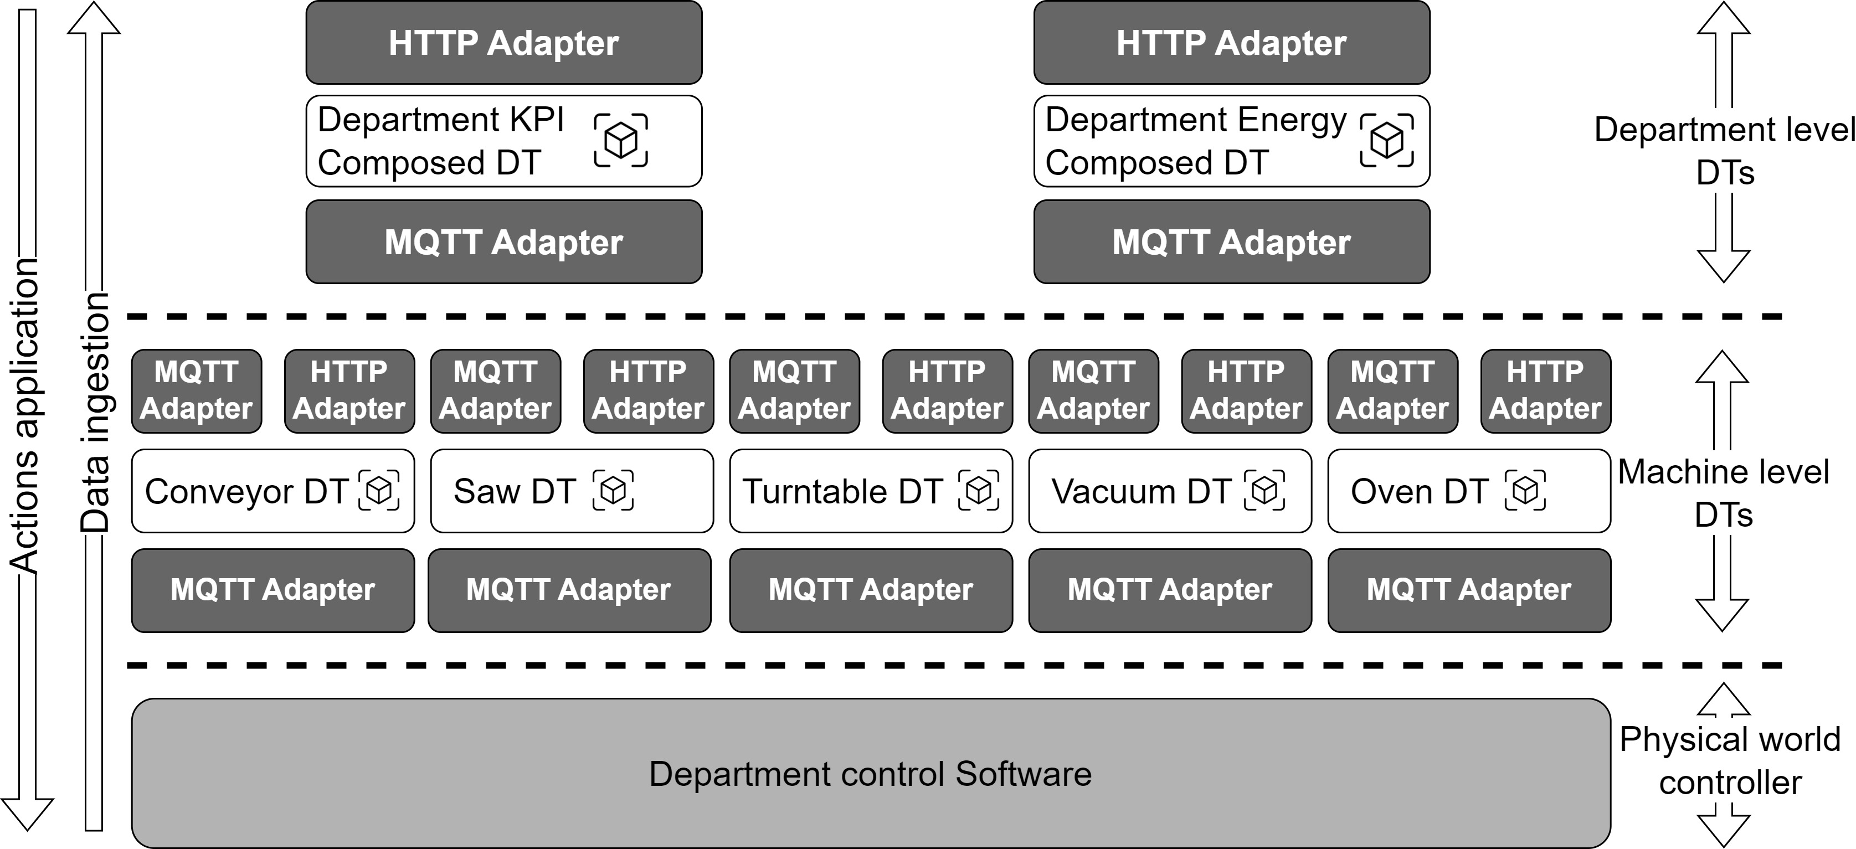
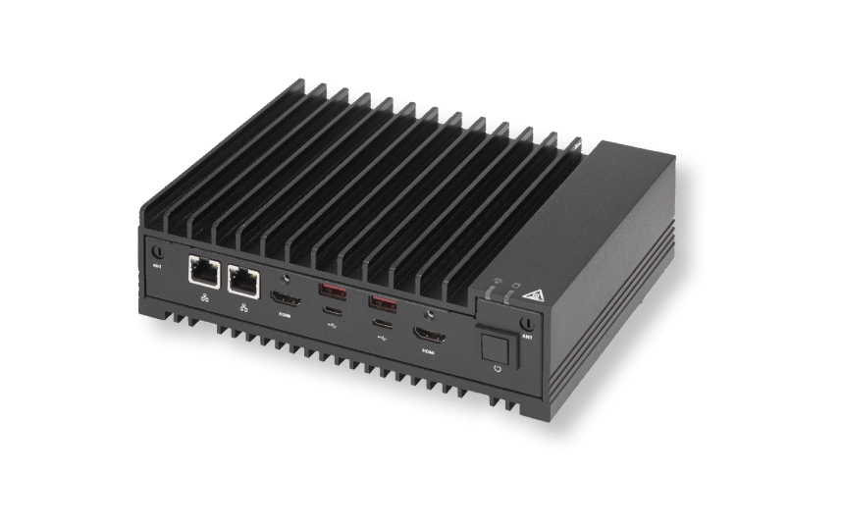
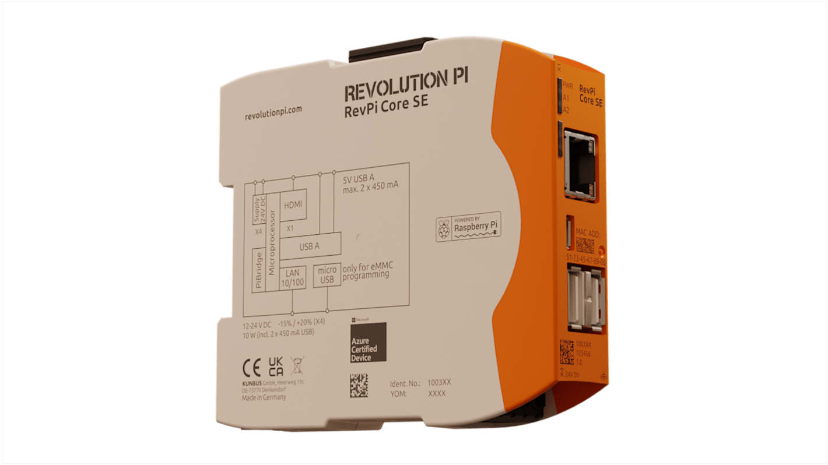
AI & DT interaction – Experimenting Advisor AI
Design:
Fischertechnik research equipment representing a 4-machines production line;
2 states sensors;
2 and 3 states actuators;
Soft-PLC controlling the Fischertechnik;
MQTT broker;
Soft-PLC software publishes system data and reads actions-requests from the broker;
5 active DTs forming the Machine Layer DTs with WLDT;
2 active DTs compositions with WLDT:
one specialized for production KPI tracking;
the other specialized for energy tracking;
DTs can control their physical counterparts;
On top of the system, the Advisor AI interacts with the DT Ecosystem.
Notes:
(1 min)
La riporto ma non la descrivo.
La riporto per darvi un’idea della complessità implementativa del sistema di macchine fisicamente davvero diverse con le loro caratteristiche intrinseche.

Slide 28
AI & DT interaction – Experimenting Advisor AI
Notes:
(1 min)
USA CORE INVECE DI SHADOWING

Slide 29

AI & DT interaction – Experimenting Advisor AI
app
Market demand data
app
app
$$Weighted OEE= \sum_{i=1}^{n}{{OEE}_{i}× \frac{{net available time}_{i}}{total net available time}}$$
Advisor AI
Speed change requests
Notes:
(1 min)
- Only machines capable of changing speed are Conveyor, Turntable and Vacuum.

Slide 30
AI & DT interaction – Experimenting Embedded AI
Target:
Integrate an Embedded AI pattern inside of a target DT of the realistic physical industrial environment (Fischertechnik);
Test data augmentation for target DT through Embedded AI;
Implement physical assets coordination based on the DT ecosystem with Embedded AI in the loop.
Notes:
(1 min)

Slide 31
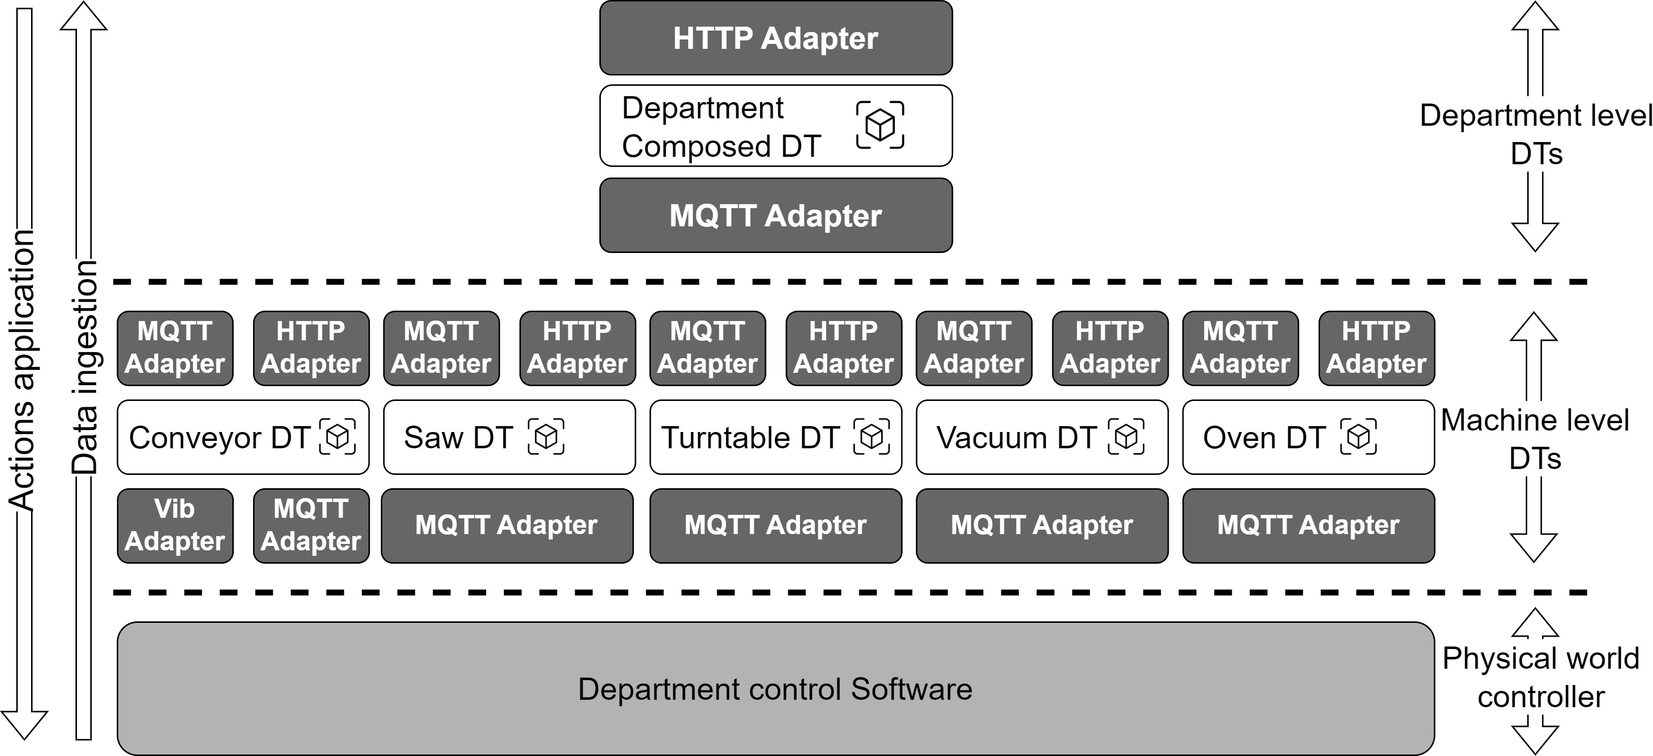


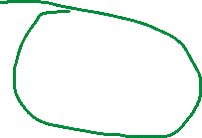

AI & DT interaction – Experimenting Embedded AI
Design:
Fischertechnik testbed based;
One department composition;
Conveyor having a Vibrational Physical Adapter simulating a vibrational sensor;
Simulation obtained with the adapter sending data from an existing dataset;
Data sent respecting the time delta from different readings;
Embedded AI inside of the Conveyor DT;
When vibrational data points drift, the Embedded AI returns a not healthy state of the associated physical asset;
A department shut-down process is then triggered by the Department DT.
Notes:
(1 min)

Slide 32
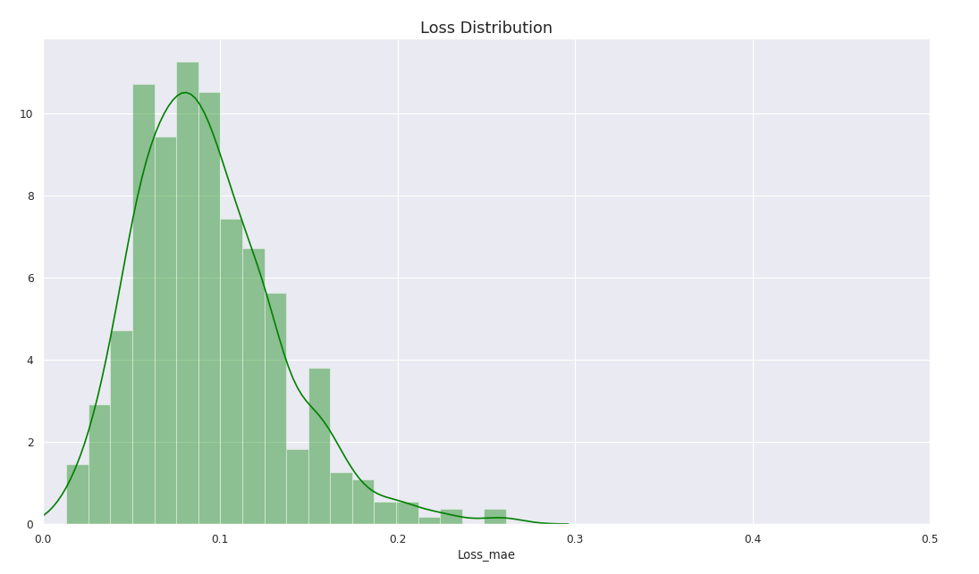
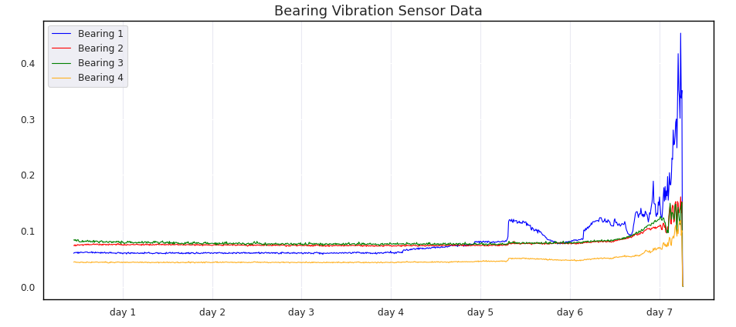
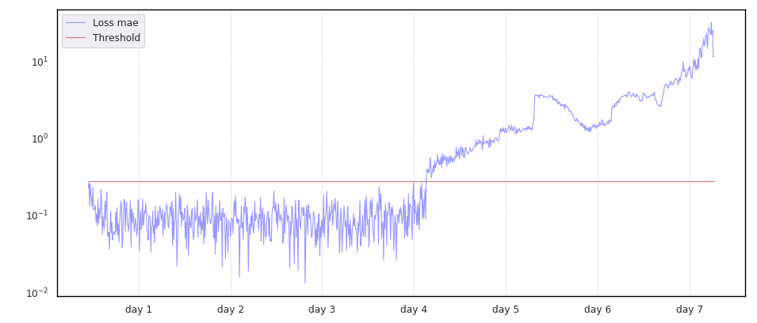
AI & DT interaction – Experimenting Embedded AI
2
1
3
Nasa Bearings dataset¹;
4 sensors for 4 bearings;
LSTM autoencoder algorithm;
AI model embedded in the conveyor DT.
¹ Data set available at: https://www.kaggle.com/datasets/vinayak123tyagi/bearing-dataset
Notes:
(1 min)
Non racconto come è fatto l’alg.

Slide 33
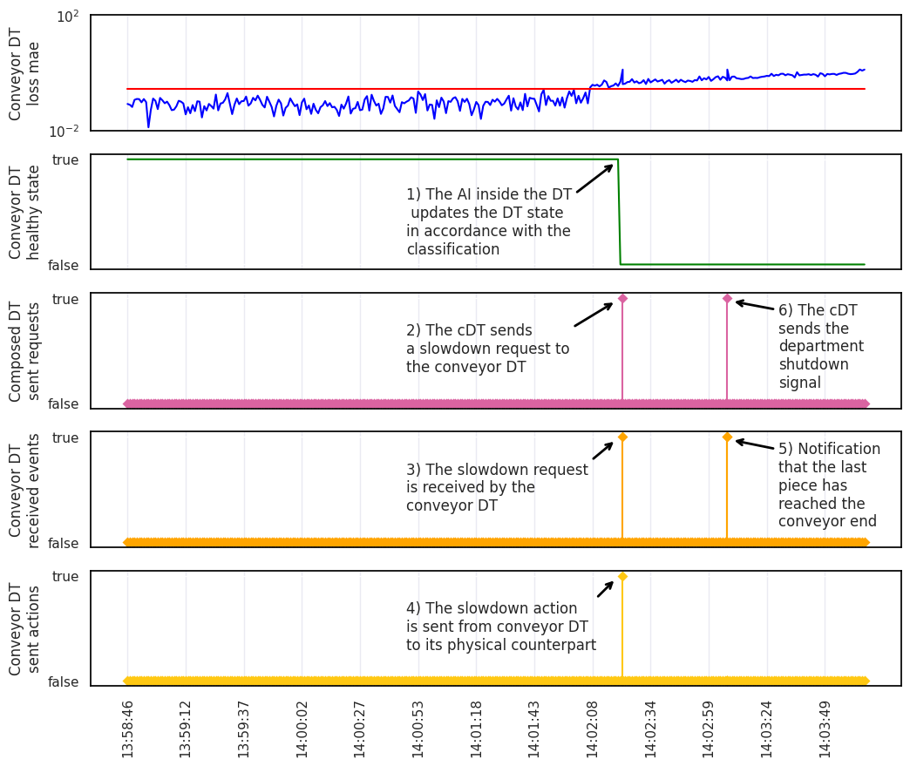
AI & DT interaction – Experimenting Embedded AI
Shut-down process:
Once the conveyor is unhealthy, the information is propagated to the composed DT;
The composed DT sends a slow-down request to the conveyor DT;
The conveyor DT shares the request to its physical counterpart;
The physical counterpart slows down;
The conveyor DT waits for the last piece in the system to end its processing activities;
Once the Composed DT is notified that the last piece has been processed, shuts-down the whole department.
Notes:
(1 min)
RICORDARE IL VANTAGGIO PER L APP ESTERNA: SENZA SAPERE NIENTE MA CONOSCENDO SOLO I DT VEDE TUTTO QUELLO CHE SUCCEDE NEL MONDO REALE.

Slide 34
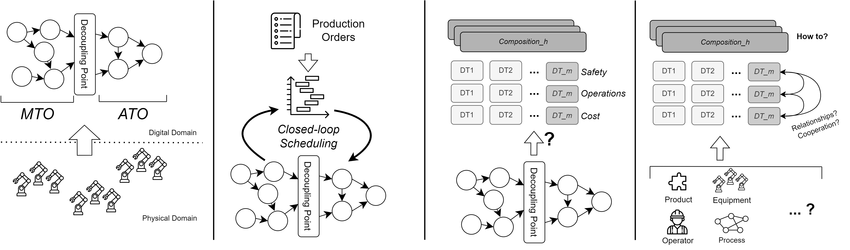
Future works
Industrial architectures
Production Scheduling
DTs Design Methods
DTs Industrial Specializations
Notes:
(1 min)
Industrial architectures:
Resulting structures from the associated DT ecosystem;
New architectures definitions based on DT ecosystem graphs;
New architectures design tools and approaches.
Production Scheduling:
Advanced scheduling supported by the DT ecosystem;
Closed-loop Scheduling enabled by production orders, production planning and production monitoring continuous interaction.

Slide 35
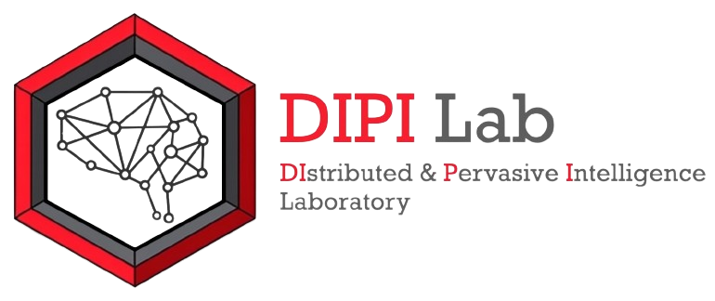




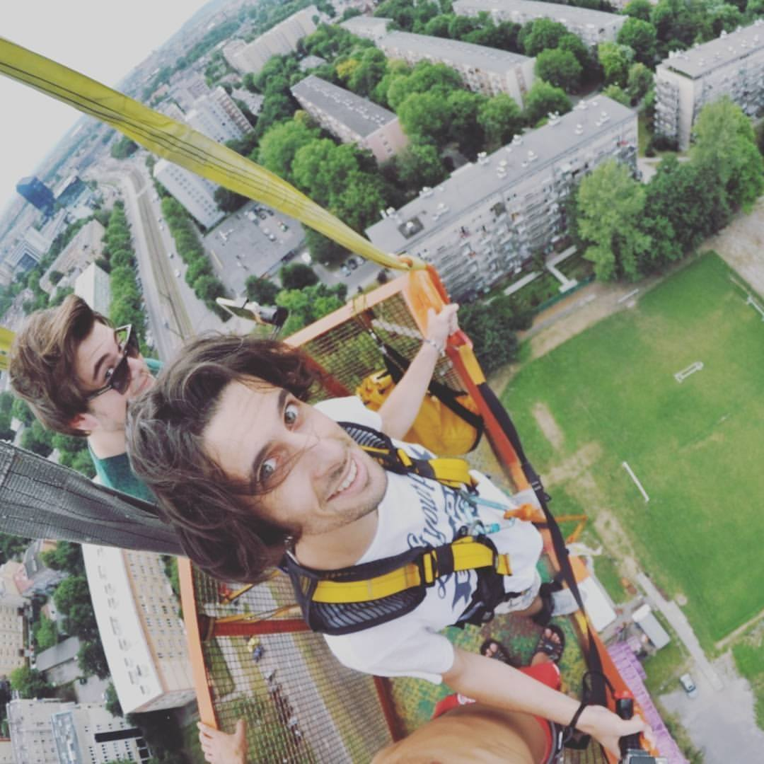
Special thanks to …
Thank you for your attention!

Slide 36
Research results: Publications
Accepted:
Marco Lippi, Matteo Martinelli, Marco Picone, Franco Zambonelli, Enabling causality learning in smart factories with hierarchical digital twins, Computers in Industry, 2023
Matteo Martinelli, Marco Lippi, Rita Gamberini, Poka-yoke meets deep learning: a proof of concept for an assembly line application, Applied Sciences, volume 12, number 21, MDPI, 2022
Marco Lippi, Stefano Mariani, Matteo Martinelli, Franco Zambonelli, Individual and collective self-development: Concepts and challenges, 17th Conference on Computer Science and Intelligence Systems (FedCSIS), 2022
Marco Lippi, Stefano Mariani, Matteo Martinelli, Franco Zambonelli, Self-Development and Causality in Intelligent Environments, 18th International Conference on Intelligent Environments (IE2022), 2022
Marco Lippi, Stefano Mariani, Matteo Martinelli, Franco Zambonelli, Franco, Individual and Collective Autonomous Development, arXiv preprint (arXiv:2109.11223), 2021
WIP:
Antonello Barbone, Samuele Burattini, Matteo Martinelli, Marco Picone, Alessandro Ricci, Antonio Virdis, Digital Twin Continuum: a Key Enabler for Pervasive Cyber-Physical Environments
Matteo Martinelli, Ann-Kathrin Splettstößer, Marco Picone, Marco Lippi, Andreas Wortmann, Hierarchical Digital Twin Ecosystem for Industrial Manufacturing Scenarios
Matteo Martinelli, Marco Lippi, Marco Picone, Andreas Wortmann, Interaction Patterns Between AI and Digital Twin Enabled Shop-Floors in the Industrial Domain
Matteo Martinelli, Marco Picone, Miguel Sellitto, Research and application framework for Industry 4.0: a vision based on Industrial Competitive Priorities
Notes:
FINISH

Slide 37
References
[1] Ghobakhloo M., Industry 4.0, digitization, and opportunities for sustainability, Journal of Cleaner Production (2020)
[2] Rebecca Duray, Mass customization origins: Mass or custom manufacturing?, International Journal of Operations \& Production Management (2002)
[3] Monostori L. et al., Complexity in engineering design and manufacturing, CIRP Annals (2012)
[4] Modrak V. et al., Exploring the Complexity Levels of Discrete Manufacturing Processes, 9th IFAC Conference on Manufacturing Modelling, Management and Control MIM (2019)
[5] Herrera V., Complexity in Manufacturing Systems: a literature review, Production Engineering (2021)
[6] Gabriel AJ., The effect of internal static manufacturing complexity on manufacturing performance, PhD Thesis, Clemson University (2007)
[7] Cheng j. et al., DT-II:Digital twin enhanced Industrial Internet reference framework towards smart manufacturing, Robotics and Computer-Integrated Manufacturing (2020)
[8] Jan Z. et al., Artificial intelligence for industry 4.0: Systematic review of applications, challenges, and opportunities, Expert Systems with Applications (2023)
[9] S. Haag, and R. Anderl., Digital Twin–Proof of concept, Manufacturing Letters 15 (2018)
[10] Minerva R. et al., Digital Twin in the IoT Context: A Survey on Technical Features, Scenarios, and Architectural Models, Proceedings of the IEEE (2020)
[11] Kaklis D. et al., Enabling digital twins in the maritime sector through the lens of AI and industry 4.0, International Journal of Information Management Data Insights (2023)
[12] Wang W. et al., A proactive material handling method for CPS enabled shop-floor, Robotics and Computer-Integrated Manufacturing (2020)
[13] Friedrich J. et al., A framework for data-driven digital twins for smart manufacturing, Computers in Industry (2022)
[14] Crespi N. et al., Digital Twins: Properties, Software Frameworks, and Application Scenarios, IT Professional (2021)
[15] Hazra A. et al., A Comprehensive Survey on Interoperability for IIoT: Taxonomy, Standards, and Future Directions, ACM Comput. Surv. (2021)
[16] Tao F. et al., Digital twin-driven product design, manufacturing and service with big data, International Journal of Advanced Manufacturing Technology (2018)

Slide 38
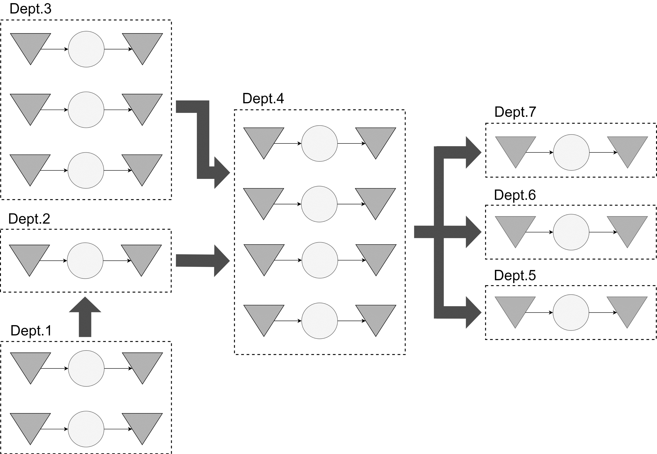
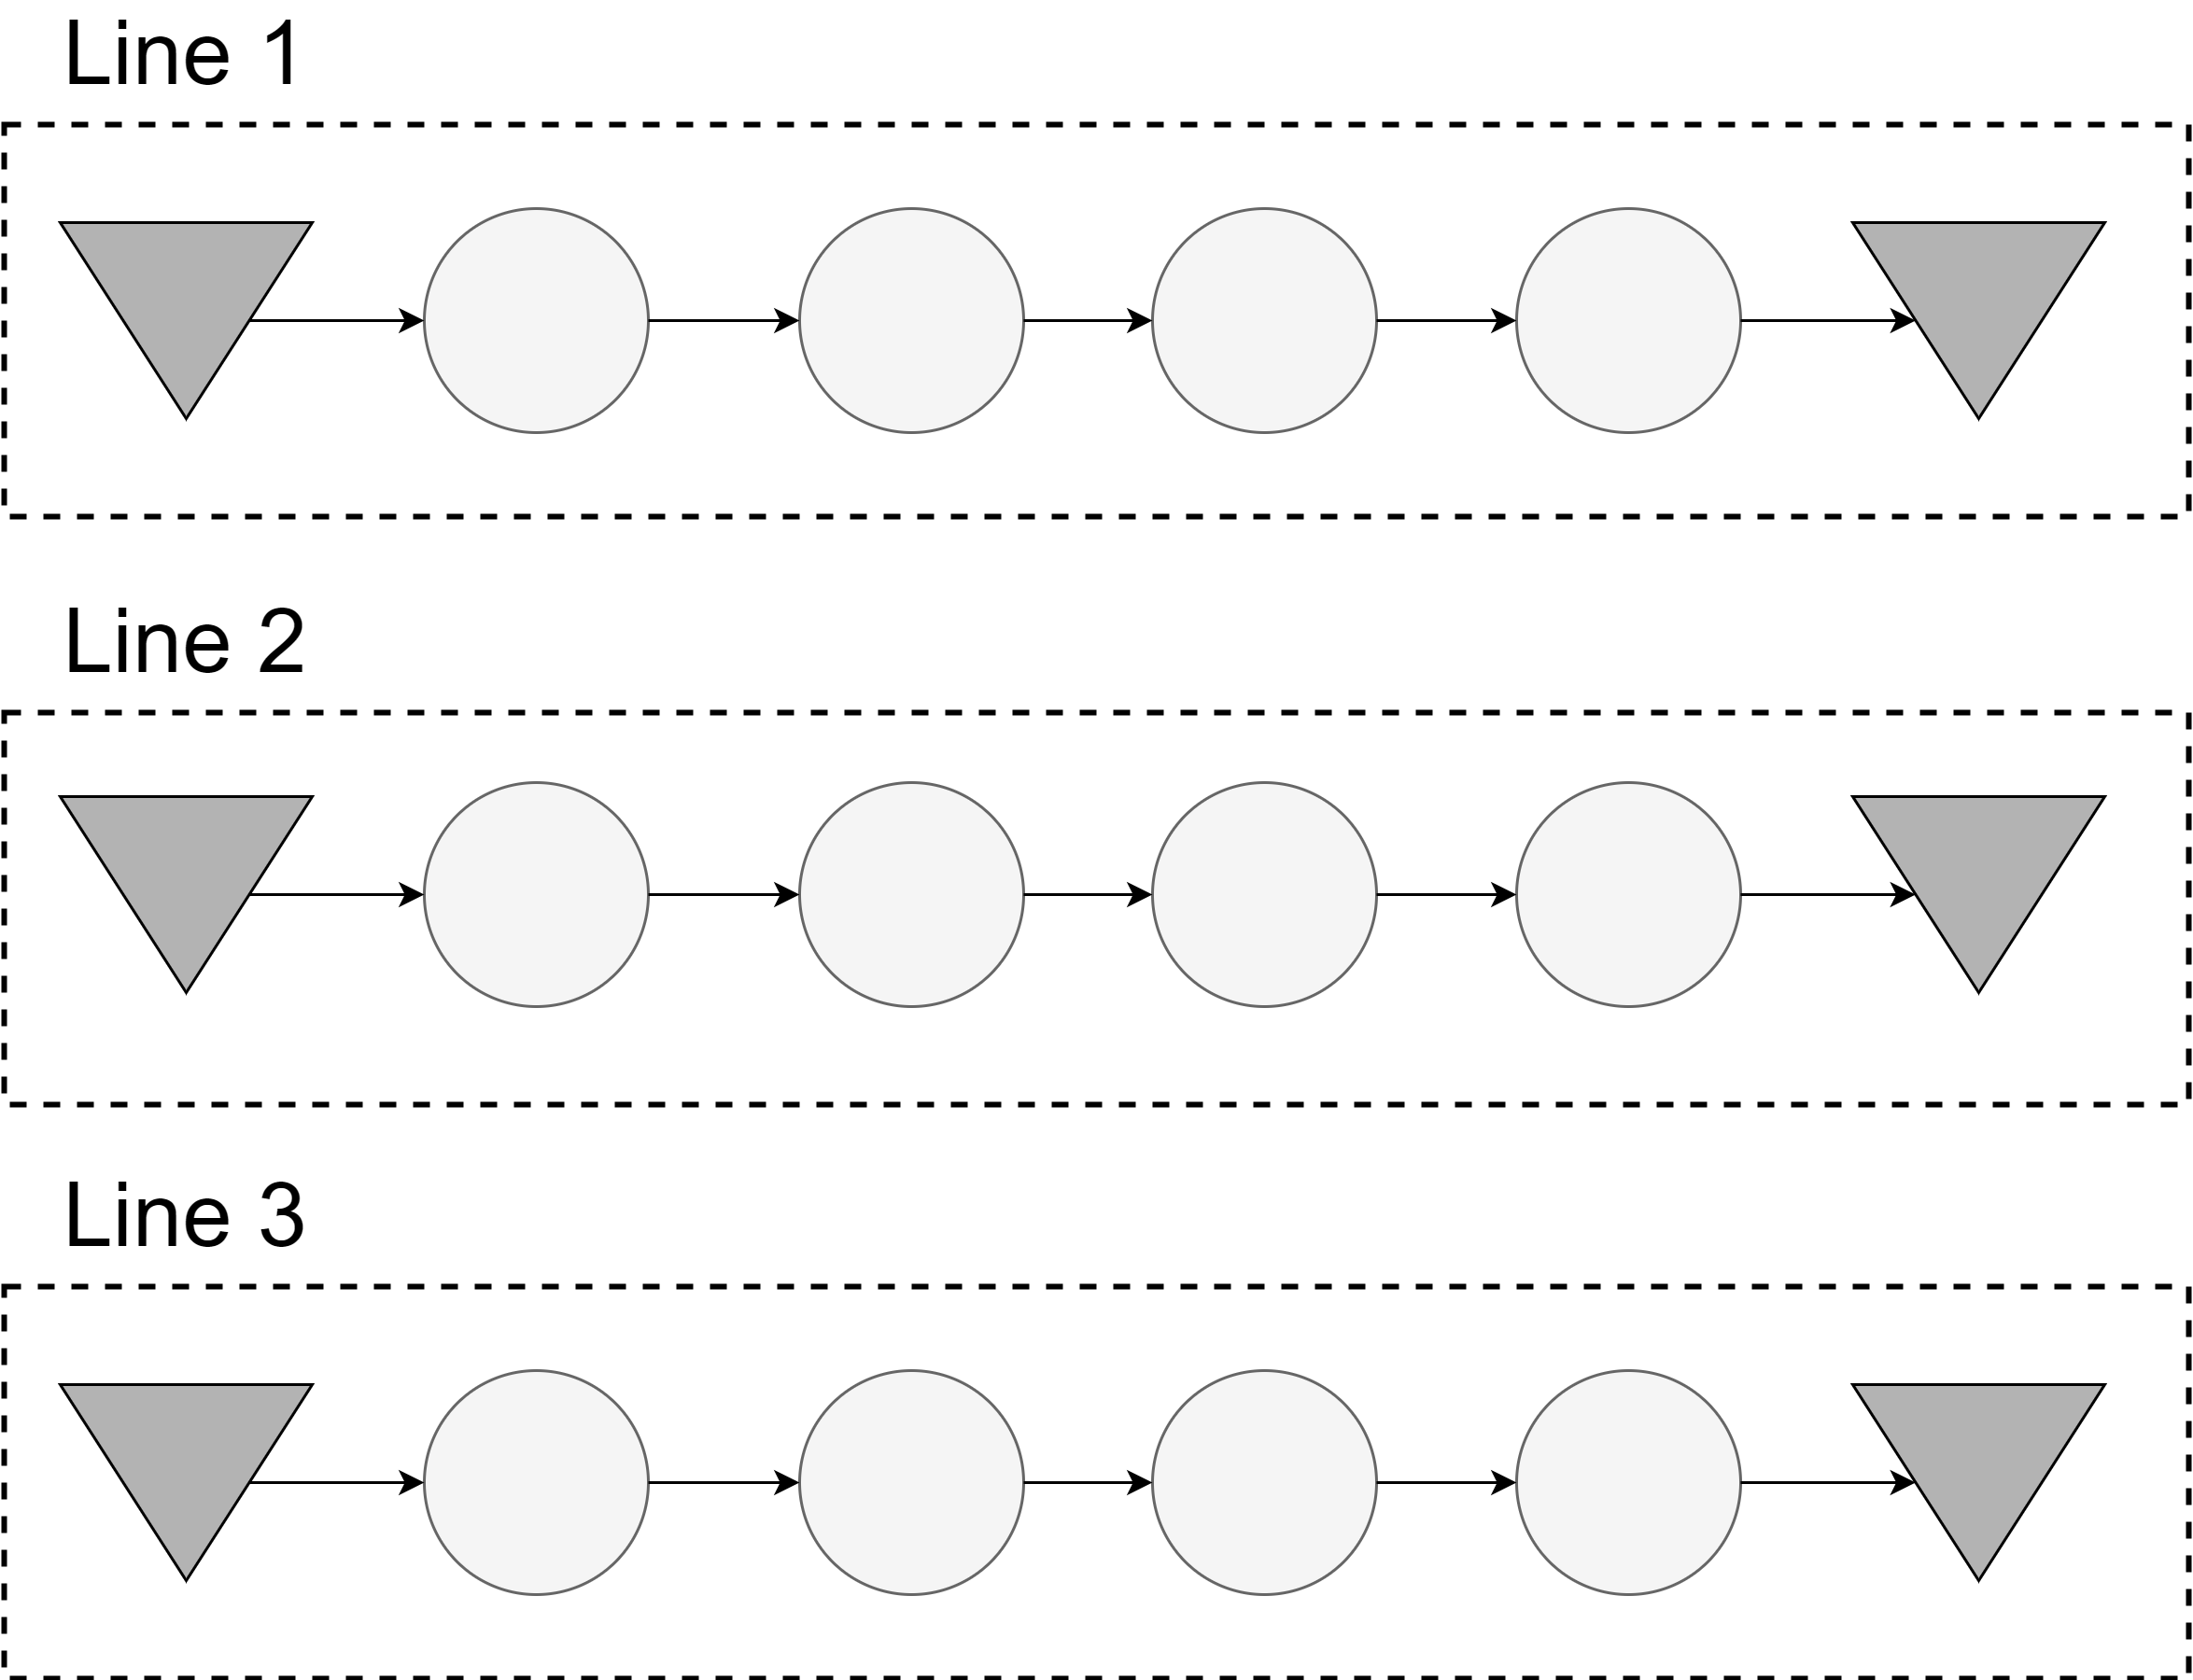
Digital Complexity in the Industrial Domain
How to calculate the OEE for a single product across different industrial architectures?
How to calculate production pollution emissions for a single product across different industrial architectures?
Notes:
PER LE DOMANDE

Slide 39
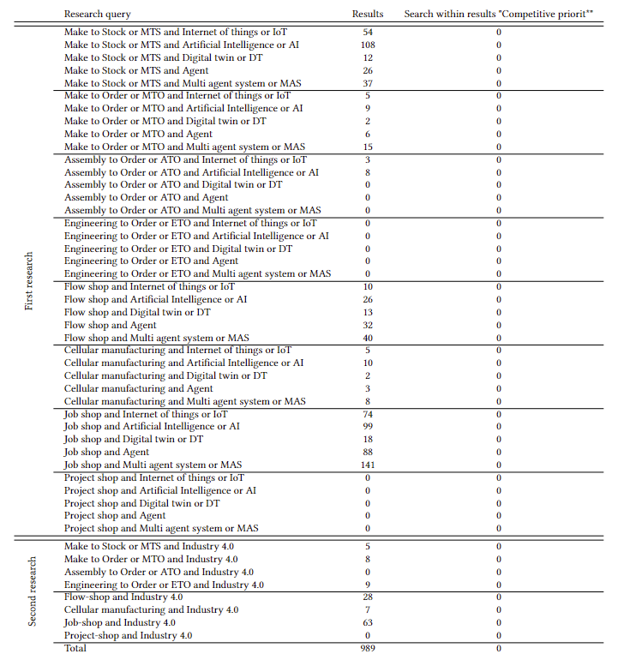
Analysis of the state of the Art
Additional filters:
from 2015 to 2022
Engineering, Decision Sciences, Computer Sciences, Business, Management and Accounting.
Results:
989 articles collected
116 articles manually selected
Architectures numbers:
Job-shop: 448 articles
MTS: 242 articles
Flow-shop: 149 articles
MTO: 45 articles
Cellular manufacturing: 35 articles
ATO: 11 articles
ETO: 24 articles
Project-shop: 0 articles
Technologies numbers:
MAS: 156 articles
Agents: 245 articles
AI: 265 articles
IoT: 152 articles
DT: 51 articles
Competitive priorities numbers: 0
Notes:
In the first research, the most considered CODP in I4.0 is MTS; least considered is ATO
In the first research, the most considered shop floor layouts I4.0 is Job-shop; least considered is Project-shop
Most considered technologies are agent systems, present for many years, and AI, which attracted a great interest in the last years.
IoT and DT, have similar results
Finally, 116 articles selected.

Slide 40
DT vs. Agents: what are the differences?
Abstraction principles:
DTs abstract physical world elements and transpose them into the digital domain;
Agents abstract human behaviour in socio-technical system and associated relation activities.
Separation of concerns:
DTs operations are limited to the boundaries of the physical counterpart and associated context;
Agents operate within the boundaries of the digital context of the whole application following the designer choices.
Relationships?
DT
A
Interaction patterns between agents and DTs:
Agents or MAS on top of a virtual environment digitalized through DTs:
DTs are a medium of the physical counterparts;
DTs can exploit augmentation capabilities to be offered to Agents;
Agents or MAS exploited by DTs to realize the cognitive DT:
For autonomous operations within the context of the physical counterpart.
Ricci A. et al., About Digital Twins, agents and multiagent systems: a cross-fertilization journey (2022),
Clemen T. et al., Multi-Agent Systems and Digital Twins for Smarter Cities (2021),
Croatti A. et al. On the Integration of Agents and Digital Twins in Healthcare (2020)
Notes:
UNDER INVESTIGATION

Slide 41
AI & DT interaction – Industrial scenario
In [14] 5 levels of maturity for DTs are depicted: descriptive DT, informative DT, predicting DT, prescriptive DT, and autonomous DT.
Observer AI: following [14], informative, predictive, or prescriptive system.
Advisor AI: following [14], prescriptive, or autonomous system.
Controller AI: following [14], predictive, prescriptive, or autonomous system.
Embedded AI: following [14] predictive, prescriptive, or autonomous system.
[14] Crespi N. et al., Digital Twins: Properties, Software Frameworks, and Application Scenarios (2021)

