Slide 1
To Churn or Not to Churn
Data driven analysis and strategies to retain high-value custumers

Slide 2
Long Term Contracts Reduce Churn
Base
Churn Rate*
Adjusted Churn Rate
-21%
6%
2 Year Contract
-10%
17%
1 year Contract
+10%
37%
Monthly Bill
+14%
41%
No Phone Plan
+22%
49%
Fiber-Optic Internet
+35%
62%
Payment Method
*Base Churn Rate is 27%
Notes:
Why is recall and F2 score more important?
Easy explanation of XGBoost
Base Percentage: 26.5%

Slide 3
Payment and Internet Drive Churn
Base
Churn Rate*
Adjusted Churn Rate
-21%
6%
2 Year Contract
-10%
17%
1 year Contract
+10%
37%
Monthly Bill
+14%
41%
No Phone Plan
+22%
49%
Fiber-Optic Internet
+35%
62%
Payment Method
*Base Churn Rate is 27%
Notes:
Why is recall and F2 score more important?
Easy explanation of XGBoost
Base Percentage: 26.5%

Slide 4
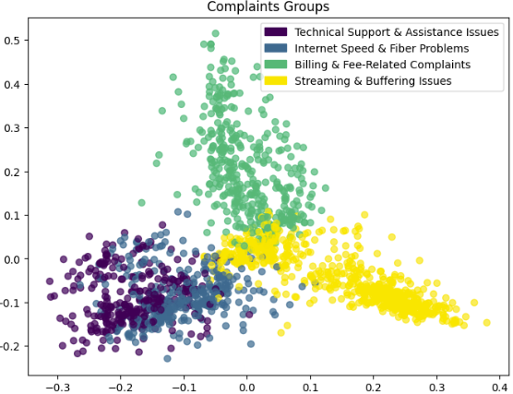




Churn Drivers Dominate Complaints
62% of Complaining Customers Churn
 | Streaming & Buffering 37% Cluster Share
 | Billing Method & Fees 24% Cluster Share
 | Internet Speed & Fiber 20% Cluster Share
 | Technical Support 19% Cluster Share
Notes:
Why is recall and F2 score more important?
Easy explanation of XGBoost
Base Percentage: 26.5%

Slide 5
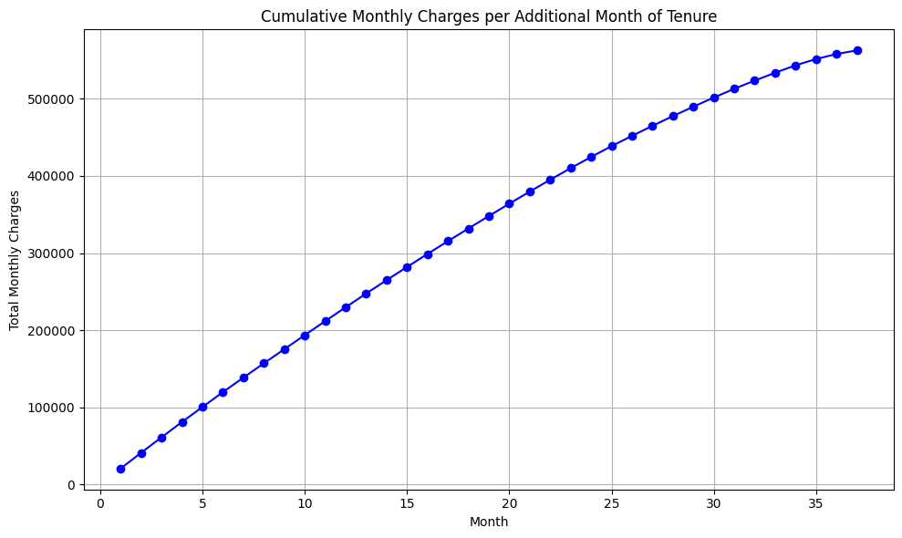
Churner are a € 560 k opportunity
Key Stats
€ 560,000
+ 21
Additional Months
Potential Additional Revenues
+ € 14
1st Year Revenues
Of Monthly Charges
€ 230,000 (41%)
84%
50 % Conversion
Churn Prediction Accuracy
€ 280,000

Slide 6




Final Suggestions
Contract
Internet
Loyalty Program
Long-Term Contracts
Sign-Up Bonuses
Discounts
Unreliable Internet:
Prioritize Complaints
Technical Concerns
Create Loyalty Program:
Tenure-Based Tiers
Offer Bundles
Earn Free Months
Earn External Rewards
Referral Program
Charges
Payment
Additional Pricing Packages
Renewal offers
Prioritize Digital Payments

Slide 7
Thank You!
Questions are welcome

Slide 8
Churn Insights
Churners
Non-Churners
Month-to-month Contracts (~60% of churners)
Low feature uptake
Higher frequency of unresolved complaints
Higher Monthly Charges (€80- €100 vs €40- €60 per month)
More likely to use mailed or electronic checks (possible “bill shock” effect)
Long-term contracts (annual/bi-annual) appear to reduce churn
Additional services (“Online Security,” “Backup,” etc.) are common among non-churners
Non-churners often have partners/dependents and remain
Longer Tenure
Notes:
Low feature uptake in churners suggests bundling or cross-selling could improve retention
Tenure, complaint count, monthly/total charges, contract type, payment method, internet tier, demographic flags, and add-on usage emerge as top predictors, it is left to be seen if these features apparent in an EDA are also reflected in the ML model

