Slide 1
Cluster Analysis
Matteo Tinè

Slide 2
Dataset
The dataset refers to data about university students in Italy, grouped by the municipality of the university
This data can be retrieved from ISTAT, the Italian national institute of statistics
http://dati.istat.it/

Slide 3
Concept
The idea is to cluster (some) cities according to composition of student body
Only 2 variables:
Percentage of female students
Percentage of foreign students
Original size: 2 variables, 270 observations

Slide 4
Preliminaries
Why only 2 variables?
No division between bachelor/master/PhD or age
Why “some” cities?
Some municipalities have very few students, even less than 10 in some cases
I considered cities with at least 1000 students
Why cities and not universities?
Some cities have more than one university
Some universities are in more than one city

Slide 5
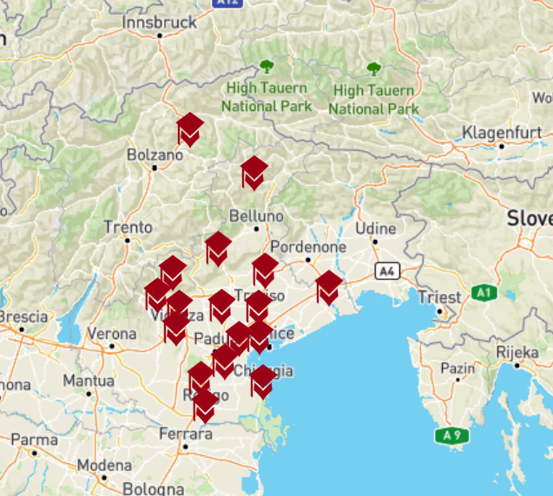
Preliminaries
University of Padua, source: https://www.unipd.it/campus-diffuso/sedi-decentrate

Slide 6

Preliminaries
Universities in Milan

Slide 7
Purpose
As mentioned, the goal is to understand the composition of the student body in different cities
It could be useful, e.g., for students picking their exchange semester destinations

Slide 8
Distance
As a first thing, check for correlation, to see what kind of distance metric to use
Also, plot points
cor(df, use="complete.obs")
## foreign_ratio females_ratio ## foreign_ratio 1.00000000 0.02799669 ## females_ratio 0.02799669 1.00000000

Slide 9
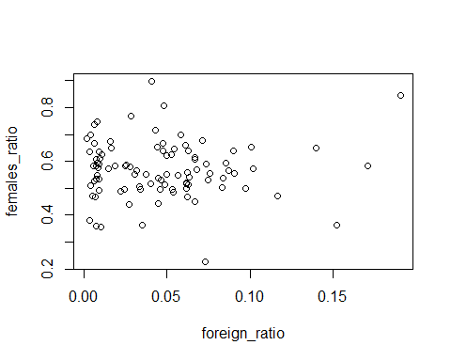
plot(df) plot(scale(df))

Slide 10
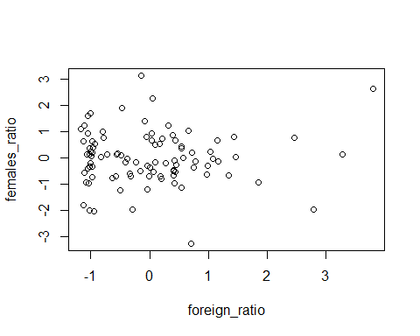

Slide 11
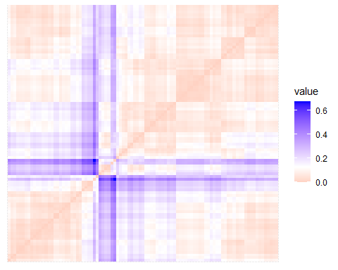
Distance
As we have seen that there is no correlation, we can use the Euclidean distance
distance <-dist(df, method = "euclidean") fviz_dist(distance, show_labels = FALSE)

Slide 12
Clustering and dendrograms
Use the distance matrix to cluster
I used average, complete and single linkage
single_linkage <- hclust(distance, method = "single") complete_linkage <- hclust(distance, method = "complete") average_linkage <- hclust(distance, method = "average")

Slide 13
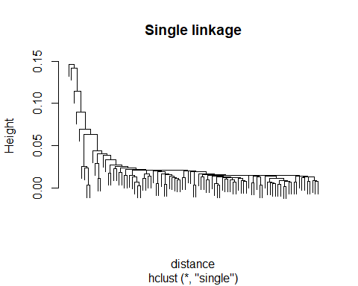

Slide 14
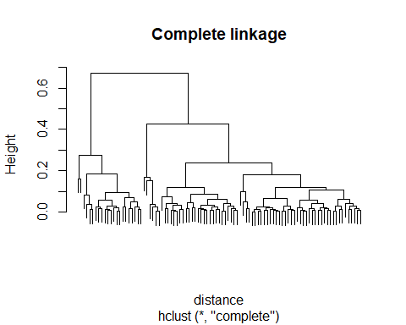

Slide 15
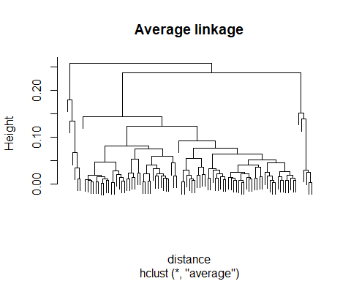

Slide 16
Correlations
Having the dendrogram, we can see if/how much they are correlated
single_dend <- as.dendrogram(single_linkage) complete_dend <- as.dendrogram(complete_linkage) average_dend <- as.dendrogram(average_linkage) dend_list <- dendlist("Single" = single_dend, "Complete" = complete_dend, "Average" = average_dend) correlations <- cor.dendlist(dend_list)

Slide 17
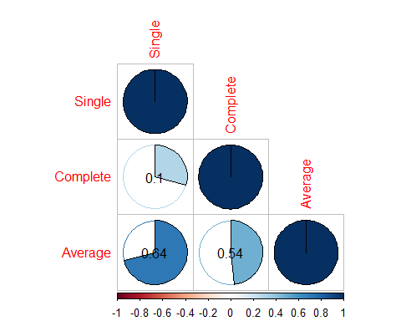
As we can see, there is a correlation but it is not statistically significant
testcorr <- cor.mtest(correlations, conf.level = 0.95, sig.level = -1) corrplot(correlations, "pie", type = "lower", p.mat = testcorr$p , insig = 'p-value')

Slide 18
Cutting trees
From the dendrograms, we can see where to cut the tree.
Single linkage: height = 0.025
Average and complete linkages: height = 0.075
single_cut <- cutree(single_linkage, h = 0.025) complete_cut <- cutree(complete_linkage, h = 0.075) average_cut <- cutree(average_linkage, h = 0.075)

Slide 19
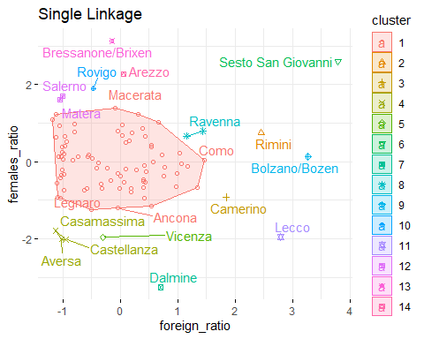
#Note that values on the axes are normalized fviz_cluster(list(data = df, cluster = single_cut), labs(title = "Single Linkage"), ellipse.type = "convex", repel = TRUE, show.clust.cent = FALSE, ggtheme = theme_minimal())+ggtitle("Single Linkage")

Slide 20
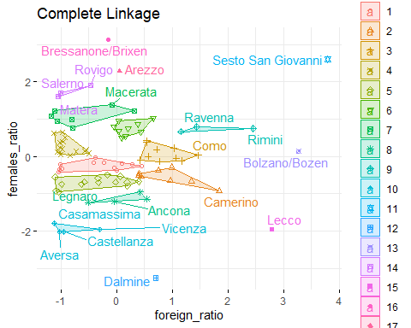
fviz_cluster(list(data = df, cluster = complete_cut), ellipse.type = "convex", repel = TRUE, show.clust.cent = FALSE, ggtheme = theme_minimal())+ggtitle("Complete Linkage")

Slide 21
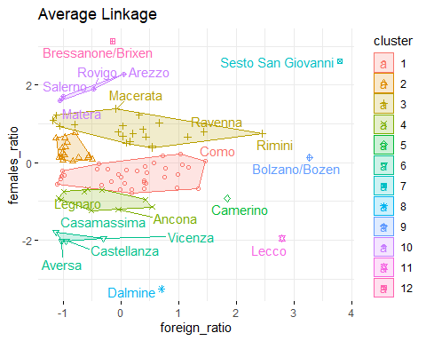
fviz_cluster(list(data = df, cluster = average_cut), ellipse.type = "convex", repel = TRUE, show.clust.cent = FALSE, ggtheme = theme_minimal())+ggtitle("Average Linkage")

Slide 22
Interpreting (some) results
There are some stable clusters
Some outliers on the right of the plot
But also 2 small clusters on the left (bottom and top)

Slide 23
Stable cluster
Let us check one of them to see what is going on
Bottom left: Casamassima, Aversa, Castellanza
Low foreign ratio, low female ratio
Why?

Slide 24
Stable cluster
One possible explanation: same type of university/departments
However: Casamassima, Castellanza have private business schools (LIUC, LUM respectively)
Aversa has an engineering department of a public university (UniCampania)
What about location?

Slide 25
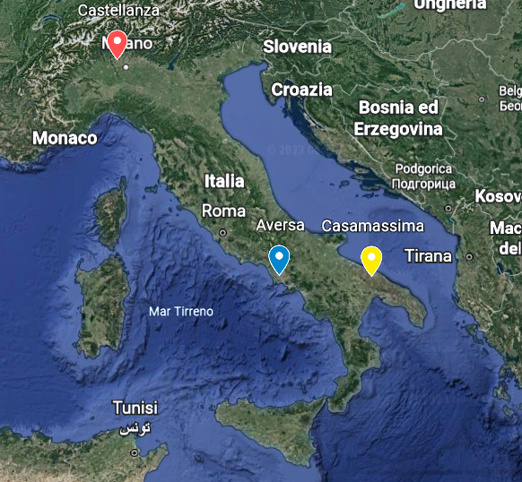
Stable cluster
City locations

Slide 26
Conclusions
Dendrograms from different methods are correlated but not significantly
Cutting trees “visually” yields different results
There are quite a few outliers
But also a couple of small, stable clusters

