Slide 1

Cloud RAN-based cellular system
Matteo Halilaga
Lorenzo Mancinelli
Rocco Giuseppe Pastore

Slide 2
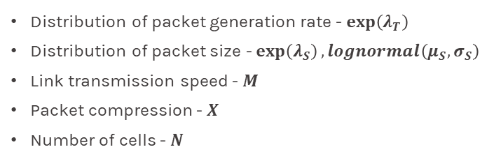
Introduction
Objectives
Configuration variables
Analyze the performances of a Cloud RAN-based cellular system using the following KPIs:
Mean end-to-end delay
Queueing time on the BBU
The operating modes of the system are:
No compression before sending a packet
Compression of X% before sending a packet
Distribution of packet generation rate - $\exp\left(λ_{T}\right)$
Distribution of packet size - $\exp\left(λ_{S}\right), lognormal\left(μ_{S},σ_{S}\right)$
Link transmission speed - $M$
Packet compression - $X$
Number of cells - $N$
1

Slide 3
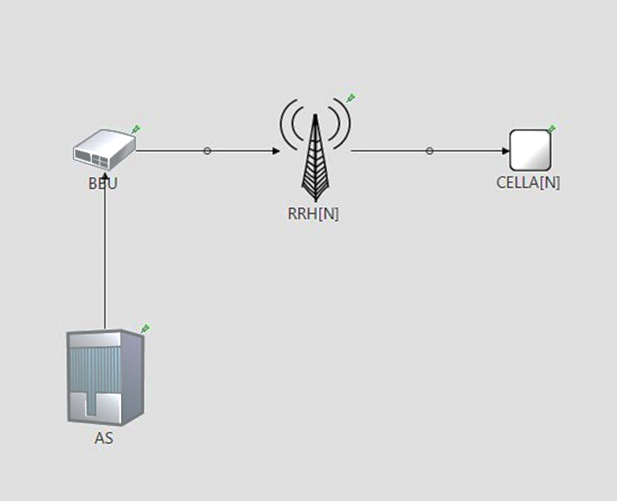
Implementation
Application Server: generates packets of size S every T seconds.
BBU: routes packets to the appropriate RRH, with or without compression.
RRH: forward the packet to the specified cell, maybe after a decompression stage.
Cell: destination of the packet. Here the end-to-end delay is measured.
message Packet {
double size;
int cell;
simtime_t timestamp;
}
2

Slide 4
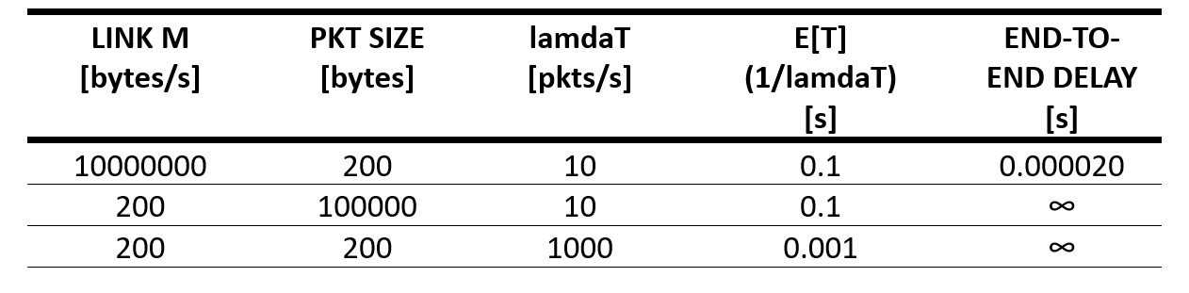
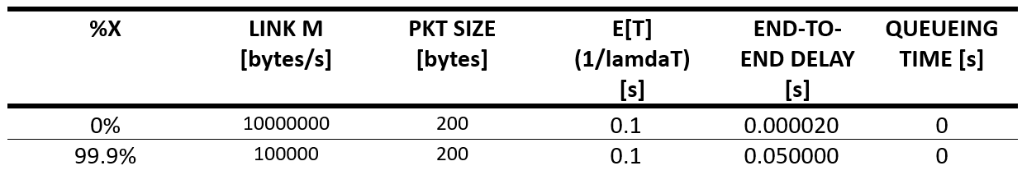
Code verification
Degeneracy tests
Without compression: very high values of link speed, packet size or generation rate lead to almost zero or infinite end-to-end delay.
With compression
Equal to the previous case.
Almost zero queueing time.
3

Slide 5
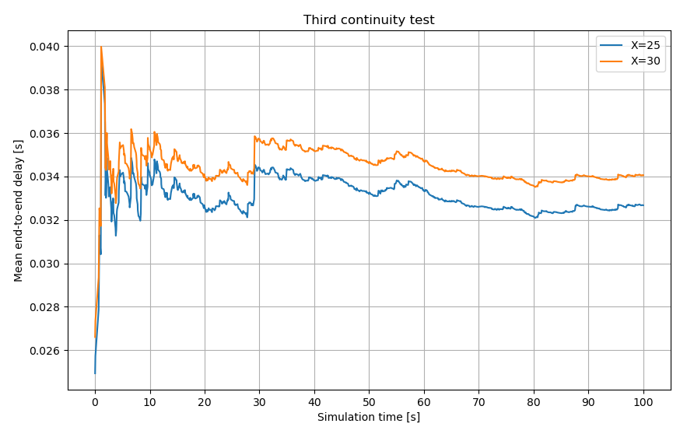
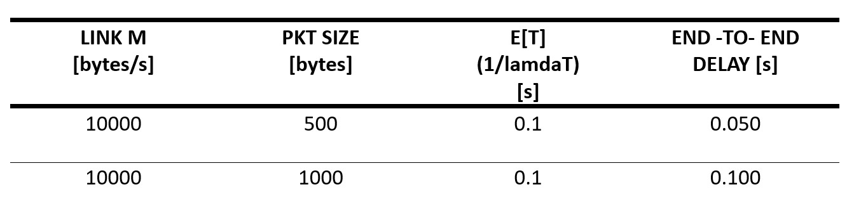
Code verification
Consistency
Continuity
Doubling the packet size leads to a doubling of the end-to-end delay.
Slight variations in simulation parameters lead to slight changes in end-to-end delay.
4

Slide 6
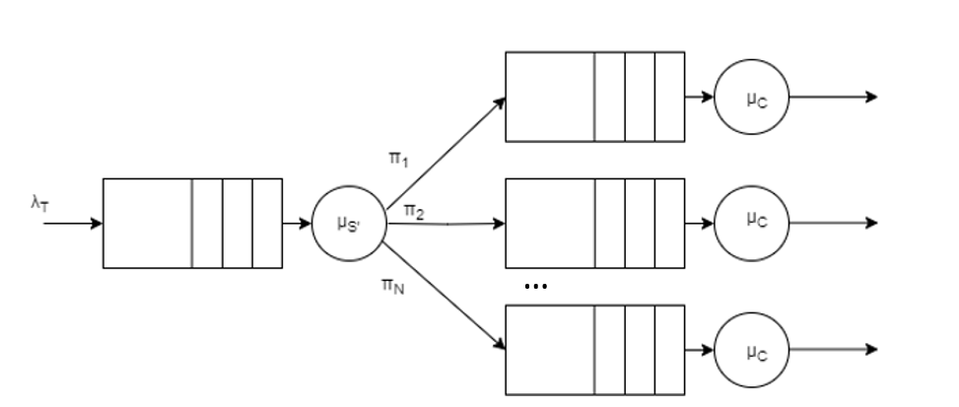
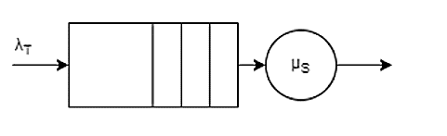
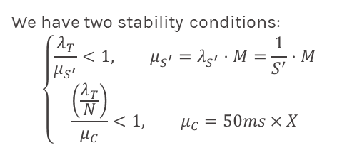

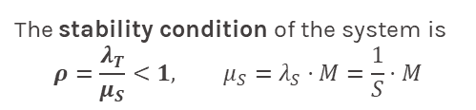
Theoretical model – exponential case
Without compression
With compression
M/M/1 system with $E\left[N\right]=\frac{ρ}{1−ρ}, E\left[R\right]=\frac{E\left[N\right]}{λ_{T}}$
M/D/1 system
The stability condition of the system is
$$ρ=\frac{λ_{T}}{μ_{S}}<1, μ_{S}=λ_{S}⋅M=\frac{1}{S}⋅M$$
We have two stability conditions:
$$\left\{\begin{aligned}\frac{λ_{T}}{μ_{S^{′}}}<1, μ_{S^{′}}=λ_{S^{′}}⋅M=\frac{1}{S^{′}}⋅M \\ \frac{\left(\frac{λ_{T}}{N}\right)}{μ_{C}}<1, μ_{C}=50ms×X\end{aligned}\right.$$
5

Slide 7
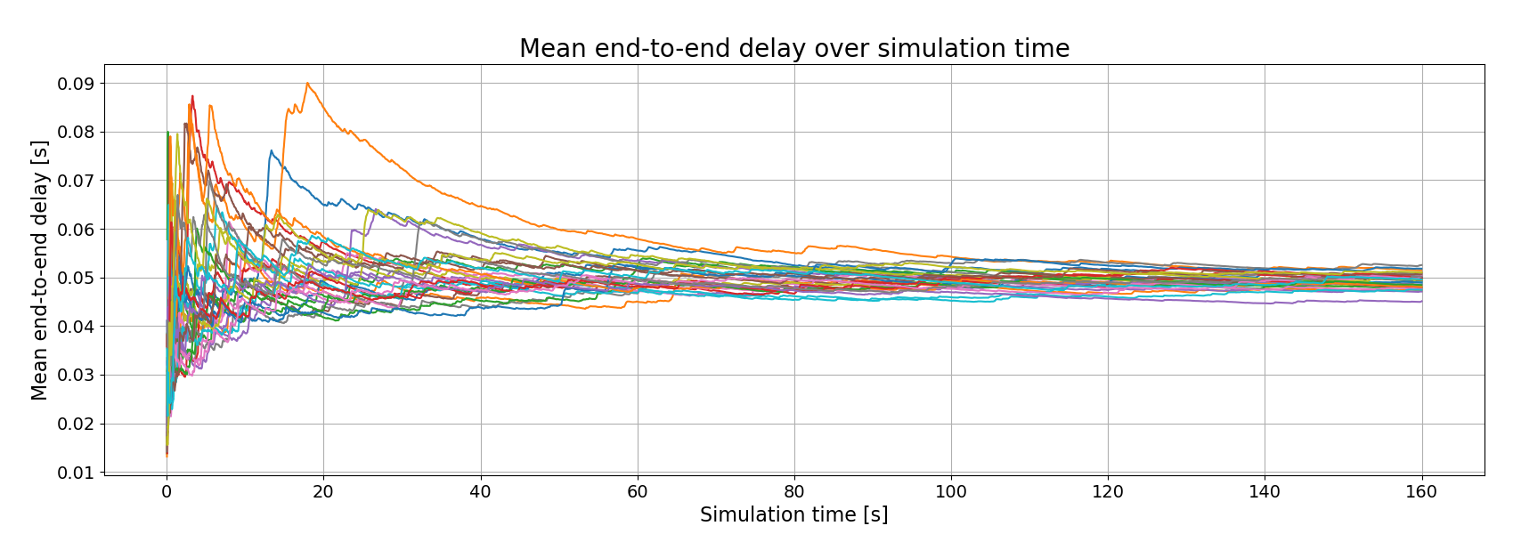
Warmup and simulation time
Warmup period = 40s
Simulation time = 160s
6

Slide 8
Scenarios
 | Load | Link speed
General load – fast link | Any type of traffic | M = 10Mbps
High load – medium link | Generic – 500 bytes Videostream – 1000 bytes | M = 1Mbps
Low load – slow link | VoIP (100, 200 bytes) | M = 100kbps
The higher the speed of the M link, the lower the system usage and the less convenient the compression will be.
7

Slide 9
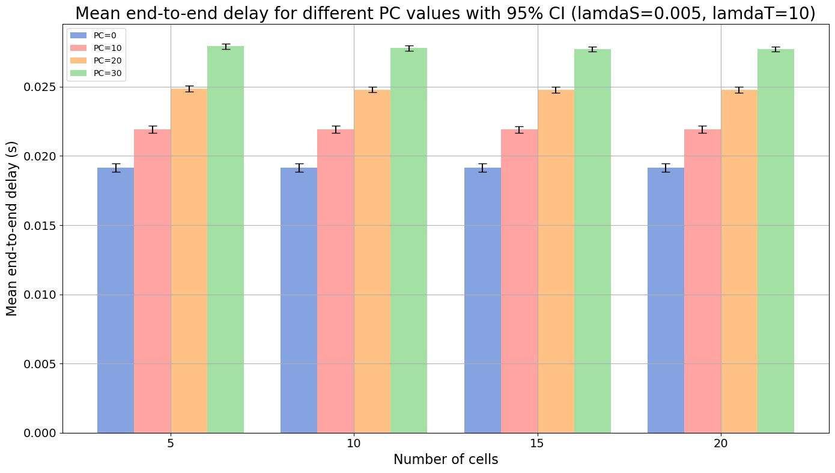
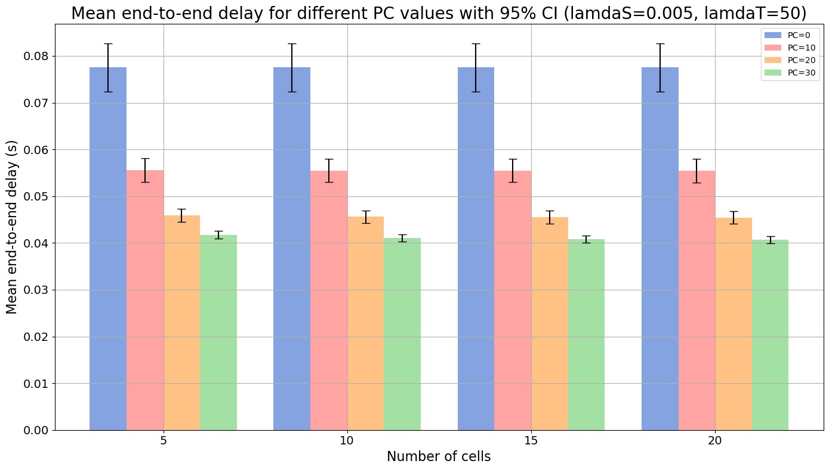



Exponential distribution – end-to-end delay
Low usage ($ρ=0,16$)
High usage ($ρ=0,8$)
Slow link $→M=100kbps$
8

Slide 10
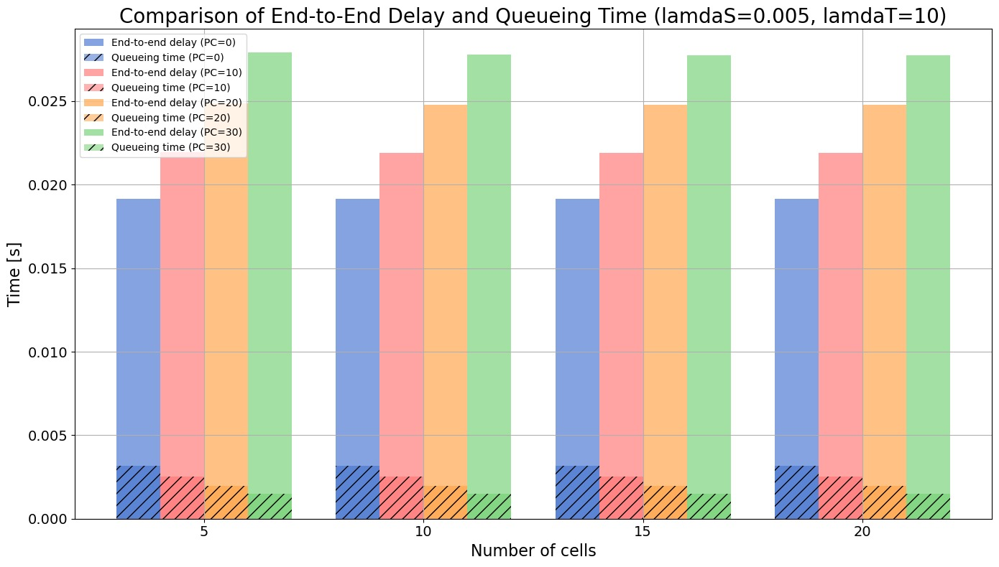
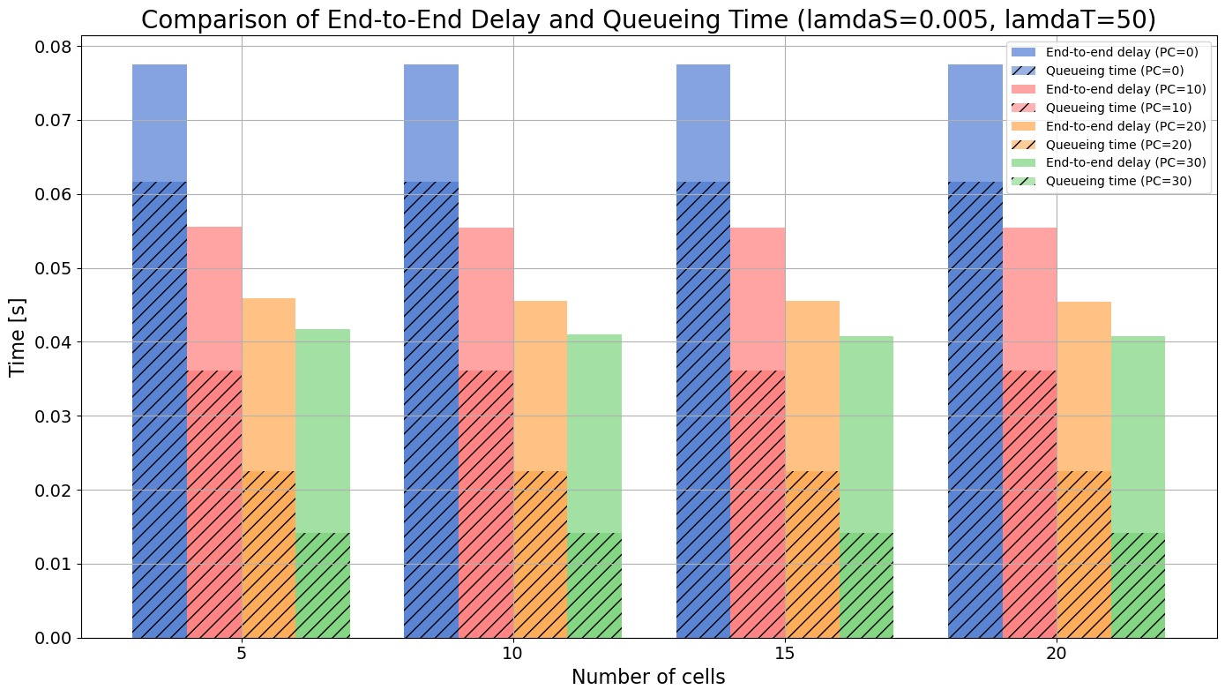
Exponential distribution – queueing time
Low usage
High usage
Slow link $→M=100kbps$
9

Slide 11
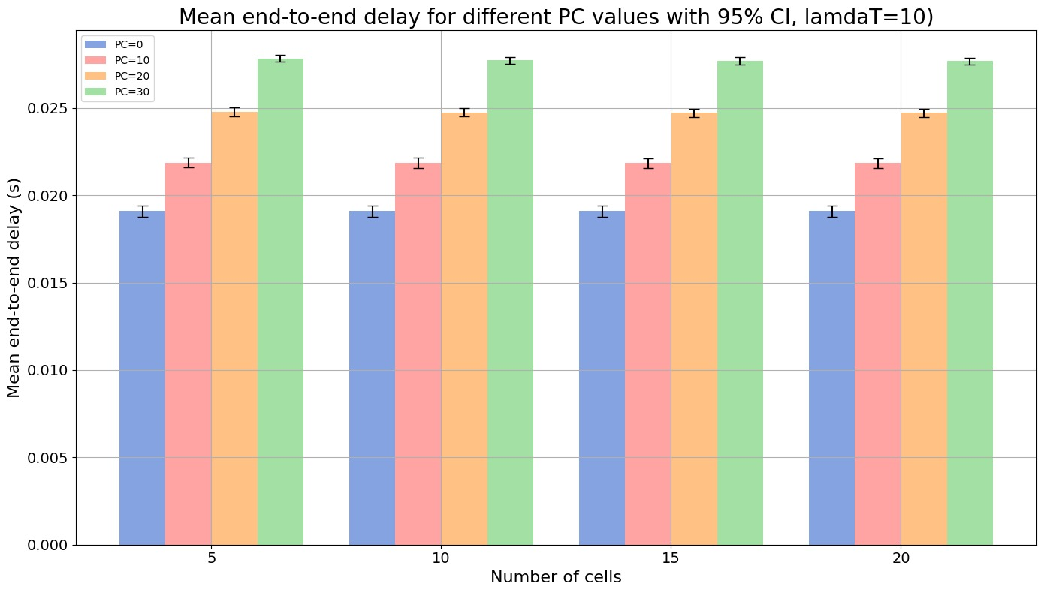
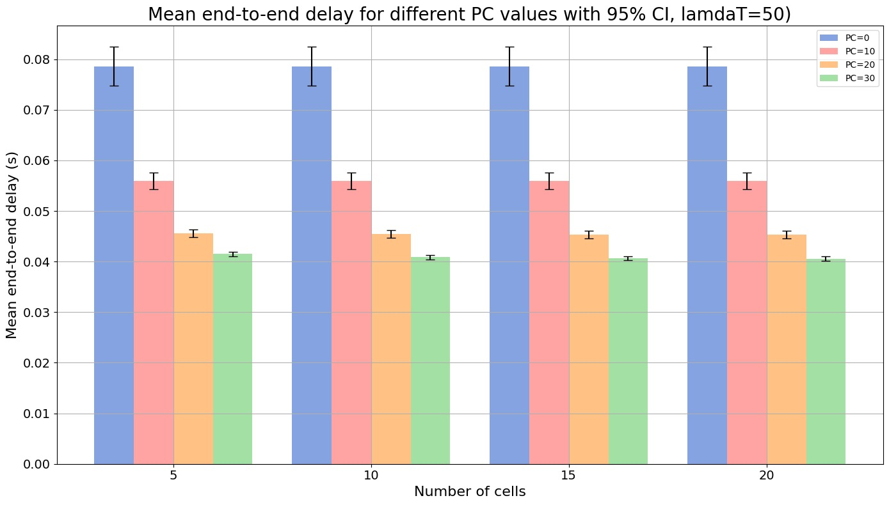
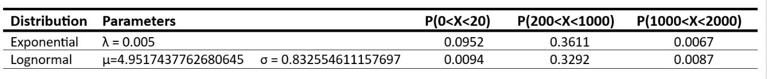

Lognormal distribution
$\sim$ same results as the exponential case!
Low usage
High usage
Low load - slow link $→S=200 bytes, M=100kbps$
10

Slide 12
Conclusion
The correct functioning of the system strongly depends on the sizing of the link between BBU and RRH.
With the same packet size and generation rate, the higher the link, the lower the system usage, given that not much queue will form on the BBU.
When there is high utilization, it’s convenient performing compression.
Increasing the number of cells improves system performance slightly when packet compression is performed.
11

