Slide 1
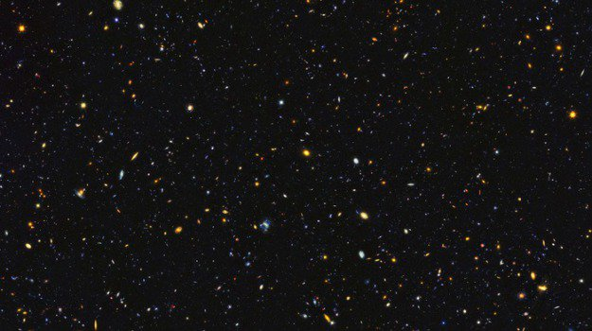

Slide 2
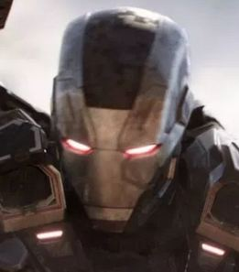
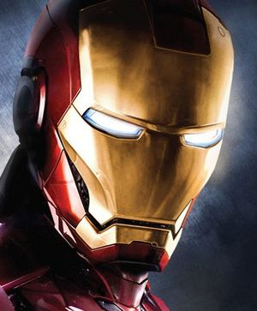
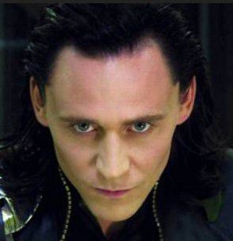
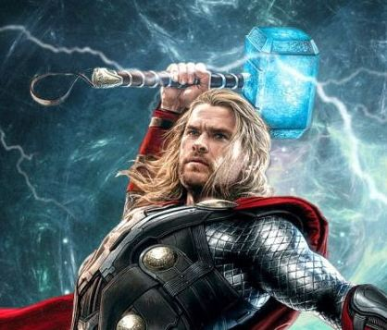
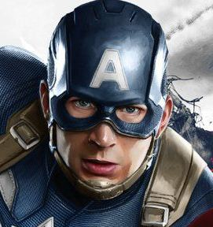
Iron man 2
Thor
Captain America

Slide 3
Iron man 2
Thor
Captain America

Slide 4
Iron man 2
Thor
Captain America

Slide 5

Iron man 2
Thor
Captain America

Slide 6
Second Idea
Dynamic Force-Directed Graphs

Slide 7
