Slide 1


USI - Matteo Alberici - IR 2021 Project

Slide 2

Web Crawling
Matteo Alberici - IR 2021 Project

Slide 3




2000 companies
CSE Crawler
250 companies
320 companies
1000 companies
Matteo Alberici - IR 2021 Project

Slide 4


[T] Name
★ Rating
CSE Crawler
Country
Nº Size
Industry
Matteo Alberici - IR 2021 Project

Slide 5

Indexing
Matteo Alberici - IR 2021 Project

Slide 6
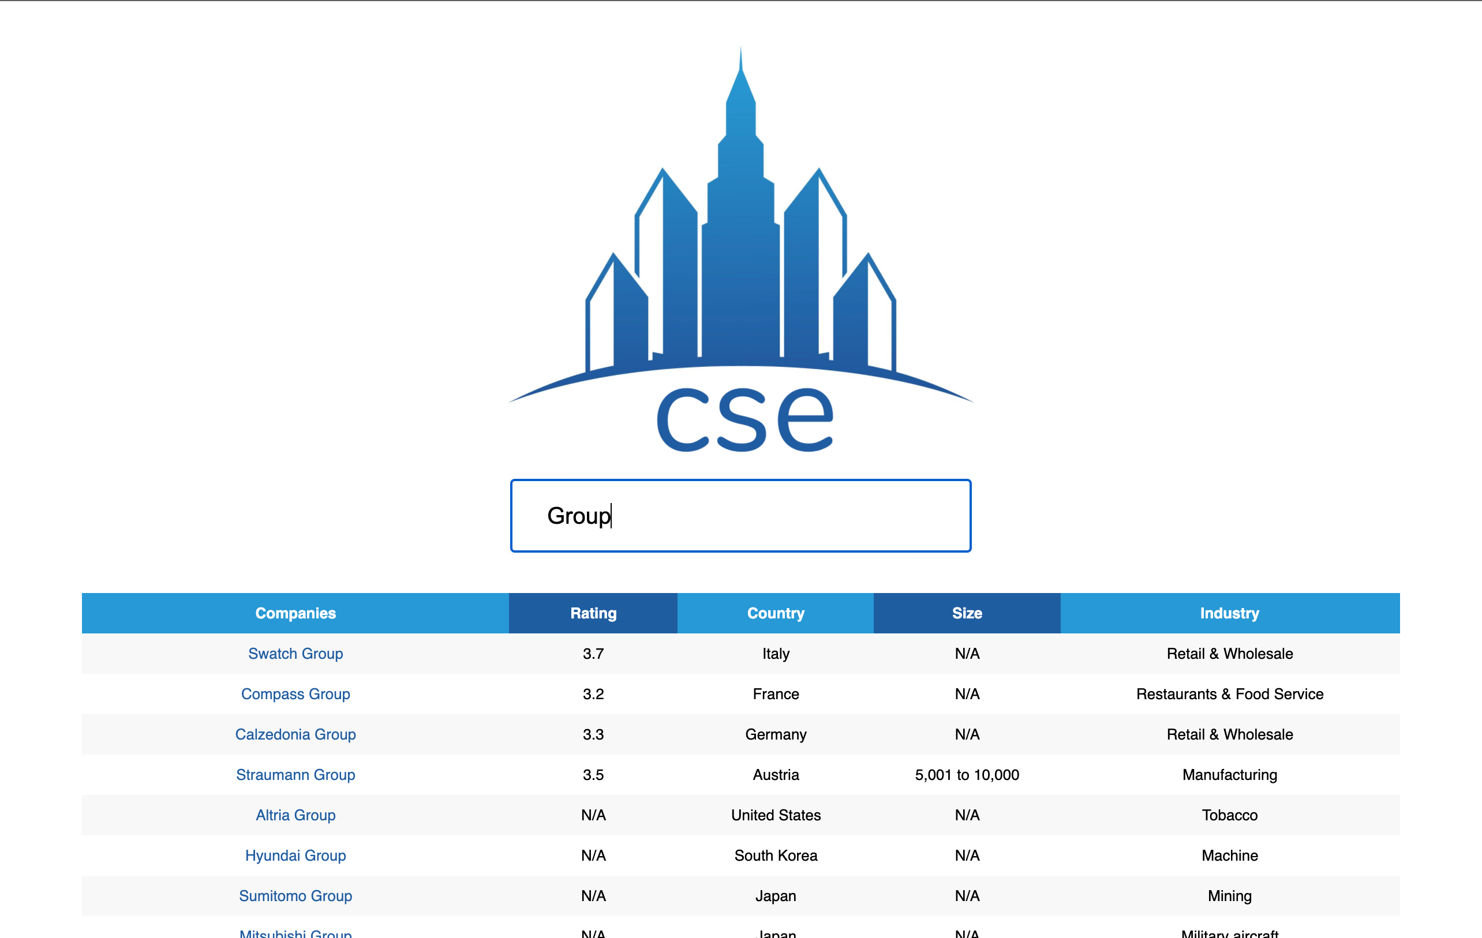
Website Demo
Matteo Alberici - IR 2021 Project

Slide 7
User Evaluation
4.5
Usability
4.8
Relevance
4.3
Interface
“not many features,
but simple and intuitive”
“nice sorting choice and
accurate and precise results”
“straightforward and intuitive interface”
Matteo Alberici - IR 2021 Project

Slide 8
Thanks For Listening!
Matteo Alberici - IR 2021 Project

