Slide 1


Slide 2
Cosa vedremo oggi
Introduzione al Web design
Storia di internet
Evoluzione di HTML

Slide 3
Cosa vedremo oggi
Internet History
Slide provenienti dalle slide del libro: “Computer Networking: a Top Down Approach”
https://gaia.cs.umass.edu/kurose_ross/ppt.php

Slide 4
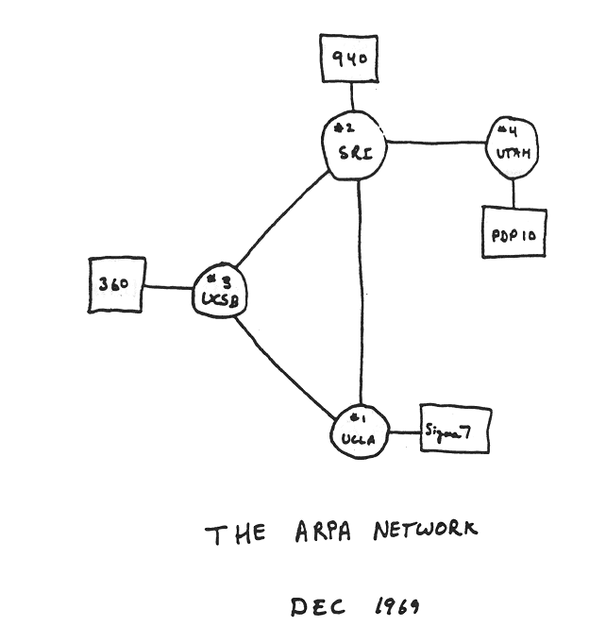
Internet history
1961-1972: Early packet-switching principles
1961: Kleinrock - queueing theory shows effectiveness of packet-switching
1964: Baran - packet-switching in military nets
1967: ARPAnet conceived by Advanced Research Projects Agency
1969: first ARPAnet node operational
1972:
  ARPAnet public demo
  NCP (Network Control Protocol) first host-host protocol
  first e-mail program
  ARPAnet has 15 nodes

Slide 5
Internet history
1972-1980: Internetworking, new and proprietary networks
1970: ALOHAnet satellite network in Hawaii
1974: Cerf and Kahn - architecture for interconnecting networks
1976: Ethernet at Xerox PARC
late70’s: proprietary architectures: DECnet, SNA, XNA
1979: ARPAnet has 200 nodes
Cerf and Kahn’s internetworking principles:
  minimalism, autonomy - no internal changes required to interconnect networks
  best-effort service model
  stateless routing
  decentralized control
define today’s Internet architecture

Slide 6
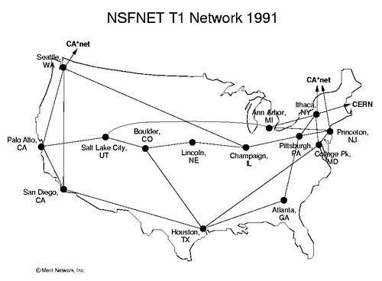
Internet history
1980-1990: new protocols, a proliferation of networks
1983: deployment of TCP/IP
1982: smtp e-mail protocol defined
1983: DNS defined for name-to-IP-address translation
1985: ftp protocol defined
1988: TCP congestion control
new national networks: CSnet, BITnet, NSFnet, Minitel
100,000 hosts connected to confederation of networks

Slide 7
Internet history
1990, 2000s: commercialization, the Web, new applications
early 1990s: ARPAnet decommissioned
1991: NSF lifts restrictions on commercial use of NSFnet (decommissioned, 1995)
early 1990s: Web
  hypertext [Bush 1945, Nelson 1960’s]
  HTML, HTTP: Berners-Lee
  1994: Mosaic, later Netscape
  late 1990s: commercialization of the Web
late 1990s – 2000s:
more killer apps: instant messaging, P2P file sharing
network security to forefront
est. 50 million host, 100 million+ users
backbone links running at Gbps

Slide 8
Internet history
2005-present: scale, SDN, mobility, cloud
  aggressive deployment of broadband home access (10-100’s Mbps)
2008: software-defined networking (SDN)
increasing ubiquity of high-speed wireless access: 4G/5G, WiFi
service providers (Google, FB, Microsoft) create their own networks
    bypass commercial Internet to connect “close” to end user, providing “instantaneous” access to social media, search, video content, …
enterprises run their services in “cloud” (e.g., Amazon Web Services, Microsoft Azure)
rise of smartphones: more mobile than fixed devices on Internet (2017)
~18B devices attached to Internet (2017)

Slide 9
Evoluzione di HTML
Evoluzione di HTML
Informazioni provenienti dalle specifiche ufficiali
https://html.spec.whatwg.org/

Slide 10
For its first five years (1990-1995), HTML went through a number of revisions and experienced a number of extensions, primarily hosted first at CERN, and then at the IETF.
With the creation of the W3C, HTML's development changed venue again. A first abortive attempt at extending HTML in 1995 known as HTML 3.0 then made way to a more pragmatic approach known as HTML 3.2, which was completed in 1997. HTML4 quickly followed later that same year.
HTML - HyperText Markup Language
CERN - European Organization for Nuclear Research, Ginevra
IETF - Internet Engineering Task Force (pubblica RFC)
RFC - Request for Comments
W3C - World Wide Web Consortium
Evoluzione di HTML

Slide 11
Evoluzione di HTML
The following year, the W3C membership decided to stop evolving HTML and instead begin work on an XML-based equivalent, called XHTML. This effort started with a reformulation of HTML4 in XML, known as XHTML 1.0, which added no new features except the new serialization, and which was completed in 2000.
After XHTML 1.0, the W3C's focus turned to
making it easier for other working groups to extend XHTML, under the banner of XHTML Modularization. In parallel with this, the W3C also worked on a new language that was not compatible with the earlier HTML and XHTML languages, calling it XHTML2
XHTML - eXtensible HyperText Markup Language
XML - eXtensible Markup Language

Slide 12
Evoluzione di HTML
Around the time that HTML's evolution was stopped in 1998, parts of the API for HTML developed by browser vendors were specified and published under the name DOM Level 1 (in 1998) and DOM Level 2 Core and DOM Level 2 HTML (starting in 2000 and culminating in 2003). These efforts then petered out, with some DOM Level 3 specifications published in 2004
but the working group being closed before all the Level 3 drafts were completed
API - Application programming interface
DOM - Document Object Model

Slide 13
Evoluzione di HTML
In 2003, the publication of XForms, a technology which was positioned as the next generation of web forms, sparked a renewed interest in evolving HTML itself, rather than finding replacements for it. This interest was borne from the realization that XML's deployment as a web technology was limited to entirely new technologies (like RSS and later Atom), rather than as a replacement for existing deployed technologies (like HTML).
XFORMS - Extensible Markup Language Forms
RSS - Really Simple Syndication

Slide 14
Evoluzione di HTML
A proof of concept to show that it was possible to extend HTML4's forms to provide many of the features that XForms 1.0 introduced, without requiring browsers to implement rendering engines that were incompatible with existing HTML web pages, was the first result of this renewed interest. At this early stage, while the draft was already publicly available, and input
was already being solicited from all sources, the specification was only under Opera Software's copyright.

Slide 15
Evoluzione di HTML
The idea that HTML's evolution should be reopened was tested at a W3C workshop in 2004, where some of the principles that underlie the HTML5 work (described below), as well as the aforementioned early draft proposal covering just forms-related features, were presented to the W3C jointly by Mozilla and Opera. The proposal was rejected on the grounds that the proposal conflicted with the previously chosen direction for the web's evolution; the W3C staff and membership voted to continue developing XML-based replacements instead

Slide 16
Evoluzione di HTML
don't break the web
Shortly thereafter, Apple, Mozilla, and Opera jointly announced their intent to continue working on the effort under the umbrella of a new venue called the WHATWG. A public mailing list was created, and the draft was moved to the WHATWG site. The copyright was subsequently amended to be jointly owned by all three vendors, and to allow reuse of the specification
WHATWG - Web Hypertext Application Technology Working Group

Slide 17
Evoluzione di HTML
The WHATWG was based on several core principles, in particular that technologies need to be backwards compatible, that specifications and implementations need to match even if this means changing the specification rather than the implementations, and that specifications need
to be detailed enough that implementations can achieve complete interoperability without reverse-engineering each other.

Slide 18
Evoluzione di HTML
The latter requirement in particular required that the scope of the HTML5 specification include what had previously been specified in three separate documents: HTML4, XHTML1, and DOM2 HTML. It also meant including significantly more detail than had previously been considered the norm

Slide 19
Evoluzione di HTML
In 2006, the W3C indicated an interest to participate in the development of HTML5 after all, and in 2007 formed a working group chartered to work with the WHATWG on the development of the HTML5 specification. Apple, Mozilla, and Opera allowed the W3C to publish the specification under the W3C copyright, while keeping a version with the less restrictive license on the WHATWG site.

Slide 20
Evoluzione di HTML
For a number of years, both groups then worked together. In 2011, however, the groups came to the conclusion that they had different goals: the W3C wanted to publish a "finished" version of "HTML5", while the WHATWG wanted to continue working on a Living Standard for HTML, continuously maintaining the specification rather than freezing it in a state with known
problems, and adding new features as needed to evolve the platform.
In 2019, the WHATWG and W3C signed an agreement to collaborate on a single version of HTML going forward: this document.
Approfondimenti https://it.wikipedia.org/wiki/HTML

