Slide 1
Progetto sistemi embedded E REAL-TIME
WEATHER STATION
Belladelli Matteo
Bordini Luca

Slide 2
Spiegazione generale
prototipo di stazione meteo
vengono monitorate le condizioni meteo attuali utilizzando 3 diversi sensori
i valori campionati sono osservabili su 3 canali di output
vengono mostrate sia le caratteristiche atmosferiche attuali che il loro andamento temporale

Slide 3
Arduino UNO Rev3 SMD
Script Python 3.7
COMPONENTS SCHEME

Slide 4
INPUT CHANNELS:
DHT11 sensor
water level detection sensor
photoresistor
button
OUTPUT CHANNELS:
I2C LCD 1602 display
LED
serial monitor
INPUT &
OUTPUT
CHANNELS

Slide 5
TASKS SCHEME
4 INPUT TASK:
DHTUpdate: read the temperature and humidity values from the DHT11 sensor
WLUpdate: read the water level value from the water level sensor
LDRUpdate: read the light value from the photoresistor
BTNUpdate: check if the button has been pressed to change page on the display
3 OUPT TASK:
LCDPrint: refresh the temperature, humidity, water level and light values on the display after converting some values
LedBlink: analyze the water level and turn the LED on/off accordingly
SerialPrint: print the temperature, humidity, water level and light values on serial monitor after converting some values

Slide 6
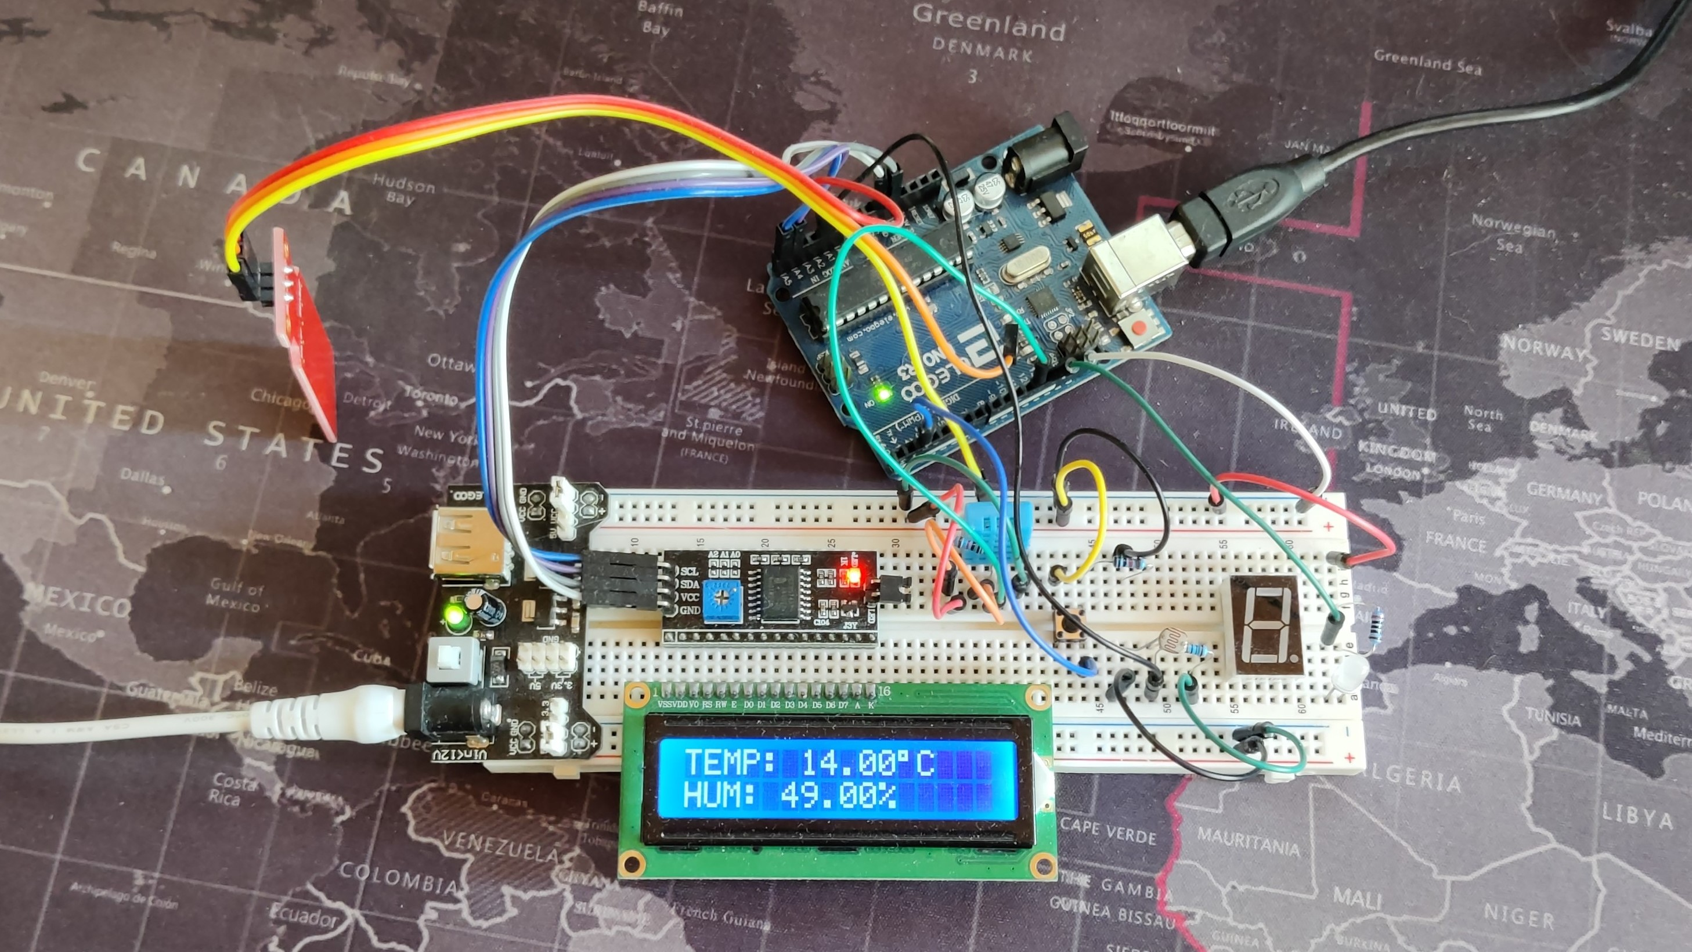
DEMO

Slide 7
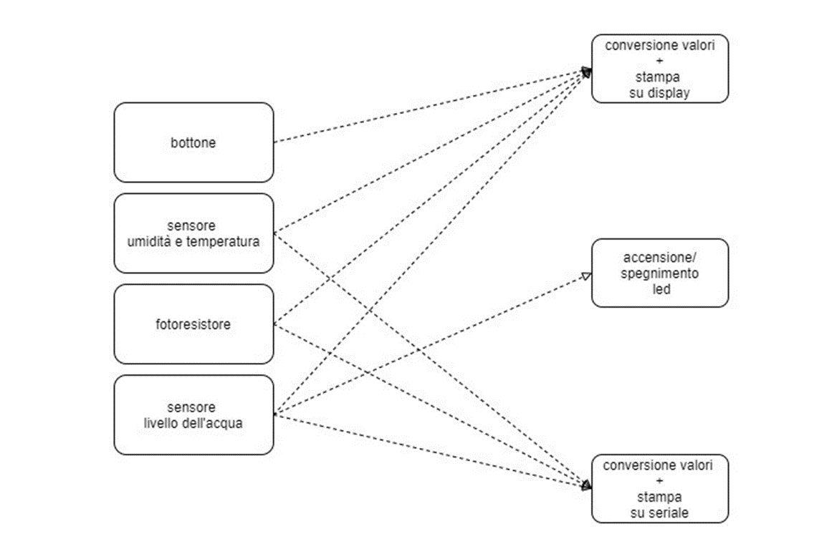
Task COMUNICATION

Slide 8
TASK LIST
TASK NAME | PERIOD | WCET
DHTUpdate | 2000 | 62
WLUpdate | 2000 | 2
LDRUpdate | 2000 | 2
BTNread | 50 | 2
LCDPrint | 2000 | 43
LEDBlink | 20000 | 2
SerialPrint | 2000 | 6

Slide 9
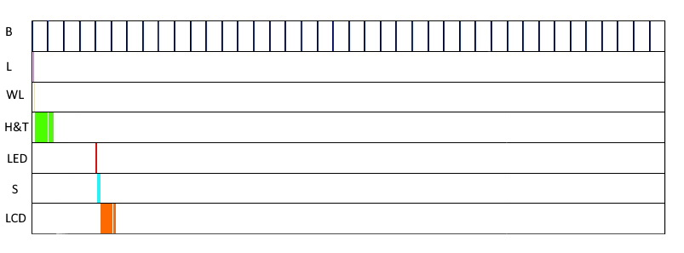
SCHEDULABILITY ANALYSIS

