Slide 1

Protecting Health Data: k-Anonymity vs Differential Privacy
under GDPR and NIS2
A theoretical study and a practical test with a Python prototype
GROUP FINAL PROJECT:
• Mattia Malservigi (Student No. 145863)
• Matteo Calloni (Student No. 145860)
• Manuel Mulloni (Student No. 145866)
ACADEMIC INSTITUTION & SUPERVISION:
Course: Data Privacy (Privacidade de Dados) – 2025/2026
Professor: Valderi Leithardt
ISCTE – Instituto Universitário de Lisboa
School of Technology and Architecture (ISTA)
Department of Information Science and Technology

Slide 2
HEALTH DATA PRIVACY GATEWAY (GDPR & NIS2)
Clinical Research vs. Patient Privacy
The Data Sharing Dilemma
Project Scope & Core Objectives
• Secondary Use of Health Data: Essential to discover disease biomarkers, evaluate treatment effectiveness, and train healthcare ML models.
• High Sensitivity (GDPR Art. 9): Health records are a special category of personal data; leaks cause social stigma, employment risks, and discrimination.
• Sweeney's Re-identification Paradox: Simply removing direct identifiers (name, SSN) fails; 87% of the US population can be uniquely re-identified by (ZIP, Gender, Birthdate).
• Linkage Attacks: External datasets (e.g. voter registries, social media) allow adversaries to match quasi-identifiers and de-anonymize patient microdata.
1. Rigorous Comparative Evaluation: Investigate the Pareto frontier between syntactic k-anonymity (Mondrian) and mathematical Differential Privacy (Laplace).
2. Real-World Privacy Gateway: Design and build an automated Python gateway that intercepts all queries, enforcing Zero Direct Access.
3. Regulatory Co-Design (GDPR + NIS2): Demonstrate that data privacy (GDPR Art. 25, 32) and cybersecurity resilience (NIS2 Art. 21, 23) operate symbiotically.
4. Full Reproducibility: Deliver verified testbeds, automated incident reporting, and exact Monte Carlo replication of published error bounds.

Slide 3
HEALTH DATA PRIVACY GATEWAY (GDPR & NIS2)
Regulatory Interplay: GDPR and NIS2 Directive
GDPR (EU 2016/679) – Rights of Data Subjects
NIS2 (EU 2022/2555) – Critical Cyber Resilience
• Core Principles (Art. 5): Data minimisation, purpose limitation, integrity, and strict accountability.
• Special Category Health Data (Art. 9): Processing prohibited in general; scientific research permitted under Art. 9(2)(j) with technical safeguards (Art. 89(1)).
• Recital 26 Legal Dichotomy: Pseudonymised data remains personal data (GDPR applies); genuinely Anonymous data falls entirely outside GDPR.
• Personal Data Breach (Art. 33): Mandatory notification to the national Supervisory Authority (CNPD in Portugal) within 72 hours.
• Healthcare as Critical Sector: Hospitals, laboratories, and health data platforms classified as 'Sectors of High Criticality' (Annex I).
• Risk-Management Measures (Art. 21(2)): Mandatory incident handling (b), supply-chain hygiene (d), cryptography/encryption (h), and access control (i, j).
• 3-Step Incident Velocity (Art. 23): Early Warning within 24h, Incident Notification within 72h, and Final Report within 1 month to national CSIRT (CNCS).
• Symbiotic Convergence: An intrusion into a health database triggers BOTH a NIS2 incident and a GDPR data breach: one unified automated response is essential.

Slide 4
HEALTH DATA PRIVACY GATEWAY (GDPR & NIS2)
Privacy Paradigms: Syntactic vs Mathematical Guarantees
k-Anonymity (Syntactic Microdata Protection)
Differential Privacy (Mathematical Query Bounds)
• Mechanism: Transforms quasi-identifiers into generalized ranges or suppressions (Mondrian algorithm) so each combination appears >= k times.
• Equivalence Classes (EC): Adversary can only narrow down an individual to an equivalence class of size |EC| >= k.
• Data Release Format: Published once as a static microdata table; supports unlimited exploratory queries with zero marginal loss.
• Vulnerabilities (WP29 Opinion 05/2014): Vulnerable to Homogeneity Attacks (all records in EC share same disease) and Background Knowledge linkage.
• Mechanism: Protects individual query responses by injecting calibrated noise: M(D) = f(D) + Laplace(scale = Delta f / epsilon).
• Mathematical Guarantee: Pr[M(D1) in S] <= exp(epsilon) * Pr[M(D2) in S] for any two neighboring datasets differing in one record.
• Key Strengths: Independent of adversary background knowledge; immune to post-processing; provable composition bounds.
• Critical Trade-offs: Finite privacy budget epsilon consumed per query; utility severely degrades on small cohorts where sensitivity Delta f is high.

Slide 5
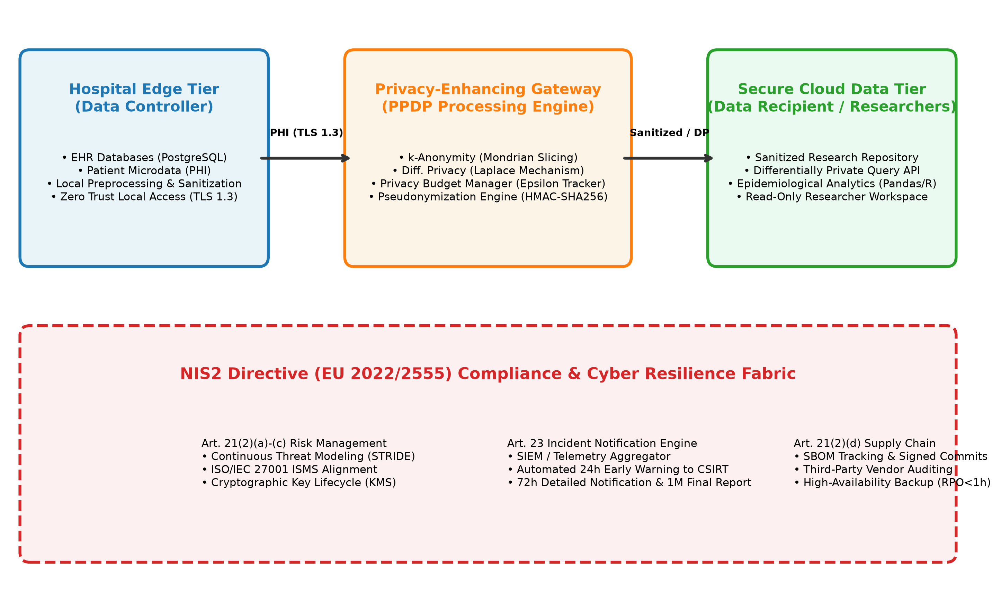
HEALTH DATA PRIVACY GATEWAY (GDPR & NIS2)
Collaborative Platform & Synthetic Clinical Cohort
Platform Architecture & Synthetic Cohort
Gateway Mediation Architecture (Figure 1)
• Collaborative Scenario: External researchers analyze cardiovascular & oncology patterns without accessing raw database records.
• Zero Direct Access: All statistical queries and dataset requests are routed through the mediating Privacy Gateway.
• Realistic Cohort (N = 1,000): Adult patients with clinically correlated attributes (Age, Gender, Postal Area, BMI, Diagnoses, Blood Pressure, Glucose).
• Small Oncology Sub-Cohort (N = 64): Specifically embedded to stress-test privacy algorithms on vulnerable, rare medical sub-populations.
• Three Modeled Roles (Figure 5): Healthcare Worker (data ingest), Privacy Officer (governance, k/epsilon tuning), Researcher (authenticated queries).

Slide 6
HEALTH DATA PRIVACY GATEWAY (GDPR & NIS2)
Privacy Gateway Enforcement Rules (Table 8)
Access, Budget & Abuse Controls
Cell Suppression, Chaining & Reporting
• Rule 1 (Authentication): Requests must carry a valid Bearer token mapped to an authorized actor (Admin, Worker, Researcher).
• Rule 2 (Revocation Registry): Token checked against blocklist; revoked tokens immediately rejected with HTTP 403 Forbidden.
• Rule 3 (Privacy Budget Manager): Enforces sequential composition (sum epsilon_i <= epsilon_max); blocks queries once allocated budget is depleted.
• Rule 4 (Abuse Detection): Rate limiting (<= 10 qpm) and fingerprint analysis detecting repeated overlapping range queries (reconstruction attacks); triggers immediate token revocation.
• Rule 5 (Small-Cell Suppression): Direct microdata queries returning fewer than 5 records (< k_thresh) are suppressed to prevent singling out.
• Rule 6 (Sensitive Leakage Check): Direct access to unanonymized sensitive clinical attributes is prohibited for researchers.
• Rule 7 (Tamper-Evident Chaining): Every transaction appends an immutable block into a SHA-256 hash chain: H_i = SHA-256(H_{i-1} || payload).
• Rule 8 (Automated Dossier Generation): Critical security events instantly generate NIS2 Art. 23 Early Warning (< 24h) and GDPR Art. 33 Breach Notification (< 72h) JSON drafts.

Slide 7
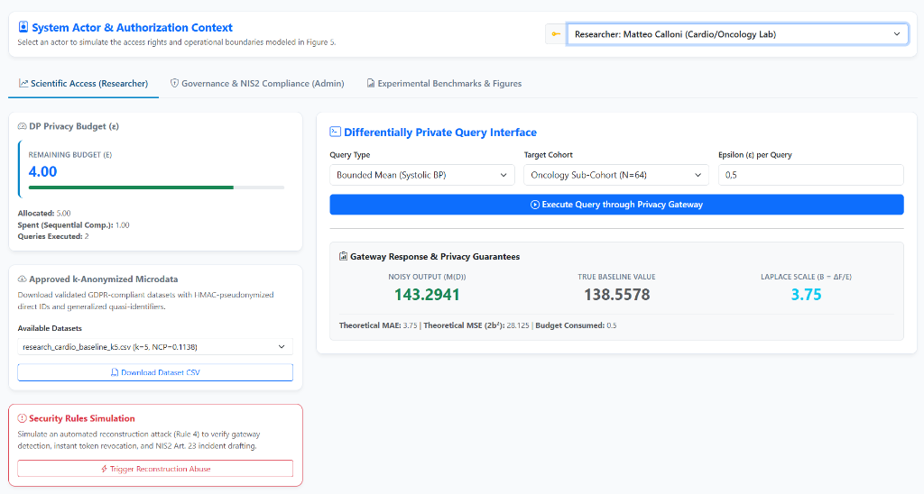
HEALTH DATA PRIVACY GATEWAY (GDPR & NIS2)
Prototype in Action: Scientific Researcher Interface
Interactive Researcher Console
Web Dashboard: Scientific Access Tab
• Active Persona: Researcher Matteo Calloni (Cardio/Oncology Lab).
• Budget Progress Bar: Real-time tracking of epsilon (4.00 remaining out of 5.00 allocated).
• Differential Privacy Query: Bounded Mean query on Systolic Blood Pressure for Oncology Sub-Cohort (N = 64).
• Calibrated Laplace Noise: Noisy result: 143.29 mmHg vs True Baseline: 138.56 mmHg (Scale b = 3.75).
• Microdata Downloads: Option to download validated GDPR k-anonymized CSV exports.
• Abuse Testing: Dedicated button to simulate automated reconstruction attacks.

Slide 8
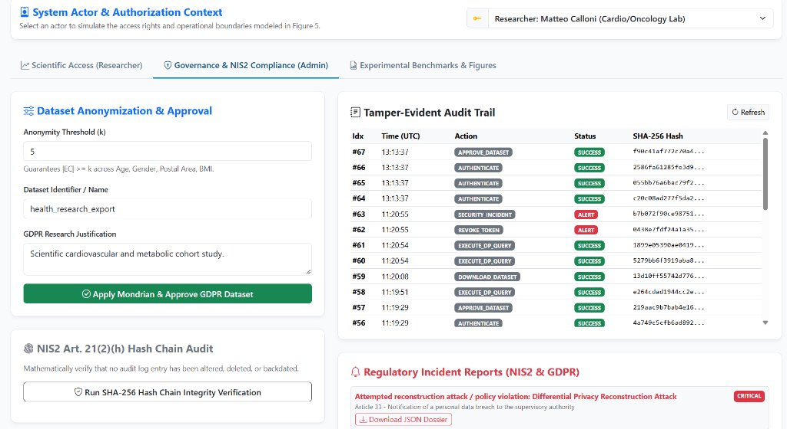
HEALTH DATA PRIVACY GATEWAY (GDPR & NIS2)
Prototype in Action: Privacy Officer & Incident Management
Governance & Security Workflow
Web Dashboard: Governance & NIS2 Tab
• Dataset Approval: Admin configures k = 5, enters research justification, and applies Mondrian partitioning.
• Automated Abuse Detection: Gateway Rule 4 detects 4 rapid identical range queries attempting patient reconstruction.
• Instant Token Revocation: Offending token revoked automatically; status changes to ALERT (Indices #62, #63).
• Incident Reporting Dossiers: Generates critical incident dossier; one-click download for NIS2 / GDPR JSON dossiers.
• Hash Chain Audit: Button to verify SHA-256 chain integrity across all historical blocks.

Slide 9
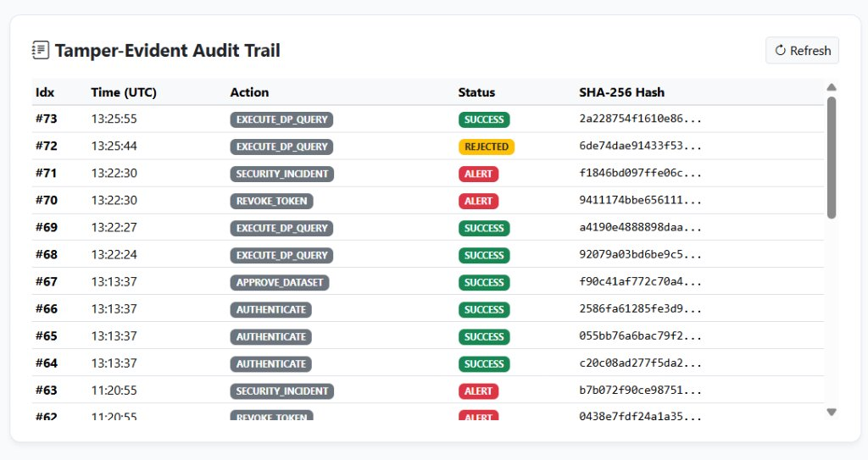
HEALTH DATA PRIVACY GATEWAY (GDPR & NIS2)
Prototype in Action: Cryptographic Audit Logging (NIS2 Art. 21)
Tamper-Evident Ledger
SHA-256 Cryptographic Hash Chain Audit Trail
• NIS2 Art. 21(2)(h) Compliance: Immutable cryptographic logging enforcing non-repudiation and evidence preservation.
• Hash Chaining Principle: Every event links mathematically to the previous hash block (H_{i-1}) starting from Genesis.
• Real-time Event Tracking: Logs AUTHENTICATE, APPROVE_DATASET, EXECUTE_DP_QUERY, REJECTED, and SECURITY_INCIDENT.
• Forensic Integrity: Modifying or deleting any historical log record breaks all subsequent hashes and triggers instant alert during auditing.

Slide 10
HEALTH DATA PRIVACY GATEWAY (GDPR & NIS2)
DP Evaluation: The Small Cohort Dilemma (Table 12)
Monte Carlo Simulation (1,000 Repetitions) – Systolic BP Mean Query [90, 210] mmHg
• Sensitivity Delta f: All Patients (N = 1000) -> Delta f = 0.12 mmHg | Oncology Group (N = 64) -> Delta f = 1.875 mmHg.
• Theoretical Bounds: Laplace scale b = Delta f / epsilon | Expected MAE = b | Expected MSE = 2*b^2. Empirical results match theoretical bounds with >99% fidelity.
ε | N_all | Scale b_all | MAE (All) | MSE (All) | N_onco | Scale b_onco | MAE (Onco) | MSE (Onco)
0.05 | 1000 | 2.4000 | 2.4298 | 11.5177 | 64 | 37.5000 | 37.6008 | 2841.1179
0.10 | 1000 | 1.2000 | 1.2109 | 2.9549 | 64 | 18.7500 | 18.9806 | 721.3787
0.20 | 1000 | 0.6000 | 0.5740 | 0.6786 | 64 | 9.3750 | 9.2642 | 171.4336
0.50 | 1000 | 0.2400 | 0.2344 | 0.1124 | 64 | 3.7500 | 3.9072 | 31.6057
1.00 | 1000 | 0.1200 | 0.1178 | 0.0272 | 64 | 1.8750 | 1.8973 | 7.2515
2.00 | 1000 | 0.0600 | 0.0612 | 0.0079 | 64 | 0.9375 | 0.9112 | 1.6288

Slide 11
HEALTH DATA PRIVACY GATEWAY (GDPR & NIS2)
k-Anonymity Evaluation: Information Loss vs Homogeneity (Table 13)
Mondrian Multidimensional Partitioning on Age, Gender, Postal Area, and BMI (N = 1,000)
• Failure of k = 3: Yields 11 homogeneous equivalence classes (min l-diversity = 1); 100% attribute disclosure for patients in those classes!
• Optimal Balance (k = 5): Zero homogeneous classes, min l-diversity = 2, low Information Loss (NCP = 0.1138), and linkage risk bounded to exactly 20%.
k | Classes | Min Size | Avg Size | Info Loss (NCP) | Max Linkage Risk | Homogeneous Classes | Min l-Diversity
3 | 260 | 3 | 3.85 | 0.0720 | 0.3333 (1/3) | 11 (VULNERABLE) | 1
5 | 145 | 5 | 6.90 | 0.1138 | 0.2000 (1/5) | 0 (PROTECTED) | 2
10 | 68 | 10 | 14.71 | 0.1798 | 0.1000 (1/10) | 0 | 3
20 | 33 | 20 | 30.30 | 0.2533 | 0.0500 (1/20) | 0 | 4
50 | 16 | 52 | 62.50 | 0.3381 | 0.0192 (1/52) | 0 | 5

Slide 12
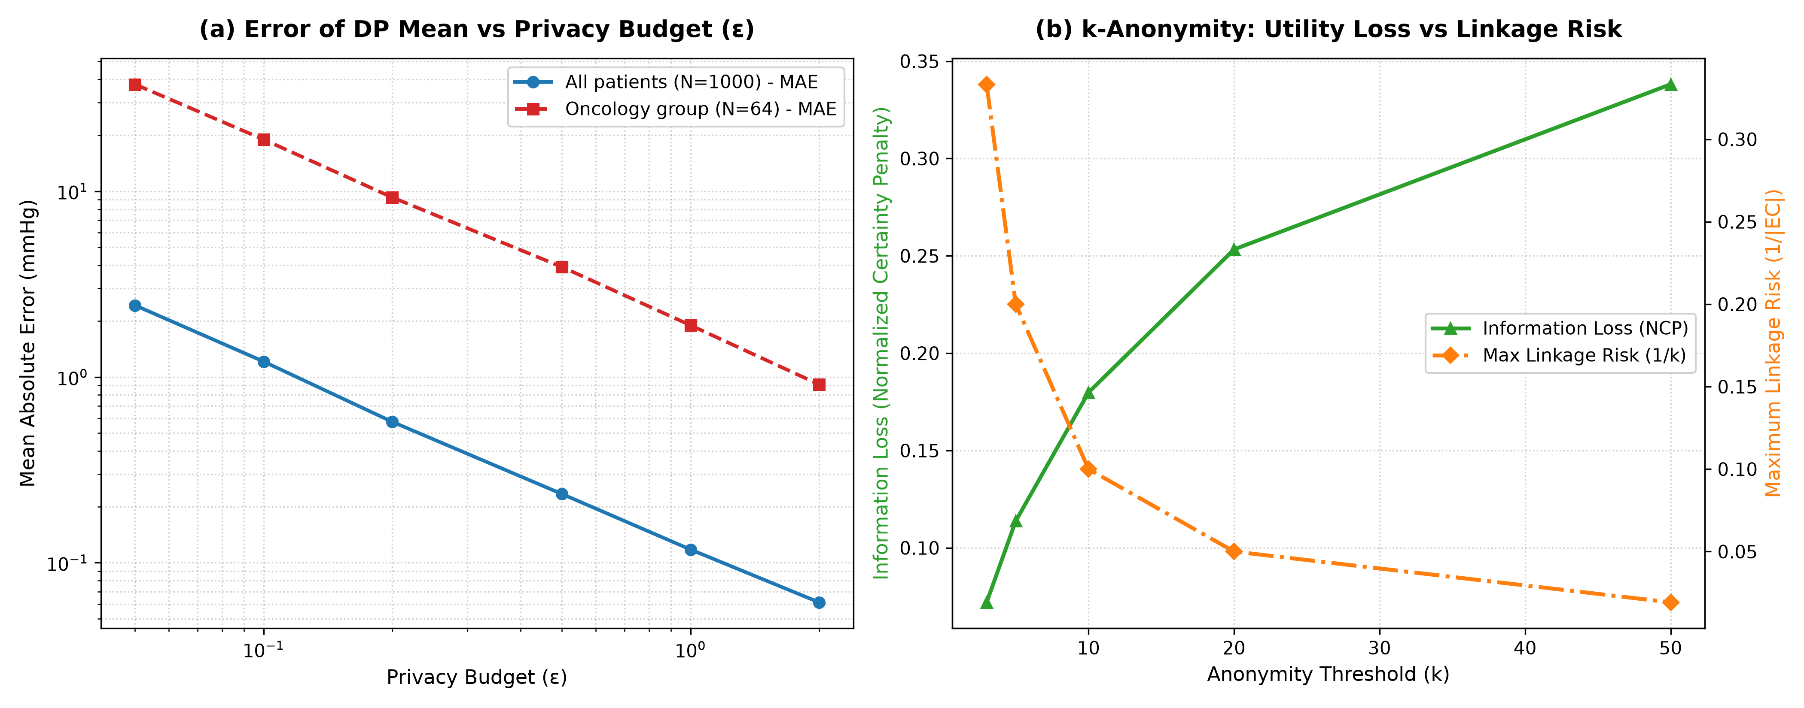
HEALTH DATA PRIVACY GATEWAY (GDPR & NIS2)
Privacy-Utility Trade-off Curves (Figure 2)
Key Empirical Insights
Generated Publication Figure 2
• Subplot (a) - DP Error vs Epsilon: Log-log scale demonstrates that noise scale drops predictably as epsilon increases. However, the oncology error curve remains parallel and > 15x higher across all budget values.
• Subplot (b) - k-Anonymity Trade-off: Dual-axis curve highlights the Pareto frontier: Increasing k steadily lowers maximum linkage risk (orange curve) at the expense of expanding generalization intervals (green curve).
• Structural Limit: DP error can be tuned via epsilon, but small cohorts suffer unavoidable loss; k-anonymity bounds linkage risk but cannot prevent homogeneity at low k.

Slide 13
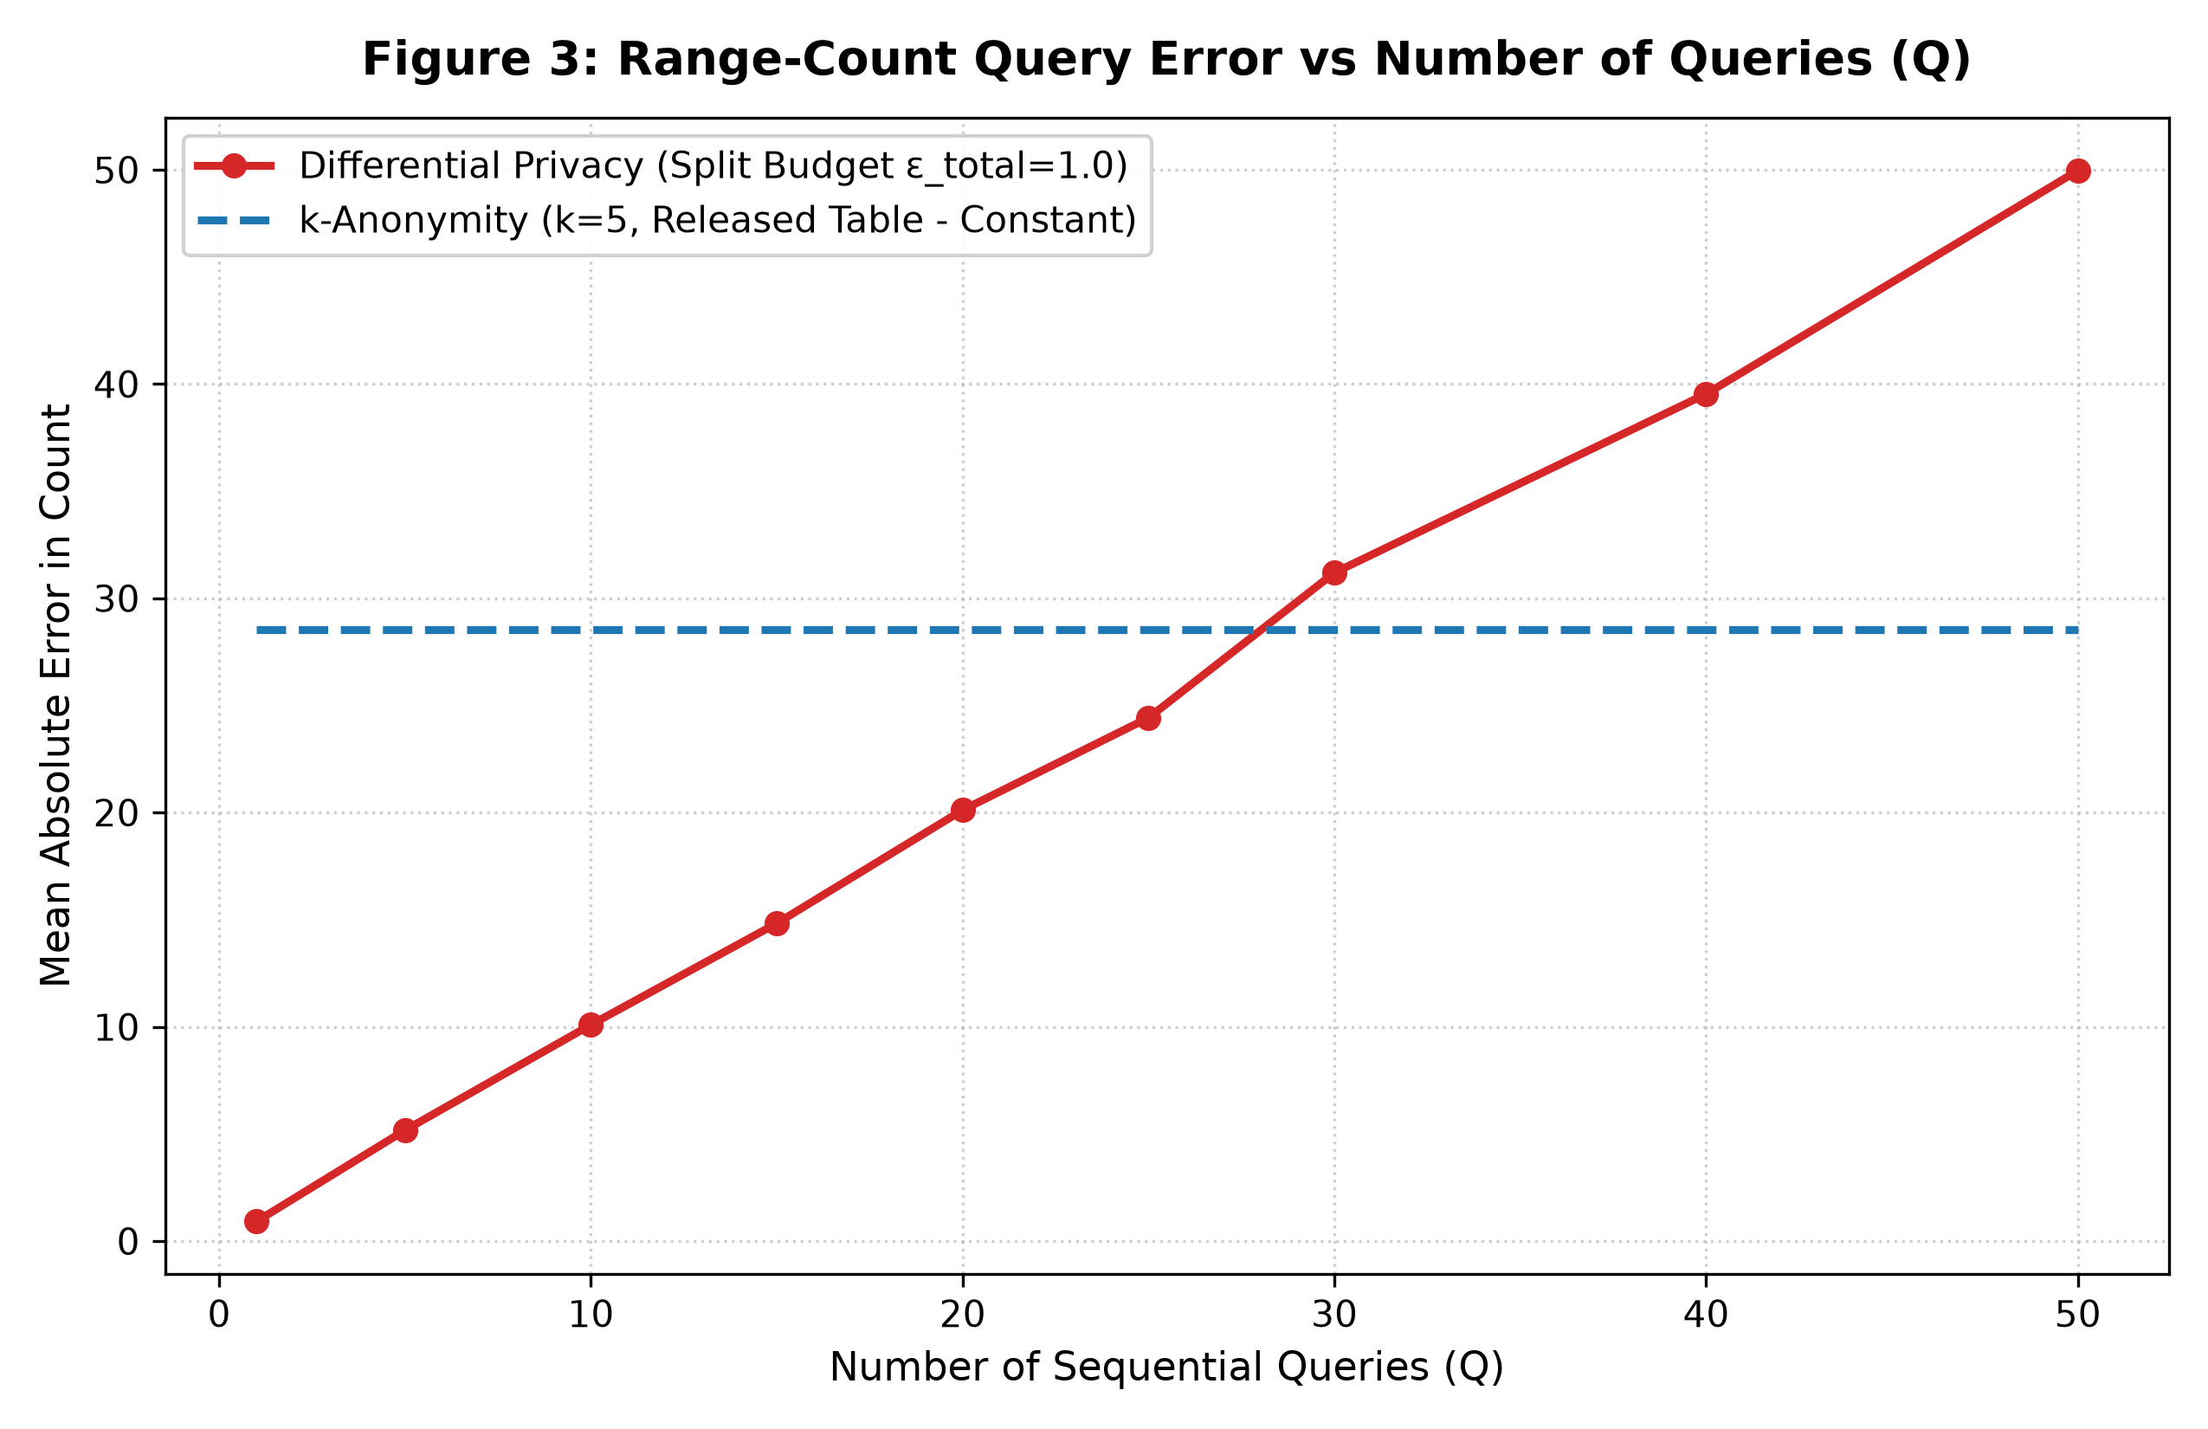
HEALTH DATA PRIVACY GATEWAY (GDPR & NIS2)
Exploratory Research: DP Budget Decay vs Static Table (Figure 3)
Sequential Query Analysis
Generated Publication Figure 3
• Simulation Parameters: Sequence of Q in [1, 50] demographic range queries under fixed privacy budget epsilon_total = 1.0.
• Differential Privacy Budget Splitting: Sequential composition mandates epsilon_i = 1.0 / Q. Sensitivity Delta f = 1 -> Noise scale b = Q / 1.0 grows linearly! MAE increases from 0.91 (Q = 1) to 49.96 (Q = 50).
• k-Anonymity (k = 5) Static Table: Generalization happens once upon release; researchers can ask unlimited queries with constant error (MAE = 28.52).
• Strategic Rule: DP is superior for small sets of pre-defined queries (Q <= 28); k-anonymity is superior for open-ended data exploration.

Slide 14
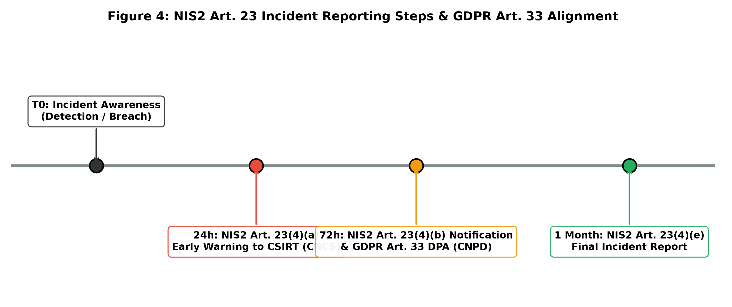
HEALTH DATA PRIVACY GATEWAY (GDPR & NIS2)
Incident Response Velocity: NIS2 Art. 23 & GDPR Art. 33 (Figure 4)
Automated Compliance Velocity
Generated Publication Figure 4
• Automated Circuit Breaker: Reconstruction burst detected by Gateway Rule 4 within 4 requests; token revoked immediately.
• Early Warning (< 24h - NIS2 Art. 23(4)(a)): CSIRT dossier generated in < 1 minute (well ahead of statutory 24h deadline), identifying attack vector and assets.
• Parallel GDPR Notification (< 72h - Art. 33): DPA notification dossier prepared for CNPD detailing Article 9 health categories involved.
• Comprehensive Final Report (< 1 month): Formal technical root-cause template populated automatically from the hash-chain log.

Slide 15
HEALTH DATA PRIVACY GATEWAY (GDPR & NIS2)
Summary of Contributions & Future Outlook
Core Theoretical & Empirical Findings
Future Research & Acknowledgments
1. Cybersecurity is Essential to Privacy: Mathematical Differential Privacy provides zero protection if the host gateway lacks authentication, token revocation, or tamper-evident audit logs (NIS2 Art. 21).
2. Complementary Technical Niches: k-Anonymity (k = 5) provides an optimal exploratory microdata release (zero homogeneity, 20% risk bound); Differential Privacy provides mathematical query safety but degrades on rare clinical cohorts.
3. Regulatory Velocity via Automation: Automated compliance rules bridge the gap between aggressive NIS2/GDPR reporting deadlines (< 24h/72h) and technical infrastructure.
• Decentralized Federated Learning: Combine local differential privacy (LDP) with federated averaging and PRISEC lightweight cryptography [11]-[13].
• Verifiable Privacy Budget Auditing: Implement Zero-Knowledge Proofs (zk-SNARKs) to cryptographically audit epsilon consumption without revealing query parameters [17].
• Hardware Enclaves (TEEs): Deploy the gateway transformation engine inside confidential compute enclaves (AMD SEV / Intel SGX).
• Academic Course: Data Privacy 2025/2026 – Prof. Valderi Leithardt, ISCTE-IUL.
• Thank you for your attention! Questions & Discussion.

