Slide 1
Impossibilities in Succinct Arguments
Black-box Extraction and More
Matteo Campanelli Protocol Labs
Joint work with:
Chaya Ganesh, Hamid Khoshakhlagh, Janno Siim

Slide 2
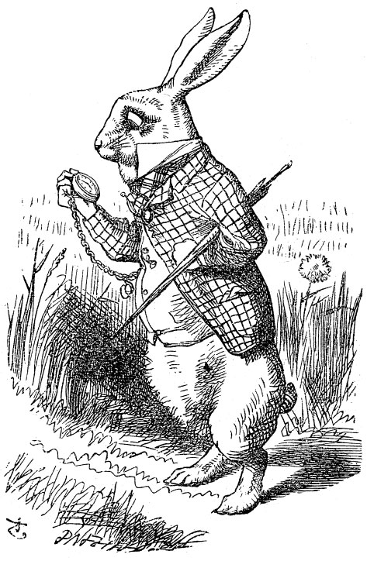
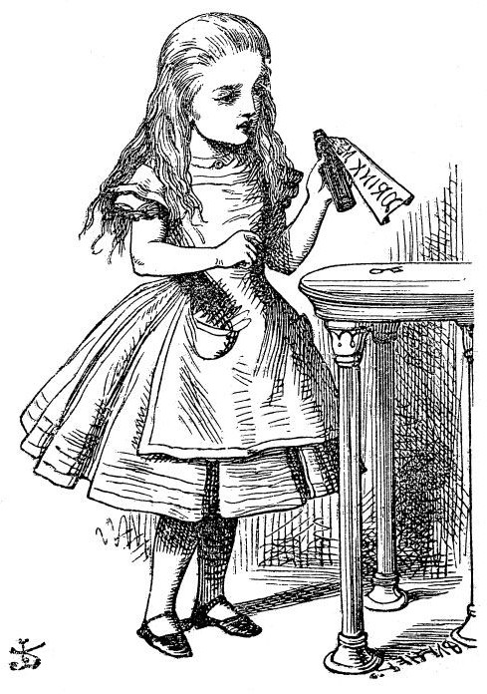
(Non-Interactive) Succinct Arguments
Bob knows w :
R(x,w)
∃ w : R(x,w)
SNARG
SNARK
π (short)

Slide 3
Setting our expectations about SNARGs
- We have several constructions that are succinct
(Groth16, Bulletproofs,…)
- …and are from idealized models or strong assumptions:
AGM, GGM, ROM, Knowledge-of-Exponent assumptions
- This is not really a coincidence

Slide 4
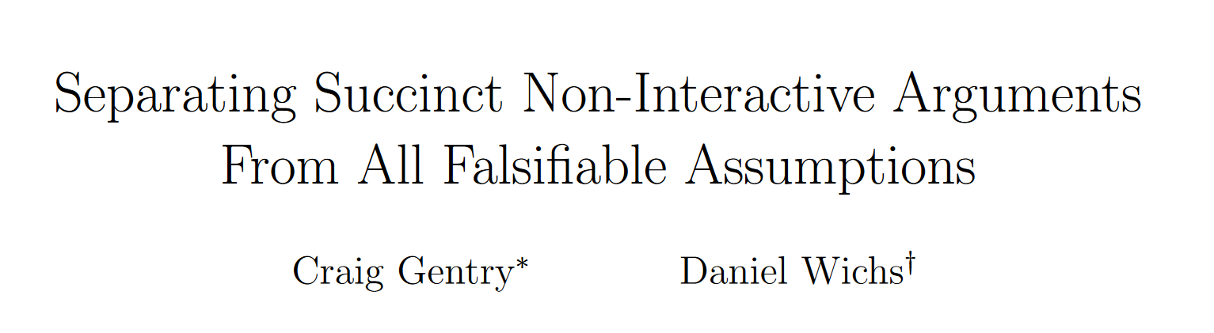
Why idealized models/strong assumptions
Gentry&Wichs (or GW)
If we “obtain” a SNARG from (true) assumption X then X is not falsifiable.
“Falsifiable” ~ “can be shown not to hold through efficient adversary interacting with efficient challenger”

Slide 5
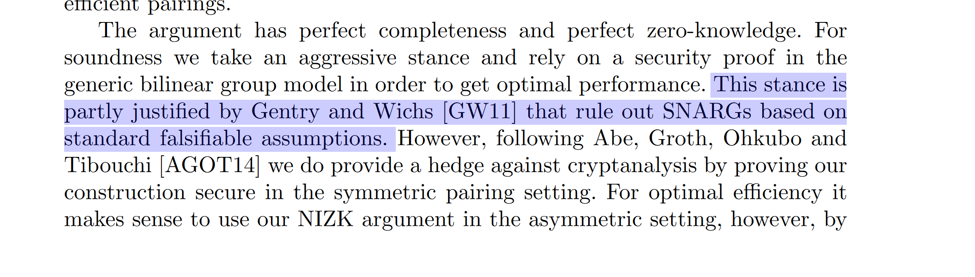
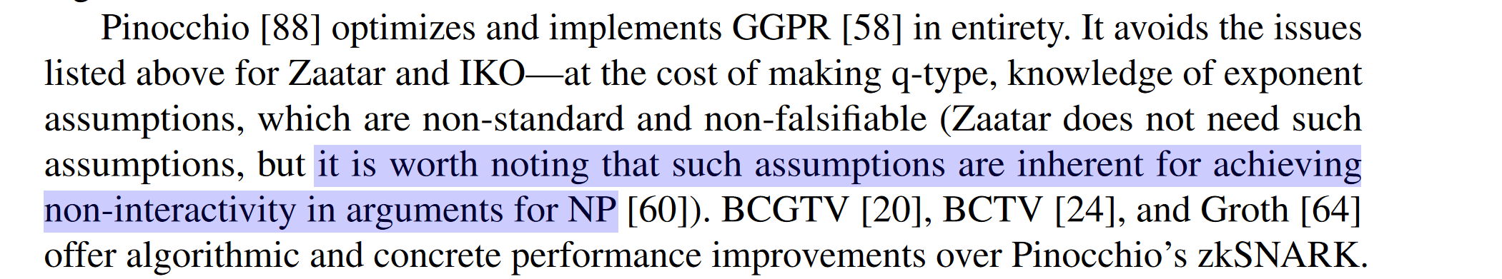
GW and related folklore
Groth16
Spartan
The statements above are balanced enough. But the folklore seems to be more extreme: “only trivial applications can be achieved with falsifiable assumptions”
To what extent is the folklore right?

Slide 6
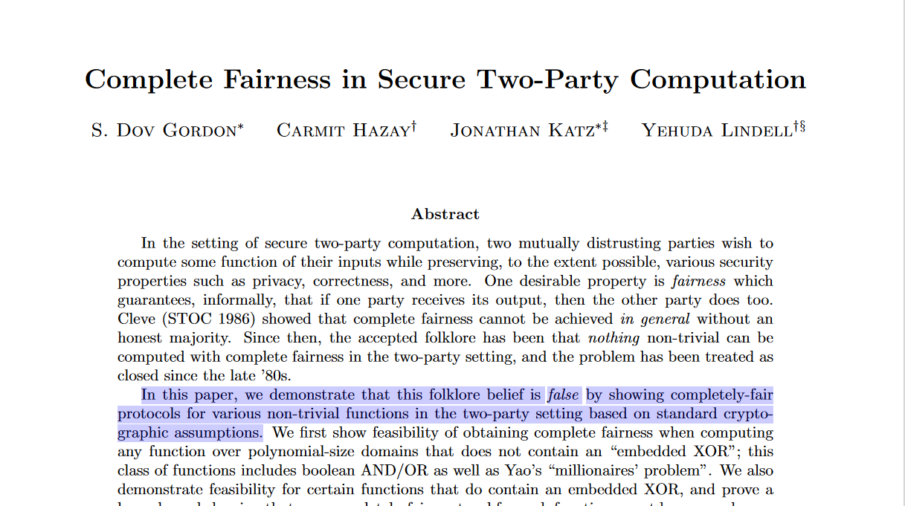
Folklore already misled us in the past
[Cleve86]: two parties cannot securely compute a function with fairness
The long-standing folklore: nothing trivial can be computed fairly by two parties
Twenty years later…
But, you could say, why would this also be the case for GW?

Slide 7
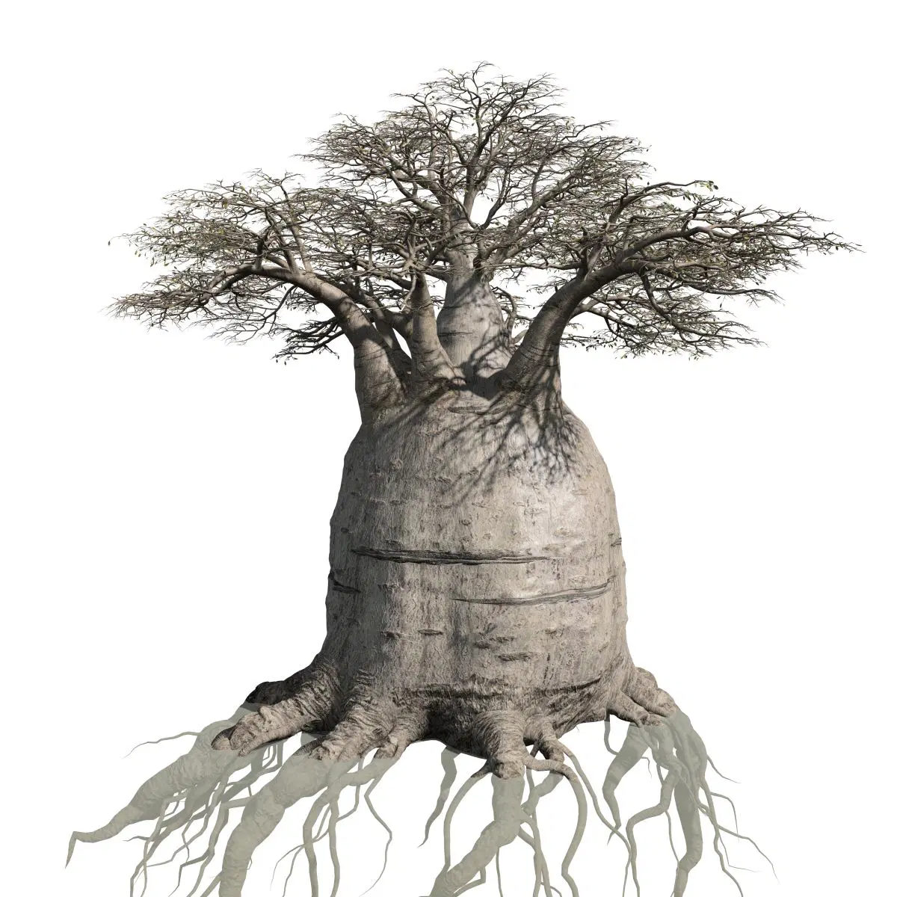
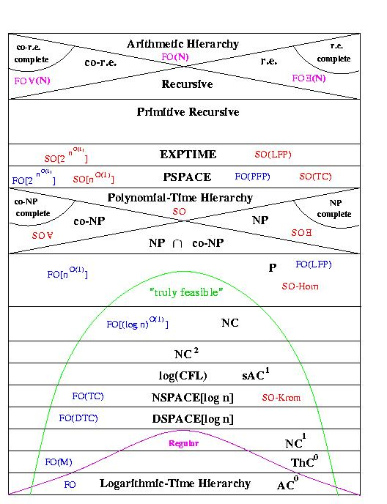
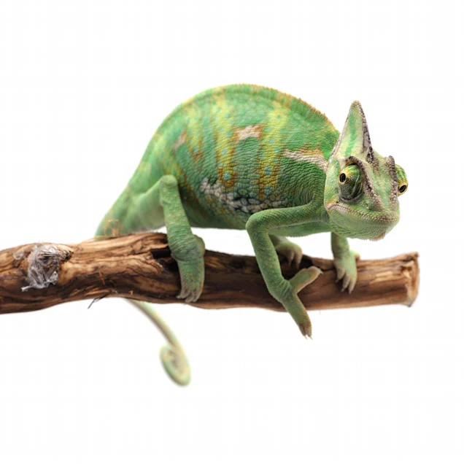
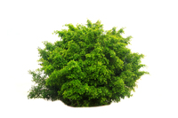
Boundaries of GW
Languages
Adaptivity
Setup model
adversary
crs
crs
CRS
Some of these boundaries are explicit in literature, some aren’t.

Slide 8
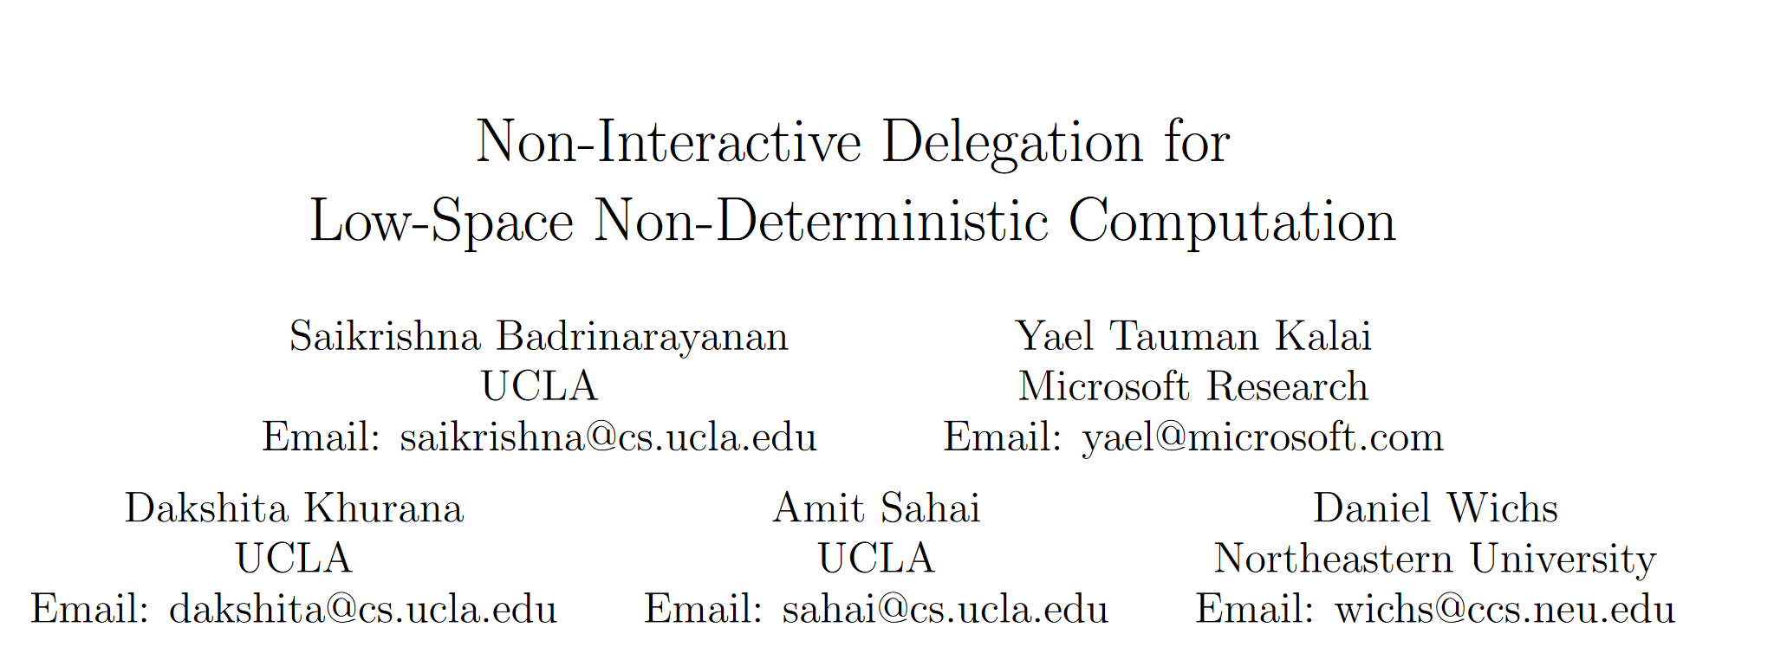
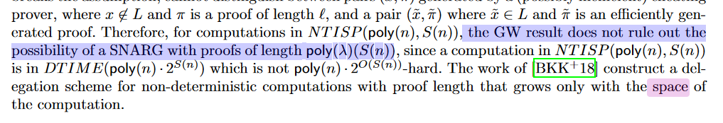
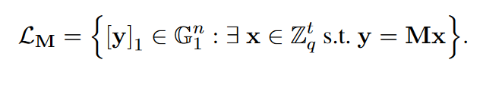
Boundaries of GW: Languages
Explicit: GW “does not cover” low-space languages
Not just esoteric languages: Merkle tree openings!
(from [CGKS22])
(builds succinct arguments from falsifiable assumptions)
Somewhat implicit: What about Kiltz&Wee15 (linear languages)?
KW15 obtains O(1) arguments for linear properties from Diffie-Hellman-like assumptions (falsifiable)

Slide 9
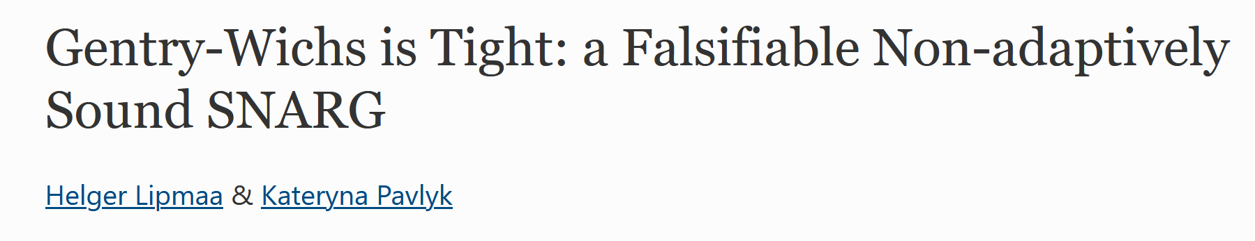
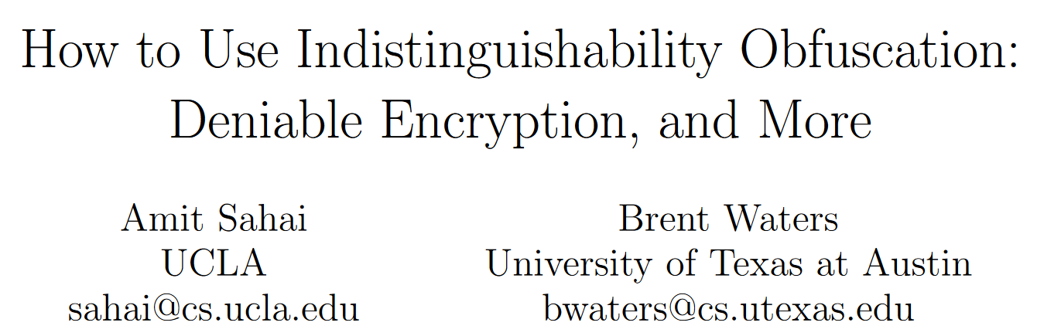
Boundaries of GW: Adaptivity
adversary
crs
- GW is for adaptive soundness
- (adversary first sees CRS and then chooses false input to break)
- What about the non-adaptive case?
Lipmaa&Pavlyk (AC21) attempt at constructing a SNARG in the non-adaptive setting from falsifiable assumptions
Unfortunately security proof has recently been shown to have serious flaw.
But we have actually been knowing a construction since 2013
(plausibly from falsifiable assumptions)
Simple construction from iO (Sahai&Waters):
P: run iO of F_{k}(x,w): if R(x,w) return PRF(k,x)
V: run iO of F’_{k}(x, π): accept if π == PRF(k,x)

Slide 10
Boundaries of GW: Setup model
crs
CRS
GW’s focus is on proof succinctness;
There is also verifier succinctness
Some works have only the first one (e.g. Kilian/Micali construction)
Some works have both (e.g., Groth16), usually obtained through preprocessing
The CRS type and size play an important role here
Preprocessing usually has a crs growing with the circuit size (|C|)
But in GW the crs needs to be short (cannot grow with instance size)
Footnote: BCCT13 shows preprocessing gives no additional power for extraction; gap still exists for soundness only.
Bottomline: There is a gap—we understand the case but not the case

Slide 11
This work: checking boundaries for GW (and more)
Some of our contributions:
Implications of GW—more explicitly
GW does hold for preprocessing SNARGs
(observation) GW does not hold for a meaningful class of languages, “trapdoor languages”
2) SNARKs and UC (blackbox extraction)
Next slides

Slide 12
This work: checking boundaries for GW (and more)
- Folklore suggests:
“Many non-trivial things seem impossible for SNARGs/SNARKs” (see prev. slide)
- We ask:
“How can we qualify this a little bit more?”
Some of our contributions:
Implications of GW—more explicitly
GW does hold for preprocessing SNARGs
(observation) GW does not hold for a meaningful class of languages, “trapdoor languages”
2) SNARKs and UC (blackbox extraction)
Next slides

Slide 13
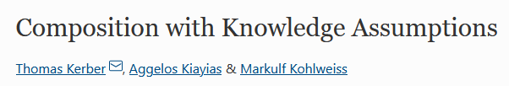
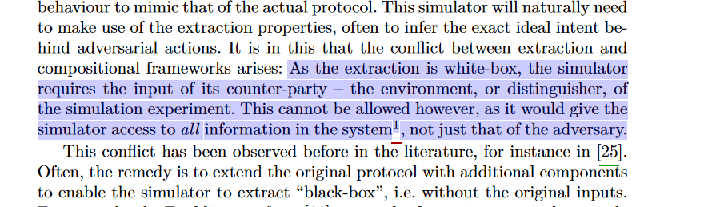
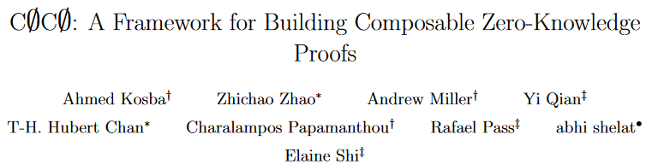
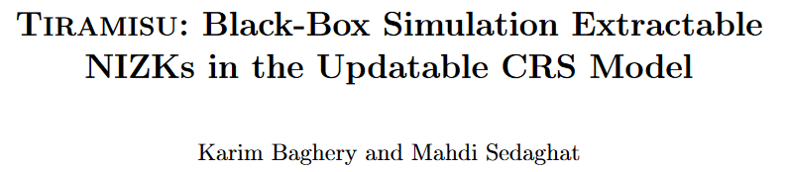
More folklore to double check: SNARKs, UC and black-box extractability
Using arguments in larger protocols requires extractability
Extractability in several succinct SNARKs:
“For all Adv … there exists Ext_{Adv} …”
This is not “black-box” extraction (Ext depends on Adv)
Not good for UC:
“ideal-world” simulator must extract a witness w/o knowledge of the environment’s algorithm
This has motivated several works with circuit-succinctness only
CØCØ, Tiramisu…
Approach: Provide (short) proof + encryption of witness; extract through decryption key
Folklore seems to be that this is the only way around it.

Slide 14
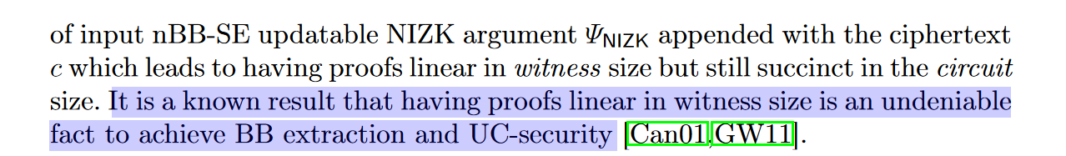
To what extent is “this” inherent?
“This” = apparent clash between succinctness and black-box knowledge soundness
To which extent do we understand this clash?
Above text from [Tiramisu]

Slide 15
Some of our contributions: (cont.)
Implications of GW—more explicitly
GW does hold for preprocessing SNARGs
(observation) GW does not hold for a meaningful class of languages, “trapdoor languages”
2) SNARKs and UC (blackbox extraction)
Adaptive and non-adaptive setting
Adaptive: “adv(crs) → (x, π)”
Non-adaptive:
adv1 → x
…; adv2(crs) → π
Adaptive BB (negative result)
(minor contribution) we provide a proof of impossibility for hard languages
Non-adaptive BB:
Positive result: non-trivial ⊆ of NP admits it!
Negative result: not all NP admits it (under standard assumptions)

Slide 16
A roadmap
Implications of GW—more explicitly
GW does hold for preprocessing SNARGs
(observation) GW does not hold for a meaningful class of languages, “trapdoor languages”
2) SNARKs and UC (blackbox extraction)
Adaptive BB (negative result)
(minor contribution) we provide a proof of impossibility for hard languages
Non-adaptive BB:
Positive result: non-trivial ⊆ of NP admits it!
Negative result: not all NP admits it (under standard assumptions)

Slide 17
Next
Implications of GW—more explicitly
GW does hold for preprocessing SNARGs
(observation) GW does not hold for a meaningful class of languages, “trapdoor languages”
2) SNARKs and UC (blackbox extraction)
Adaptive BB (negative result)
(minor contribution) we provide a proof of impossibility for hard languages
Non-adaptive BB:
Positive result: non-trivial ⊆ of NP admits it!
Negative result: not all NP admits it (under standard assumptions)

Slide 18


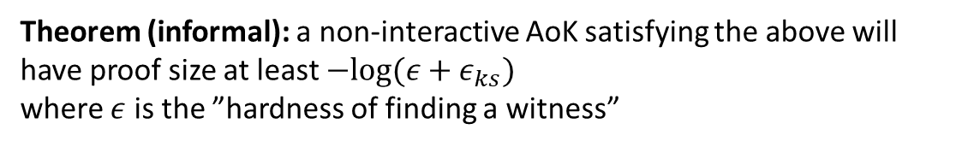
Negative result for Succinct Adaptive BB Extraction
Definition (adaptive BB extraction):
$$∃ Ext ∀ PPT A$$
Theorem (informal): a non-interactive AoK satisfying the above will have proof size at least $−log⁡(ε+ε_{ks})$
where $ε$ is the ”hardness of finding a witness”
(proof is straightforward; bound can be strengthened lookin at connection with leakage-resilient OWF)
Follow up observation: separation between ROM and standard model (succinct adaptive BB extr is possible in the ROM from falsifiable assumptions: Bulletproofs or Kilian/Micali)

Slide 19
Next
Implications of GW—more explicitly
GW does hold for preprocessing SNARGs
(observation) GW does not hold for a meaningful class of languages, “trapdoor languages”
2) SNARKs and UC (blackbox extraction)
Adaptive BB (negative result)
(minor contribution) we provide a proof of impossibility for hard languages
Non-adaptive BB:
Positive result: non-trivial ⊆ of NP admits it!
Negative result: not all NP admits it (under standard assumptions)

Slide 20
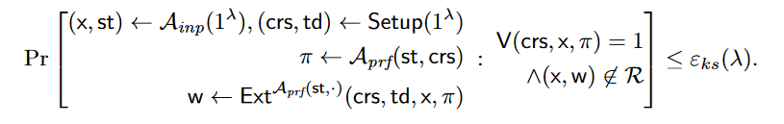

Defining non-Adaptive BB Extraction
Definition (non-adaptive BB extraction):
$$∃ Ext ∀ PPT A=(A_{inp}, A_{prf})$$
NB: This is not straight-line extractability; it is just black-box

Slide 21
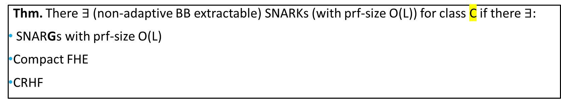
The positive result
We’ll look at this in a sec!
Thm. There $∃$ (non-adaptive BB extractable) SNARKs (with prf-size O(L)) for class C if there $∃:$
SNARGs with prf-size O(L)
Compact FHE
CRHF
Corollary: There plausibly exist non-adapt BB-extr SNARKs of O(1) size for class C from falsifiable assumptions.
If iO exists from falsifiable assumptions
On the complexity class C:
- C is FewP: subset of NP with at most poly # of witnesses
- example: R*(cm; w, opn) := “R(w) AND Open(cm, w, opn)” (for perfectly binding cm and arbitrary NP relation R)

Slide 22
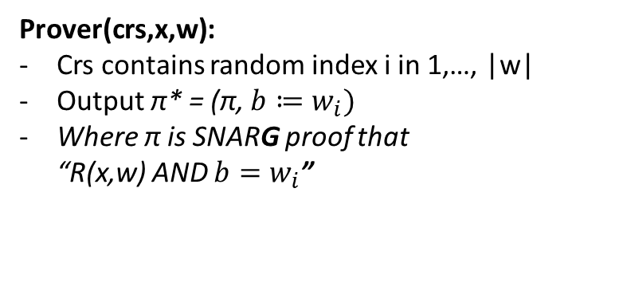
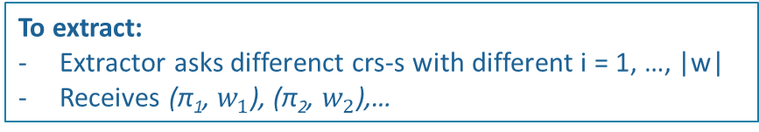
Sketch of construction of na-BB SNARK
Goal: let the extractor produce w through oracle-access to A (keeping proof succinct)
Idea: let the proof contain one bit of the witness; the extractor can ask more proofs and retrieve more bits
To extract:
Extractor asks differenct crs-s with different i = 1, …, |w|
Receives (π₁, $w_{1}$), (π₂, $w_{2}$),…
Problem 1:
This works only if there a single witness (UP)
To go beyond UP (FewP) we can “fingerprint” witnesses through CRHF
Prover(crs,x,w):
Crs contains random index i in 1,…, |w|
Output π* = (π, ${b≔w}_{i})$
Where π is SNARG proof that “R(x,w) AND ${b=w}_{i}$”
Problem 2 (more subtle):
Prover should not know the index it is revealing
We can use FHE/PIR for that
(and provide a sk to Ext)
NB: we ignore ZK for now

Slide 23
Next
Implications of GW—more explicitly
GW does hold for preprocessing SNARGs
(observation) GW does not hold for a meaningful class of languages, “trapdoor languages”
2) SNARKs and UC (blackbox extraction)
Adaptive BB (negative result)
(minor contribution) we provide a proof of impossibility for hard languages
Non-adaptive BB:
Positive result: non-trivial ⊆ of NP admits it!
Negative result: not all NP admits it (under standard assumptions)

Slide 24
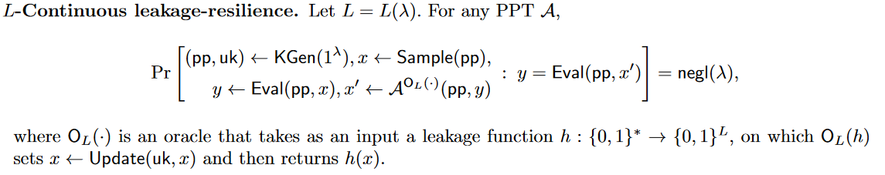
Negative result from Continuous-Leakage Resilient OWF
The result we just saw cannot be extended to all NP
We can show that “short enough” non-adaptive BB proofs can be used to break a certain type of leakage resilient OWF
Under DLOG

Slide 25
In closing
GW is not an “all encompassing” reason for why it is (theoretically) hard to build SNARG/Ks
E.g., Trapdoor languages, low-space languages, non-adaptivity…
Adaptivity matters for black-box extractability (required for UC)
Still open:
Extending our result of GW for preprocessing CRS: non parameter-preserving reductions
GW and accumulation-based techniques?
See paper for additional discussion of boundaries about impossibility in SNARG/Ks

Slide 26
Thanks!
Questions?
https://eprint.iacr.org/2022/638.pdf

Slide 27
This work
- black-box extractability
(minor contribution) we provide a proof that adaptive-BB extractability is impossible for hard languages
Next we ask: what happens for the non-adaptive case?
Non-adaptive = adversary first declares statement x; only after can see crs and push proof
(move part below to different slide)
Surprise: it is possible to obtain non-adaptive BB-extraction for a non-trivial subset of NP!
SNARK is constructed from SNARG + FHE + CRHF
Plausibly instantiatable from non-falsifiable assumptions
Q: so maybe non-adaptive BB-extraction possible for all NP?
Our next result: we answer “no”
Theorem: If Continuous-Leakage OWF exist then it one cannot obtain such SNARKs for all NP
Corollary: under DDH such SNARKs cannot exist for all NP

