Slide 1
Fokker-Planck Equation and its Related Topics
Venkata S Chapati
Hiro Shimoyama
Department of Physics and Astronomy, University of Southern Mississippi

Slide 2
Overview
Background
Basic Terminology
  Stochastic Process
  Probability Notations
  Markov Process
  Brownian Motion
Descriptions of Random Systems
  Langevin Equation
  Fokker-Planck Equation
  The Solutions
Applications
Summary

Slide 3
Background
The equation arose in the work of Adriaan Fokker's 1913 thesis. Fokker studied under Lorentz.
Max Planck derived the equation and developed it as probability processes.
It was sophisticated as mathematical formulation from Brownian motion.

Slide 4
Basic Terminology
(For the preparation)
Stochastic Process
Probability Notations
Markov Process
Brownian Motion

Slide 5
1. Stochastic Process I
A stochastic process is the time evolution of the stochastic variable. If Y is the stochastic variable then Y(t) is the stochastic process.
A stochastic variable is defined by specifying the set of possible values called range of set of states and the probability distribution over the set.
The set can be discrete, continuous or multidimensional

Slide 6
Stochastic Process II
A stochastic process is simply a collection of random variables indexed by time. It will be useful to consider separately the cases of discrete time and continuous time.
For a discrete time stochastic process X = {Xn, n = 0, 1, 2, . . .} is a countable collection of random variables indexed by the non-negative integers.
Continuous time stochastic process X = {Xt, 0 t < 1} is an uncountable collection of random variables indexed by the non-negative real numbers

Slide 7
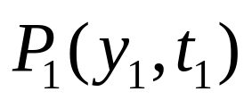
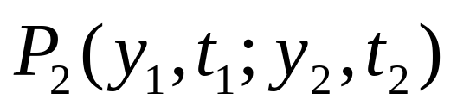
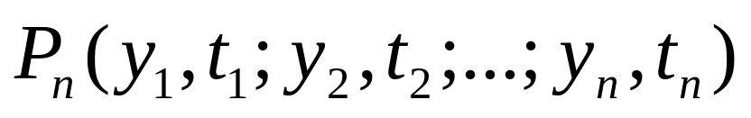
2. Probability Notations
The probability density that the stochastic variable y has value y₁ at time t₁ =
The joint probability density that the stochastic variable y has value y₁ at time t₁ and value y₂ at time t₂ =
Thus, it will be eventually,

Slide 8
3. Markov Process
It is a stochastic process in which the distribution of future states depends only on the present state and not on how it arrived in the present state.
It is a random process in which the probabilities of states in a series depend only on the properties of the immediately preceding state and independent of the path by which the preceding state was reached.
Markov process can be continuous as well as discrete.

Slide 9
4. Brownian Motion
Brownian motion is named after the botanist Robert Brown who observed the movement of plant spores floating on water.
It is a zigzag, irregular motion exhibited by minute particles of matter which is caused by the molecular-level of the interaction.

Slide 10
Descriptions of Random Systems
Langevin Equation
Fokker-Planck Equation

Slide 11
1. Langevin Equation I
The Langevin equation is named after the French physicist Paul Langevin (1872–1946).
This is one type of equation of motion used to study Brownian motion.

Slide 12
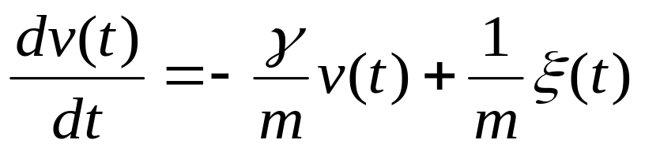
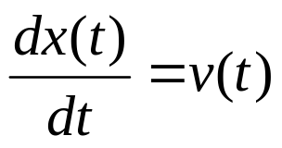
Langevin Equation II
Langevin equation of motion can be written as
v(t) is the velocity of the particle in a fluid at time t

Slide 13
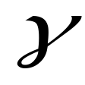

Langevin Equation III
x(t) is the position of the particle.
is a constant called friction coefficient.
is a random force describing the average effect of the Brownian motion.

Slide 14
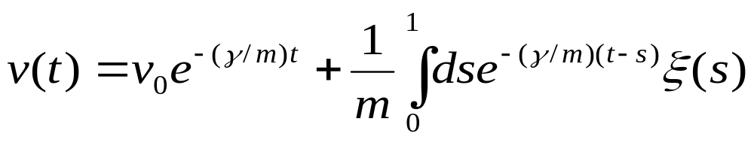
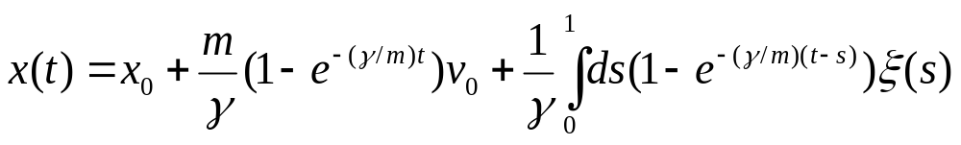
Langevin Equation IV
The solution

Slide 15
2. Fokker-Plank Equation I
Fokker and Planck made the first use of the equation for the statistical description of the Brownian motion of the particle in the fluid.
Fokker-Planck equation is one of the simplest equations in terms of continuous macroscopic variables.

Slide 16
Fokker-Plank Equation II
Fokker-Planck equation describes the time evolution of probability density of the Brownian particle.
The equation is a second order differential Equation.
There is no unique solution since the equation contains random variables.

Slide 17
Fokker-Plank Equation III
The Fokker-Planck equation describes not only stationary, but dynamics of the system if the proper time-dependent solution is used.
Fokker-Planck equation can be derived into Schroedinger equation.

Slide 18
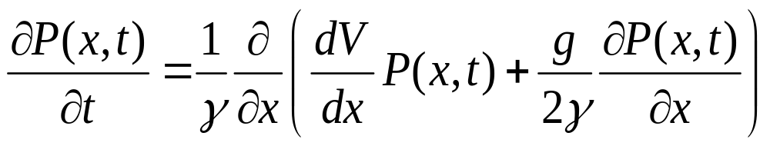

Fokker-Plank Equation IV
Consider a Brownian particle moving in one dimensional potential well, v(x).
The Fokker-Planck equation for the probability density P( x,t ) to find the Brownian particle in the interval x → x+dx at time t is
is the friction coefficient.

Slide 19
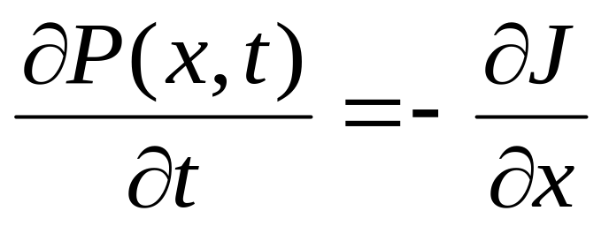
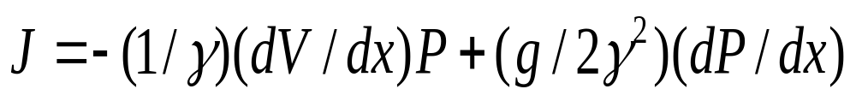
Fokker-Plank Equation V
where

Slide 20
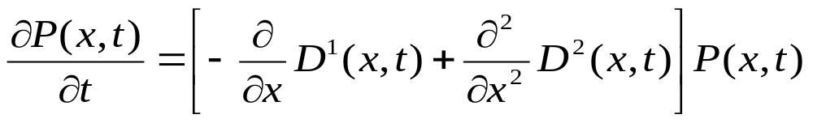
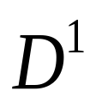
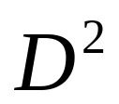
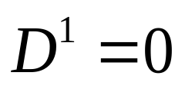
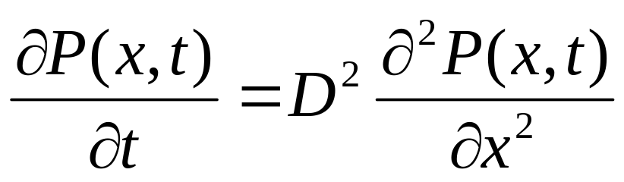
Fokker-Plank Equation VI
In general
is Drift Vector
is Diffusion Tensor
If is then

Slide 21
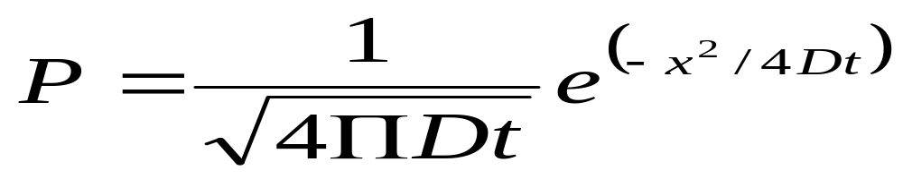
3. The Solutions
(Fokker Planck Equation)
This equation is called diffusion equation.
The basic solution is:

Slide 22
The Solutions (continued)
F-P equation has a linear drift vector and constant diffusion tensor; thus, one can obtain Gaussian distributions for the stationary as well as for the in-stationary solutions.
When the coefficients obey certain potential conditions, the stationary solution is obtained by quadratures.
A F-P equation with one variable can give the stationary solution.

Slide 23
The Solutions (continued)
Other Methods:
Transformation of Variables
Reduction to a Hermitian Problem
Numerical Integration Method
Expansion into Complete Sets
Matrix Continued-Fraction Method
WKB Method

Slide 24
Applications of Fokker-Planck Equation
Lasers
Polymers
Particle suspensions
Quantum electronic systems
Molecular motors
Finance

Slide 25
Summary
The Fokker-Planck equation is one of the best methods for solving any stochastic differential equation.
It is applicable to equilibrium as well as non equilibrium systems.
It describes not only the stationary properties but also the dynamic behavior of stochastic process.

Slide 26
References
H Resken – The Fokker Planck Equation
R.K.Pathria – Statistical Mechanics
N.G. Van Kampen– Stochastic Process in Physics and Chemistry
Riechl – Statistical Physics

