Slide 1







Analysis of Higgs boson decay into four leptons at 8 TeV
Matteo Malucchi
October 2022
Analysis of Higgs boson decay into four leptons at 8 TeV Matteo Malucchi

Slide 2
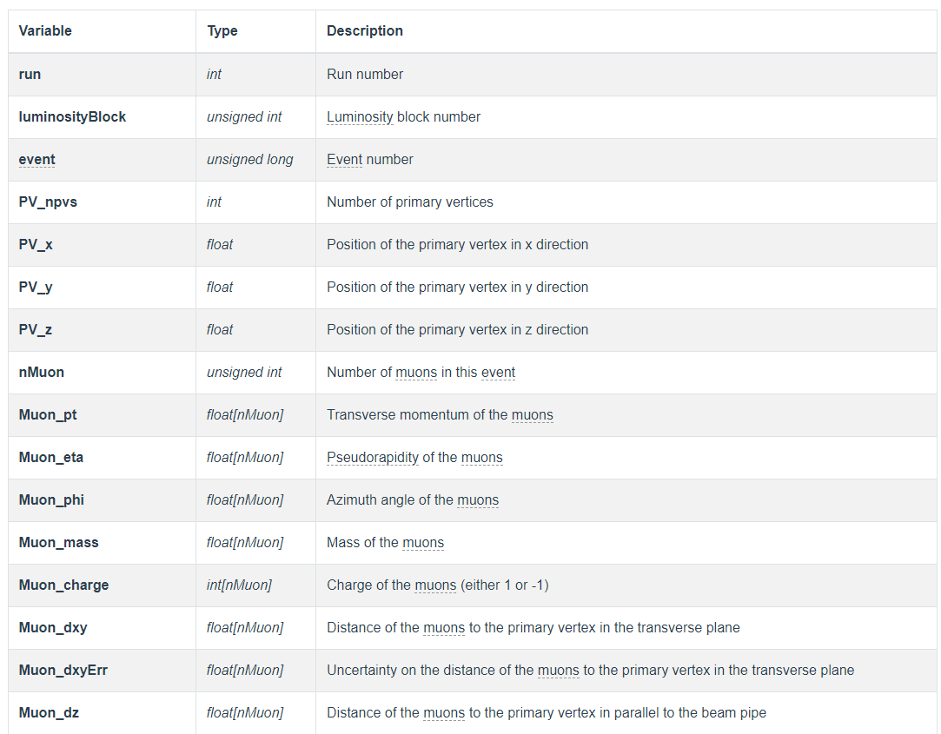
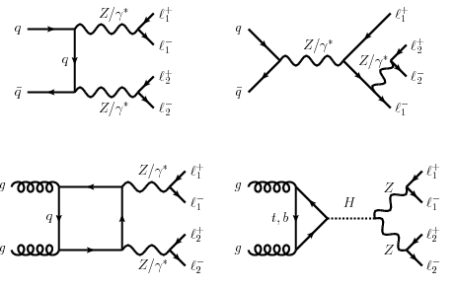
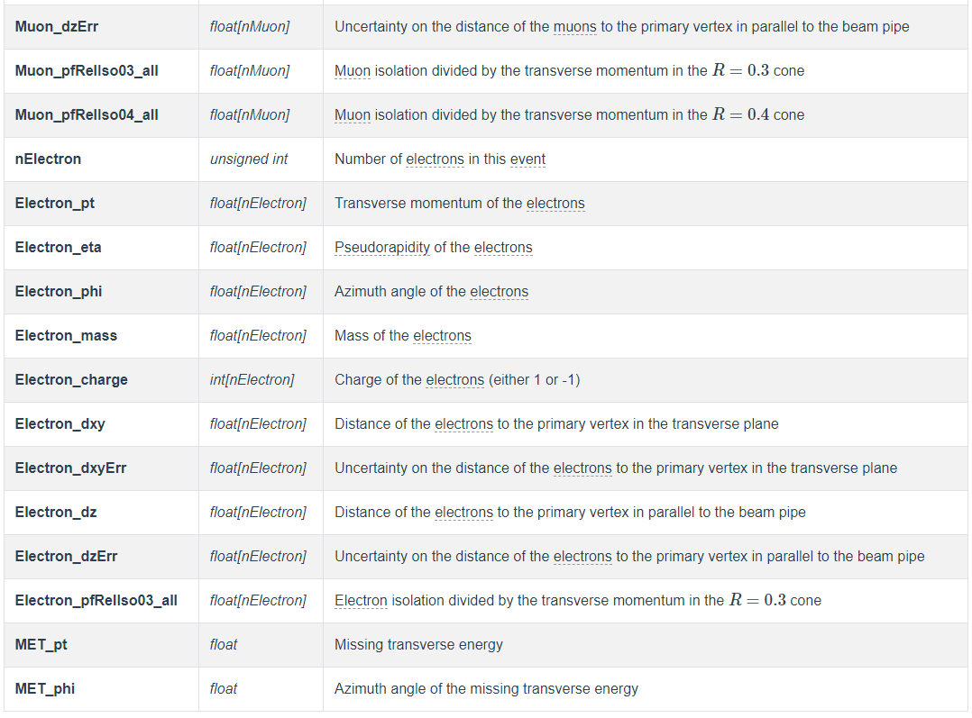

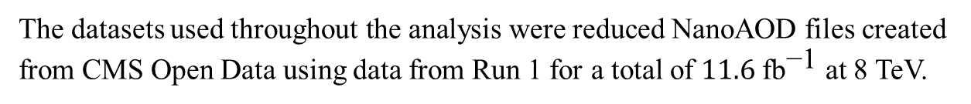
$$H→ZZ^{∗}→l_{1}^{+}l_{1}^{−}l_{2}^{+}l_{2}^{−}$$
The datasets used $\text{throughout} \text{the} \text{analysis} \text{were}$reduced NanoAOD files created from CMS Open Data using data from Run 1 for a total of $11.6 \text{f}{\text{b}}^{\text{−1}}$ at 8 TeV.
SM ZZ background
SM Higgs signal
Analysis of Higgs boson decay into four leptons at 8 TeV Matteo Malucchi

Slide 3
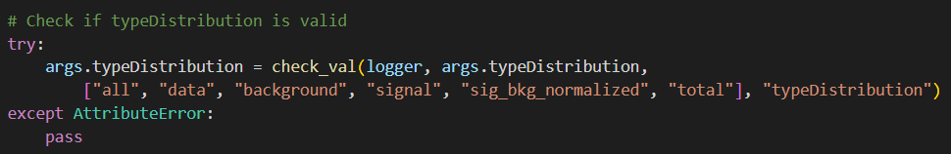
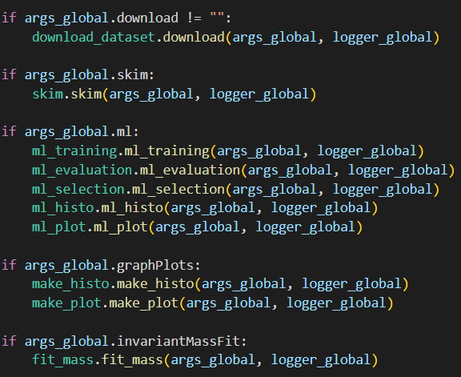
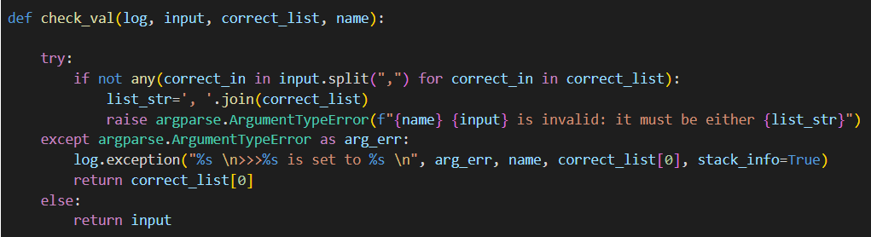
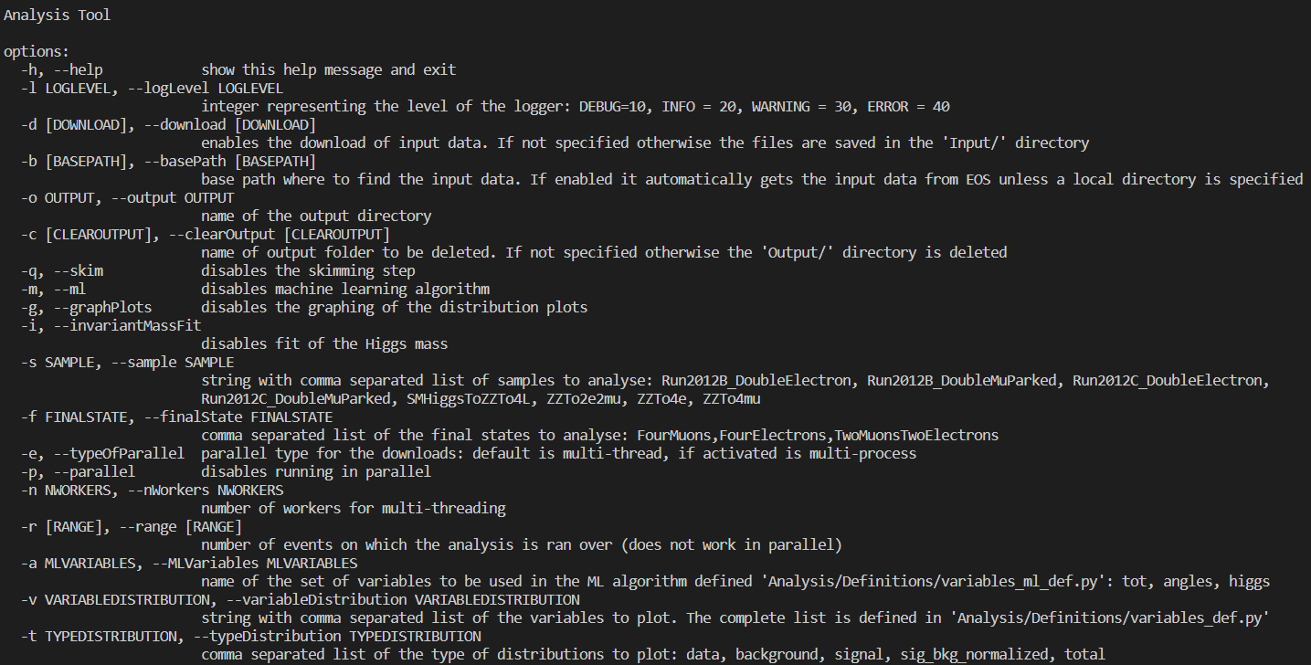
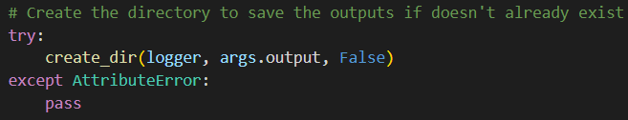
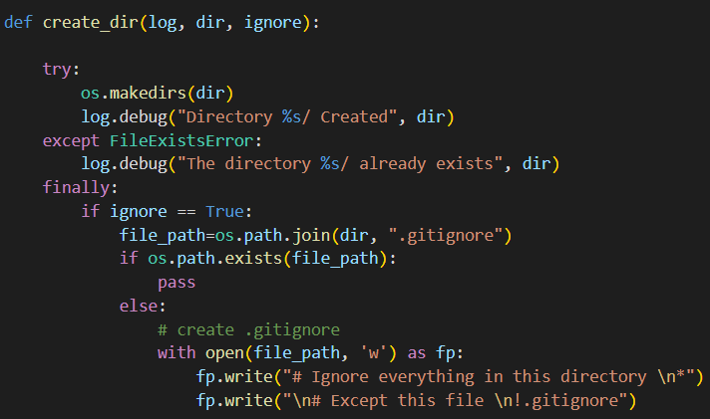
Set up and run the analysis
set_up.py
run_analysis.py
Analysis of Higgs boson decay into four leptons at 8 TeV Matteo Malucchi

Slide 4
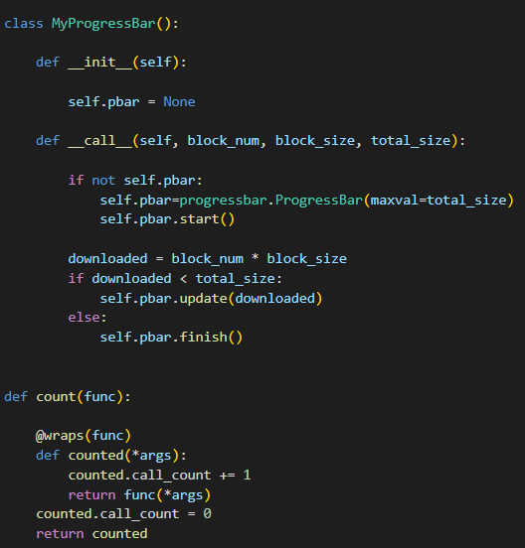
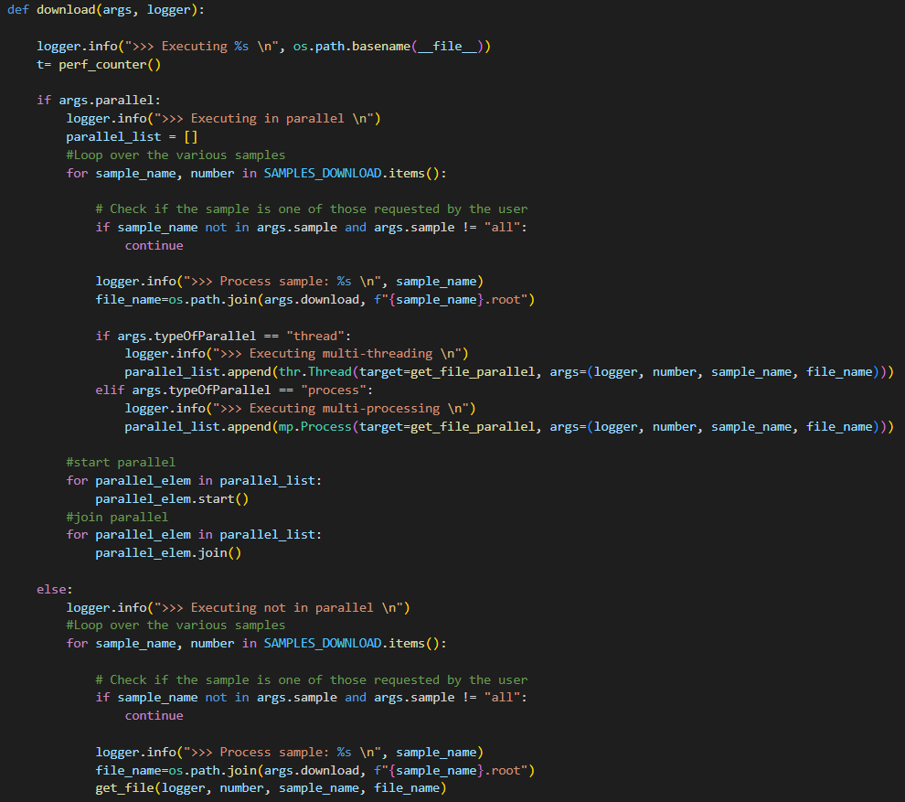
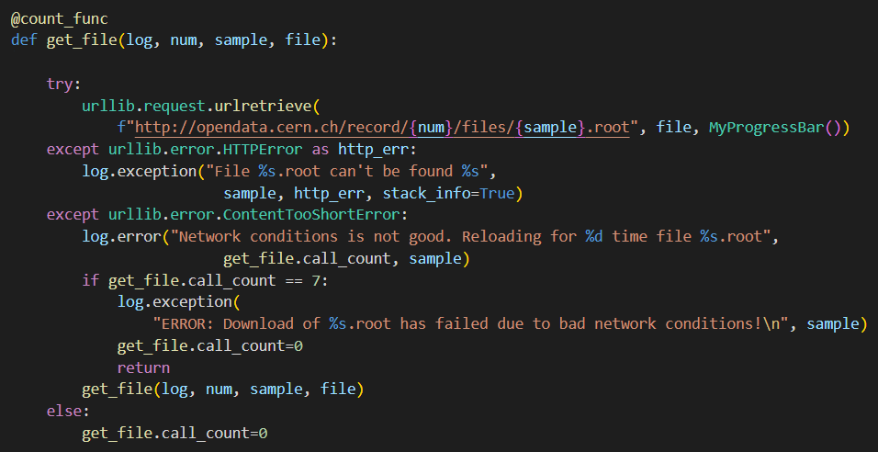
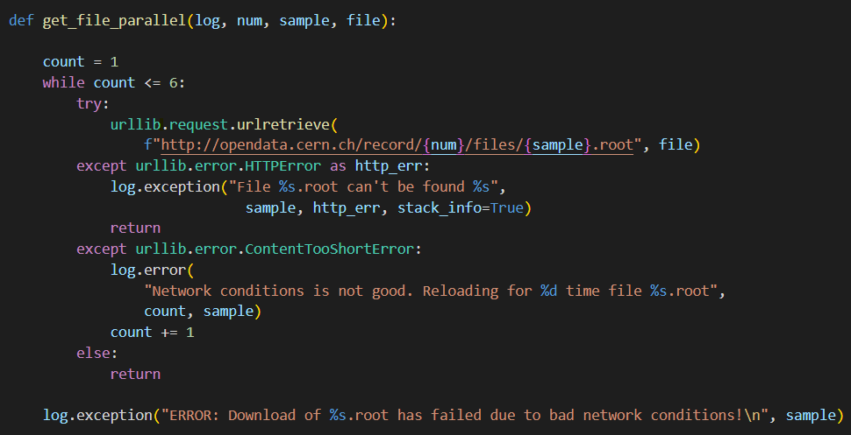
Download the datasets
download_dataset.py
Analysis of Higgs boson decay into four leptons at 8 TeV Matteo Malucchi

Slide 5
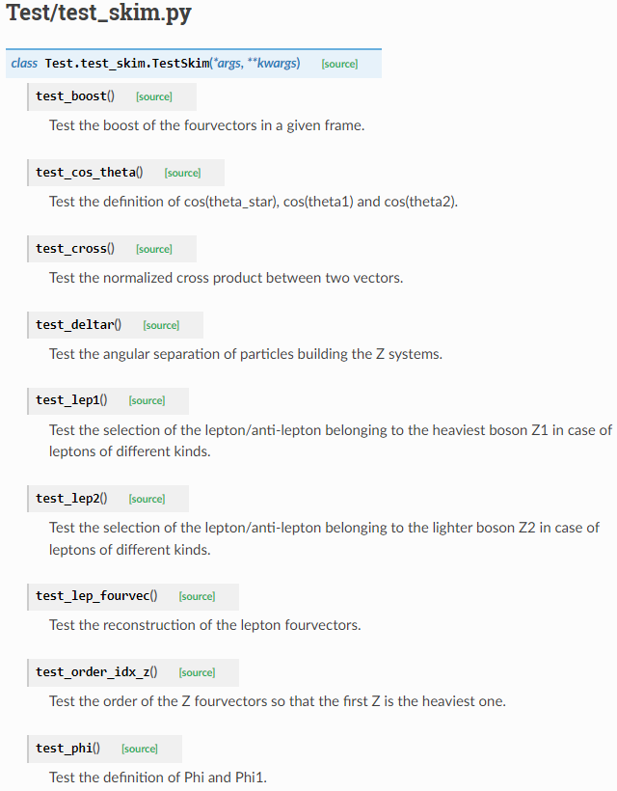
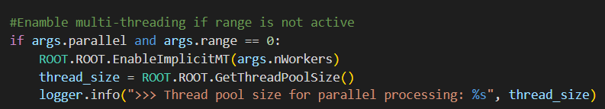
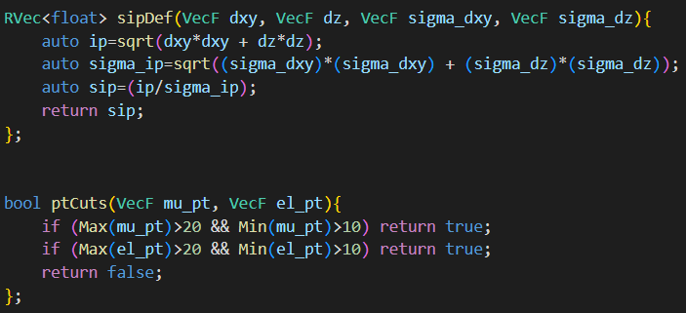
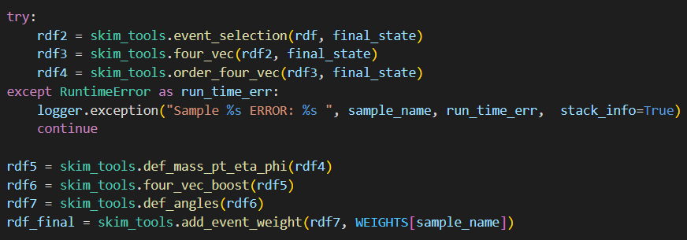
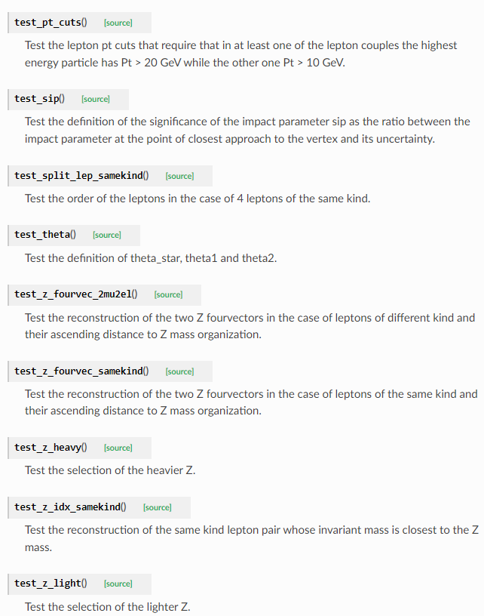
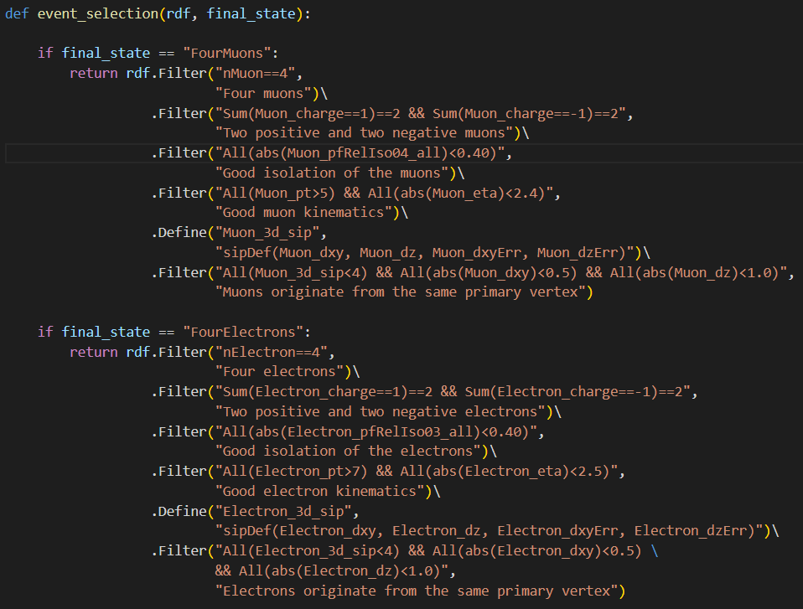
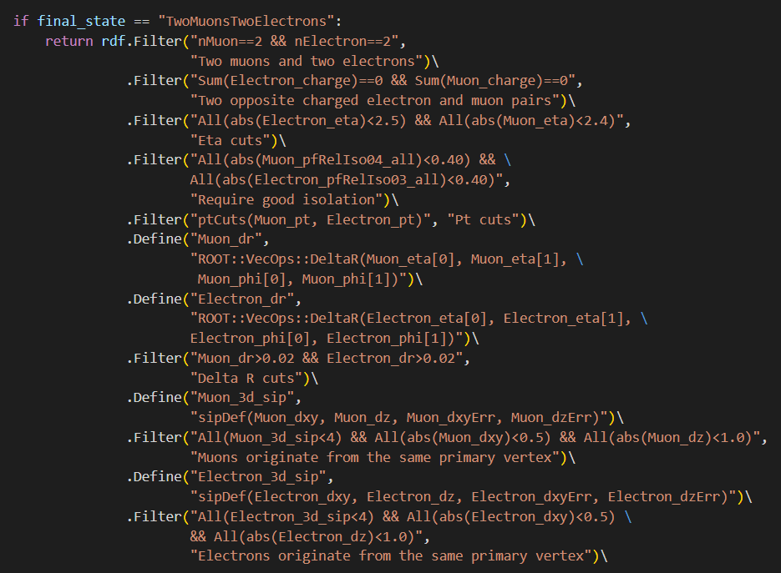
Skim the dataset
test_skim.py
skim.py
skim_functions.h
skim_tools.py
Analysis of Higgs boson decay into four leptons at 8 TeV Matteo Malucchi

Slide 6
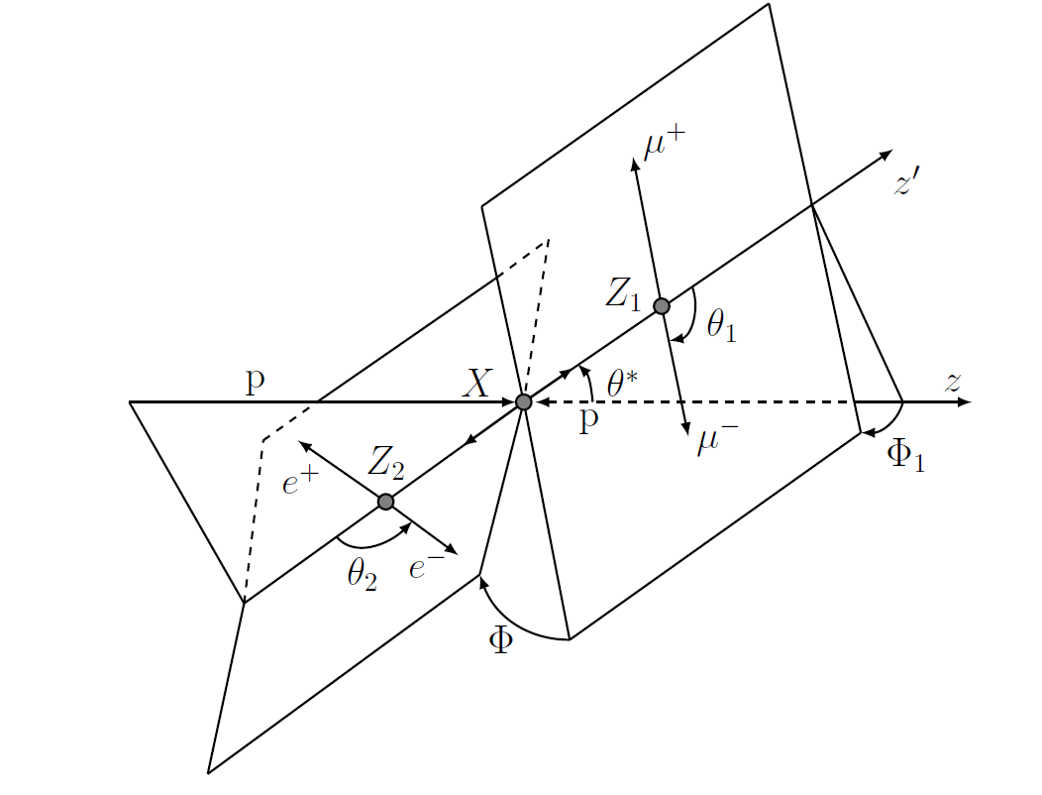
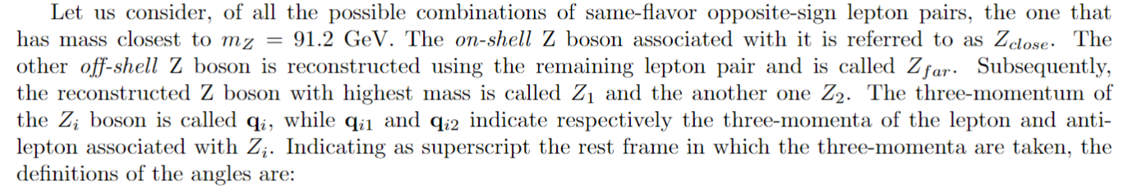
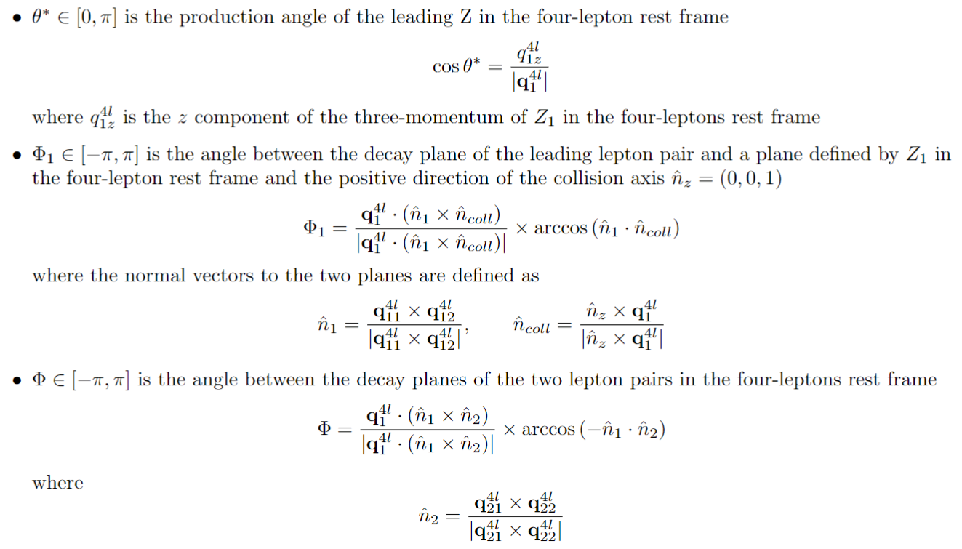
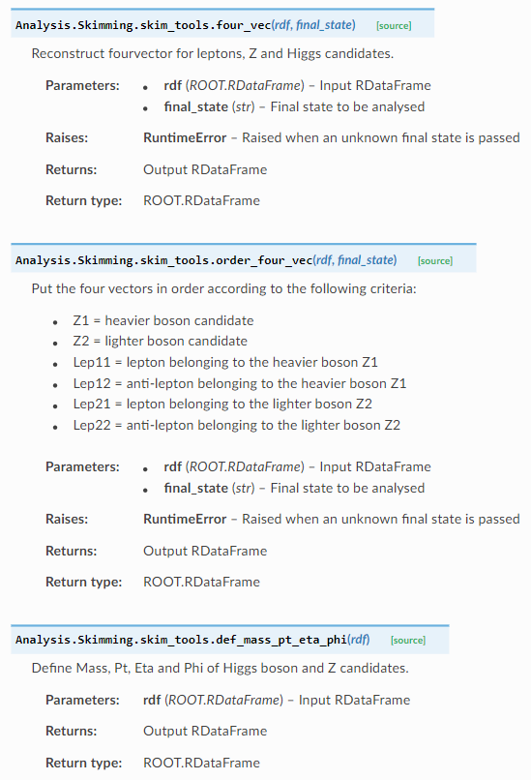
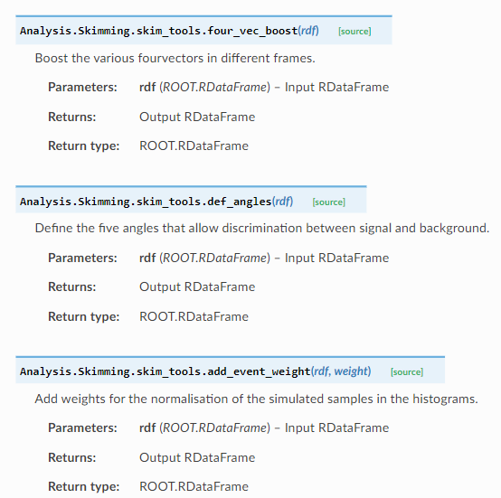
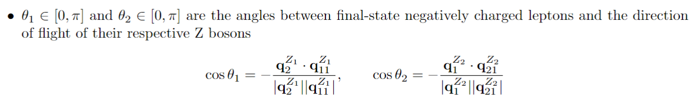
Define the decay angles
skim_tools.py
Analysis of Higgs boson decay into four leptons at 8 TeV Matteo Malucchi

Slide 7
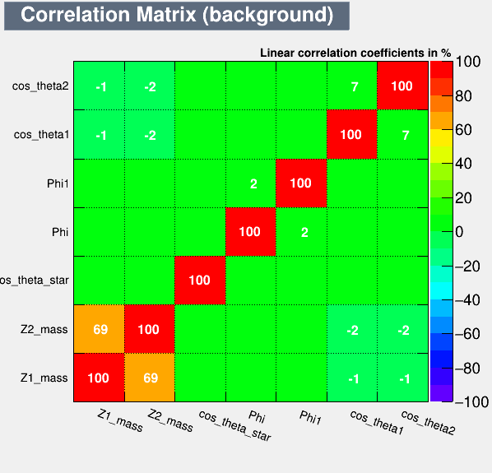
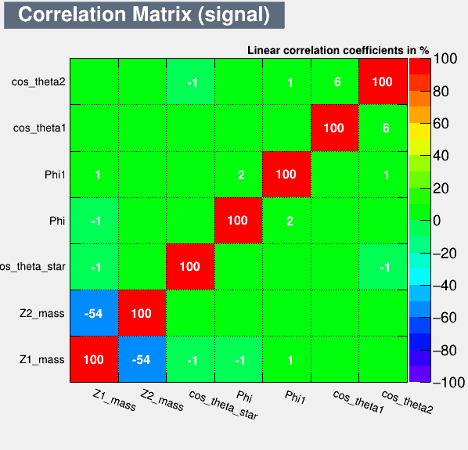

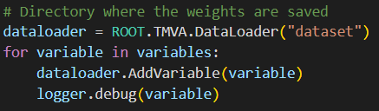

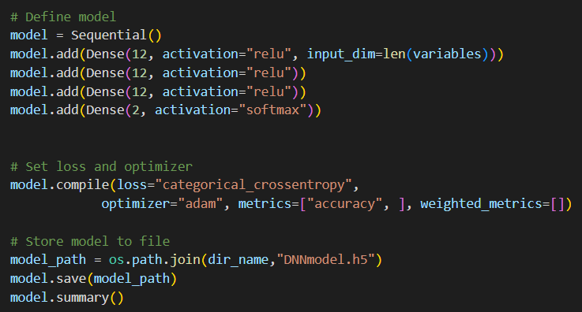
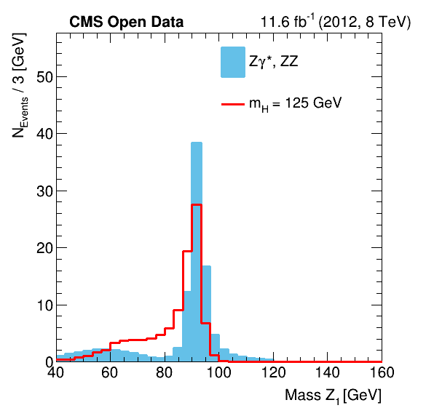
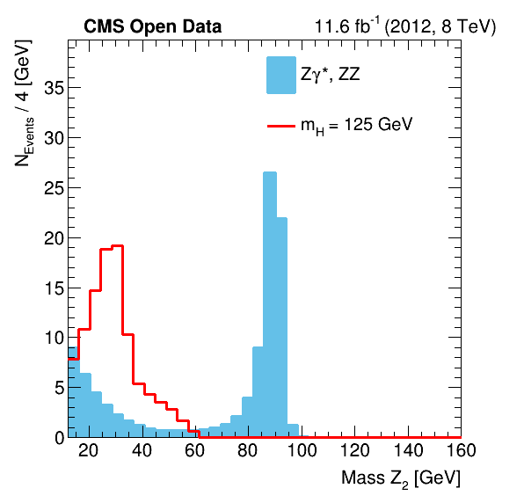
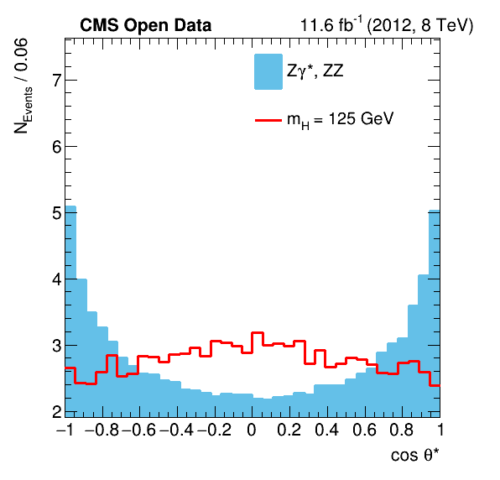
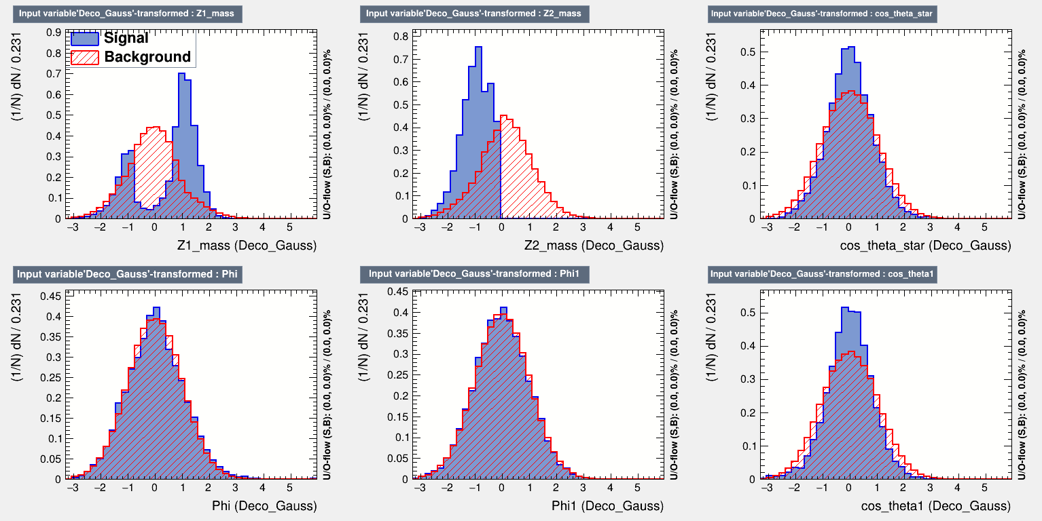
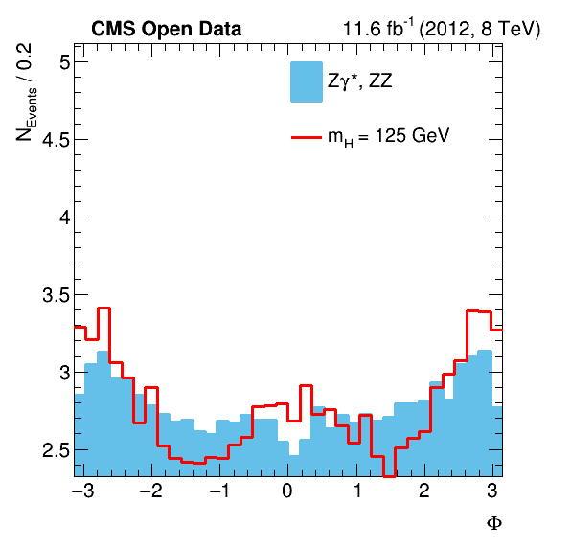
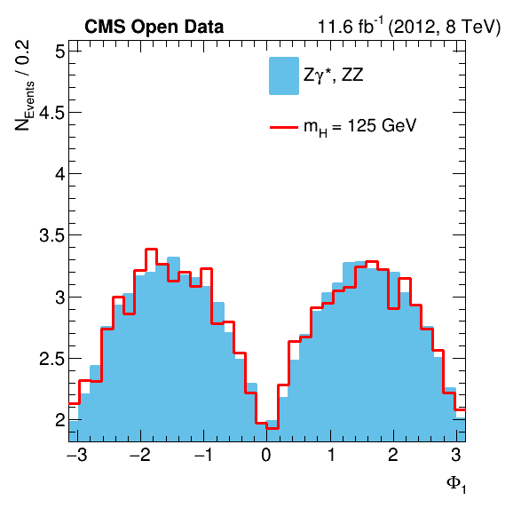
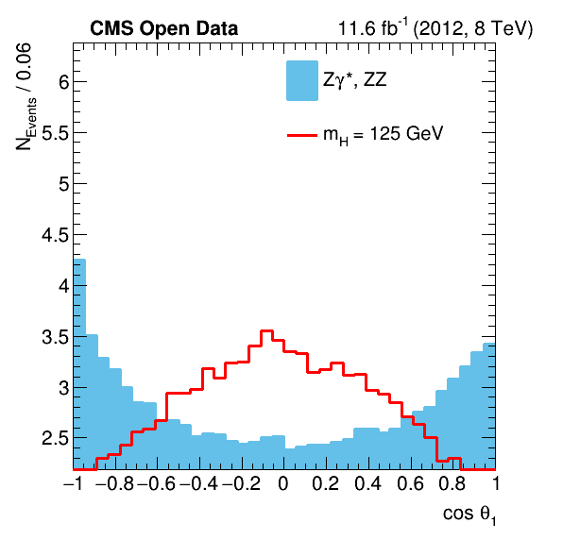
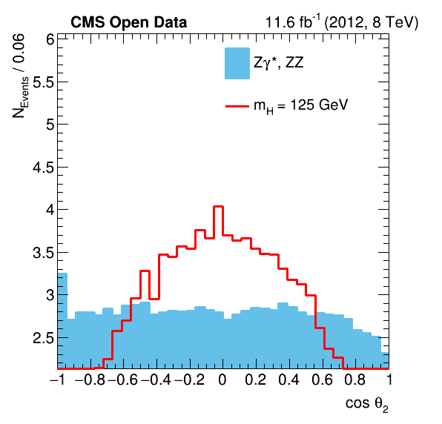
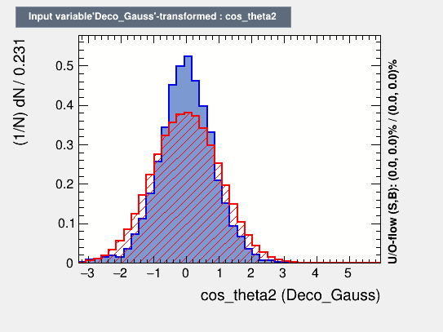
DNN variables and model
ml_training.py
Analysis of Higgs boson decay into four leptons at 8 TeV Matteo Malucchi

Slide 8
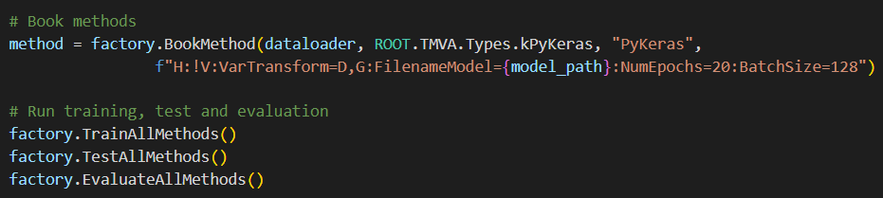
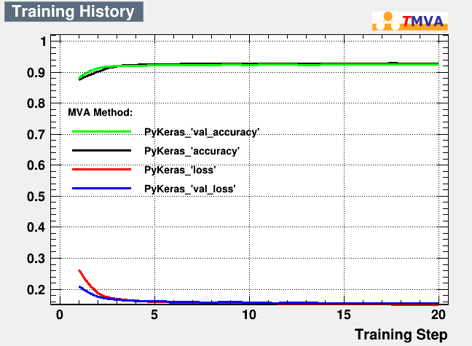
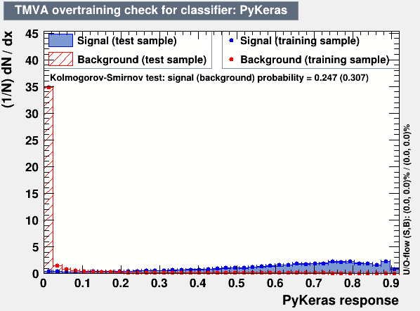
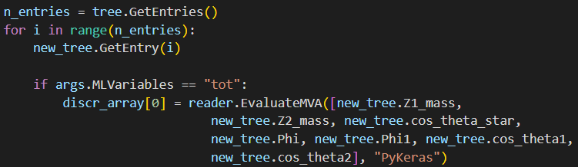
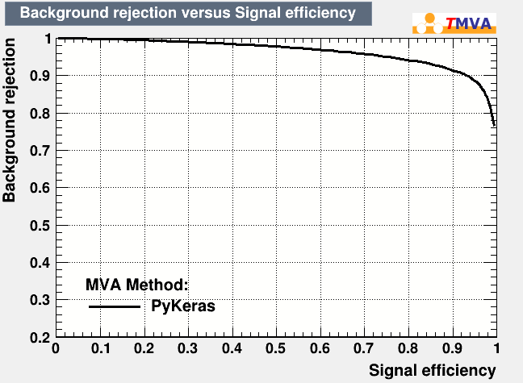
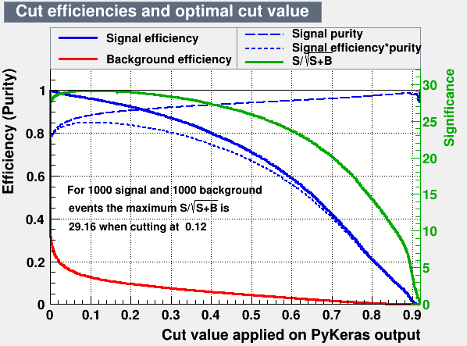
DNN training
ml_training.py
ml_evaluation.py
ml_selection.py
Analysis of Higgs boson decay into four leptons at 8 TeV Matteo Malucchi

Slide 9
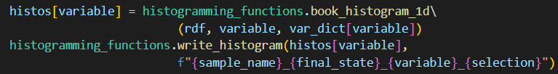
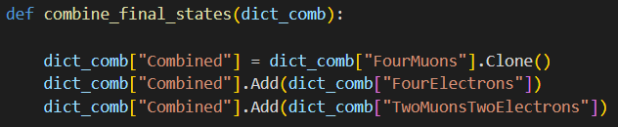
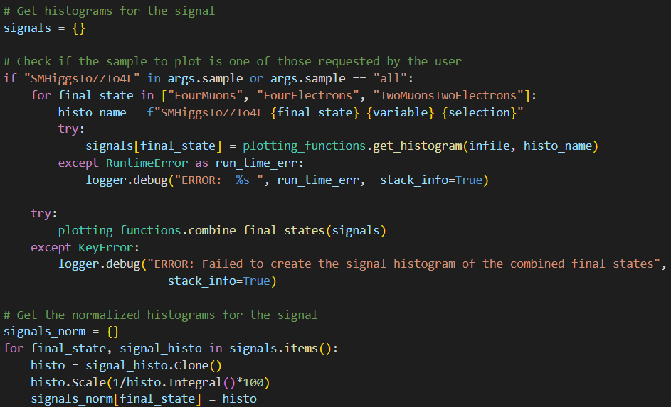
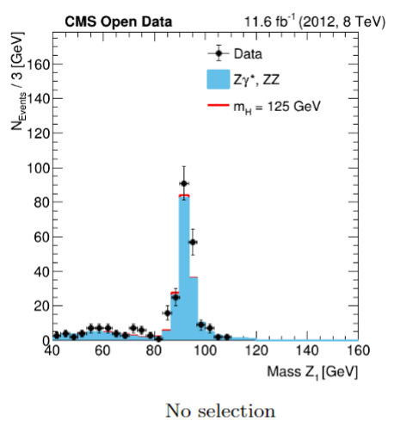





Histograms e plots
make_histo.py
plotting_functions.py
make_plot.py
histogramming_functions.py
Analysis of Higgs boson decay into four leptons at 8 TeV Matteo Malucchi

Slide 10



Higgs mass VS DNN Discriminant
ml_histo.py
ml_plot.py
Analysis of Higgs boson decay into four leptons at 8 TeV Matteo Malucchi

Slide 11



Higgs mass fit
fit_mass.py
Analysis of Higgs boson decay into four leptons at 8 TeV Matteo Malucchi

