Slide 1

AI for Finance: Forecasting pricing of futures contract
Matteo minardi, july 2023

Slide 2
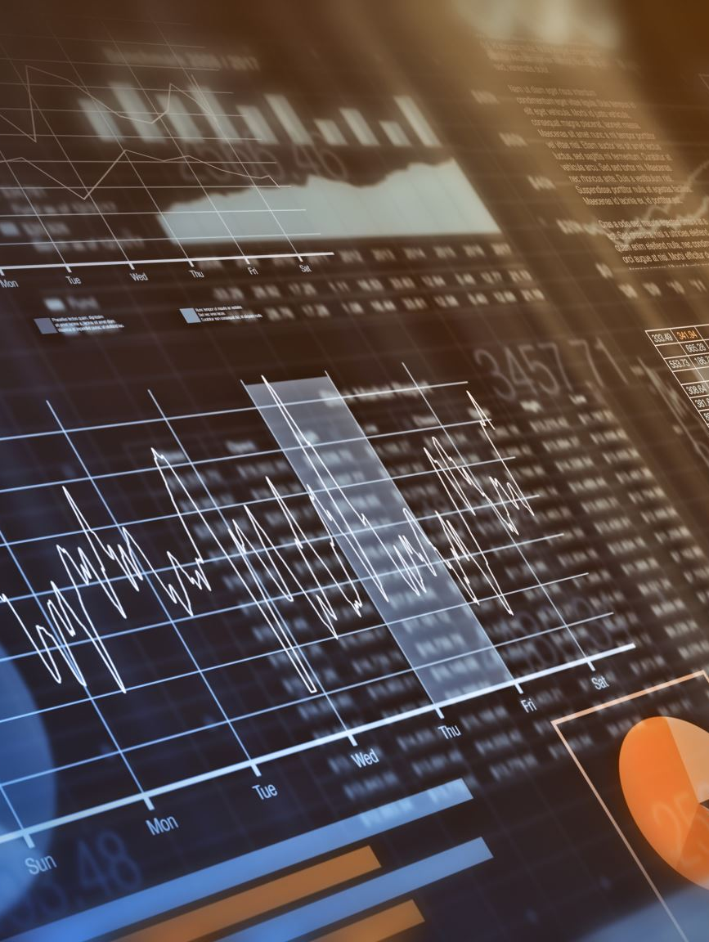
Table of contents
Introduction to the problem
Refinitiv Eikon and Data used
Proposed solutions
Econometric Analysis
AI approach
Conclusions

Slide 3
Introduction to the problem
Critical task for financial professionals, investors, and traders alike. Financial instruments that enable parties to buy or sell an underlying asset at a predetermined price and date in the future
Predicting future price movements, investors can take advantage of profitable opportunities, minimize potential losses, and optimize their trading strategies
Forecasting futures prices is complex and challenging Influenced by supply and demand dynamics, underlying stock performance, market sentiment and regulatory changes

Slide 4
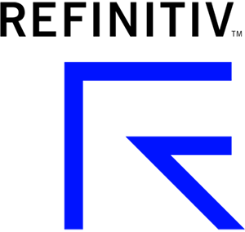
Refinitiv Eikon and Data used
The data has been taken from the Refitiv Eikon database: a leading financial data and analytics platform that provides real-time market data, news, and analytics tools for financial professionals and institutions. Since the quality of this database is very high, the data doesn’t need any cleaning process.
The data that has been used was downloaded from the Derivatives section of the Apple company (AAPL.O). The selected futures contract is AAPF3N3.
Data used:
AAPL.O price series
AAPF3N3 price series
SPREAD computed between the previous two series
SPX price series, used for market reference
News headlines about Apple in a predefined time period

Slide 5

Proposed solutions
To find a reliable solution, two main approaches have been tried The first one is simpler and more intuitive, the second one relies on a more exhaustive analysis:
Underlying stock performance
Standard pricing
Percentage returns
Incorporating the market and sentiment analysis
For each solution, an OLS has been computed to check the statistical significance of the models
With each approach, two methods have been performed: one not-so-fair, trying to predict the future values relying on future data that wouldn't be available in a real-life scenario, just to show and ideal case, and a second one done in the correct way but obviously on a shorter forecast window.

Slide 6
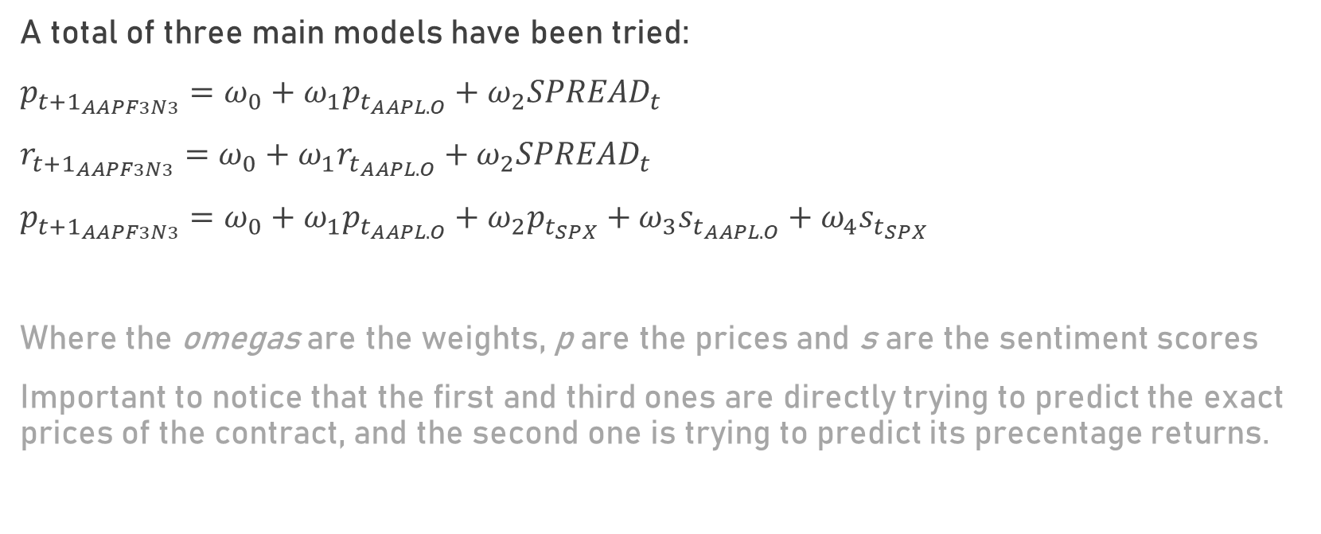
Forecasting models
A total of three main models have been tried:
$p_{t+1_{AAPF3N3}}=ω_{0}+ω_{1}p_{t_{AAPL.O}}+ω_{2}SPREAD_{t}$
$r_{t+1_{AAPF3N3}}=ω_{0}+ω_{1}r_{t_{AAPL.O}}+ω_{2}SPREAD_{t}$
$p_{t+1_{AAPF3N3}}=ω_{0}+ω_{1}p_{t_{AAPL.O}}+ω_{2}p_{t_{SPX}}+ω_{3}s_{t_{AAPL.O}}+ω_{4}s_{t_{SPX}}$
Where the omegas are the weights, p are the prices and s are the sentiment scores
Important to notice that the first and third ones are directly trying to predict the exact prices of the contract, and the second one is trying to predict its precentage returns.

Slide 7
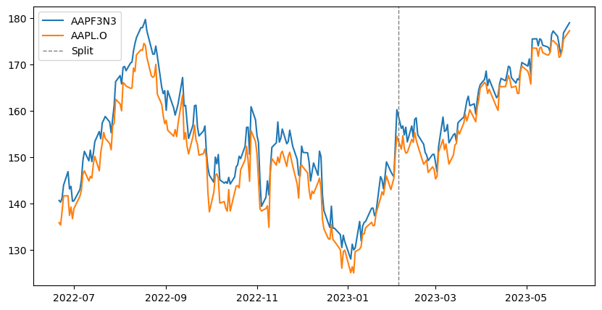
General intuition: ideal (unrealistic) case
Visualizing ideal results, assuming to split a hypothetical dataset right where the dotted line is placed, trying to predict the evolution of the price of the contract, training it on the price of the main stock, and seeing how they might behave in the future.

Slide 8
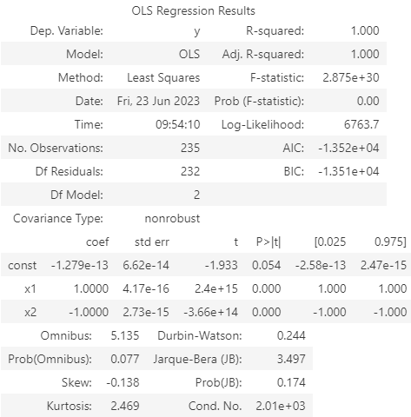
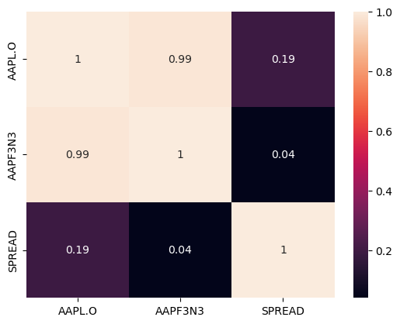

Underlying stock performance
$p_{t+1_{AAPF3N3}}=ω_{0}+ω_{1}p_{t_{AAPL.O}}+ω_{2}SPREAD_{t}$
Given the fact that the price of the Apple stock and the contract have almost a correlation of 1, it was expected that also the R-squared was going to be 1, since obviously the Apple price is extremely significant for the estimate.

Slide 9
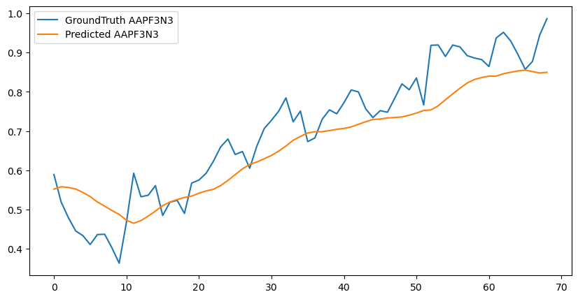
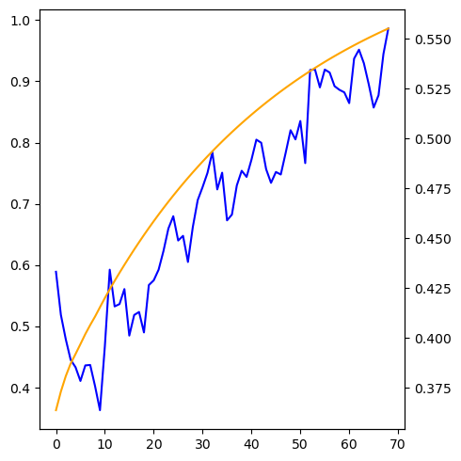
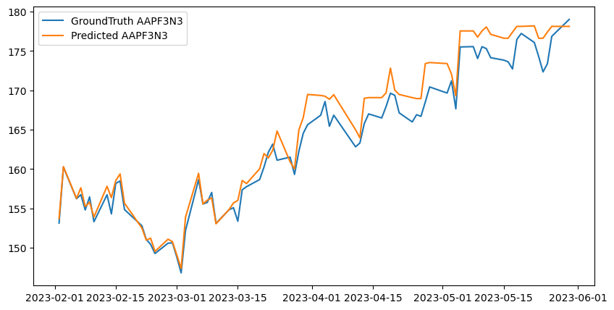
Underlying stock performance (price)
UNFAIR RESULTS VS FAIR RESULTS
Above: using LSTM, Below: using RF
Fig.2: fair prediction, multiple results
Fair prediction, single result
Single value prediction: Accuracy score: 0.9968941058794363 Predicted value: 0.9303200797880049 GroundTruth value: 0.9860506290456943

Slide 10
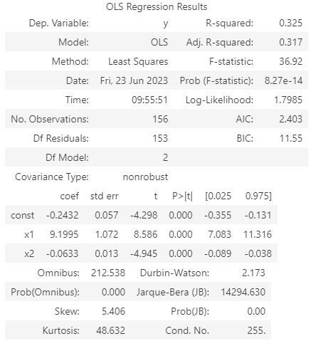
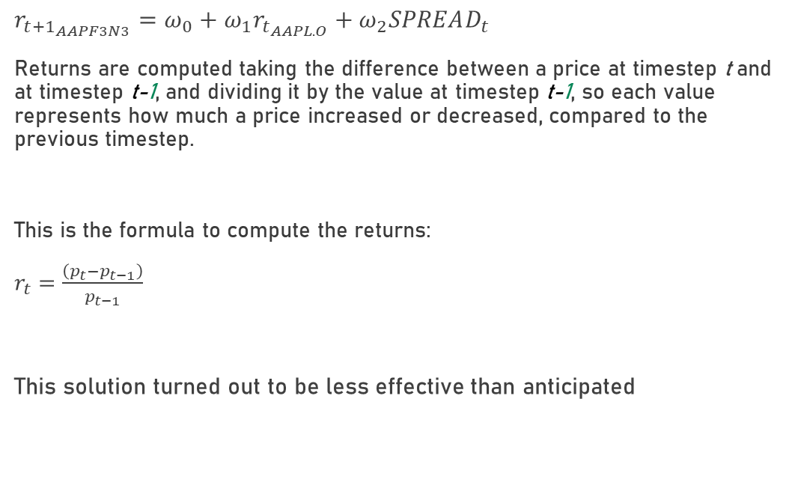
Underlying stock performance
$r_{t+1_{AAPF3N3}}=ω_{0}+ω_{1}r_{t_{AAPL.O}}+ω_{2}SPREAD_{t}$
Returns are computed taking the difference between a price at timestep t and at timestep t-1, and dividing it by the value at timestep t-1, so each value represents how much a price increased or decreased, compared to the previous timestep.
This is the formula to compute the returns:
$r_{t}=\frac{\left(p_{t}−p_{t−1}\right)}{p_{t−1}}$
This solution turned out to be less effective than anticipated

Slide 11
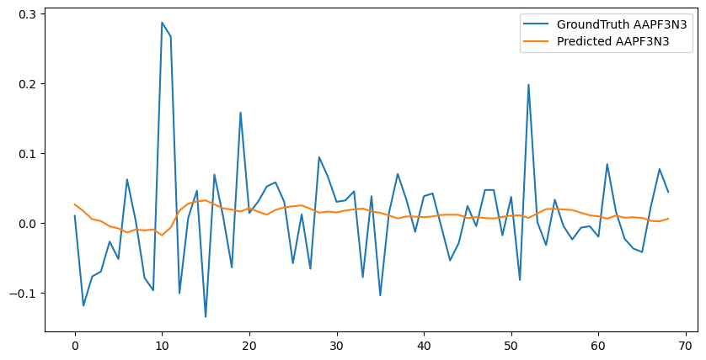
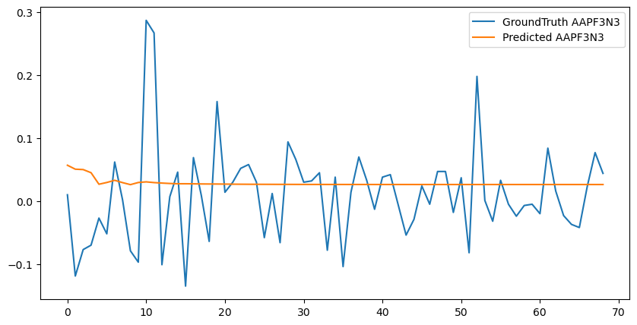
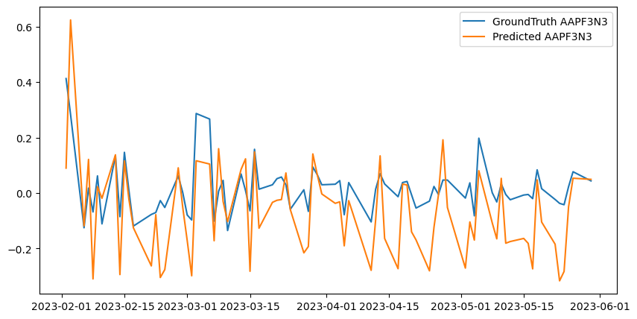
Underlying stock performance (returns)
UNFAIR RESULTS VS FAIR RESULTS
Fair prediction, single result
Single value prediction: Accuracy score: 0.9999361599 Predicted value: 0.05198999999999999 GroundTruth value: 0.044

Slide 12
Incorporating the market and sentiment analysis
Sentiment Analysis is the process of ‘computationally’ determining whether a piece of writing is positive, negative or neutral. It’s also known as opinion mining, deriving the opinion or attitude of a speaker.
Since the market is heavily influenced by people's feeling and fears, it would be appropriate to start considering a sentiment analysis over the news of the specific stock and use it as additional information for the final prediction.
In order to try to increase the performance even more, it has been decided to also consider the market performance, using the SP500 index. This could be useful to have a sort of baseline for performance comparison.
VADER (Valence Aware Dictionary and sEntiment Reasoner) is a lexicon and rule-based sentiment analysis tool that is specifically attuned to sentiments expressed in social media. PUNKT is a tokenizer.

Slide 13
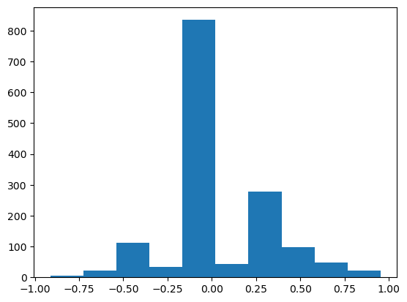
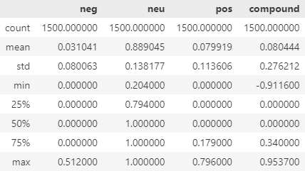
Incorporating the market and sentiment analysis
After downloading 1500 news headlines for each the Apple stock and the SP500 stock, the polarity scores can be computed. These are the results for the SP500 index:

Slide 14
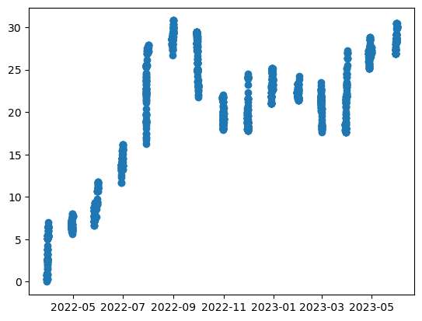
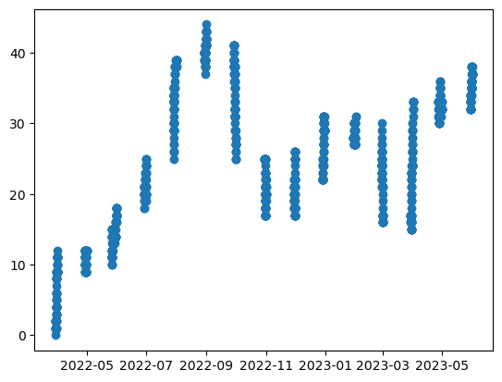
Incorporating the market and sentiment analysis
Summing up all the sentiment scores, grouping them by their date, allows to compute a general sentiment score for each time step. This measure is used to identify particular moments in which the general public opinion changed, meaning it increased by a significant amount or decreased surprisingly. These are the results for the Apple index, showing the before and after of the additional quantization:

Slide 15
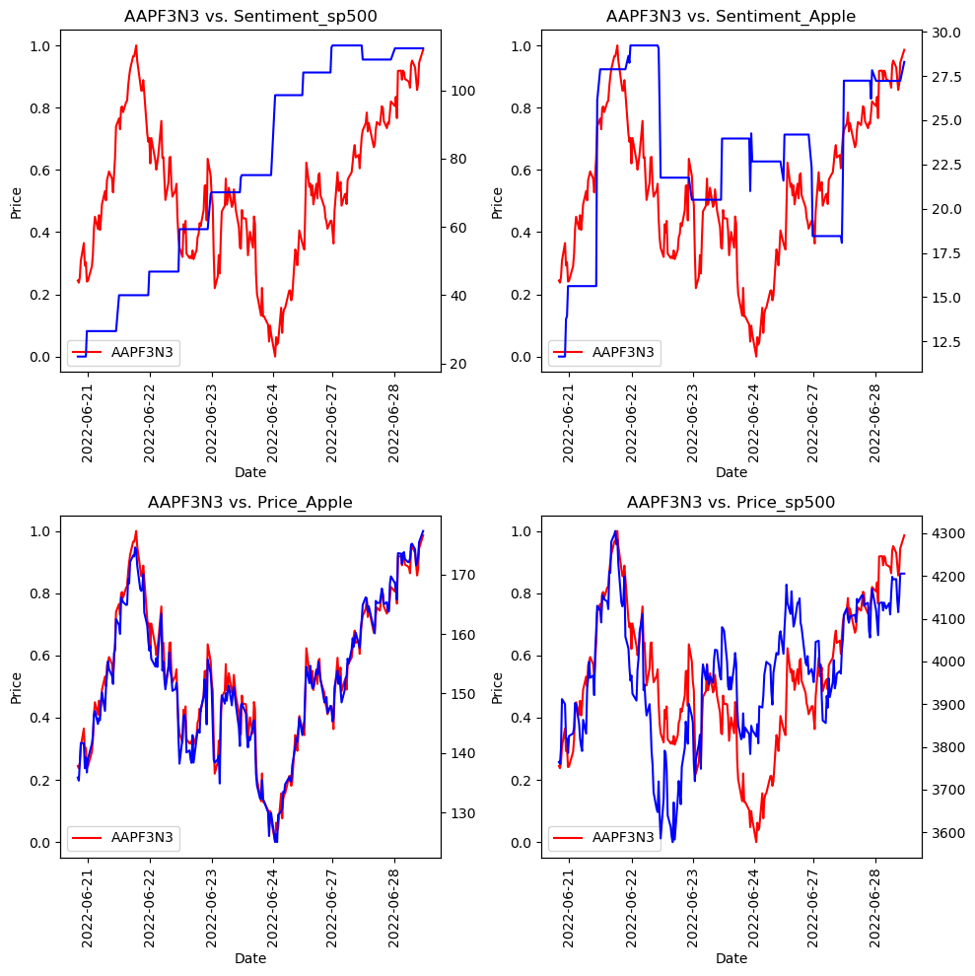
Incorporating the market and sentiment analysis
Now that all the needed information has been computed, let’s see how the different series relate with each other.
This will give us an insight of what is eventually going to be useful in the prediction.

Slide 16
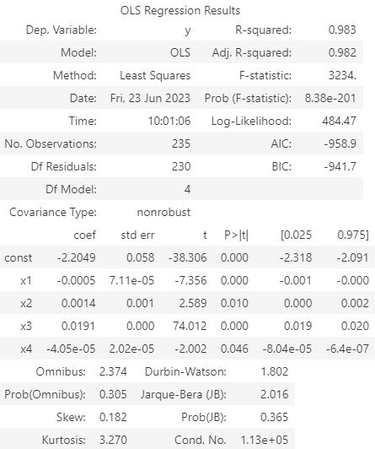
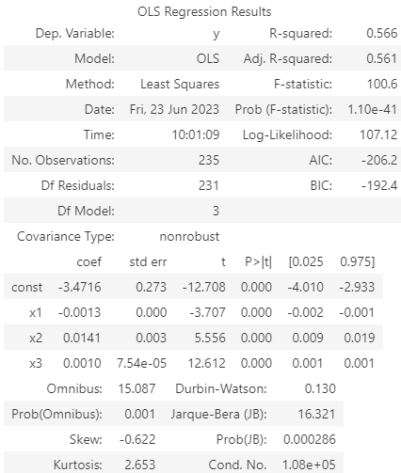
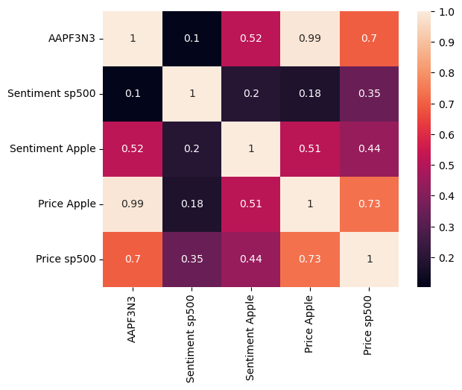
Incorporating the market and sentiment analysis
Let’s see the significance of these parameters from a statistical point of view:

Slide 17
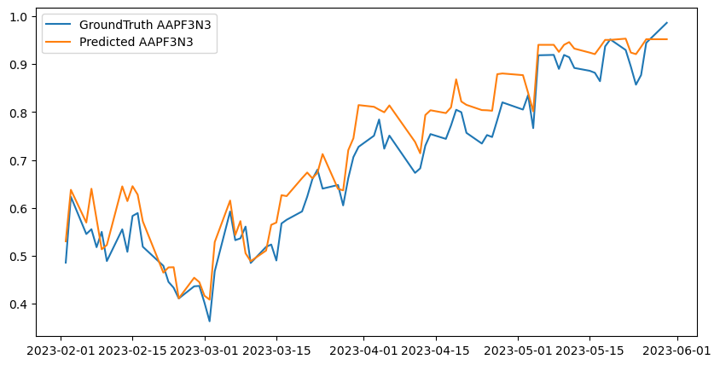
Incorporating the market and sentiment analysis
UNFAIR RESULTS VS FAIR RESULTS
A new LSTM unfair prediction is not useful in this case since it would be the exact same as the one computed at the very first step.
Altough it might seem less accurate than the very first method, it's still probably better because incorporating more information as the indipendent variables in surely better because its error is much less variance influenced, so overall the last model is surely the most robust.
Fair prediction, single result
Accuracy score: 0.9973582206918469 Predicted value: 0.9346523867785396 GroundTruth value: 0.9860506290456943

Slide 18
Comparing results
Model | Observed value | Predicted value | Accuracy (1 - SE)
Standard pricing | 0.93 | 0.98 | 0.99
Using returns | 0.052 | 0.044 | 0.99
Final model | 0.93 | 0.98 | 0.99

Slide 19
Conclusions
This project showed both good and bad results about each method. In the end, as expected, we can conclude that predictions are feasible in the short term, because there isn't a big amount of unknowns, while being definitely much harder for values further in the future.
This experiment also proved how sometimes a good sentiment analysis could help in these kind of problems, but it is still not enough to have accurate predictions because of the very randomic behavior of the market.

