Slide 1

LEARN HOW TO SELL MULTIPLE TYPES OF PRODUCTS UNDER BUDGET CONSTRAINT
ONLINE LEARNING APPLICATIONS PROJECT

Slide 2
PROJECT DEVELOPEMENT
01
03
05
Single product and
Stochastic environment
Single product and
Adversarial environment
Slightly non-stationary environment
02
04
Multiple products and
Stochastic environment
Multiple products and
Adversarial environment

Slide 3
SETTINGS
In this dynamic pricing scenario, a company must decide which products to sell and at what prices over a sequence of T rounds, with the goal of maximizing profit while respecting a total production capacity B. There are N types of products, and prices must be chosen from a small, discrete set P.
At each round, a new buyer arrives with a private valuation vi for each product type i. The buyer purchases one unit of every product priced lower than their respective valuations.
Importantly, the company must ensure that the total number of products sold across all rounds does not exceed B. Each round involves the company selecting product offerings and prices, followed by the buyer making purchase decisions based on their valuations.

Slide 4

01
Single product and Stochastic environment
01.1 without budget
01.2 with budget

Slide 5
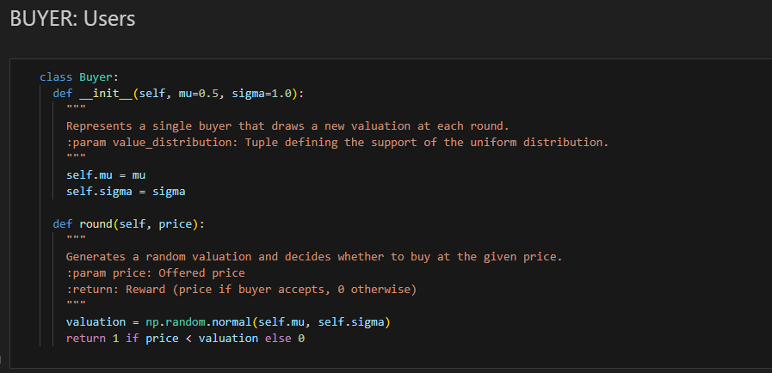
Build a stochastic environment: A distribution over the valuations of a single type of product

Slide 6
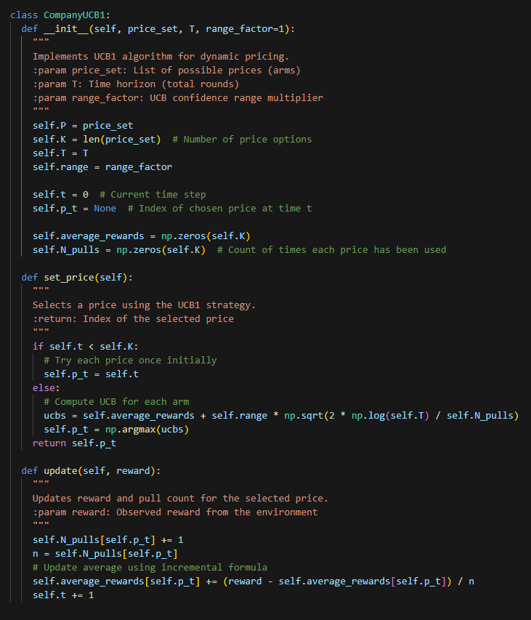
Build a pricing strategy using UCB1 ignoring the budget.
The CompanyUCB1 class uses the UCB1 algorithm to dynamically choose prices from a fixed set to maximize revenue over a time horizon.
It balances exploration and exploitation by initially trying each price once, then selecting prices based on optimistic reward estimates using upper confidence bounds.
After each round, it updates the average reward and selection count for the chosen price.

Slide 7
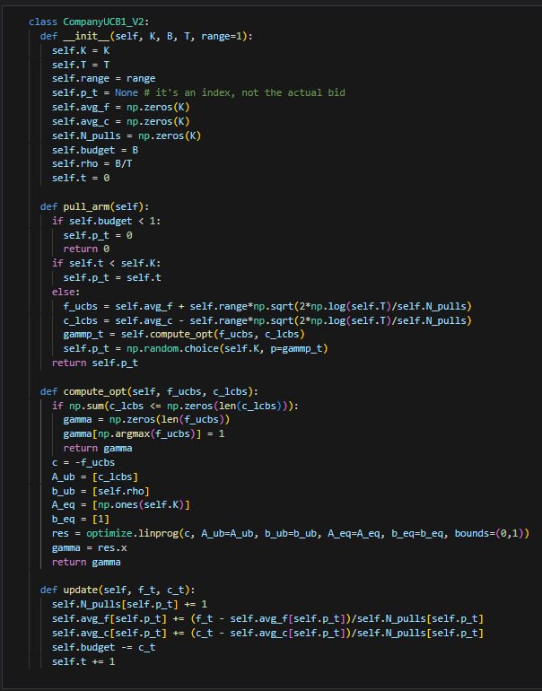
Build a pricing strategy extending UCB1 to handle the budget
The CompanyUCB1_V2 class extends the standard UCB1 approach by incorporating budget constraints.
At each round, the agent selects the arm by balancing upper confidence bounds on expected revenue f and lower confidence bounds on cost c using a linear program to maximize gain under a per-round budget limit ρ = B/T.
This adaptive policy ensures that price selections remain both profitable and feasible

Slide 8
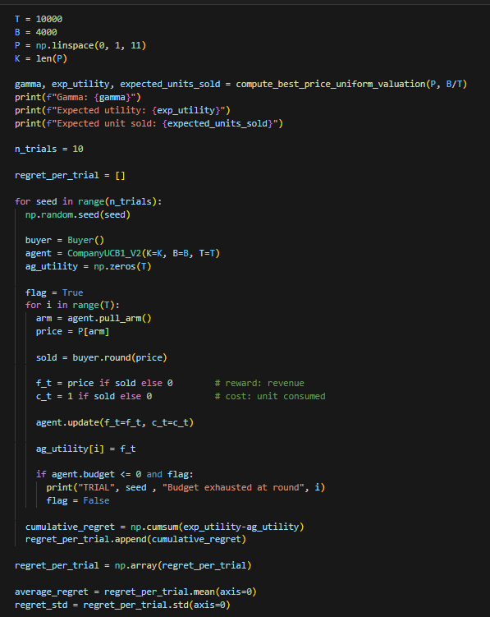
SIMULATION
We simulate the dynamic pricing over 10 different trials having:
T = 10000 B = 4000

Slide 9
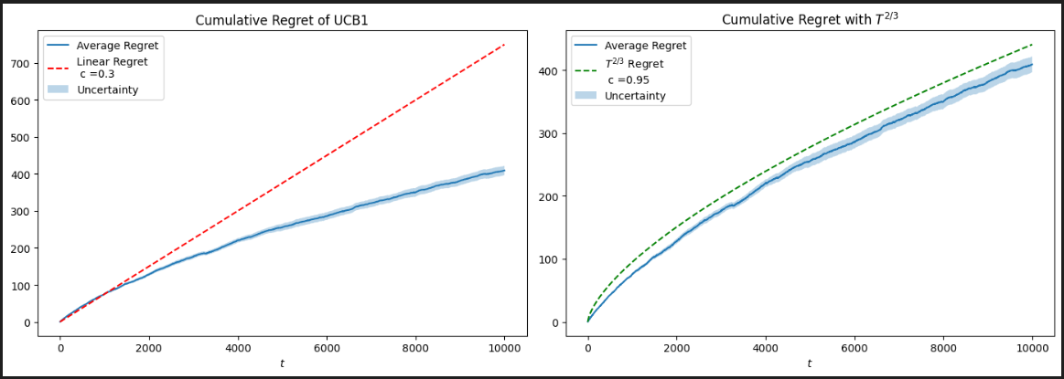
REGRET BOUNDS: no budget

Slide 10
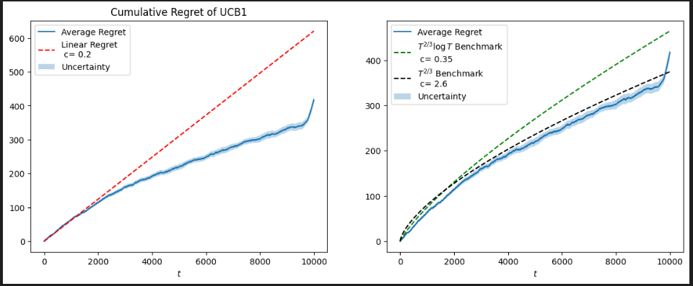
REGRET BOUNDS: with budget

Slide 11
02
Multiple products and Stochastic environment

Slide 12
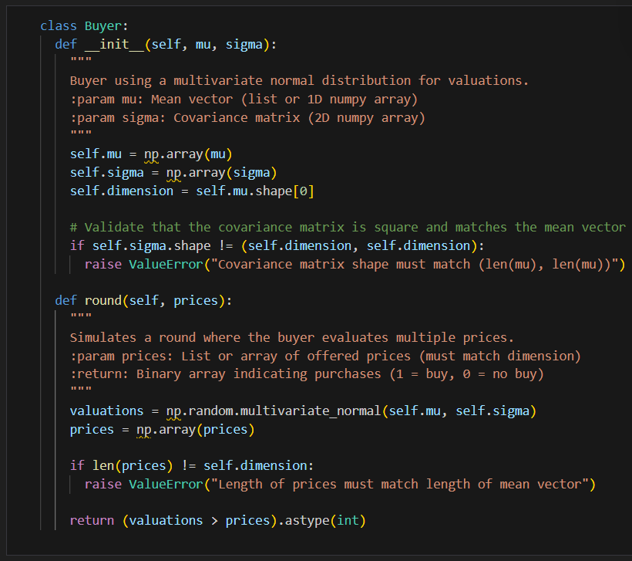
The buyers are the same adapted for multiple products

Slide 13
Build a pricing strategy extending the combinatorial UCB1 to handle the budget

Slide 14
03
Single product and Adversarial environment

Slide 15
04
Multiple products and Adversarial environment

Slide 16
05
Slightly non-stationary environment

Slide 17
REMARKS:

