Slide 1
LEARN HOW TO SELL MULTIPLE TYPES OF PRODUCTS UNDER BUDGET CONSTRAINT
ONLINE LEARNING APPLICATION PROJECT

Slide 2
Project requirements
Requirement 1
Single product and stochastic environment
Requirement 2
Multiple products and stochastic environment
Requirement 3
Best-of-both-worlds algorithms with a single product
Requirement 4
Best-of-both-worlds with multiple products
Requirement 5
Slightly non-stationary environments with multiple products

Slide 3
Setting
A company has to choose prices dynamically.
The goal of the company is to maximize profit in different selling scenarios with specific environment settings and according to different buyers behavior.

Slide 4
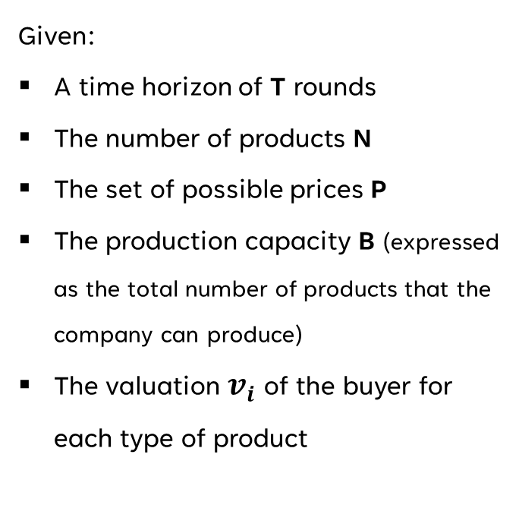
Parameters and interaction
Given:
A time horizon of T rounds
The number of products N
The set of possible prices P
The production capacity B (expressed as the total number of products that the company can produce)
The valuation $v_{i}$ of the buyer for each type of product
At each round:
The company chooses the types of product to sell and set the price for each type of product
A buyer with a valuation for each type of product arrives
The buyer buys a unit of product if the price smaller than his valuation
If the product is sold, the budget of the company is decreased

Slide 5
Requirement 1
1.1 - Single product and Stochastic environment
without Budget constraint
1.2 - Single product and Stochastic environment
with Budget constraint

Slide 6
Environment
Requirement 1.1
Company
Buyer
Single product selling
No budget constraints
Has a distribution over the valuation of a single product
Modelled as a Gaussian distribution

Slide 7
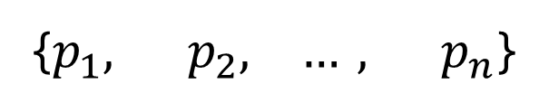
Solution
Requirement 1.1
{$p_{1}, p_{2}, …, p_{n}$}
UCB1 approach:
Compute UCB for all the arms (prices)
Choose the arm with the highest UCB
Update the agent
Baseline computation:
Expected rewards calculated weighting the prices vector with the conversion probability

Slide 8
simulation
Requirement 1.1
We provide results for a simulation with the following parameters:
Time horizon T = 10000
Price set P on the interval [0, 1]
Gaussian distribution N(0.5, 1.0) for the buyer distribution
For measuring the uncertainty on the result the simulation is executed over 10 trials

Slide 9
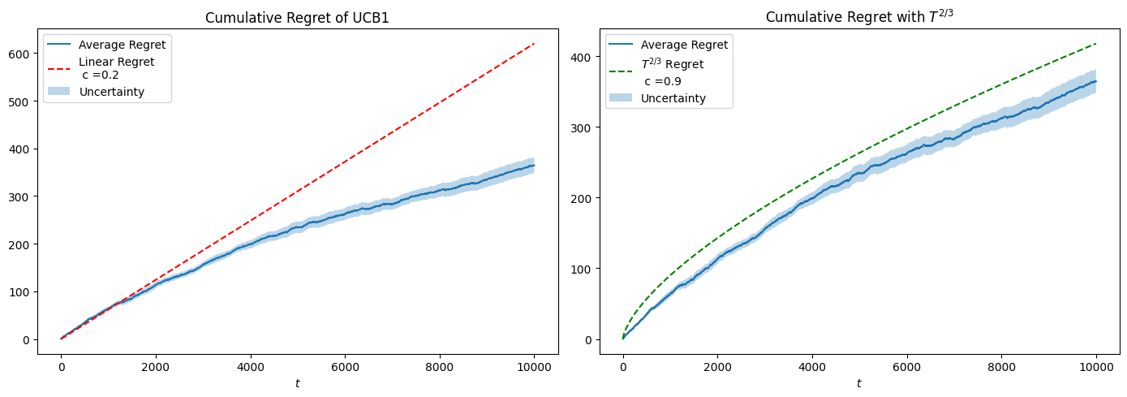
Results
Requirement 1.1

Slide 10
Environment
Requirement 1.2
Company
Buyer
Single product selling
Budget constraints
Has a distribution over the valuation of a single product
Modelled as a Gaussian distribution

Slide 11
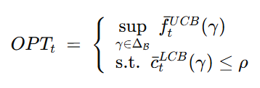
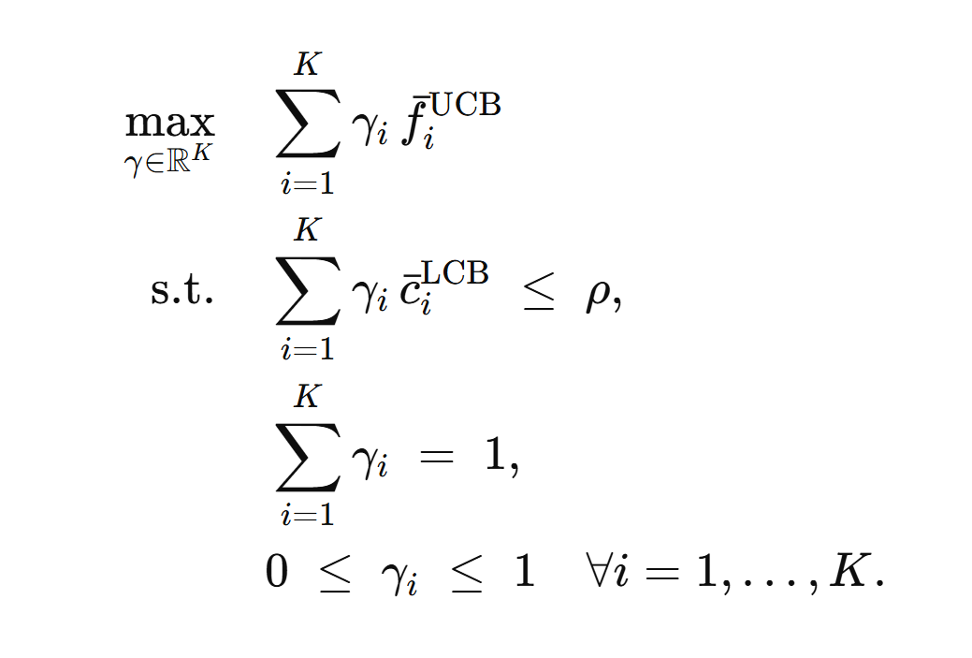
Solution
Requirement 1.2
UCB1-like approach:
Compute UCB for rewards and LCB for costs
Solve the linear program to find the optimal probabilities
Draw an arm from the computed distribution
Get the reward and the cost (unit sold)
Update the agent
Different baseline computation
Linear program for finding the optimal strategy gamma

Slide 12
simulation
Requirement 1.2
We provide results for a simulation with the following parameters:
Time horizon T = 10000
Budget B = 4000
Price set P on the interval [0, 1]
Gaussian distribution N(0.5, 1.0) for the buyer distribution
For measuring the uncertainty on the result the simulation is executed over 10 trials

Slide 13
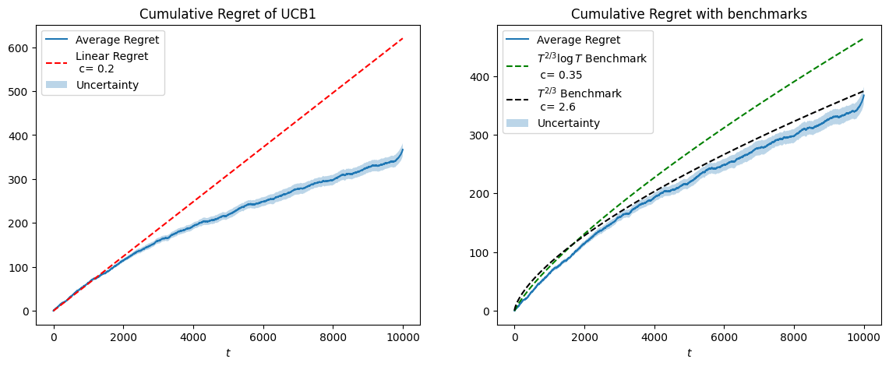
Results
Requirement 1.2

Slide 14
Requirement 2
Multiple products and Stochastic environment

Slide 15
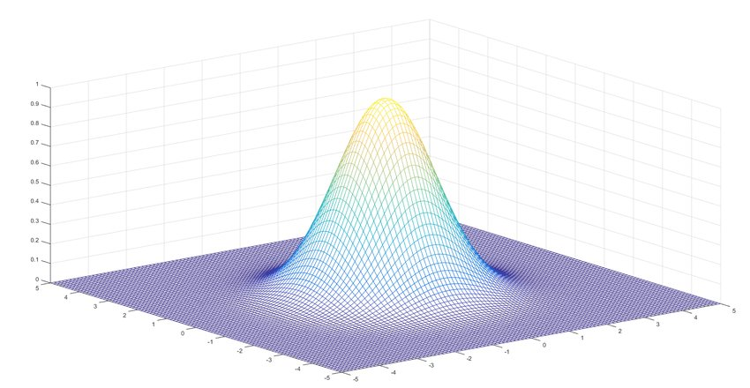
Environment
Requirement 2
Company
Buyer
Multiple product selling
Budget constraints
Has a joint distribution over the valuation of the products
Modelled as a Multivariate Gaussian distribution

Slide 16
Proposed Solutions
Requirement 2
APPROACH 1
APPROACH 2
APPROACH 3
Product-wise decomposition with independent UCB for each product.
Same approach as Req. 1.2 but for N > 1 products
A priori calculation of all superarms with cartesian product.
Full combinatorial optimization with linear program solving for joint pricing decisions.
Same approach as approach 2 but greedy: we don't optimize solving the linear program
Baseline Computation
Linear program for finding the optimal gamma matrix

Slide 17
simulation
Requirement 2
We provide results for a simulation with the following parameters:
Time horizon T = 10000
Budget B = 16000
Price set P on the interval [0, 1]
Number of Products 3
Multivariate Gaussian distribution with mean vector [0.5, 0.6, 0.7] and covariance matrix [[0.1, 0.05, 0.02], [0.05, 0.1, 0.03], [0.02, 0.03, 0.1]].
For measuring the uncertainty on the result the simulation is executed over 5 trials

Slide 18
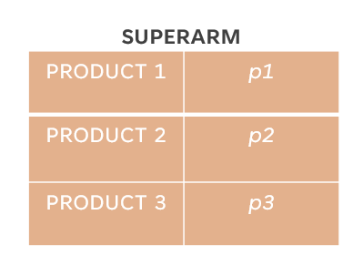
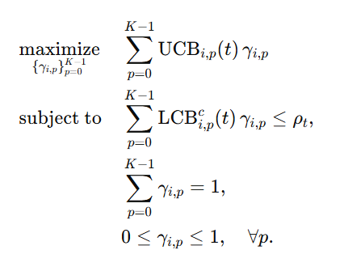
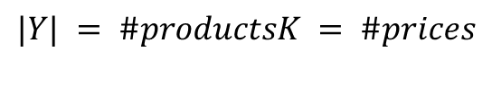
Approach 1
Requirement 2
Product-wise UCB1 approach:
Compute UCB for rewards and LCB for costs for each product
Compute the optimal strategy gamma for each product using the linear program
Generate and pull the superarm using the gamma matrix
Get prices and check for units sold
Update the agent
$$|Y| = \#productsK = \#prices$$

Slide 19
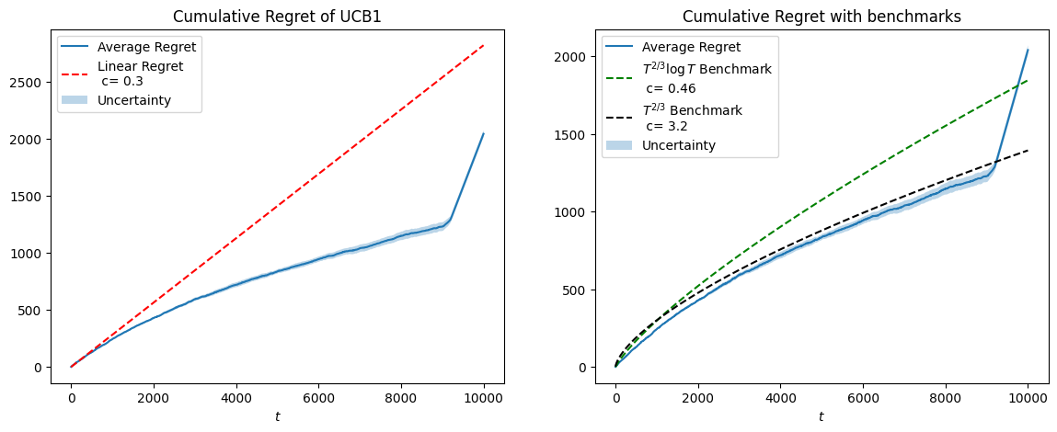
Results
Requirement 2 – Approach 1

Slide 20
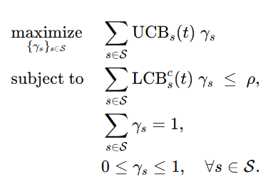

Approach 2
Requirement 2
Full combinatorial UCB1 approach:
Generate all the combination of prices (superarms) with cartesian product
Compute UCB for rewards and LCB for costs for each superarm
Solve the linear program to find the gamma
Pull the superarm using the gamma and get the reward and the cost (if sold)
Update the agent
Given $S$ the set of superarms:

Slide 21
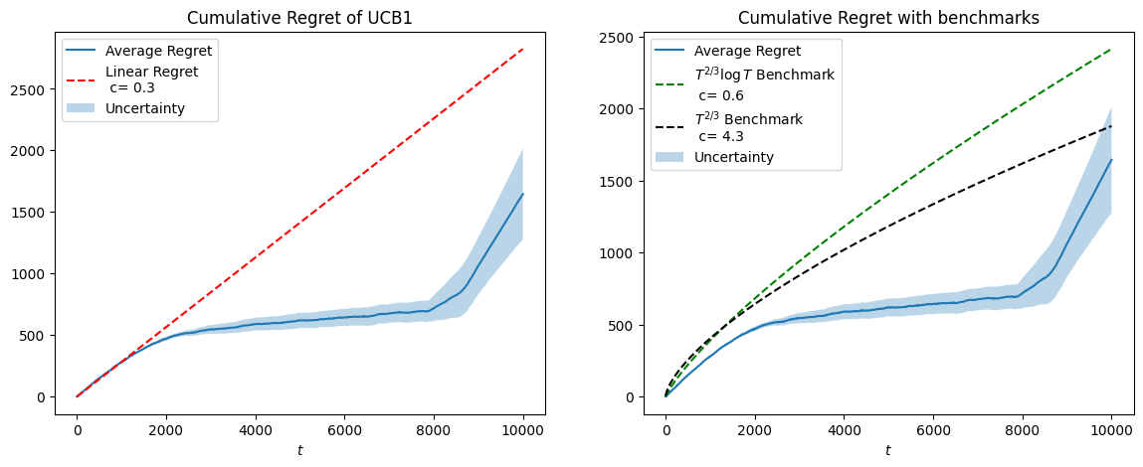
Results
Requirement 2 – Approach 2

Slide 22
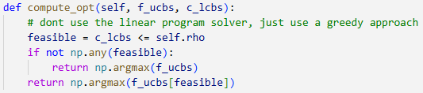
Approach 3
Requirement 2
Full combinatorial UCB1 approach, with greedy:
Generate all the combination of prices (superarms) with cartesian product
Compute UCB for rewards and LCB for costs for each superarm
Choose feasible superarm which maximize utility, without linear program optimization
Pull the superarm and get the reward and the cost (if sold)
Update the agent

Slide 23
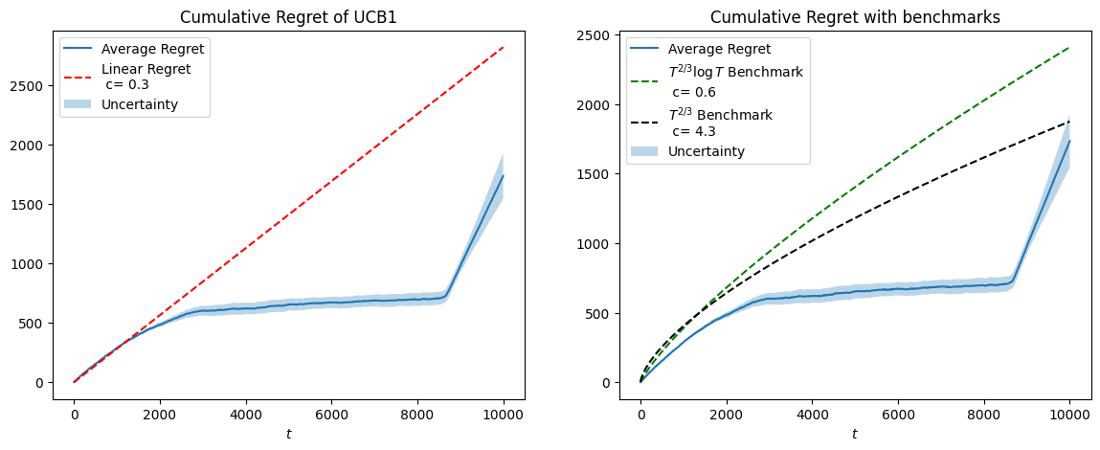
Results
Requirement 2 – Approach 3

Slide 24
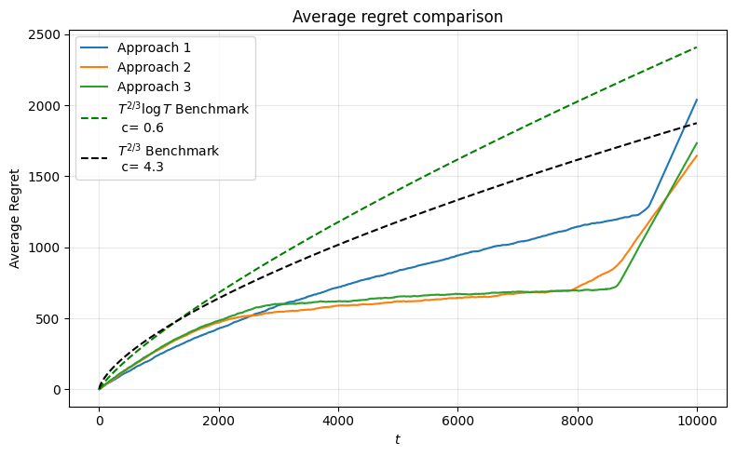
Result Summary
Requirement 2
Approach 1:
Less arms and good learning process, but worse regret
Approach 2:
Many arms (full combinatorial) but learns well and achieves better regret
Approach 3:
Similar to approach 2, but faster and depletes the budget later

Slide 25
Requirement 3
Single product and Adversarial environment

Slide 26
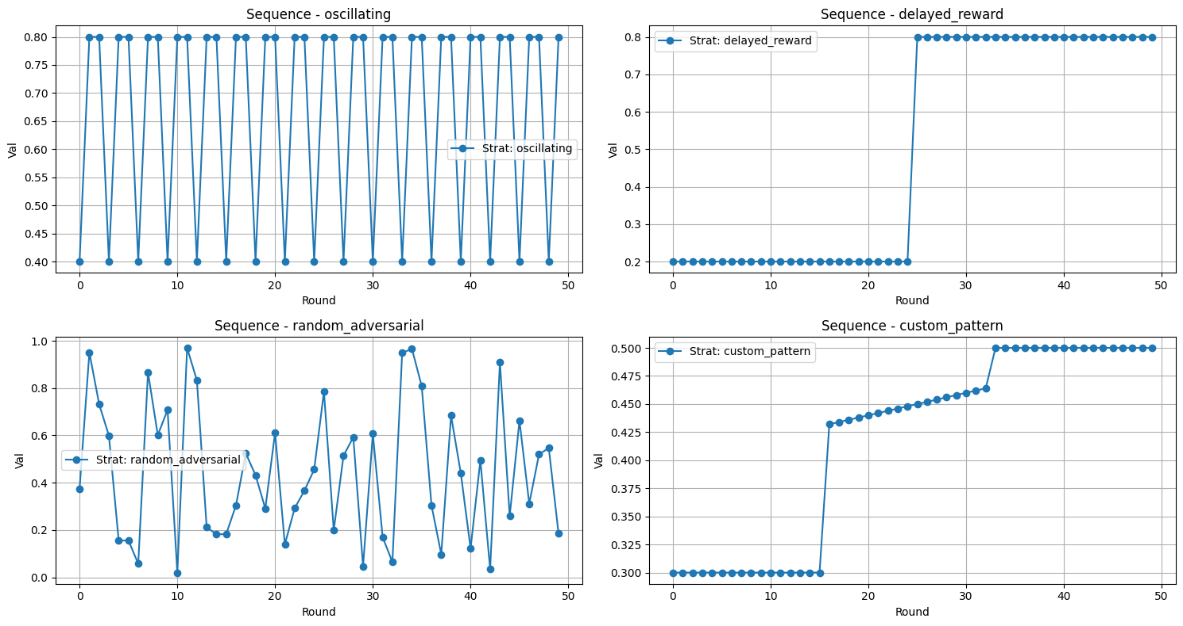
Environment
Requirement 3
Company
Buyer
Single product selling
Budget constraints
Adversarial valuations changing the expected value of the gaussian over time

Slide 27
Proposed Solutions
Requirement 3
Using the pacing strategy with a Lagrangian multiplier λ.
If sales exceed ρ, λ increases, lowering the next price;
If sales fall short, λ decreases, increasing the next price.
APPROACH 1
APPROACH 2
Bandit Feedback:
Full Feedback:
EXP3 agent used as regret minimizer for price selection.
Hedge agent used as regret minimizer for price selection.
Baseline Computation
For each price, compute its expected utility and expected cost. Among the prices that satisfy the budget constraint c ≤ ρ, choose the one with the highest expected utility (best fixed arm a priori).

Slide 28
simulation
Requirement 3
We provide results for a simulation with the following parameters:
Time horizon T = 10000
Budget B = 5000
Price set P on the interval [0, 1]
For measuring the uncertainty on the result the simulation is executed over 5 trials

Slide 29
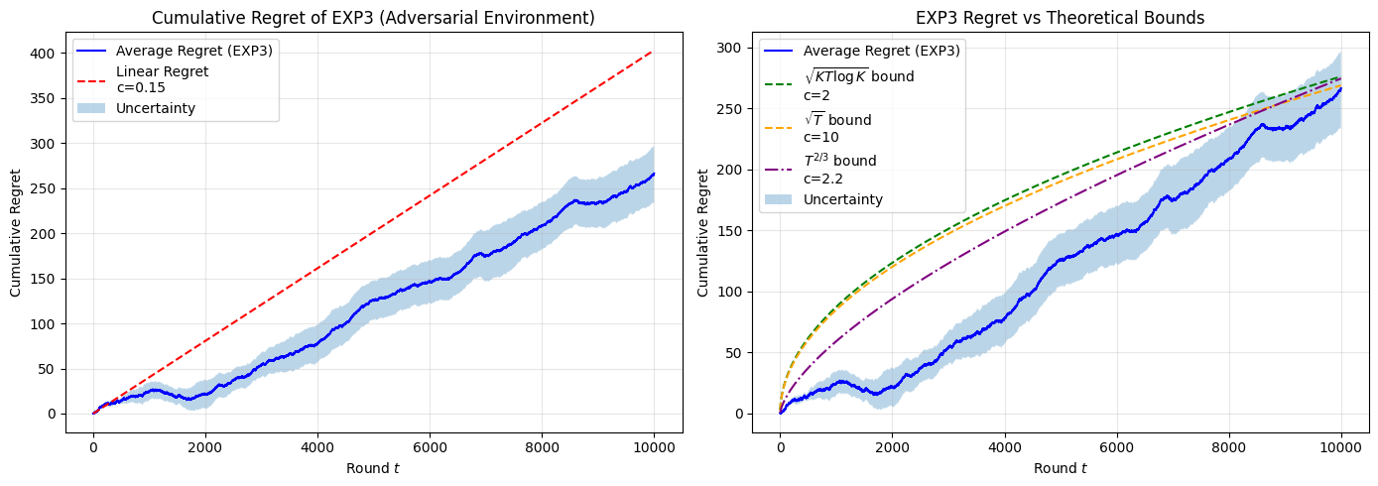
Results
Requirement 3
APPROACH 1 – BANDIT FEEDBACK

Slide 30
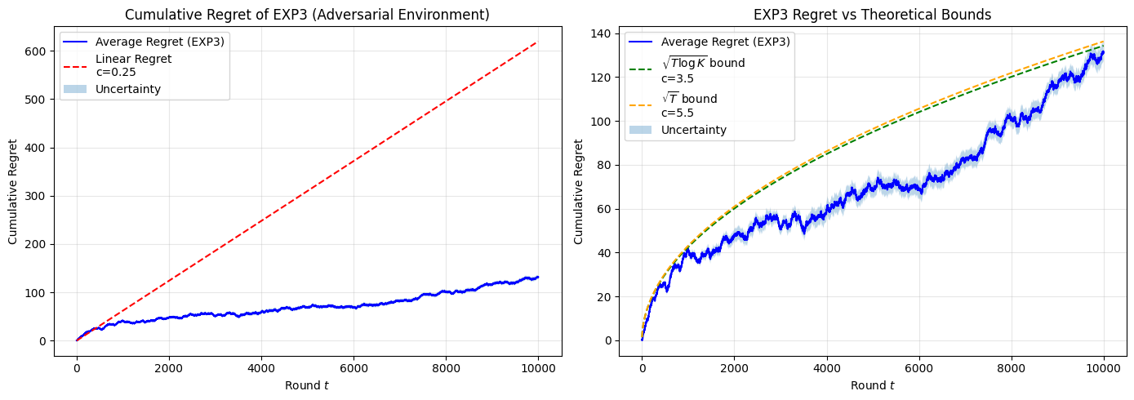
Results
Requirement 3
APPROACH 2 - FULL FEEDBACK

Slide 31
Requirement 4
Multiple products and Adversarial environment

Slide 32
Environment
Requirement 4
Company
Buyer
Multiple product selling
Budget constraints
Adversarial valuations changing over time:
oscillating,
delayed reward,
random,
custom pattern

Slide 33
Proposed Solutions
Requirement 4
Using the pacing strategy with a Lagrangian multiplier λ.
If sales exceed ρ, λ increases, lowering the next price;
If sales fall short, λ decreases, increasing the next price.
Bandit Feedback:
EXP3 agent used as regret minimizer for price selection, for each product.
Baseline Computation
For each product and price, compute expected utility and cost. Evaluate all product–price combinations and select the one with the highest expected utility subject to ∑c ≤ ρ.

Slide 34
simulation
Requirement 4
We provide results for a simulation with the following parameters:
Time horizon T = 50000
Budget B = 80000
Price set P on the interval [0, 1]
Number of Products: 3
For measuring the uncertainty on the result the simulation is executed over 5 trials

Slide 35
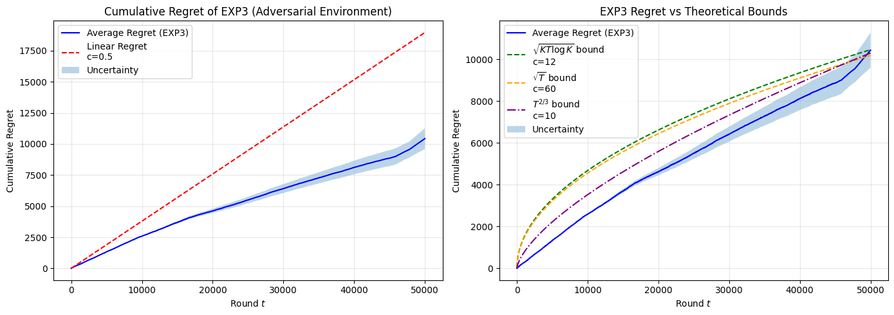
Results
Requirement 4

Slide 36
Requirement 5
Slightly non-stationary environment

Slide 37
Environment
Requirement 5
Company
Buyer
Multiple product selling
Budget constraints
Slightly Non-stationary behavior
Adversarial valuations changing over time in a fixed, predetermined way.

Slide 38
Proposed Solutions
Requirement 5
Using UCB with Sliding Window: we empirically choose a window size W, such that only the most recent W samples are considered when computing the UCB.
Baseline a Priori
Compute the expected utility for the initial and the target buyer distributions. Take the average of the two optimal utilities as reference benchmark.
Baseline a Posteriori
At each round t, compute the optimal expected utility given the current buyer distribution (μt,σ).

Slide 39
simulation
Requirement 5
We provide results for a simulation with the following parameters:
Time horizon T = 10000
Budget B = 16000
Price set P on the interval [0, 1]
Number of Products 3
Window size 2500
Covariance Matrix [[0.1, 0.05, 0.02], [0.05, 0.1, 0.03], [0.02, 0.03, 0.1]], fixed
Initial Mean vector [0.6, 0.5, 0.7]
Target Mean vector [0.4, 0.6, 0.5]
For measuring the uncertainty on the result the simulation is executed over 5 trials

Slide 40
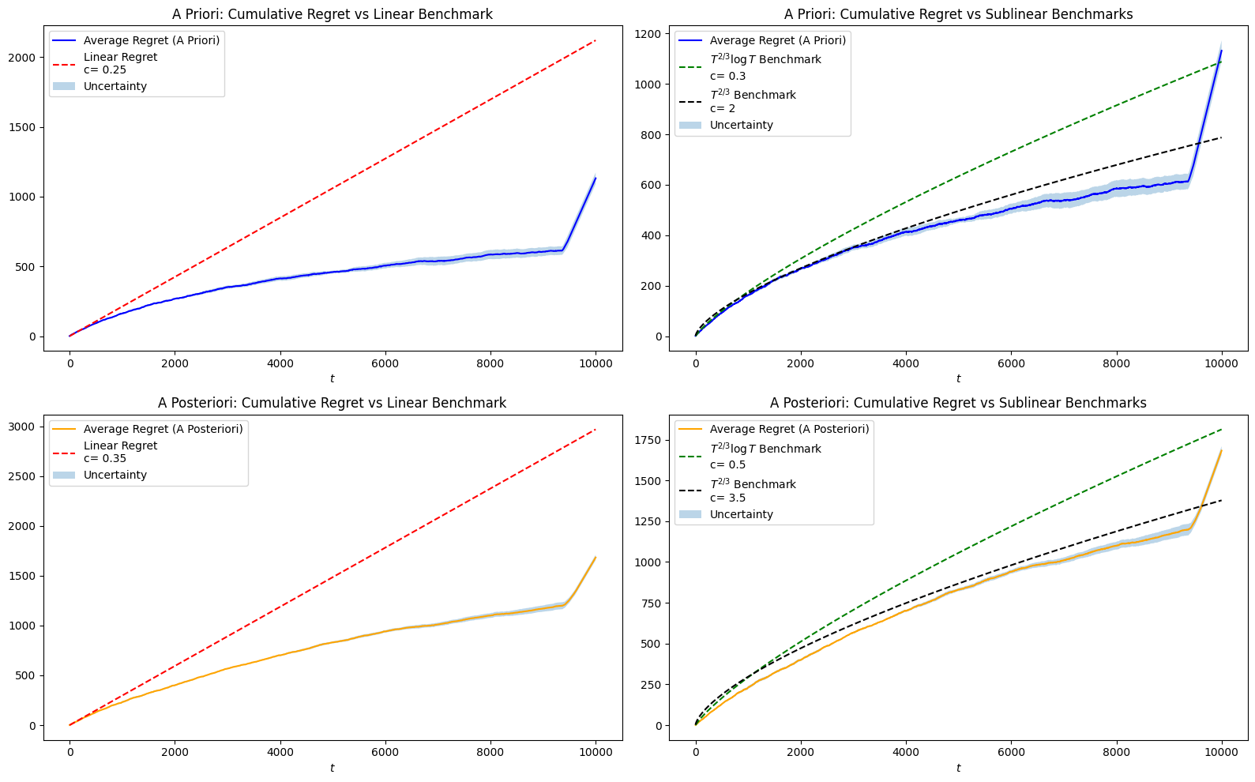
Results
Requirement 5
BASELINE A PRIORI

Slide 41
Results
Requirement 5
BASELINE A POSTERIORI

Slide 42
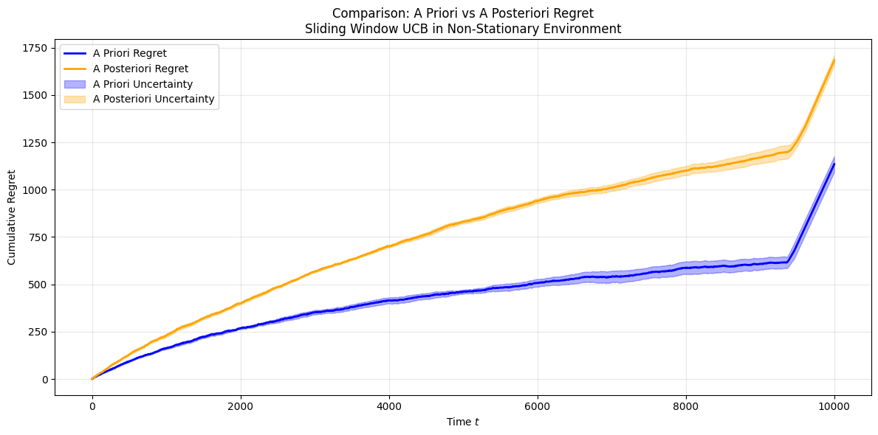
Results
Requirement 5
COMPARISON

Slide 43
CONCLUSIONS

Slide 44
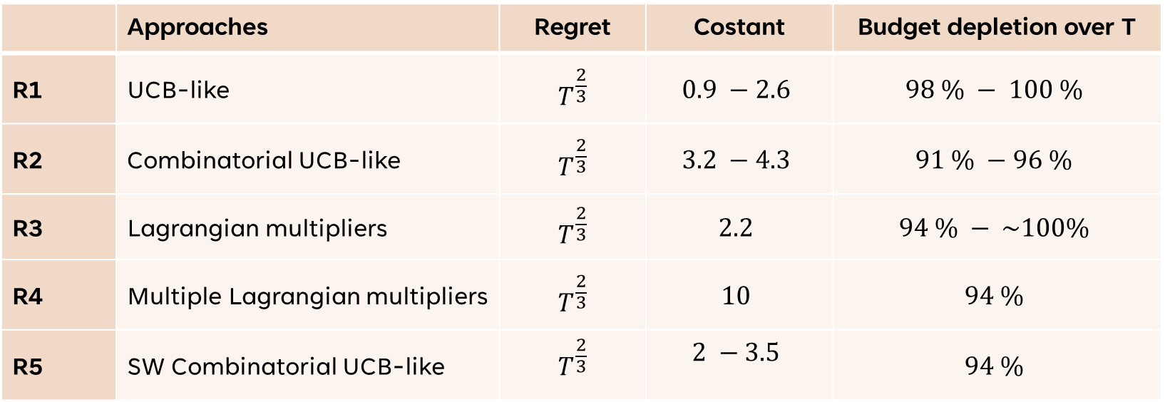
Conclusions
 | Approaches | Regret | Costant | Budget depletion over T
R1 | UCB-like | $$T^{\frac{2}{3}}$$ | $$0.9 −2.6$$ | $$98 \% − 100 \%$$
R2 | Combinatorial UCB-like | $$T^{\frac{2}{3}}$$ | $$3.2 −4.3$$ | $$91 \% −96 \%$$
R3 | Lagrangian multipliers | $$T^{\frac{2}{3}}$$ | $$2.2$$ | $$94 \% − \sim 100\%$$
R4 | Multiple Lagrangian multipliers | $$T^{\frac{2}{3}}$$ | $$10$$ | $$94 \%$$
R5 | SW Combinatorial UCB-like | $$T^{\frac{2}{3}}$$ | $$2 −3.5$$ | $$94 \%$$

