Slide 1

LEARN HOW TO SELL MULTIPLE TYPES OF PRODUCTS UNDER BUDGET CONSTRAINT
ONLINE LEARNING APPLICATIONS PROJECT

Slide 2
PROJECT DEVELOPEMENT
01
03
05
Single product and
Stochastic environment
Single product and
Adversarial environment
Slightly non-stationary environment
02
04
Multiple products and
Stochastic environment
Multiple products and
Adversarial environment

Slide 3
SETTINGS
In this dynamic pricing scenario, a company must decide which products to sell and at what prices over a sequence of T rounds, with the goal of maximizing profit while respecting a total production capacity B. There are N types of products, and prices must be chosen from a small, discrete set P.
At each round, a new buyer arrives with a private valuation vi for each product type i. The buyer purchases one unit of every product priced lower than their respective valuations.
Importantly, the company must ensure that the total number of products sold across all rounds does not exceed B. Each round involves the company selecting product offerings and prices, followed by the buyer making purchase decisions based on their valuations.

Slide 4
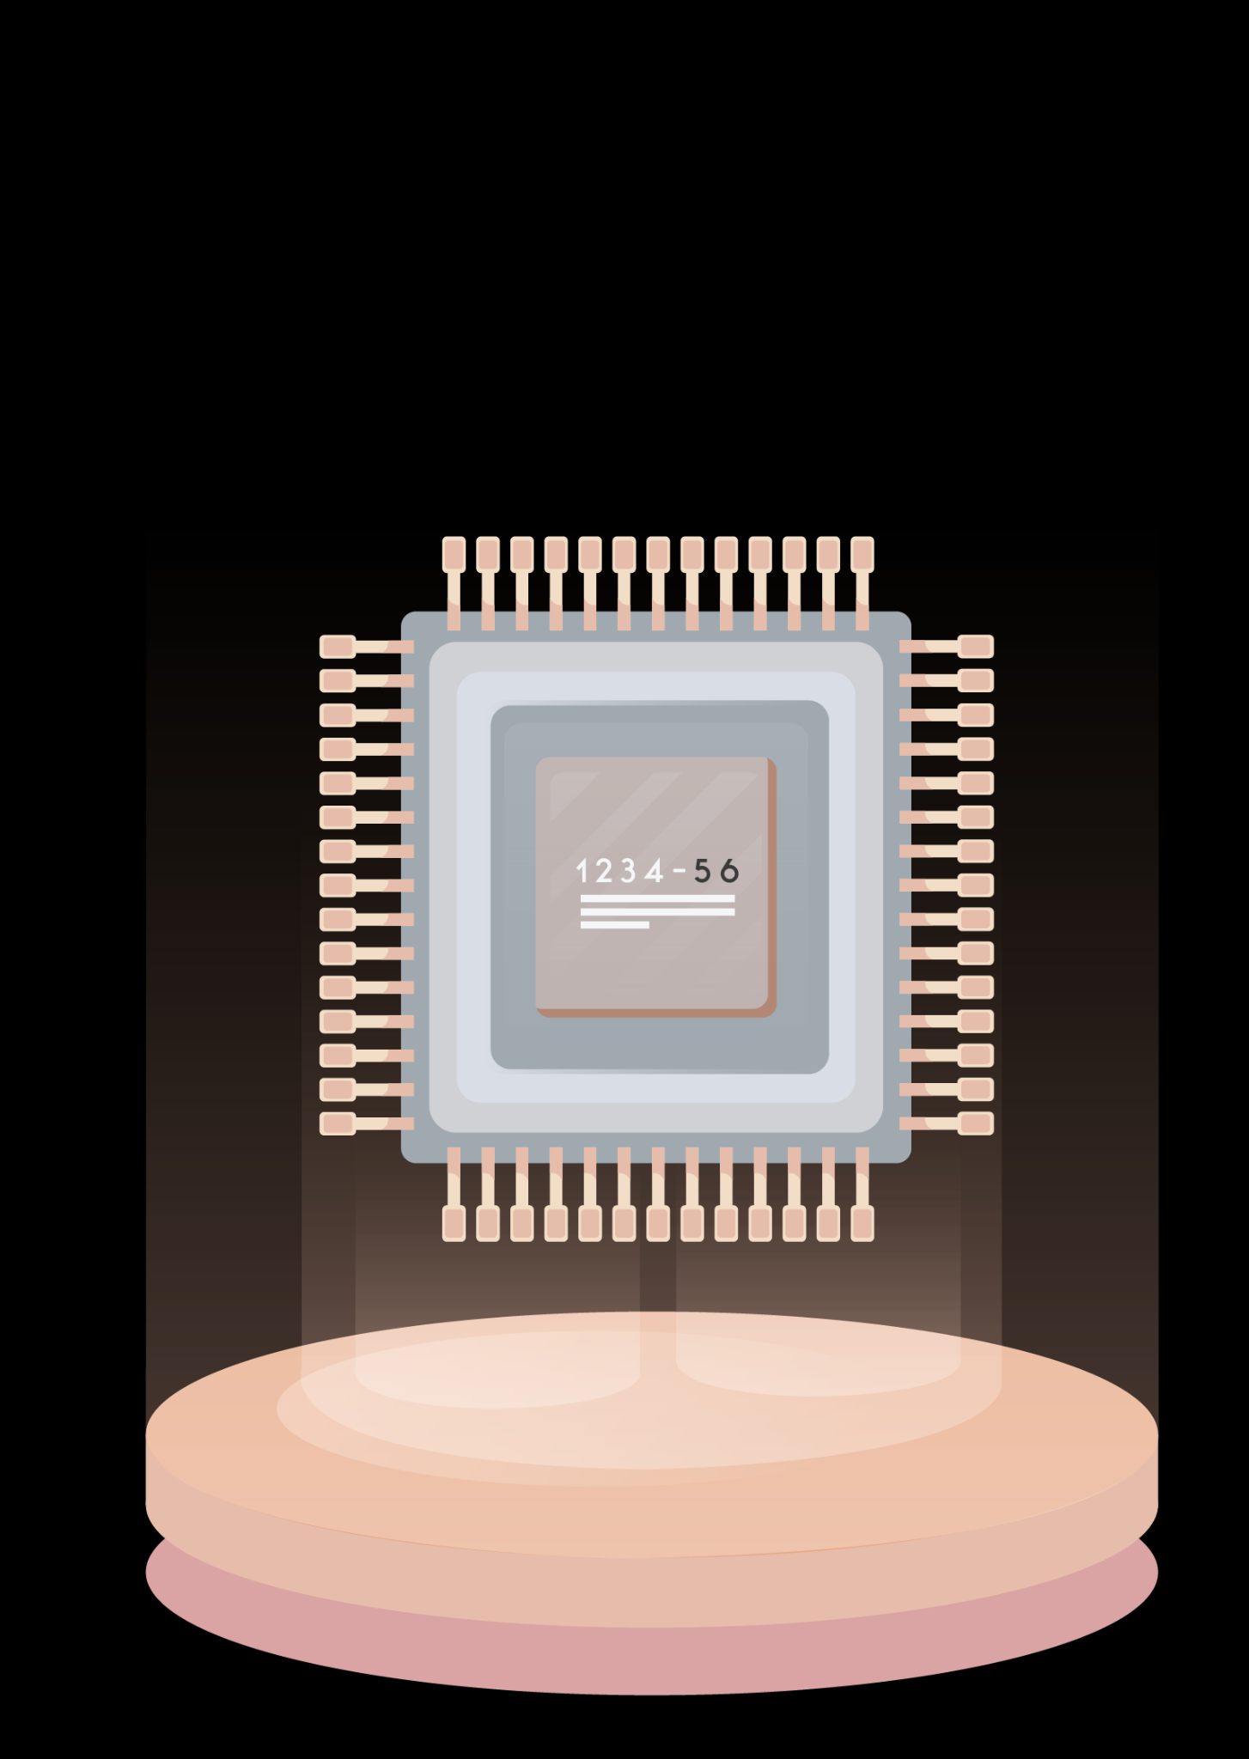
01
Single product and Stochastic environment
01.1 without budget
01.2 with budget

Slide 5
Spiegazione r1:

Slide 6
Buyer company nO budget

Slide 7
Simulation

Slide 8
res

Slide 9
company budget spiegazione budget

Slide 10
Sim e nuovi results

Slide 11
02
Multiple products and Stochastic environment 1. 2. 3.

Slide 12
Spiegazione r2:

Slide 13
New buyer
Immagine gaussiana

Slide 14
Metodo 1: poche arm sample sulla distribuzione impara bene ma peggior regret

Slide 15
Sim e res

Slide 16
Metodo 2: possiamo fare meglio? molte arm impara bene regret Perfetto tempo esponenziale

Slide 17
Sim e res

Slide 18
Metodo 3: metodo 2 ottimizzato togliendo il LP 1.togli quelli che non rientrano nel budget 2.utility migliore

Slide 19
Sim e res

Slide 20
03
Single product and Adversarial environment

Slide 21
Spiegazione r3:

Slide 22
Nouvo buyer adversarial!!!! highly non stationary

Slide 23
Metodo 1 multiplicative pacing + exp3

Slide 24
Metodo 1 multiplicative pacing + exp3

Slide 25
Sim e res

Slide 26
Metodo 2 modificare direttamente l’algoritmo di exp3 v2 non funziona

Slide 27
Sim e res

Slide 28
Metodo 3 full feedback

Slide 29
Sim e res

Slide 30
04
Multiple products and Adversarial environment

Slide 31
Buyer ( unito r2 e r3)

Slide 32
Metodo 1 del r3

Slide 33
Sim e res

Slide 34
05
Slightly non-stationary environment

Slide 35
buyer
Media che cambia poco nel tempo

Slide 36
Metodo SW

Slide 37
Sim e res opt a priori

Slide 38
Sim e res opt a posteriori

Slide 39
Riassunto conclusione

