Slide 1

??? Presentation.mainslide.title ???

Slide 2
once.upon.a.time
A TRUE STORY

Slide 3
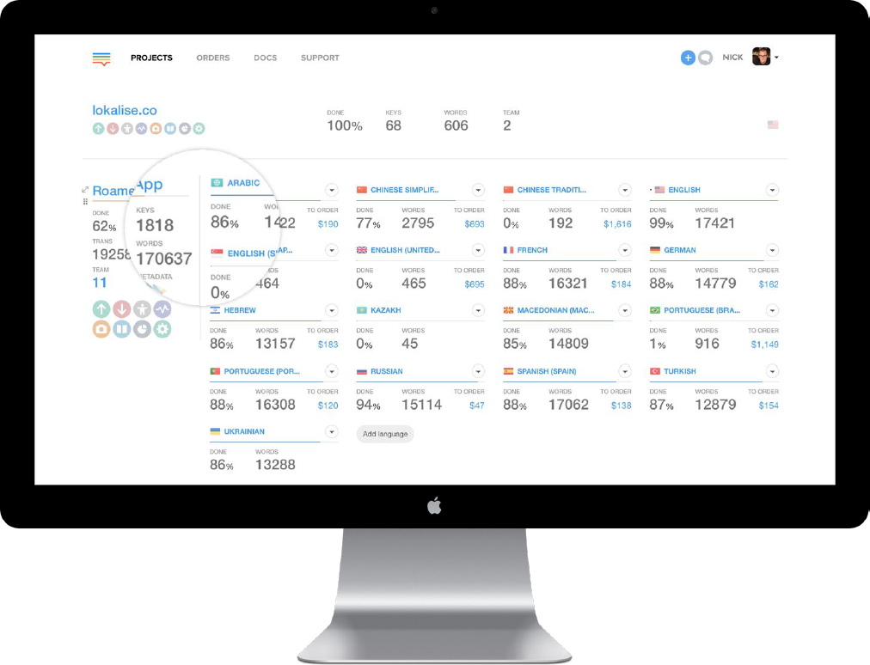
LOKALIZE.FEATURES.DASHBOARD
With integrating Lokalise iOS and/or Android SDK into your apps, not only you instantly update your text strings on the end-user devices, but also get the localization intelligence on your users.

Slide 4
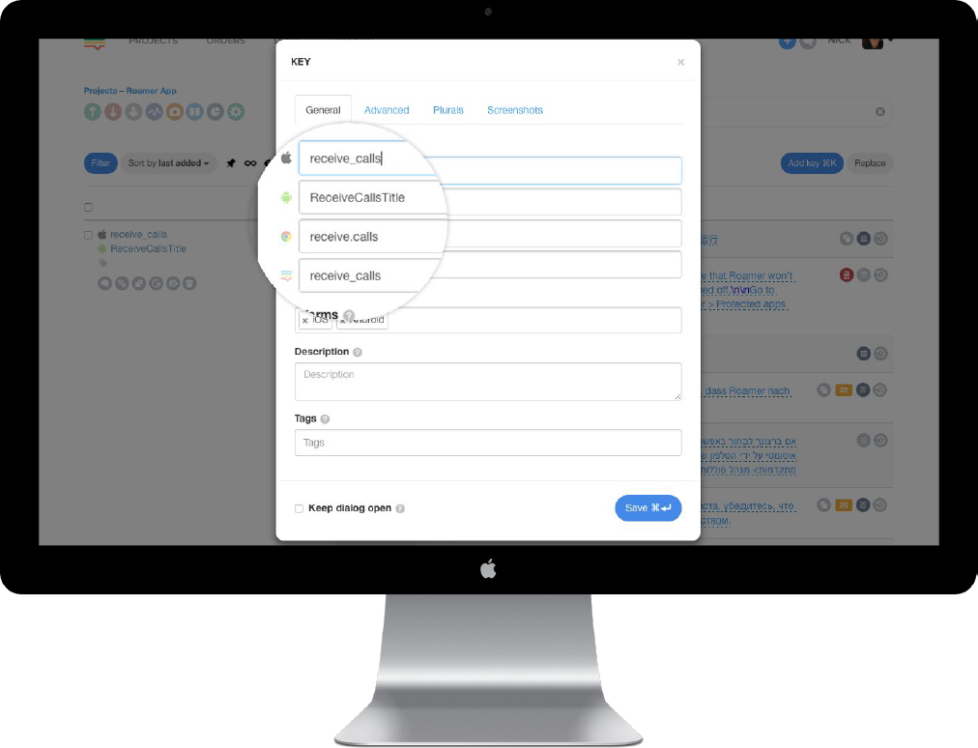
LOKALIZE.FEATURES.Multiplatform
Keep all platform keys in the same project
Universal Placeholders
Import / Export to/from different platforms when needed.
Keys with similar names are merged on import.
No more redundant duplicate keys.

Slide 5
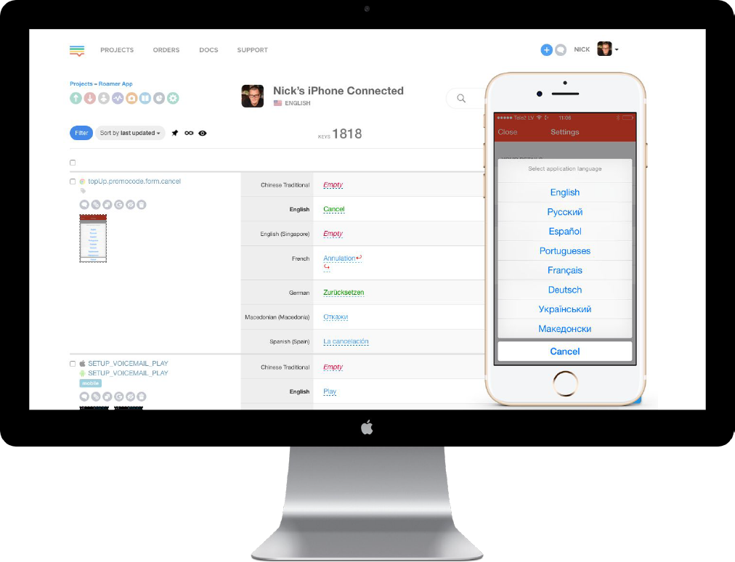
LOKALIZE.FEATURES.SDK+OTA
Live Edit Module in Lokalise SDK
In-context mobile editor for your translators and QA.
iOS and Android Lokalise OTA SDK
Instant over-the-air updates on end-user devices bypassing Appstore and Google Play.

Slide 6
LOKALIZE.FEATURES.for.developers
Language auto-fill
Easily chain languages by setting up auto-fill rules. Once translations in languages you set up for monitoring are updated, the chained languages get updated as well.

Slide 7
LOKALIZE.FEATURES.for.developers
Project snapshots
Take a snapshot of your project or retrieve project copies
from previous snaps.

Slide 8
LOKALIZE.FEATURES.TRANSLATION.HISTORY
Project snapshots
Take a snapshot of your project or retrieve project copies
from previous snaps.

Slide 9
LOKALIZE.FEATURES.TRANSLATION.MEMORY
Project snapshots
Take a snapshot of your project or retrieve project copies
from previous snaps.

Slide 10
LOKALIZE.FEATURES.LIVEJS
LiveJS: web in-context editor
Focus on a particular language pair working right on the
respective page of your website without distractions.

Slide 11
LOKALIZE.FEATURES.API.AND.CLI
Advanced API and CLI tool
Integrate with your existing setup using our API or command-line tool.

Slide 12
LOKALIZE.FEATURES.KEY.REFERENCING
Advanced API and CLI tool
Integrate with your existing setup using our API or command-line tool.

Slide 13
LOKALIZE.FEATURES.KEY.VALIDATION
Advanced API and CLI tool
Integrate with your existing setup using our API or command-line tool.

Slide 14
LOKALIZE.FEATURES.GRAMMAR.CHECK
title
text

Slide 15
LOKALIZE.FEATURES.GLOSSARY
Advanced API and CLI tool
Integrate with your existing setup using our API or command-line tool.

Slide 16
LOKALIZE.FEATURES.PROOFREADING
title
text

Slide 17
LOKALIZE.FEATURES.MULTILINGUAL.VIEW
title
text

Slide 18
LOKALIZE.FEATURES.TRANSLATION.CTX
title
text

Slide 19
LOKALIZE.FEATURES.PLURALS
title
text

Slide 20
LOKALIZE.FEATURES.MACHINE.TRANSLATION
title
text

Slide 21
LOKALIZE.FEATURES.TOOLS.INTEGRATION
title
text

Slide 22
LOKALIZE.FEATURES.WORKFLOW
Task oriented.
text
Project Chat.
text
Project activity.
text

Slide 23
LOKALIZE.FEATURES.TRANSLATE.LIKE.A.PRO
Task oriented.
text

Slide 24
LOKALIZE.FEATURES.INSIGHTS
Insights.
text
Translators Stats.
text

Slide 25
demo

Slide 26
AND.THE.OTHERS?
Google Translate API
https://www.getapp.com/it-management-software/a/lokalise/alternatives/
https://siftery.com/lokalise/alternatives

