Slide 1

??? Presentation.mainslide.title ???

Slide 2

once.upon.a.time
A TRUE STORY
i18n extraction
send to an external Agency
receive back translation
overwrite i18n
build / next development cycle..

Slide 3
once.upon.a.time
A TRUE STORY
i18n extraction
send to an external Agency
receive back translation
overwrite i18n
build / next development cycle..
normalization
normalization (revert)

Slide 4
once.upon.a.time
A TRUE STORY
i18n extraction
send to an external Agency
receive back translation
overwrite i18n
build / next development cycle..
normalization
normalization (revert)
merge
normalization
WAIT
i18n extraction
next development cycle..

Slide 5
once.upon.a.time
A TRUE STORY
i18n extraction
send to an external Agency
receive back translation
overwrite i18n
build / next development cycle..
normalization
normalization (revert)
merge
normalization
poor translation / errors
WAIT
i18n extraction
next development cycle..

Slide 6
once.upon.a.time
A TRUE STORY
Another Internal Team…
Internal Team «parallel» translation
i18n extraction
send to an external Agency
receive back translation
overwrite i18n
build / next development cycle..
normalization
normalization (revert)
WAIT
WAIT
merge
merge (from paper!!)
normalization
resolve conflicts!
poor translation / errors
WAIT
i18n extraction
next development cycle..

Slide 7
once.upon.a.time
A TRUE STORY
Another Internal Team…
Internal Team «parallel» translation
HARD to master
i18n extraction
send to an external Agency
receive back translation
overwrite i18n
build / next development cycle..
normalization
normalization (revert)
WAIT
WAIT
error PRONE
merge
ZERO-automation
tedious
merge (from paper!!)
normalization
resolve conflicts!
poor translation / errors
INefficient
overall POOR quality
WAIT
i18n extraction
out of CONTROL
next development cycle..

Slide 8
WHAT.DO.WE.NEED?
Automation
Error-proof
Professional service
Zero-mail service
Integration features
i18n validation / optimization
A process easy to control
i18n versioning
Cost-saving tool

Slide 9
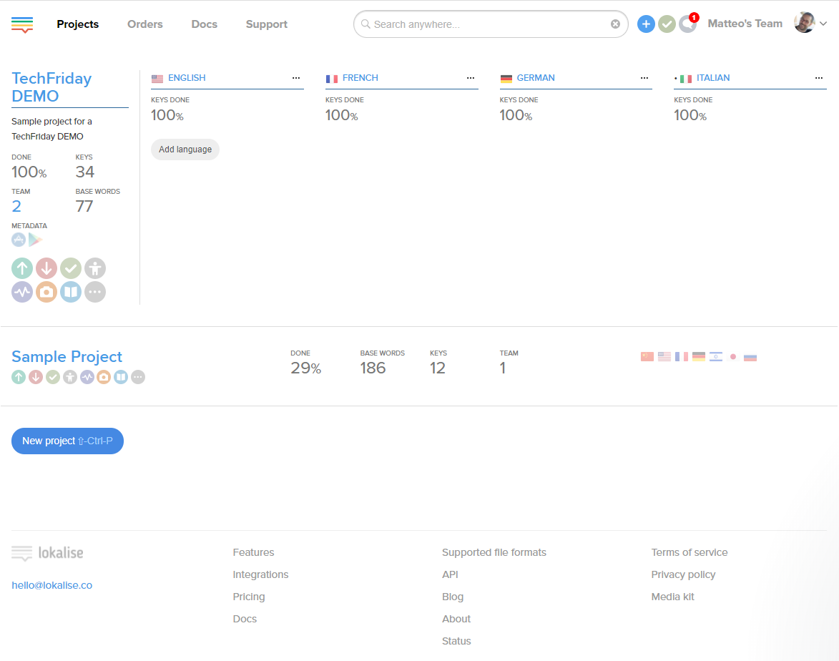
LOKALIZE.FEATURES.DASHBOARD
Notes:
With integrating Lokalise iOS and/or Android SDK into your apps, not only you instantly update your text strings on the end-user devices, but also get the localization intelligence on your users.

Slide 10
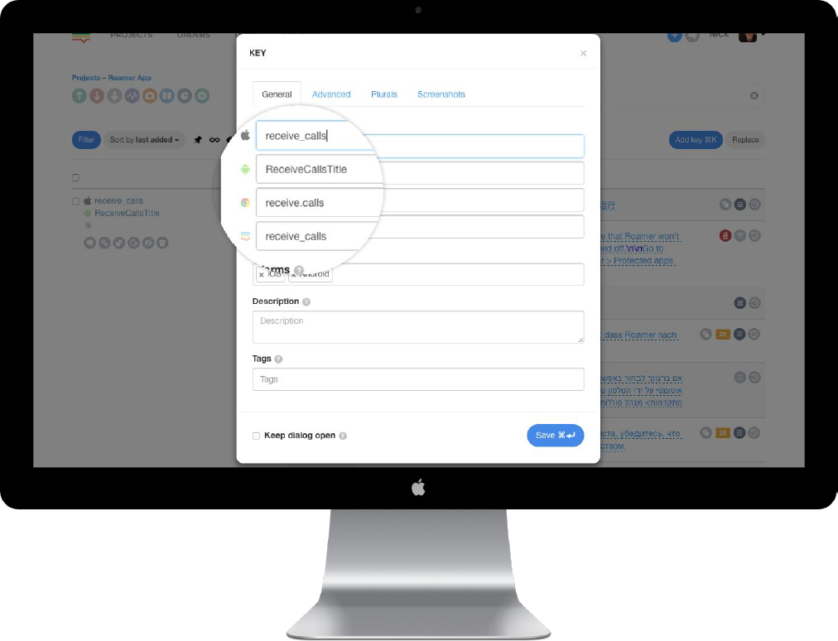
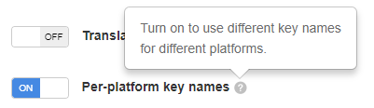
LOKALIZE.FEATURES.Multiplatform
Notes:
Keep all platform keys in the same project
Universal Placeholders
Import / Export to/from different platforms when needed.
Keys with similar names are merged on import.
No more redundant duplicate keys.

Slide 11
LOKALIZE.FEATURES.for.developers
Language auto-fill
Easily chain languages by setting up auto-fill rules. Once translations in languages you set up for monitoring are updated, the chained languages get updated as well.

Slide 12
LOKALIZE.FEATURES.for.developers
Project snapshots
Take a snapshot of your project or retrieve project copies
from previous snaps.

Slide 13
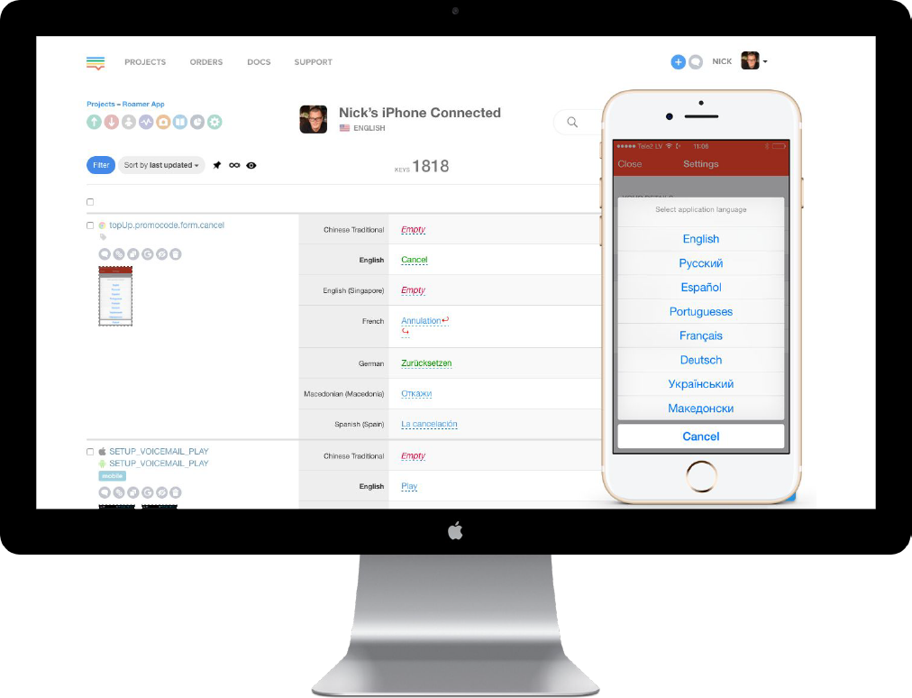
LOKALIZE.FEATURES.SDK+OTA
Notes:
Live Edit Module in Lokalise SDK
In-context mobile editor for your translators and QA.
iOS and Android Lokalise OTA SDK
Instant over-the-air updates on end-user devices bypassing Appstore and Google Play.

Slide 14
LOKALIZE.FEATURES.TRANSLATION.HISTORY
Project snapshots
Take a snapshot of your project or retrieve project copies
from previous snaps.

Slide 15
LOKALIZE.FEATURES.TRANSLATION.MEMORY
Project snapshots
Take a snapshot of your project or retrieve project copies
from previous snaps.

Slide 16
LOKALIZE.FEATURES.LIVEJS
LiveJS: web in-context editor
Focus on a particular language pair working right on the
respective page of your website without distractions.

Slide 17
LOKALIZE.FEATURES.API.AND.CLI
Advanced API and CLI tool
Integrate with your existing setup using our API or command-line tool.

Slide 18
LOKALIZE.FEATURES.KEY.REFERENCING
Advanced API and CLI tool
Integrate with your existing setup using our API or command-line tool.

Slide 19
LOKALIZE.FEATURES.KEY.VALIDATION
Advanced API and CLI tool
Integrate with your existing setup using our API or command-line tool.

Slide 20
LOKALIZE.FEATURES.GRAMMAR.CHECK
title
text

Slide 21
LOKALIZE.FEATURES.GLOSSARY
Advanced API and CLI tool
Integrate with your existing setup using our API or command-line tool.

Slide 22
LOKALIZE.FEATURES.PROOFREADING
title
text

Slide 23
LOKALIZE.FEATURES.MULTILINGUAL.VIEW
title
text

Slide 24
LOKALIZE.FEATURES.TRANSLATION.CTX
title
text

Slide 25
LOKALIZE.FEATURES.PLURALS
title
text

Slide 26
LOKALIZE.FEATURES.MACHINE.TRANSLATION
title
text

Slide 27
LOKALIZE.FEATURES.TOOLS.INTEGRATION
title
text

Slide 28
LOKALIZE.FEATURES.WORKFLOW
Task oriented.
text
Project Chat.
text
Project activity.
text

Slide 29
LOKALIZE.FEATURES.TRANSLATE.LIKE.A.PRO
Task oriented.
text

Slide 30
LOKALIZE.FEATURES.INSIGHTS
Insights.
text
Translators Stats.
text

Slide 31
demo

Slide 32
AND.THE.OTHERS?
Google Translate API
https://www.getapp.com/it-management-software/a/lokalise/alternatives/
https://siftery.com/lokalise/alternatives

