Slide 1

??? Presentation.mainslide.title ???

Slide 2

once.upon.a.time
A TRUE STORY
i18n extraction
send to an external Agency
receive back translation
overwrite i18n
build / next development cycle..

Slide 3
once.upon.a.time
A TRUE STORY
i18n extraction
send to an external Agency
receive back translation
overwrite i18n
build / next development cycle..
normalization
normalization (revert)

Slide 4
once.upon.a.time
A TRUE STORY
i18n extraction
send to an external Agency
receive back translation
overwrite i18n
build / next development cycle..
normalization
normalization (revert)
merge
normalization
WAIT
i18n extraction
next development cycle..

Slide 5
once.upon.a.time
A TRUE STORY
i18n extraction
send to an external Agency
receive back translation
overwrite i18n
build / next development cycle..
normalization
normalization (revert)
merge
normalization
poor translation / errors
WAIT
i18n extraction
next development cycle..

Slide 6
once.upon.a.time
A TRUE STORY
Another Internal Team…
Internal Team «parallel» translation
i18n extraction
send to an external Agency
receive back translation
overwrite i18n
build / next development cycle..
normalization
normalization (revert)
WAIT
WAIT
merge
merge (from paper!!)
normalization
resolve conflicts!
poor translation / errors
WAIT
i18n extraction
next development cycle..

Slide 7
once.upon.a.time
A TRUE STORY
Another Internal Team…
Internal Team «parallel» translation
HARD to master
i18n extraction
send to an external Agency
receive back translation
overwrite i18n
build / next development cycle..
normalization
normalization (revert)
WAIT
WAIT
error PRONE
merge
ZERO-automation
tedious
merge (from paper!!)
normalization
resolve conflicts!
poor translation / errors
INefficient
overall POOR quality
WAIT
i18n extraction
out of CONTROL
next development cycle..

Slide 8
WHAT.DO.WE.NEED?
Automation
Error-proof
Professional service
Zero-mail service
Integration features
i18n validation / optimization
A process easy to control
i18n versioning
Cost-saving tool
Glossary
Context-aware translation
..some fun!

Slide 9
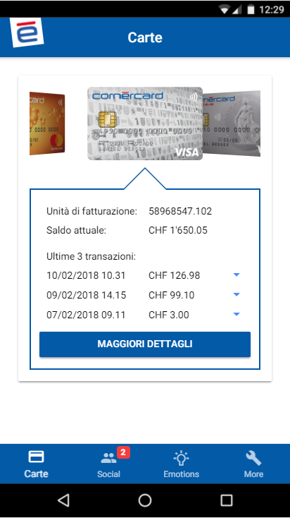
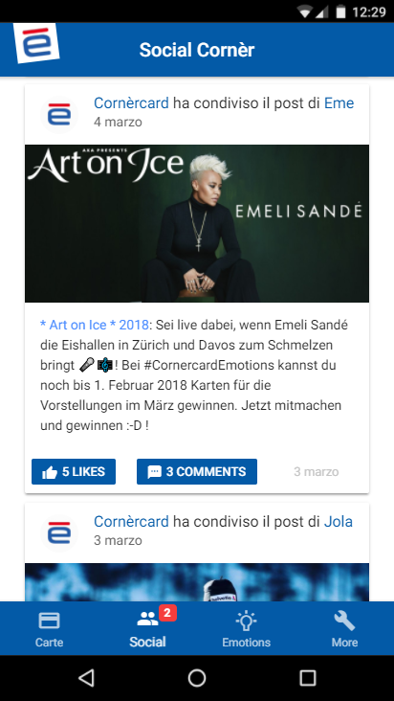
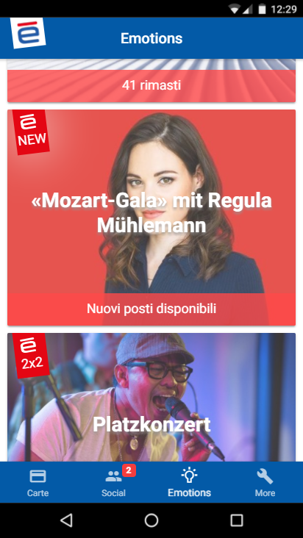
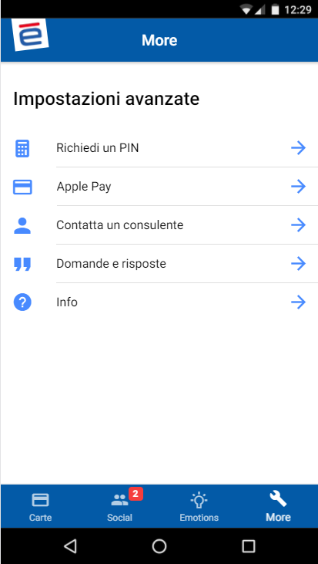



LOKALIZE.FEATURES.DEMO.I18N.SETUP

Slide 10
LOKALIZE.FEATURES.DEMO.I18N.SETUP
npm install @ngx-translate/core --save

Slide 11
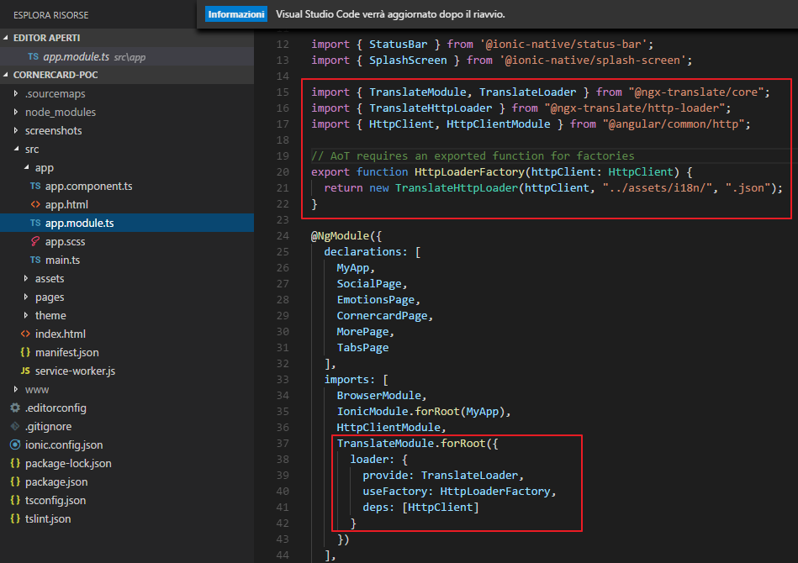
LOKALIZE.FEATURES.DEMO.I18N.SETUP

Slide 12
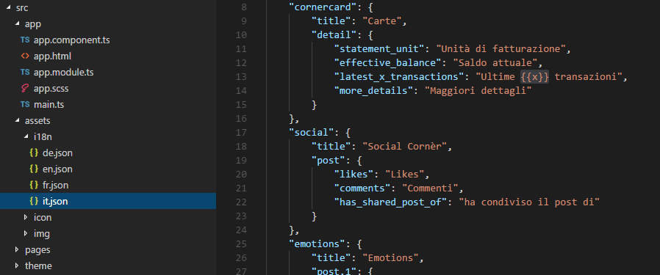
LOKALIZE.FEATURES.DEMO.I18N.SETUP

Slide 13
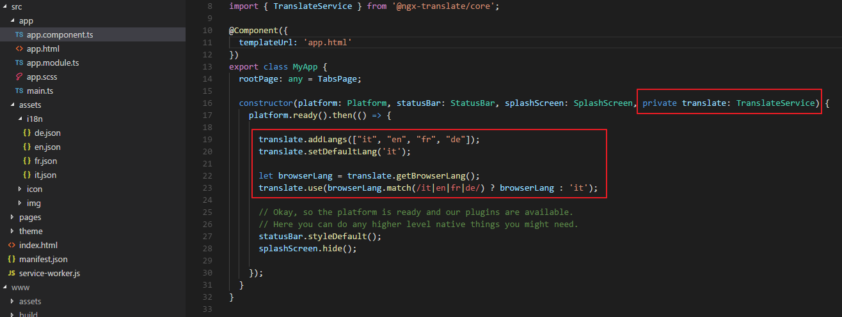
LOKALIZE.FEATURES.DEMO.I18N.SETUP

Slide 14
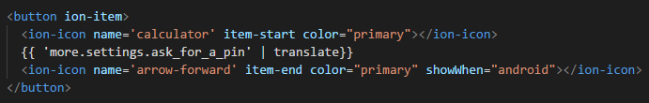
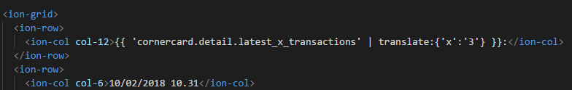
LOKALIZE.FEATURES.DEMO.I18N.SETUP

Slide 15
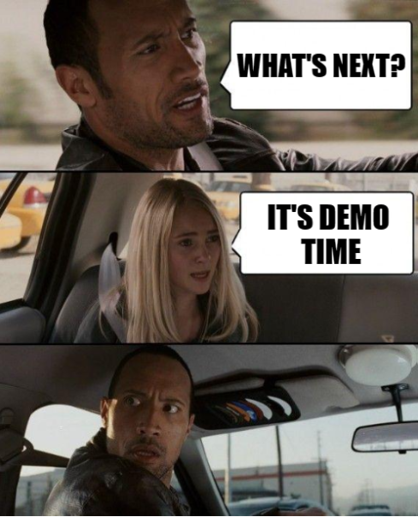

Slide 16
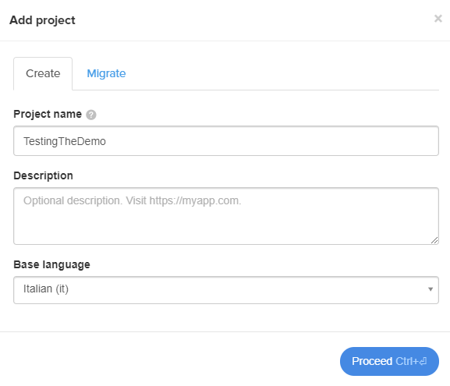
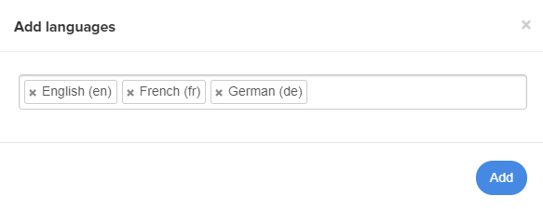
LOKALIZE.FEATURES.DEMO.NEW.PROJECT

Slide 17
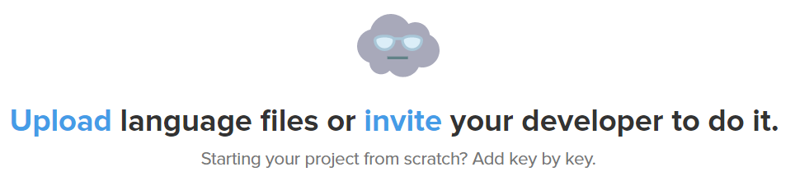
LOKALIZE.FEATURES.DEMO.UPLOAD.KEYS

Slide 18
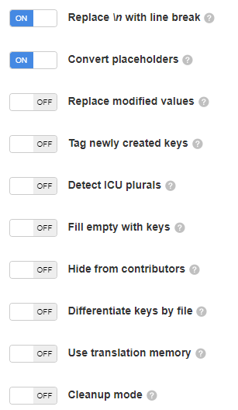
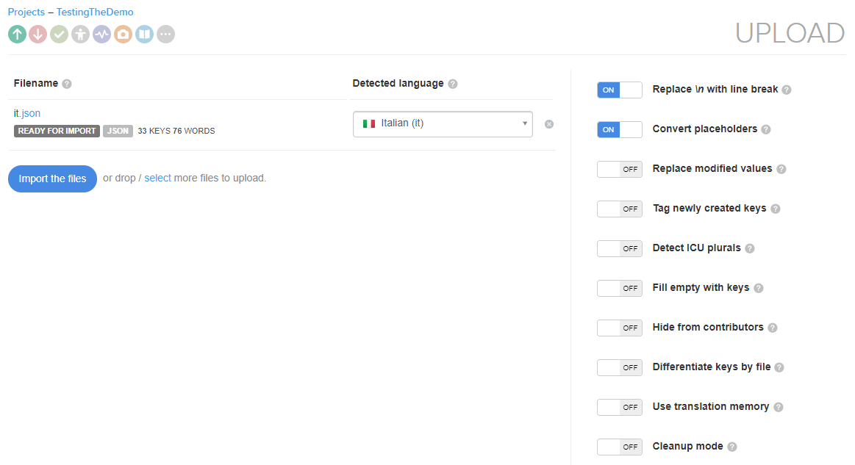
LOKALIZE.FEATURES.DEMO.UPLOAD.KEYS

Slide 19
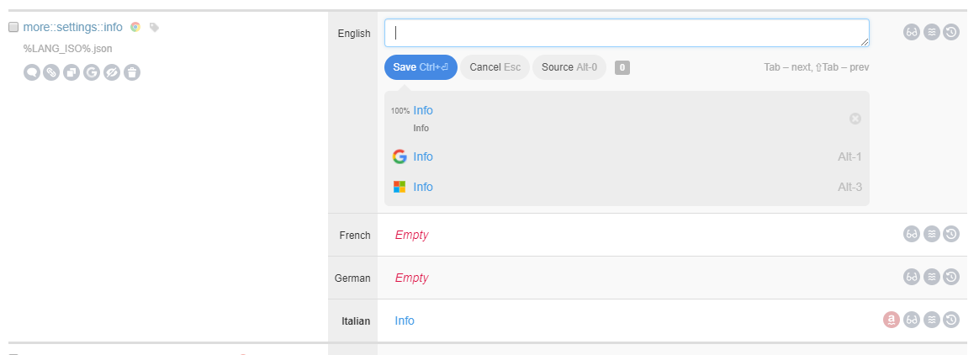
LOKALIZE.FEATURES.DEMO.TRANSLATE

Slide 20
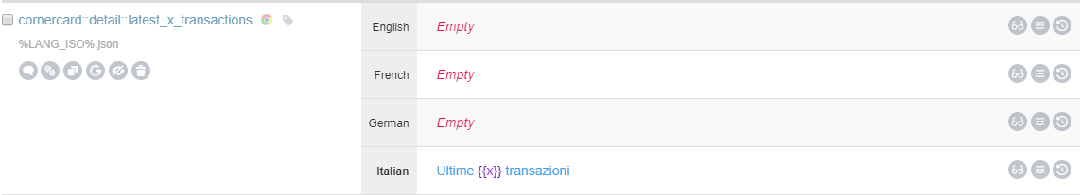
LOKALIZE.FEATURES.DEMO.PLACEHOLDERS

Slide 21
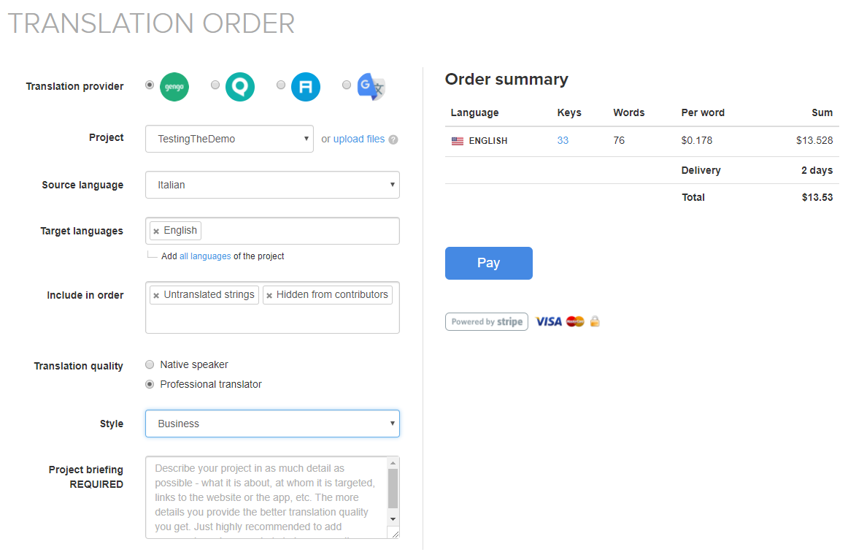
LOKALIZE.FEATURES.DEMO.BUY.I18N

Slide 22
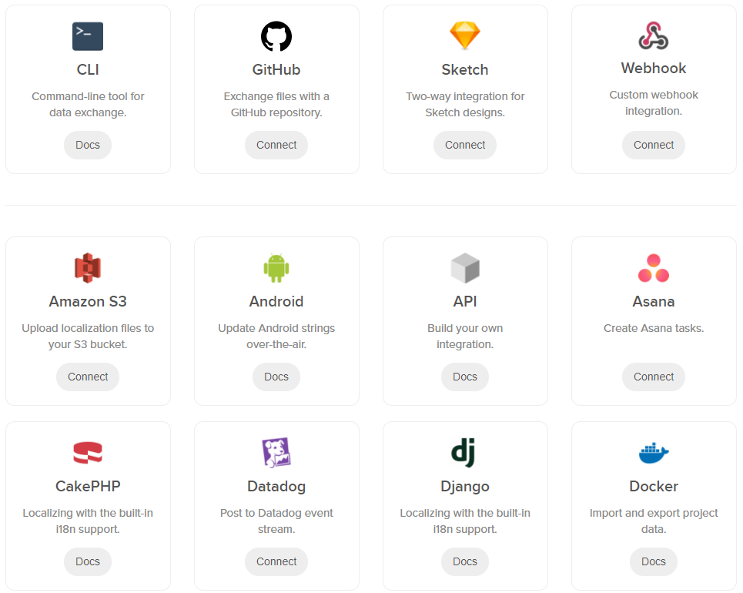
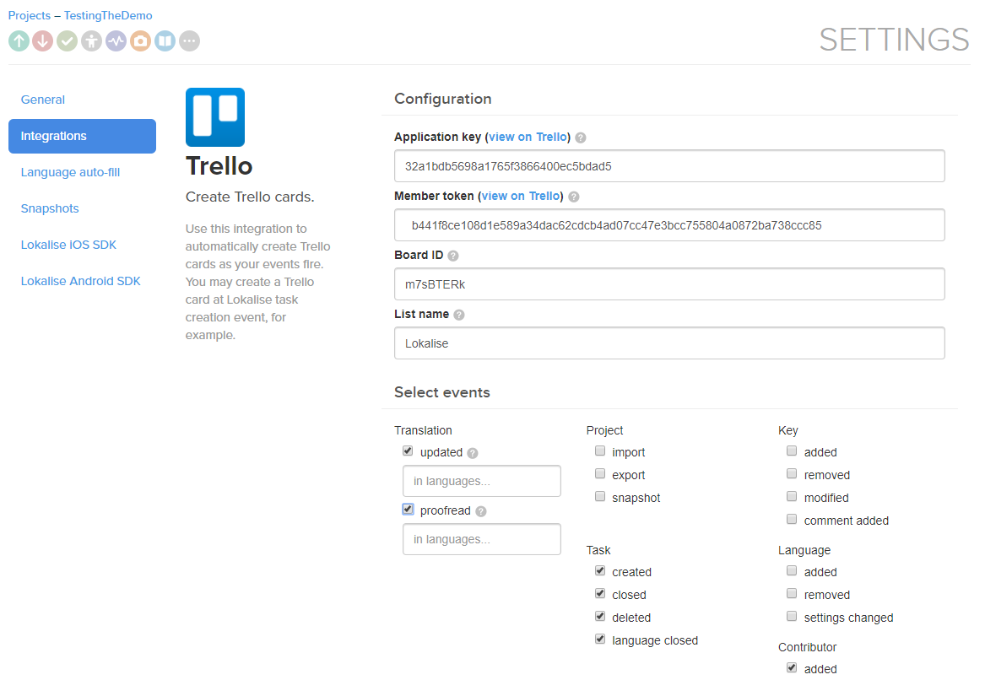
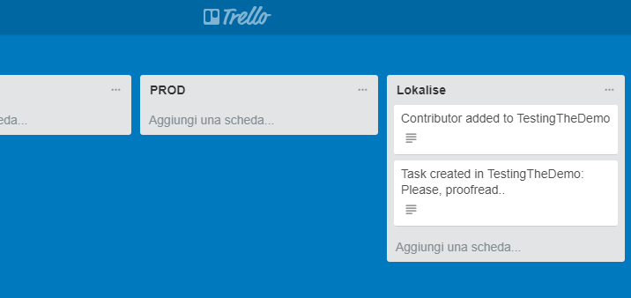
LOKALIZE.FEATURES.DEMO.INTEGRATION

Slide 23
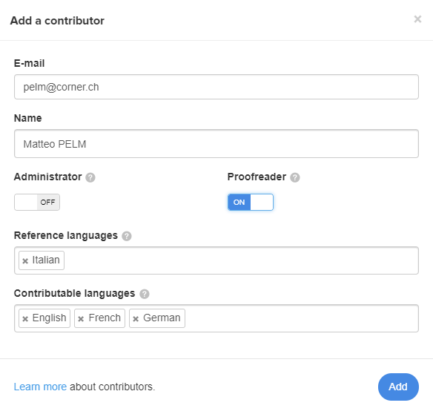
LOKALIZE.FEATURES.DEMO.CONTRIBUTORS

Slide 24

LOKALIZE.FEATURES.DEMO.SCREENSHOTS

Slide 25
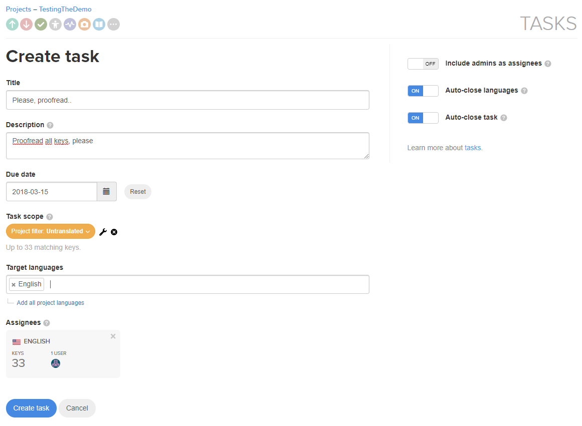
LOKALIZE.FEATURES.DEMO.TASKS

Slide 26
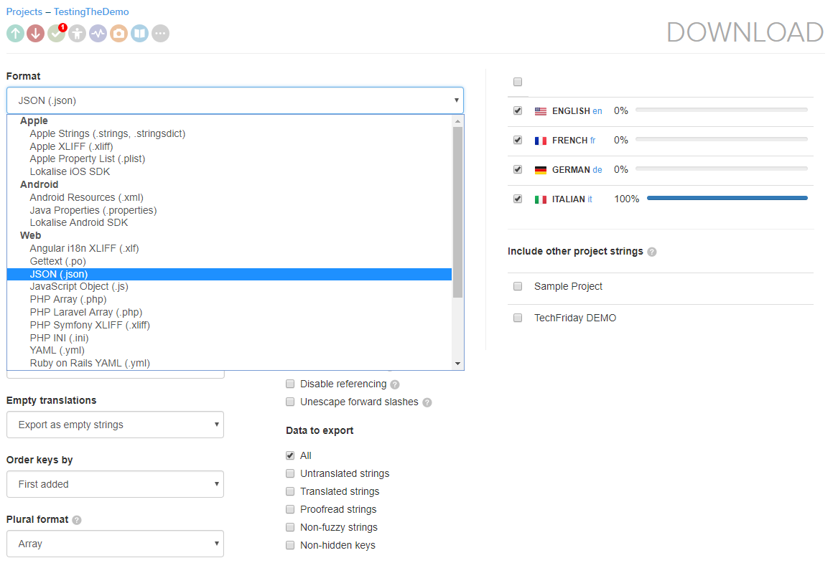
LOKALIZE.FEATURES.DEMO.DOWNLOAD

Slide 27
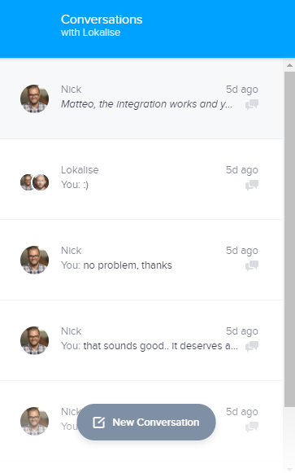
LOKALIZE.FEATURES.DEMO.SUPPORT

Slide 28
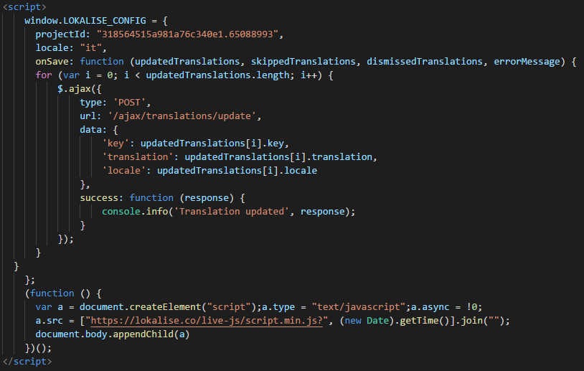
LOKALIZE.FEATURES.DEMO.LIVE.EDITING

Slide 29
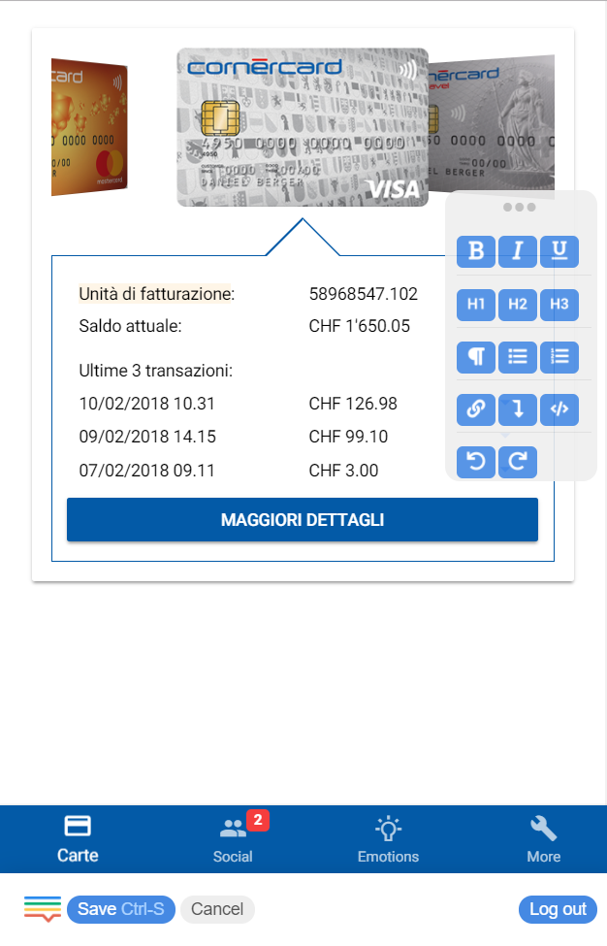
LOKALIZE.FEATURES.DEMO.LIVE.EDITING

Slide 30
LOKALIZE.FEATURES.DEMO.OTHER.FEATURES
translation history
translation memory
multiplatform
insights (stats)
CLI
OTA updates (only native apps)
API
glossary
spelling
key referencing
upvoting
project snapshots
project chat/activity
plurals
inline machine translation

Slide 31

A.SIMPLE.PROCESS
A TRUE STORY
keys extraction
upload to Lokalise
translation
download to code
merge

Slide 32
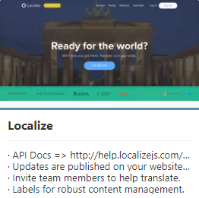
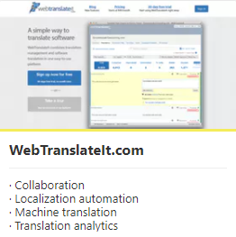
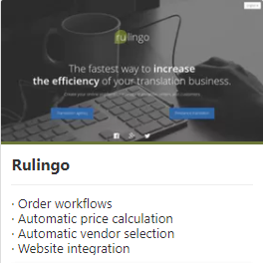
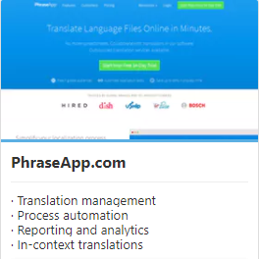
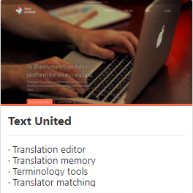
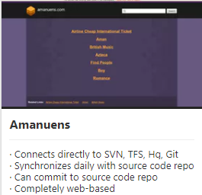
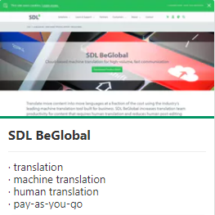

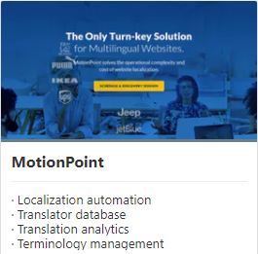
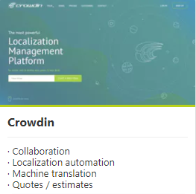
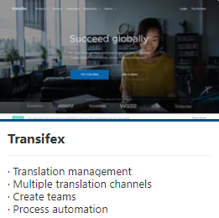

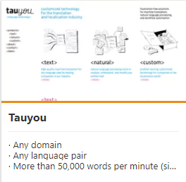
AND.THE.OTHERS?
Source: https://www.getapp.com/it-management-software/a/lokalise/alternatives/

Slide 33
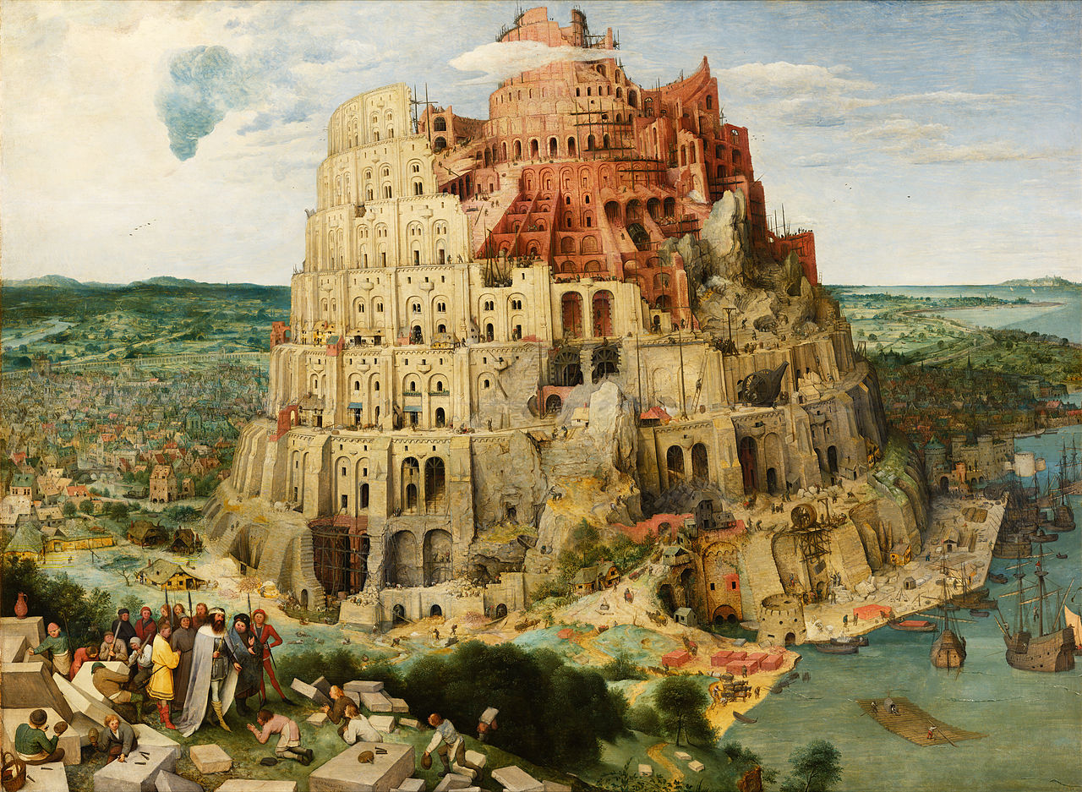
THANK.YOU

