Slide 1

STUD-IA made by Pizza Numbers

Slide 2

UPLOAD FILE/PDF & LINK

Slide 3

SUMMARIZE IT

Slide 4

CHAT BOT

Slide 5

TEST YOURSELF

Slide 6
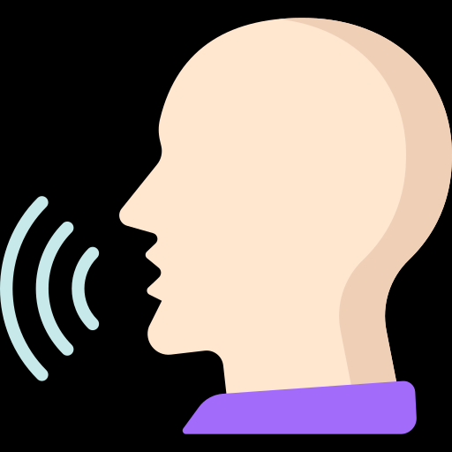
TEXT TO SPEECH

Slide 7

TECHNICAL DETAILS

Slide 8

DEMO

