Slide 1
SecurePubSub Project Final presentation
Outline
Initial goals and requirements
14-01-2025

Slide 2
SecurePubSub Project Final presentation
Outline
Initial goals and requirements
14-01-2025

Slide 3
SecurePubSub Project Final presentation
Outline
The Process Timeline
14-01-2025

Slide 4
SecurePubSub Project Final presentation
Outline
The results obtained
14-01-2025

Slide 5
SecurePubSub Project Final presentation
Outline
Lessons learnt
14-01-2025

Slide 6
SecurePubSub Project Final presentation
Outline
Project demo
14-01-2025

Slide 7

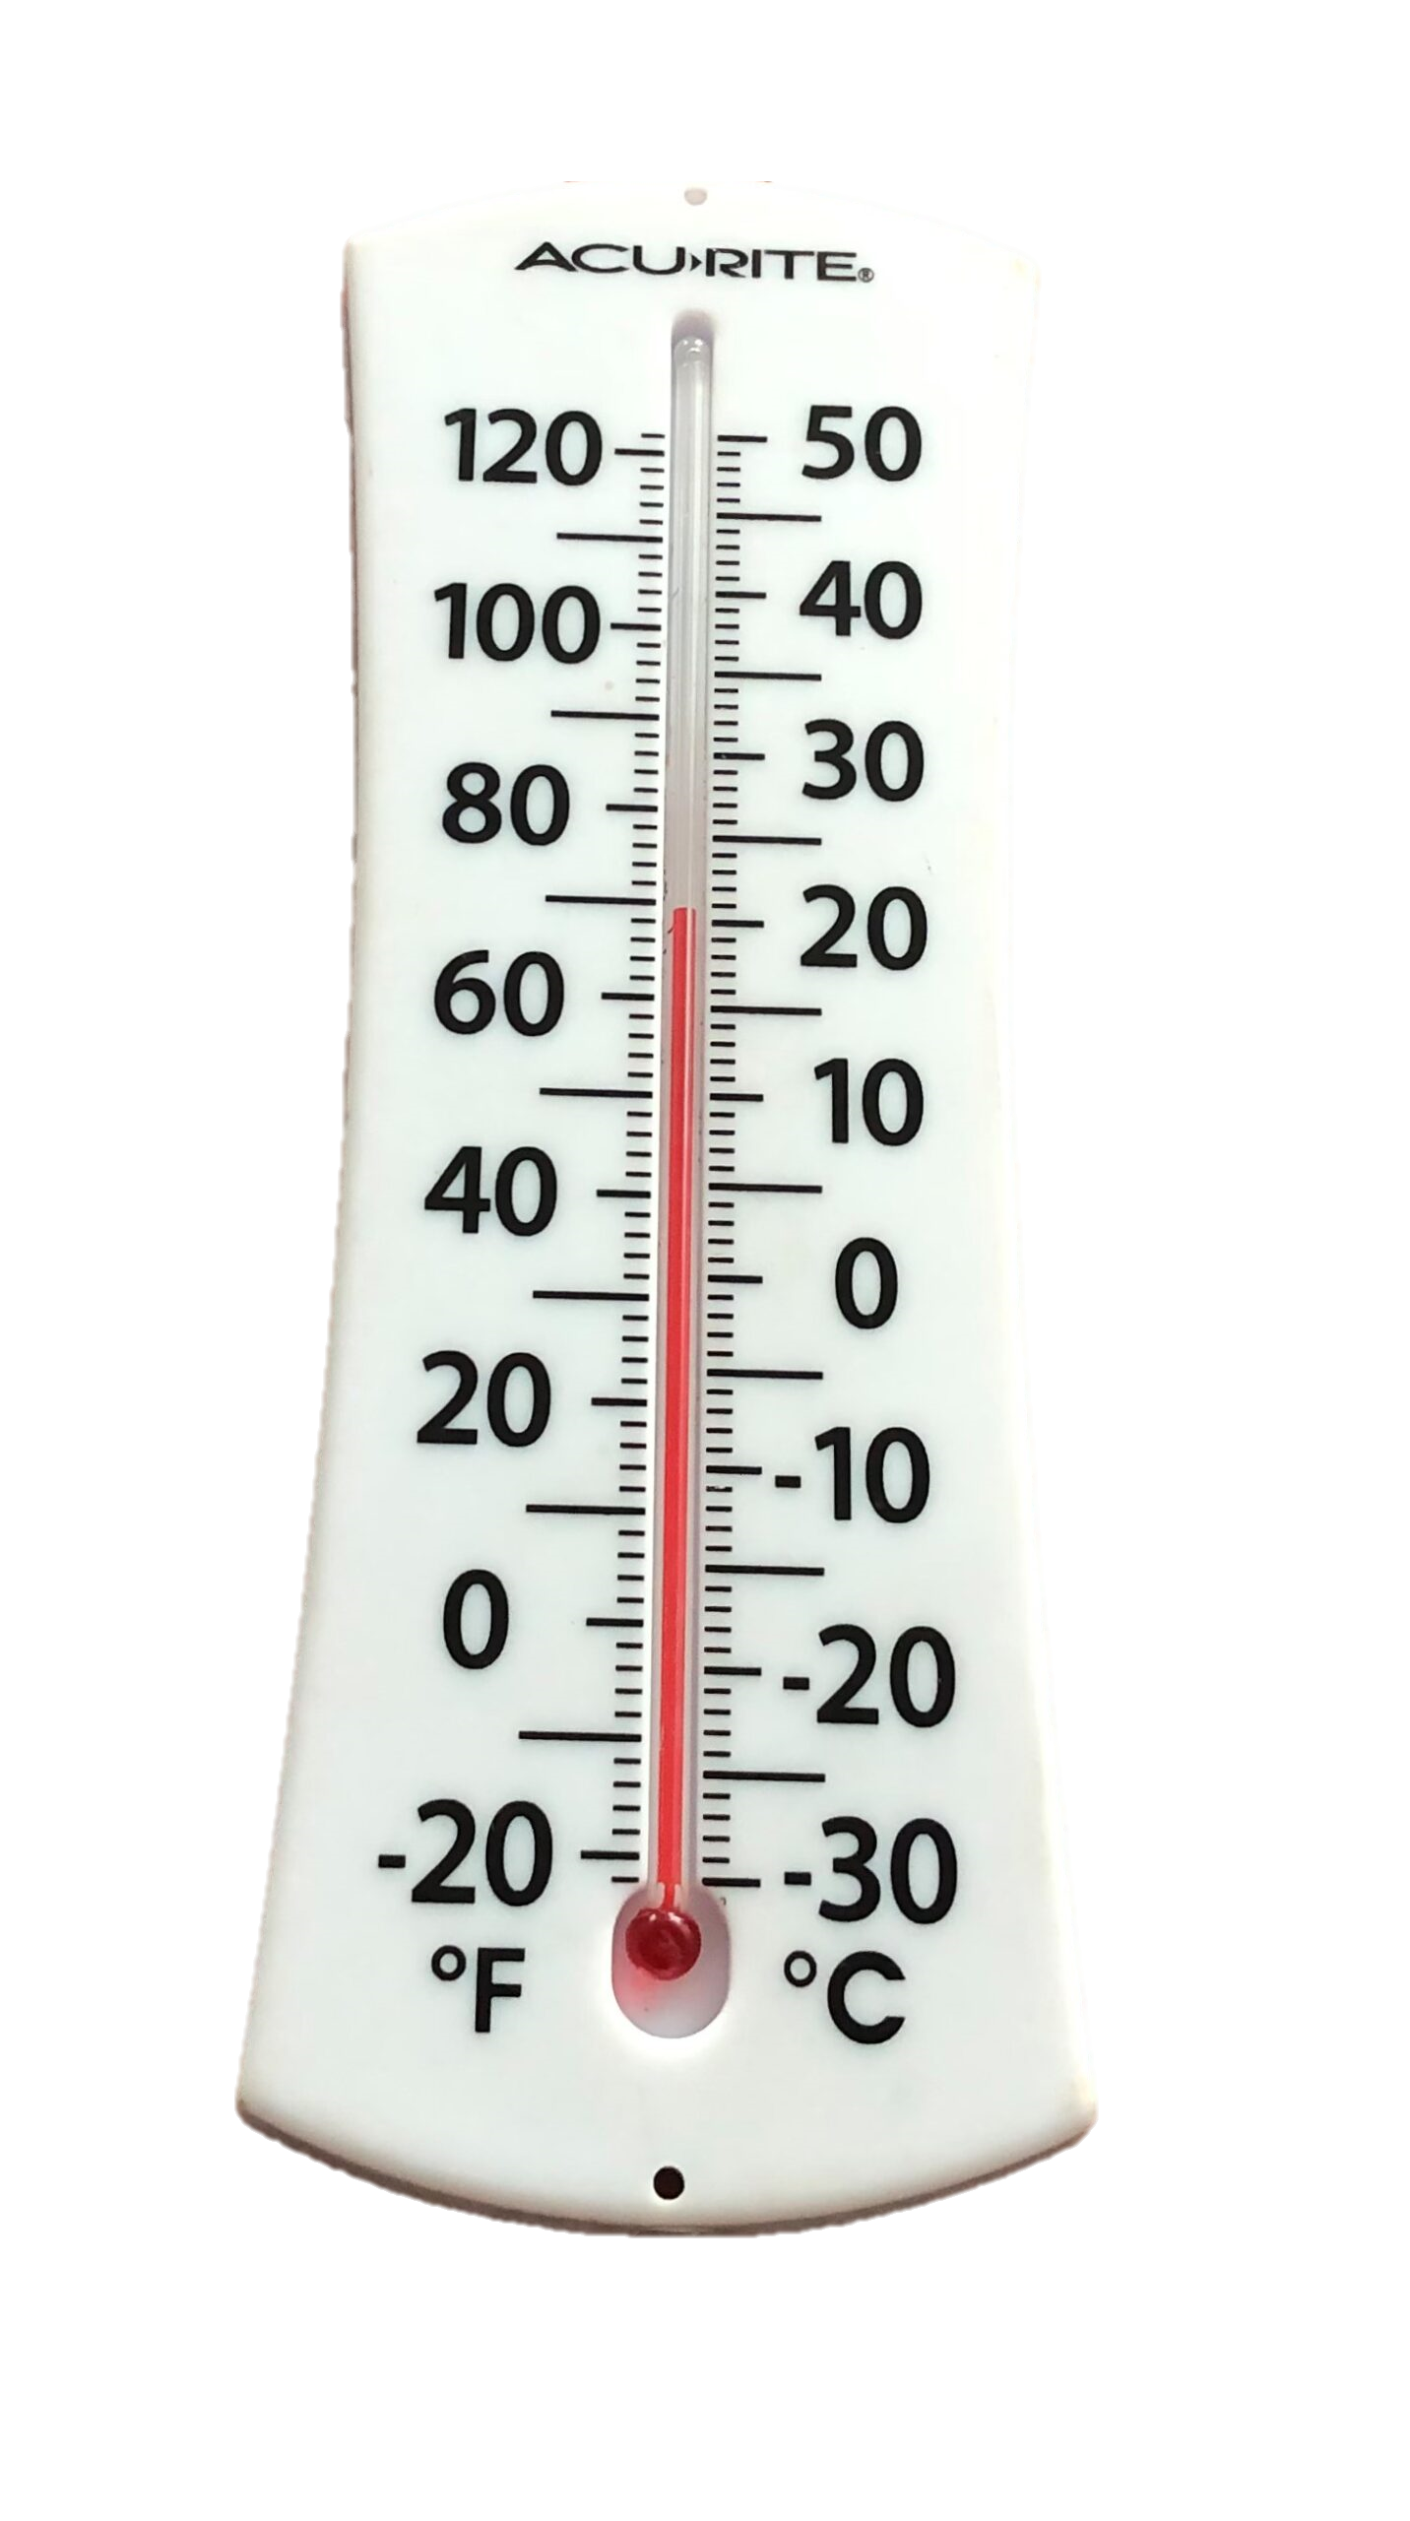
The OPC UA Technology

Slide 8

The OPC UA Technology
23.01 °C
20.12045 °C

Slide 9

The OPC UA Technology
23.01 °C
20.12045 °C

Slide 10



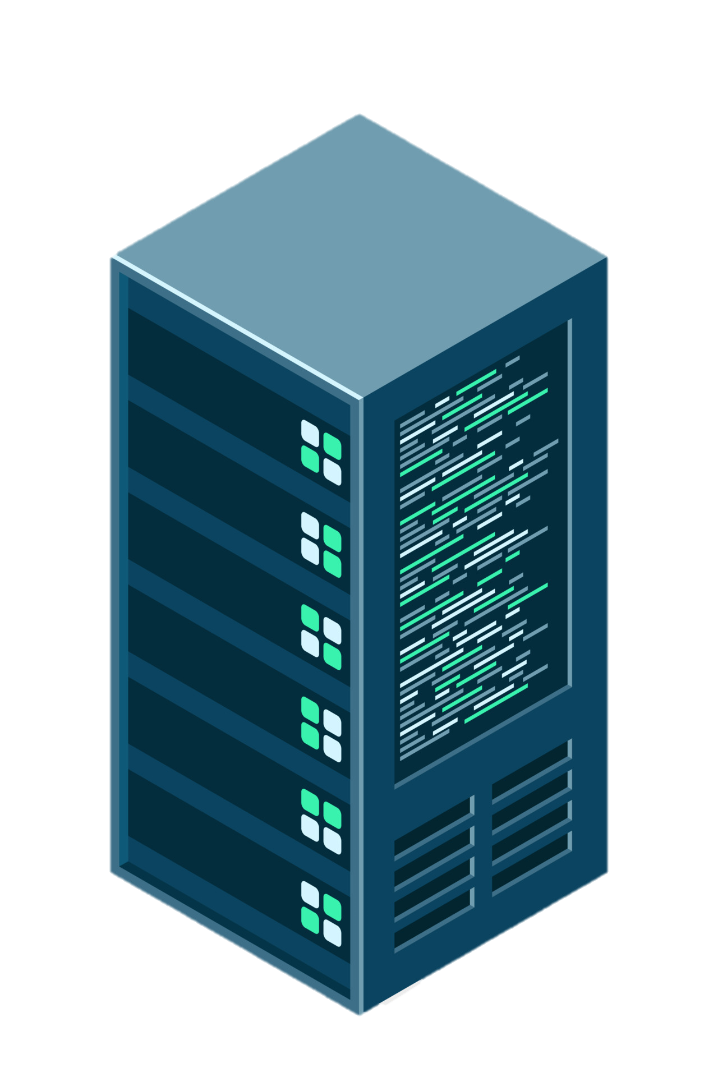







The security layer
SKS Server
Multicast IP
Publishers
Subscriber

Slide 11
Initial Goals and Requirements

Slide 12
XML configuration
Recovery mechanism SKS

Slide 13
Recovery mechanism SKS
XML configuration
RTT
tool

Slide 14
Recovery mechanism SKS
XML configuration
RTT
tool

Slide 15
The Process Timeline

Slide 16
Sprint #0
2024-10-07
First zero meeting
First meeting with customer
Getting to know each other
2024-10-13
Sprint #1
2024-10-14
Studying the OPC UA technology
Setting up environment (GH, CICD)
Familiarise with SCRUM practice
2024-10-27

Slide 17
Sprint #0
First zero meeting
First meeting with customer
Getting to know each other
2024-10-07
2024-10-13
Sprint #1
2024-10-14
Studying the OPC UA technology
Setting up environment (GH, CICD)
Familiarise with SCRUM practice
2024-10-27
Sprint #2
2024-10-28
Completed documentation (v1)
Backlog refinement
Completed SKS recovery mechanism
2024-11-10

Slide 18
Sprint #1
2024-10-14
Studying the OPC UA technology
Setting up environment (GH, CICD)
Familiarise with SCRUM practice
2024-10-27
Sprint #2
2024-10-28
Completed documentation (v1)
Backlog refinement
Completed SKS recovery mechanism
2024-11-10
Sprint #3
2024-11-11
Late sprint planning
Completed configuration Publisher
Backlog refinement
2024-11-24

Slide 19
2024-10-28
Completed documentation (v1)
Backlog refinement
Completed SKS recovery mechanism
Sprint #2
2024-11-10
Sprint #3
2024-11-11
Late sprint planning
Completed configuration Publisher
Backlog refinement
2024-11-24
Sprint #4
2024-11-25
Adjusted sprint planning
Completed configuration Subscriber and SKS (complete architecture deployment)
Beta prototype presented
2024-12-08

Slide 20
Sprint #3
2024-11-11
Late sprint planning
Completed configuration Publisher
Backlog refinement
2024-11-24
Sprint #4
2024-11-25
Adjusted sprint planning
Completed configuration Subscriber and SKS (complete architecture deployment)
Beta prototype presented
2024-12-08
Sprint #5
2024-12-09
New document versions
Completed RTT development
Acceptance test plan
2024-12-22

Slide 21
Sprint #4
2024-11-25
Adjusted sprint planning
Completed configuration Subscriber and SKS (complete architecture deployment)
Beta prototype presented
2024-12-08
Sprint #5
2024-12-09
New document versions
Completed RTT development
Acceptance test plan
2024-12-22
Sprint #6
2024-12-23
Implemented certificate trust-list (new customer requirement)
Completed Acceptance Tests (successfully)
Aligning documentation
2025-01-05

Slide 22

Sprint #5
2024-12-09
New document versions
Completed RTT development
Acceptance test plan
2024-12-22
Sprint #6
2024-12-23
Implemented certificate trust-list (new customer requirement)
Completed Acceptance Tests (successfully)
Aligning documentation
2025-01-05
FINAL PRESENTATION
&
CUSTOMER DELIVERY

Slide 23
Sprint #7
FINAL PRESENTATION
&
CUSTOMER DELIVERY

Slide 24

Verification and Validation
Unit Tests with Gtest throughout the entire development process
Integration Tests with Gtest following a bottom-up approach
Acceptance Test Plan covering 100% of initial requirements
All tests passed successfully

Slide 25





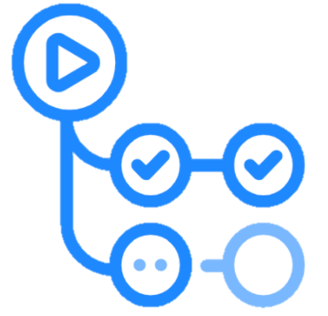


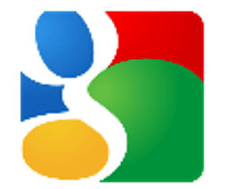



Skills acquired

Slide 26
Some team lessons learnt
Every team member brings different innate skills to the team
Building trust is fundamental
to achieve big goals together
Git will always have your
back, no matter what
Continuous communication is
essential in large teams
When time is scarse, it is
necessary to cut on
useless details

Slide 27
Some team lessons learnt
Building trust is fundamental
to achieve big goals together
Every team member brings different innate skills to the team
Continuous communication is
essential in large teams
Git will always have your
back, no matter what
When time is scarse, it is
necessary to cut on
useless details

Slide 28
Some team lessons learnt
Every team member brings different innate skills to the team
Building trust is fundamental
to achieve big goals together
When time is scarse, it is
necessary to cut on
useless details
Continuous communication is
essential in large teams
Git will always have your
back, no matter what

Slide 29
Some team lessons learnt
Building trust is fundamental
to achieve big goals together
Every team member brings different innate skills to the team
Continuous communication is
essential in large teams
When time is scarse, it is
necessary to cut on
useless details
Git will always have your
back, no matter what

Slide 30
Some team lessons learnt
Building trust is fundamental
to achieve big goals together
Every team member brings different innate skills to the team
Continuous communication is
essential in large teams
When time is scarse, it is
necessary to cut on
useless details
Git will always have your
back, no matter what

Slide 31
Some team lessons learnt
Building trust is fundamental
to achieve big goals together
Every team member brings different innate skills to the team
Continuous communication is
essential in large teams
When time is scarse, it is
necessary to cut on
useless details
Git will always have your
back, no matter what

Slide 32
Product Demo

Slide 33
Deployment – 1 Simple Setup
SKS Server
Publisher
Multicast IP
Subscriber

Slide 34
Deployment – 2 Increment & Decrement
SKS Server
Publisher
Multicast IP
Subscriber

Slide 35


Deployment – 3 Complex Architecture
SKS Server
Multicast IP
Publishers
Subscribers

