Slide 1
Marionette
Runtime Behavioural Configuration and A/B/n Testing for Microservices Systems
Author: Matteo Sissa | Advisor: Prof. Matteo Camilli
23.10.2025
Notes:
Hello everyone. I’m Matteo Sissa and today I’ll be talking about my master’s thesis project which is called Marionette. It was developed under the supervision of professor Matteo Camilli who is here in the committee

Slide 2
Overview
01
02
03
Problem Identification
Marionette Framework
Experimental Results
Problem Statement
Current Solutions
High-level View
Code Transformation
Centralised Manager
Feasibility Experiments
Overhead Analysis
Development Gains
Notes:
The presentation is split into three sections.
First, we’re going to identify the problem. Then, describe the Marionette framework and how it tackles the issue. Finally, we’ll see some experiments and the results obtained.

Slide 3
Overview
01
02
03
Problem Identification
Marionette Framework
Experimental Results
Problem Statement
Current Solutions
High-level View
Code Transformation
Centralised Manager
Feasibility Experiments
Overhead Analysis
Development Gains
Notes:
The presentation is divided into three sections.
First, we’re going to identify the problem. Then, describe the Marionette framework and how it tackles the issue. Finally, we’ll see some experiments and the results obtained.

Slide 4
Overview
01
02
03
Problem Identification
Marionette Framework
Experimental Results
Problem Statement
Current Solutions
High-level View
Code Transformation
Centralised Manager
Feasibility Experiments
Overhead Analysis
Development Gains
Notes:
The presentation is divided into three sections.
First, we’re going to identify the problem. Then, describe how the Marionette framework tackles the issue. Finally, we’ll see some experiments and the results obtained.

Slide 5
Problem Identification
01
Notes:
Mute

Slide 6
01
02
03
“Is it possible to achieve fine-grained, runtime behavioural control in a microservice system?”
Notes:
The question that drove the investigation for this thesis is the following: “Is it possible to achieve fine-grained, runtime behavioural control in a microservice system?”

Slide 7
01
02
03
“Is it possible to achieve fine-grained, runtime behavioural control in a microservice system?”
The goal of this project is to enable behavioural flexibility in a microservice system.
x
Scalability
x
Fault-tolerance
x
Resource management
Control at the level of a single method or function.
x
A/B Testing
x
Feature Flags
The behaviour can be selected and switched at runtime among the available ones.
x
Redeployment
Notes:
It is possible to highlight some keywords and break it down into parts.

Slide 8
01
02
03
behavioural control
fine-grained
runtime
The goal of this project is to enable behavioural flexibility in a microservice system.
Control at the level of a single method or function.
The behaviour can be selected and switched at runtime among the available ones.
x
A/B Testing
x
Scalability
x
Feature Flags
x
x
Redeployment
Fault-tolerance
x
Resource management
Notes:
So, in the context of a microservice system, this project aims to obtain behavioural flexibility and control.
This control should be at a fine-grained level, more precisely at the method or function level.
Finally, it should happen at runtime, without any need for code recompilation or redeployment.

Slide 9
01
02
03
behavioural control
fine-grained
runtime
The goal of this project is to enable behavioural flexibility in a microservice system.
Control at the level of a single method or function.
The behaviour can be selected and switched at runtime among the available ones.
x
A/B Testing
x
Scalability
x
Feature Flags
x
x
Redeployment
Fault-tolerance
x
Resource management
Notes:
So, in the context of a microservice system, this project aims to obtain behavioural flexibility and control.
This control should be at a fine-grained level, more precisely at the method or function level.
Finally, it should happen at runtime, without any need for code recompilation or redeployment.

Slide 10
01
02
03
behavioural control
fine-grained
runtime
The goal of this project is to enable behavioural flexibility in a microservice system.
Control at the level of a single method or function.
The behaviour can be selected and switched at runtime among the available ones.
x
A/B Testing
x
Scalability
x
Feature Flags
x
x
Redeployment
Fault-tolerance
x
Resource management
Notes:
So, in the context of a microservice system, this project aims to obtain behavioural flexibility and control.
This control should be at a fine-grained level, more precisely at the method or function level.
Finally, it should happen at runtime, without any need for code recompilation or redeployment.

Slide 11

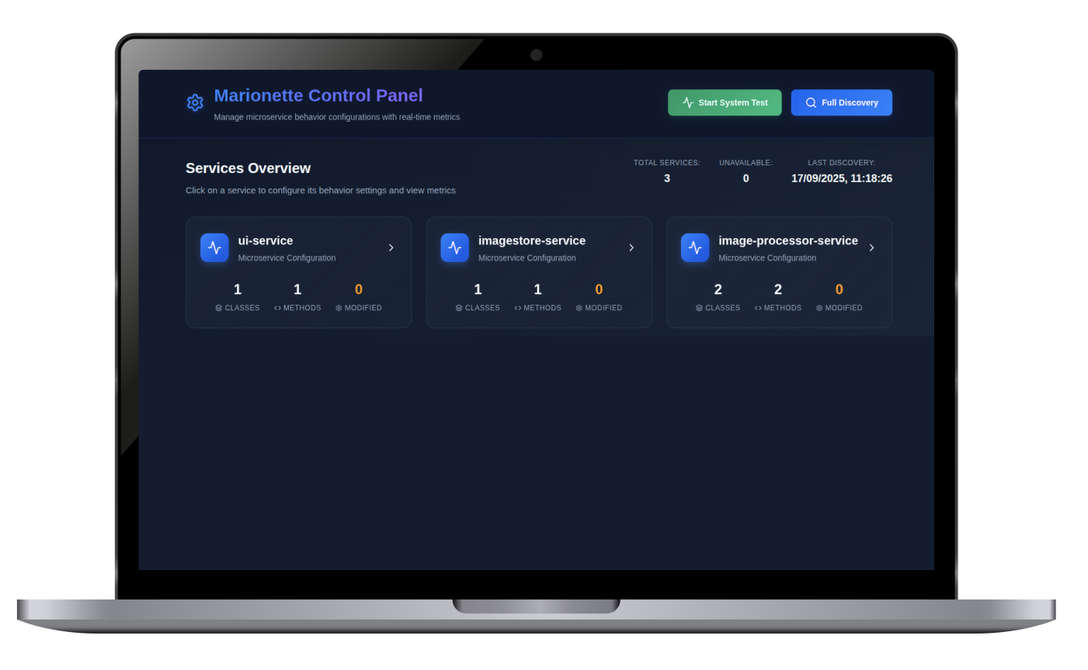
High-level Goal
01
02
03
Original
Variants
Behavioural Configuration Manager
Microservice Application
Notes:
This is the high-level picture of the goal we would like to reach.
On the right-hand side there is the deployed microservice application, changing in behaviour.
On the left-hand side, the behavioural configuration manager is an external service that offers an intuitive graphical interface for behavioural configuration and connects to the services within the application to control them.

Slide 12
The Marionette Framework
02

Slide 13
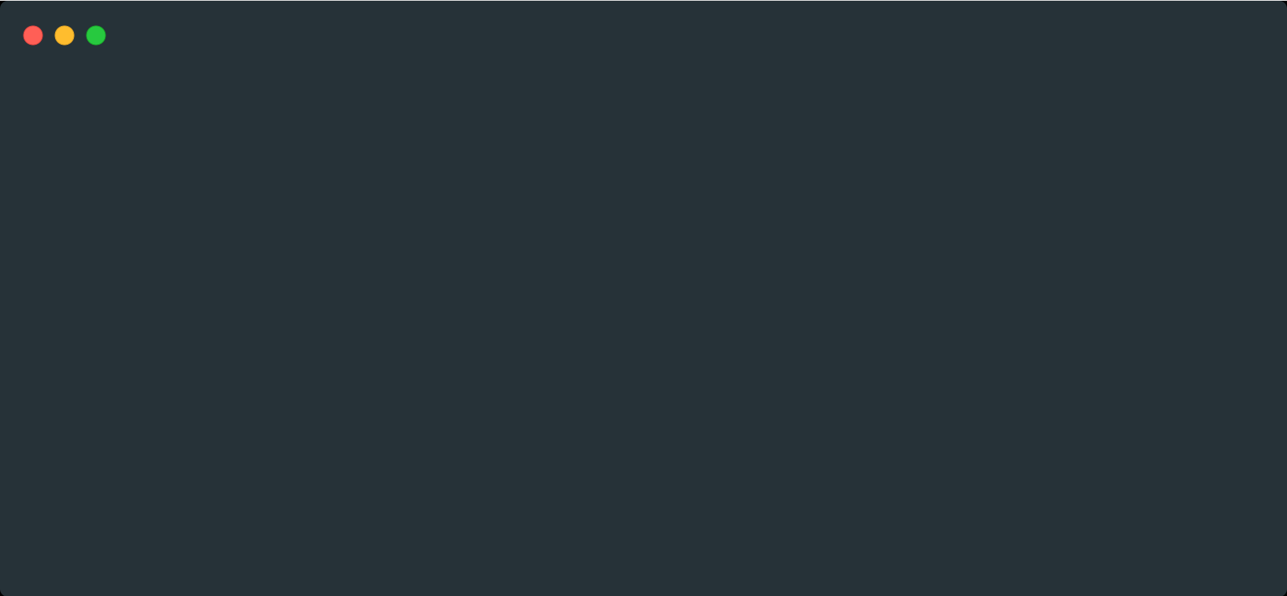
Source Code Transformation Steps
1
Copy of the original microservice project.
2
Injection of new classes implementing the control layer.
01
02
03
public Image enhanceImage(Image image) {
// Add AI enhancement
image.applyAIEnhancement();
image.adjustBrightness();
return image;
}
public Image enhanceImage(Image image) {
image.adjustBrightness();
return image;
}
Original Implementation
Variant Implementation
Notes:
The first contribution of this thesis is a development support tool that allows developers to define alternative implementations of the same method in the codebase of a microservice and it automatically takes care of transforming the source code to expose the control of the variants to external managers.
The tool is developed to work on java-based projects, so that is why I’m using object oriented jargon in the explanation, like classes or methods.
So the first step is to make the developer define some variant implementation for a method.
In the slide we can see the example of an image processing method.
On the left-hand side, there is the original implementation, while on the right-hand side, the user places the variant implementation in a different class file (while switching slide).

Slide 14
Source Code Transformation Steps
1
Copy of the original microservice project.
3
Incorporation of switching logic for all methods with variants.
2
Injection of new classes implementing the control layer.
01
02
03
public class ImageEnhancerAI {
...
...
}
public class ImageEnhancer {
...
...
}
public Image enhanceImage(Image image) {
// Add AI enhancement
image.applyAIEnhancement();
image.adjustBrightness();
return image;
}
public Image enhanceImage(Image image) {
image.adjustBrightness();
return image;
}
Original Implementation
Variant Implementation
Notes:
It is possible to add multiple variants for the same method as well as have multiple methods with variants in the same microservice

Slide 15

Source Code Transformation Steps
1
Copy of the original microservice project.
01
02
03
public class ImageEnhancerAI {
...
...
}
public class ImageEnhancer {
...
...
}
public Image enhanceImage(Image image) {
// Add AI enhancement
image.applyAIEnhancement();
image.adjustBrightness();
return image;
}
public Image enhanceImage(Image image) {
image.adjustBrightness();
return image;
}
Original Codebase
Original Implementation
Variant Implementation
Notes:
So let’s now consider this to be the whole codebase of the microservice, in which the variants have been defined.
When the development support tool takes over, it first incorporates into the codebase additional components that expose the behavioural control to external agents (while changing slide).

Slide 16
Source Code Transformation Steps
1
Copy of the original microservice project.
01
02
03
Behaviour Registry for behaviour mapping.
Behaviour Controller to externalize management.
Instrumented Microservice
BehaviourController
Original Codebase
BehaviourRegistry
3
Incorporation of switching logic for all methods with variants.
Notes:
The BehaviourRegistry is the central data structure that dynamically keeps the mapping between any method with variants and the currently used alternative.
The BehaviourController exposes the control of these mappings to external agents via HTTP calls.
Finally, a source code transformation process takes place in the original codebase to make sure that all methods with variants first query the BehaviourRegistry to know which alternative is currently active, and then dispatch the call to the correct implementation.

Slide 17
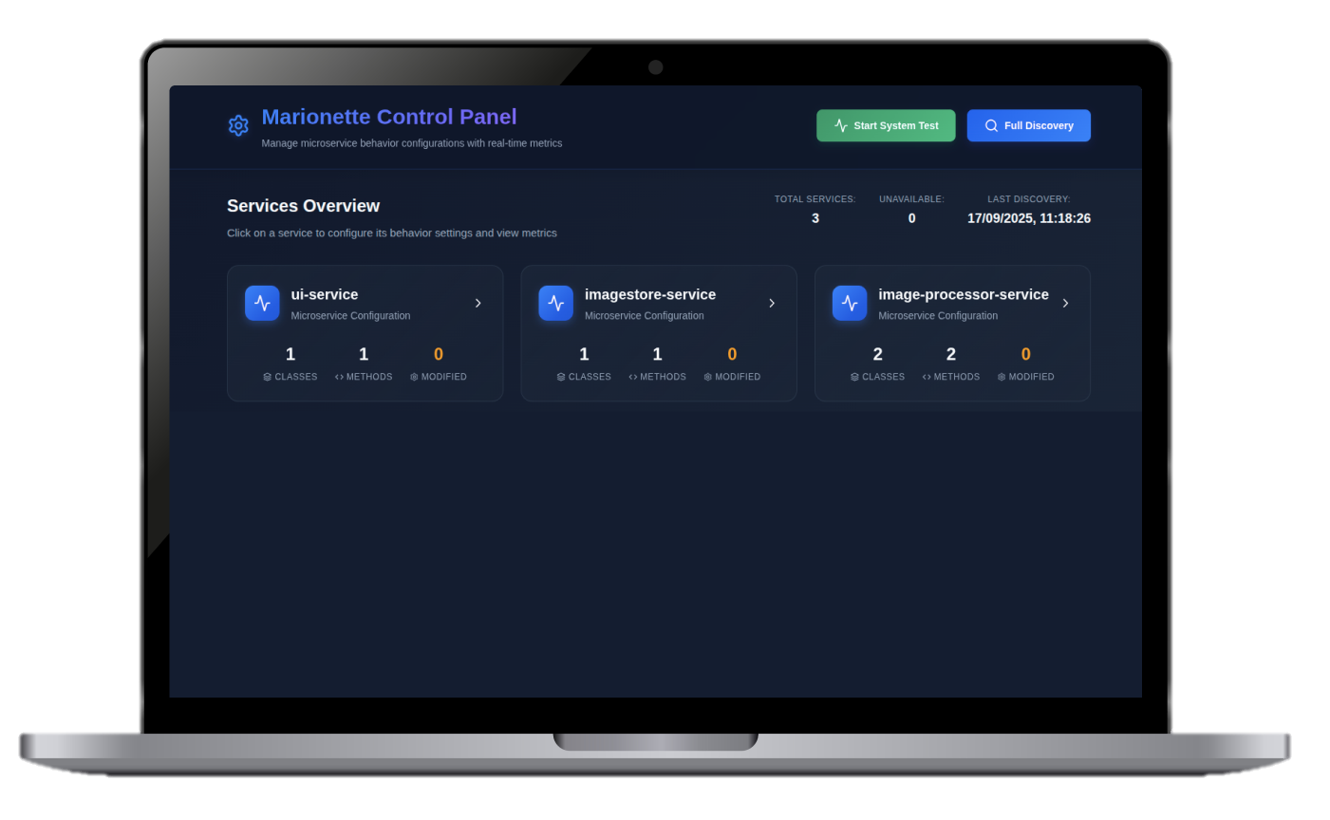
Centralised Behavioural Management
01
02
03
Thanks to the injected Behaviour Controller, it is possible to attach to the instrumented microservices and manage their behavioural configuration.
Marionettist Service
Original Codebase
BehaviourController
BehaviourRegistry
Original Codebase
BehaviourController
BehaviourRegistry
Notes:
Thanks to this first contribution, we can instrument microservices and externalise control of their behaviour.
As a second contribution of this project, we developed a separate service, called “The Marionettist”, which automatically connects to the BehaviourController components and offers an intuitive graphical interface for configuration management.

Slide 18

The A/B/n Testing Pipeline
01
02
03
"Can we build an A/B/n testing pipeline on top of Marionette to automatically compare behavioral combinations at the system-level?"
Notes:
On top of the Marionette technology, we then wondered where it was possible to design an automated A/B/n testing pipeline.
Indeed, we now have the possibility to define variants of behaviour at the method level scattered across the microservices of an application. Therefore, we can try to compare all possible combinations of these behaviours based on some metrics.

Slide 19


The A/B/n Testing Pipeline
"Can we build an A/B/n testing pipeline on top of Marionette to automatically compare behavioral combinations at the system-level?"
01
02
03
Extract
Metrics
Original Codebase
BehaviourController
BehaviourRegistry
Original Codebase
BehaviourController
Apply
Config
Wait
BehaviourRegistry
Notes:
The A/B/n testing pipeline was integrated in the Marionettist service.
It first generates all possible system-level configurations, and it equally splits the total time allocated for the test across configurations. Then it runs a loop of three steps for each configuration.
First, it applies the current configuration on the microservices. It then waits for the allocated time slot to observe how the application performs. Finally, it extracts runtime metrics that will be used for comparison.
It is relevant to notice that the metrics extracted from the running system, as well as the total duration of the test, are parametrizable by the user.
At the end, the pipeline produces a ranking of the three top performing ones based on the monitored metrics. The ranking is generated by comparing the configurations with a lexicographic strategy. The system first compares configurations against the first metric defined by the user in order of priority. Only when there is a tie, the second metric is employed and so on so forth.

Slide 20
Experimental Results
03
Notes:
Let’s now employ the technology on a real microservice-based application.

Slide 21





The Outfit App
01
02
03
The Outfit App is a microservice-based application that allows users to view a gallery of outfit ideas and upload their own outfit pictures.
Gallery View
1. Extract raw images
2. Enhance images
ImageProcessor Service
3. Return UI
UI Service
ImageStore Service
Notes:
The experimentation was run on a custom application, called the Outfit App.
This application allows users to see a gallery of pictures about outfit ideas and upload images of their favourite outfits.
It is composed of three microservices. All images uploaded by users are stored in the Image store service. The image processor on top extracts images from the image store, processes them to enhance their appearance and returns them to the UI service, which builds the UI for the user.

Slide 22



Experiment Setup
01
02
03
The experiment included four variation points scattered across all microservices in the Outfit App.
UI Service
Beautiful
Simple
Image Store Service
Compression
Untouched
Manual
External Lib
Image Processor Service
No Cache
Cache
Total number of system-level configurations: $2^{4}=16$
The collected metrics are: P95 Response Time, JVM Memory Usage, CPU Usage.
The experiment ran for 8 hours.
Notes:
We injected four variation points across the services of the outfit app.
The UI service contains a more or less complex version of the UI.
The image store service can use compression to reduce the size of pictures uploaded by users or leave them untouched.
The image processor service contains two versions of the image processing algorithm. The Manual version applies raw bit a bit manipulation, while the other one leverages an external library specialised in image processing.
Moreover, it is possible to enable or disable a caching feature in the imageprocessor. With the cache disabled, the image processor fetches fresh images from the imagestore for each user request, while with the cache active, it is possible to share already processed images across user requests.
These four variation points generate 16 total combinations at the system-level.
The collected metrics are the response time, the JVM memory usage and the CPU usage.
The experiment ran for 8 hours, which means that each configuration was tested for half an hour.

Slide 23



Final Ranking
01
02
03
:
}
UI
Simple
:
Image Store
Compression
:
Image Processor
External Lib
No Cache
:
}
UI
Simple
:
Image Store
Compression
:
Image Processor
Manual
Cache
:
}
UI
Simple
:
Image Store
Compression
:
Image Processor
Manual
No Cache
Notes:
These are the top three configurations coming out from the experiment.
We can notice that some behavioural choices remain consistent across top configurations, like for the UI and Image store services.
On the other hand, the configuration in the image processor is more variable and reveals a tradeoff that we can better analyse through data.

Slide 24
Results Analysis
01
02
03
External Lib & No Cache
Manual & Cache
Manual & No Cache
Notes:
This is one of the plot that is automatically generated by the system at the end of the test.
There is a subplot for each metric. Each subplot has the list of services on the x-axis and each colour corresponds to a different system-level configuration, in order of ranking.

Slide 25
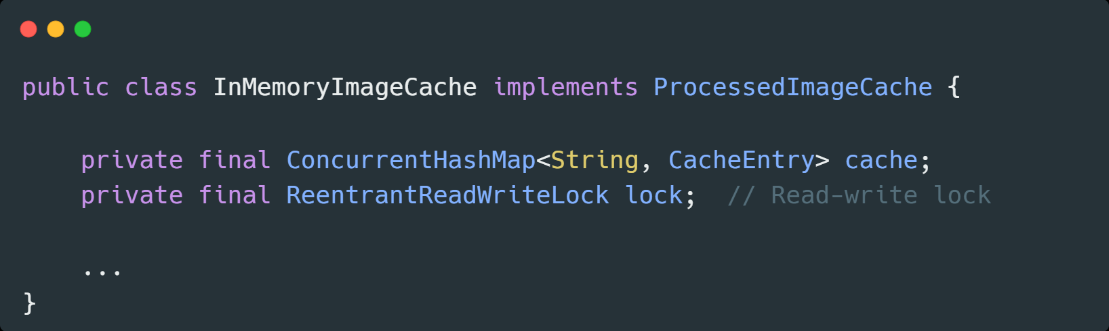
Results Analysis
01
02
03
External Lib & No Cache
Manual & Cache
Manual & No Cache
Notes:
If we focus on the response time, we can see that the results are quite uniform across configurations.
This originally surprised me because I designed the cache component in the image processor as an improvement on the response time.
A more accurate analysis of the code made me realise that the cache was not that impactful on the response time because it had to manage thread safety through a locking-based mechanism. The read-write lock blocks any concurrent read and write operation while a write is in progress.

Slide 26
01
02
03
External Lib & No Cache
Manual & Cache
Manual & No Cache
Read-Write Lock
Notes:
If we focus on the response time, we can see that the results are quite uniform across configurations.
This originally surprised me because I designed the cache component in the image processor as an improvement on the response time.
A more accurate analysis of the code made me realise that the cache was not that impactful on the response time because it had to manage thread safety through a locking-based mechanism. The read-write lock blocks any concurrent read and write operation while a write is in progress.

Slide 27
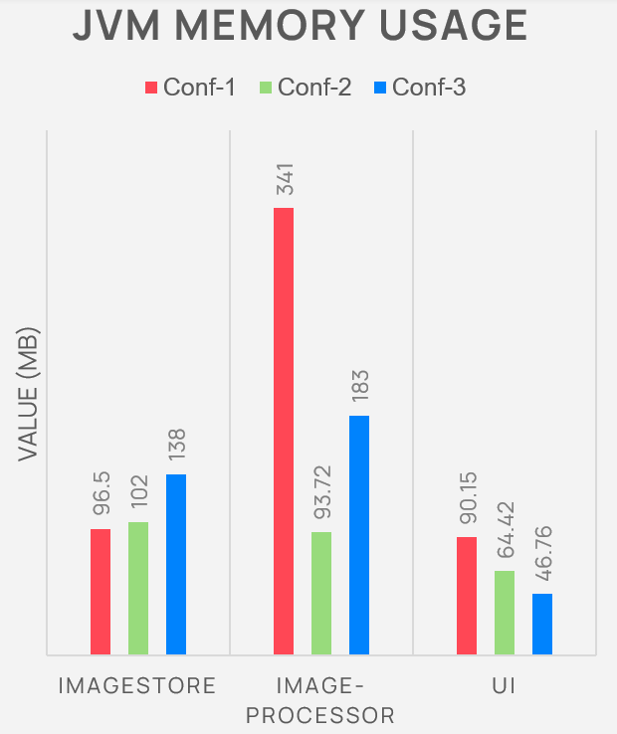
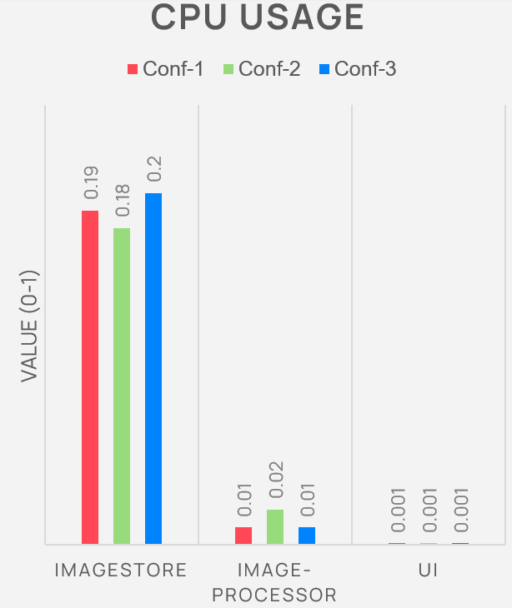
01
02
03
External Lib & No Cache
Manual & Cache
Manual & No Cache
Notes:
Now let’s focus our attention on the memory and cpu usage.
We can narrow down the analysis to the image processor which is the only service changing in configuration.

Slide 28

01
02
03
External Lib & No Cache
Manual & Cache
Manual & No Cache
Notes:
The data shows that avoiding the cache increases memory consumption, which is understandable since for every user request, the image processor must fetch the images again and reprocess them.
On the other hand, the absence of the cache to be managed halves the cpu usage.

Slide 29

Overhead Analysis
01
02
03
Three methods exposing variants in the Outfit App have been instrumented to compare their execution time before and after the transformation. More than 1,500 samples were collected for each method, averaged and compared.
4 - 6%
Notes:
The second part of the experimentation was about measuring the overhead introduced by the marionette instrumentation. By comparing the execution time of three different methods before and after the source code transformation, we obtained consistent results between 4 and 6% of relative overhead.
Therefore, when adopting the framework, developers should ponder whether the behavioural flexibility offered by the system outweighs the relatively small execution overhead.

Slide 30
Development Gains
01
02
03
The pie chart illustrates the distribution of source code lines across project components.
The codebase contains 8,820 lines, representing developer effort that would otherwise need to be written manually.
1816
Marionette Tool (Java)
5841
Marionettist Backend (Java)
1163
Marionettist Frontend (JS)
Source code analysis with cloc: https://github.com/AlDanial/cloc
Notes:
Finally, we ran some analysis on the source code to try to quantify the development gains when adopting the Marionette framework. The codebase, as of now, contains more than 8 thousands lines of code if we count all components of the solution. This represents substantial development effort that is taken care of automatically by adopting the framework directly.

Slide 31
What can we conclude?
01
02
03
What are the advantages of this A/B/n testing pipeline compared to traditional approaches?
Definitive Selections
and Trade-offs
The framework supports developers in the decision-making process.
Some behaviours are consistently more performant.
Others reveal trade-offs that must be analysed to make a thoughtful choice.
Fine Granularity
The framework allows to make comparisons of different configurations at the method level.
Operational Simplicity
Compared to traditional A/B/n testing, the operational complexity is reduced.
There is no need to manage multiple deployed versions of the same service and split user traffic.
Notes:
So these are the conclusions that we can draw at the end of the experimentation on the advantages of the A/B/n testing pipeline.

Slide 32
What can we conclude?
What are the advantages of this A/B/n testing pipeline compared to traditional approaches?
01
02
03
Definitive Selections
and Trade-offs
Fine Granularity
Operational Simplicity
The framework supports developers in the decision-making process.
Some behaviours are consistently more performant.
Others reveal trade-offs that must be analysed to make a thoughtful choice.
The framework allows to make comparisons of different configurations at the method level.
Compared to traditional A/B/n testing, the operational complexity is reduced.
There is no need to manage multiple deployed versions of the same service and split user traffic.
Notes:
First, the pipeline supports developers in the decision-making process of system-level configurations. Some behavioural selections are consistent across top configurations, while others show tradeoffs to be analysed through data.
Then, the pipeline enables the comparison at a fine granularity, at the method level.
Finally, the operational complexity is greatly reduced compared to traditional Abn testing frameworks. No need to manage multiple deployments of the same service or route user traffic.

Slide 33
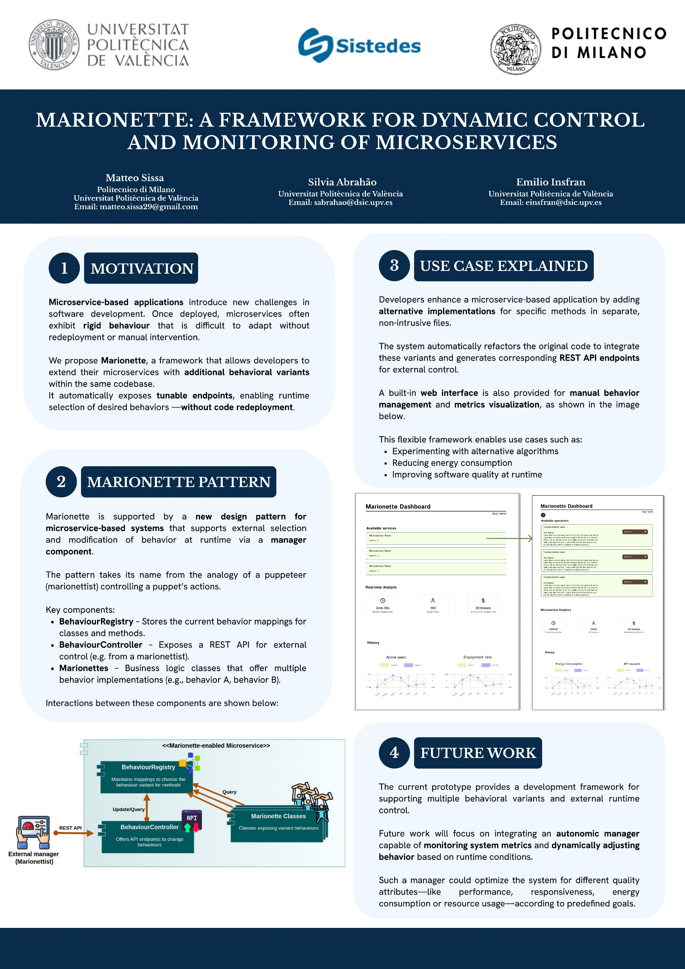
Jornadas Sistedes – Cordoba 2025
01
02
03
This thesis was presented in the form of a poster at a national software engineering conference in Spain called Jornadas Sistedes.
It was an opportunity to discuss the project with researchers and experts in the field.

Slide 34
Thank you for your attention

