Slide 1
From Data Warehouse to Lakehouse: A Comparative Review
Matteo Toma
matteo.toma1@studenti.unipr.it
Computer Science
2022

Slide 2
Introduction
Digital information systems nowadays continuously generate an enormous amount of data.
This data needs to be stored in an efficient way and requires also data ingestion and knowledge extraction capabilities.
There are different ways to manage all this data:
Big Data Storage System
Data Warehouses
Data Lakes

Slide 3
Introduction
But the problem is to find a good way to use them, because of they weaknesses.
The pace of technological progress has revolutionized the way we generate, collect and process big data.
The problem is that Big Data originates from multiple sources are complex, mixed and unstructured and them arrives a varying speeds.
Also, the ETL (Extract, Transform and Load) cannot support high-speed data ingestion and handle variations in the structure.

Slide 4
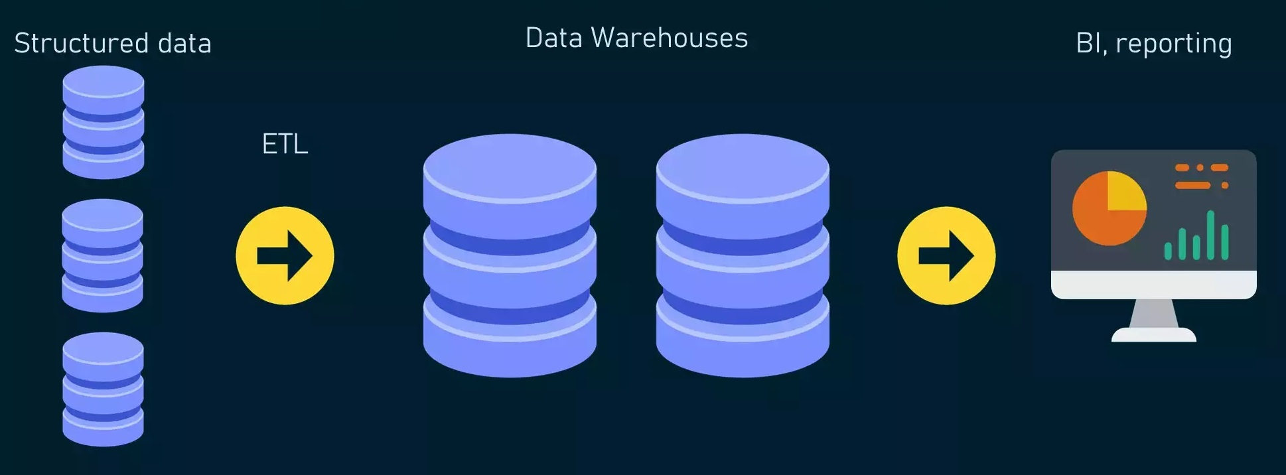
Introduction
In the 1990s, Data Warehouses gained popularity thanks to the ETL processes, extracting, trasforming and loading all informations from multiple data sources.
Also, Data Warehouses integrated tools like Business Intelligence (BI). It could offer a fast execution of complex frequent analytical queries to generate insights for business decisions.
Data Warehouse Architecture

Slide 5
Introduction
With the born of Big Data, Data Warehouse couldn’t afford
high-speed and high-volume data from social media (because they can contain images, text, and audio, or data from multiple connected devices or IoT.
Those data must be ingested, processed, and linked in near real-time for just-in-time decision support.
But in the last twenty years Data Lakes (DL) evolved to support the storage requirements of high-speed hybrid unstructured data. Data lake structure permits to use structured, unstructured, and semi-structured data, thanks to a metadata management system that enables data discovery, governance, data preparation, and cleansing.

Slide 6
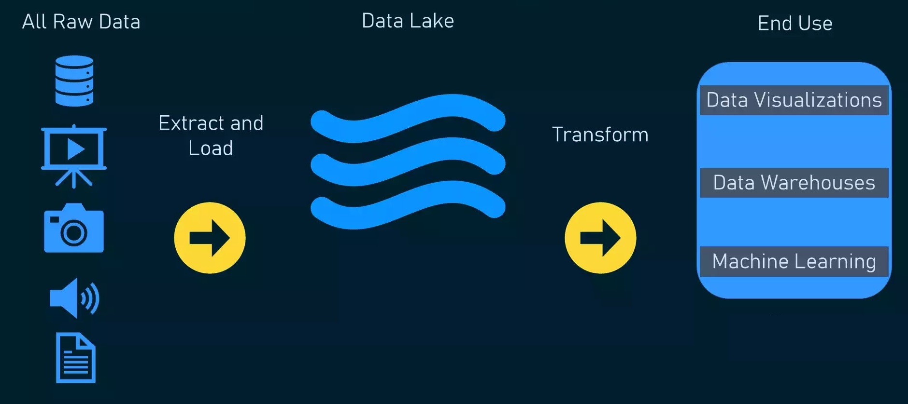
Introduction
Data Lake Architecture
Unfortunately, Data Lake technology has led to a new problem:
Data ended up turning into data swamps due to the delay in processing the raw data. This delay has caused a waste of resources and a loss of value.
To combine the capabilities of DL and DW a new solution was born: Data Lakehouse (LH).

Slide 7


Overview and related work
Data Warehouse (DW)
“DW is a time-variant, subject-oriented, integrated, and nonvolatile collection of data that aids management's decision-making process” -Inmon
Yang et.al studied the modeling the categorization of DWs:
ETL and data integration
Improving data quality
Master data management
Big data management
Metadata management
Reference data management
Data Lake (DL)
“A solution to address the shortcomings of the DW” -Dixon
Inmon suggested to raise the level of data organization in a DL into several Data Ponds based on source, purpose, and the type of data as:
Raw data pond
Analog data pond
Application data pond
Textual data pond
Archival data pond

Slide 8



Overview and related work
Data conditioning techniques are applied to make the data in the ponds accessible and useful.
Farid et al. presented a data discovery, integrity checking, and constraint definition and enforcement tool called CLAMS:
It combines signals from several sources of many datasets with user input to provide accurate data corrections.
It uses a module called Hadoop Distributed File System (HDFS) that can identifies data sources for cleaning and executes information extraction to produce semi-structured datasets.
Mathis et al. proposed a centralized and scalable DL storage for organizations, which enables knowledge discovery using additional techniques and 3rd party tools but there is no agreed-upon definition of the DL components or architecture.
Ravat et al proposed a functional architecture that addressed the categorization of generic and extensible metadata. To extract information for BI, metadata were used to describe each dataset and to link datasets.
In this way, data analysts and business intelligence specialists can analyze accessible data to improve, for example, medical treatments.

Slide 9

Overview and related work
With limited bandwidth, ingesting data from external sources requires high levels of parallelism, and no in-depth analysis is performed.
DLs contain so much data and there is no comprehensive schema or catalog, making it difficult to discover data!
Data Lakehouse (LH)
Shiyal presented a comprehensive study to identify the key factors influencing the evolution of the DW and DL into the data LH.
These are the features:
The flexible big data storage component of DLs.
The structured clean integrated storage of DW.
Components of DL to facilitate data integration, discovery, metadata management, and analytics.
A series of big data analytics, artificial intelligence, and machine learning tools can be applied to the data at various stages of processing.
Components of DW to enable Online Analytical Processing (OLAP) queries for BI.

Slide 10


Overview and related work
WHY DL AND DW ARE NOT ENOUGH?
The use of separate DLs and DWs adds complexity and makes it harder to build seamless data connections and processing pipelines.
DLs and DWs may support different data types, schemas, and SQL dialects, and this cause an increased number of ETL/ELT jobs spanning multiple systems which in turn can increase the probability of errors and bugs.
SQL DWs and their APIs cannot manage unstructured data due to their complexity.
DWs and DLs are not well suited to handle machine learning and data science applications.
Some recent systems used Apache Iceberg and Delta Lake to manage data and execute ACID transactions to ensure data integrity and consistency.
Even if metadata layers improve management capabilities, they don’t guarantee good SQL performance.

Slide 11






Examples of DW, DL, & LH
DynamoDB
Hadoop
Amazon Redshift
IBM DB2
Microsoft SQL Server databases
Examples of DW storage systems
Example of DL storage:

Slide 12
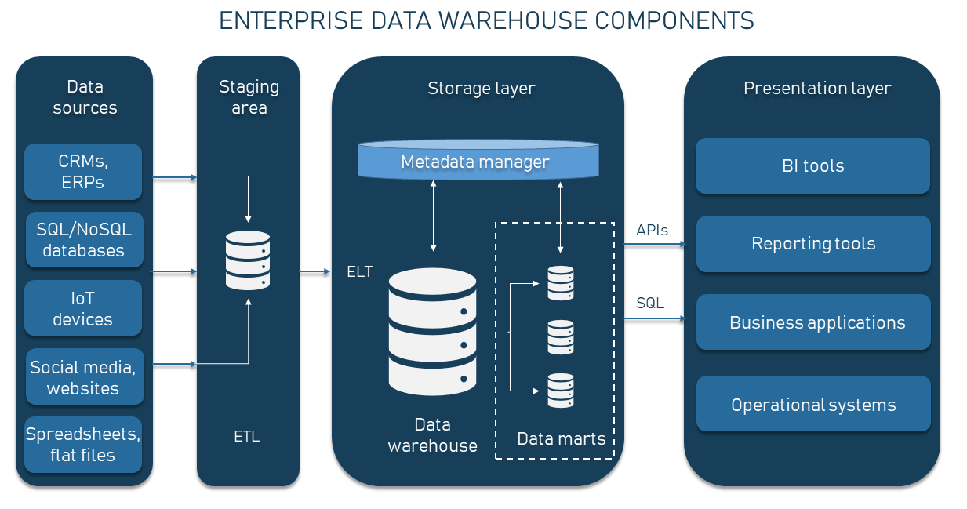
Data Lakehouse architecture

Slide 13
Data Lakehouse functionality
Data access Data ingestion
ANALYTICS REPORTING QUERYING BUSINESS INSIGHTS
BATCH
REAL-TIME
STREAMING DATA
DATA NORMALIZATION
CLEANING
AGGREGATION
VALIDATION
DATA CAPTURING
HIGH ACCESSIBILITY
SCALABILITY
AVAILABILITY
HIERCHICAL DISTRIBUTION
DATA ADMINISTRATION
Data transformation Data Storage

Slide 14
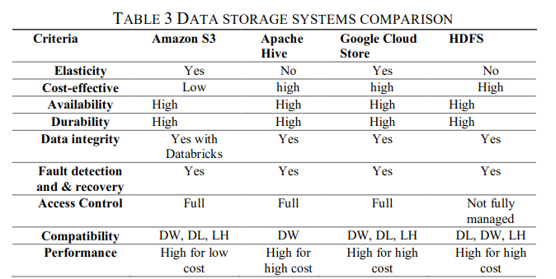
Proposed data lakehouse architecture
Required Features and Proposed Model
A robust storage management strategy guarantees that the data is always available to users and applications.
These are the most important characteristics of frameworks for DWs, DLs and LH.

Slide 15
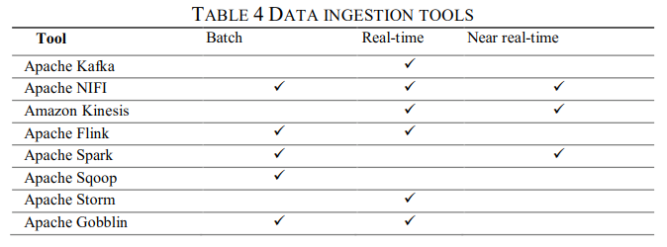
Proposed data lakehouse architecture
Due to the continuing growth in the volume of data, fast data ingestion and knowledge extraction in a cost-effective manner is a challenging problem due to
volume, velocity, variety, and veracity
variation in data structure and content
need for real-time BI
This table compares the commonly used data import technologies based on the type of data ingested.

Slide 16
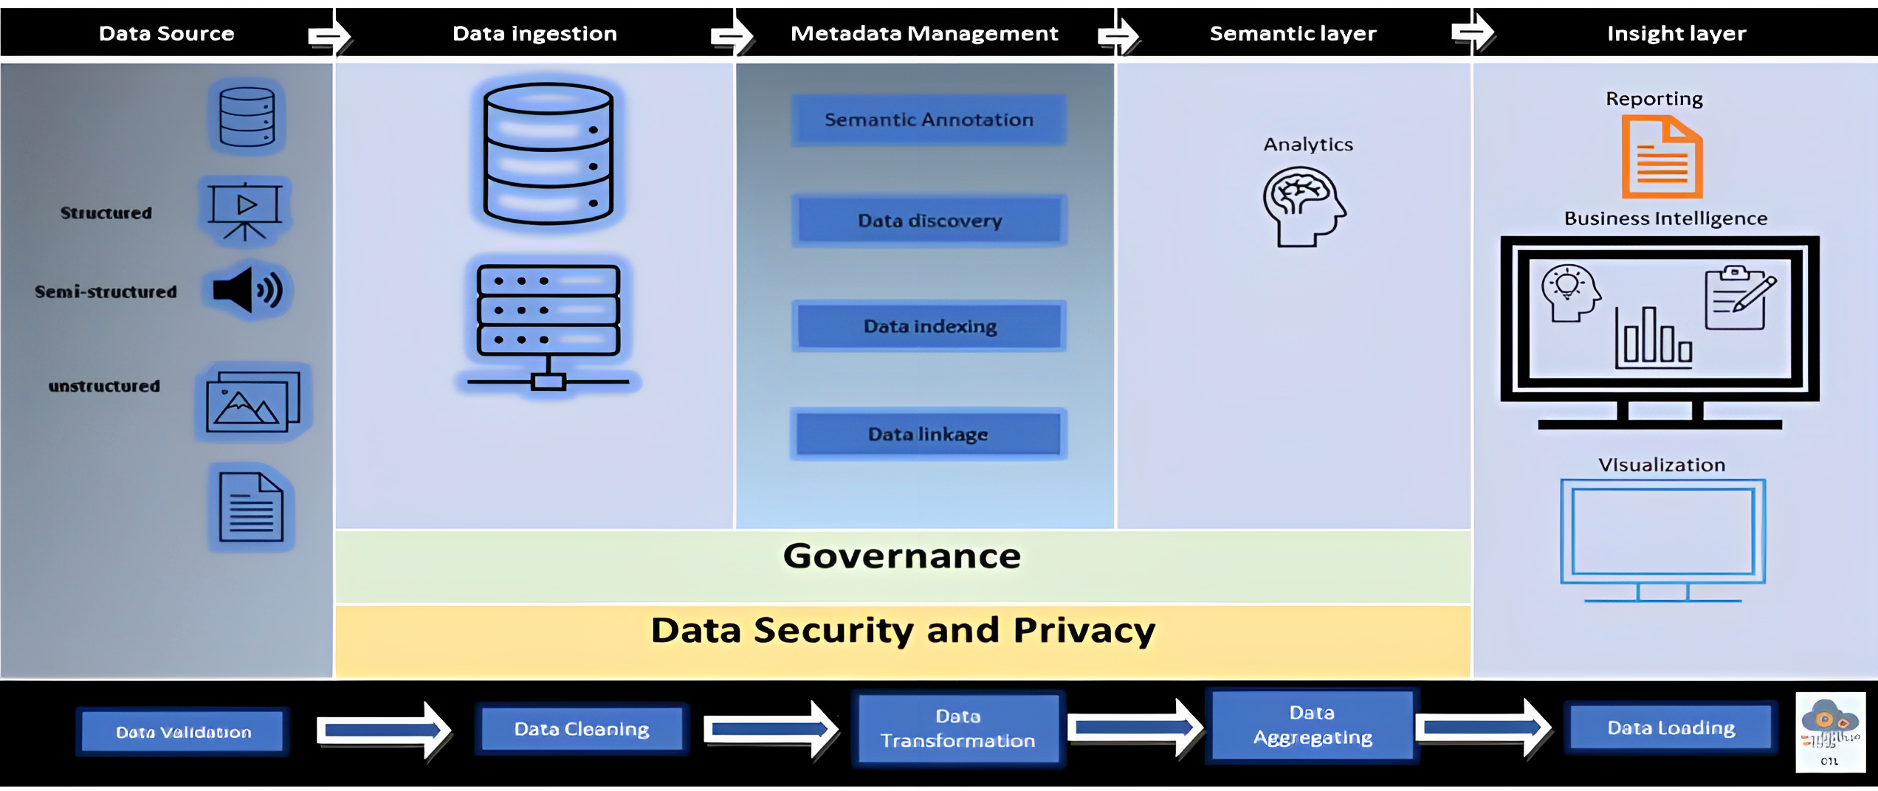
Proposed data lakehouse architecture
FINAL LAKEHOUSE ARCHITECTURE

Slide 17

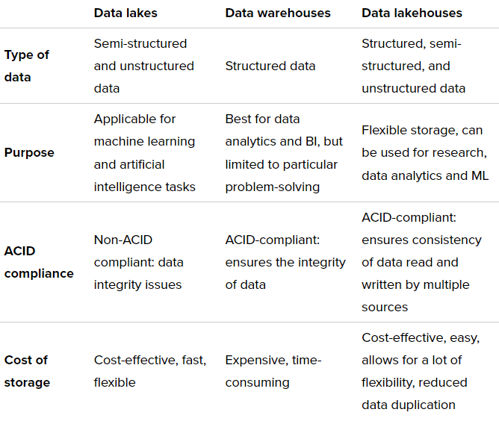
Conclusions and Future Works
Overview of DL, DW and DLHs
Future Works
Develop:
An advanced and intelligent data ingestion pipeline with knowledge extraction and linking capabilities.
A data profiling method to capture the significant and anomalous data to reduce storage footprint and enhancing data linking capabilities
A knowledge graph to augment the metadata management in LH.

Slide 18
References
[1] A. A. Harby; F. Zulkernine, From Data Warehouse to Lakehouse: A Comparative Review, IEEE 2022.
[2] Inmon, W. H. (1995). What is a data warehouse. Prism Tech Topic, 1(1), 1-5.
[3] Dixon J (2010) Pentaho, hadoop, and data lakes.
[4] Yang, Q., Ge, M., & Helfert, M. (2019). Analysis of Data Warehouse Architectures: Modeling and Classification. In ICEIS (2) (pp. 604-611).
[5] Farid, M., Roatis, A., Ilyas, I. F., Hoffmann, H. F., & Chu, X. (2016, June). CLAMS: bringing quality to data lakes. In Proceedings of the 2016 International Conference on Management of Data .
[6] Mathis, C. (2017). Data lakes. Datenbank-Spektrum, 17(3), 289-293.
[7] Sarrel, M. (2022). Digging Deeper into Iceberg: ACID Transactions on Tables.
[8] Dalaleli,N (2021). Delta Lake - ACID Transactions.
[9] Logunova, I (2022). Data Warehouses vs. Data Lakes vs. Data Lakehouses.
[10] Altexsoft, 2021. Data Lakehouse: Concept, Key Features, and Architecture Layers.

Slide 19
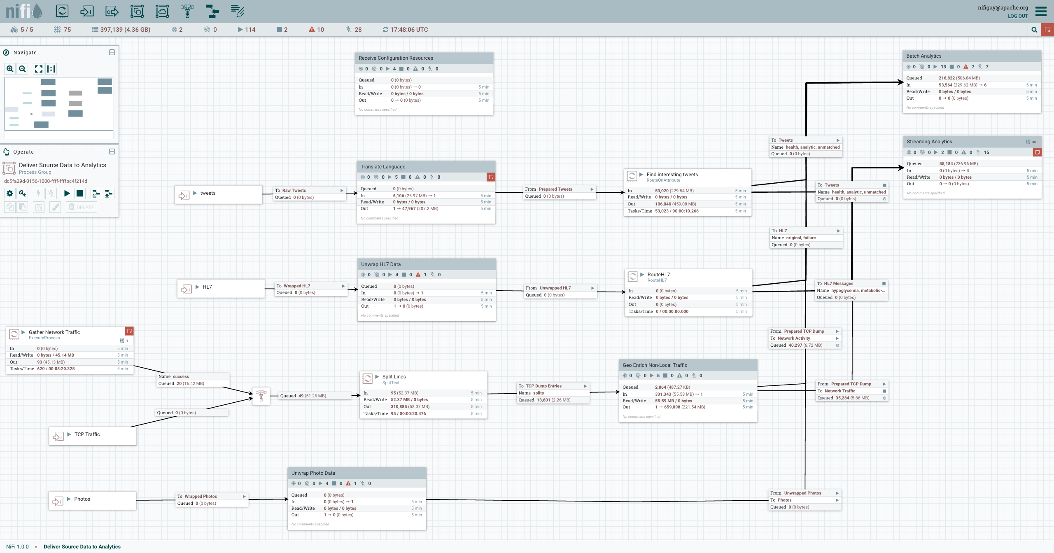
Extra Slide
Source: https://nifi.apache.org/assets/images/flow.png
Example Graph of APACHE nifi

