Slide 1

EFFECTS OF CLASSIFICATION METHODS ON DOW JONES INDEX STOCKS.
Matteo Vadi
Università degli Studi di Siena, 27/07/2020

Slide 2
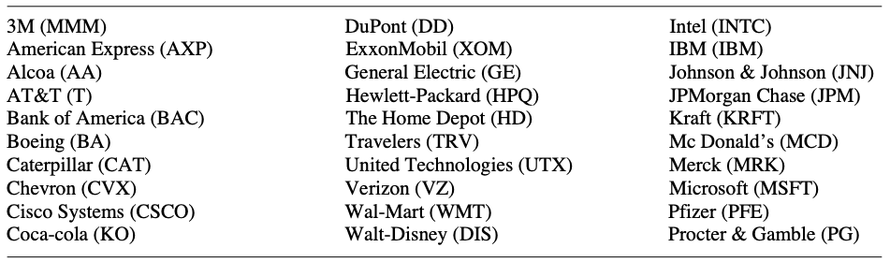
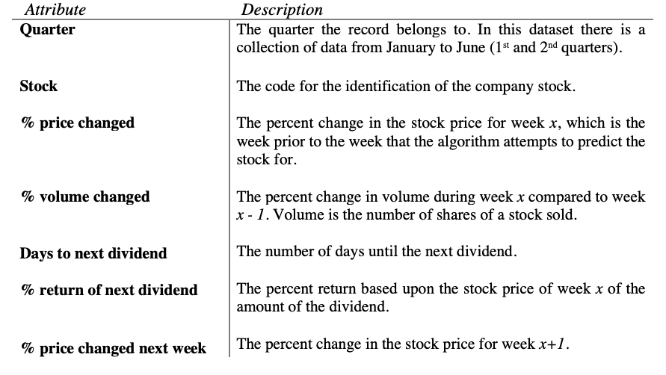
DATASET (credits to M. S. Brown, M. Pelosi & H. Dirska - 2013)
“Blue chips” in 2011:
Decision rule for the output variable:
Collection of data regarding the Dow Jones Index Stocks over a period of 6 months, from January to June 2011, divided in quarters.
Heterogeneity in the variables, due to the different aspects they refer to and not all of them connected to the goal.
Presence of NA values in the dataset for specific variables, specific dates and homogeneous with respect to all the stock indices.
$$if \% change price in the following week ≥0 then «buy or not sell»$$
Useful attributes for the Classification:

Slide 3
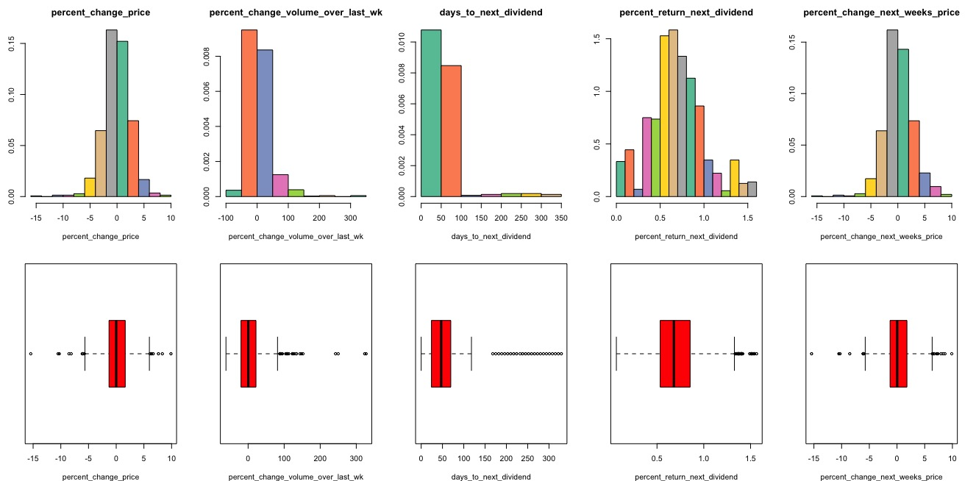
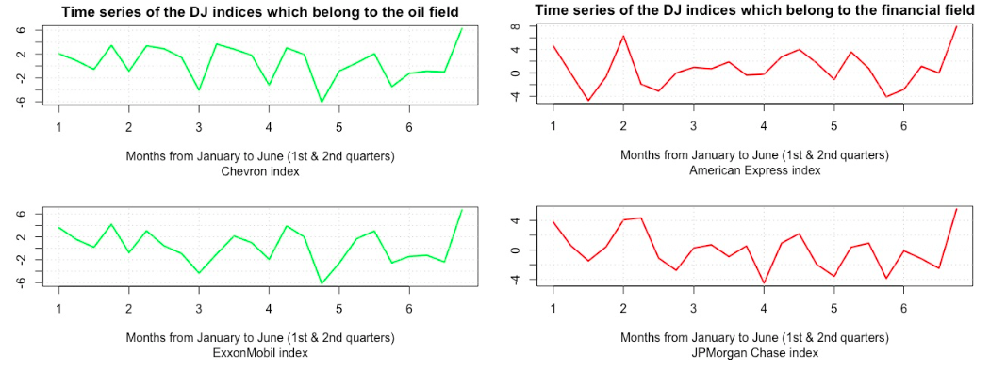
DATA EXPLORATION
Histograms and box-plots for the numerical attributes:
Data Visualization univariate techniques for both numerical and categorical attributes.
Summary statistics for the numerical attributes, in order to check for possible outliers.
Time series representation of the % change in price week by week for specific sectors.
Time series representation for the stock indices which belong to the oil
and financial sectors:

Slide 4
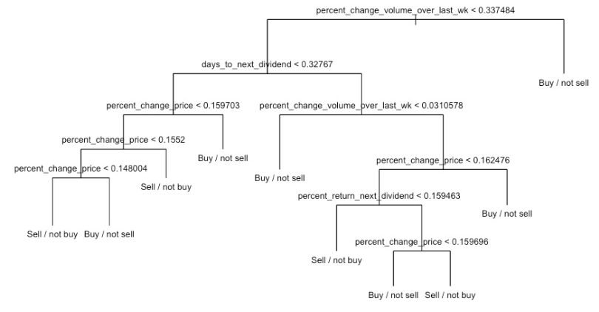
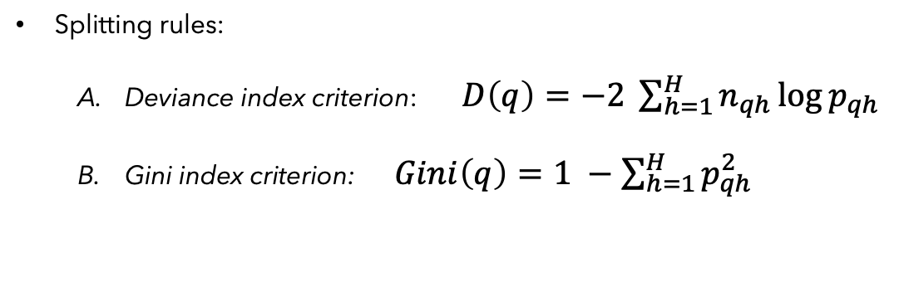
CLASSIFICATION 1. Classification Trees
Two ways of selecting Training & Test Sets:
1. Training set composed by the records which refer to the 1° quarter &
Test set for those to the 2°.
2. Training set sampled randomly as the 2/3 of the entire dataset & Test set
as a consequence.
Splitting rules:
Deviance index criterion: $D\left(q\right)=−2 \sum_{h=1}^{H}{n_{qh}\log{p_{qh}}}$
Gini index criterion: $Gini\left(q\right)=1 −\sum_{h=1}^{H}{p_{qh}^{2}}$
For both the CTs and the Naïve Bayes, two different ways of selecting Training & Test sets.
Euristic approach based on a top-down build of the tree, considering two different splitting criteria.
Post-pruning Cross Validation for the reduction of the dimension of the trees.
Computation of the accuracy index, as the ratio between the sum of corrected predictions among all the observations.
Example of a post-pruning tree:
Case with train & test set according to “quarter” and “deviance” splitting criterion.

Slide 5
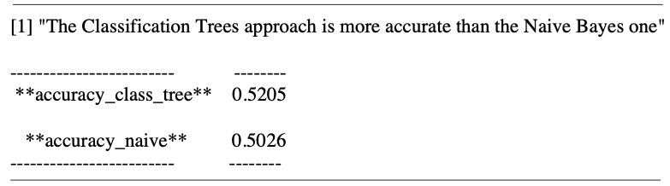
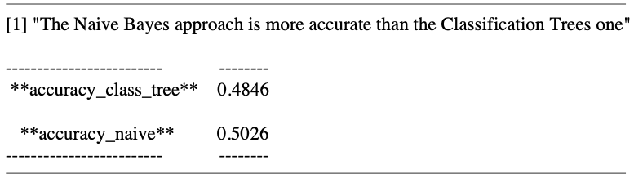
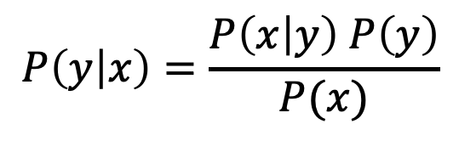
CLASSIFICATION 2. Naïve Bayes & Results
Bayes Theorem:
$$P\left(y | x\right)=\frac{P\left(x | y\right) P\left(y\right)}{P(x)}$$
Results as the comparison between the two approaches:
Case#1 - Train & test sets according to the quarter and “deviance” as splitting criterion for the CTs.
Probability approach, based on the computation of the a-posteriori conditional probability for the output variable, given the predictors (attributes).
Bayes Theorem for the computation of the probability that the output variable belongs to the target class.
Comparison between the results of the CTs approach and the Naïve Bayes one with respect to the Training & Test sets according to the quarters.
Case#2 - Train & test sets according to the quarter and “Gini” as splitting criterion for the CTs.

