Slide 1
DATA BASES 2 JPA Project
Mattia Siriani (10571322) Matteo Visotto (10608623)

Slide 2
Index
Specification
Conceptual (ER) and logical data models
Trigger design and code
ORM relationship design with explanations
Entities code
Interface diagrams or functional analysis of the specifications
List of components
UML sequence diagrams

Slide 3
Specification

Slide 4
Specifications – Customer Application
Telco is a prepaid online service that uses two applications with the same database.
A customer application is accessible both to unlogged and logged user displaying the service packages offered by the company. A service package has an ID and it comprises one or more services that could by of four types: fixed phone, mobile phone (minutes, SMS + extra fee), fixed internet or mobile internet (gigabytes + extra fee). Each service package is sold with different validity period (12, 24 or 36 months) having different monthly price based on the duration of the subscription. In addition, Telco offers different types of optional products that can be bought with a service package and with a validity period equals to the service package one.
From the home a user can buy a service package accessing a buy page where he can select the service package, 0 or more optional products, a validity period and the start date of the subscription. After confirm a confirmation page is displayed, showing the selected items and the total price to be prepaid. If the user is logged in a buy button is show, otherwise, he can register/login and return back in the confirmation page after completion.
The buy button creates an order record and it displays a payment page where the user can access an external service to complete the payment. If the operation is successful, the order in marked as completed and an activation record is scheduled for the chosen date. Instead, if the payment fails, the order is marked as suspended and the user as insolvent. An insolvent user when logs in can see a list of suspended orders in telco homepage, each of them has a buy button to try the payment again.
When a user fails three payments an alert is raised and stored in the database.

Slide 5
Specifications – Employee Application
An employee application is accessible only from authorized people.
In the homepage an employee can create new services, combining them into a service package and associate 0 or more optional products users can buy with. He can also set the available validity period with monthly prices.
In a sales report page, instead, different statistics can be displayed:
Number of total purchase per package.
Number of total purchase per package and validity period.
Total value of sales per package with and without the optional products.
Average number of optional products sold together with each service package.
List of insolvent users, suspended orders and alerts.
Best seller optional product, i.e. the optional product with the greatest value of sales across all the sold service packages.

Slide 6
Specification interpretation
Both username and email are unique attributes for the user and so both can be used to login
Administrators are the employee; they cannot create an account but credential are given
Administrators can access their application using “/admin” path
An alert is raised only once for a user and it remains forever
Materialized views (not available in MySQL) are been substituted with tables populated by means of triggers.
The fixed phone service contains 50000 minutes only (more than minutes in the longest month), this because a fixed phone cannot have SMS/Internet.

Slide 7
ER Diagrams

Slide 8
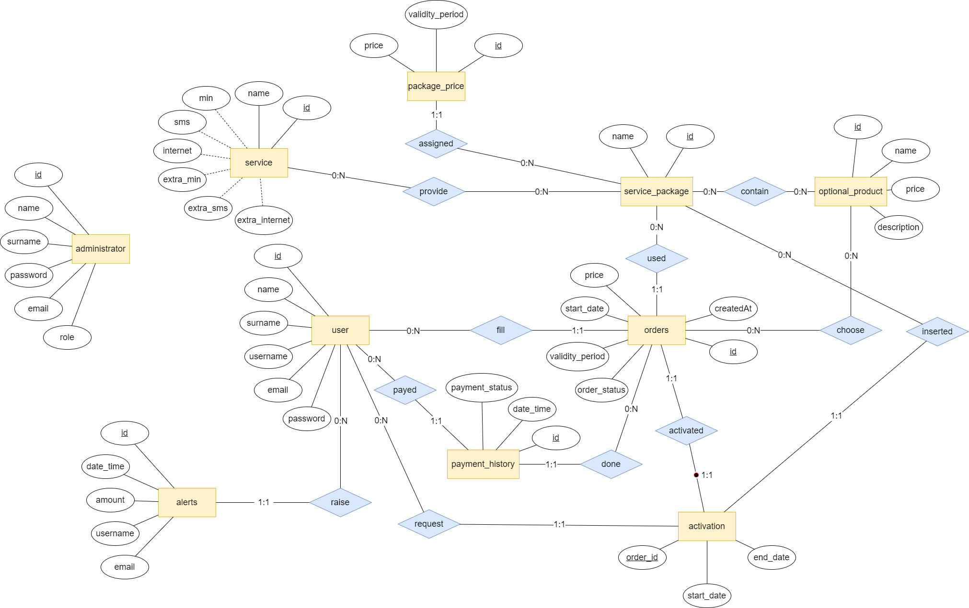
Entity Relationship

Slide 9
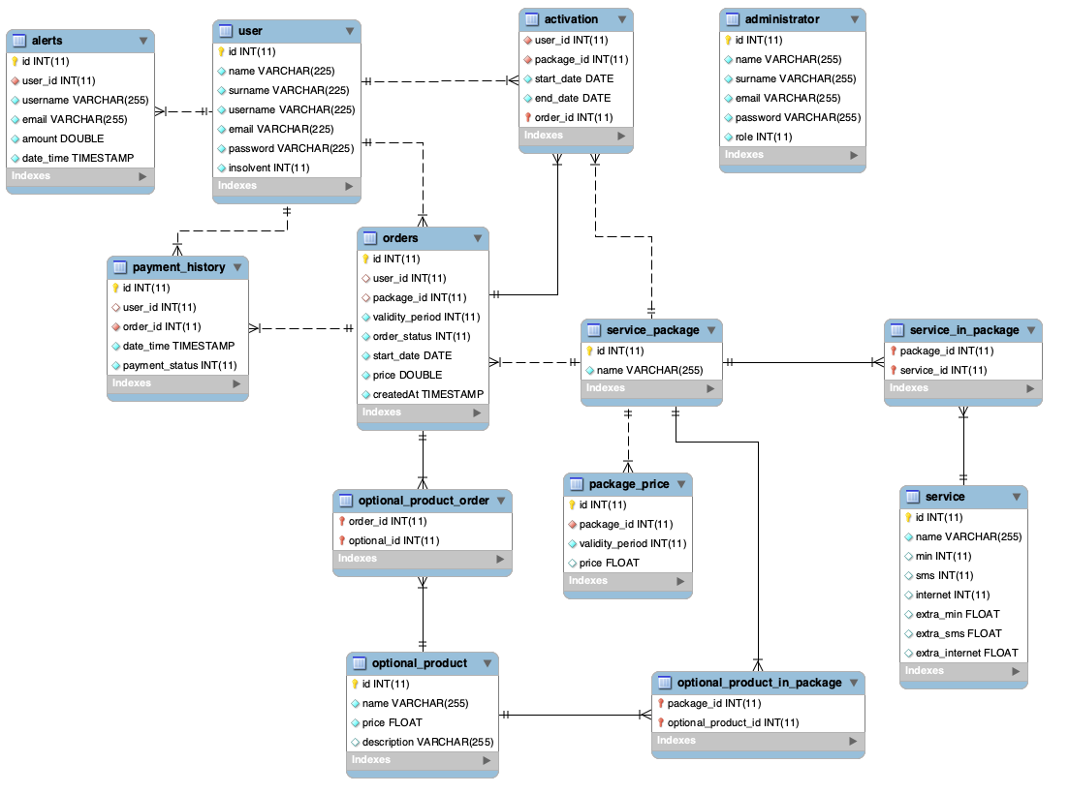
Entity Relationship
A service contains all the fields for minute, SMS and internet. They are set to NULL when the service does not contain that ”service”
Package prices are set in a dedicated table because, in this way, it is possible to support validity period different from 12, 24 or 36 months.
Order status is managed as an integer number (0 – Created, 1 – Payed, 2 - Rejected)
Payment Status is managed as an integer as well (0 – Failure, 1 - Success)

Slide 10
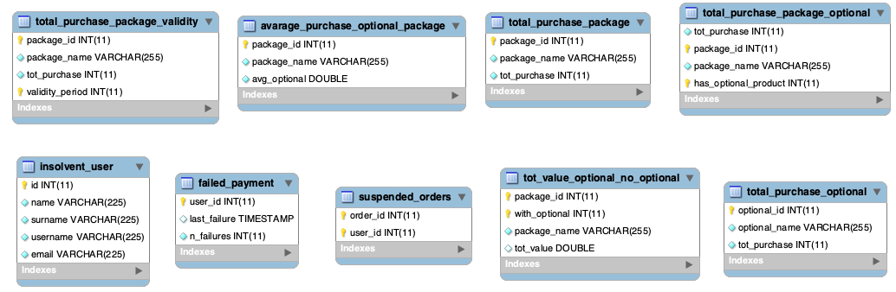
Entity Relationship – Materialized View
MySQL does not support materialized views so we decide to create tables without relationship with the database schema inserting, deleting and updating data using triggers.

Slide 11
SQL DDL

Slide 12
SQL DDL
CREATE TABLE IF NOT EXISTS `activation` (
`user_id` int(11) NOT NULL,
`package_id` int(11) NOT NULL,
`start_date` date NOT NULL,
`end_date` date NOT NULL,
`order_id` int(11) NOT NULL,
PRIMARY KEY (`order_id`),
KEY `package_id` (`package_id`),
KEY `user_id` (`user_id`)
)
CREATE TABLE IF NOT EXISTS `administrator` (
`id` int(11) NOT NULL AUTO_INCREMENT,
`name` varchar(255) NOT NULL,
`surname` varchar(255) NOT NULL,
`email` varchar(255) NOT NULL,
`password` varchar(255) NOT NULL,
`role` int(11) NOT NULL DEFAULT 1,
PRIMARY KEY (`id`)
)

Slide 13
SQL DDL
CREATE TABLE IF NOT EXISTS `alerts` (
`id` int(11) NOT NULL AUTO_INCREMENT,
`user_id` int(11) NOT NULL,
`username` varchar(255) NOT NULL,
`email` varchar(255) NOT NULL,
`amount` double NOT NULL,
`date_time` timestamp NOT NULL DEFAULT current_timestamp() ON UPDATE current_timestamp(),
PRIMARY KEY (`id`),
KEY `user_id` (`user_id`)
)
CREATE TABLE IF NOT EXISTS `optional_product` (
`id` int(11) NOT NULL AUTO_INCREMENT,
`name` varchar(255) NOT NULL,
`price` float NOT NULL,
`description` varchar(255) DEFAULT NULL,
PRIMARY KEY (`id`)
)

Slide 14
SQL DDL
CREATE TABLE IF NOT EXISTS `optional_product_in_package` (
`package_id` int(11) NOT NULL,
`optional_product_id` int(11) NOT NULL,
PRIMARY KEY (`package_id`,`optional_product_id`),
KEY `optional_product_id` (`optional_product_id`)
)
CREATE TABLE IF NOT EXISTS `optional_product_order` (
`order_id` int(11) NOT NULL,
`optional_id` int(11) NOT NULL,
PRIMARY KEY (`order_id`,`optional_id`),
KEY `optional_id` (`optional_id`)
)

Slide 15
SQL DDL
CREATE TABLE IF NOT EXISTS `orders` (
`id` int(11) NOT NULL AUTO_INCREMENT,
`user_id` int(11) DEFAULT NULL,
`package_id` int(11) DEFAULT NULL,
`validity_period` int(11) NOT NULL,
`order_status` int(11) NOT NULL DEFAULT 0,
`start_date` date NOT NULL,
`price` double NOT NULL DEFAULT 0,
`createdAt` timestamp NOT NULL DEFAULT current_timestamp(),
PRIMARY KEY (`id`),
KEY `orders_ibfk_2` (`package_id`),
KEY `user_id` (`user_id`) USING BTREE
)
CREATE TABLE IF NOT EXISTS `package_price` (
`id` int(11) NOT NULL AUTO_INCREMENT,
`package_id` int(11) NOT NULL,
`validity_period` int(11) NOT NULL,
`price` float DEFAULT NULL,
PRIMARY KEY (`id`),
KEY `package_id` (`package_id`)
)

Slide 16
SQL DDL
CREATE TABLE IF NOT EXISTS `payment_history` (
`id` int(11) NOT NULL AUTO_INCREMENT,
`user_id` int(11) DEFAULT NULL,
`order_id` int(11) NOT NULL,
`date_time` timestamp NOT NULL DEFAULT current_timestamp(),
`payment_status` int(11) NOT NULL DEFAULT 0,
PRIMARY KEY (`id`),
KEY `order_id` (`order_id`),
KEY `payment_history_ibfk_1` (`user_id`)
)
CREATE TABLE IF NOT EXISTS `service` (
`id` int(11) NOT NULL AUTO_INCREMENT,
`name` varchar(255) NOT NULL,
`min` int(11) DEFAULT NULL,
`sms` int(11) DEFAULT NULL,
`internet` int(11) DEFAULT NULL,
`extra_min` float DEFAULT NULL,
`extra_sms` float DEFAULT NULL,
`extra_internet` float DEFAULT NULL,
PRIMARY KEY (`id`)
)

Slide 17
SQL DDL
CREATE TABLE IF NOT EXISTS `service_in_package` (
`package_id` int(11) NOT NULL,
`service_id` int(11) NOT NULL,
PRIMARY KEY (`package_id`,`service_id`),
KEY `service_id` (`service_id`)
)
CREATE TABLE IF NOT EXISTS `service_package` (
`id` int(11) NOT NULL AUTO_INCREMENT,
`name` varchar(255) NOT NULL,
PRIMARY KEY (`id`)
)

Slide 18
SQL DDL
CREATE TABLE IF NOT EXISTS `user` (
`id` int(11) NOT NULL AUTO_INCREMENT,
`name` varchar(225) NOT NULL,
`surname` varchar(225) NOT NULL,
`username` varchar(225) NOT NULL,
`email` varchar(225) NOT NULL,
`password` varchar(225) NOT NULL,
`insolvent` int(11) NOT NULL DEFAULT 0,
PRIMARY KEY (`id`),
UNIQUE KEY `username` (`username`),
UNIQUE KEY `email` (`email`)
)

Slide 19
SQL DDL – Materialized Views
CREATE TABLE IF NOT EXISTS `avarage_purchase_optional_package` (
`package_id` int(11) NOT NULL,
`package_name` varchar(255) NOT NULL,
`avg_optional` double NOT NULL DEFAULT 0,
PRIMARY KEY (`package_id`)
)
CREATE TABLE IF NOT EXISTS `failed_payment` (
`user_id` int(11) NOT NULL,
`last_failure` timestamp NULL DEFAULT current_timestamp() ON UPDATE current_timestamp(),
`n_failures` int(11) NOT NULL DEFAULT 0,
PRIMARY KEY (`user_id`)
)

Slide 20
SQL DDL – Materialized Views
CREATE TABLE IF NOT EXISTS `insolvent_user` (
`id` int(11) NOT NULL,
`name` varchar(225) NOT NULL,
`surname` varchar(225) NOT NULL,
`username` varchar(225) NOT NULL,
`email` varchar(225) NOT NULL,
PRIMARY KEY (`id`)
)
CREATE TABLE IF NOT EXISTS `suspended_orders` (
`order_id` int(11) NOT NULL,
`user_id` int(11) NOT NULL,
PRIMARY KEY (`order_id`,`user_id`)
)

Slide 21
SQL DDL – Materialized Views
CREATE TABLE IF NOT EXISTS `total_purchase_optional` (
`optional_id` int(11) NOT NULL,
`optional_name` varchar(255) NOT NULL,
`tot_purchase` int(11) NOT NULL DEFAULT 0,
PRIMARY KEY (`optional_id`)
)
CREATE TABLE IF NOT EXISTS `total_purchase_package` (
`package_id` int(11) NOT NULL,
`package_name` varchar(255) NOT NULL,
`tot_purchase` int(11) NOT NULL,
PRIMARY KEY (`package_id`)
)

Slide 22
SQL DDL – Materialized Views
CREATE TABLE IF NOT EXISTS `total_purchase_package_optional` (
`tot_purchase` int(11) NOT NULL DEFAULT 0,
`package_id` int(11) NOT NULL,
`package_name` varchar(255) NOT NULL,
`has_optional_product` int(11) NOT NULL,
PRIMARY KEY (`package_id`,`has_optional_product`)
)
CREATE TABLE IF NOT EXISTS `total_purchase_package_validity` (
`package_id` int(11) NOT NULL,
`package_name` varchar(255) NOT NULL,
`tot_purchase` int(11) NOT NULL,
`validity_period` int(11) NOT NULL,
PRIMARY KEY (`package_id`,`validity_period`)
)

Slide 23
SQL DDL – Materialized Views
CREATE TABLE IF NOT EXISTS `tot_value_optional_no_optional` (
`package_id` int(11) NOT NULL,
`with_optional` int(11) NOT NULL,
`package_name` varchar(255) NOT NULL,
`tot_value` double DEFAULT 0,
PRIMARY KEY (`package_id`,`with_optional`)
)

Slide 24
SQL DDL - View
CREATE VIEW `number_optional_package` AS SELECT `o1`.`package_id` AS `package_id`, COUNT(`o`.`optional_id`) AS `number` FROM (`telco`.`optional_product_order` `o` JOIN `telco`.`orders` `o1` ON(`o`.`order_id` = `o1`.`id`)) GROUP BY `o`.`order_id`,`o1`.`user_id`

Slide 25
Trigger design & code

Slide 26
check_validity_period_validity
BEGIN
DECLARE val INT;
SET val = (SELECT COUNT(*) FROM package_price AS p WHERE p.package_id = new.package_id AND p.validity_period = new.validity_period);
IF val = 0 THEN
SIGNAL SQLSTATE '23000' SET MESSAGE_TEXT = 'Invalid validity period’;
END IF;
END
ON orders BEFORE INSERT
This trigger checks if the inserted validity period for the new order is allowed or not.

Slide 27
create_activation_record
BEGIN
DECLARE l_package_id INT;
DECLARE l_start_date date;
DECLARE l_validity_period INT;
SET l_package_id = (SELECT package_id FROM orders WHERE id = new.order_id);
SET l_start_date = (SELECT start_date FROM orders WHERE id = new.order_id);
SET l_validity_period = (SELECT validity_period FROM orders WHERE id = new.order_id);
IF new.payment_status = 1 THEN
INSERT INTO activation (user_id, package_id, start_date, end_date, order_id) VALUES (new.user_id, l_package_id, l_start_date, DATE_ADD(l_start_date, INTERVAL l_validity_period MONTH), new.order_id);
END IF;
END
ON payment_history AFTER INSERT
This trigger is used to create automatically the activation record for the user order after a payment has been completed successfully.

Slide 28
create_failure_user
BEGIN
INSERT INTO failed_payment (user_id, last_failure, n_failures) VALUES (new.id, NULL, 0);
END
ON user AFTER INSERT
This trigger is used to populate the failed_payment table when a new user is created, initializing the record to 0 failure.

Slide 29
create_purchase_optional
BEGIN
INSERT INTO total_purchase_optional (tot_purchase, optional_id, optional_name) VALUES (0, new.id, new.name);
END
ON optional_product AFTER INSERT
This trigger is used to populate the total_purchase_optional table for statistic purpouse when a new optional product is created.

Slide 30
create_purchase_optional_avg
BEGIN
INSERT INTO avarage_purchase_optional_package (package_id, package_name, avg_optional) VALUES (new.id, new.name, 0);
END
ON service_package AFTER INSERT
This trigger is used to populate the avarage_purchase_optional_package table for statistic purpouse when a new service package is created.

Slide 31
create_purchase_package
BEGIN
INSERT INTO total_purchase_package (package_id, package_name, tot_purchase) VALUES (NEW.id, NEW.name, 0);
END
ON service_package AFTER INSERT
This trigger is used to populate the total_purchase_package table for statistic purpouse when a new service package is created.

Slide 32
create_purchase_package_optional
BEGIN
INSERT INTO total_purchase_package_optional (tot_purchase, package_id, package_name, has_optional_product) VALUES (0, new.id, NEW.name, 0), (0, new.id, NEW.name, 1);
END
ON service_package AFTER INSERT
This trigger is used to populate the total_purchase_package_optional table for statistic purpouse when a new service package is created.

Slide 33
create_purchase_package_validity
BEGIN
INSERT INTO total_purchase_package_validity (tot_purchase, package_id, package_name, validity_period) VALUES (0, new.id, new.name, 12), (0, new.id, new.name, 24), (0, new.id, new.name, 36);
END
ON service_package AFTER INSERT
This trigger is used to populate the total_purchase_package_validity table for statistic purpouse when a new service package is created.

Slide 34
create_tot_value_package
BEGIN
INSERT INTO tot_value_optional_no_optional (tot_value, package_id, package_name, with_optional) VALUES (0, new.id, NEW.name, 0), (0, new.id, NEW.name, 1);
END
ON service_package AFTER INSERT
This trigger is used to populate the tot_value_optional_no_optional table for statistic purpouse when a new service package is created.

Slide 35
delete_failure_user
BEGIN
DELETE FROM failed_payment WHERE user_id = old.id;
END
ON user AFTER DELETE
This trigger is used to remove the user from failed_payment table when the user is deleted

Slide 36
delete_purchase_optional
BEGIN
DELETE FROM total_purchase_optional WHERE optional_id = old.id;
END
ON optional_product AFTER DELETE
This trigger is used to remove the corresponding record from total_purhcase_optional when an optional product is deleted.

Slide 37
delete_purchase_optional_avg
BEGIN
DELETE FROM avarage_purchase_optional_package WHERE package_id = old.id;
END
ON service_packege AFTER DELETE
This trigger is used to remove the corresponding record from avarage_purchase_optional_package when a service package is deleted.

Slide 38
delete_purchase_package
BEGIN
DELETE FROM total_purchase_package WHERE package_id = old.id;
END
ON service_packege AFTER DELETE
This trigger is used to remove the corresponding record from total_purchase_package when a service package is deleted.

Slide 39
delete_purchase_package_optional
BEGIN
DELETE FROM total_purchase_package_optional WHERE package_id = old.id;
END
ON service_packege AFTER DELETE
This trigger is used to remove the corresponding record from total_purchase_package_optional when a service package is deleted.

Slide 40
delete_purchase_package_validity
BEGIN
DELETE FROM total_purchase_package_validity WHERE package_id = old.id;
END
ON service_packege AFTER DELETE
This trigger is used to remove the corresponding record from total_purchase_package_validity when a service package is deleted.

Slide 41
delete_tot_value_package
BEGIN
DELETE FROM tot_value_optional_no_optional WHERE package_id = old.id;
END
ON service_packege AFTER DELETE
This trigger is used to remove the corresponding record from tot_value_optional_no_optional when a service package is deleted.

Slide 42
manage_insolvent_user
BEGIN
DECLARE number int;
IF new.payment_status = 0 THEN
UPDATE user set insolvent = 1 WHERE id = new.user_id;
ELSE
SET number = (SELECT COUNT(*) FROM payment_history AS p1 WHERE p1.payment_status = 0 AND p1.user_id = new.user_id AND p1.order_id NOT IN (SELECT p2.order_id FROM payment_history AS p2 WHERE p2.payment_status = 1 AND p2.user_id = new.user_id));
IF number = 0 THEN
UPDATE user set insolvent = 0 WHERE id = new.user_id;
END IF;
END IF;
END;
ON payment_history AFTER INSERT
This trigger is used to set a user as insolvent if a new payment fails, otherwise to remove the insolvent status when all his pending payments has been payed.

Slide 43
optional_in_package_for_order
BEGIN
DECLARE val INT DEFAULT 0;
SET val = (SELECT COUNT(*) as verify FROM optional_product_in_package AS o JOIN orders AS t ON t.package_id = o.package_id WHERE t.id=new.order_id AND o.optional_product_id = new.optional_id);
IF val = 0 THEN
SIGNAL SQLSTATE '23000'
SET MESSAGE_TEXT = 'Optional product not in package';
END IF;
END
ON optional_product_order BEFORE INSERT
This trigger is used to verify if the optional products associated with a service package in an order really belongs to the service package.

Slide 44
raise_new_alert
BEGIN
DECLARE l_username varchar(255);
DECLARE l_email varchar(255);
DECLARE l_amount double;
SET l_amount = (SELECT SUM(price) FROM orders AS o WHERE o.user_id = new.user_id AND o.id NOT IN (SELECT p.order_id FROM payment_history AS p WHERE p.user_id = new.user_id AND p.payment_status = 1));
SET l_email = (SELECT email FROM user WHERE id = new.user_id);
SET l_username = (SELECT username FROM user WHERE id = new.user_id);
IF new.n_failures = 3 THEN
INSERT INTO alerts (user_id, email, username, amount, date_time) VALUES (new.user_id, l_email, l_username, l_amount, new.last_failure);
END IF;
END
ON failed_payments AFTER UPDATE
This trigger is used to rise an alert when the number of failed payment for a user reach the number 3.

Slide 45
retrieve_insolvent_users
BEGIN
IF old.insolvent = 0 and new.insolvent = 1 THEN
INSERT INTO insolvent_user (id, name, surname, username, email) VALUES (new.id, new.name, new.surname, new.username, new.email);
ELSEIF old.insolvent = 1 and new.insolvent = 0 THEN
DELETE FROM insolvent_user WHERE id = new.id;
END IF;
END
ON user BEFORE UPDATE
This trigger is used to add a user to the insolvent user lists when he wasn’t insolvent but he fails a payment.

Slide 46
retrieve_suspended_orders
BEGIN
DECLARE number int;
IF new.order_status = 2 THEN
SET number = (SELECT count(*) FROM suspended_orders WHERE order_id=new.id AND user_id=new.user_id);
IF number = 0 THEN
INSERT INTO suspended_orders (order_id, user_id) VALUES (new.id, new.user_id);
END IF;
ELSEIF new.order_status = 1 or new.order_status = 0 THEN
DELETE FROM suspended_orders WHERE order_id = new.id;
END IF;
END
ON orders AFTER UPDATE
This trigger is used to add an order to the suspended list when its status is a failed payment (status=2), otherwise, the order is removed from the suspended list when it is payed (status = 1) or created (status=0).

Slide 47
set_base_price
BEGIN
DECLARE amount double;
SET amount = (SELECT price FROM package_price WHERE package_id = new.package_id AND validity_period = new.validity_period);
SET new.price = amount * new.validity_period;
END
ON orders BEFORE INSERT
This trigger calculate and set the price for a new order without taking into account the value of the optional product if included.

Slide 48
update_failed_payment
BEGIN
IF new.payment_status = 0 THEN
UPDATE failed_payment SET n_failures = n_failures + 1, last_failure = CURRENT_TIMESTAMP() WHERE user_id = new.user_id;
END IF;
END
ON payment_history AFTER INSERT
This trigger in used to update the number of payment failures of an user when a new failed payment is inserted.

Slide 49
update_order_price_optional
BEGIN
DECLARE p DOUBLE;
DECLARE v_period INT;
SET p = (SELECT price FROM optional_product WHERE id = new.optional_id);
SET v_period = (SELECT validity_period FROM orders WHERE id=new.order_id);
UPDATE orders SET price = price + (p*v_period) WHERE id = new.order_id;
END
ON optional_product_order AFTER INSERT
This trigger update the amount of an order summing the price of the optional products bought with (considering also the validity period selected within the order).

Slide 50
update_order_status
BEGIN
IF new.payment_status = 0 THEN
UPDATE orders SET order_status = 2 WHERE id = new.order_id;
ELSE
UPDATE orders SET order_status = 1 WHERE id = new.order_id;
END IF;
END
ON payment_history AFTER INSERT
This trigger is used to update the order for which a user make a payment. Status 2 means suspended (payment failure -> 0), status 1 means success.

Slide 51
update_purchase_optional
BEGIN
DECLARE oId int;
DECLARE done INT DEFAULT FALSE;
DECLARE cur CURSOR FOR select optional_id from optional_product_order where order_id = new.id;
DECLARE CONTINUE HANDLER FOR NOT FOUND SET done = TRUE;
IF (old.order_status = 0 or old.order_status = 2) and new.order_status = 1 THEN
OPEN cur;
ins_loop: LOOP
FETCH cur INTO oId;
IF done THEN
LEAVE ins_loop;
END IF;
UPDATE total_purchase_optional SET tot_purchase = tot_purchase + 1 WHERE optional_id = oId;
END LOOP;
CLOSE cur;
END IF;
END
ON orders BEFORE UPDATE
When an order is successfully payed, this trigger increments the number of purchase for the optional products included in the order.

Slide 52
update_purchase_package
BEGIN
IF (old.order_status = 0 or old.order_status=2) and new.order_status = 1 THEN
UPDATE total_purchase_package SET tot_purchase = tot_purchase + 1 WHERE package_id = new.package_id;
END IF;
END
ON orders BEFORE UPDATE
When an order is successfully payed, this trigger increments the number of purchase for the ordered service package.

Slide 53
update_purchase_package_avg
BEGIN
IF new.order_status = 1 THEN
UPDATE avarage_purchase_optional_package SET avg_optional = IFNULL((SELECT SUM(number) FROM number_optional_package WHERE package_id = new.package_id),0) / (SELECT count(*) FROM orders WHERE package_id=new.package_id) WHERE package_id=new.package_id;
END IF;
END
ON orders AFTER UPDATE
When an order is successfully payed, this trigger recalculate the average optional products users buy within the package.
In this case is after update due to the usage of a view.

Slide 54
update_purchase_package_optional
BEGIN
DECLARE counter int;
SET counter = IFNULL((SELECT count(*) FROM optional_product_order WHERE order_id = new.id GROUP BY order_id), 0);
IF (old.order_status = 0 or old.order_status=2) and new.order_status = 1 THEN
IF counter = 0 THEN
UPDATE total_purchase_package_optional set tot_purchase = tot_purchase + 1 where package_id = new.package_id AND has_optional_product = 0;
ELSE
UPDATE total_purchase_package_optional set tot_purchase = tot_purchase + 1 where package_id = new.package_id AND has_optional_product = 1;
END IF;
END IF;
END
ON orders BEFORE UPDATE
When an order is successfully payed, this trigger increments the number of purchase for the service package with or without optional products included.
(NOT REQUESTED)

Slide 55
update_purchase_package_validity
BEGIN
IF (old.order_status = 0 or old.order_status=2) and new.order_status = 1 THEN
UPDATE total_purchase_package_validity SET tot_purchase = tot_purchase + 1 WHERE package_id = new.package_id AND validity_period = new.validity_period;
END IF;
END
ON orders BEFORE UPDATE
When an order is successfully payed, this trigger increments the number of purchase for the service package considering the selected validity period.

Slide 56
update_tot_value_package
BEGIN
DECLARE optional_price double;
DECLARE validity_price double;
SET optional_price = (SELECT COALESCE(SUM(o.price) , 0) FROM optional_product_order AS x JOIN optional_product AS o ON o.id = x.optional_id WHERE x.order_id = new.id);
SET validity_price = (optional_price * old.validity_period);
IF (old.order_status = 0 or old.order_status = 2) and new.order_status = 1 THEN
UPDATE tot_value_optional_no_optional SET tot_value = tot_value + new.price where package_id = new.package_id AND with_optional = 1;
UPDATE tot_value_optional_no_optional SET tot_value = tot_value + (new.price - validity_price) where package_id = new.package_id AND with_optional = 0;
END IF;
END
ON orders BEFORE UPDATE
When an order is successfully payed, this trigger update the total sold value of the selected service package both considering and not optional products.

Slide 57
ORM design

Slide 58
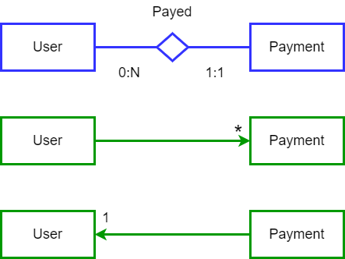
Relationship ”Payed”
User -> Payment @OneToMany to access all the payments that a certain user has done.
Payment -> User @ManyToOne to access the user that has done a specific payment.

Slide 59
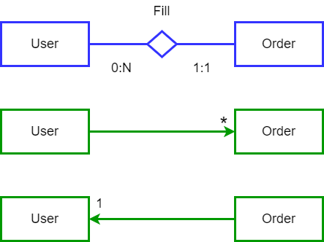
Relationship ”Fill”
User -> Order @OneToMany to access all the orders that a user has created.
Order -> User @ManyToOne to access the user that has created a specific order.

Slide 60
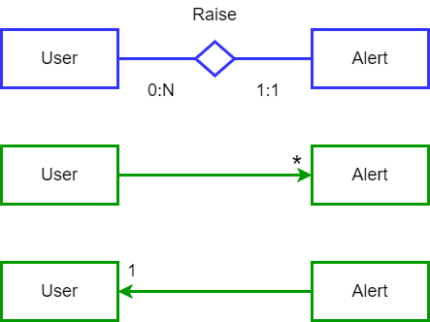
Relationship ”Raise”
User -> Alert @OneToMany to access all the alerts raised by a user, according to our specific interpretation, only an alert per user could be raised.
Alert -> User @ManyToOne to access the user that has raised a specific alert.

Slide 61
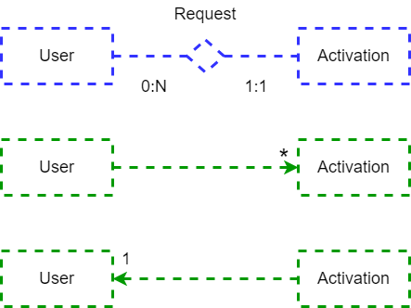
Relationship ”Acquire”
User -> Activation @OneToMany to access all the activations acquired by a user. Not implemented.
Activation -> User @ManyToOne to access the user that has acquired a specific activation. Not implemented.

Slide 62
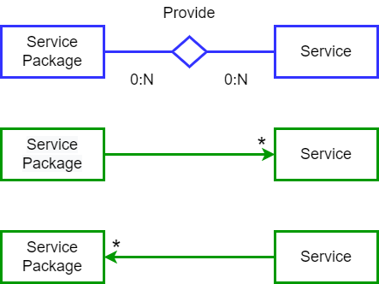
Relationship ”Provide”
Service Package -> Service @ManyToMany to access all the services provided in a service package.
Service -> Service Package @ManyToMany to access all the service packages that have a specific service.

Slide 63
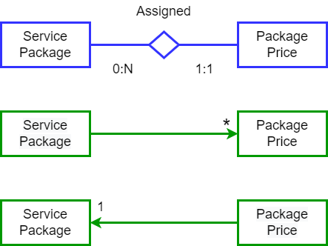
Relationship ”Assigned”
Service Package -> Package Price @OneToMany to access all the prices assigned to a service package.
Package Price -> Service Package @ManyToOne to access the service package that has a specific package price.

Slide 64
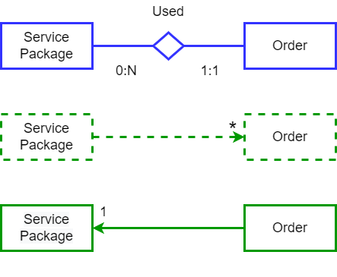
Relationship ”Used”
Service Package -> Order @OneToMany to access all the orders of a service package. Not implemented.
Order -> Service Package @ManyToOne to access the service package that has been bought in a specific order.

Slide 65
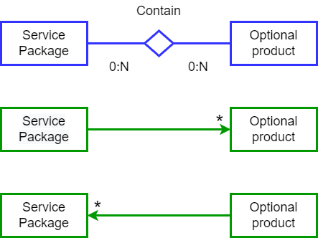
Relationship ”Contain”
Service Package -> Optional product @ManyToMany to access all the optional products contained in a service package.
Optional product -> Service Package @ManyToMany to access all the service packages that have a specific optional product.

Slide 66
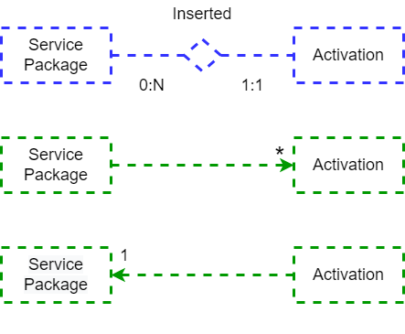
Relationship ”Inserted”
Service Package -> Activation @OneToMany to access all the activations related to a service package. Not implemented.
Activation -> Service Package @ManyToOne to access the service package that has been inserted in a specific activation. Not implemented.

Slide 67
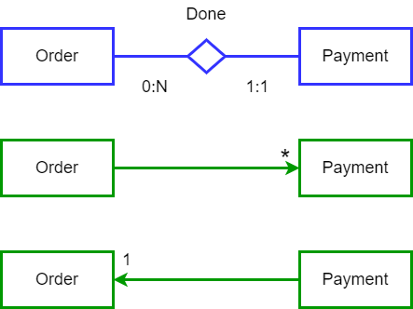
Relationship ”Done”
Order -> Payment @OneToMany to access all the payments done in a specific order.
Payment -> Order @ManyToOne to access the order that has try to pay by a specific payment.

Slide 68
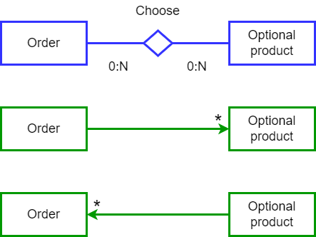
Relationship ”Choose”
Order -> Optional product @ManyToMany to access all the optional products contained in an order.
Optional product -> Order @ManyToMany to access all the orders that have a specific optional product.

Slide 69
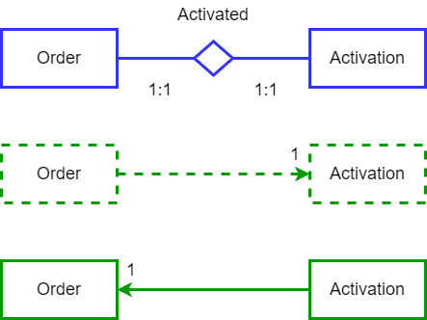
Relationship ”Activated”
Order -> Activation @OneToMany to access the activation schedule related to the correspondent order. Not implemented.
Activation -> Order @ManyToOne to access the order that corresponds to a specific activation.

Slide 70
Entities

Slide 71
Activation
@Entity
@Table(name = "activation")
public class Activation {
@Id
@Column(name = "order_id", nullable = false)
Integer id;
@MapsId
@OneToOne(fetch = FetchType.LAZY, optional = false)
@JoinColumn(name = "order_id", nullable = false)
Order orders;
@Column(name = "user_id", nullable = false)
Integer userId;
@Column(name = "package_id", nullable = false)
Integer packageId;
@Column(name = "start_date", nullable = false)
LocalDate startDate;
@Column(name = "end_date", nullable = false)
LocalDate endDate;
}

Slide 72
Administrator
@Entity
@Table(name = "administrator")
public class Administrator {
@Id
@GeneratedValue(strategy = GenerationType.IDENTITY)
@Column(name = "id", nullable = false)
Integer id;
@Column(name = "name", nullable = false)
String name;
@Column(name = "surname", nullable = false)
String surname;
@Column(name = "email", nullable = false)
String email;
@Column(name = "password", nullable = false)
String password;
@Column(name = "role", nullable = false)
Integer role;
}

Slide 73
Alert
@Entity
@Table(name = "alerts")
public class Alert {
@Id
@GeneratedValue(strategy = GenerationType.IDENTITY)
@Column(name = "id", nullable = false)
Integer id;
@ManyToOne(fetch = FetchType.LAZY)
@JoinColumn(name = "user_id")
User user;
@Column(name = "username", nullable = false)
String username;
@Column(name = "email", nullable = false)
String email;
@Column(name = "amount", nullable = false)
Double amount;
@Column(name = "date_time", nullable = false)
Date dateTime;
}

Slide 74
AveragePurchaseOptionalPackage
@Entity
@Table(name = "avarage_purchase_optional_package")
public class AveragePurchaseOptionalPackage {
@Id
@Column(name = "package_id", nullable = false)
Integer id;
@Column(name = "package_name", nullable = false)
String packageName;
@Column(name = "avg_optional", nullable = false)
Double avgOptional;
}

Slide 75
FailedPayment
@Entity
@Table(name = "failed_payment")
public class FailedPayment {
@Id
@Column(name = "user_id", nullable = false)
Integer id;
@Column(name = "last_failure")
Date lastFailure;
@Column(name = "n_failures", nullable = false)
Integer nFailures;
}

Slide 76
InsolventUser
@Entity
@Table(name = "insolvent_user")
public class InsolventUser {
@Id
@Column(name = "id", nullable = false)
Integer id;
@Column(name = "name", nullable = false, length = 225)
String name;
@Column(name = "surname", nullable = false, length = 225)
String surname;
@Column(name = "username", nullable = false, length = 225)
String username;
@Column(name = "email", nullable = false, length = 225)
String email;
}

Slide 77
OptionalProduct
@Entity
@Table(name = "optional_product")
public class OptionalProduct {
@Id
@GeneratedValue(strategy = GenerationType.IDENTITY)
@Column(name = "id", nullable = false)
Integer id;
@Column(name = "name", nullable = false)
String name;
@Column(name = "price", nullable = false)
Double price;
@Column(name = "description")
String description;
@ManyToMany(mappedBy = "optionalProducts")
List<ServicePackage> servicePackages = new ArrayList<>();
}

Slide 78
OptionalProductInPackage
@Entity
@Table(name = "optional_product_in_package")
public class OptionalProductInPackage {
@EmbeddedId
OptionalProductInPackageId id;
@MapsId("packageId")
@ManyToOne(fetch = FetchType.LAZY, optional = false)
@JoinColumn(name = "package_id", nullable = false)
ServicePackage _package;
@MapsId("optionalProductId")
@ManyToOne(fetch = FetchType.LAZY, optional = false)
@JoinColumn(name = "optional_product_id", nullable = false)
OptionalProduct optionalProduct;
}

Slide 79
OptionalProductOrder
@Entity
@Table(name = "optional_product_order")
public class OptionalProductOrder {
@EmbeddedId
OptionalProductOrderId id;
@MapsId("orderId")
@ManyToOne(fetch = FetchType.LAZY, optional = false)
@JoinColumn(name = "order_id", nullable = false)
Order order;
@MapsId("optionalId")
@ManyToOne(fetch = FetchType.LAZY, optional = false)
@JoinColumn(name = "optional_id", nullable = false)
OptionalProduct optional;
}

Slide 80
Order
@Entity
@Table(name = "orders")
public class Order {
@Id
@GeneratedValue(strategy = GenerationType.IDENTITY)
@Column(name = "id", nullable = false)
Integer id;
@ManyToOne(fetch = FetchType.LAZY)
@JoinColumn(name = "user_id")
User user;
@ManyToOne(fetch = FetchType.LAZY)
@JoinColumn(name = "package_id")
ServicePackage _package;
@Column(name = "validity_period", nullable = false)
Integer validityPeriod;
@Column(name = "order_status", nullable = false)
Integer orderStatus;
@Column(name = "order_status", nullable = false)
Integer orderStatus;
@Column(name = "start_date", nullable = false)
LocalDate startDate;
@Column(name = "price", nullable = false)
Double price;
@Column(name = "createdAt", nullable = false)
Date createdAt;
@ManyToMany
@JoinTable(name = "optional_product_order",
joinColumns = @JoinColumn(name = "order_id"),
inverseJoinColumns = @JoinColumn(name = "optional_id"))
List<OptionalProduct> optionalProducts = new ArrayList<>();
@OneToMany(mappedBy = "order")
List<PaymentHistory> paymentHistories = new ArrayList<>();
}

Slide 81
PackagePrice
@Entity
@Table(name = "package_price")
public class PackagePrice {
@Id
@GeneratedValue(strategy = GenerationType.IDENTITY)
@Column(name = "id", nullable = false)
Integer id;
@ManyToOne(fetch = FetchType.LAZY)
@JoinColumn(name = "package_id")
ServicePackage _package;
@Column(name = "validity_period", nullable = false)
Integer validityPeriod;
@Column(name = "price")
Double price;
}

Slide 82
PaymentHistory
@Entity
@Table(name = "payment_history")
public class PaymentHistory {
@Id
@GeneratedValue(strategy = GenerationType.IDENTITY)
@Column(name = "id", nullable = false)
Integer id;
@ManyToOne(fetch = FetchType.LAZY)
@JoinColumn(name = "user_id")
User user;
@ManyToOne(fetch = FetchType.LAZY, optional = false)
@JoinColumn(name = "order_id", nullable = false)
Order order;
@Column(name = "date_time", nullable = false)
Date dateTime;
@Column(name = "payment_status", nullable = false)
Integer paymentStatus;
}

Slide 83
Service
@Entity
@Table(name = "service")
public class Service {
@Id
@GeneratedValue(strategy = GenerationType.IDENTITY)
@Column(name = "id", nullable = false)
Integer id;
@Column(name = "name", nullable = false)
String name;
@Column(name = "min")
Integer min;
@Column(name = "sms")
Integer sms;
@Column(name = "internet")
Integer internet;
@Column(name = "extra_min")
Double extraMin;
@Column(name = "extra_sms")
Double extraSms;
@Column(name = "extra_internet")
Double extraInternet;
@ManyToMany(mappedBy = "services")
List<ServicePackage> servicePackages = new ArrayList<>();
}

Slide 84
ServiceInPackage
@Entity
@Table(name = "service_in_package")
public class ServiceInPackage {
@EmbeddedId
ServiceInPackageId id;
@MapsId("packageId")
@ManyToOne(fetch = FetchType.LAZY, optional = false)
@JoinColumn(name = "package_id", nullable = false)
ServicePackage _package;
@MapsId("serviceId")
@ManyToOne(fetch = FetchType.LAZY, optional = false)
@JoinColumn(name = "service_id", nullable = false)
Service service;

Slide 85
ServicePackage
@Entity
@Table(name = "service_package")
public class ServicePackage {
@Id
@GeneratedValue(strategy = GenerationType.IDENTITY)
@Column(name = "id", nullable = false)
Integer id;
@Column(name = "name", nullable = false)
String name;
@OneToMany(mappedBy = "_package", cascade = CascadeType.ALL)
List<PackagePrice> packagePrices = new ArrayList<>();
@ManyToMany
@JoinTable(name = "optional_product_in_package",
joinColumns = @JoinColumn(name = "package_id"),
inverseJoinColumns = @JoinColumn(name = "optional_product_id"))
List<OptionalProduct> optionalProducts = new ArrayList<>();
@ManyToMany
@JoinTable(name = "service_in_package",
joinColumns = @JoinColumn(name = "package_id"),
inverseJoinColumns = @JoinColumn(name = "service_id"))
List<Service> services = new ArrayList<>();
}

Slide 86
SuspendedOrder
@Entity
@Table(name = "suspended_orders")
public class SuspendedOrder {
@EmbeddedId
SuspendedOrderId id;
}

Slide 87
TotalPurchaseOptional
@Entity
@Table(name = "total_purchase_optional")
public class TotalPurchaseOptional {
@Id
@Column(name = "optional_id", nullable = false)
Integer id;
@Column(name = "optional_name", nullable = false)
String optionalName;
@Column(name = "tot_purchase", nullable = false)
Integer totPurchase;
}

Slide 88
TotalPurchasePackage
@Entity
@Table(name = "total_purchase_package")
public class TotalPurchasePackage {
@Id
@Column(name = "package_id", nullable = false)
Integer id;
@Column(name = "package_name", nullable = false)
String packageName;
@Column(name = "tot_purchase", nullable = false)
Integer totPurchase;
}

Slide 89
TotalPurchasePackageOptional
@Entity
@Table(name = "total_purchase_package_optional")
public class TotalPurchasePackageOptional {
@EmbeddedId
TotalPurchasePackageOptionalId id;
@Column(name = "tot_purchase", nullable = false)
Integer totPurchase;
@Column(name = "package_name", nullable = false)
String packageName;
}

Slide 90
TotalPurchasePackageValidity
@Entity
@Table(name = "total_purchase_package_validity")
public class TotalPurchasePackageValidity {
@EmbeddedId
TotalPurchasePackageValidityId id;
@Column(name = "package_name", nullable = false)
String packageName;
@Column(name = "tot_purchase", nullable = false)
Integer totPurchase;
}

Slide 91
TotValueOptionalNoOptional
@Entity
@Table(name = "tot_value_optional_no_optional")
public class TotValueOptionalNoOptional {
@EmbeddedId
private TotValueOptionalNoOptionalId id;
@Column(name = "package_name", nullable = false)
private String packageName;
@Column(name = "tot_value")
private Double totValue;
}

Slide 92
User
@Entity
@Table(name = "user")
public class User {
@Id
@GeneratedValue(strategy = GenerationType.IDENTITY)
@Column(name = "id", nullable = false)
Integer id;
@Column(name = "name", nullable = false, length = 225)
String name;
@Column(name = "surname", nullable = false, length = 225)
String surname;
@Column(name = "username", nullable = false, length = 225)
String username;
@Column(name = "email", nullable = false, length = 225)
String email;
@Column(name = "password", nullable = false, length = 225)
String password;
@Column(name = "insolvent", nullable = false)
Integer insolvent;
@OneToMany(mappedBy = "user")
List<PaymentHistory> paymentHistories = new ArrayList<>();
@OneToMany(mappedBy = "user")
List<Alert> alerts = new ArrayList<>();
@OneToMany(mappedBy = "user")
List<Order> orders = new ArrayList<>();

Slide 93
Entities with @EmbeddedId interpretation
We have used @EmbeddedId in different entities when classes have a composite primary key. In order to use this Id we exploit the @Embeddable annotation to use a class as Id of an entity and all the attribute present in that class represent the composite primary key of the entity.

Slide 94
Functional analysis of the interactions

Slide 95
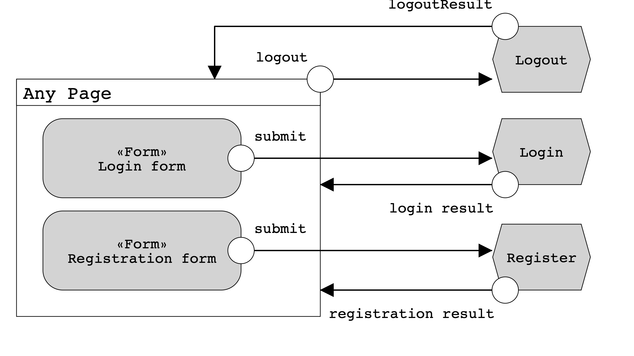
Functional analysis of the interaction
Login, registration and logout (if user is logged in) are available in any moment. Errors and result redirects are performed in the same page the user starts the flow. For this reason the view is identified as ‘Any Page’

Slide 96
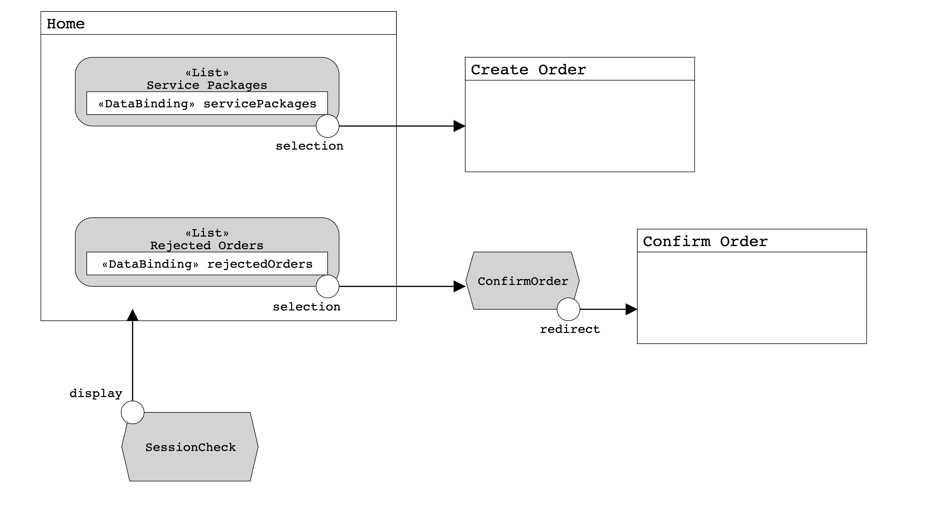
Functional analysis of the interaction
In the home page a user can select a service package to buy it; while, if he is logged in, he can also see the list of his rejected orders and confirms them again.

Slide 97
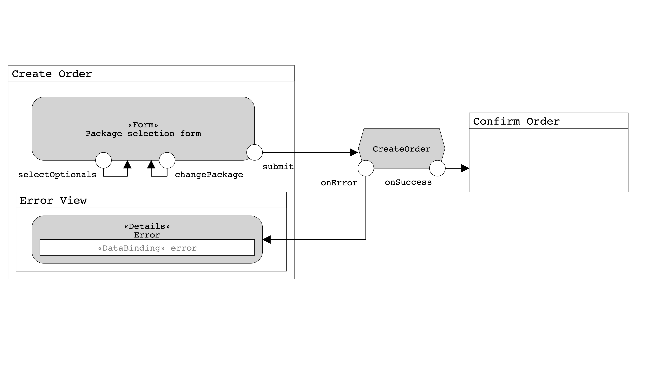
Functional analysis of the interaction
The create order page has the same functionalities for a logged or an unlogged user. A user can change the selected service package and he can also select optional products to buy with. On submit, the order is displayed in the confirmation page.

Slide 98
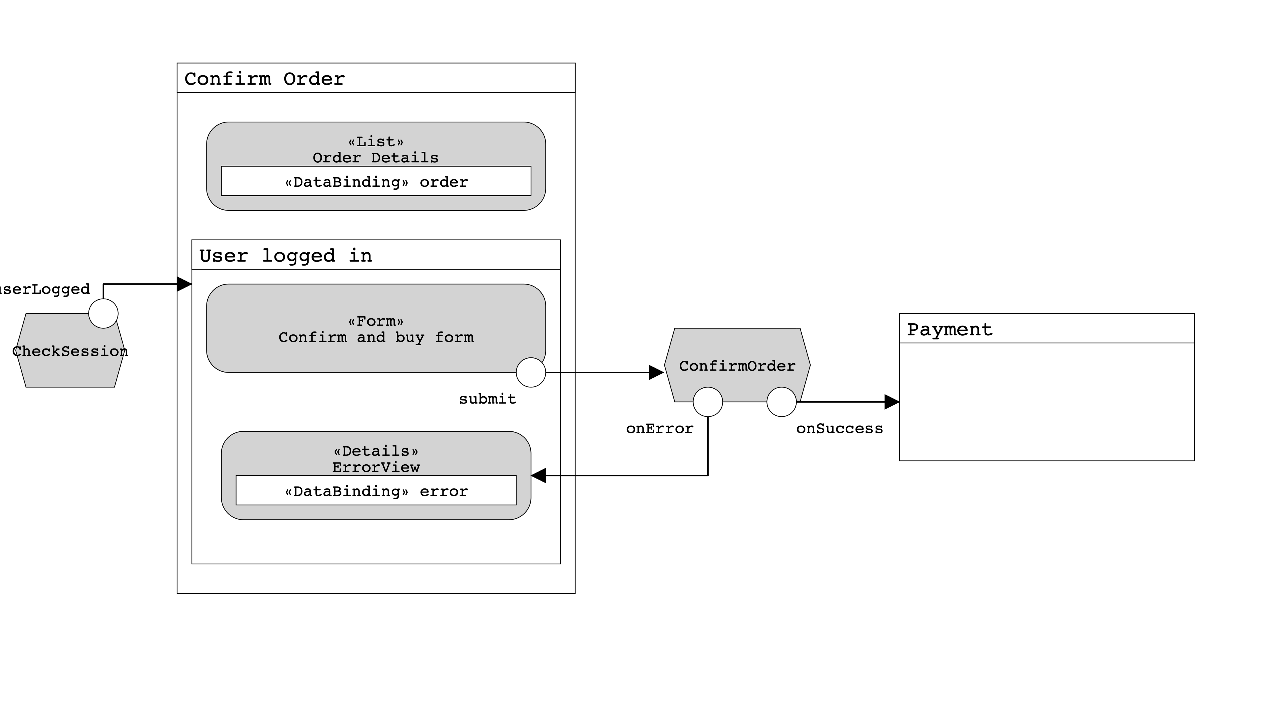
Functional analysis of the interaction
To confirm an order a user has to be logged in. If not he can only see the details of the order but he has to complete the login/registration to proceed. Once an order is confirmed the payment page is displayed.
u

Slide 99
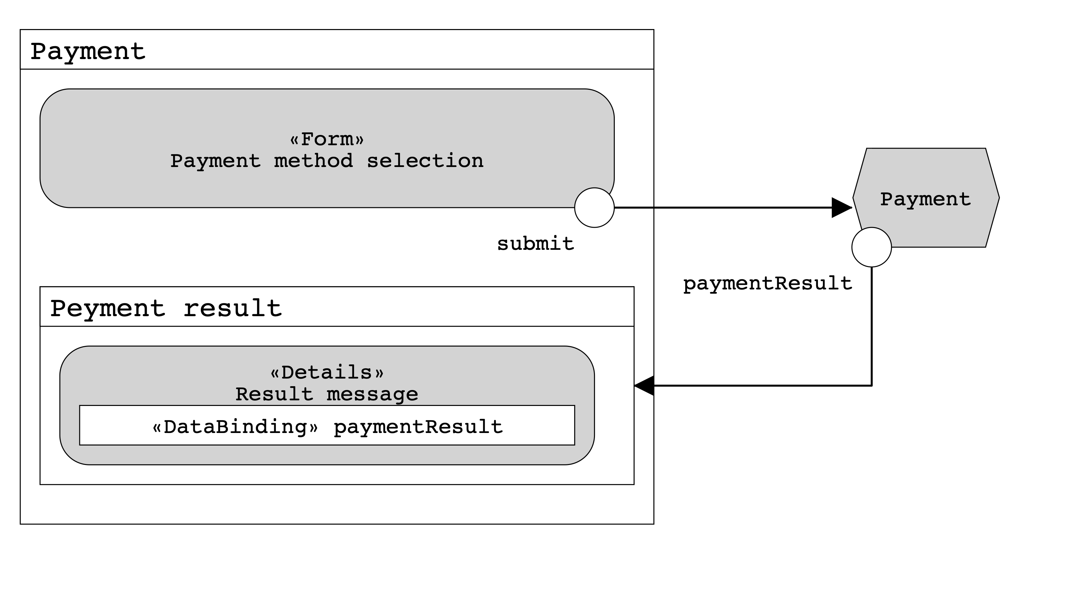
Functional analysis of the interaction
Finally, a logged user, can access the payment page. Once selected the payment method it is possible to confirm the operation, and the result is then displayed.

Slide 100
Components

Slide 101
Client components
AdminLoginServlet: handle the login process of an administrator.
LogoutAdminServlet: handle the logout process of an administrator.
AdminHomeServlet: retrieve from the DB all the information useful for the dashboard page.
AdminOptionalProductServlet: let the administrator create a new optional product, checking if it is already existing or not.
AdminServicePackageServlet: let the administrator create a new service package, checking if it is already existing or not.
AdminServiceServlet: let the administrator create a new service, checking if it is already existing or not.
AdminStatsServlet: retrieve from the DB all the information stored in all the materialized view.

Slide 102
Client components
RegisterServlet: handle the register process of a user.
LoginServlet: handle the login process of a user.
LogoutServlet: handle the logout process of a user.
HomeServlet: retrieve from the DB all the service packages and all the orders in pending of the current user (if it is logged).
CreateOrderServlet: retrieve in GET all the service package and do a POST when the user has fill all the mandatory fields (creating a pending order and setting it in the session).
ConfirmOrderServlet: retrieve in GET the order from the session and show all its parameters. A POST is done when the logged user confirm the order and an order entity is stored in the DB. If the order is a rejected one, instead of managing the order from the session, it reads it from the DB.
PaymentServlet: retrieve and show in GET all the information of an order that the user has to pay. A POST is done when the user tries to do a payment and the servlet save in the DB the result of the current payment (modifying also the status of the order if the payment has been successful (1) or if the payment has failed (2)).

Slide 103
Views
adminLogin.html: where the administrator logs in. Mapped at “/admin/login”.
adminDashboard.html: where the administrator can create service packages, optional products or services. Mapped at “admin/dashboard”.
adminStats.html: where the administrator check the statistics retrieved from the materialized views. Mapped at “admin/stats”.
index.html: the landing page where are present all the service packages available. Mapped at “/”.
buyService.html: where the user fill all the required parameters to buy a service package. Mapped at “/order/create/pId=?”.
confirmationPage.html: where the user confirm the order done in the previous page. Mapped at “/order/confirm”.
paymentPage.html: where the user can select the preferred payment method and then pay. Mapped at “/order/pay?orderId=?”.
paymentResult.html: where the user can see if the payment of his order has been successful or not. Mapped at “/order/pay”.

Slide 104
Java beans
OptionalProductBean: This bean is being used when we call the API, in order to retrieve only the relevant data.
PendingOrderBean: This bean is being used when we need to handle an order in the session, before the user confirm it (persisting it).

Slide 105
Business tier
@Stateless AdministratorService
getAdministratorByEmail(String)
@Stateless AlertService
getAllAlerts()
@Stateless AveragePurchaseOptionalPackageService
getAllAveragePurchaseOptionalPackages()
@Stateless InsolventUserService
getAllInsolventUsers()
@Transactional OptionalProductService
getOptionalProductById(Integer)
isOptionalProductAlreadyExisting(String)
getAllOptionalProducts()
createOptionalProduct(OptionalProduct)
@Transactional OrderService
getOrderById(Integer)
getOrdersOfUser(Integer)
createOrder(Order)
@Transactional PaymentService
makePayment(PaymentHistory)
@Transactional ServicePackageService
getServicePackageById(Integer)
getServicePackageByName(String)
isServicePackageNameAlreadyExist(name)
getAllServicePackages()
createServicePackage(ServicePackage)

Slide 106
Business tier
@Stateless ServiceService
getServiceById(Integer)
getServiceByName(String)
isServiceAlreadyExisting(String)
getAllServices()
createService(Service)
@Stateless SuspendedOrderService
getAllSuspendedOrders()
@Stateless TotalPurchaseOptionalService
getAllTotalPurchaseOptional()
@Stateless TotalPurchasePackageOptionalService
getAllTotalPurchasePackageOptional()
@Stateless TotalPurchasePackageService
getAllTotalPurchasePackages()
@Stateless TotalPurchasePackageValidityService
getAllTotalPurchasePackageValidity()
@Stateless TotValueOptionalNoOptionalService
getAllTotValueOptionalNoOptional()
@Stateless UserService
getUserById(Integer)
getUserByEmail(String)
getUserByUsername(String)
checkUsername(String)
checkEmail(String)
createUser(User)

Slide 107
Additional info of the components design
We have implemented different controllers that call the services described in the slides before, but those controllers have the same name and do the same job of the correspondent service (performing additional controls), so we have decided to not describe them.
We have implemented a single API function “getOptionalProductByPackageId” that retrieves the optional products of a selected Service Package. This API has the following path: “/api/optional/package/{id: [0-9]+}”
We have implemented different exceptions that are catch when something unexpected happens.
In the Business Tier we have chosen @Transactional when the correspondent service needs to perform multiple queries in one transaction and using this notation when a query fails, the whole transaction will rollback.

Slide 108
UML sequence diagrams

Slide 109
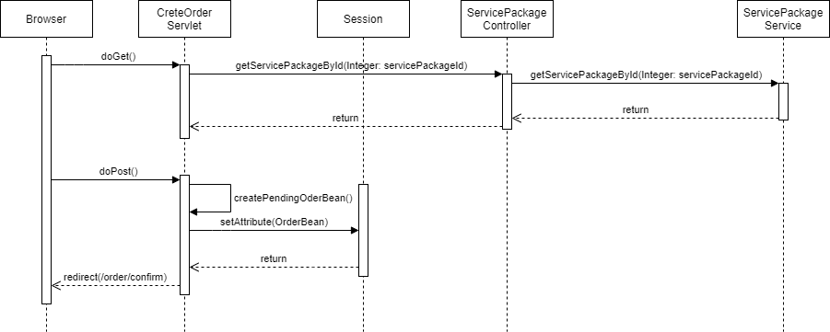
Create order

Slide 110
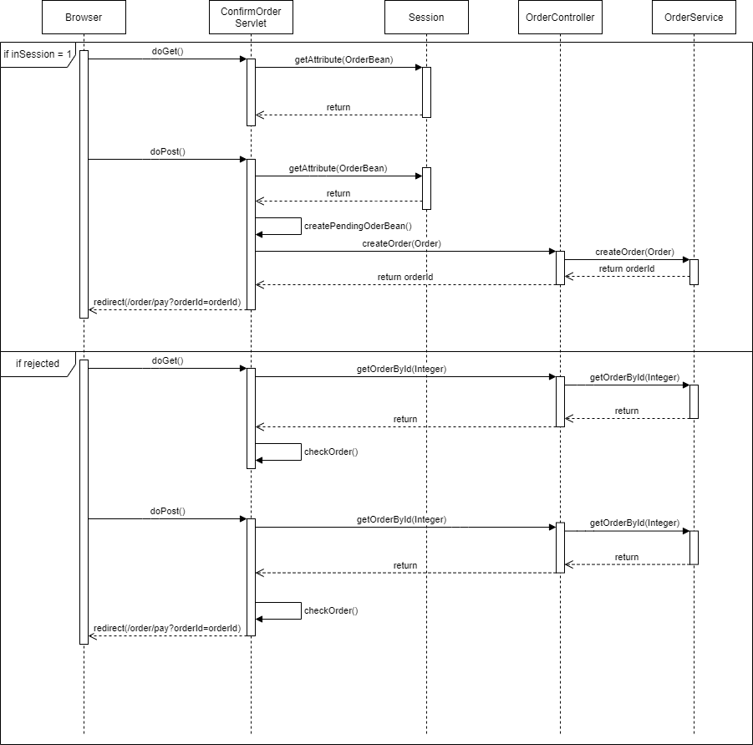
Confirm order

Slide 111
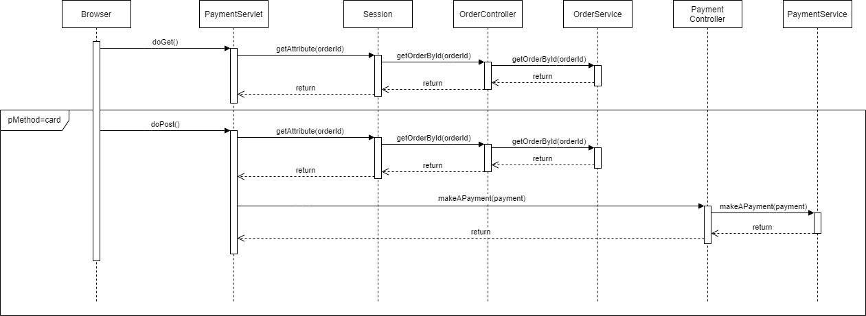
Payment

