Slide 1
Project Presentation
Mattia Siriani (10571322) & Matteo Visotto (10608623)
DIMA Course – Politecnico di Milano

Slide 2
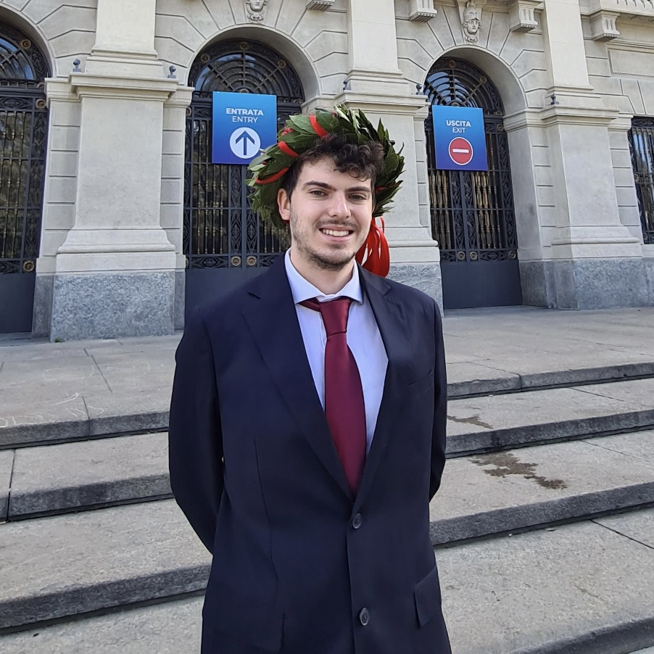
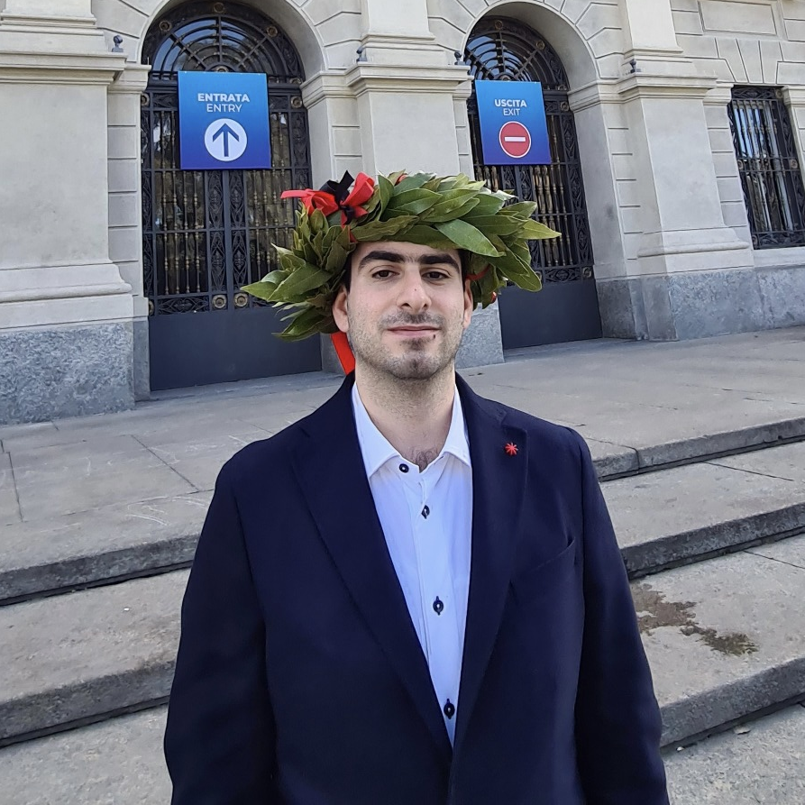
The team
MATTIA SIRIANI
MATTEO VISOTTO
M.Sc Computer Science and Engineering
M.Sc Computer Science and Engineering

Slide 3

Introduction
The idea
The original idea is given by Bending Spoons.
The application
Keep track of product prices, get notification and explore other user preferences.
Our choice
Social network style
Backend processing and data management
Per user personalization
Data synchronization
Multi-device

Slide 4









Technologies
iOS Application
Notification
Backend
Apple SwiftUI
Firebase Cloud Messaging (FCM)
Nginx WebServer
PHP-FPM
MariaDB
Social authentication
Avatars
Google Sign-In
Facebook Sign-In
Apple Sign-In
DiceBear Avatars

Slide 5




Device and capabilities
Support iOS/iPadOS 14 and later version
iPhone portrait
iPad portrait and landscape
Widgets both for iPhone and iPad
Translation in English and Italian

Slide 6





Functionalities
Track product price
Keep track of the price of your favorite products
Explore
Explore products added by other users by different criteria
Notification
Get notified when a tracked product price falls
Synchronization
Keep your data and preferences synced with your devices

Slide 7






Testing
Unit Tests
25 Unit tests for internal application logic
Apple TestFlight
11 Users joined TestFlight beta program
iPhone UI Tests
68 UI tests for iPhone views
Watch UI Tests
9 UI tests for Apple Watch views
iPad UI Tests
67 UI tests for iPad views portrait and landscape

Slide 8
Further implementation
Internationalization of Amazon website
Improve user suggestion
(ML backend engine)
1
2
3
Currencies internationalization back-end side

Slide 9

DEMO TIME

