Slide 1
Project Presentation
Mattia Siriani (10571322) & Matteo Visotto (10608623)
DIMA Course – Politecnico di Milano

Slide 2
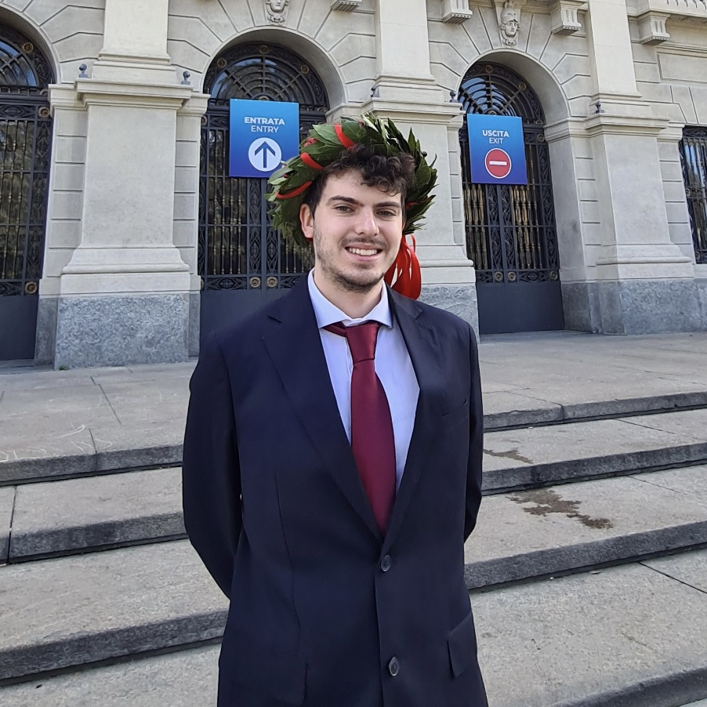
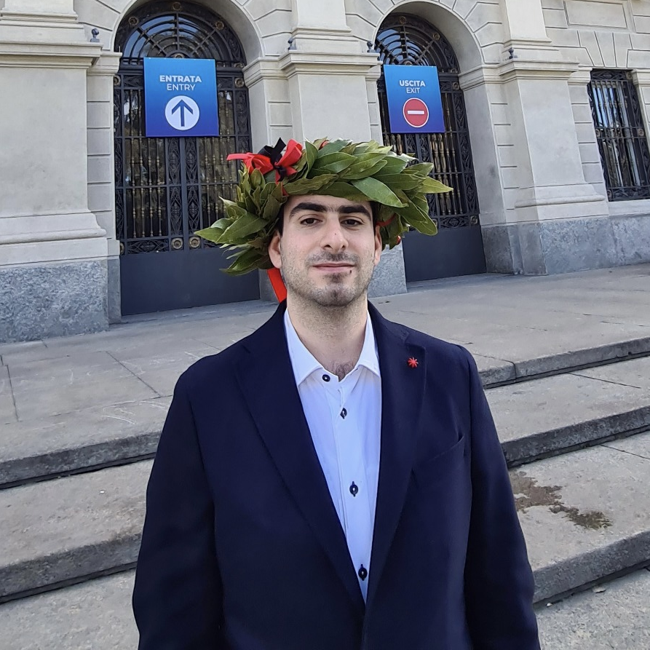
The team
MATTIA SIRIANI
MATTEO VISOTTO
M.Sc Computer Science and Engineering
M.Sc Computer Science and Engineering

Slide 3
Introduction

Slide 4









Technologies
iOS Application
Notification
Backend
Apple SwiftUI
Firebase Cloud Messaging (FCM)
Nginx WebServer
PHP-FPM
MariaDB
Social authentication
Avatars
Google Sign-In
Facebook Sign-In
Apple Sign-In
DiceBear Avatars

Slide 5





Functionalities
Track product price
Keep track of the price of your favourite products
Explore
Explore products added by other users by different criteria
Notification
Get notified when a tracked product price falls down
Synchronization
Keep your data and preferences synced with your devices

Slide 6
Supported devices
iOS 14 +
iPhone portrait
iPad portrait + landscape
Widgets iphone + ipad

