Slide 1
Project Presentation
Mattia Siriani (10571322) & Matteo Visotto (10608623)
DIMA Course – Politecnico di Milano

Slide 2
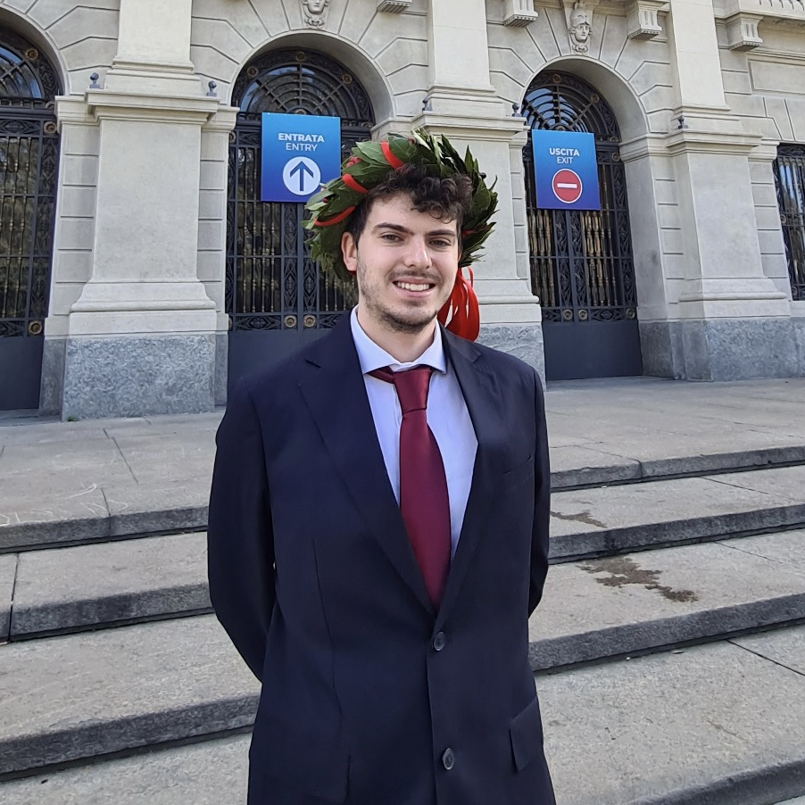
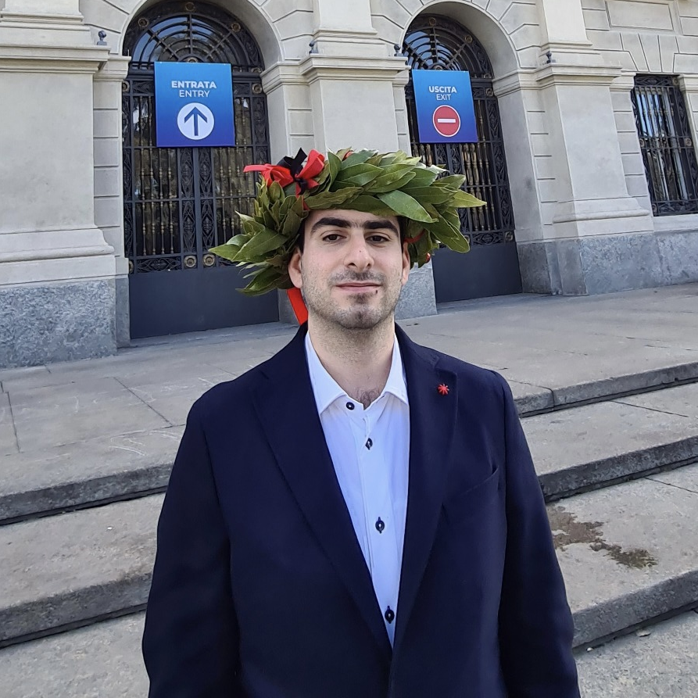
The team
MATTIA SIRIANI
MATTEO VISOTTO
M.Sc Computer Science and Engineering
M.Sc Computer Science and Engineering

Slide 3
Introduction
The idea
Testo dell’introduzione
The application
Testo dell’introduzione
Our choice
Obbligo login x tracking

Slide 4









Technologies
iOS Application
Notification
Backend
Apple SwiftUI
Firebase Cloud Messaging (FCM)
Nginx WebServer
PHP-FPM
MariaDB
Social authentication
Avatars
Google Sign-In
Facebook Sign-In
Apple Sign-In
DiceBear Avatars

Slide 5




Device and capabilities
Support iOS/iPadOS 14 and later version
iPhone portrait
iPad portrait and landscape
Widgets both for iPhone and iPad
Translation in English and Italian

Slide 6





Functionalities
Track product price
Keep track of the price of your favourite products
Explore
Explore products added by other users by different criteria
Notification
Get notified when a tracked product price falls
Synchronization
Keep your data and preferences synced with your devices

Slide 7
Further implementation
Internationalization of Amazon website
Improve user suggestion
(ML backend engine)
1
2
3
Currencies internationalization back-end side

Slide 8

DEMO TIME

