Slide 1
Project Presentation
Daniele Sinigaglia (10574224)
Mattia Siriani (10571322)
Matteo Visotto (10608623)

Slide 2

The project
Smart Buildings and Neighborhoods
Temperature and humidity sensors deployed in rooms of different neighborhood buildings
HVAC in the same room of a sensor activated by received data
Long term persistent data for analysis

Slide 3





Technologies
IoT Motes Sensors
Communication
Backend flow
Contiki-NG
Mosquitto MQTT Broker
Node-Red
Statistics
Actuators
Apache Spark
Python

Slide 4





Functionalities
Data sampling
Motes read and send temperature and humidity readings periodically
Data storage
Published data are stored permanently for further uses
Data analysis
Data can be analyzed to retrieve different type of statistics
Data on-demand
Data can be also read on-demand for live computation/use (ex. actuators)

Slide 5








High level flow
Cloud Mosquitto Broker
RPL Border Router
tun0
Pub/Sub
Broker bridge
TunSlip6
Local Mosquitto Broker
Pub/Sub
Subscribe
Node-Red
Write
Data
Storage
6LowPan Network
Actuators
Read
POST
Apache
Spark
Notification

Slide 6
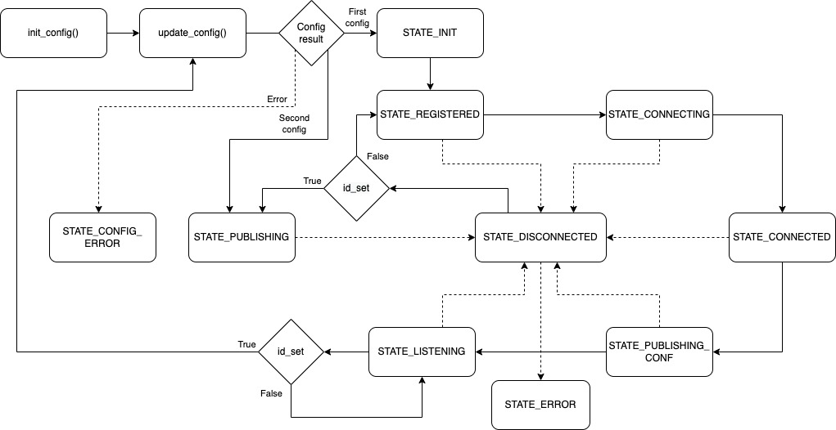
Sensor State Machine

Slide 7
MQTT Topics
Base topic:
mtds/sensor/
Configuration topic:
config/{{sensor_id}}
Ex: mtds/sensor/config/mtdssens_0002
Publication topic:
data/A/B/C/D
Ex: mtds/sensor/data/A/0/S/1
Building
Neighborhood
/
/
/
Floor
Room
*Dividing location in topics is useful to subscribe for data with different granularity

Slide 8
Node-Red Flows
Sensor configurator
Data saving

Slide 9
Spark analysis
Hourly, daily, and weekly moving average of each environmental quantity, at room, building, and
Neighborhood-scale.
1
2
Month of the year with the highest average night-day temperature difference, for each building.
Daily and night temperature difference at room and building-level.
3

Slide 10
Actuators
1
2
Read sensor publication based on the location topic
Smart devices with full flagged operating system
Operations are simulated with a console print and a Telegram
notification
Contains the logic to perform operations based on received data
3
4

Slide 11

DEMO TIME

