Slide 1
Kenyatta University SCH 301: Coordination and Organometallic Chemistry
Acknowledgements
Course Text: Chemistry: the Molecular Nature of Matter and Change, 5th ed, 2009, Martin S. Silberberg, McGraw-Hill
This Inorganic Chemistry course is intended for those students enrolled in a science /engineering oriented curricula, with particular emphasis on chemistry, biochemistry, and biology. The material on these slides is taken primarily from the course text but the instructor has modified, condensed, or otherwise reorganized selected material. Additional material from other sources may also be included. Interpretation of course material to clarify concepts and solutions to problems is the sole responsibility of this instructor.

Slide 2
Coordination Compounds (Complexes)
Most distinctive aspect of transition metal chemistry
Complex – Substances that contain at least one complex ion/coordination entity
Complex ion – Species consisting of a “central metal cation” (either a main-group or transition metal) that is bonded to molecules and/or anions called “Ligands”
The Complex ion is typically associated with other (counter) ions to maintain neutrality
A coordination compound behaves like an electrolyte in water
Complex ion and counter ion separate
Complex ion behaves like a polyatomic ion – the ligands and central atom remain attached

Slide 3
Definitions
Coordination sphere
Coordination number = 6
3Cl–
(counterion)
ligand
(coordination sphere)
M
N forms a coordinate covalent bond to the metal
Coordination compound
Notes:
Coordinate covalent bond, hence coordination compounds

Slide 4
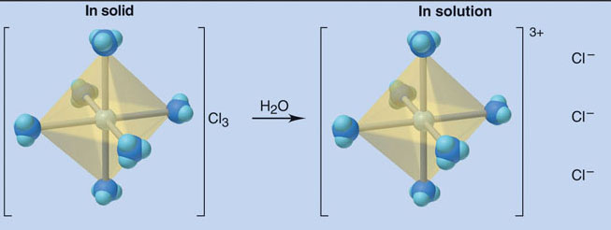
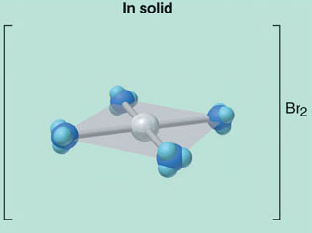
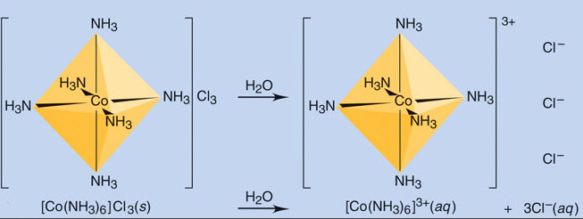
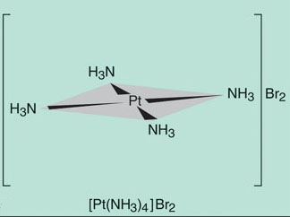
Coordination Compounds (Complexes)
Components of Coordination Compound
When solid complex dissolves in water, the complex ion and the counter ions separate, but ligands remain bound to central atom
Central
Atom
Ligands
Counter
Ions

Slide 5
Complex ions
A complex ion is described by the metal ion and the number and types of ligands attached to it
The bonding between metal and ligand generally involves formal donation of one or more of the ligand's electron pairs
The metal-ligand bonding can range from covalent to more ionic
Furthermore, the metal-ligand bond order can range from one to three (single, double, triple bonds)
Ligands are viewed as Lewis Bases (donate electron pairs), although rare cases are known involving Lewis acidic ligands

Slide 6
Complex ions
The complex ion structure is related to three characteristics:
Coordination Numbers
The number of ligand atoms that are bonded directly to the central metal ion
Coordination number is specific for a given metal ion in a particular oxidation state and compound
Coordination number in [Co(NH₃)₆]³⁺ is 6
The most common coordination number in complex ions is 6, but 2 and 4 are common, with a few higher

Slide 7
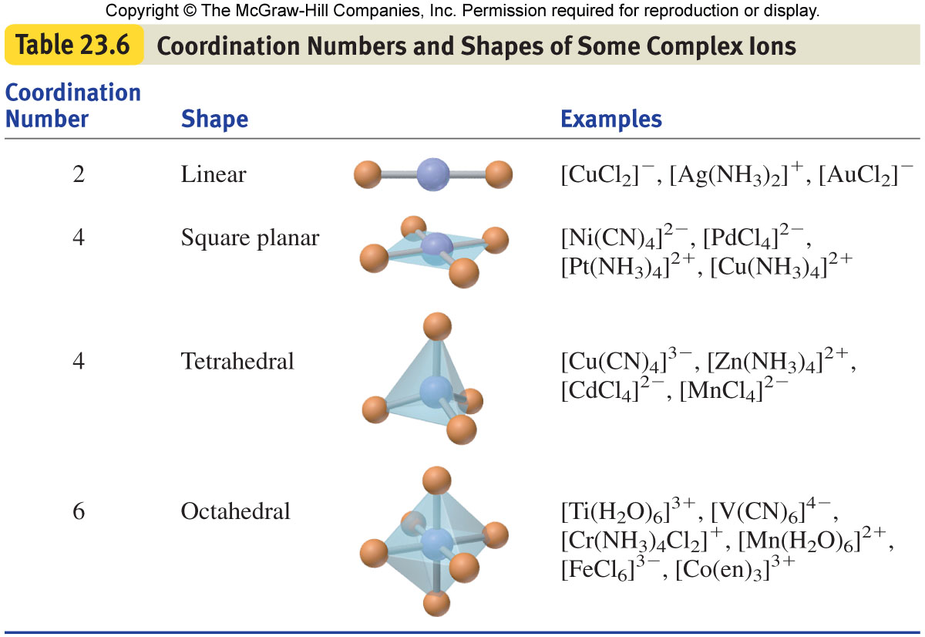
Complex ions
Geometry – Depends on Coordination No. & Nature of Metal Ion
Metal ion | CN | Shape | d^{x}
Cu⁺ | 2 | Linear | d¹⁰
Ag⁺ | 2 | Linear | d¹⁰
Au⁺ | 2 | Linear | d¹⁰
Ni²⁺ | 4 | Octahedral Sq Planar | d⁸
Pd²⁺ | 4 | Octahedral Sq Planar | d⁸
Pt²⁺ | 4 | Octahedral Sq Planar | d⁸
Cu²⁺ | 4 | Octahedral Sq Planar | d⁹
Cu³⁺ | 4 | Tetrahedral | d⁸
Zn²⁺ | 4 | Tetrahedral | d¹⁰
Cd²⁺ | 4 | Tetrahedral | d¹⁰
Mn²⁺ | 4 | Tetrahedral | d⁵
Ti³⁺ | 6 | Octahedral | d¹
V²⁺ | 6 | Octahedral | d³
Cr³⁺ | 6 | Octahedral | d³
Mn²⁺ | 6 | Octahedral | d⁵
Fe³⁺ | 6 | Octahedral | d⁵
Co³⁺ | 6 | Octahedral | d⁶
d¹
d⁸
d³
d⁹
d⁵
d¹⁰
d⁶

Slide 8
Complex ions
Donor Atoms per Ligand
The Ligands of complex ions are “molecules” or “anions” with one or more donor atoms that each donate a lone pair of electrons to the metal ion to form a covalent bond
Atoms with lone pairs of electrons often come from Groups 15, 16, or 17 (or 5, 6, and 7 in main-group elements)

Slide 9
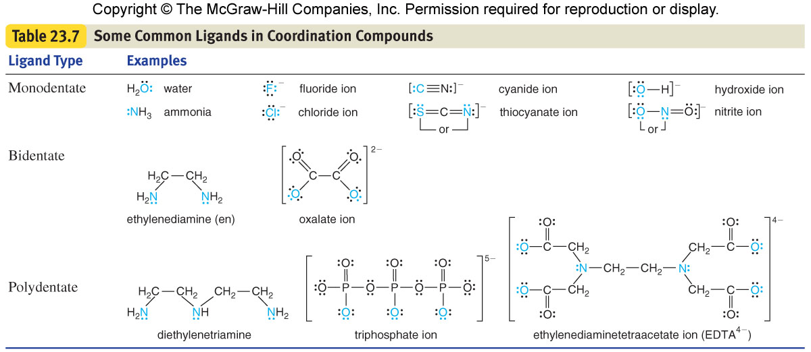
Complex ions
Ligands are classified in terms of the number of donor atoms (teeth) that each uses to bond to the central metal ion
Monodentate Ligands use a “single” donor atom
Bidentate Ligands have two donor atoms
Polydentate Ligands have more than two donor atoms

Slide 10
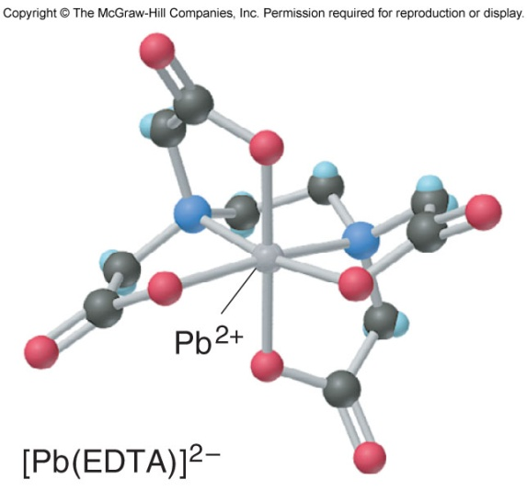
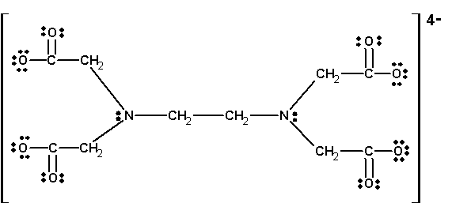
Complex ions
Chelates (Greek “chela” – crab’s claw)
Bidentate and Polydentate ligands give rise to “rings” in the complex ion
Ex: Ethylene Diamine (abbreviated (en) in formulas)
(:N – C – C – N:)
forms a 5-member ring, with the two electron donating N atoms bonding to the metal atom
Such ligands seem to grab the metal ion like claws
Ethylenediaminetetraacetate (EDTA)
Used in treating heavy-metal poisoning, by acting as a scavenger of lead and other heavy-metal ions, removing them from blood and other body fluids

Slide 11
Formulas and Names of Coordination Compounds
Three important rules for writing formulas of coordination compounds
The central atom/ion symbol is listed first.
The cation is written before the anion (for charged complexes)
The charge of the cation(s) is balanced by the charge of the anions
In the complex ion the ligand symbols(line formulae, abbreviations or acronyms) are listed in alphabetical order,
Single letter symbols precede two letter symbols (CO and Cl)
Placement of ligands does not depend on the charge of the ligand
The entire ion is placed in brackets, i.e., [ ]

Slide 12
Formulas and Names of Coordination Compounds
Coordination Compounds Formulas
Example # 1
K₂[Co(NH₃)₂Cl₄]
Two compound cations (K⁺) – Total Charge +2
Ion Central Metal Cation (Co²⁺) – Total Charge +2
Neutral Ligands (2 NH₃) – Total Charge 0
Charged Ligands (4 Cl⁻) – Total Charge -4
Net Charge on Complex Ion – - 2 [Co(NH₃)₂Cl₄]⁻²
Net Cation Charge – +2
K⁺₂[Co²⁺(NH₃)₂Cl⁻₄]

Slide 13
Formulas and Names of Coordination Compounds
Coordination Compounds Formulas
Example # 2 – Complex Ion and Counter Ion
[Co(NH₃)₄Cl₂]Cl
Counter Ion (Cl⁻) (not part of complex ion) – Total charge -1
Complex Ion - Neutral Ligands (4 NH₃) – Total Charge 0
Complex Ion - Anion Ligands (2 Cl⁻) – Total Charge -2
Complex Ion - [Co(NH₃)₄Cl₂]⁺ – Total Charge +1
Complex Ion - Central Metal Atom (Co) – Total Charge +3
[Co³⁺(NH₃)₄Cl⁻₂]⁺Cl⁻

Slide 14
Formulas and Names of Coordination Compounds
Example #3 – Complex Cation and Complex Anion
[Co(NH₃)₅Br]₂[Fe(CN)₆]
Complex Cation - [Co(NH₃)₅Br]²⁺
Complex Cation Central Atom (Co⁺³) – Total charge +3
Complex Cation Neutral Ligands (5 NH₃) – Total Charge 0
Complex Cation Anionic Ligand (Br⁻) – Total Charge -1
Complex Anion ([Fe(CN)₆]⁴⁻) – Total Charge -4
Complex Anion Central Cation (Fe²⁺) – Total Charge +2
Complex Anion Ligand (6 CN⁻¹) – Total Charge -6
[Co³⁺(NH₃)₅Br⁻]₂[Fe²⁺(CN⁻)₆]
2 x (3 -1) = 4 2 - 6 = -4

Slide 15
Formulas and Names of Coordination Compounds
Naming Coordination Compounds
Rules
The Cation is named before the Anion
Within the Complex Ion, the Ligands are named, in alphabetical order, before the metal ion
Neutral Ligands generally have the molecule name, with exceptions Ex NH₃ (ammine), H₂O (aqua), C=O (carbonyl)
Anionic Ligands drop the e in –ide and add –o after the root name Ex. Cl⁻ becomes “chlorido”
A numerical prefix indicates the number of ligands of a particular type Ex di (2), tri (3), tetra (4)
[Co(NH₃)₄Cl₂]Cl
Tetraamminedichloridocobalt(III)chloride

Slide 16
Formulas and Names of Coordination Compounds
Names of Some Neutral and Anionic Ligands
Neutral |  | Anionic
Name | Formula | Name | Formula
Aqua | H₂O | Fluorido | F⁻
Ammine | NH₃ | Chlorido | Cl⁻
Carbonyl | CO | Iodido | I⁻
Nitrosyl | NO | Hydroxido | OH⁻
 |  | Cyanido | CN⁻
Names of Some Metals Ions in Complex Anions
Metal | Symbol | Name in anion
Iron | Fe | Ferrate
Copper | Cu | Cupprate
Lead | Pb | Plumbate
Silver | Ag | Argentate
Gold | Au | Aurate
Tin | Sn | Stannate

Slide 17
Numerical Prefixes used in Complex Anions
Di | Bis | II
Tri | Tris | III
Tetra | Tetrakis | IV
Penta | pentakis | V
Hexa | Hexakis | VI
Septa | Septakis | VII

Slide 18
Formulas and Names of Coordination Compounds
Naming Coordination Compounds
Rules
Some ligand names already contain a numerical prefix
Ethylenediamine
In these cases the number of ligands is indicated by such terms as: bis (2), tris(3), tetrakis(4)
A compound with two ethylene ligands would contain the following ligand name
bis(ethylenediamine)

Slide 19
Formulas and Names of Coordination Compounds
Naming Coordination Compounds
Rules
The oxidation state of the central metal ion is given by a Roman numeral (in parentheses) only if the metal ion can have more than one state, as in the compound
[Co(NH₃)₄Cl₂]Cl
Tetraamminedichloridocobalt(III)chloride
If the complex ion is an anion, drop the ending of the Central metal name and add “–ate”
K[Pt(NH₃)Cl₅] K⁺[Pt⁴⁺(NH₃)Cl⁻₅]⁻
Potassium amminepentachloridoplatinate(IV)
Na₄[FeBr₆] Na⁺₄[Fe²⁺Br⁻₆]
Sodium hexabromidoferrate(II)

Slide 20
Practice Problem
What is the systematic name of Na₃[AlF₆]?
Ans: Complex ion – [AlF₆]³⁻
Ligands 6 (hexa) F⁻ ions (Fluorido)
Complex ion is an “anion”
End of metal ion Aluminum must be changed to –ate
Complex ion name – hexafluoridoaluminate
Aluminum has only the +3 oxidation state so Roman numerals are not required
Na³⁺ is the positive counter ion; it is separated from the complex anion by a space
Na₃[AlF₆] Sodium Hexfluoridoaluminate

Slide 21
Practice Problem
What is the systematic name of [Co(en)₂Cl₂]NO₃?
Ans: Listed alphabetically, there are two Cl⁻ (dichlorido) and two “en” [bis(ethylenediamine] ligands
Note: Alphabetically refers to the root chemical names:
Chlorido & Ethylenediamine
The “Complex ion” is a “Cation,” with a charge of +1
[Co³⁺(en)₂Cl⁻₂]⁺
The metal name in a complex ion is unchanged - Cobalt
Because cobalt can have several oxidation states, its charge must be specified - Cobalt (III)
One Nitrate ion (NO⁻₃) balances the +1 complex cation
Dichloridobis(ethylenediamine)cobalt(III) nitrate

Slide 22
Practice Problem
What is the formula of:
tetraamminebromochlroroplatinum(IV) chloride
Ans: The central atom of the complex cation is written first
Platinate(IV) Pt⁴⁺
The ligands follow in alphabetical order of root chemical name
Tetraammine (NH₃) Bromido (Br⁻) Chloro (Cl⁻)
Complex ion formula - [Pt(NH₃)₄BrCl]²⁺ [Pt⁴⁺(NH₃)₄Br⁻Cl⁻]²⁺
To balance the +2 charge of the complex cation, 2 Cl⁻ counter ions are required
[Pt(NH₃)₄BrCl]Cl₂

Slide 23
Practice Problem
What is the formula of
hexaamminecobalt(III) tetrachloroferrate(III)
Ans: Compound consists of two complex ions
Complex Cation – Six hexammine (NH₃) & cobalt(III) (Co³⁺)
Complex Cation – [Co(NH₃)₆]³⁺ [Co³⁺(NH₃)₆]³⁺
Complex Anion – tetrachlorido - 4 Cl⁻
Complex Anion – ferrate(III) - Fe³⁺
Complex Anion – [FeCl⁻₄]⁻
Complex cation – balanced by 3 complex anions
Coordinate Compound – [Co(NH₃)₆][FeCl₄]⁻₃

Slide 24
TIsomerism in Coordination Compounds
Isomers are compounds with the same chemical formula but different properties
Constitutional (Structural) Isomers
Two compounds with the same formula, but with atoms connected differently
Two Types
Coordination Isomers – Composition of the complex ion changes but not the compound
Ex. Ligand and counter ion exchange positions
[Pt(NH₃)4Cl₂](NO₂)₂ [Pt(NH₃)₄(NO₂)₂]Cl₂
Ex. Two sets of ligands reversed
[Cr(NH₃)₆][Co(CN)₆] [Co(NH₃)₆][Cr(CN)₆]
(NH₃ is ligand of Cr³⁺ in one compound and of Co³⁺ in the other)

Slide 25
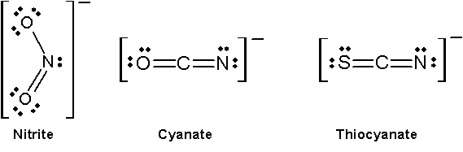
Constitutional (Structural) Isomers
Linkage Isomers
Composition of the complex ion remains the same, but the attachment of the ligand donor atom changes
Some ligands can bind to the metal ion through either of two donor atoms
Ex. pentaamminenitrocobalt(III) chloride
[Co(NH₃)₅(NO₂]Cl₂
pentaamminenitritocobalt(III) chloride
[Co(NH₃)₅(ONO]Cl₂
Ex. Cyanate ion can attach via lone pair of electrons on
the Oxygen atom (NCO:)
or the Nitrogen atom (isocyanato (OCN:)
Other examples of alternate electron
donor pairs for Linkage IsomerS

Slide 26
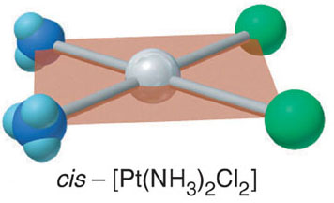
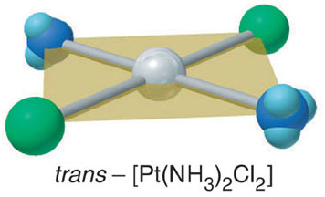
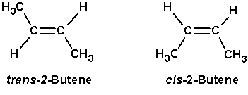
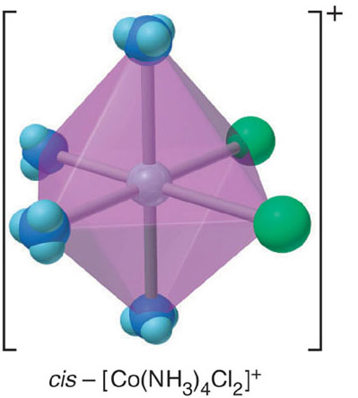
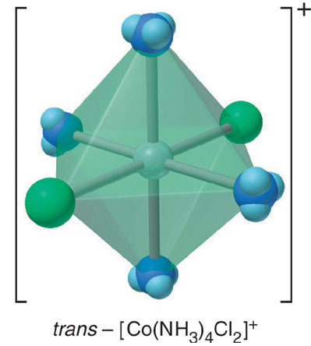
Constitutional (Structural) Isomers
Stereo Isomers
Compounds that have the same atomic connections but different spatial arrangements of the atoms
Geometric Isomers (cis-trans isomers [diastereomers])
Atoms or groups of atoms arranged differently in space relative to the “Central” metal

Slide 27
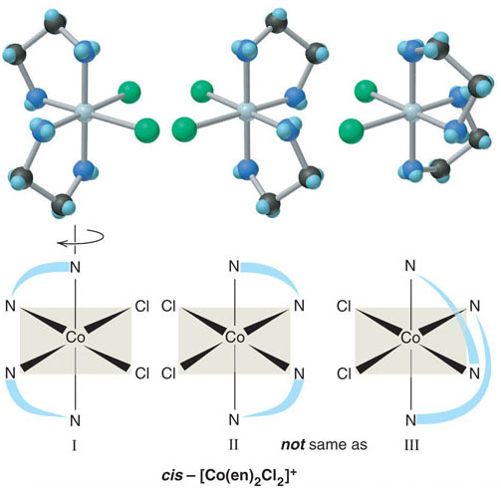
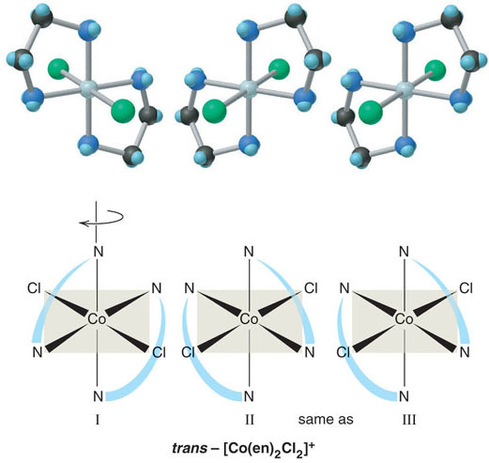
Constitutional (Structural) Isomers
Stereo Isomers
Optical Isomers (enantiomers)
Occur when a molecule and its mirror image can not be superimposed
Optical isomers have distinct physical properties like other types of isomers, with one exception – the direction in which they rotate the plane of polarized light
Optical isomerism in an octahedral complex ion
Rotating structure I in the trans compound gives structure III,which is the same as structure II, its mirror image,
The trans compound does not have any mirror images
Rotating structure I in the cis compound gives structure III, which is not the same as structure II, its mirror image,
Image I & Image III are optical isomers

Slide 28
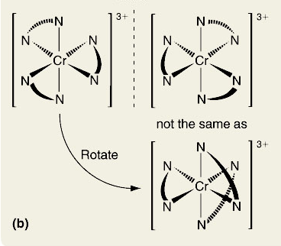
Practice Problem
Draw all stereo isomers for the following
[Pt(NH₃)₂Br₂] Cr(en)₃]³⁺ (en = H₂NCH₂CH₂NH₂)
Pt(II) complex is Square Planar Geometry
Two different monodentate ligands
Geometric Isomers
Each isomer is superimposable on the mirror image – no optical isomerism
trans
cis
Ethylenediamine is a bidentate ligand
The Cr³⁺ has a coordination number of 6 and an octahedral geometry, similar to Co³⁺
The three bidendate ions are identical
∴ No geometric isomerism
This complex ion has a nonsuperimposable mirror image
∴ Optical Isomerism does occur

Slide 29
Theoretical Basis for the Bonding and Properties of Complexes
Questions
How do Metal Ligands bonds form
Why certain geometries are preferred
Why are complexes often brightly colored
Why are complexes often paramagnetic – attracted to a magnetic field as a result of their electron pairs being unpaired

Slide 30
Valence Bond Theory
Theoretical Basis for the Bonding and Properties of Complexes
Application of Valence Bond Theory to Complex Ions
In the formation of a complex ion, the filled ligand orbital overlaps the empty metal-ion orbital
The Ligand (Lewis Base) donates the electron pair and the metal-ion (Lewis Acid) accepts it to form one of the covalent bonds of the complex ion (Lewis adduct)
When one atom in a bond donates both electrons the bond is referred to as a ”coordinate covalent bond”
The number and type of metal-ion hybrid orbitals occupied by ligand lone pairs determine the geometry of the complex ion

Slide 31
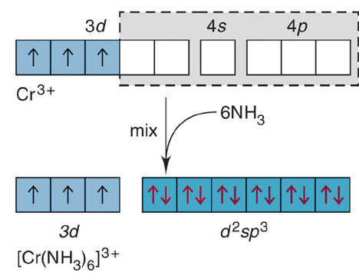
Valence Bond Theory
Application of Valence Bond Theory to Complex Ions
Octahedral Complexes (six electron groups about central atom)
Ex. Hexaamminechromium(III) ion [CrNH₃)₆]³⁺
Six hybrid orbitals are needed to make the ion
The six lowest energy orbitals of the Cr³⁺ ion
Two 3d, one 4s, three 4p
mix and become six equivalent d²sp³ hybrid orbitals that point to the corners of an octahedron
The six d²sp³ hybrid orbitals are filled with the six electron pairs from the six NH₃ ligands
Note the lowest 6 energy levels for Cr3+ involve both n=3 & n=4 sublevels
The 3d orbitals are of lower energy than the 4s and 4p orbitals
The hybrid designation, d²sp³, follows this order
If all the orbitals had the same “n” value, the order would have been sp³d²
Paramagnetic
Unpaired e⁻

Slide 32
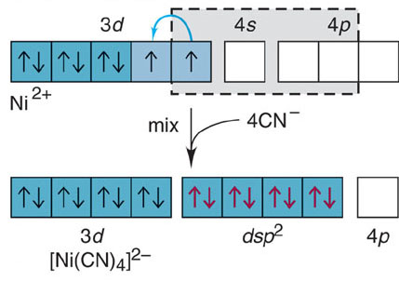
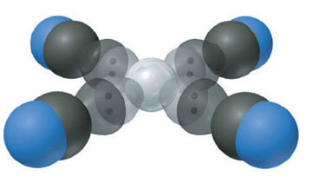
Valence Bond Theory
Application of Valence Bond Theory to Complex Ions
Square Planar Complexes (four electron groups about central atom)
Metal ions with a d⁸ configuration usually form square planar complexes
In the [Ni(CN)₄]²⁻ ion, the model proposes
one 3d, one 4s, two 4p for Ni²⁺
to from four dsp² hybrid orbitals pointing the corners of a square accepting one electron pair from each of the four CN⁻ orbitals
Note the filling of the first 4 unhybridized 3d orbitals after one 3d, one 4s and two 4p orbitals combine to form the four dsp² hybrid orbitals
Paramagnetic
Unpaired e⁻

Slide 33
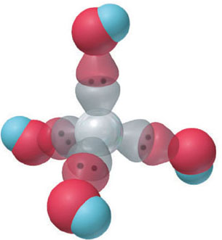
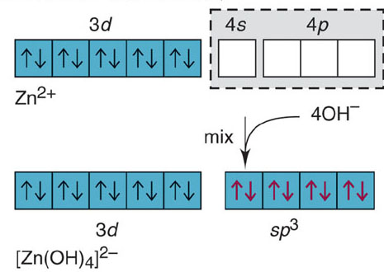
Valence Bond Theory
Application of Valence Bond Theory to Complex Ions
Tetrahedral Complexes (four electron groups about central atom)
Metal ions that have a filled d sublevel, such as Zn+2 [Ar] 3d¹⁰ often form Tetrahedral complexes
In the [Zn(OH)₄]²⁻ ion, the model proposes the lowest available Zn²⁺ orbitals
one 4s, three 4p
mix to become four sp3 hybrid orbitals that point to the corners of a tetrahedron, occupied by four lone pairs, one from each of the four OH⁻ ligands
Diamagnetic

Slide 34
Crystal Field Theory
Valence Bond Theory pictures and rationalizes bonding and shape of molecules
VB theory gives little insight into the colors of coordination compounds and can be ambiguous with regard to magnetic properties
Crystal Field Theory explains color and magnetism
Highlights the “effects” on the d-orbital energies of the metal ion as the ligands approach

Slide 35
Crystal Field Theory
What is Color?
White light is electromagnetic radiation consisting of “all” wavelengths (λ) in the “visible” range
Objects appear “colored” in white light because they absorb certain wavelengths and reflect or transmit others
Opaque objects reflect light
Clear objects transmit light
If the object absorbs all visible wavelengths, it appears “black”
If the object reflects all visible wavelengths, it appears “white”

Slide 36
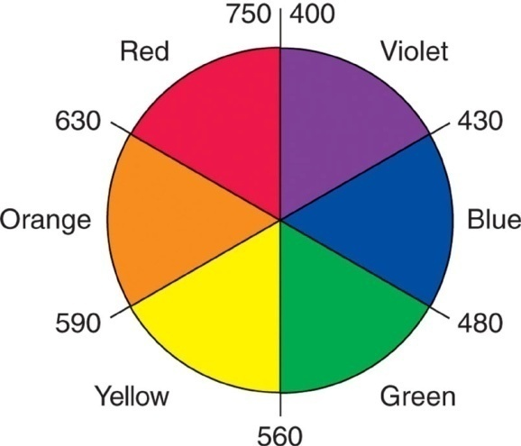
Crystal Field Theory
What is Color?
Each color has a “complimentary” color
An object has a particular color for two reasons
It reflects (or transmits) light of that color or
It absorbs light of the “complimentary” color
Ex. If an object absorbs only red (compliment of green), it is interpreted as “green”
Colors with approximate wavelength ranges
Complimentary colors, such as red and green, lie opposite each other

Slide 37
Crystal Field Theory
In CF Theory, the properties of complexes result from the splitting of d-orbital energies
Split d-orbital energies arise from “electrostatic” interactions between the positively charged metal ion cation and the negative charge of the ligands
The negative charge of the ligand is either partial as in a polar neutral ligand like NH₃, or full, as in an anionic ligand like Cl⁻

Slide 38
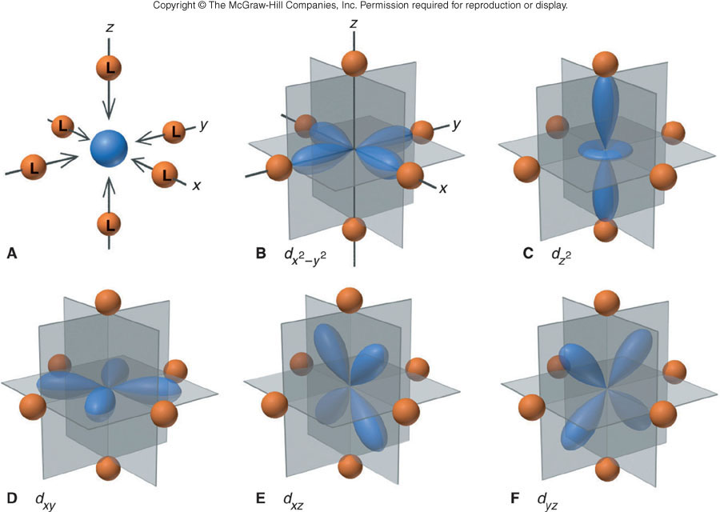
Crystal Field Theory
The ligands approach the metal ion along the mutually perpendicular x, y, and z axes (octahedral orientation), minimizing the overall energy of the system
B & C Lobes of the d_{x2-y2} and d_{z2} orbitals lie directly in line with the approaching ligands and have stronger repulsions
D, E, F lobes of the d_{xy}, d_{xz}, and d_{yz} orbitals lie “between” the approaching ligands, so the repulsion are weaker

Slide 39
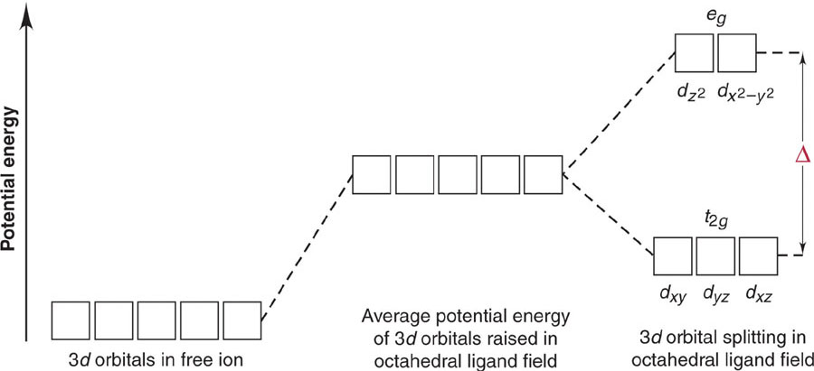
Crystal Field Theory
An energy diagram of the orbitals shows all five d orbitals are higher in energy in the forming complex than in the free metal ion, because of the repulsions from the approaching ligands
Crystal Field Splitting Energy - The d orbital energies are “split” with the two d_{x2-y2} and d_{z2} orbitals (eg orbital set) higher in energy than the d_{xy}, d_{xz}, and d_{yz} orbitals (t₂g orbital set)
Strong-field ligands, such as CN⁻ lead to larger splitting energy
Weak-field ligands such as H₂O lead to smaller splitting energy
Crystal Field Splitting Energy
Forming Complex

Slide 40
Crystal Field Theory
Explaining the Colors of Transition Metals
Diversity in colors is determined by the energy difference (Δ) between the t₂g and eg orbital sets in complex ions
When the ions absorbs light in the visible range, electrons move from the lower energy t₂g level to the higher eg level, i.e., they are “excited” and jump to a higher energy level
Δ E electron = E_{photon} = hv = hc/λ
The substance has a “color” because only certain wavelengths of the incoming white light are absorbed

Slide 41
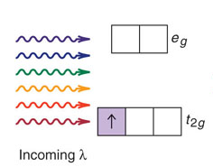
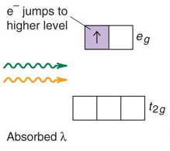

Crystal Field Theory
Example – Consider the [Ti(H₂O)₆]³⁺ ion – Purple in aqueous solution
Hydrated Ti³⁺ is a d¹ ion, with the d electron in one of the three lower energy t_{2g} orbitals
The energy difference (ΔA) between the t_{2g} and e_{g} orbitals corresponds to the energy of photons spanning the green and yellow range
These colors are absorbed and the electron jumps to one of the e_{g} orbitals
Red, blue, and violet light are transmitted as purple

Slide 42
Crystal Field Theory
For a given “ligand”, the color depends on the oxidation state of the metal ion – the number of “d” orbital electrons available
A solution of [V(H₂O)₆]²⁺ ion is violet
A solution of [V(H₂O)₆]³⁺ ion is yellow
For a given “metal”, the color depends on the ligand
[Cr(NH₃)₆]³⁺ (yellow-orange)
[Cr(NH₃)₅]²⁺ (Purple)
Even a single ligand is enough to change the color

Slide 43
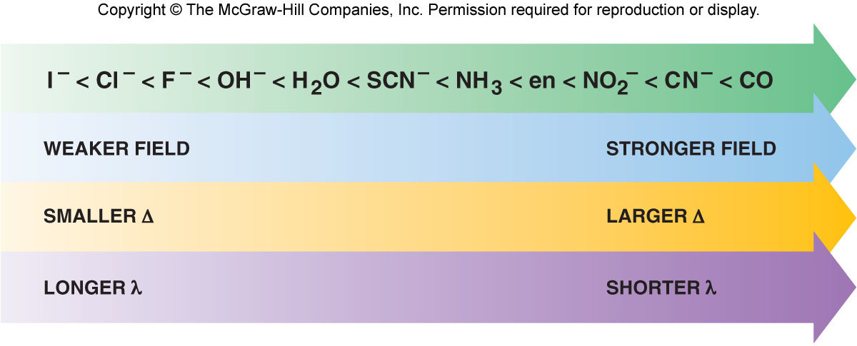
Crystal Field Theory
Spectrochemical Series
The Spectrochemical Series is a ranking of ligands with regard to their ability to split d-orbital energies
For a given ligand, the color depends on the oxidation state of the metal ion
For a given metal ion, the color depends on the ligand
As the crystal field strength of the ligand increases, the splitting energy (Δ) increases (shorter wavelengths of light must be absorbed to excite the electrons

Slide 44
Practice Problem
Rank the following ions in terms of the relative value of Δ and of the energy of visible light absorbed
[Ti(H₂O)₆]³⁺ Ti(NH₃)₆]³⁺ Ti(CN)₆]³⁺
Ans:
Oxidation State of Ti is +3 in all formulas
From the spectrochemical series table, the ligand strength is in the order:
CN⁻ > NH₃ > H₂O
Relative size of Δ, thus, the energy of light absorbed is
Ti(CN)₆]³⁺ > Ti(NH₃)₆]³⁺ > [Ti(H₂O)₆]³⁺

Slide 45
Explaining the Magnetic Properties of Transition Metal Complexes
The splitting of energy levels influence magnetic properties
Affects the number of unpaired electrons in the metal ion “d” orbitals
According to Hund’s rules, electrons occupy orbitals one at a time as long as orbitals of “equal energy” are available
When “all” lower energy orbitals are “half-filled (all +½ spin state)”, the next electron can
Enter a half-filled orbital and pair up (with a –½ spin state electron) by overcoming a repulsive pairing energy (E_{pairing})
or
Enter an empty, higher energy orbital by overcoming the crystal field splitting energy (Δ)
The relative sizes of E_{pairing} and (Δ) determine the occupancy of the d orbitals

Slide 46
Explaining the Magnetic Properties of Transition Metal Complexes
The occupancy of “d” orbitals, in turn, determines the number of unpaired electrons, thus, the paramagnetic behavior of the ion
Ex. Mn²⁺ ion ([Ar] 3d⁵) has 5 unpaired electrons in 3d orbitals of equal energy
In an octahedral field of ligands, the orbital energies split
The orbital occupancy is affected in two ways:
Weak-Field ligands (low Δ) and High-Spin complexes
Strong-Field ligands (high Δ) and Low-Spin complexes
(from spectrochemical series)

Slide 47
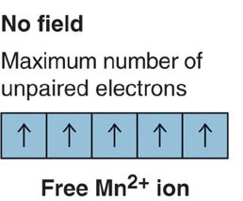
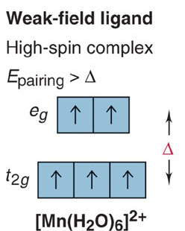
Explaining the Magnetic Properties of Transition Metal Complexes
Weak-Field ligands and High-Spin complexes
Ex. [Mn(H₂O)₆]²⁺ Mn²⁺ ([Ar] 3d⁵)
A weak-field ligand, such as H₂O, has a “small” crystal field splitting energy (Δ)
It takes less energy for “d” electrons to move to the “e_{g}” set (remaining unpaired) rather than pairing up in the “t_{2g}” set with its higher repulsive pairing energy (E_{pairing})
Thus, the number of unpaired electrons in a weak-field ligand complex is the same as in the free ion
Weak-Field Ligands create high-spin complexes, those with a maximum of unpaired electrons
Generally Paramagnetic

Slide 48
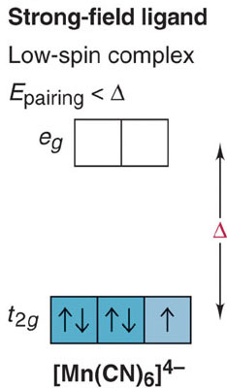
Explaining the Magnetic Properties of Transition Metal Complexes
Strong-Field Ligands and Low-Spin Complexes
Ex. [Mn(CN)₆]⁴⁻
Strong-Field Ligands, such CN⁻, cause large crystal field splitting of the d-orbital energies, i.e., higher (Δ)
(Δ) is larger than (E_{pairing})
Thus, it takes less energy to pair up in the “t_{2g}“ set than would be required to move up to the “e_{g}” set
The number of unpaired electrons in a Strong-Field Ligand complex is less than in the free ion
Strong-Field ligands create low-spin complexes, i.e., those with fewer unpaired electrons
Generally Diamagnetic
Fewer
unpaired electrons

Slide 49
Explaining the Magnetic Properties of Transition Metal Complexes
Orbital diagrams for the d¹ through d⁹ ions in octahedral complexes show that both high-spin and low-spin options are possible only for:
d⁴ d⁵ d⁶ d⁷ ions
With three “lower” energy t_{2g} orbitals available, the d¹, d², d³ ions always form high-spin (unpaired) complexes because there is no need to pair up
Similarly, d⁸ & d⁹ ions always form high-spin complexes because the 3 orbital t_{2g} set is filled with 6 electrons (3 pairs)
The two t_{2g} orbitals must have either two d⁸ or one d⁹ unpaired electron

Slide 50
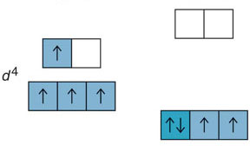
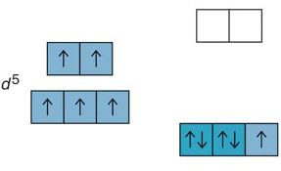
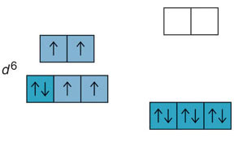
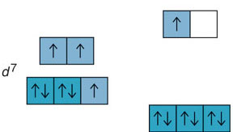
Explaining the Magnetic Properties of Transition Metal Complexes
high spin: weak-field ligand
low spin: strong-field ligand
high spin: weak-field ligand
low spin: strong-field ligand

Slide 51
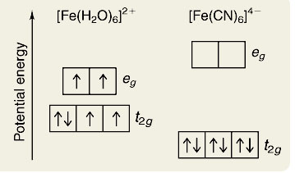
Practice Problem
Iron(II) forms an essential complex in hemoglobin
For each of the two octahedral complex ions
[Fe(H₂O)₆]²⁺ [Fe(CN)₆]⁴⁻
Draw an orbital splitting diagram, predict the number of unpaired electrons, and identify the ion as low-spin or high spin
Ans:
Fe²⁺ has the [Ar] 3d⁶ configuration
H₂O produces smaller crystal field splitting (Δ) than CN⁻
The [Fe(H₂O)₆]²⁺ has 4 unpaired electrons (high spin)
The [Fe(CN)₆]⁴⁻ has no unpaired electrons (low spin)

Slide 52
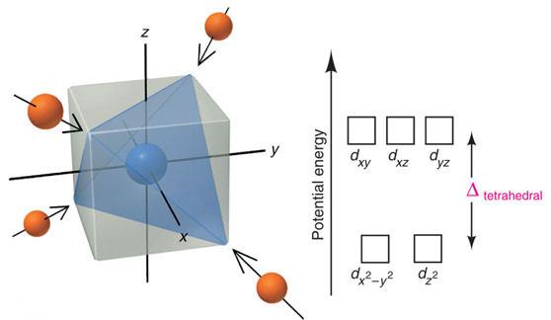
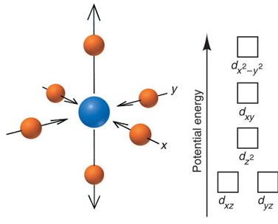
Crystal Field Theory
Four electron groups about the central atom
Four ligands around a metal ion also cause d-orbital splitting, but the magnitude and pattern of the splitting depend on the whether the ligands are in a “tetrahedral” or “square planar” arrangement
Tetrahedral – AX₄
Octahedral – AX₄E₂ (2 ligands along “z” axis removed)
Splitting of d-orbital energies by a tetrahedral field of ligands
Splitting of d-orbital energies by a square planar field of ligands.

Slide 53
Crystal Field Theory
Tetrahedral Complexes
Ligands approach corners of a tetrahedron
None of the five metal ion “d” orbitals is directly in the path of the approaching ligands
Minimal repulsions arise if ligands approach the d_{xy}, d_{yz}, and d_{yz} orbitals closer than if they approach the d_{x}²_{-y}² and d_{z}² orbitals (opposite of octahedral case)
Thus, the d_{xy}, d_{yz}, and d_{yz} orbitals experience more electron repulsion and become higher energy
Splitting energy of d-orbital energies is “less” in a tetrahedral complex than in an octahedral complex
Δ_{tetrahedral} < Δ_{octahedral}
Only high-spin tetrahedral complexes are known because the magnitude of (Δ) is small (weak)

Slide 54
Crystal Field Theory
Square Planar Complexes
Consider an Ocatahedral geometry with the two z axis ligands removed, ∴no z-axis interactions take place
Thus, the d_{z2}, d_{xz} an d_{yz} orbital energies decrease
The two ‘d” orbitals in the xy plane (d_{xy}, d_{x}²_{-y}²) interact most strongly with the approaching ligands
The (d_{xy}, d_{x}²_{-y}²) orbital has its lobes directly on the x,y axis and thus has a higher energy than the d_{xy} orbital
Square Planar complexes are generally strong field – low spin and generally diamagnetic
d⁸ metals ions such as [PdCl₄]²⁻ have 4 pairs of the electrons filling the lowest energy levels and are thus, “diamagentic”

