Slide 1
Part 1: Prepare the data infrastructure

Slide 2
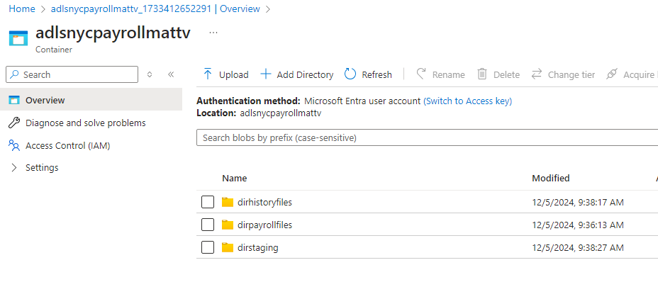
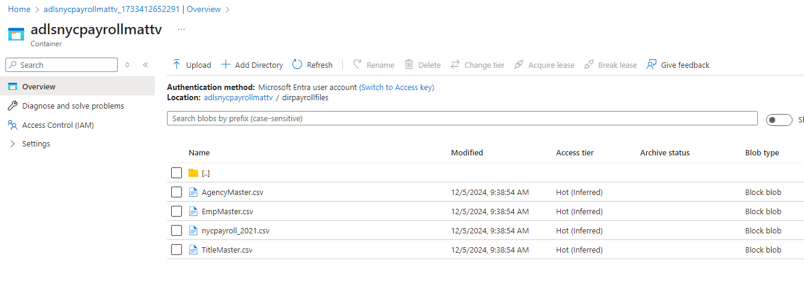
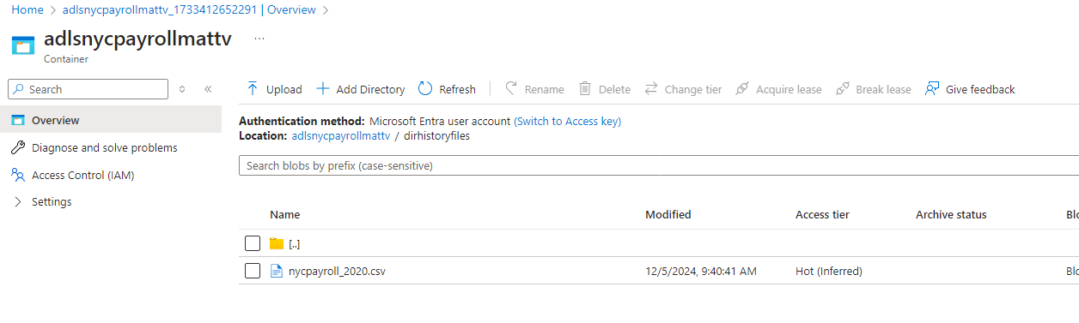
1a. DataLakeGen2 that shows files are uploaded

Slide 3
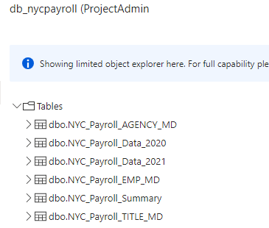
1b. Above 5 tables created in SQL db

Slide 4
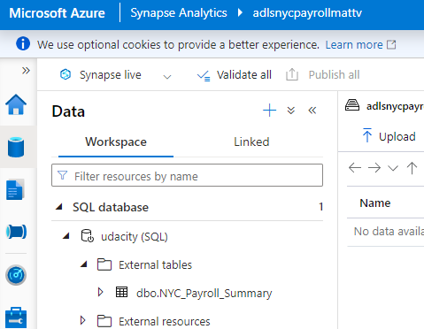
1C. External Table Created In Synapse

Slide 5
Part 2: Create Linked Services

Slide 6
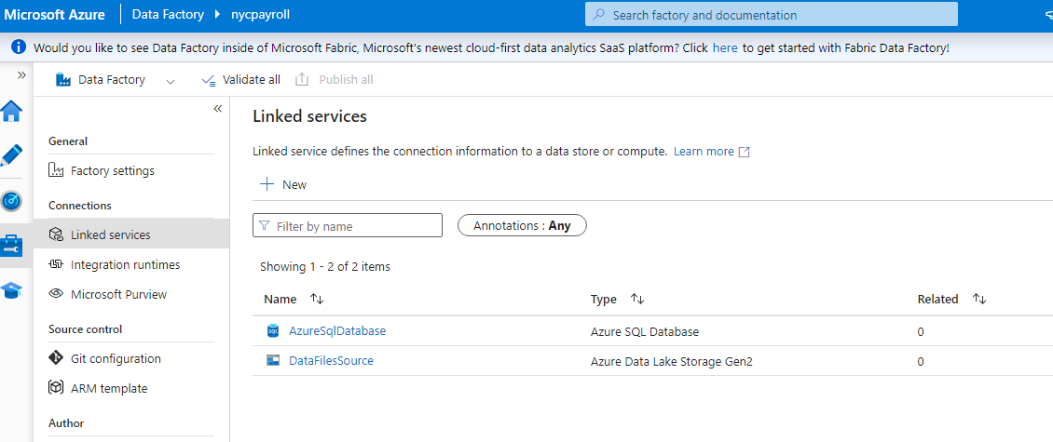
Linked Services Page After Creation
Added Synapse Linked Service after

Slide 7
Part 3: Create Datasets in Azure Data Factory

Slide 8
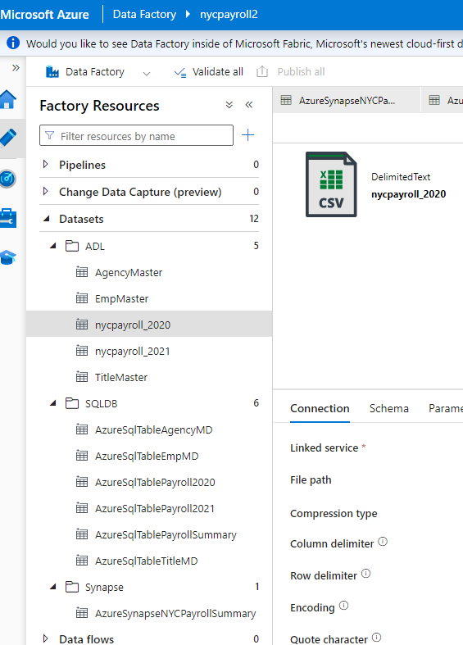
Datasets in Data Factory

Slide 9
Part 4: Create Data Flows

Slide 10
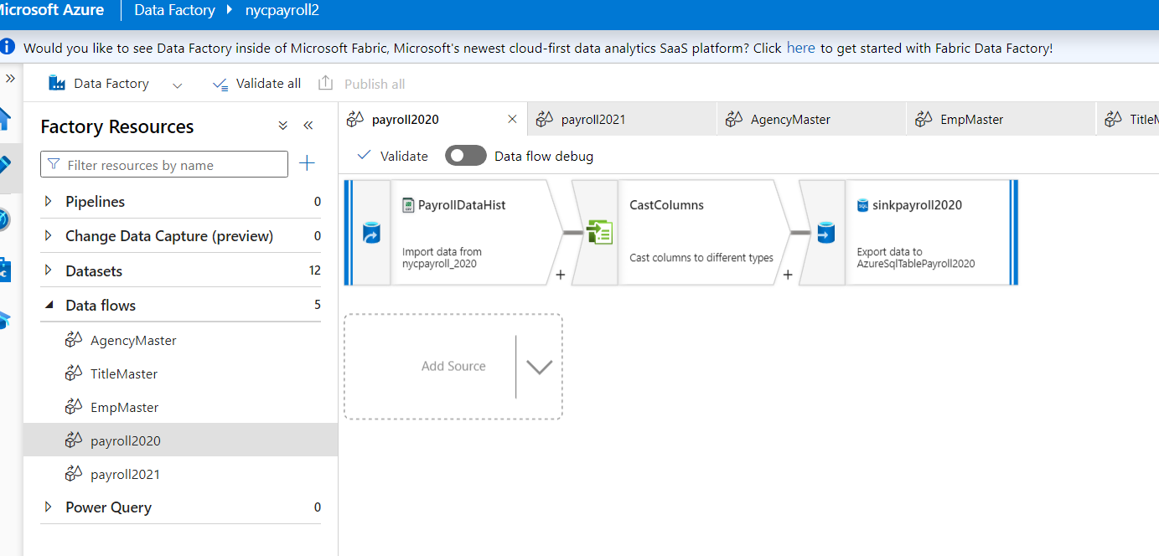

Slide 11
Part 5: Data Aggregation and Parameterization

Slide 12
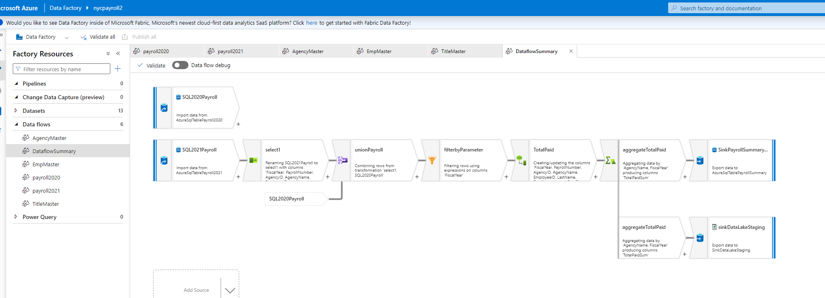

Slide 13
Part 6: Pipeline Creation

Slide 14
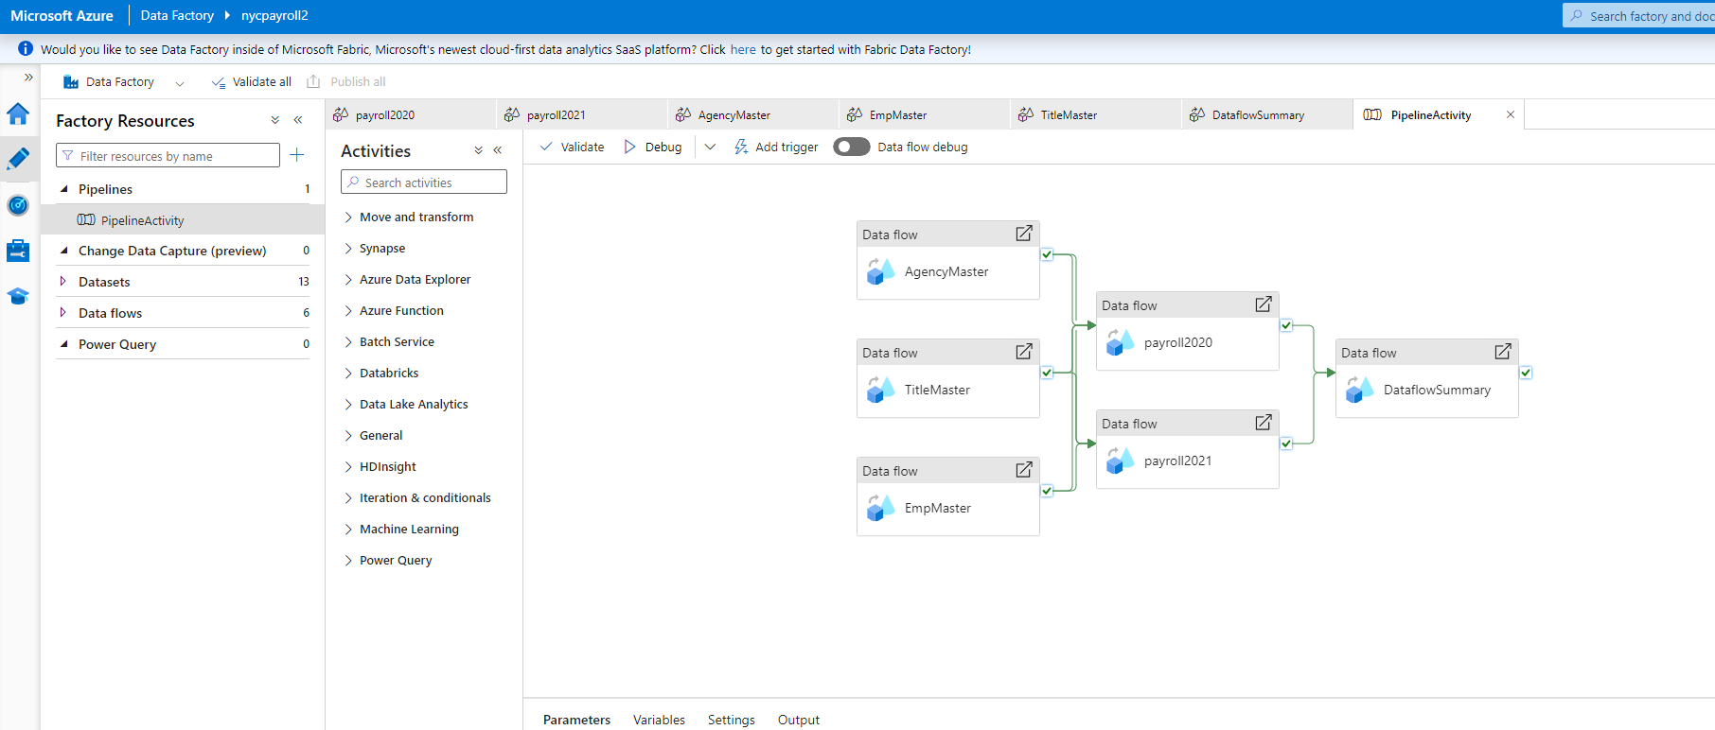

Slide 15
Part 7: Trigger and Monitor Pipeline

Slide 16
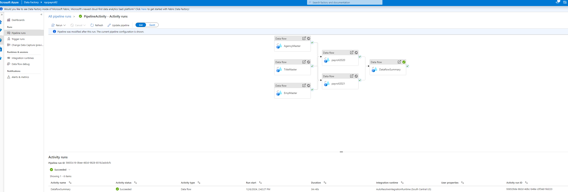
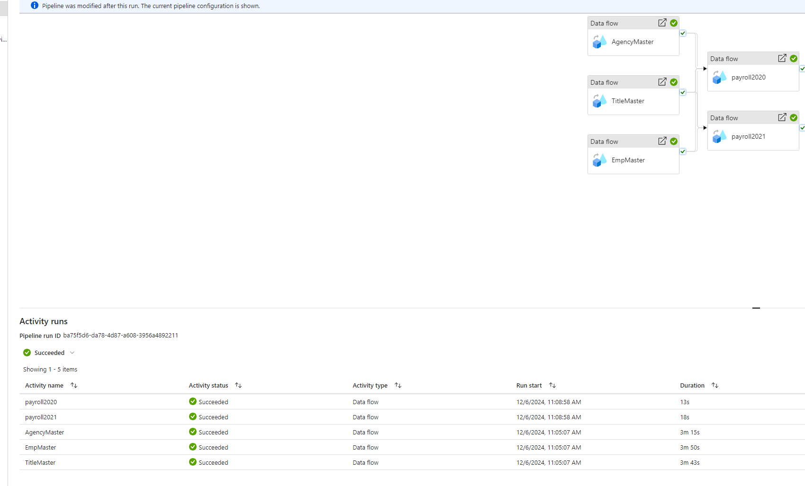
Had to rerun last dataflow activity

Slide 17
Part 8: Verify Pipeline run artifacts

Slide 18
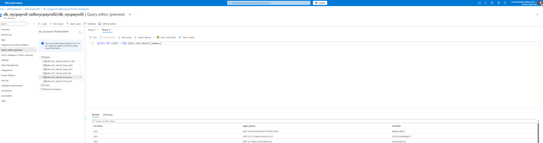
8a) Query data in SQL DB summary table (destination table). This is one of the sinks defined in the pipeline.

Slide 19
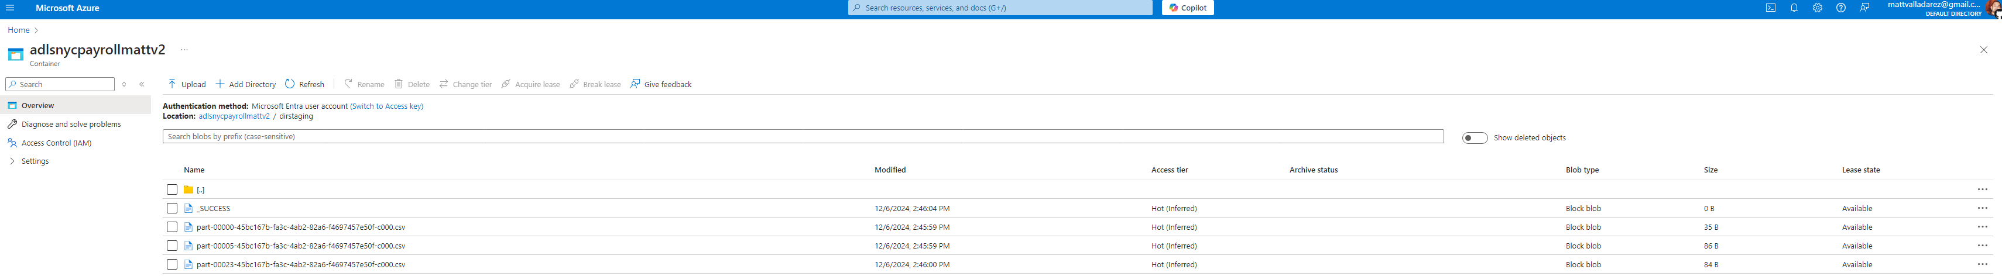
8b) Check the dirstaging directory in Datalake if files got created. This is one of the sinks defined in the pipeline

Slide 20
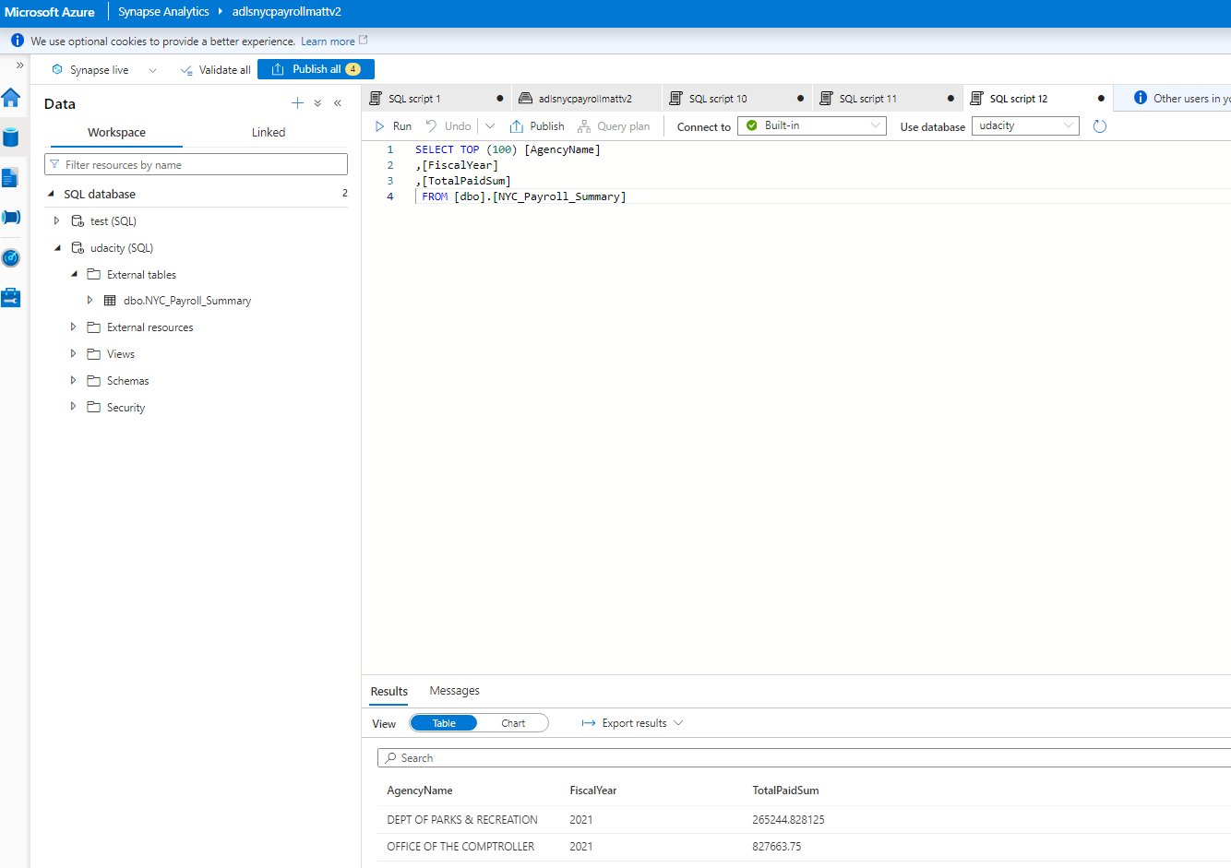
8c) Query data in Synapse external table that points to the dirstaging directory in Datalake.

