Slide 1
America’s beers – boozy or just bitter?
Matt Farrow, Megan Ball
DS6306

Slide 2
Data Dictionary
Beers
Breweries
Name (beer name)
Beer ID
ABV (alcohol by volume)
IBU (international bitterness units)
Brewery ID
Style
Ounces
Brew ID
Name (brewery name)
City
State

Slide 3
Handling Missing Values
Many Missing IBU
Impute Mean by Beer Style
Remove Remaining Rows
Containing NAs

Slide 4
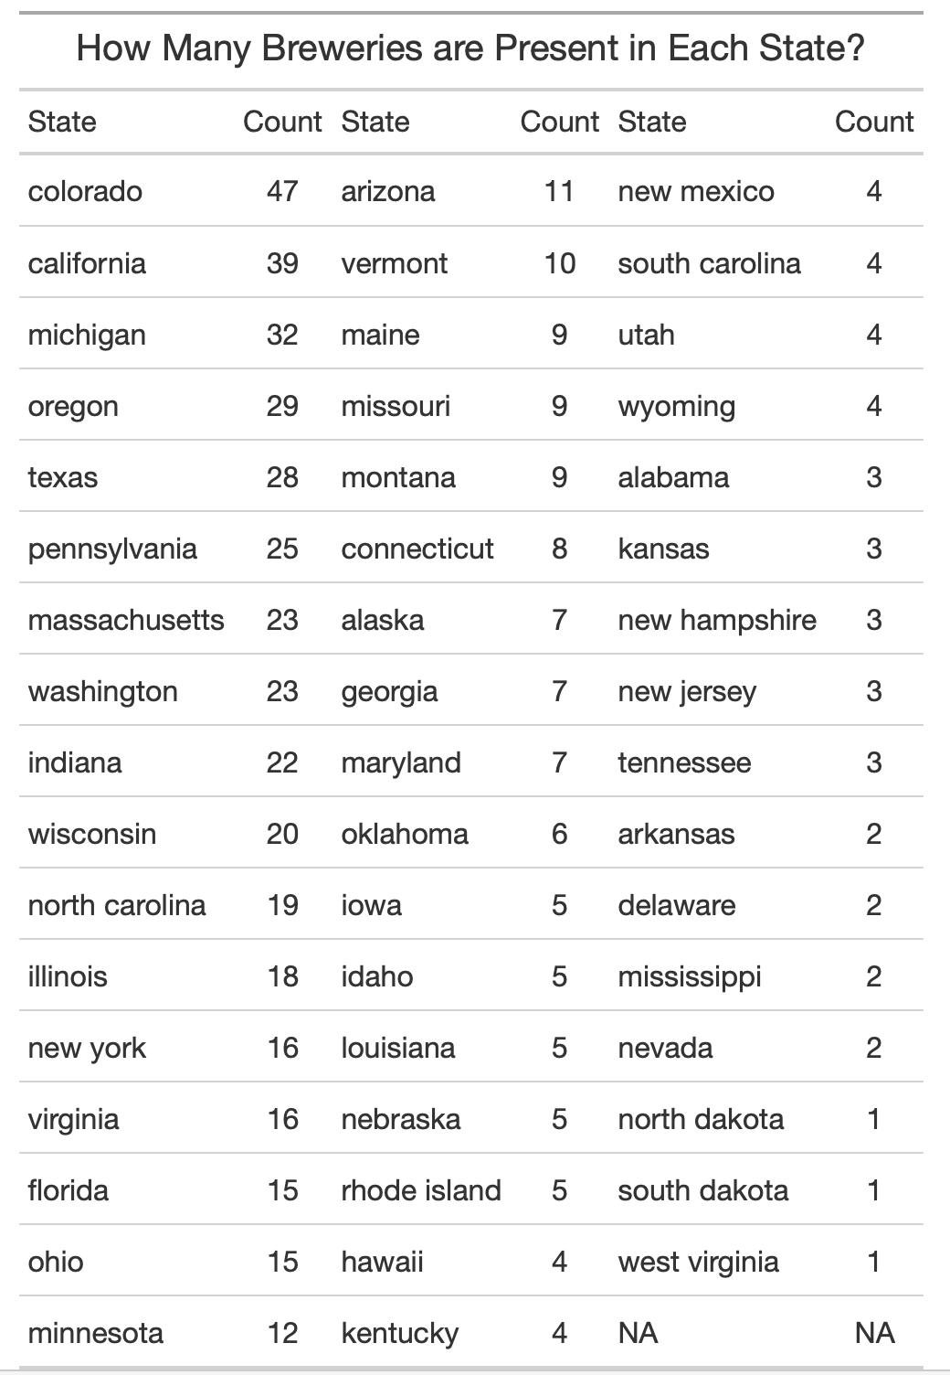
Breweries by state
First – let’s take a look at which states have the highest concentration of breweries
We have a clear outlier in Colorado with a total of 47 breweries!
North Dakota, South Dakota, and West Virginia all tie with only one brewery per ‘state’

Slide 5
Alcohol by volume
Overall, most states have similar median values for ABV… except for Utah
The median ABV tends to be largely between 5% and 6% across the US

Slide 6

IBU for each state
West virginia likes their beer very bitter, with the highest ibu at 57.5

Slide 7
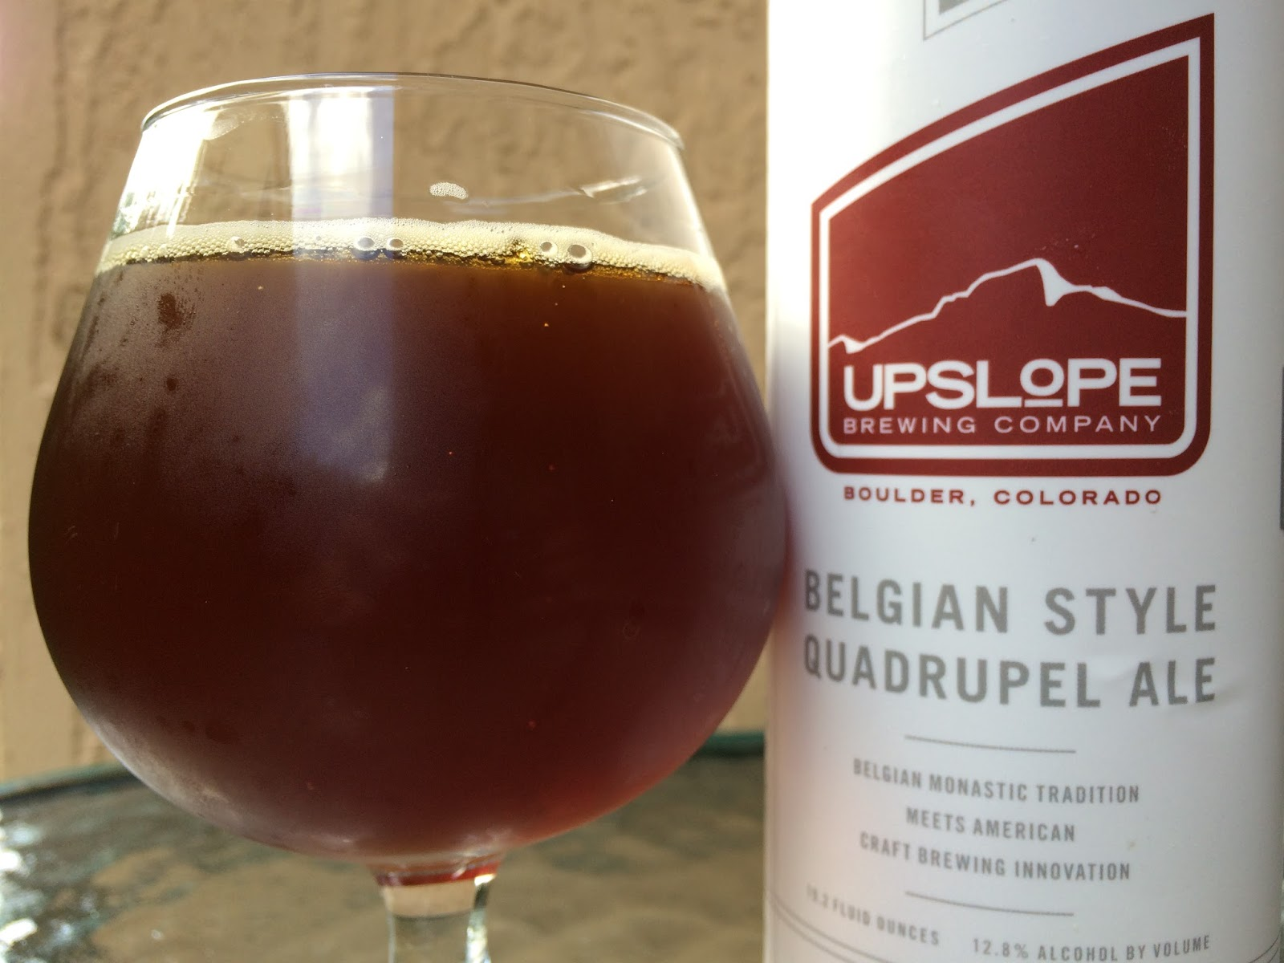
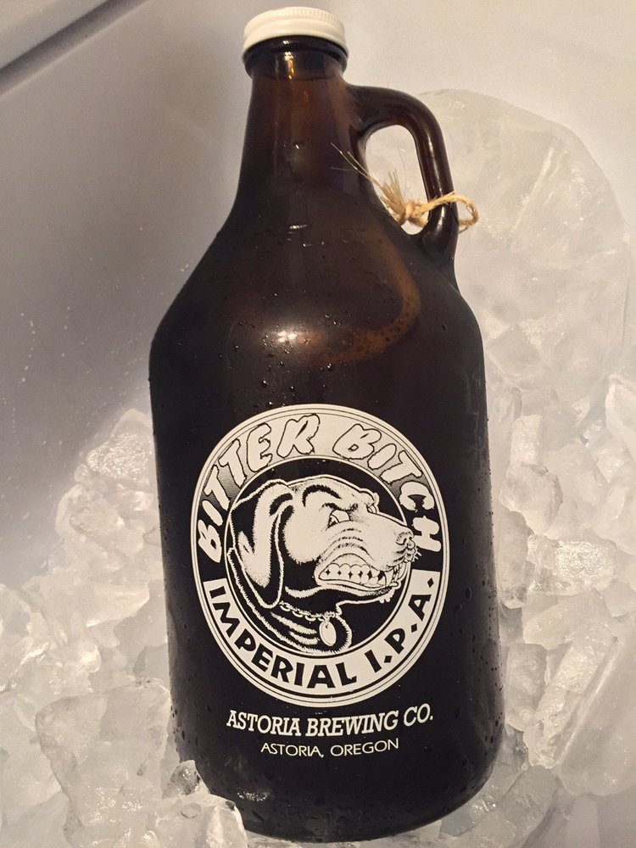
Which state has the beer with highest abv? Ibu?
Most alcoholic – 12.8%
Most bitter – 138 IBU
Lee Hill Series Vol. 5 - Belgian Style Quadrupel Ale
Upslope Brewing Co., Boulder, CO
Bitter Bitch Imperial IPA
Astoria Brewing Co., Astoria, OR

Slide 8
Abv overall
Belgian Style Quadrupel Ale at 12.8%
London Balling at 12.5%
Csar at 12%

Slide 9
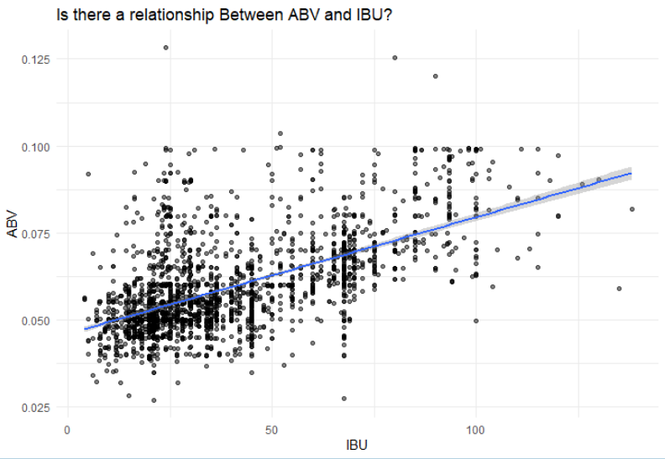
Relationship between bitter & boozy
In general, there appears to be a relationship between IBU and ABV.
Based on our assessment, we may be able to predict ABV based on IBU along with style and other variables of interest.

