Slide 1
America’s beers – boozy or just bitter?
Matt Farrow, Megan Ball
DS6306

Slide 2
Data Dictionary
Beers (2,410)
Breweries (558)
Name (beer name)
Beer ID
ABV (alcohol by volume)
IBU (international bitterness units)
Brewery ID
Style
Ounces
Brew ID
Name (brewery name)
City
State

Slide 3
Handling Missing Values
Many Missing IBU
Impute Mean by Beer Style
Remove Remaining Rows
Containing NAs

Slide 4
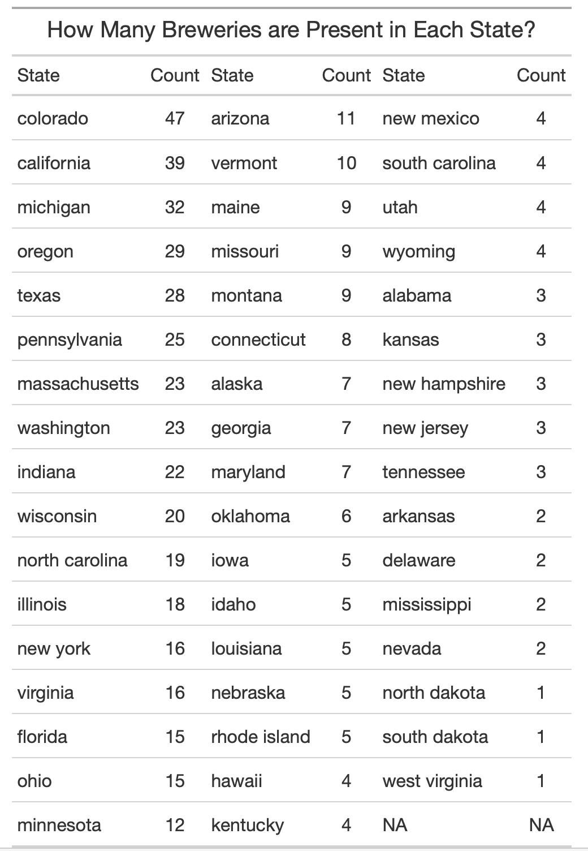
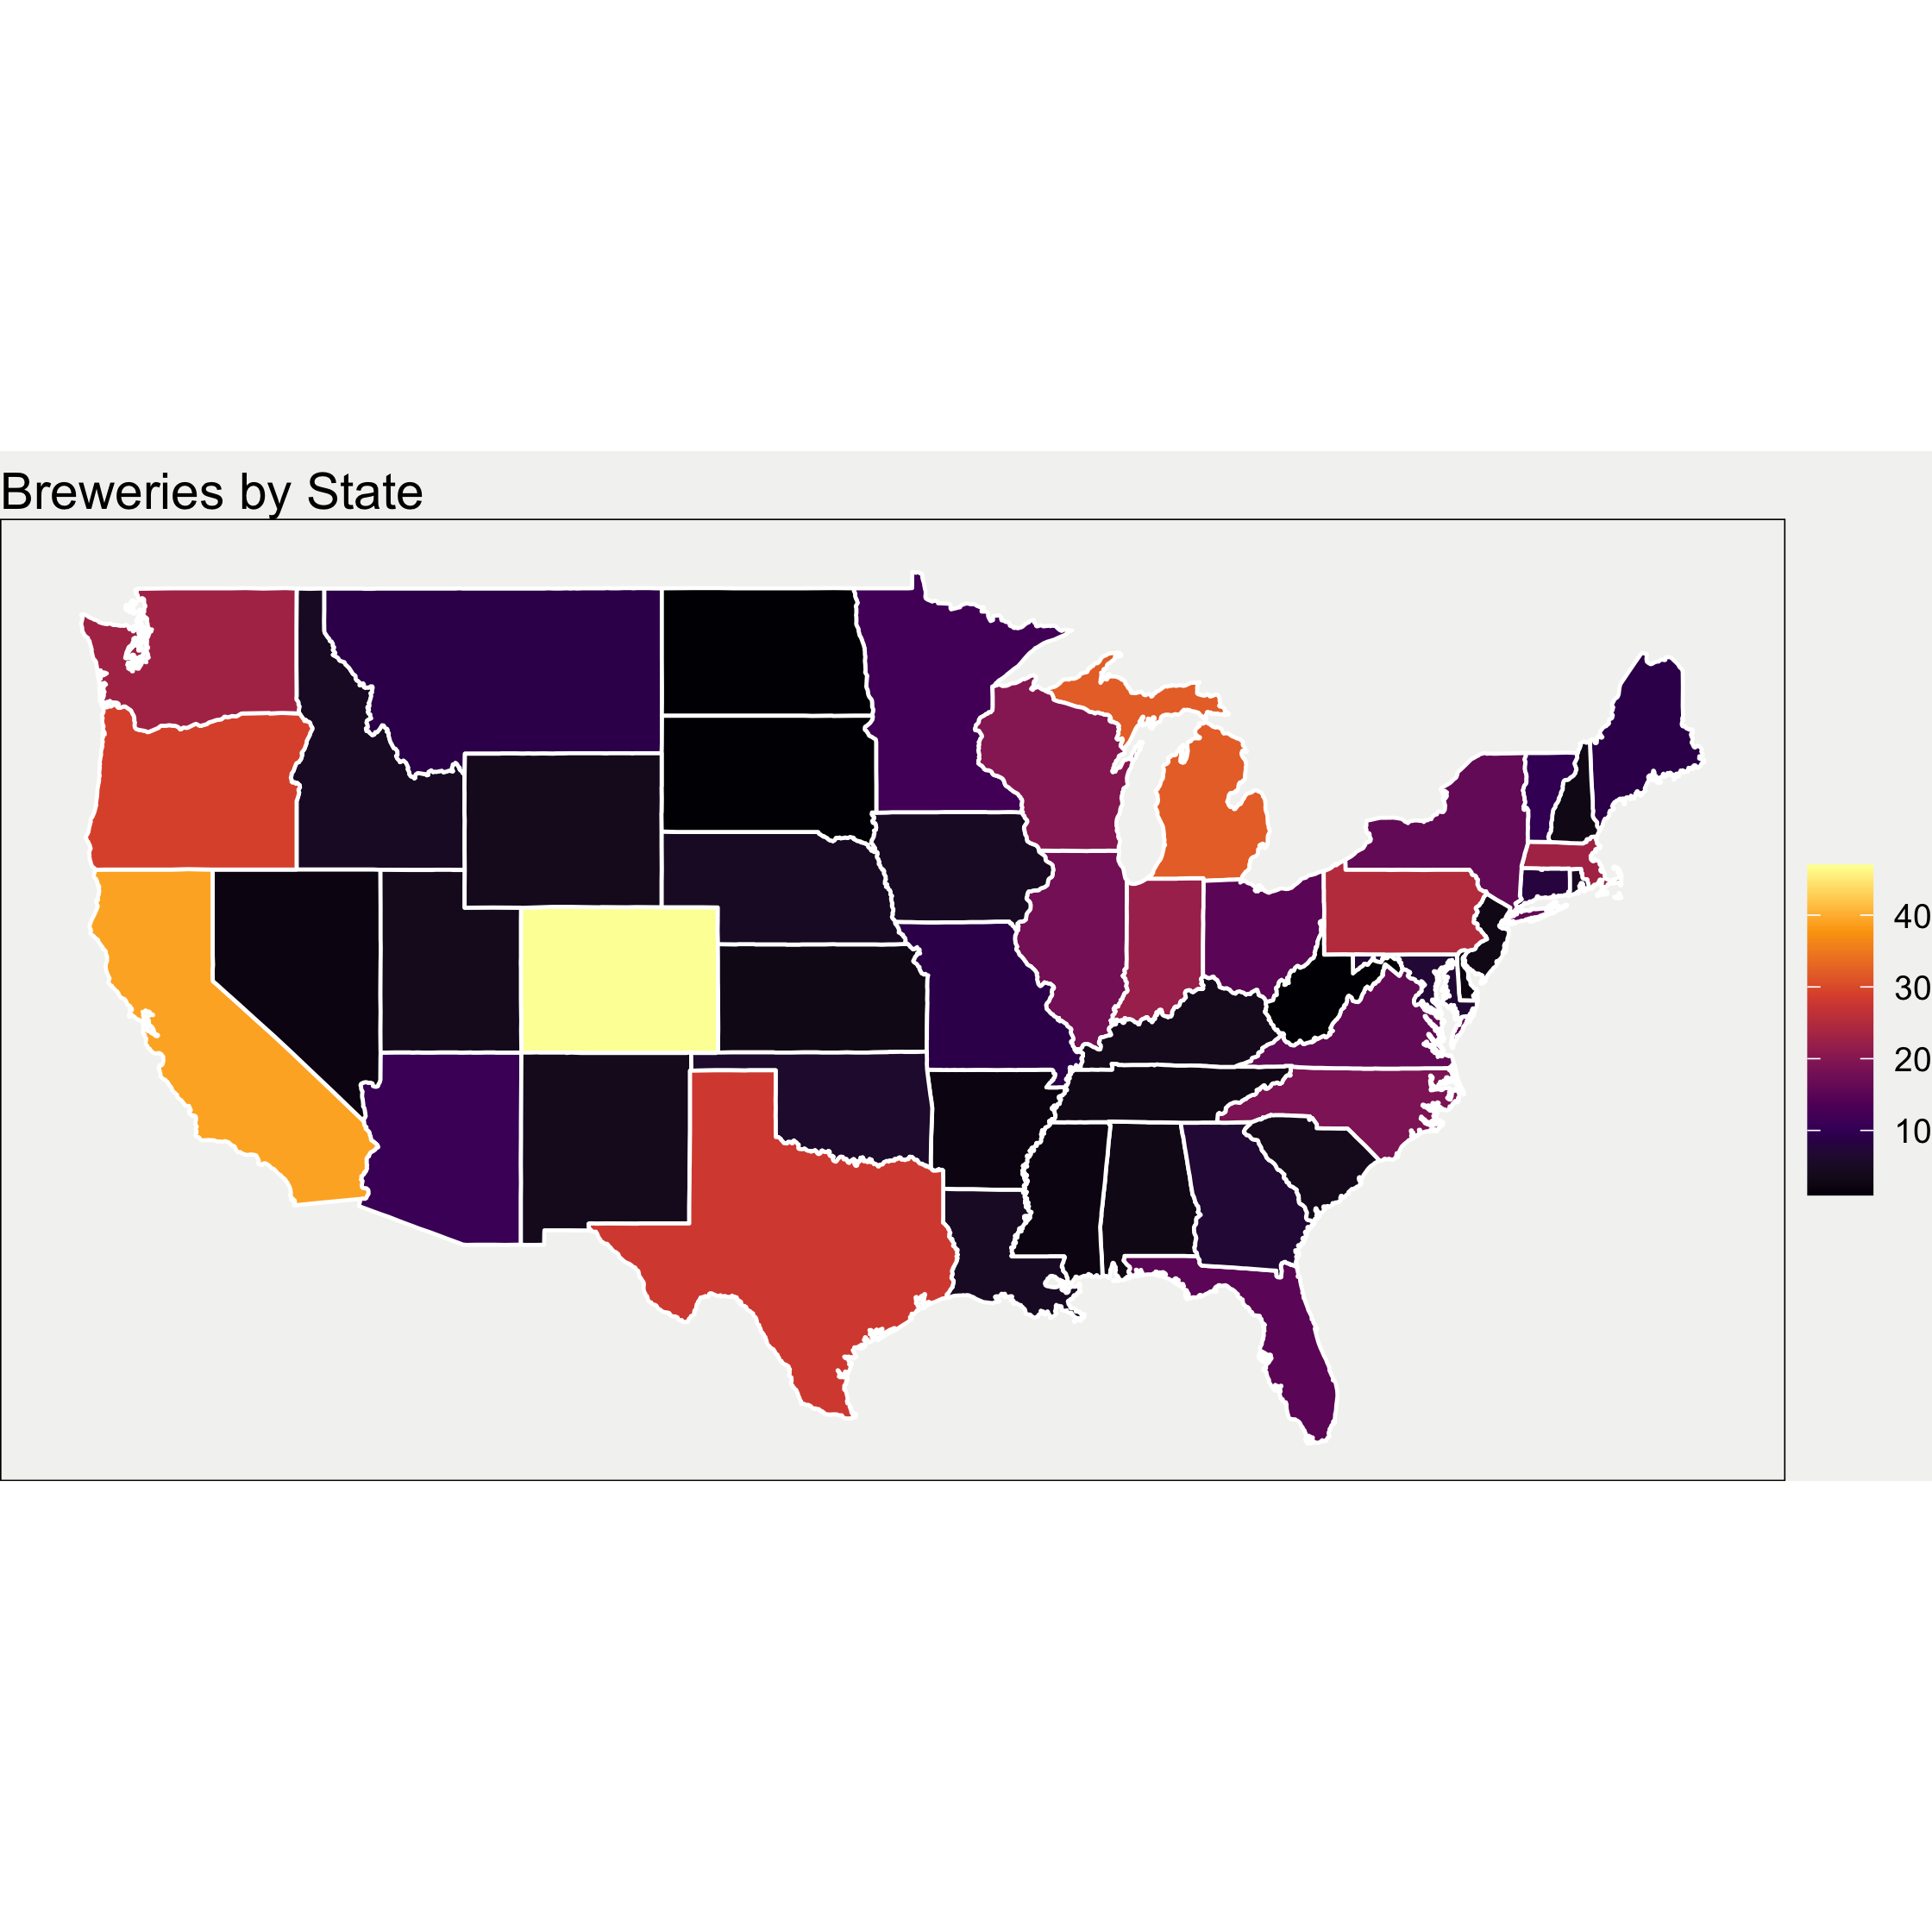
Breweries by state
Colorado is a clear outlier with 47 breweries
North Dakota, South Dakota, and West Virginia all tie with only one brewery per state

Slide 5
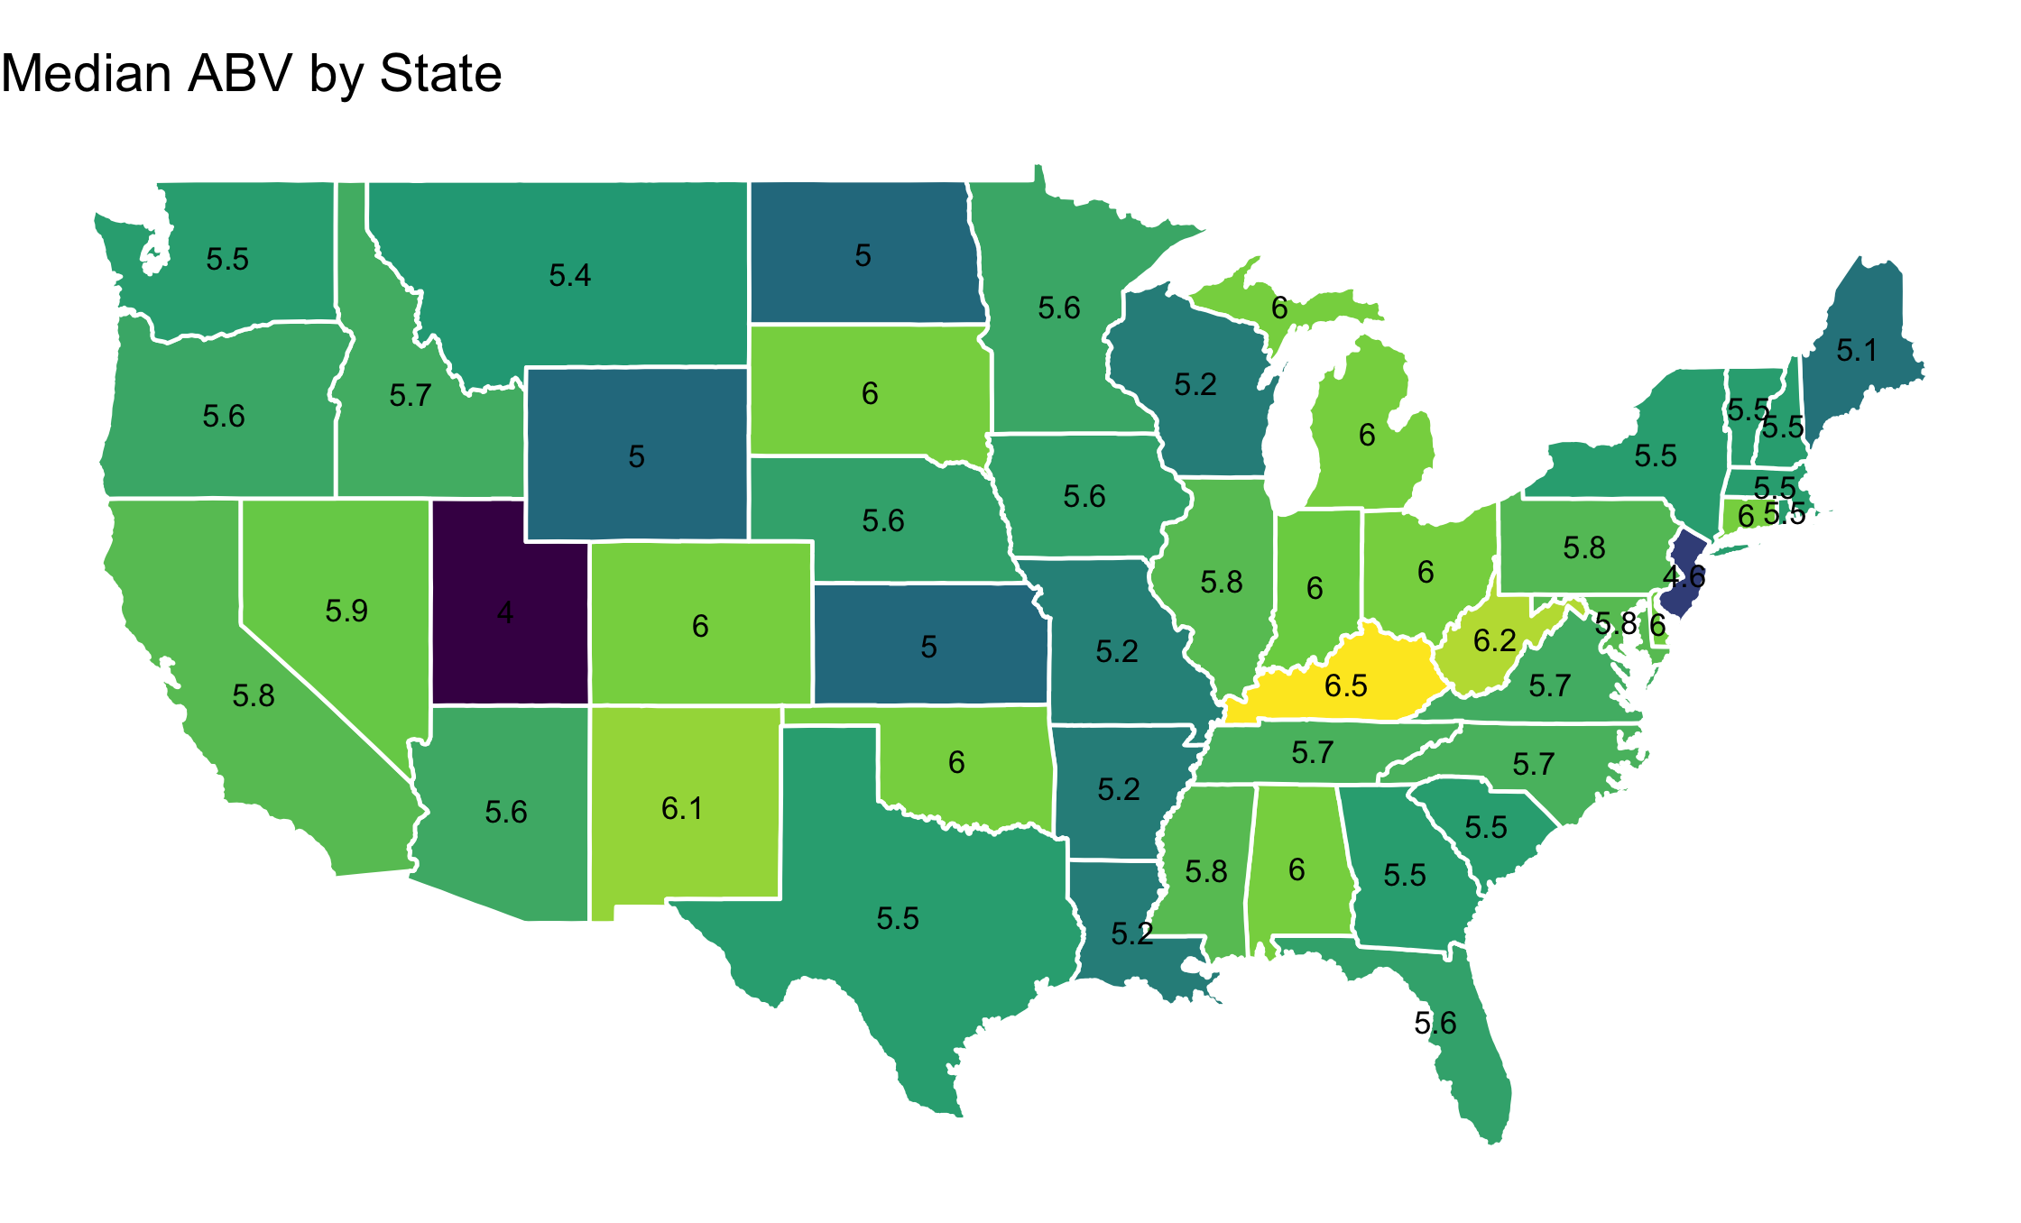
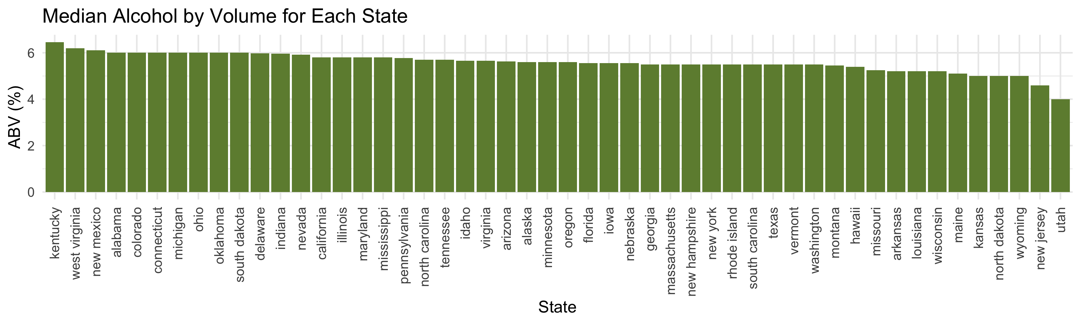
ABV for each state
Overall, most states have similar median values for ABV… except for Utah
The median ABV tends to be largely between 5% and 6% across the US
Confidential — For Internal Use Only

Slide 6
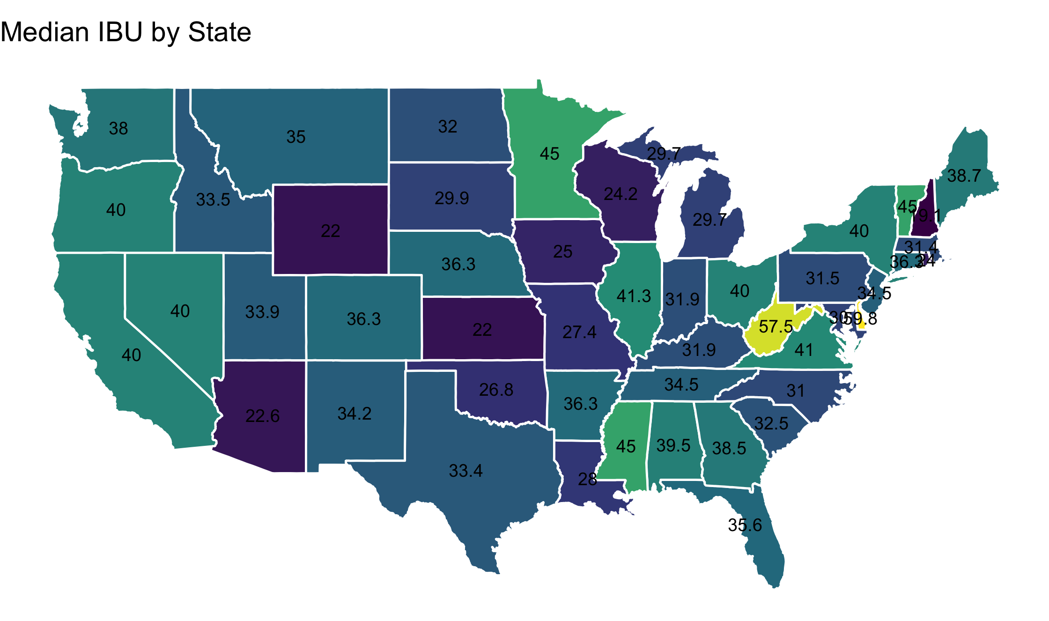
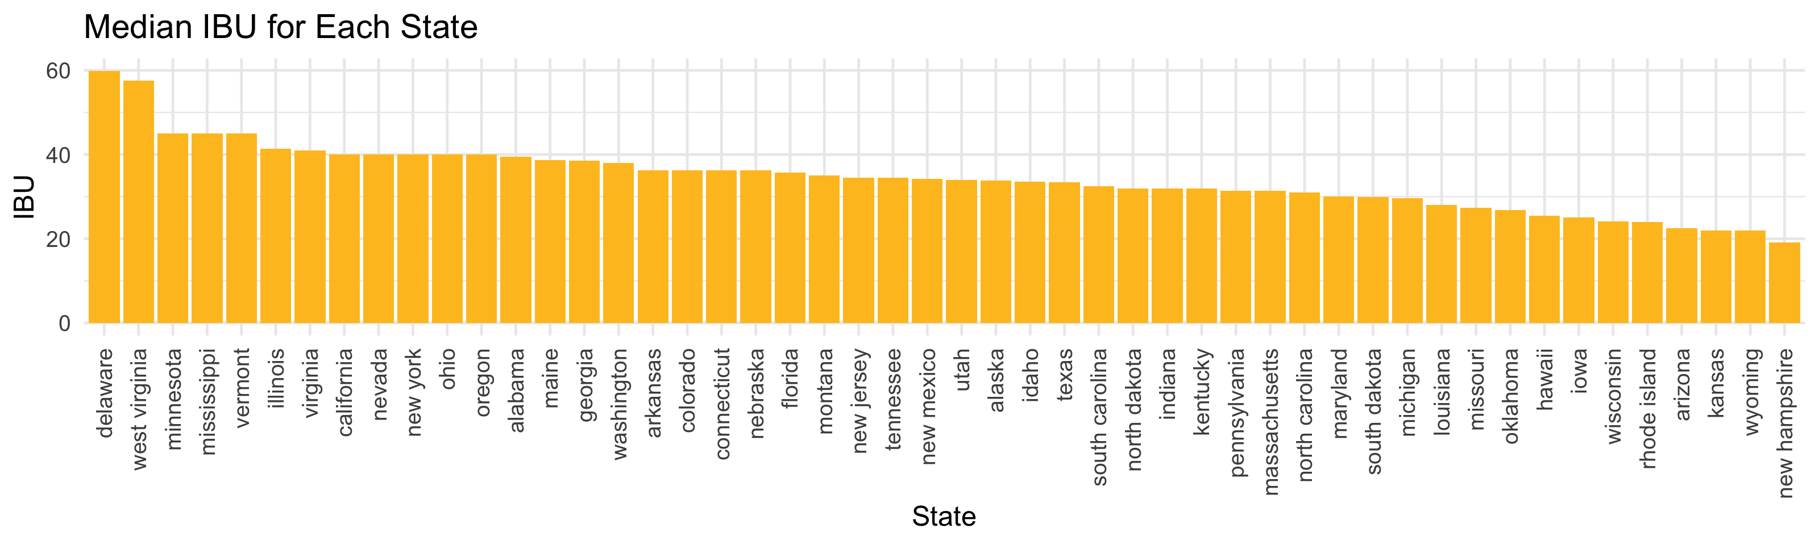
IBU for each state
Brewery | Beer | IBU
Greenbrier Valley Brewing Company | Wild Trail Pale Ale | 44
 | Mothman Black IPA | 71
Brewery | Beer | IBU
Iron Hill Brewery & Restaurant | Appreciation Ale | 68*
Twin Lakes Brewing Company | Greenville Pale Ale | 52
Wide range of bitterness in beers across america
Confidential — For Internal Use Only

Slide 7
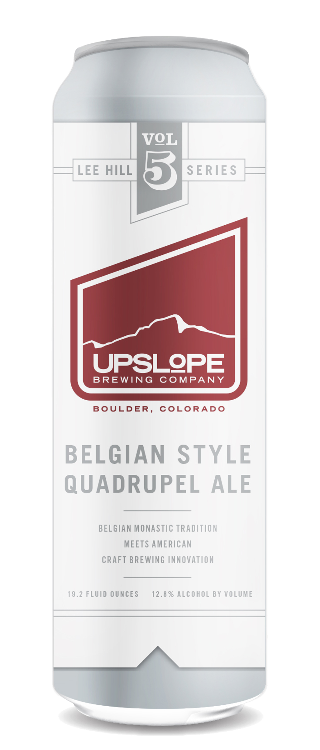
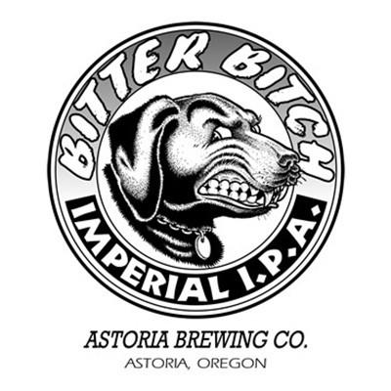
Which state has the beer with highest abv? Ibu?
Most alcoholic – 12.8%
Most bitter – 138 IBU
Lee Hill Series Vol. 5
Belgian Style Quadrupel Ale
Upslope Brewing Co.
Boulder, CO
Bitter Bitch Imperial IPA
Astoria Brewing Co.
Astoria, OR

Slide 8
Abv overall
Belgian Style Quadrupel Ale (12.8%)
London Balling (12.5%)
Csar (12%)
Confidential — For Internal Use Only

Slide 9
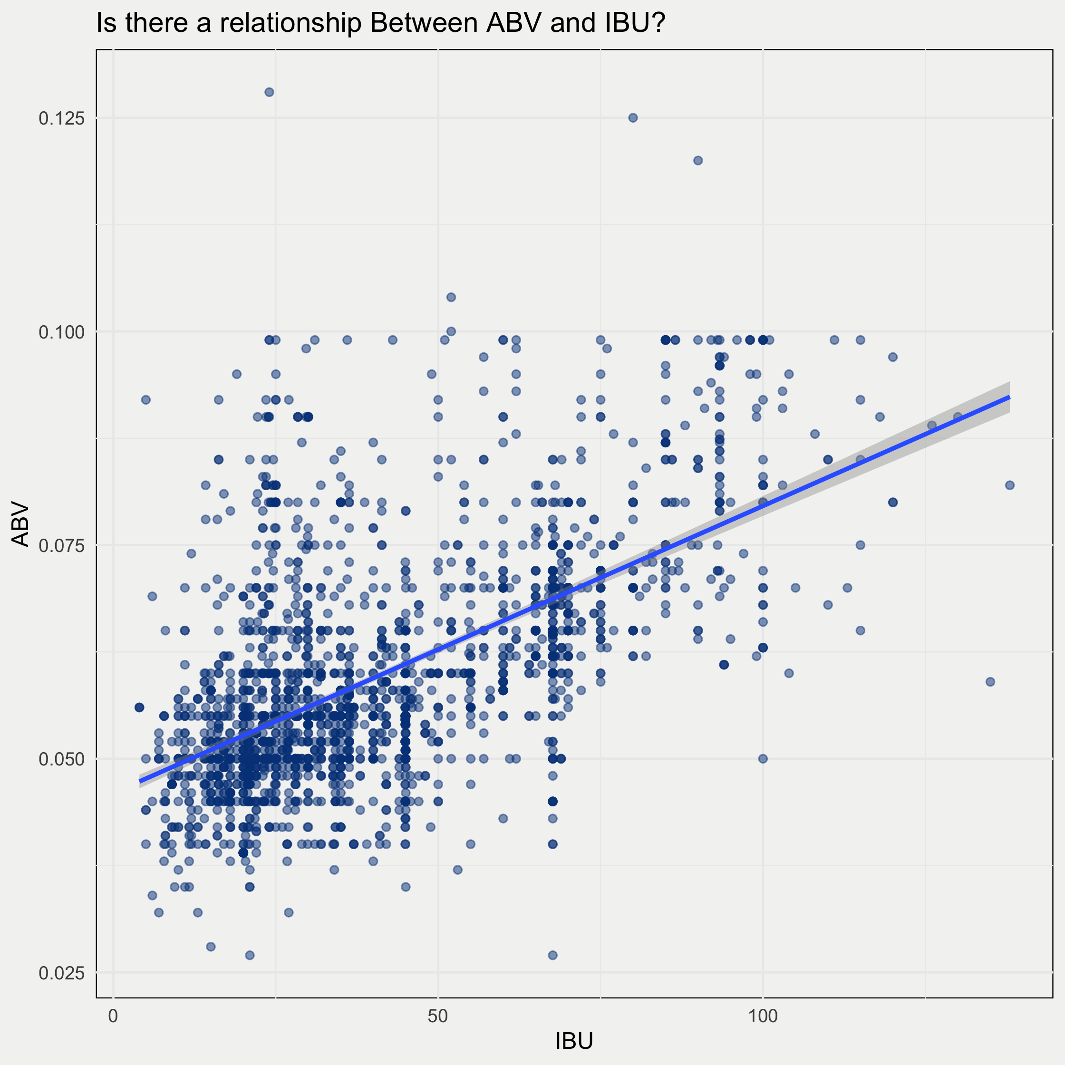
Relationship between bitter & boozy
In general, there appears to be a relationship between IBU and ABV.
Based on our assessment, we may be able to predict ABV based on IBU along with style and other variables of interest in future analyses

Slide 10
Can we guess which is an ipa?
Based on a beer’s IBU and ABV, we can predict if a beer will be an IPA or other type of ale with an overall accuracy of 89%
Our model correctly predicted 107 out of 116 as Ales (92%) and 117 out of 135 as IPAs (87%)
To further improve our predictions, we can research the true IBU and ABV values instead of using imputation
 | Reference
Prediction | Ale | IPA
Ale | 107 | 18
IPA | 9 | 117

Slide 11
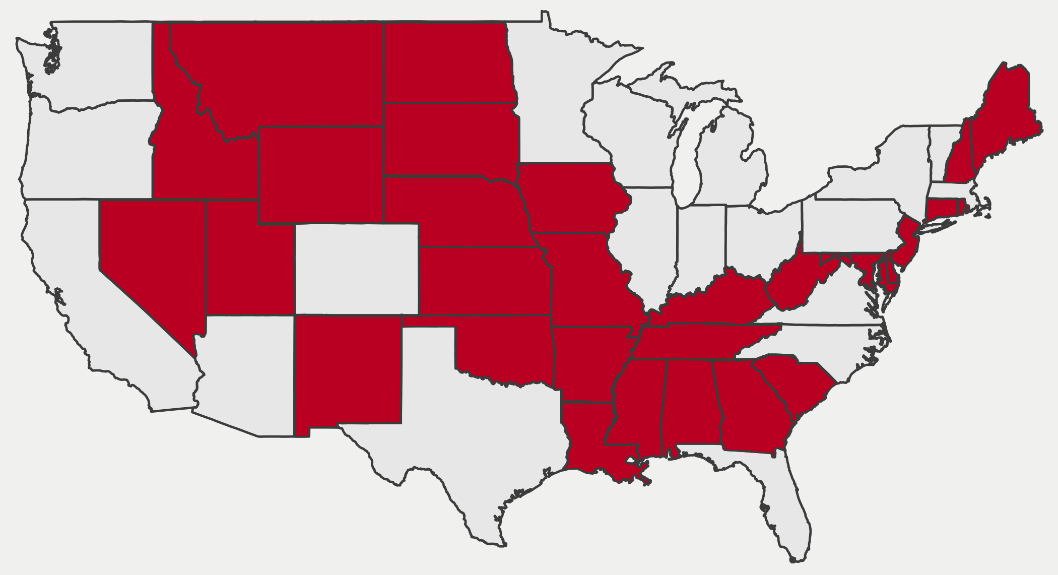
Middle America offers untapped potential for Ipas
Red states have fewer than 10 IPAs available to consumers!

Slide 12
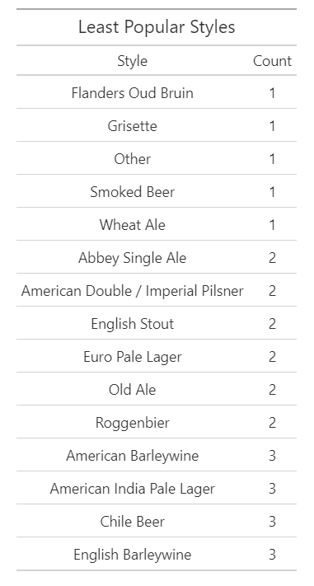
More Opportunity
Aside from distribution, there is also opportunity for new beer styles
These fifteen styles are the least popular canned beers and offer opportunity for new markets

