Slide 1
America’s beers – boozy or just bitter?
Matt Farrow, Megan Ball
DS6306

Slide 2
Data Dictionary
Beers (2,410)
Breweries (558)
Name (beer name)
Beer ID
ABV (alcohol by volume)
IBU (international bitterness units)
Brewery ID
Style
Ounces
Brew ID
Name (brewery name)
City
State
Confidential — For Internal Use Only

Slide 3
Handling Missing Values
Many Missing IBU
Impute Mean by Beer Style
Remove Remaining Rows
Containing NAs
Confidential — For Internal Use Only

Slide 4
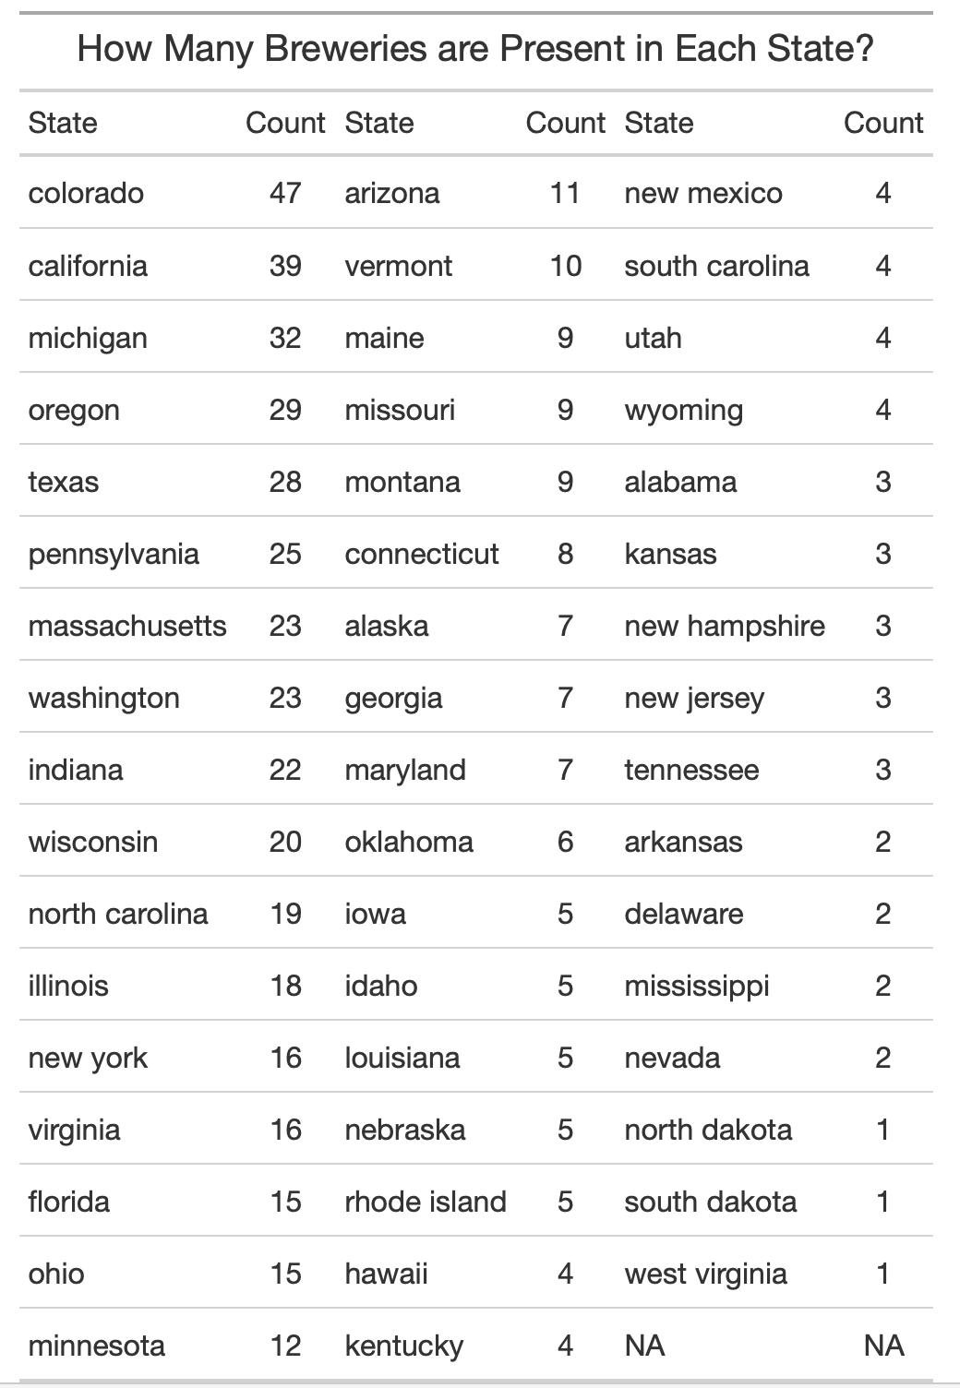
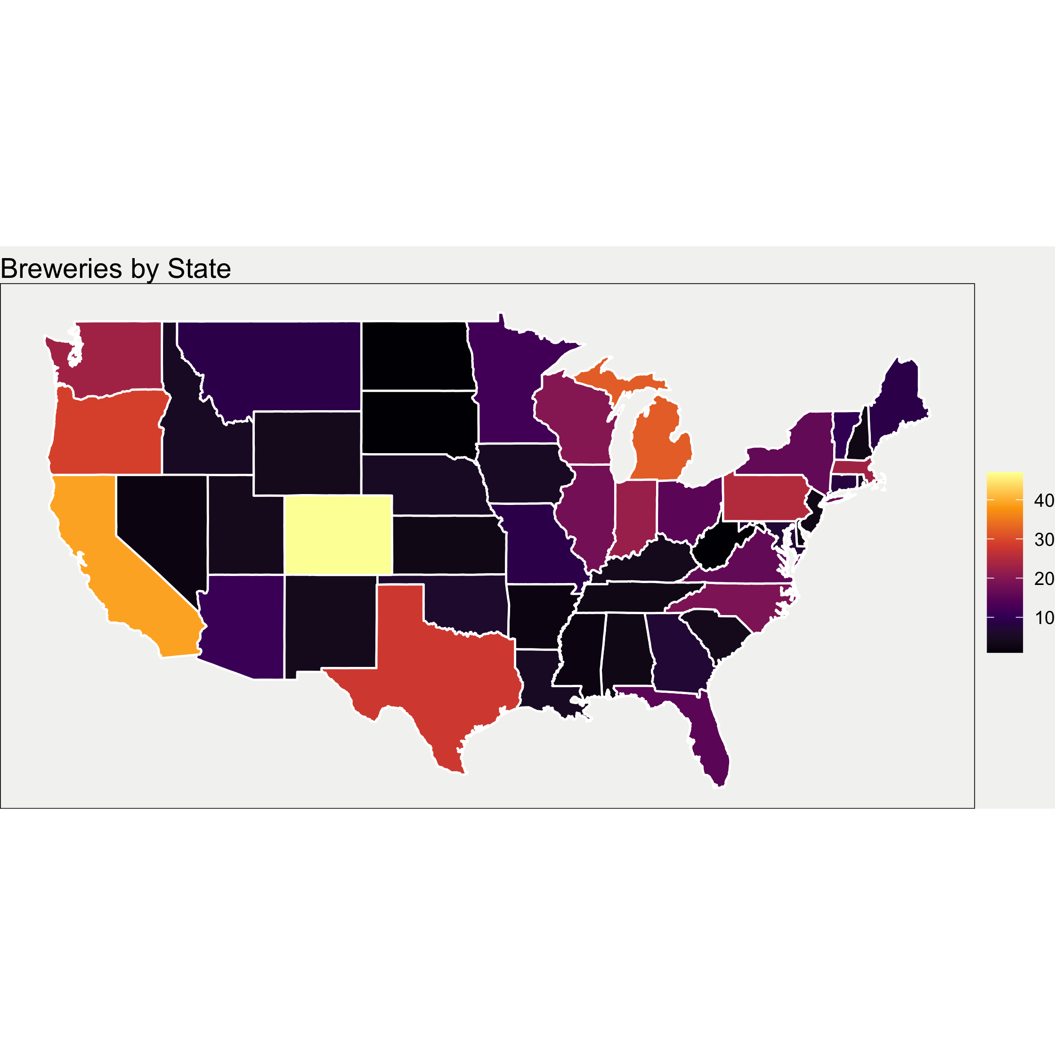
Breweries by state
Colorado is a clear outlier with 47 breweries
North Dakota, South Dakota, and West Virginia all tie with only one brewery per state
Confidential — For Internal Use Only

Slide 5
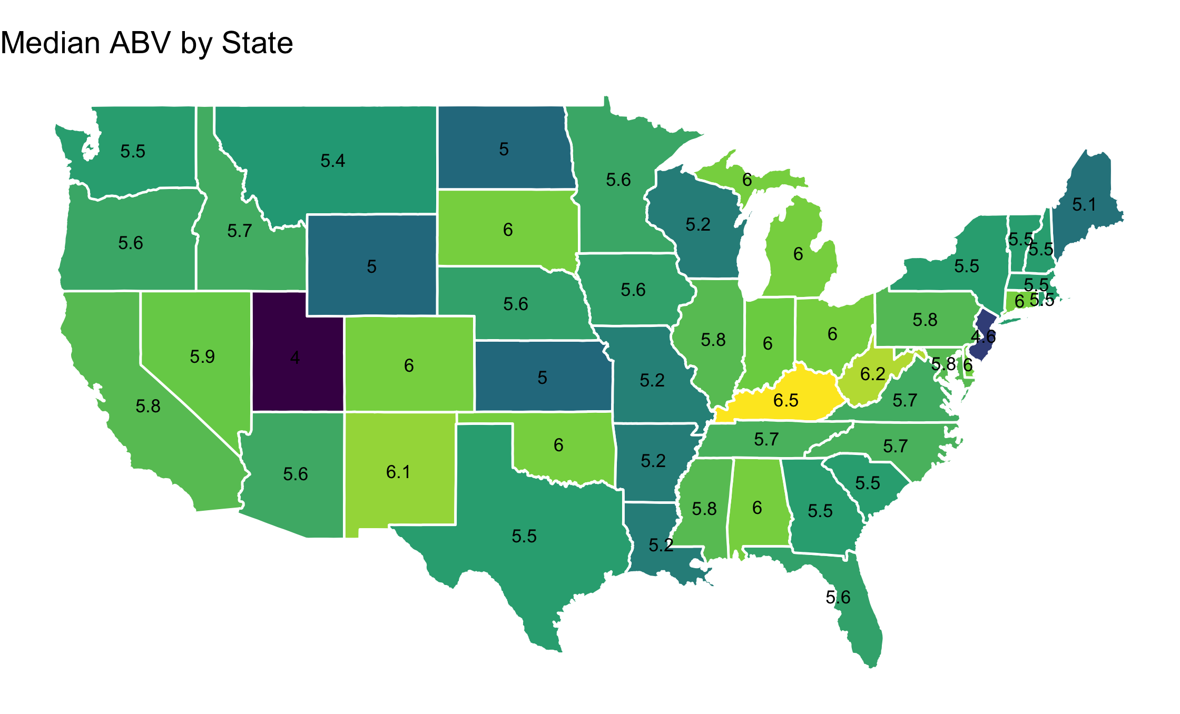
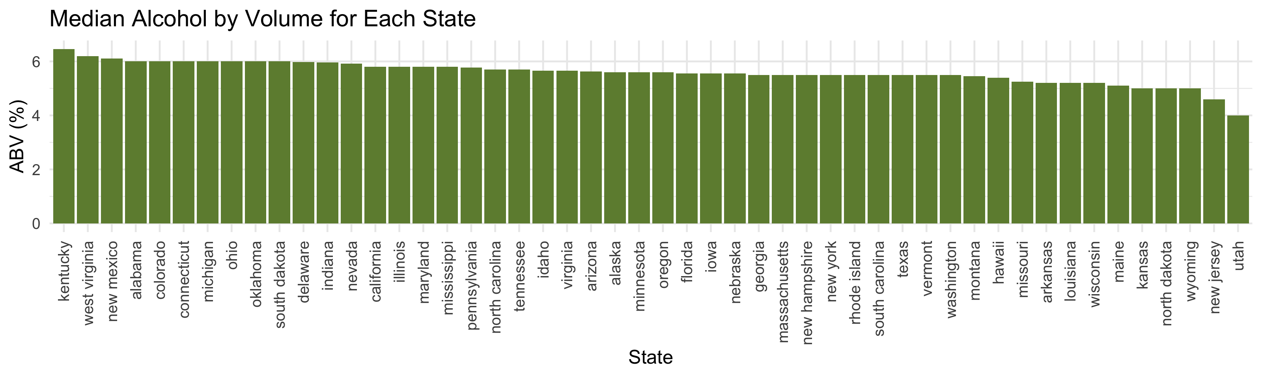
ABV for each state
Overall, most states have similar median values for ABV… except for Utah
The median ABV tends to be largely between 5% and 6% across the US
Confidential — For Internal Use Only

Slide 6
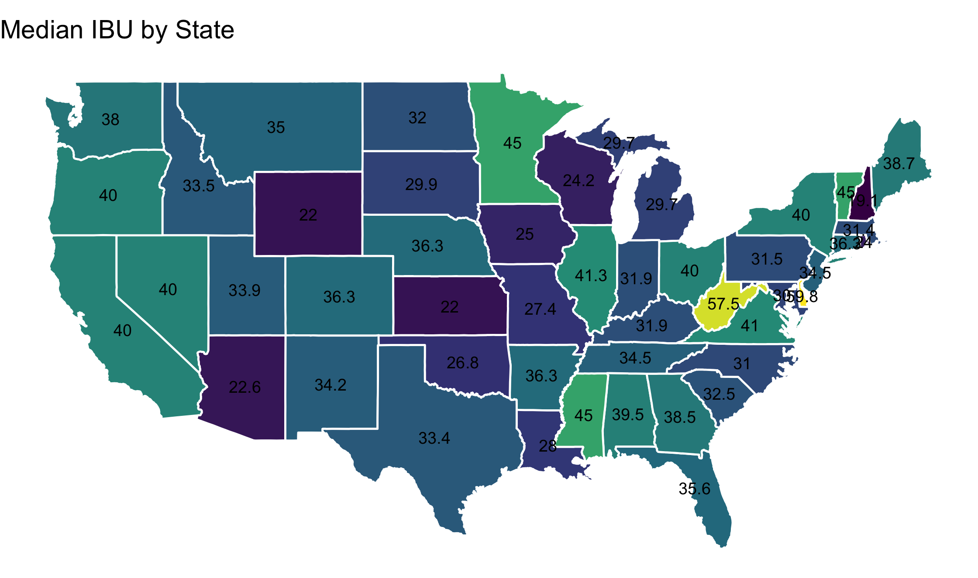
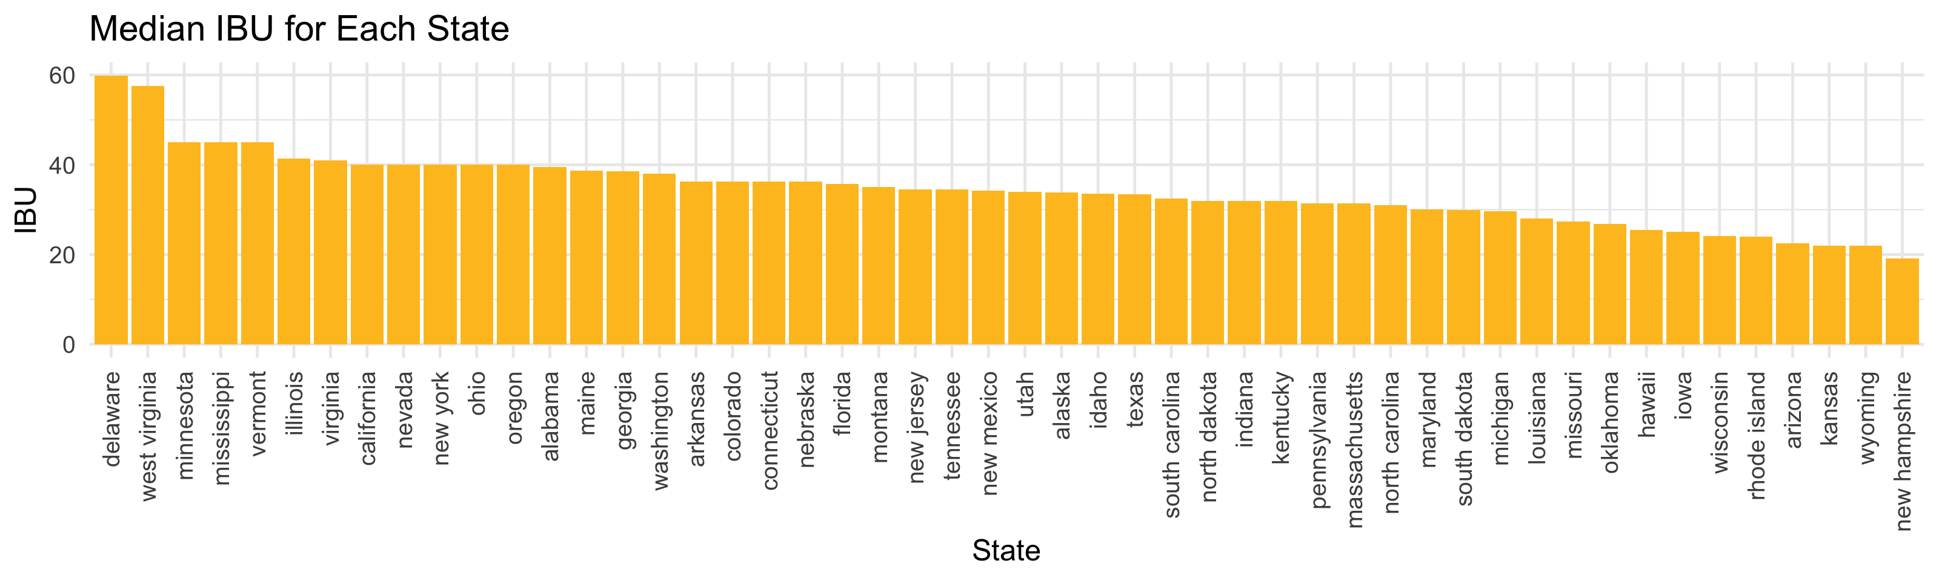
IBU for each state
West virginia likes their beer very bitter, with the highest ibu at 57.5
Confidential — For Internal Use Only

Slide 7
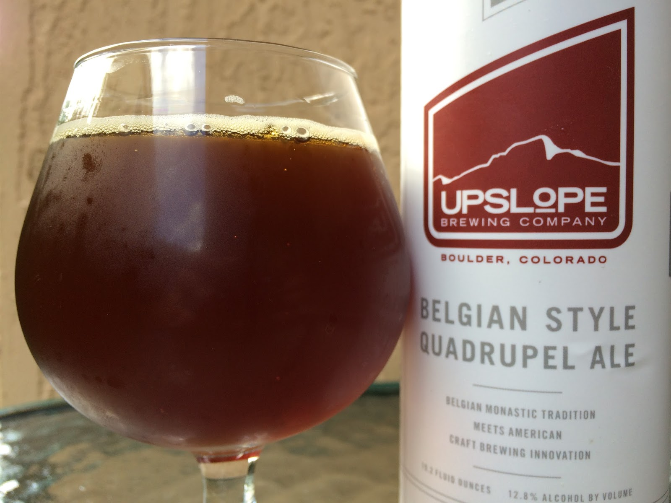
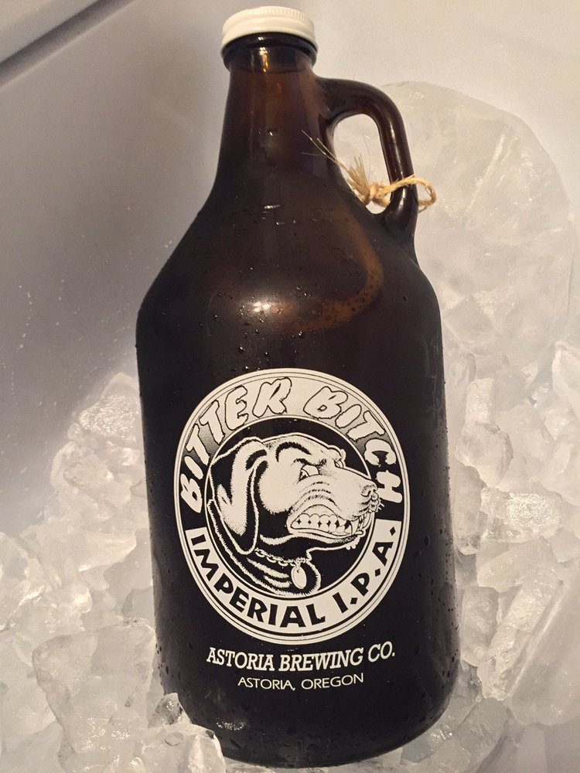
Which state has the beer with highest abv? Ibu?
Most alcoholic – 12.8%
Most bitter – 138 IBU
Lee Hill Series Vol. 5 - Belgian Style Quadrupel Ale
Upslope Brewing Co., Boulder, CO
Bitter Bitch Imperial IPA
Astoria Brewing Co., Astoria, OR
Confidential — For Internal Use Only

Slide 8
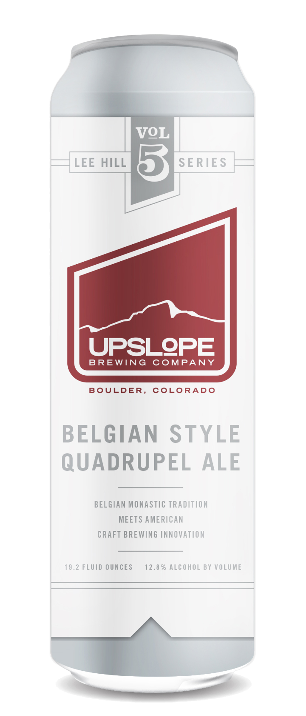
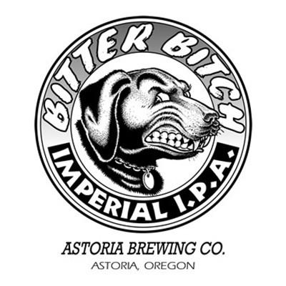
Which state has the beer with highest abv? Ibu?
Most alcoholic – 12.8%
Most bitter – 138 IBU
Lee Hill Series Vol. 5
Belgian Style Quadrupel Ale
Upslope Brewing Co.
Boulder, CO
Bitter Bitch Imperial IPA
Astoria Brewing Co.
Astoria, OR
Confidential — For Internal Use Only

Slide 9
Abv overall
Belgian Style Quadrupel Ale (12.8%)
London Balling (12.5%)
Csar (12%)
Confidential — For Internal Use Only

Slide 10
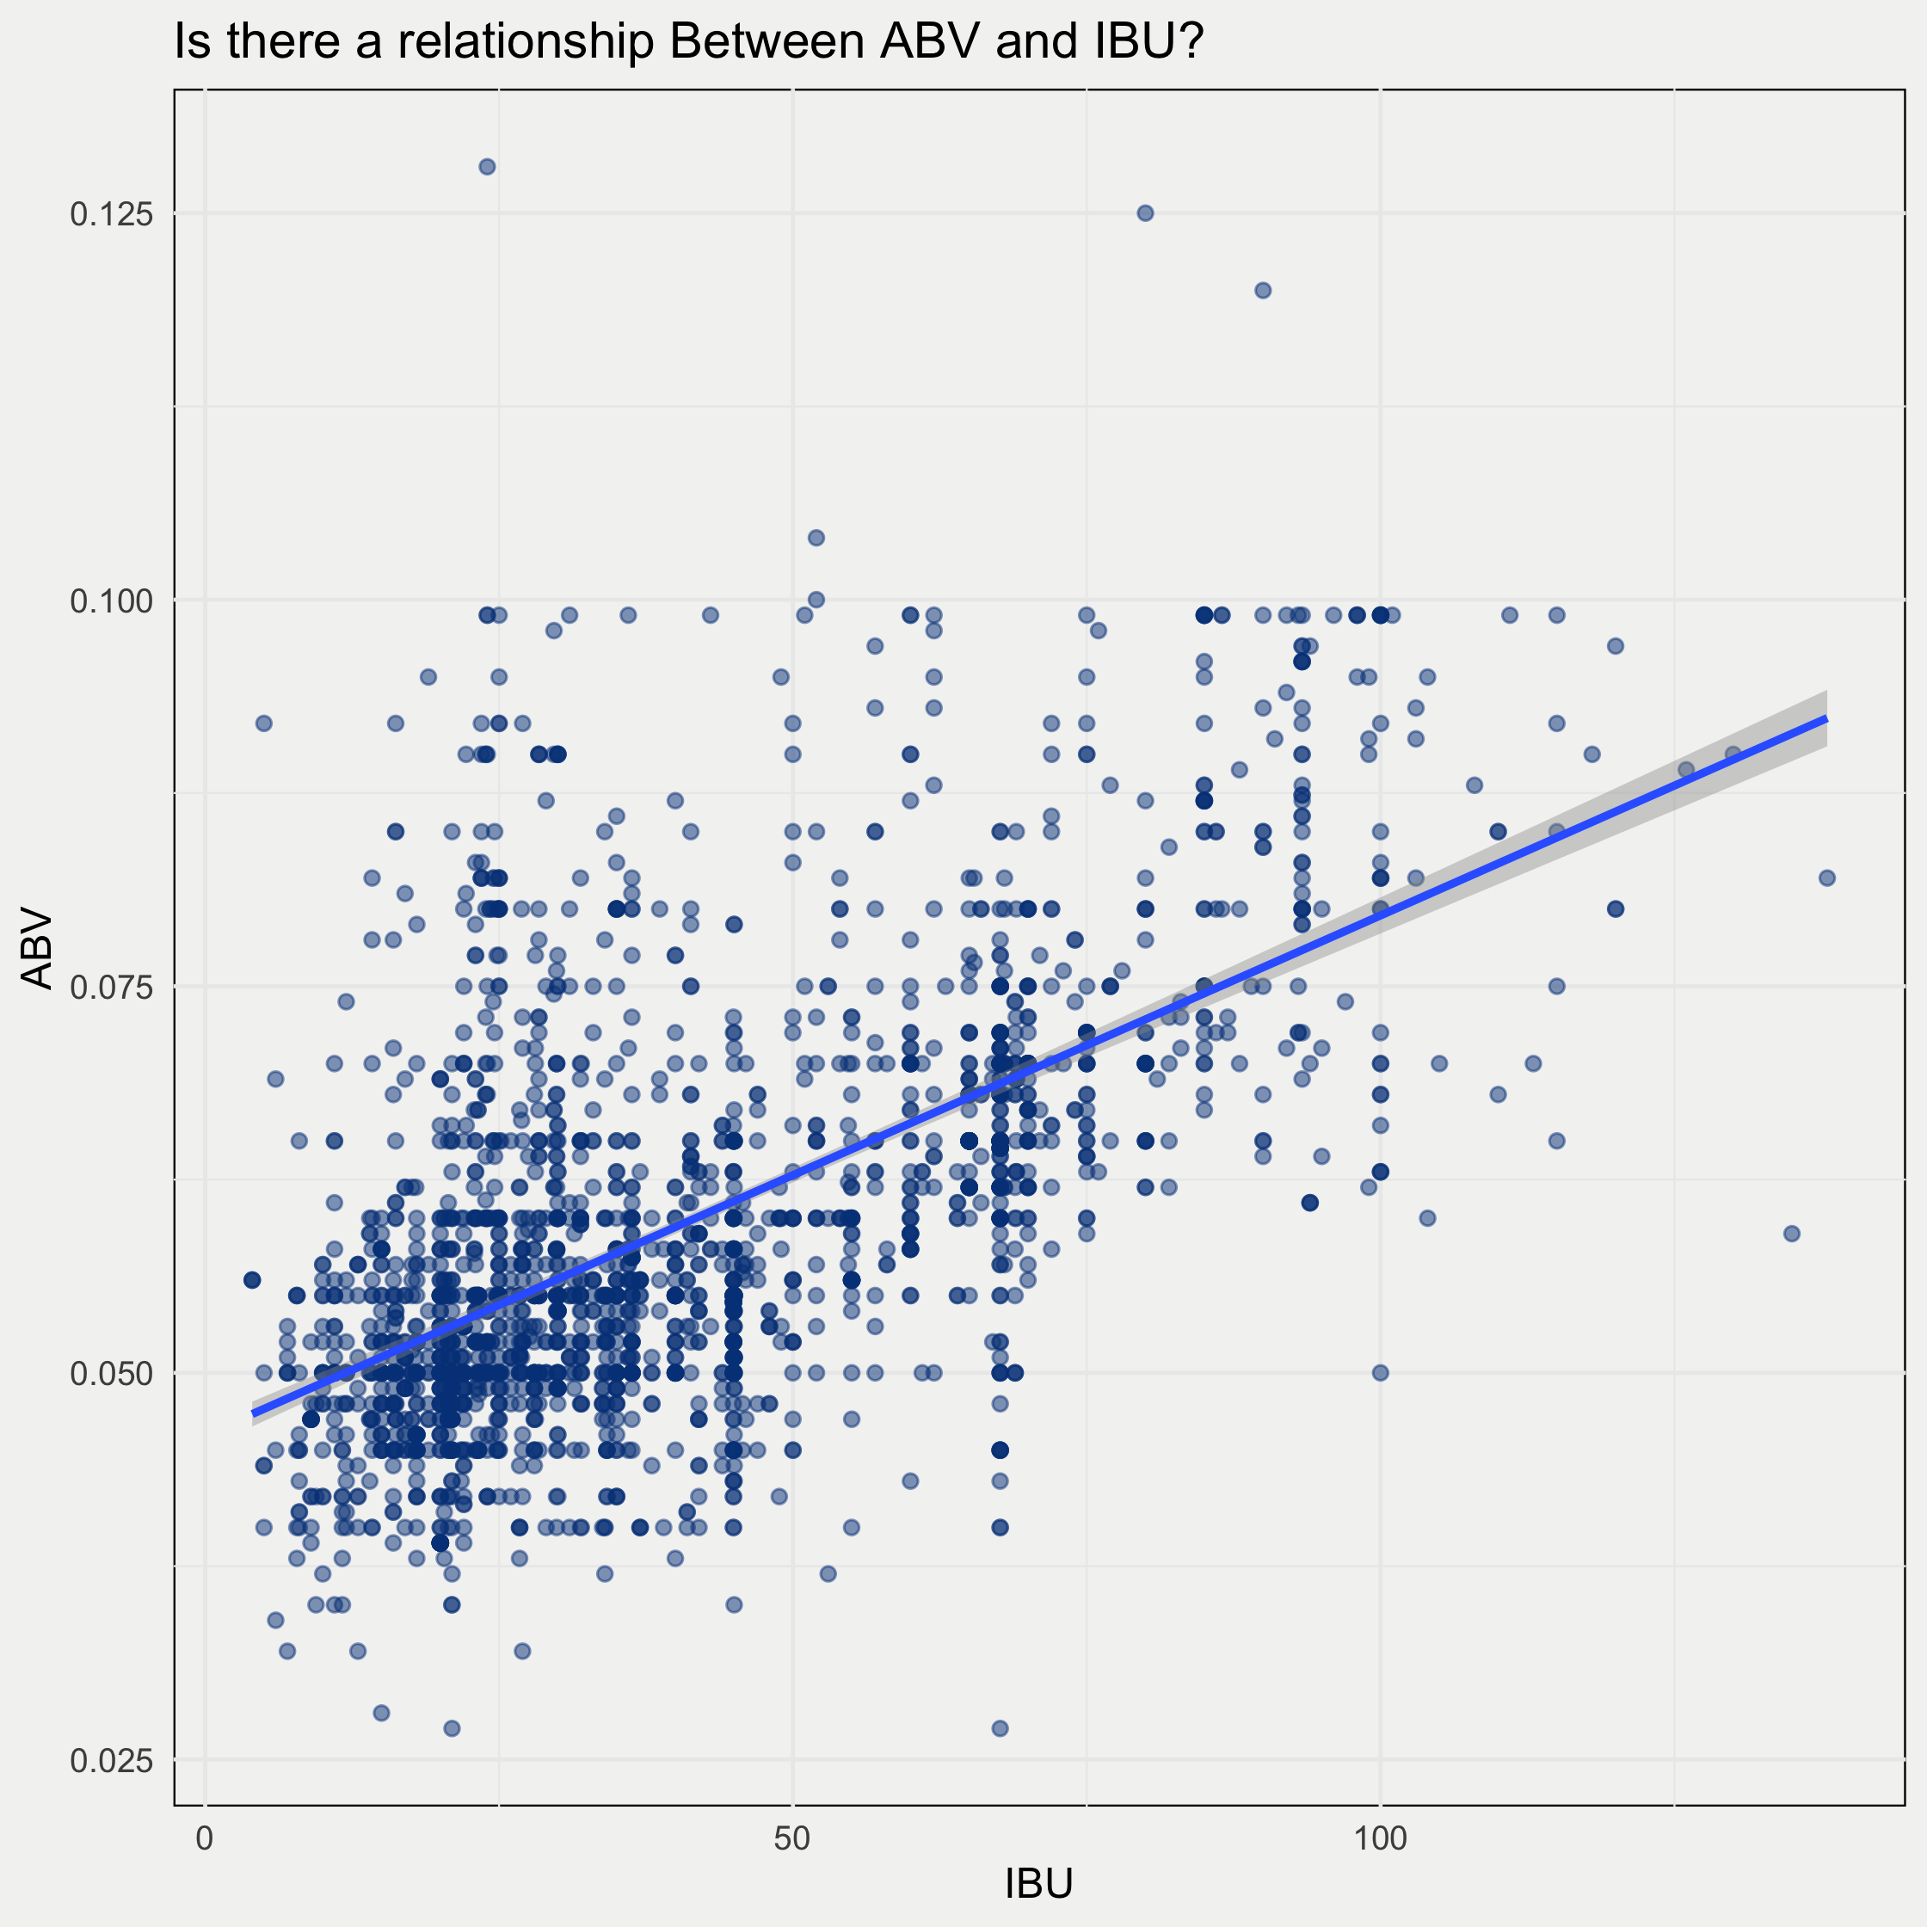
Relationship between bitter & boozy
In general, there appears to be a relationship between IBU and ABV.
Based on our assessment, we may be able to predict ABV based on IBU along with style and other variables of interest.
Confidential — For Internal Use Only

Slide 11
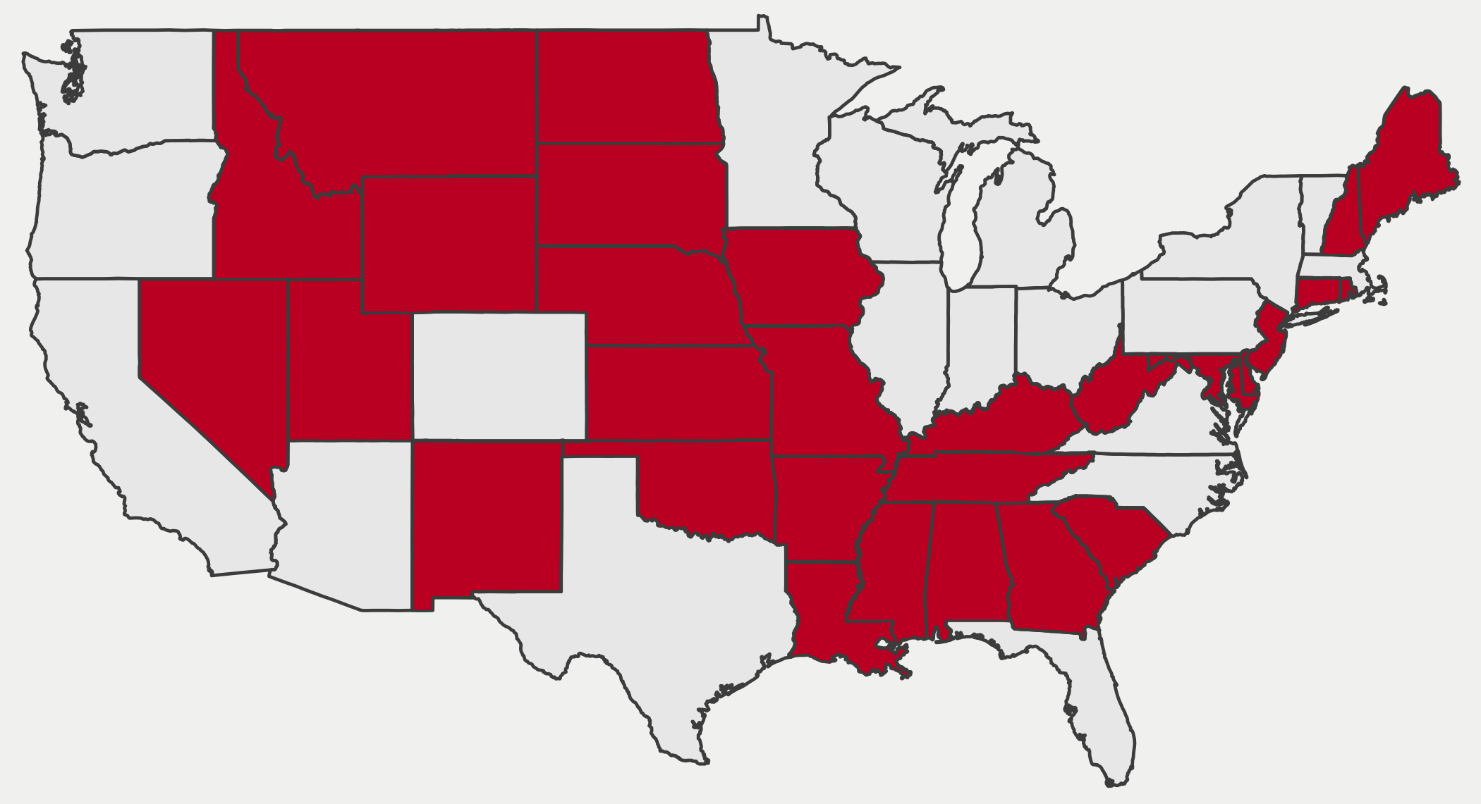
Middle America offers untapped potential for Ipas
Red states have fewer than 10 IPAs available to consumers

