Slide 1
America’s beers – boozy or just bitter?
Matt Farrow, Megan Ball
DS6306

Slide 2
Data Description

Slide 3
Handling Missing Values

Slide 4
Breweries by state
MB comment: map or top 10 table?
First – let’s take a look at which states have the highest concentration of breweries
We have a clear outlier in Colorado with a total of 47 breweries!
North Dakota, South Dakota, West Virginia, and Washington, D.C. all tie with only one brewery per ‘state’

Slide 5
Abv and ibu
We can either use the maps, your bar charts, or some other visual aid for comparing ABV & IBU
I think we either use the map for breweries by state OR ABV/IBU and not both
I will experiment with other visual aids

Slide 6
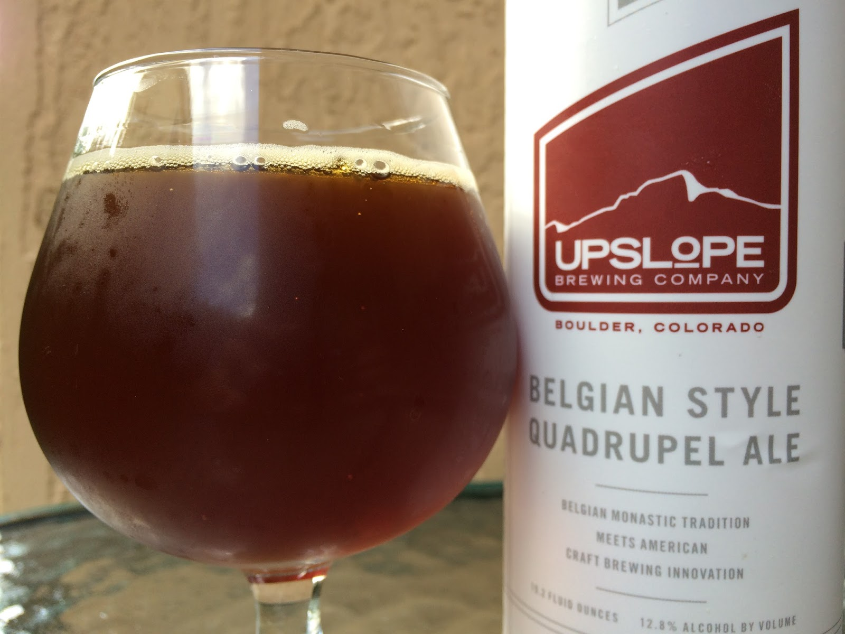
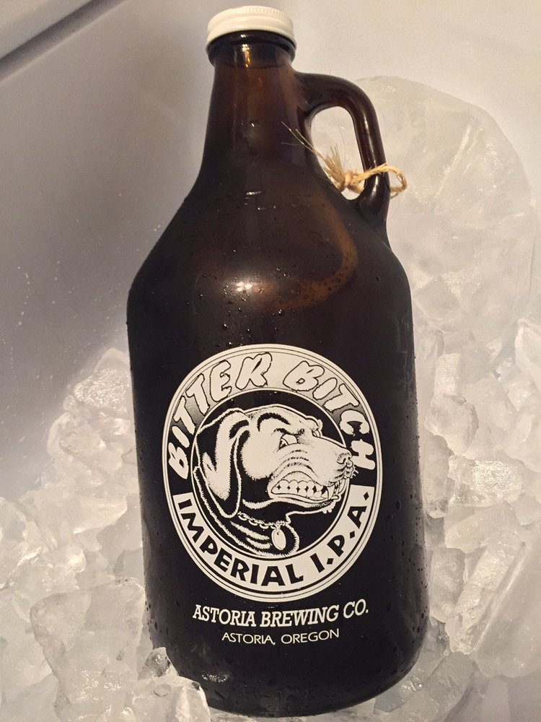
Most alcoholic
Most bitter

